Slide 1
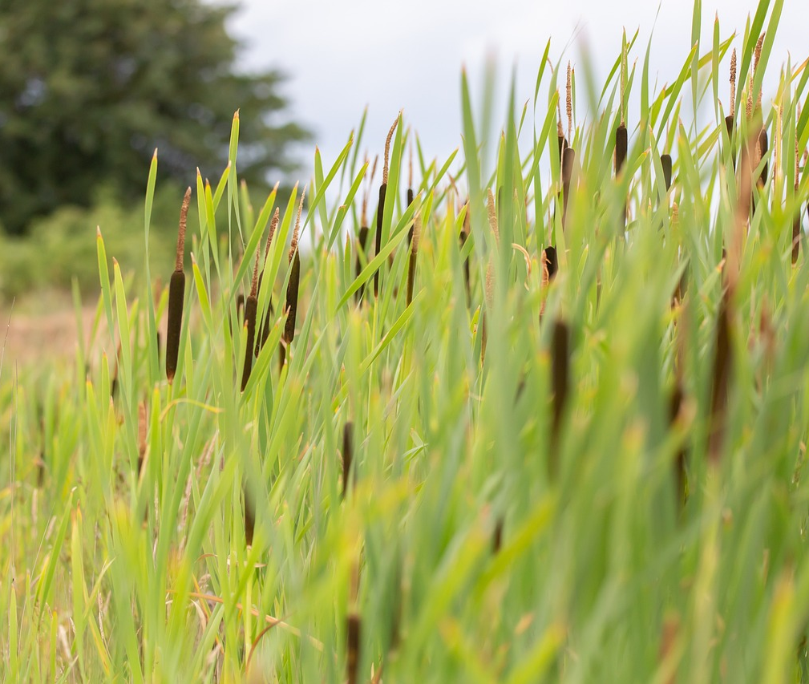
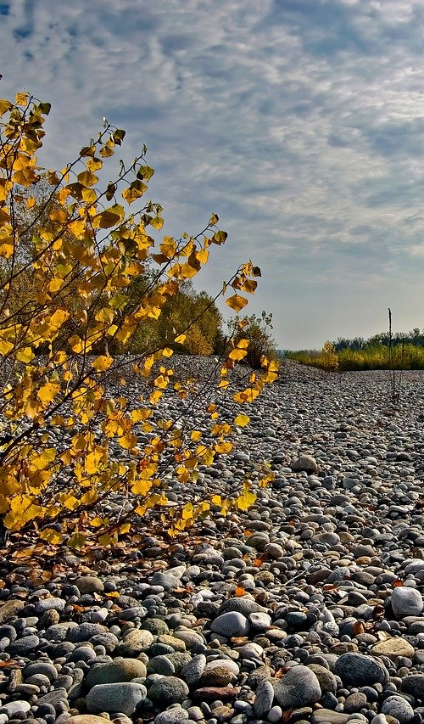
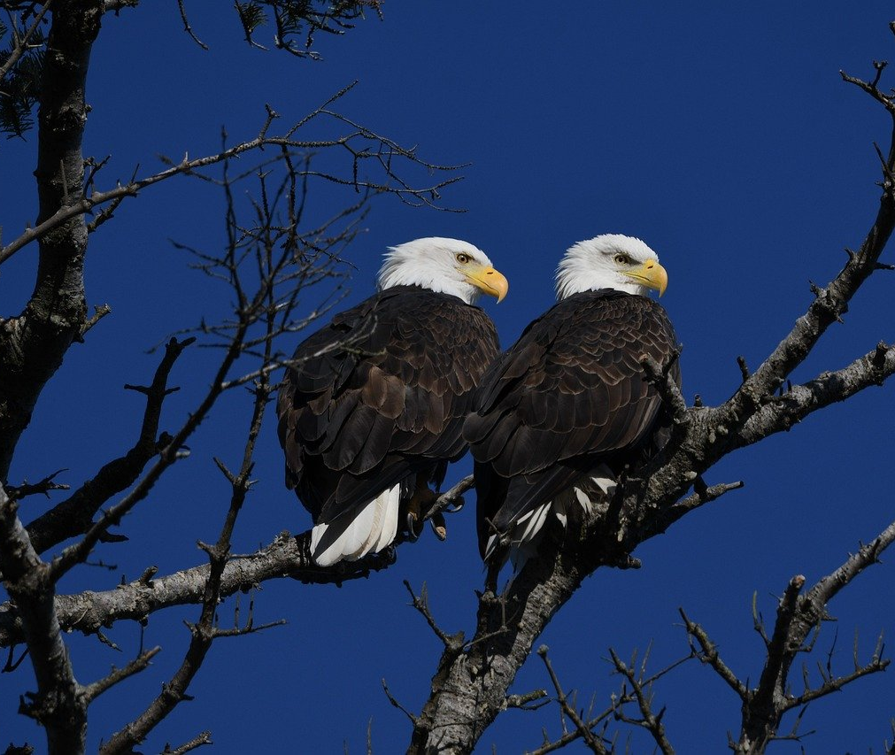
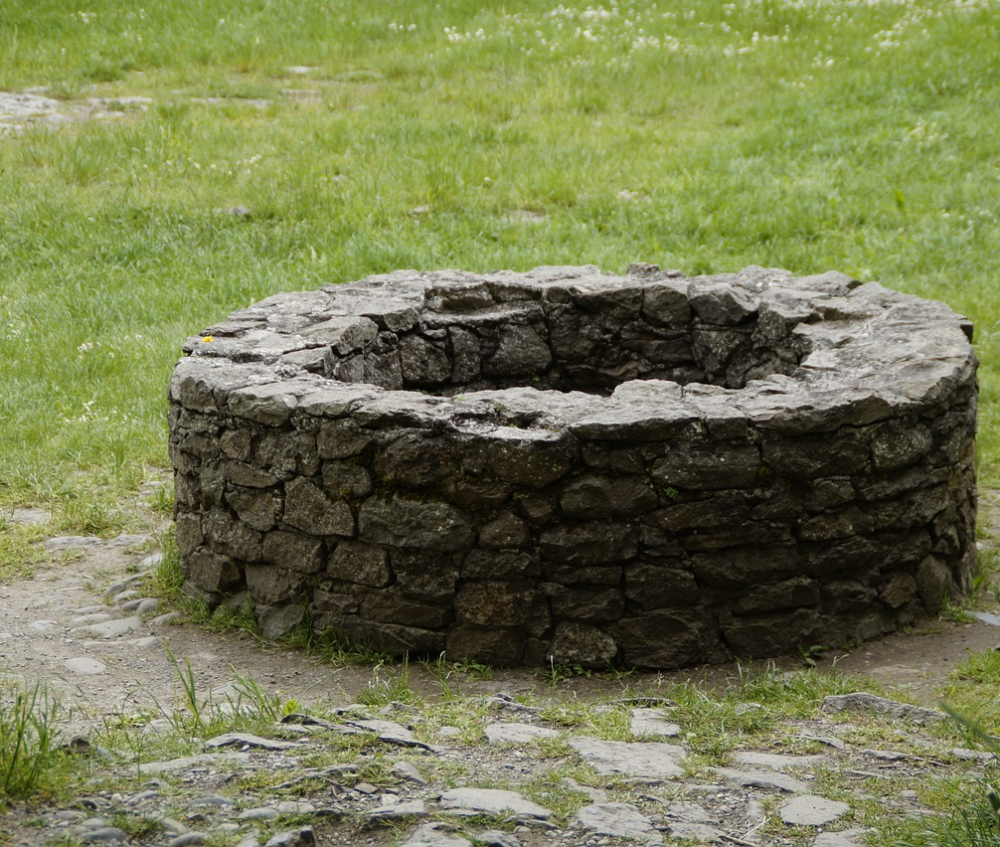
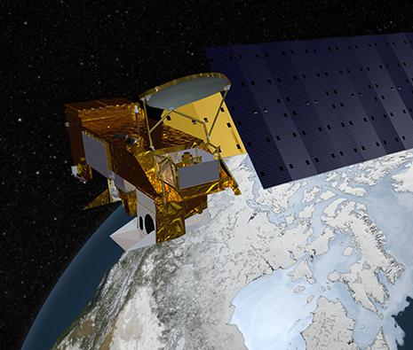
Searching for Water
Searching for Water
Notes:
These images all show ways of finding water. Bald eagles hunt fish; cattails grow by water; smooth stones often show up in riverbeds; people dig wells to find water; satellites can identify where there is water.
Image credits:
https://pixabay.com/photos/bald-eagles-eagle-bird-animal-8493350/
https://pixabay.com/photos/river-bank-weeds-riverbank-plants-5335588/
https://pixabay.com/photos/river-bed-sassi-autumn-pebbles-8304238/
https://pixabay.com/photos/fountain-old-stone-wall-wall-round-788430/
https://aqua.nasa.gov/content/about-aqua

Slide 2
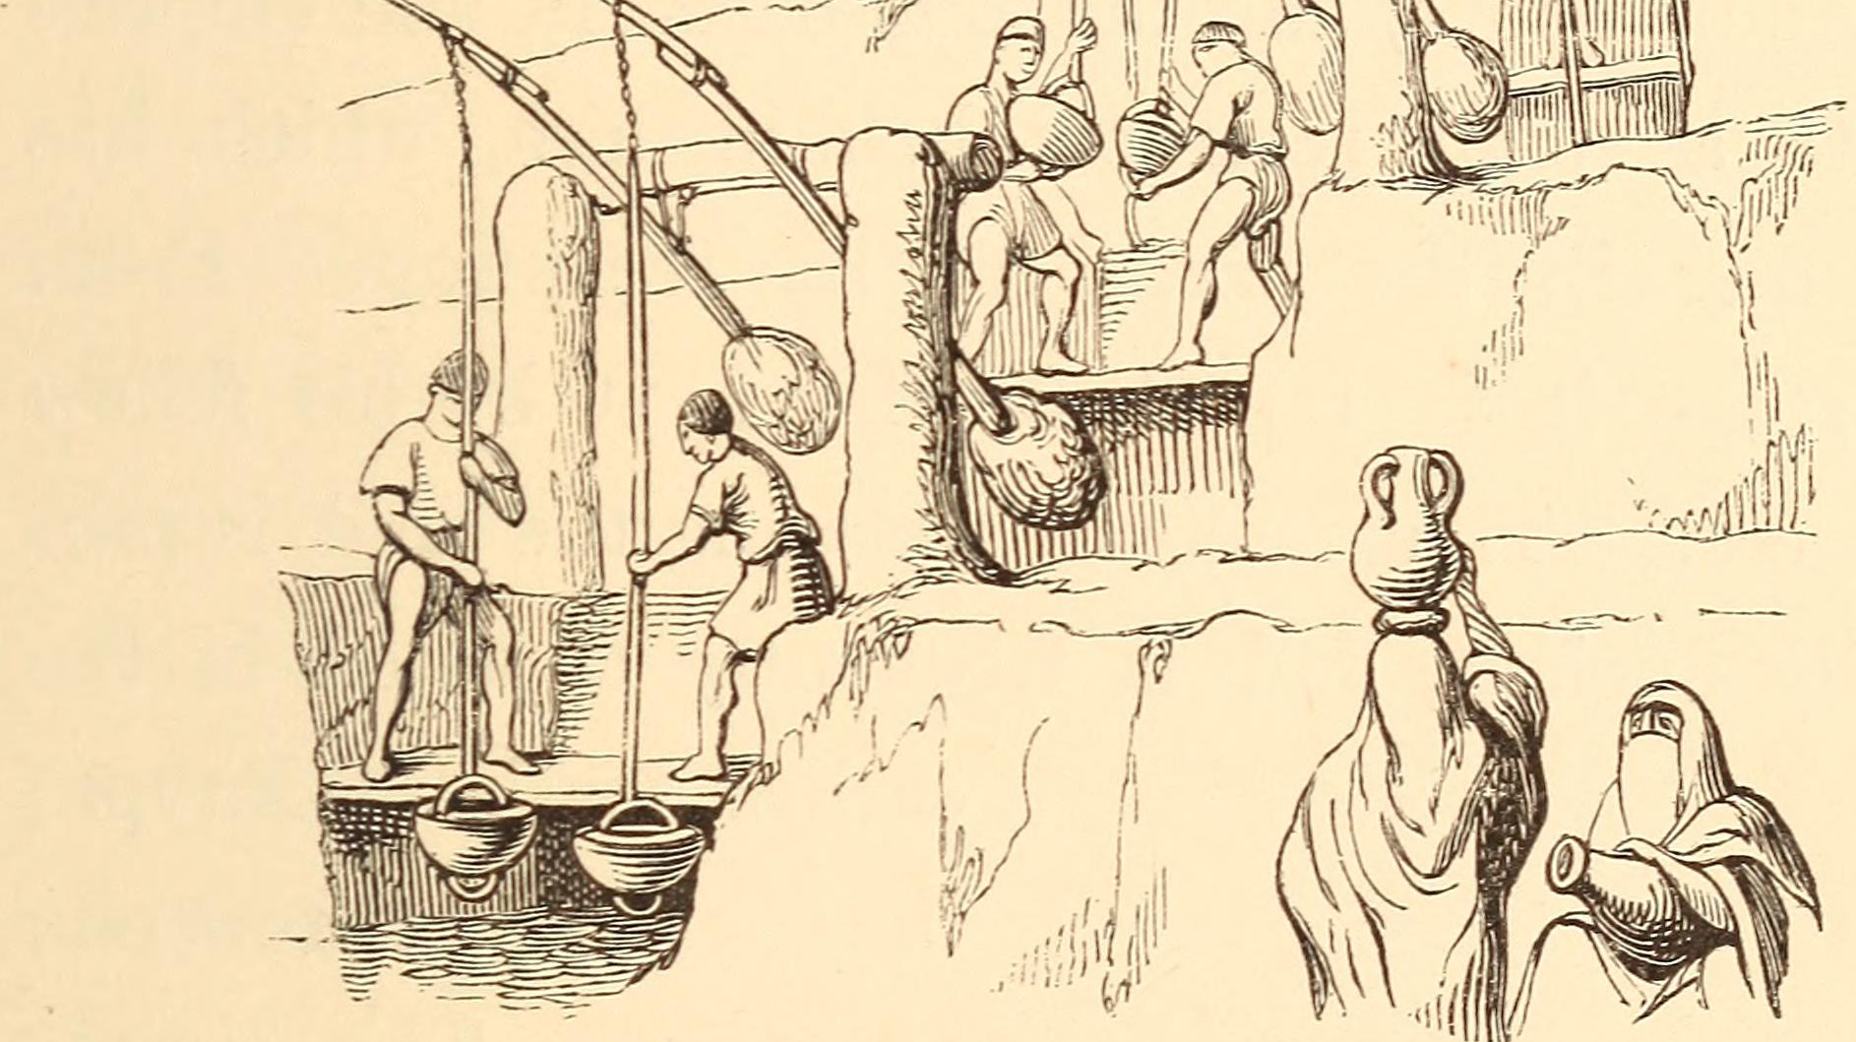
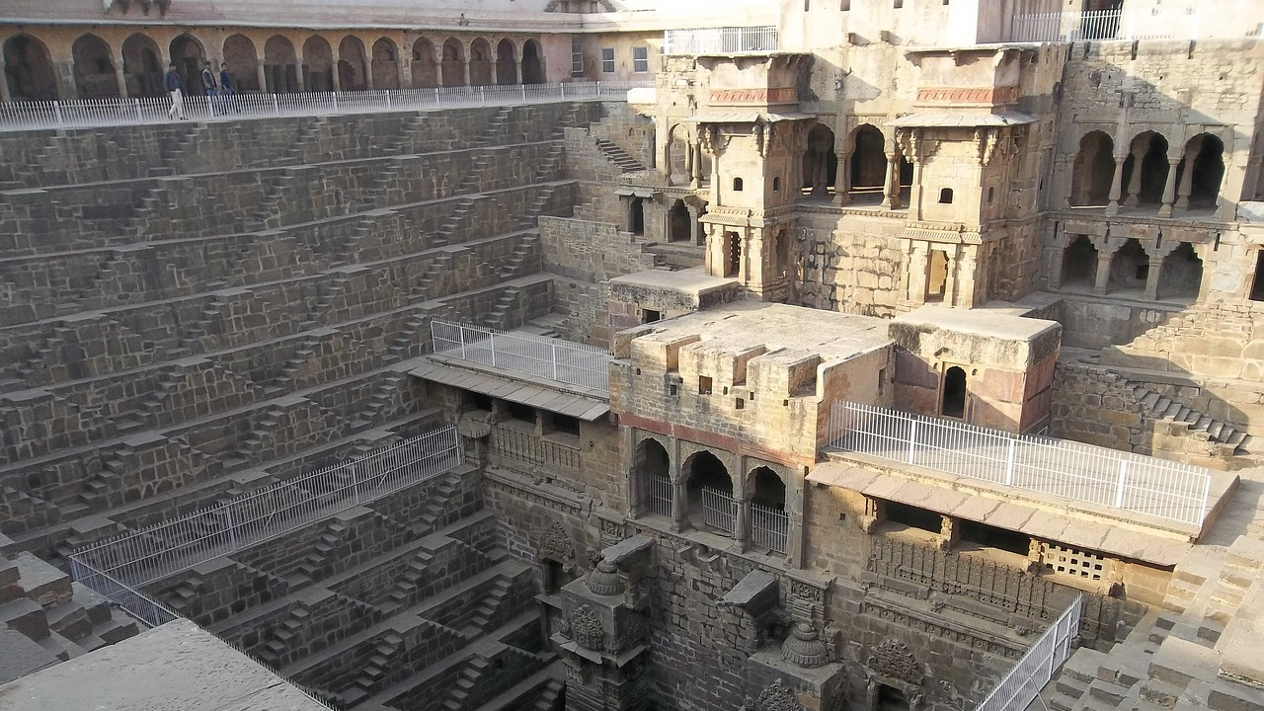
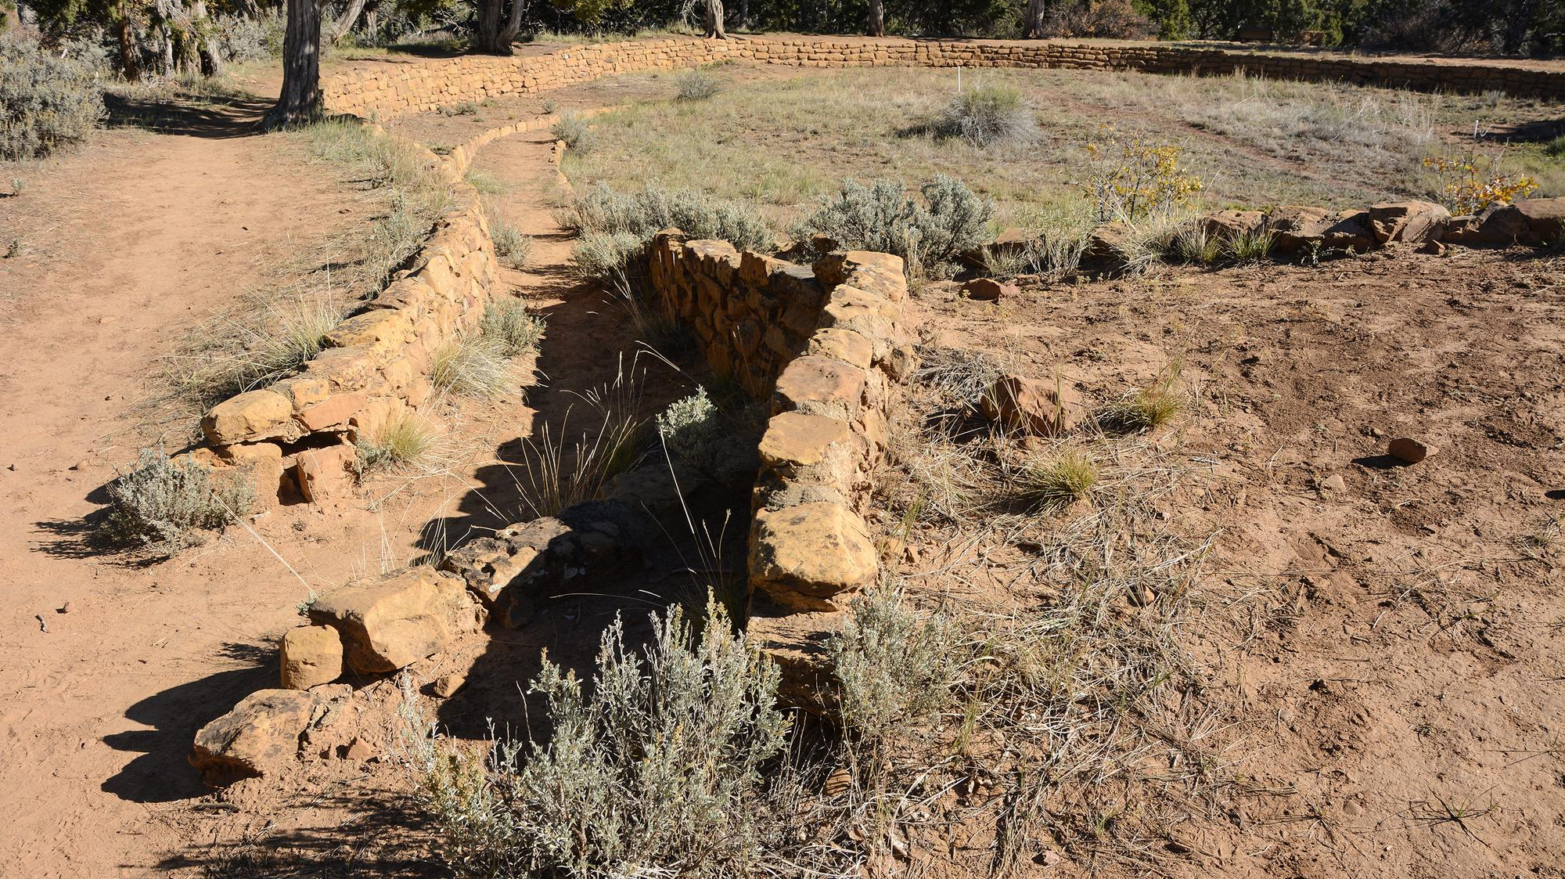
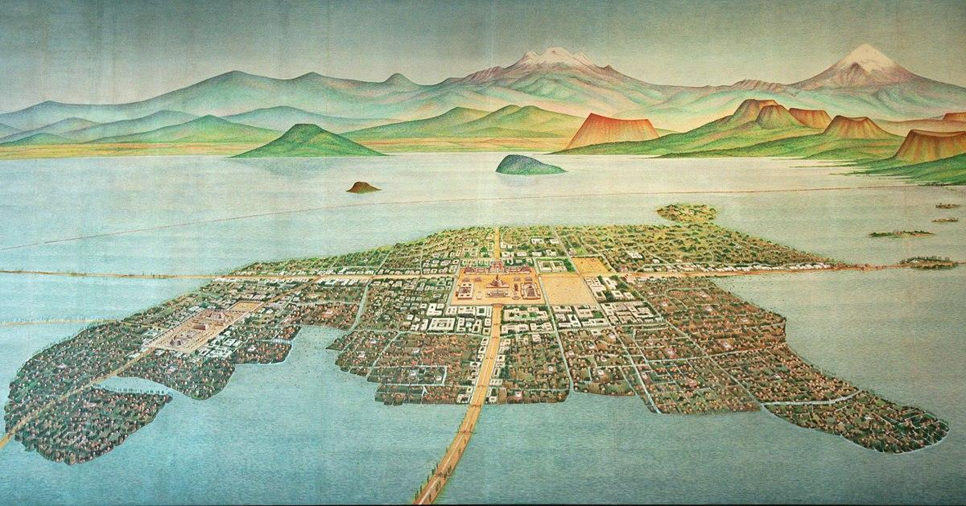
Water Technologies
Water Technologies
Notes:
These images show ways humans have moved water from one place to another. From left to right, top to bottom, they are the shadoof in Egypt, stepwells in India, reservoirs in the Southwest, and water redirection systems in Central America.
Image credits:
https://archive.org/stream/upnilehomeagainh00fair/upnilehomeagainh00fair#page/n128/mode/1up
https://pixabay.com/photos/ancient-indian-well-2149176/
https://www.nps.gov/media/photo/gallery-item.htm?pg=6562374&id=8885e3d0-5b7f-4a5a-99c5-3a0460033cd1&gid=F1ABB7F6-5F04-468E-A602-B1C703D5A8E7
https://www.flickr.com/photos/101561334@N08/9755215791/

