Slide 1
In Good Hands: Designing Space Gloves
NASA VIDEOS

Slide 2
Format of video slides
An optional NASA video or video clip is provided for each Engineering Adventure. For each Adventure, the video or video clip can be accessed on the NASA YouTube channel two different ways:
First slide: Click link to play the video or clip
Second slide: Use QR code to open and play the video or clip
If you do not have access to WiFi, download and print these slides and use the QR codes with a phone or tablet that has good cell reception.
The second slide for each Adventure also includes definitions of some unfamiliar terms used in the video.
Videos are also linked in the digital version of the Educator Guide, in the Reflect & Wrap Up section of each Adventure.

Slide 3
Ready, S.E.T., Go!
Understanding Space Trash

Slide 4
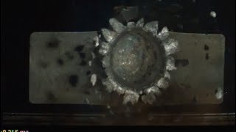
Video clip: Testing impact of space trash (start 2:33, end 2:53)
Notes:
NOTE: Audio refers to the speed as “25 times faster than a 44 Mag,” a type of gun. Consider muting for your students.
Full video: NASA has big ‘guns’ to study micrometeorite & space debris impacts - See test fires (4:11)
Video Credit: NASA’s Goddard Space Flight Center
James Tralie (ADNET):
Lead Producer
Lead Editor
Videographer
Sam Molleur (NASA/JPL):
Producer
Videographer
Dave Hendon (NASA/White Sands):
White Sands Videographer
Support
Marcus Sandy (NASA/White Sands):
Manager, White Sands Hypervelocity Testing
Dennis Garcia (NASA/White Sands):
.50-Caliber Test Conductor
Russ Stein (NASA/Goddard):
Micrometeoroid Protection System Product Design Lead
Bruno Sarli (NASA/Goddard):
System Engineer for CCRS
Art Pardo (NASA/White Sands):
White Sands Lead Electrical Technician
Animations from NASA/CILabs, NASA/JPL, and ESA.

Slide 5
Video clip: Testing impact of space trash (0:20)
Use QR code to play video.
It should start at 2:23.
Stop at 2:53 if it keeps playing.
Words in the video:
velocity – how fast something is moving
“New York to San Francisco in 5 minutes” – a plane takes over 5 hours to fly between these two cities
Notes:
NOTE TO EDUCATOR: Mute the audio to avoid a gun reference. (“25 times faster than a 44 Mag,” a type of gun.)

Slide 6
Engineering Adventure 1
Everyday Gloves

Slide 7
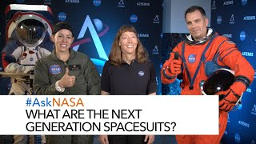
Video: What Are the Next Generation Spacesuits? (3:31)
Notes:
Updated schedule: Artemis astronauts will go to the moon no sooner than 2026.
Spacesuits are personalized spaceships that mimic all of the protections from the harsh environment of space and the basic resources that Earth and its atmosphere provide.
Spacesuit Engineers Amy Ross, Kristine Davis and Dustin Gohmert showcase the advanced features of the next generation spacesuits that will be worn by astronauts as they explore the Moon as part of the Artemis program.
Submit question below using #AskNASA and subscribe to learn more from our experts.

Slide 8
Video: What Are the Next Generation Spacesuits? (3:31)
Use QR code to play video. Play the whole video.
Update: Artemis moon launch will be no sooner than 2026.
Words in the video:
mobility – how easy it is to move around
bearing – a part that makes it easy to move a joint
Artemis – a NASA project taking astronauts to the Moon
contingency – something that may, or may not, happen in the future
egress – a fancy word for getting out of a spacecraft
Notes:
Updated schedule: Artemis astronauts will go to the moon no sooner than 2026.

Slide 9
Engineering Adventure 2
Chilling Out

Slide 10
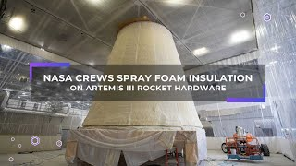
Video: NASA Crews Spray Foam Insulation on Artemis III Rocket Hardware (1:25)
Notes:
The audio is music only, you may want to read the captions aloud for learners. Explain any unfamiliar words.
Text:
NASA's SLS (Space Launch System) Rocket Accelerates from 0 to 17,400 MPH in just 8 minutes.
During Launch and ascent, SLS experiences extreme pressures and temperatures.
A flexible and durable insulation provides thermal protection for every part of the SLS in order to mitigate risks to the rocket during flight.
At NASA's Marshall Space Flight Center in Huntsville, Alabama, technicians recently completed applying the spray-on foam insulation to the Launch Vehicle Stage and Adapter (LVSA).
The cone-shaped LVSA connects the rocket's cores stage to its upper stage and partially encloses it.
The LVSA will be used for Artemis III, which will return humans to the moon for the first time in more than 50 years.
The thermal protection system foam for the LVSA is applied entirely by hand.
It is the largest piece of SLS hardware to be hand sprayed.
Technicians use a tool similar to a spray gun to apply thermal protection system material.
They take turns, starting at the bottom of the spray lane moving to the top of the cone before proceeding to the next lane.
Once it's cured, certain areas are sanded down to meet thickness requirements.
The entire process takes several months.
The LVSA is fully manufactured at Marshall by NASA and lead contractor Teledyne Brown Engineering.
Full video: NASA has big ‘guns’ to study micrometeorite & space debris impacts - See test fires (4:11)
Video Credit: NASA’s Goddard Space Flight Center
James Tralie (ADNET):
Lead Producer
Lead Editor
Videographer
Sam Molleur (NASA/JPL):
Producer
Videographer
Dave Hendon (NASA/White Sands):
White Sands Videographer
Support
Marcus Sandy (NASA/White Sands):
Manager, White Sands Hypervelocity Testing
Dennis Garcia (NASA/White Sands):
.50-Caliber Test Conductor
Russ Stein (NASA/Goddard):
Micrometeoroid Protection System Product Design Lead
Bruno Sarli (NASA/Goddard):
System Engineer for CCRS
Art Pardo (NASA/White Sands):
White Sands Lead Electrical Technician
Animations from NASA/CILabs, NASA/JPL, and ESA.

Slide 11
Video: NASA Crews Spray Foam Insulation on Artemis III Rocket Hardware (1:25)
Use QR code to play video.
Play the whole video.
Words in the video:
SLS – Space Launch System rocket
accelerates – goes faster
ascent – the time when the rocket is rising
insulation – a material that protects against extreme temperatures
mitigate – make a hazard less dangerous
Notes:
The audio is music only, you may want to read the captions aloud for learners. Explain any unfamiliar words.

Slide 12
Engineering Adventure 3
Ready for Impact

Slide 13
Video clip: Testing designs for impact (start at 0:54, end at 1:23)
Notes:
Full video: NASA has big ‘guns’ to study micrometeorite & space debris impacts - See test fires (4:11)
Video Credit: NASA’s Goddard Space Flight Center
James Tralie (ADNET):
Lead Producer
Lead Editor
Videographer
Sam Molleur (NASA/JPL):
Producer
Videographer
Dave Hendon (NASA/White Sands):
White Sands Videographer
Support
Marcus Sandy (NASA/White Sands):
Manager, White Sands Hypervelocity Testing
Dennis Garcia (NASA/White Sands):
.50-Caliber Test Conductor
Russ Stein (NASA/Goddard):
Micrometeoroid Protection System Product Design Lead
Bruno Sarli (NASA/Goddard):
System Engineer for CCRS
Art Pardo (NASA/White Sands):
White Sands Lead Electrical Technician
Animations from NASA/CILabs, NASA/JPL, and ESA.

Slide 14
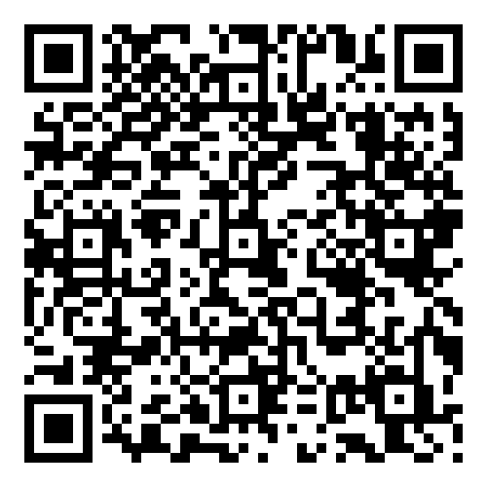
Video Clip: Testing designs for impact (0:30)
Use QR code to play video.
It should start at 0:54.
Stop at 1:23 if it keeps playing.
Words in the video:
projectile – an object that is launched or thrown very quickly
micrometeoroid – a tiny grain of rock in outer space
withstand – hold up, bear up, survive
impact – the act of one thing hitting another
containment – the act of holding something in

Slide 15
Engineering Adventure 4
Dangerous Dust

Slide 16
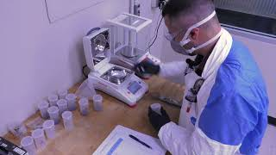
Video Clip: Moon Dust Is Difficult (start at beginning, end at 1:01)
Notes:
Lunar Dust is Difficult…
NASA Johnson Sep 28, 2023
Full video (2:40) : https://youtu.be/CRao0yq1LE4?si=4yUuS7cDv_yKI4uc
What is NASA doing to address the issue of lunar dust? The Lunar Development and Test Facility at NASA’s Johnson Space Center will test spacesuits, spacecraft components, and hardware with conditions similar to those found on the Moon. Teams will also be able to experiment with regolith simulant and vacuum chambers to help NASA develop dust mitigation technologies and countermeasures.
https://www.nasa.gov/centers/johnson/home/index.html
Join NASA as we go forward to the Moon and on to Mars -- discover the latest on Earth, the Solar System and beyond with a weekly update in your inbox.
Subscribe at: www.nasa.gov/subscribe

Slide 17
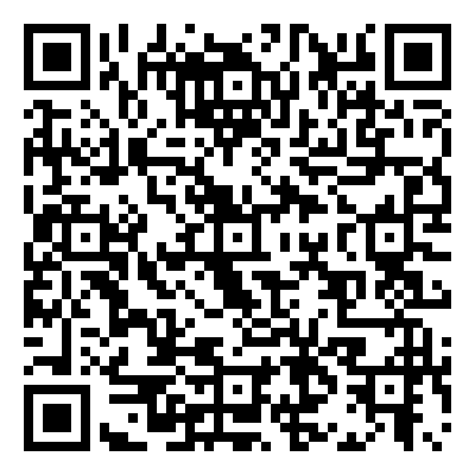
Video Clip: Moon Dust Is Difficult (1:00)
Use QR code to play video.
Start at the beginning.
Stop at 1:03 if it keeps playing.
Words in the video:
barren – empty
encounter – meet
NASA missions – trips to space run by the U.S. government
commercial space missions – trips to space run by businesses
regolith – moon dirt

Slide 18
Engineering Adventure 5
Create a Space Glove

Slide 19
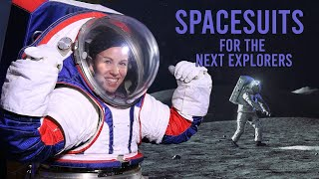
Video Clip: Different missions need different suits
(Start at 1:38, end at 2:33)
Notes:
Full video: Spacesuits for the Next Explorers (Full feature) (12:02)
NASA Johnson Space Center
Get a behind the scenes look at the creation of NASA’s new spacesuit, the xEMU (Exploration Extravehicular Mobility Unit). In this full feature, you’ll discover how the spacesuit is being built for NASA’s new missions beyond low-Earth orbit, looking forward to astronauts walking on the Moon and Mars and exploring in person. Testing for the suit takes place in the desert, underwater, and in unique NASA laboratories that can simulate the gravity of the Moon, Mars, or no gravity at all. The end result will be a spacesuit that has more flexibility, more power and more capability to allow astronauts to explore like never before.
For more information, visit: www.nasa.gov/suitup

Slide 20
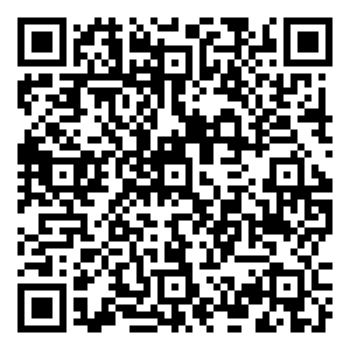
Video Clip: Different missions need different suits (0:55)
Use QR code to play video clip.
It should start at 1:38.
Stop at 2:33 if it keeps playing.
Words in the video:
contingency – something that may, or may not, happen in the future
EVA – spacewalk (Extra Vehicular Activity)
prototype – an early engineering design that will be improved
culminating – ending
Notes:
Full video: Spacesuits for the Next Explorers (Full feature) (12:02)
NASA Johnson Space Center

Slide 21
Engineering Adventure 6
Improve a Space Glove

Slide 22
Video Clip: Improving a suit for exploring a planet (Start at 4:13, end at 4:47)
Notes:
Full video: Spacesuits for the Next Explorers (Full feature) (12:02)
NASA Johnson Space Center
Get a behind the scenes look at the creation of NASA’s new spacesuit, the xEMU (Exploration Extravehicular Mobility Unit). In this full feature, you’ll discover how the spacesuit is being built for NASA’s new missions beyond low-Earth orbit, looking forward to astronauts walking on the Moon and Mars and exploring in person. Testing for the suit takes place in the desert, underwater, and in unique NASA laboratories that can simulate the gravity of the Moon, Mars, or no gravity at all. The end result will be a spacesuit that has more flexibility, more power and more capability to allow astronauts to explore like never before.
For more information, visit: www.nasa.gov/suitup

Slide 23
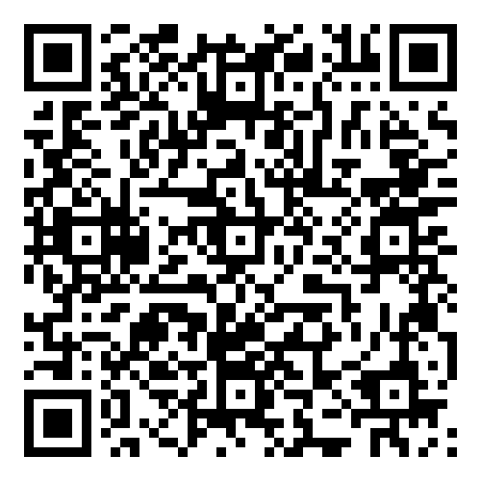
Video Clip: Improving a suit for exploring a planet (0:36)
Use QR code to play video clip.
It should start at 4:13.
End at 4:47 if it keeps playing.
Words in the video:
reliable – something you can count on
durable – something that lasts a long time
geology – the study of rocks and minerals on Earth and other planets
lunar – of the Moon or on the Moon
Notes:
Full video: Spacesuits for the Next Explorers (Full feature) (12:02)
NASA Johnson Space Center

Slide 24
End of Engineering Videos
No video for Engineering Adventure 7

