Slide 1
Engineering
Remote Sensing
Activities 1-9
Our Ideas Poster
Prep & Setup Guide with Blank Cards
Screen Reader Version - NOT for Print

Slide 2
Poster Components
The following slides are based on the printable PDF version of the blank slides/cards with examples that you can use to set up your “Our Ideas Posters” and are not intended to be printed.
These slides are formatted to be more accessible to screen readers.
We recommend using these slides as a guide for blind and low vision educators and printing out the PDFs for sighted learners.

Slide 3
Corresponding PDFs include
Poster Pages to build the poster
  (pages numbered in lower right corner with corresponding adventure(s))
Poster Pages with examples are for educator reference only and not intended to print.
Blank Pages for more space or to build your own poster
Blank ¼ page cards for learners to add additional terms, drawings, ideas
Term cards:
Icon-only
Term + icon

Slide 4
Set Up
You need a wall or whiteboard area of about 80” Length x 60” Height.
Please see the following pages for setup examples.
You may choose alternative layouts or formats to fit your learning environment.

Slide 5
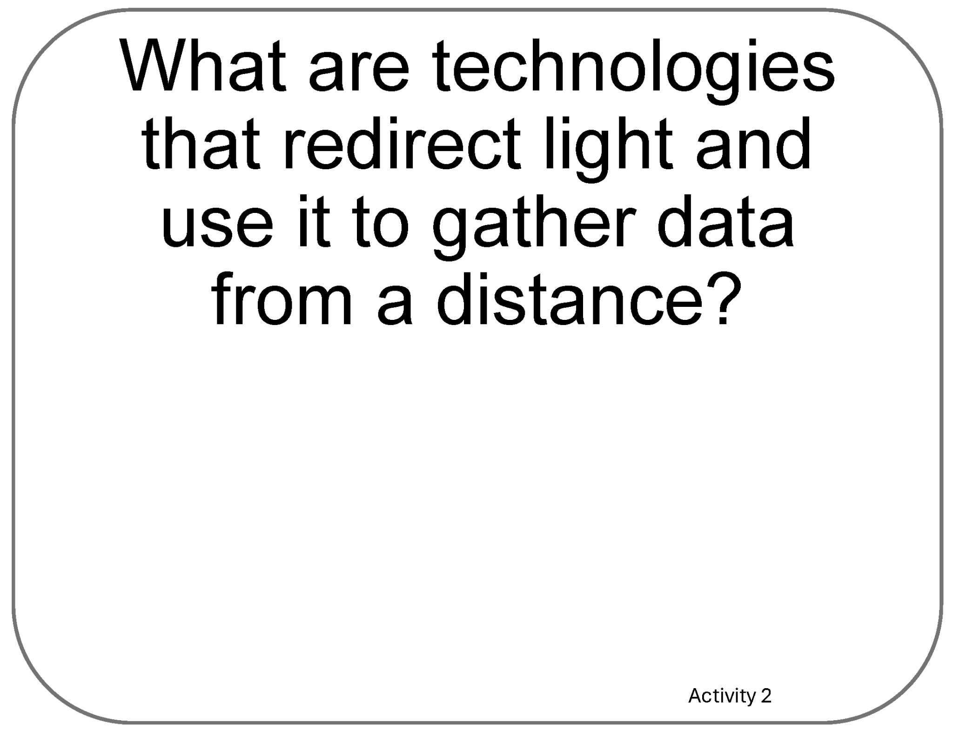
Poster Pages Examples
(Reference - do not print)

Slide 6
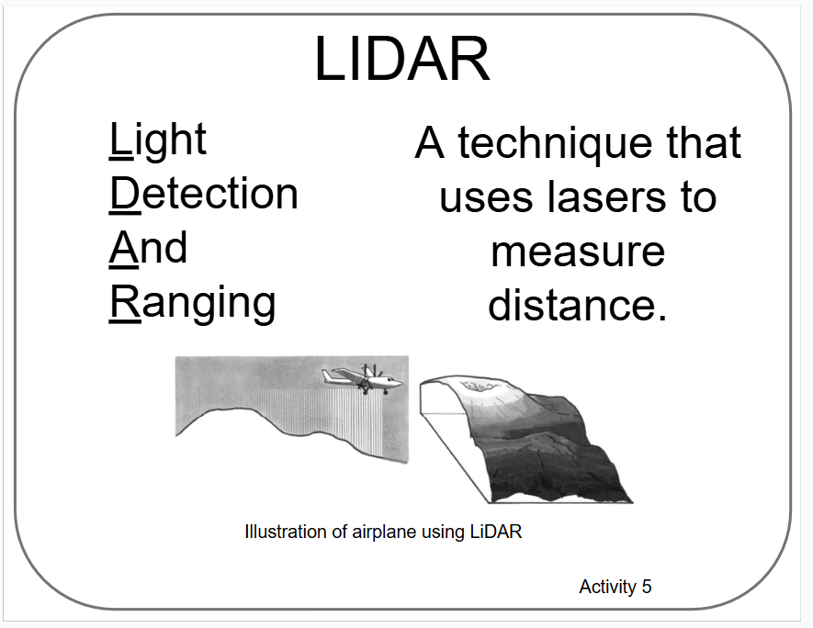
Term Card Example
(Reference - do not print)

Slide 7
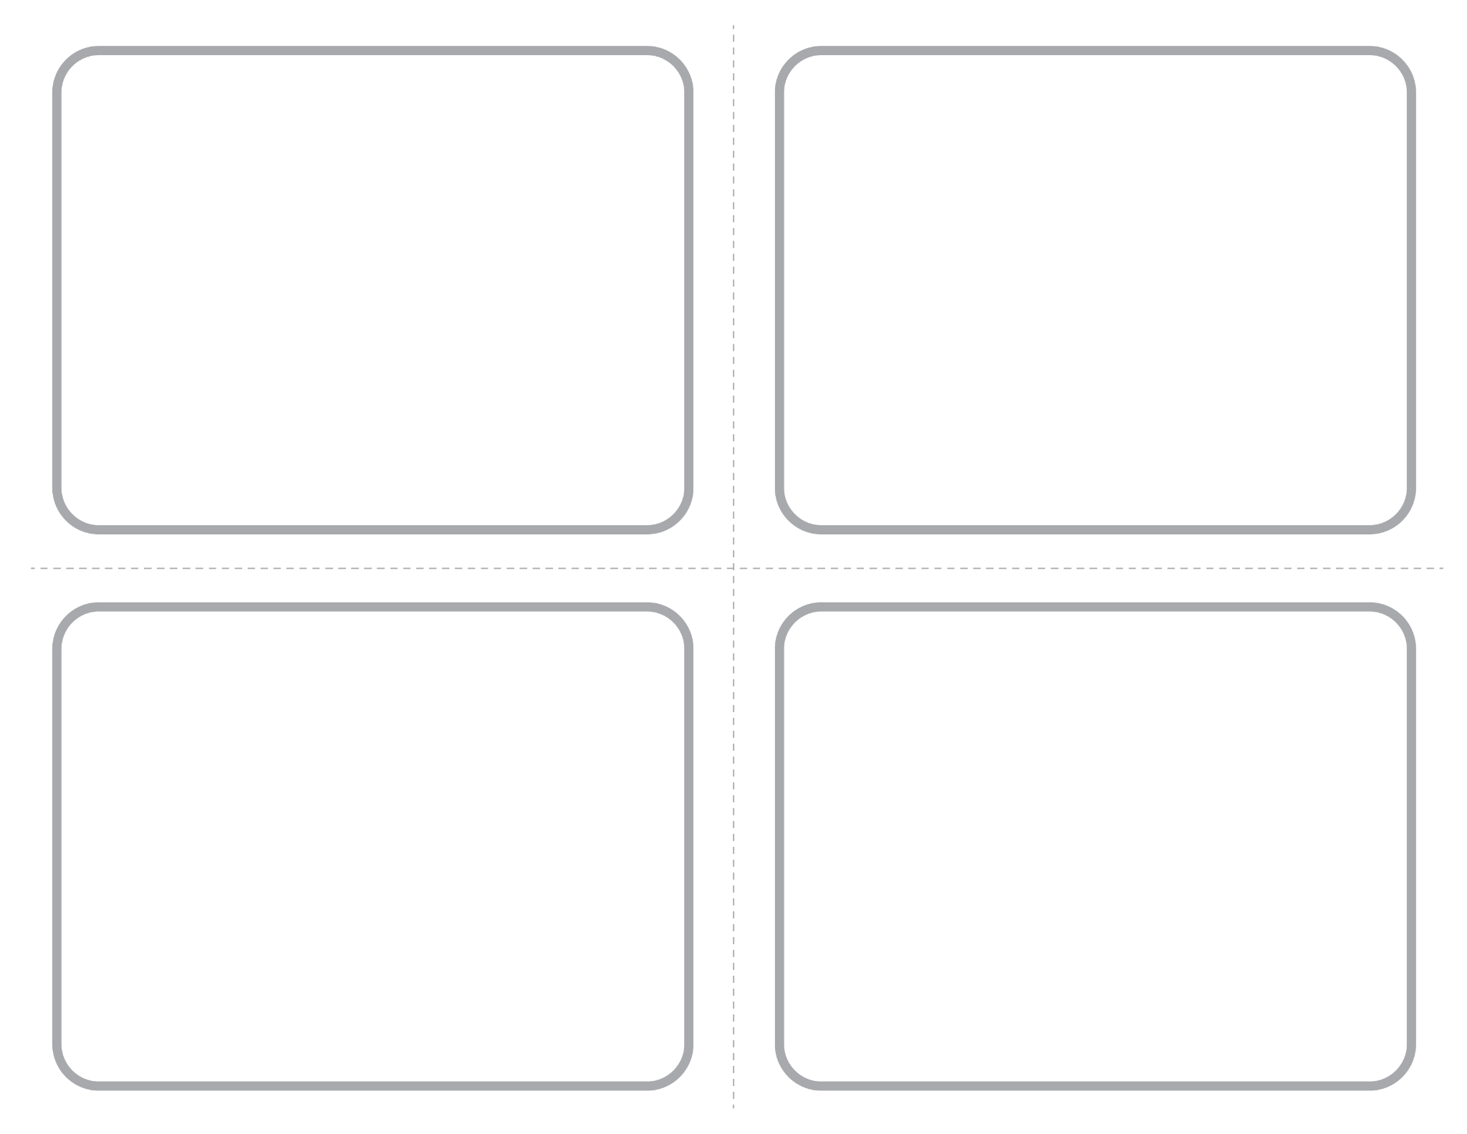
Blank ¼ Page Card Screenshot
Intended for learner responses

Slide 8
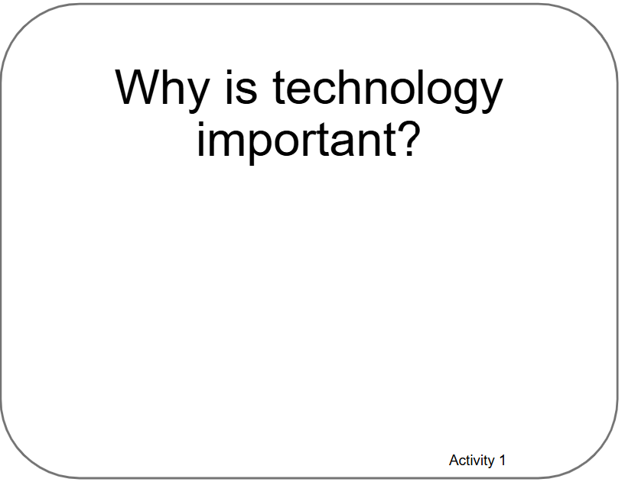
Poster Pages with Examples from Learners

Slide 9
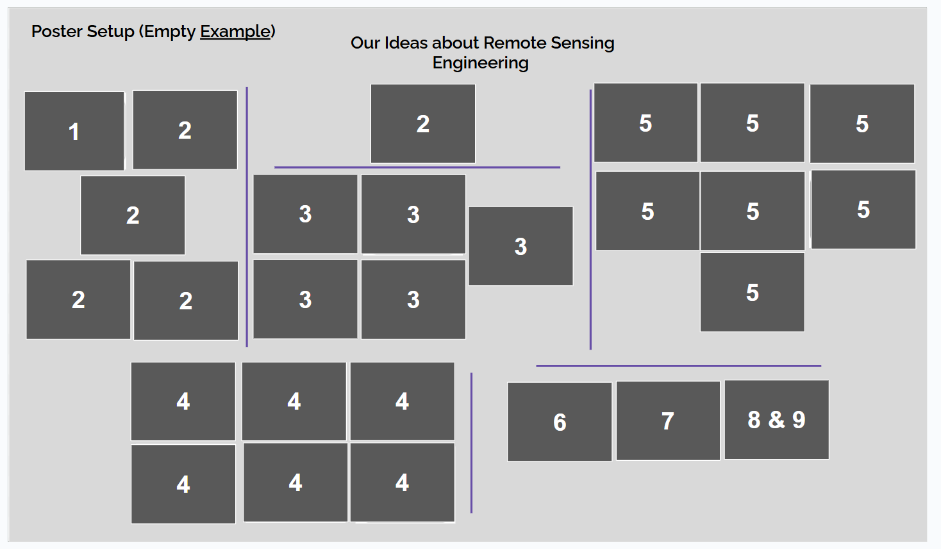
How to Set Up Poster by Activity Numbers

Slide 10
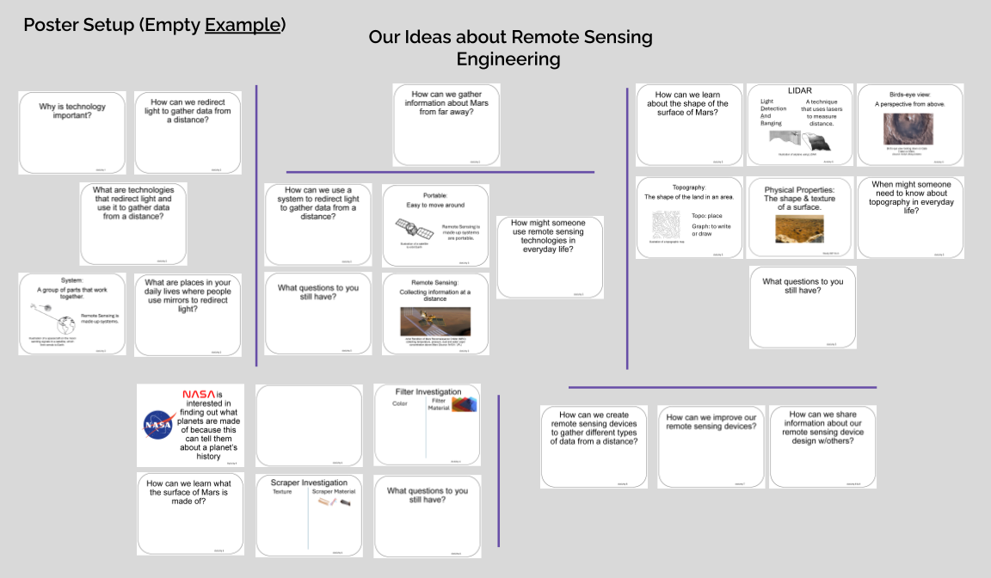
Poster Setup with Unfilled Examples

Slide 11
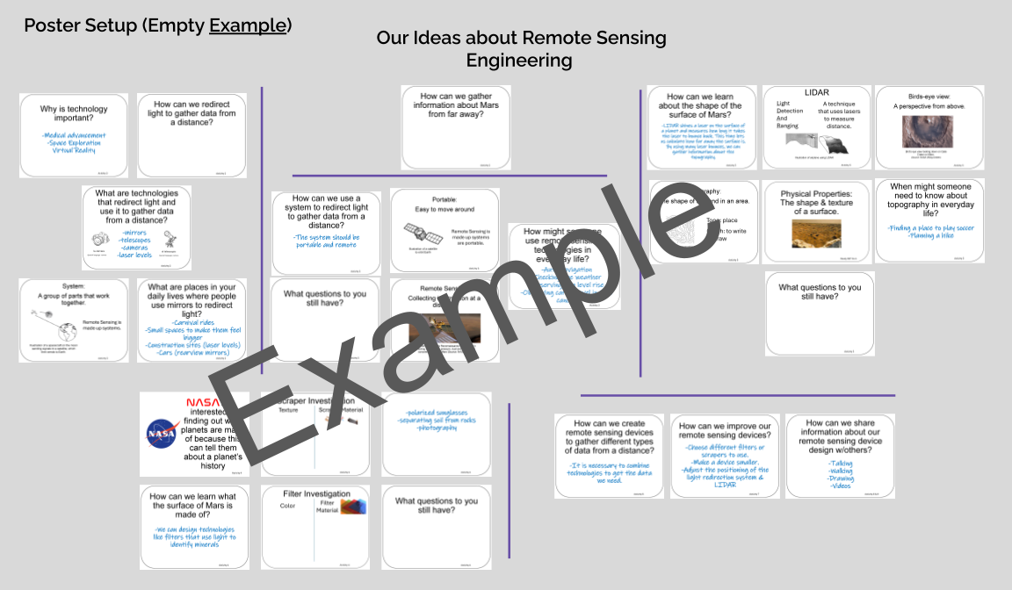
Poster Setup Layout with Learner Examples

Slide 12
Details about Learner Examples
The following two slides are a compromise to allow for alt text readability.
They are formatted for visual access, and not necessarily in a way that is best for screen readers, but do allow for alt text for each of the example cards.
They are optional, and can be skipped if they are not helpful to you.

Slide 13
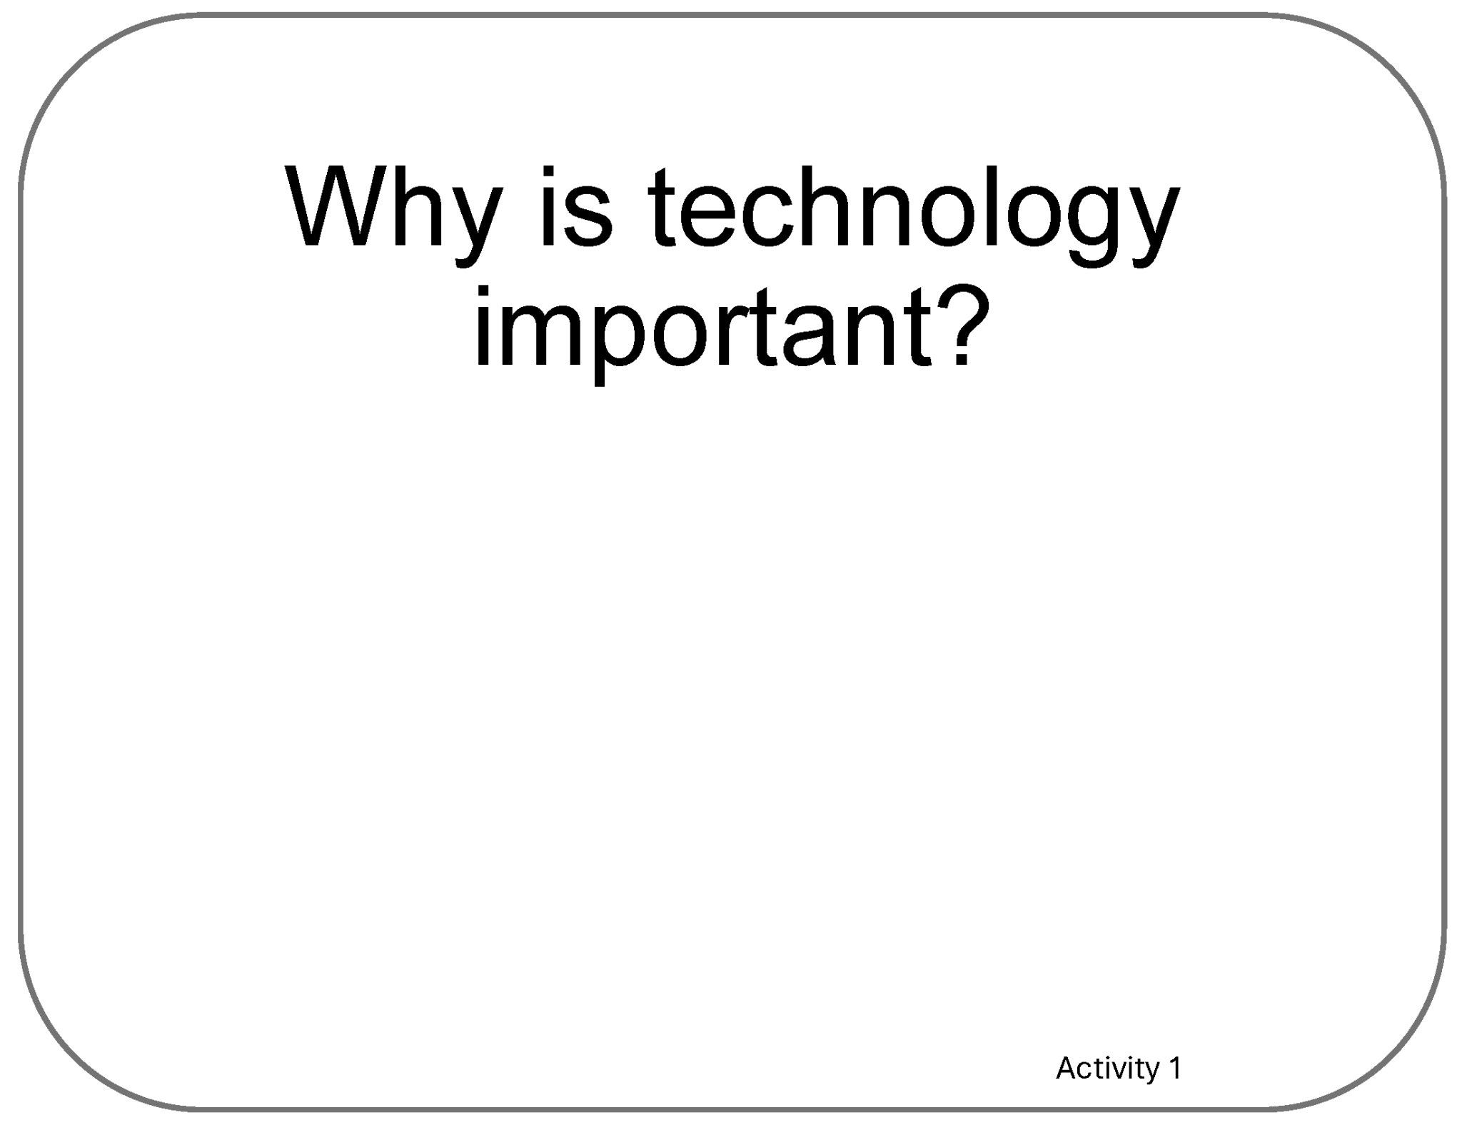
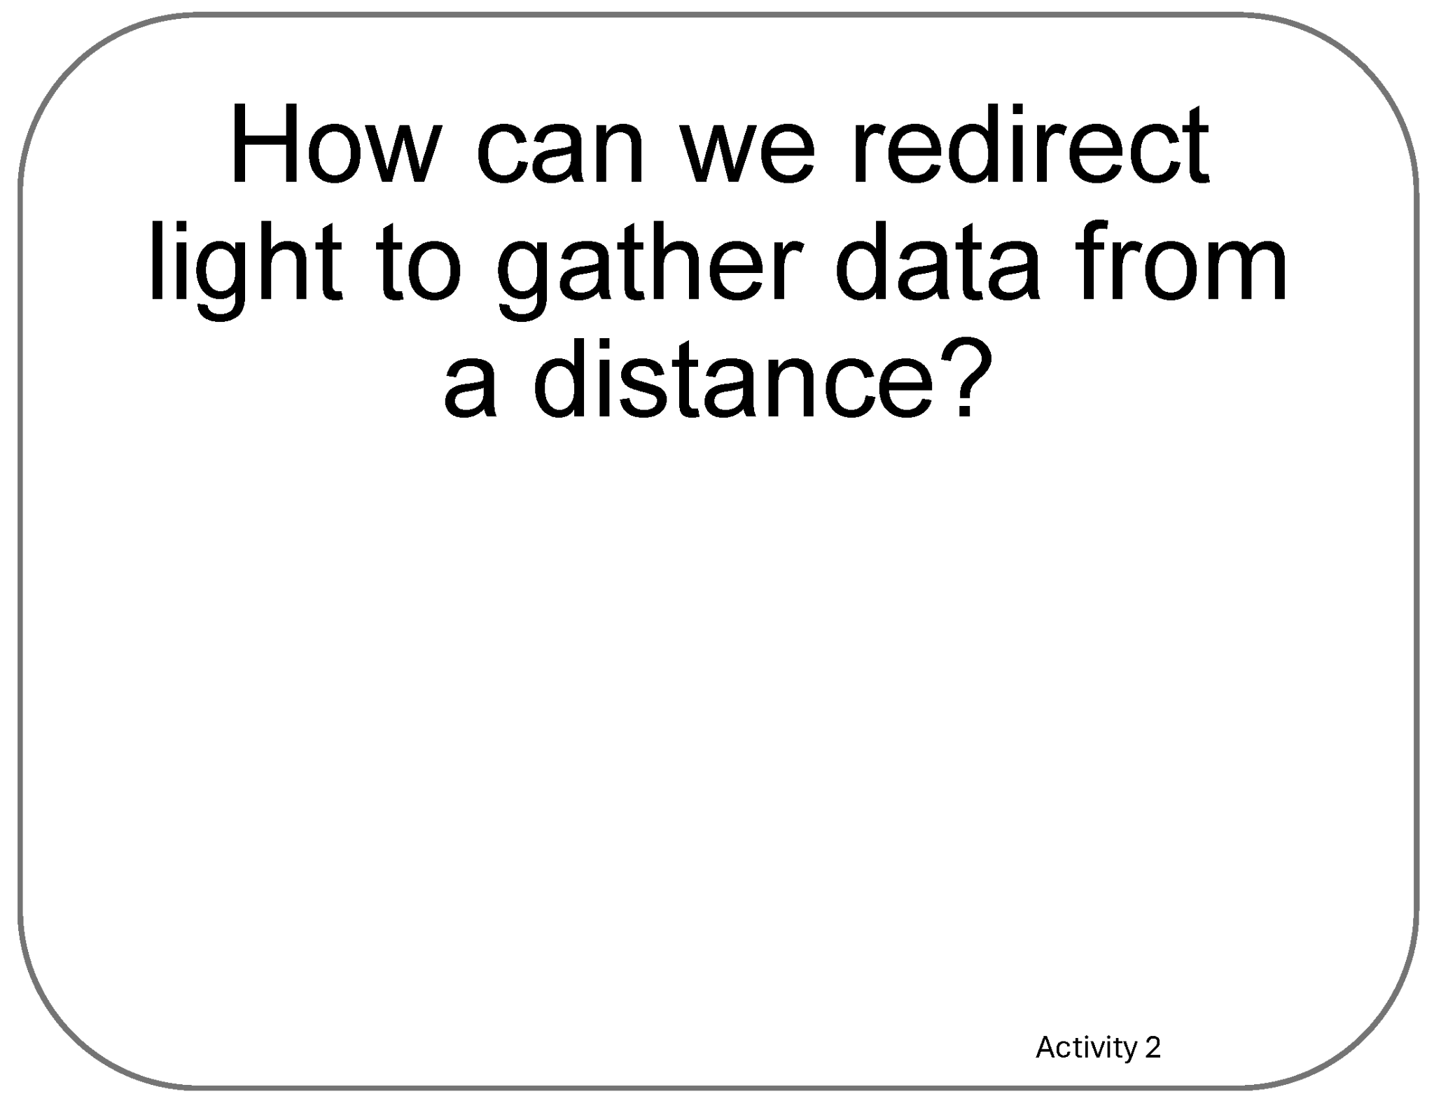
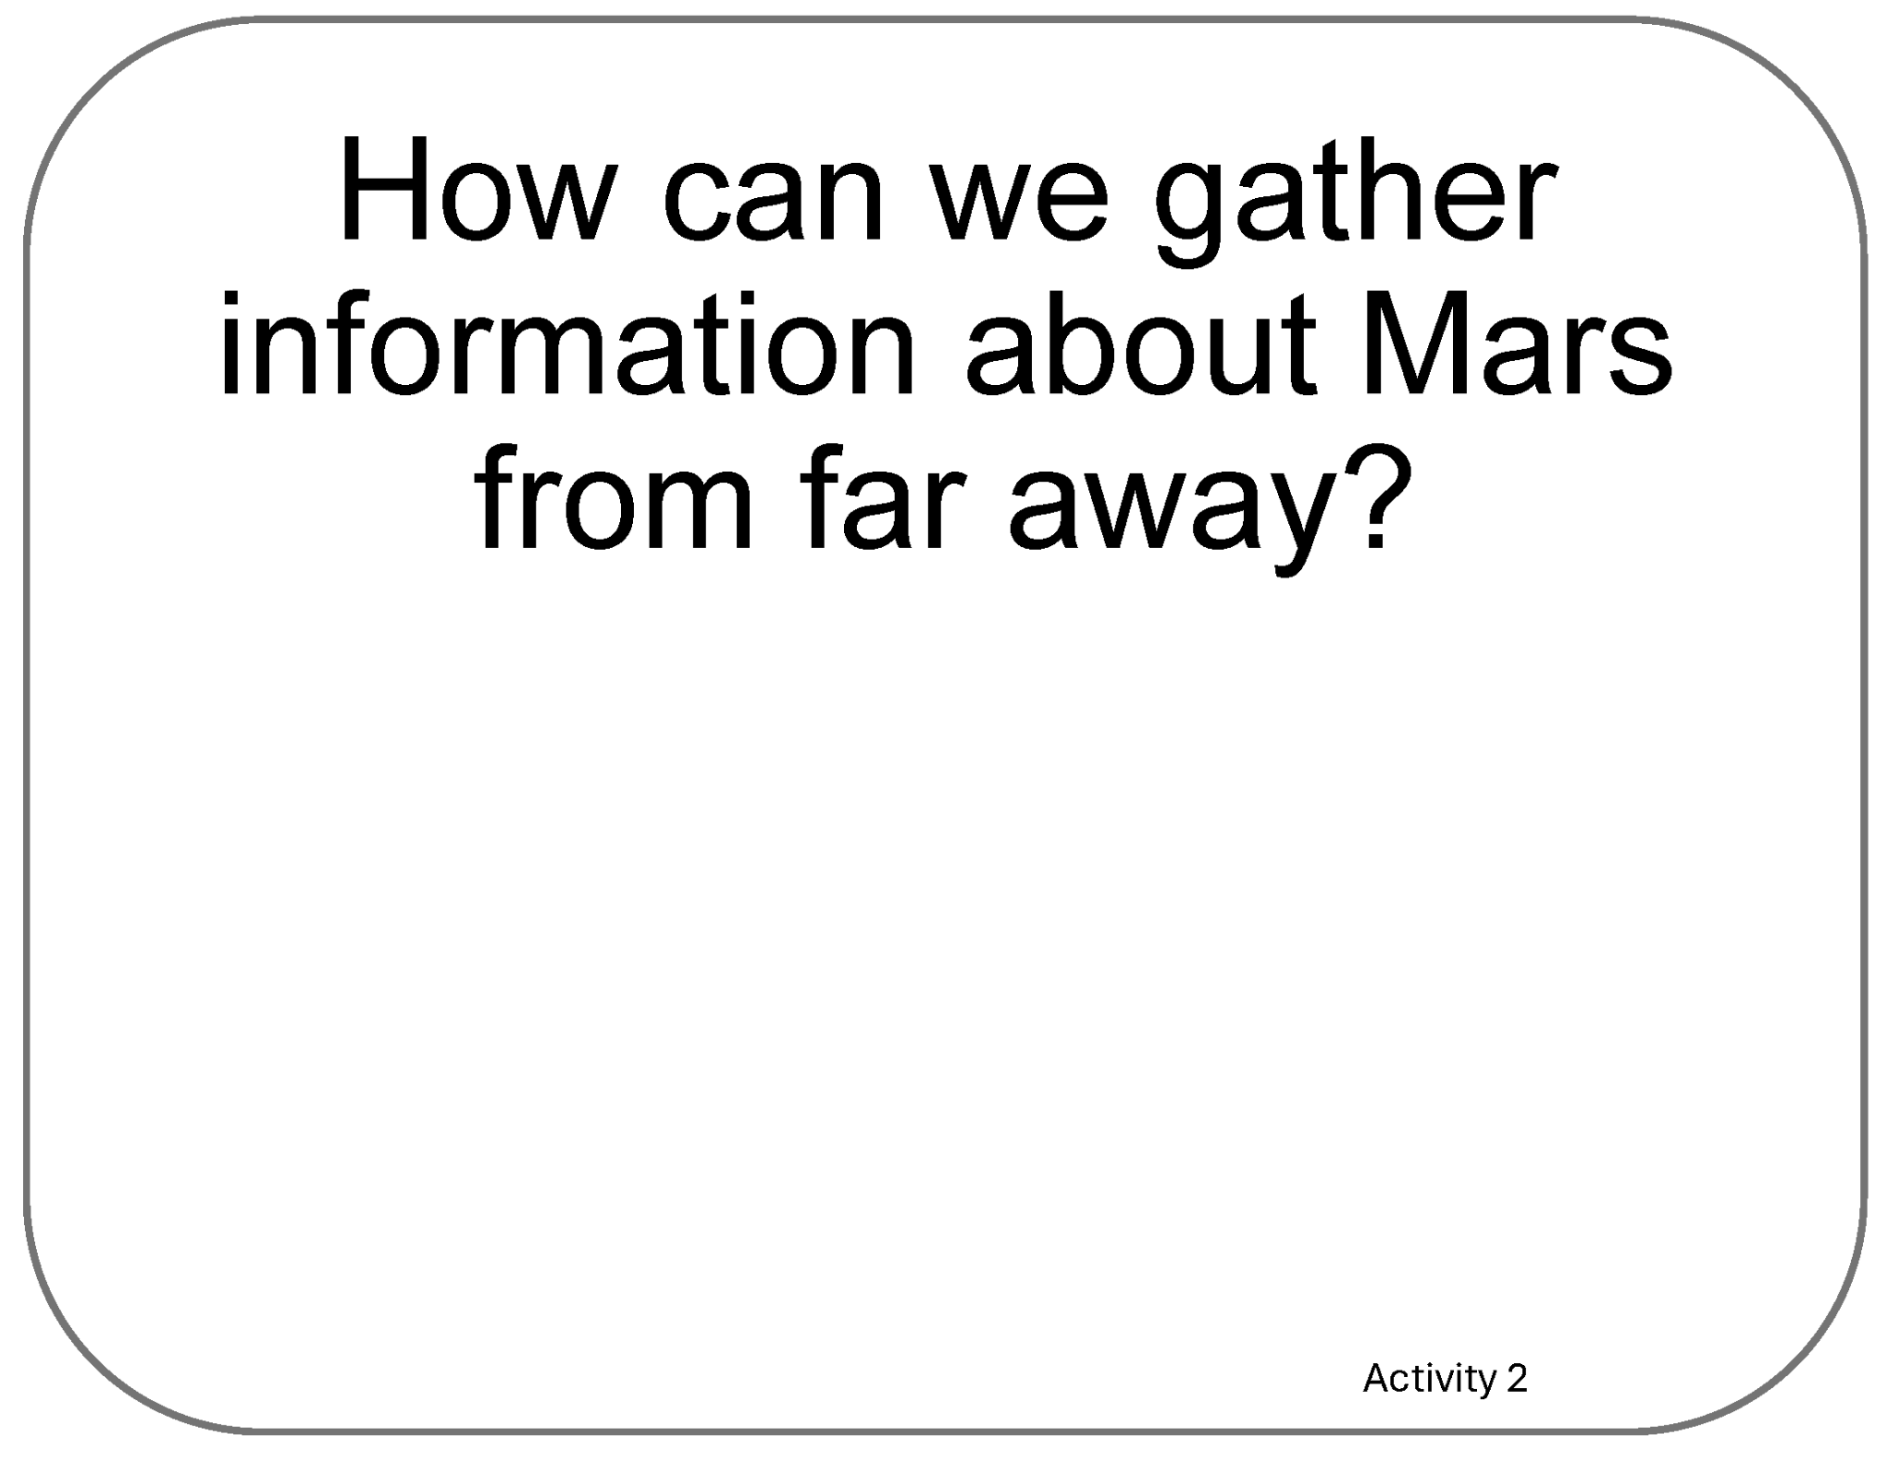
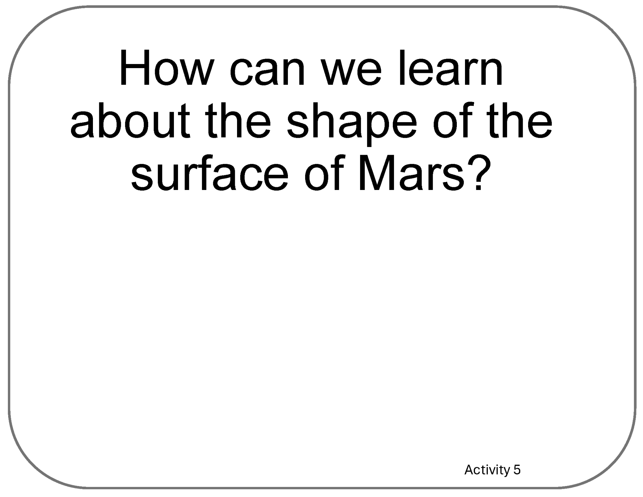
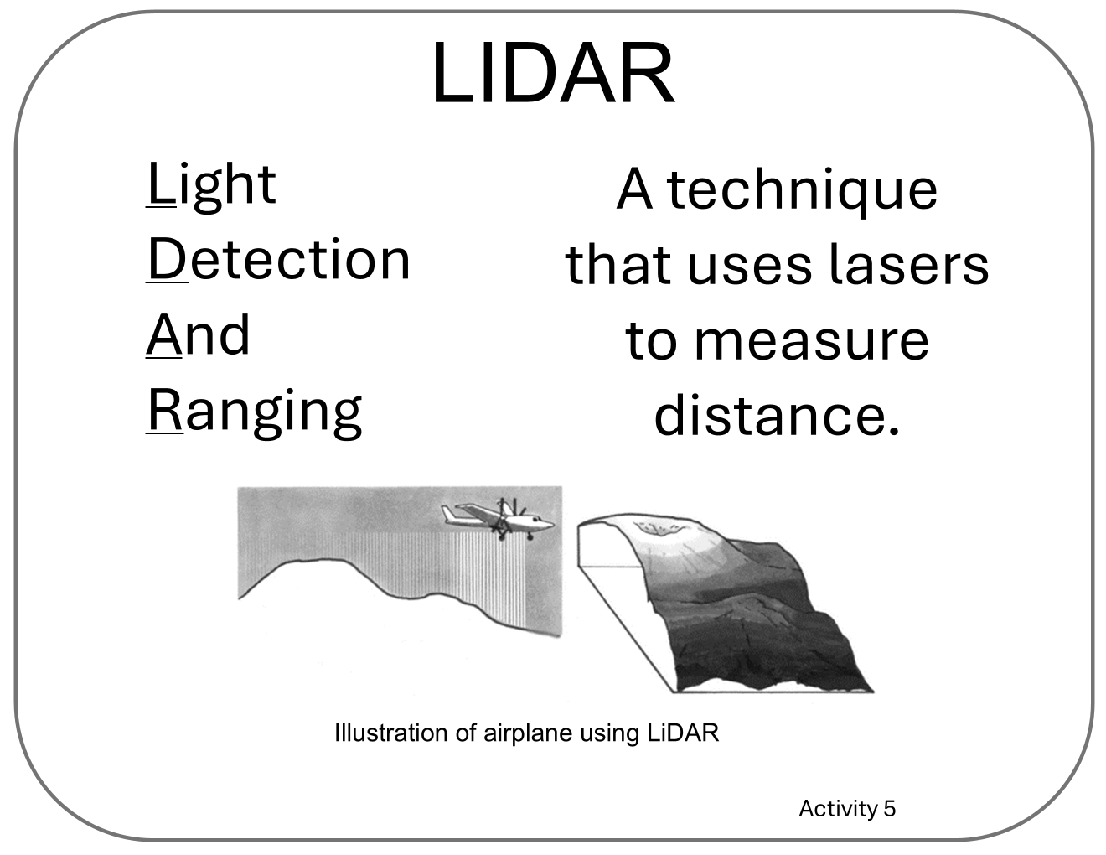
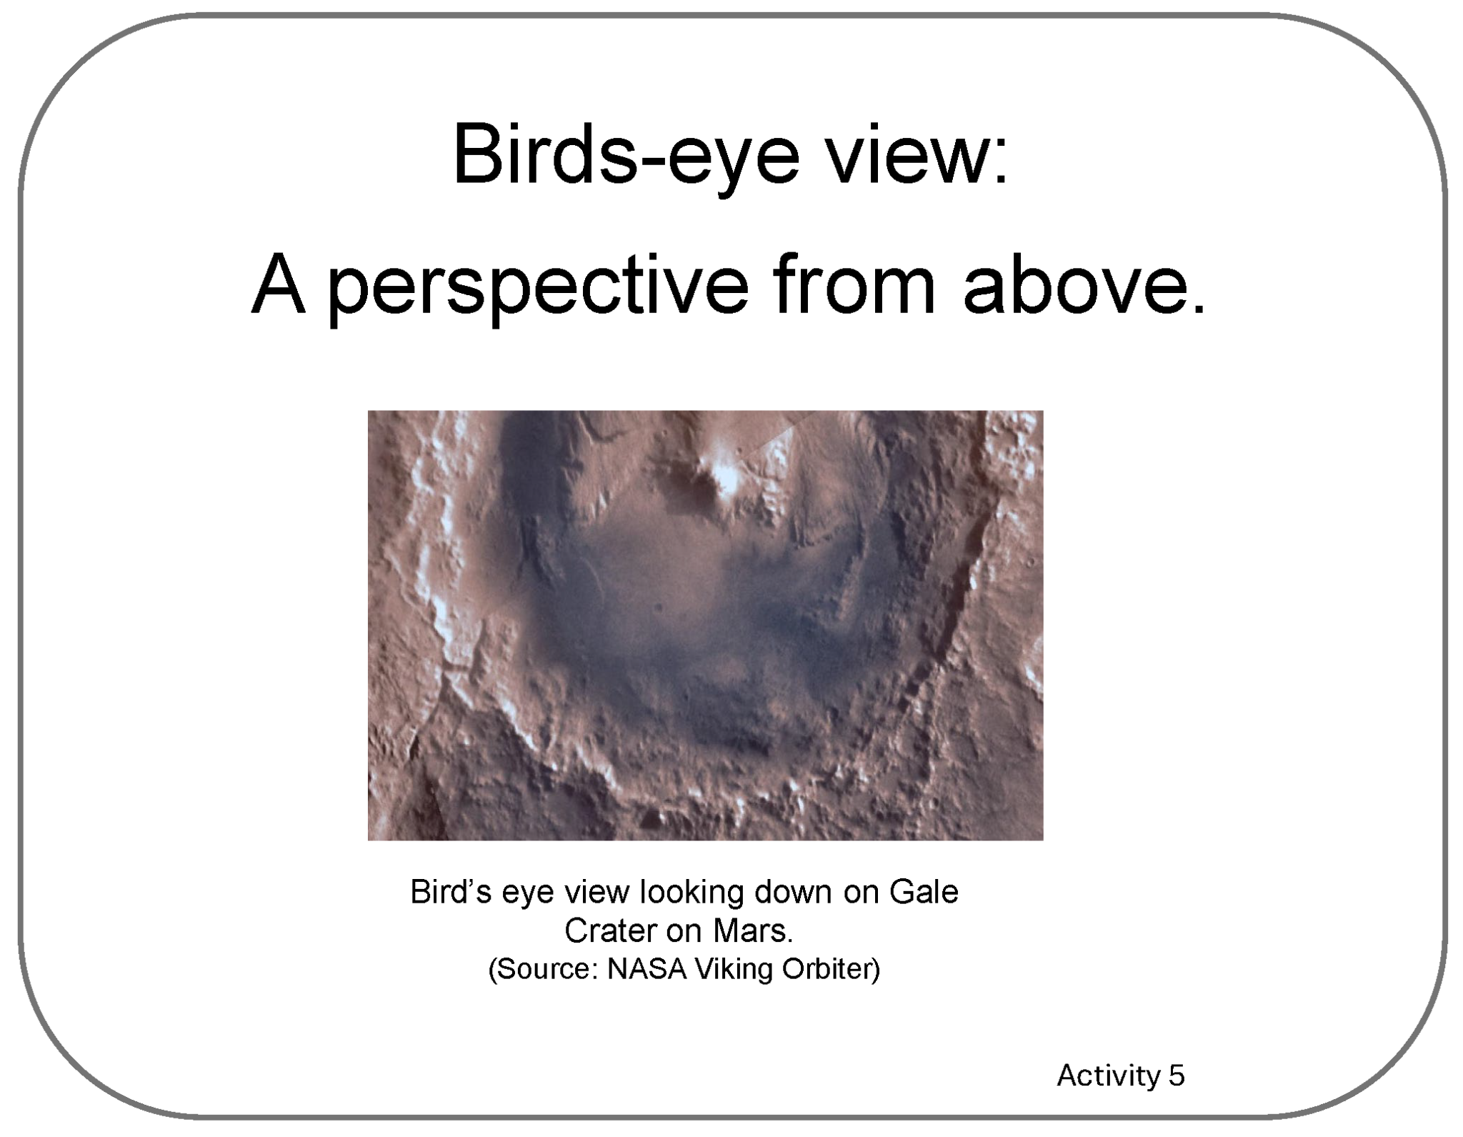
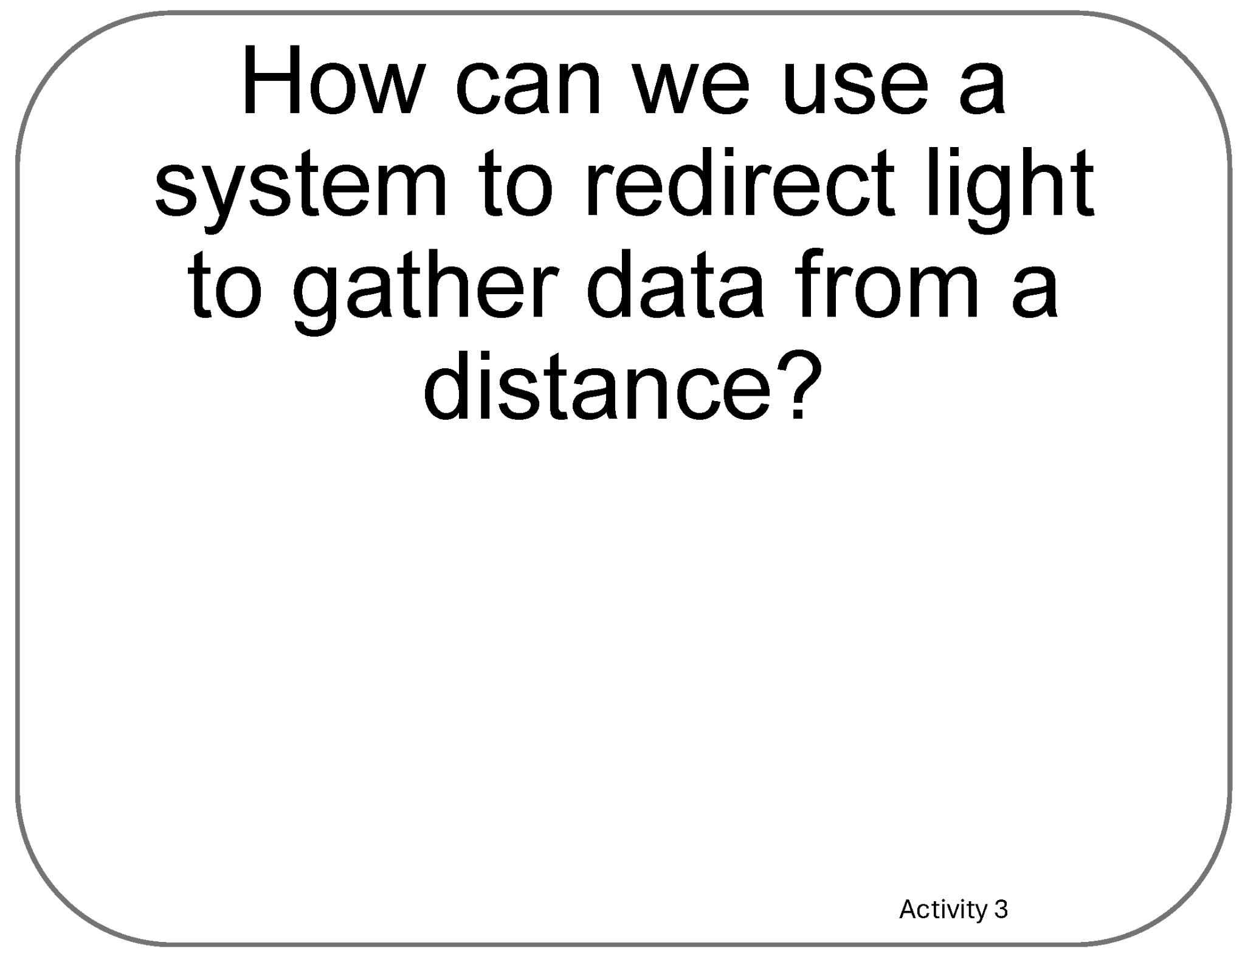
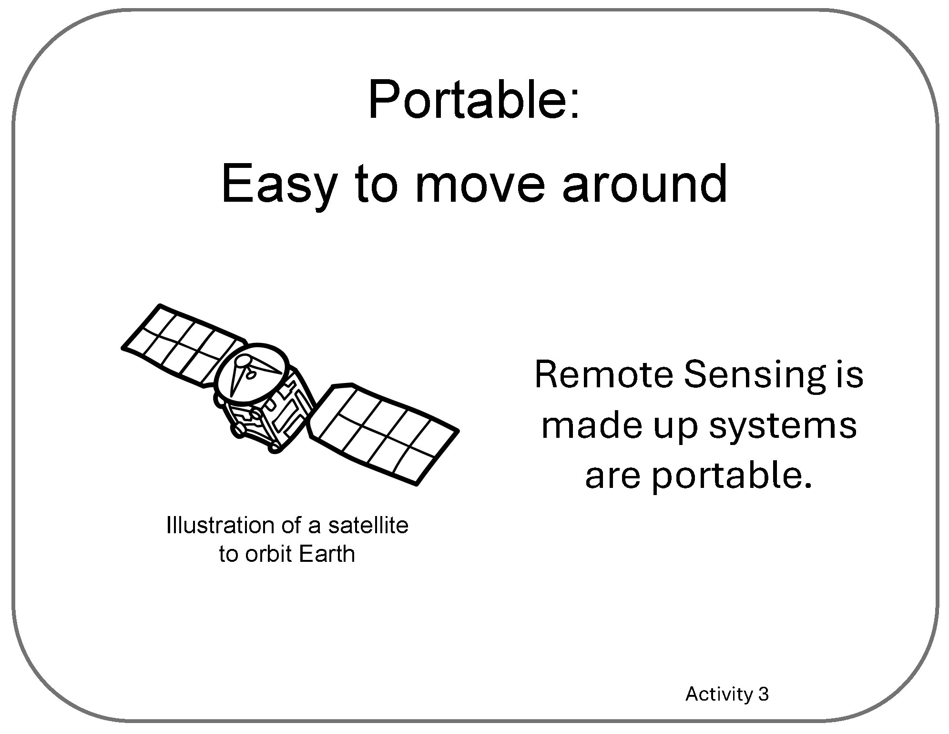
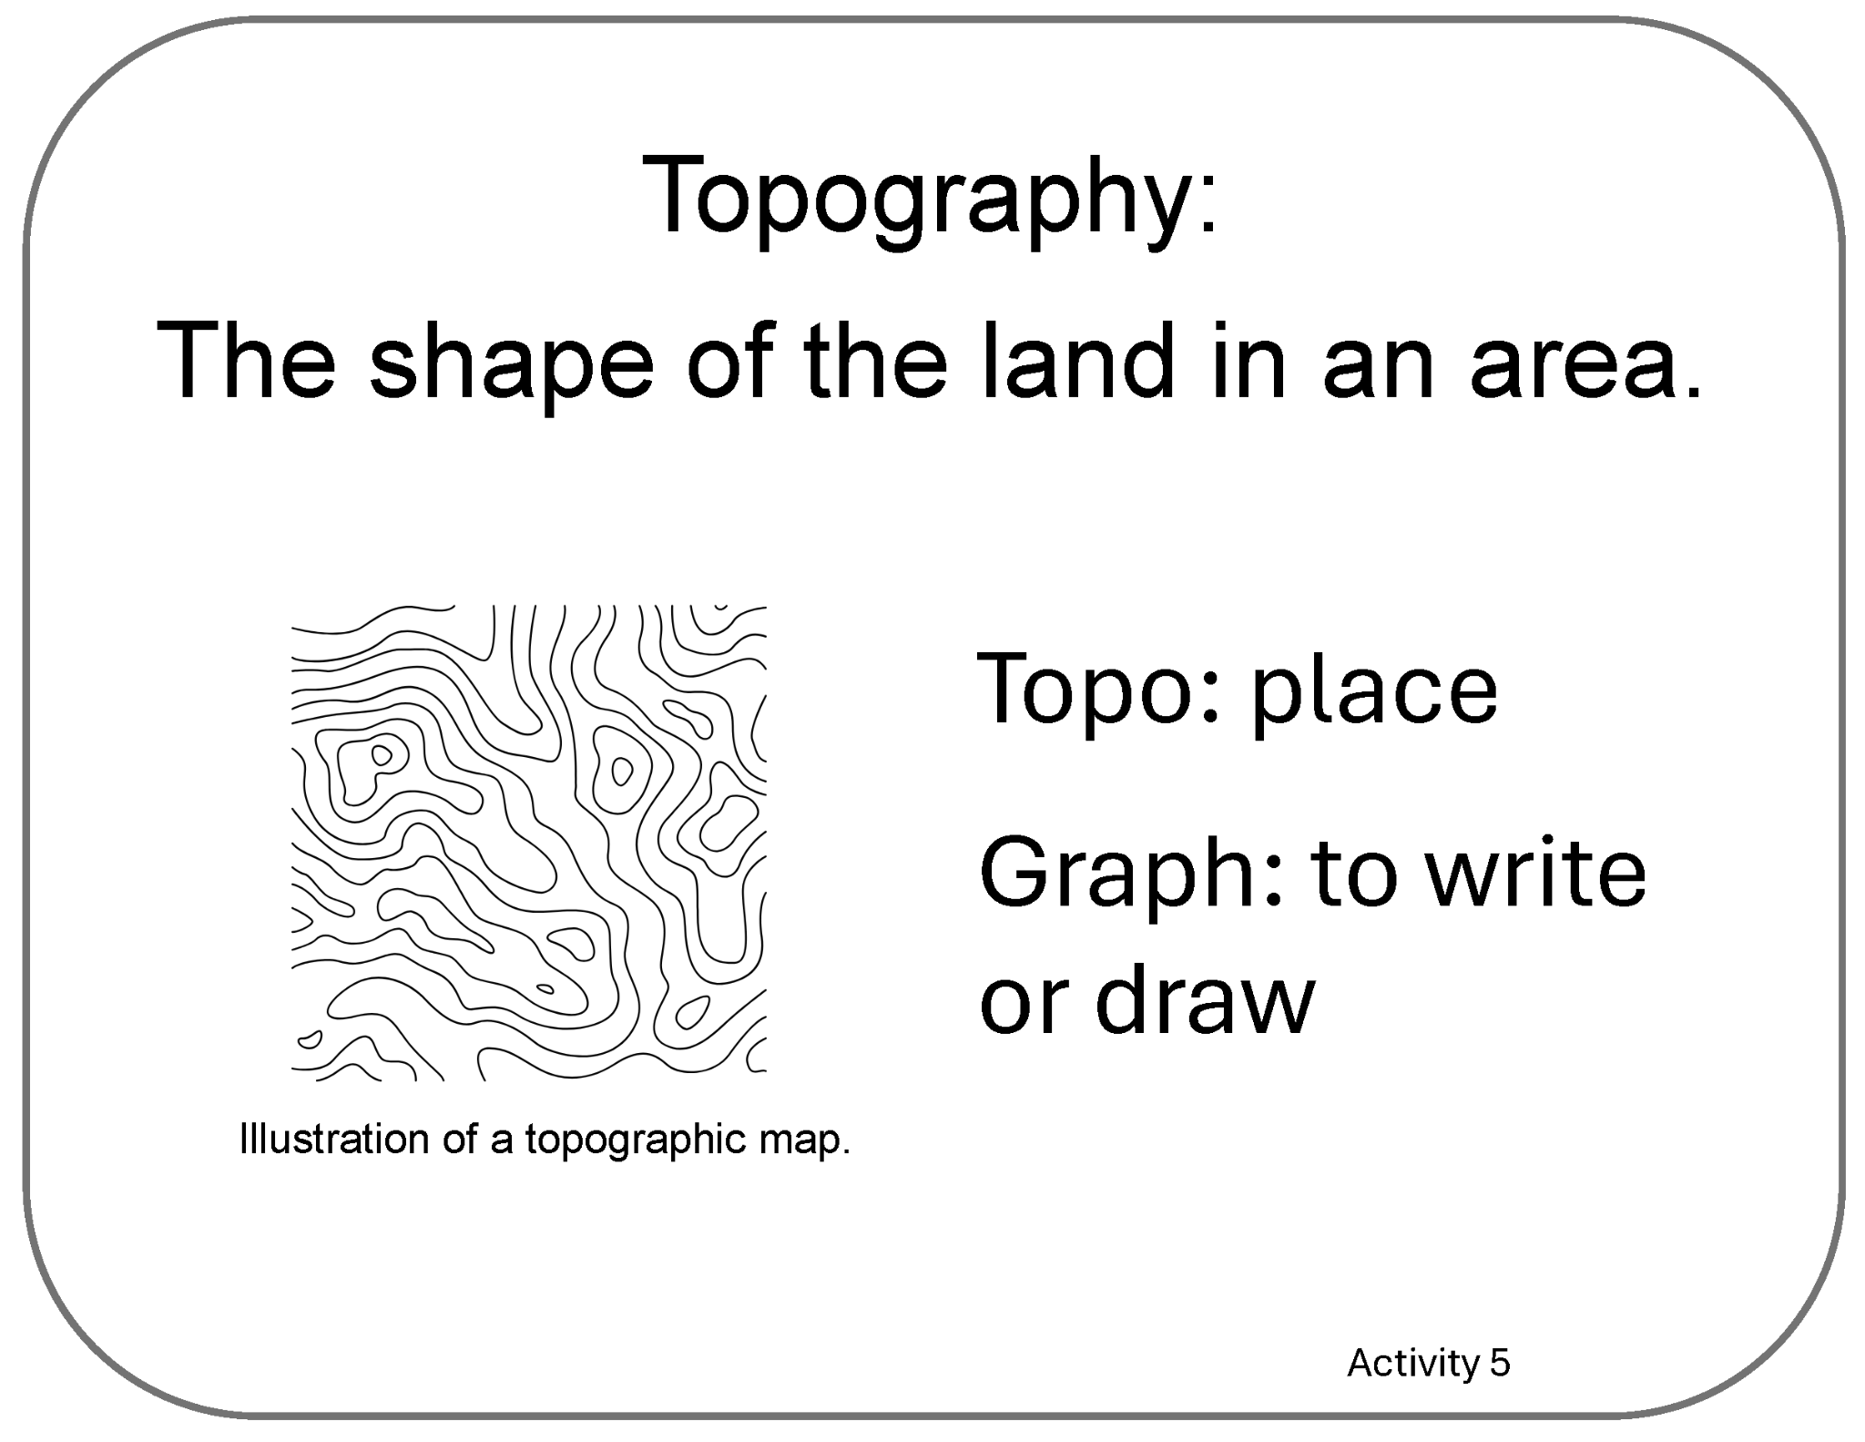
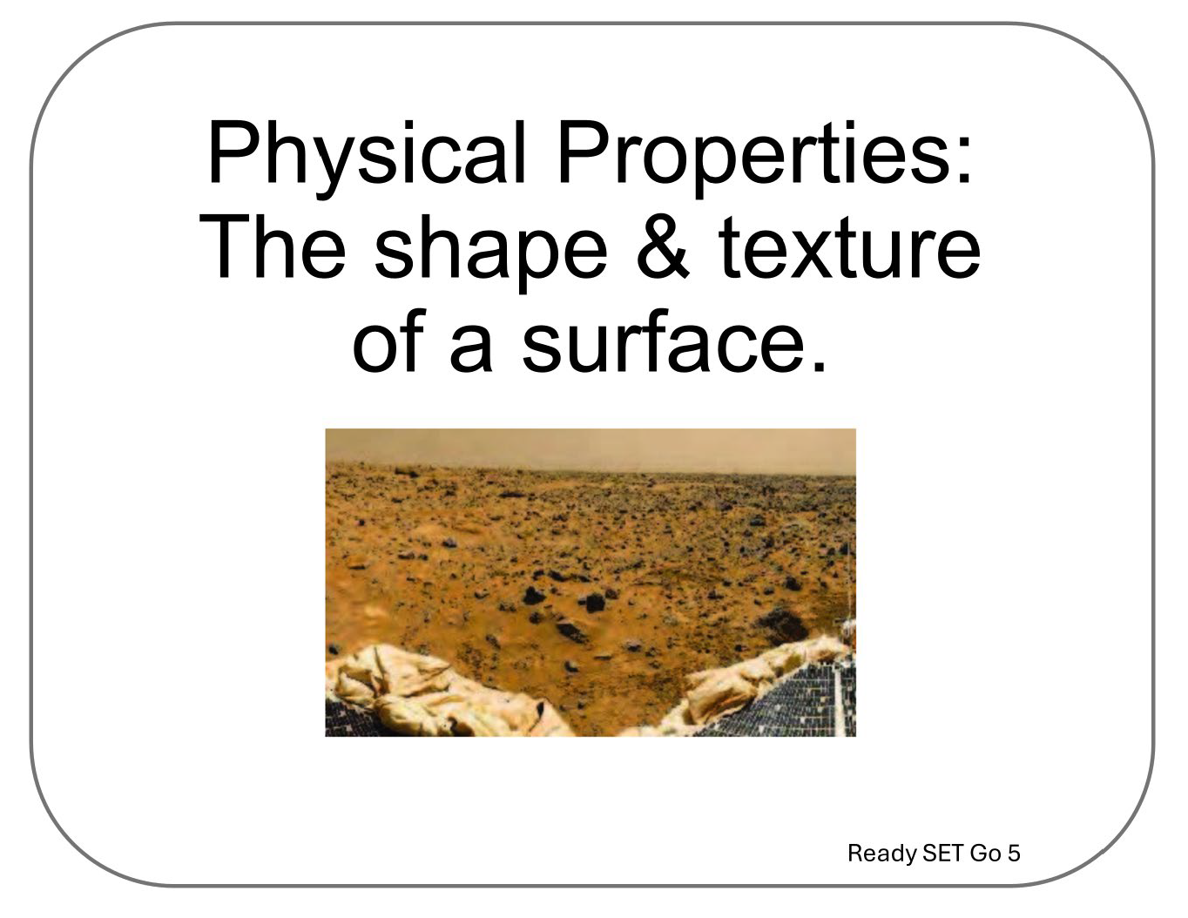
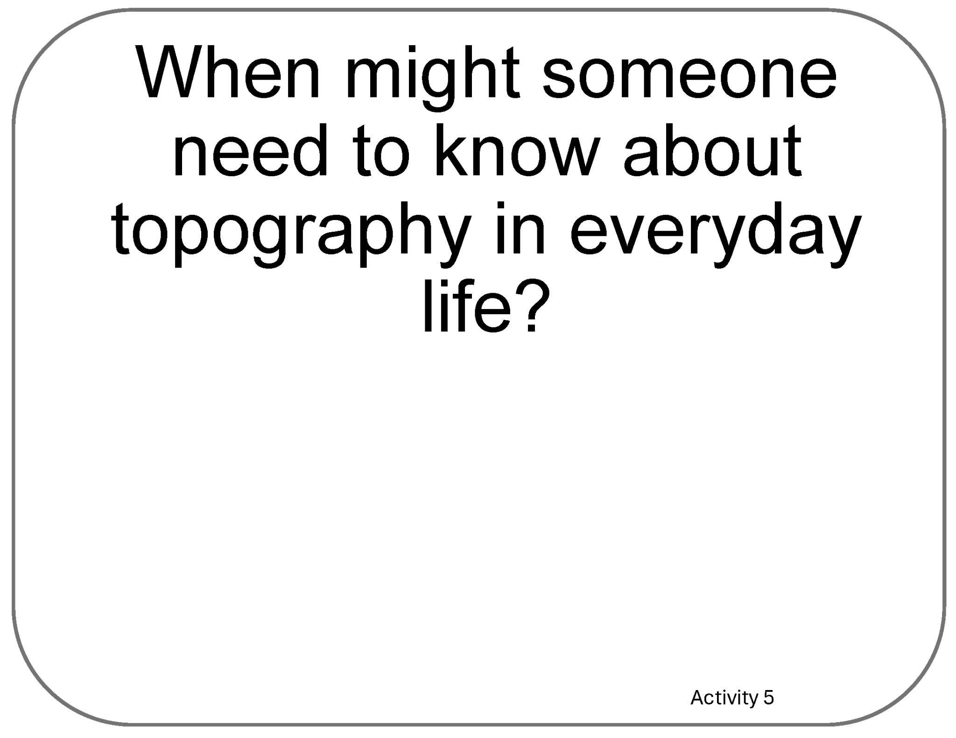
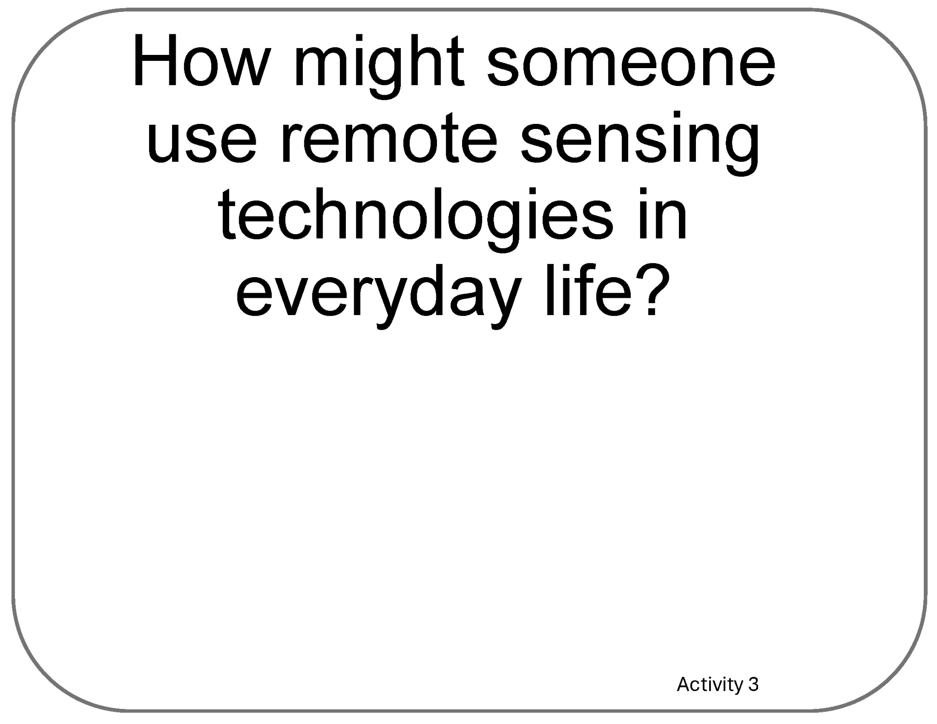
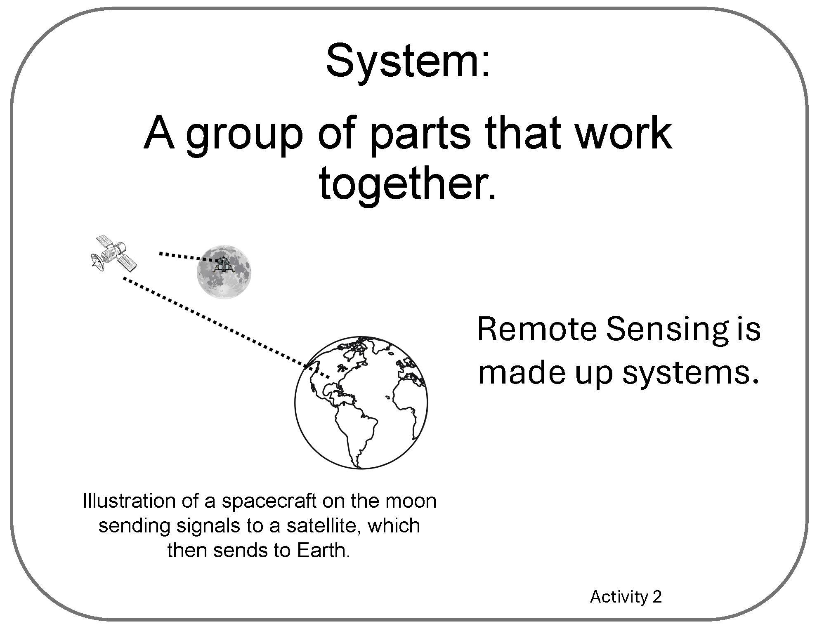
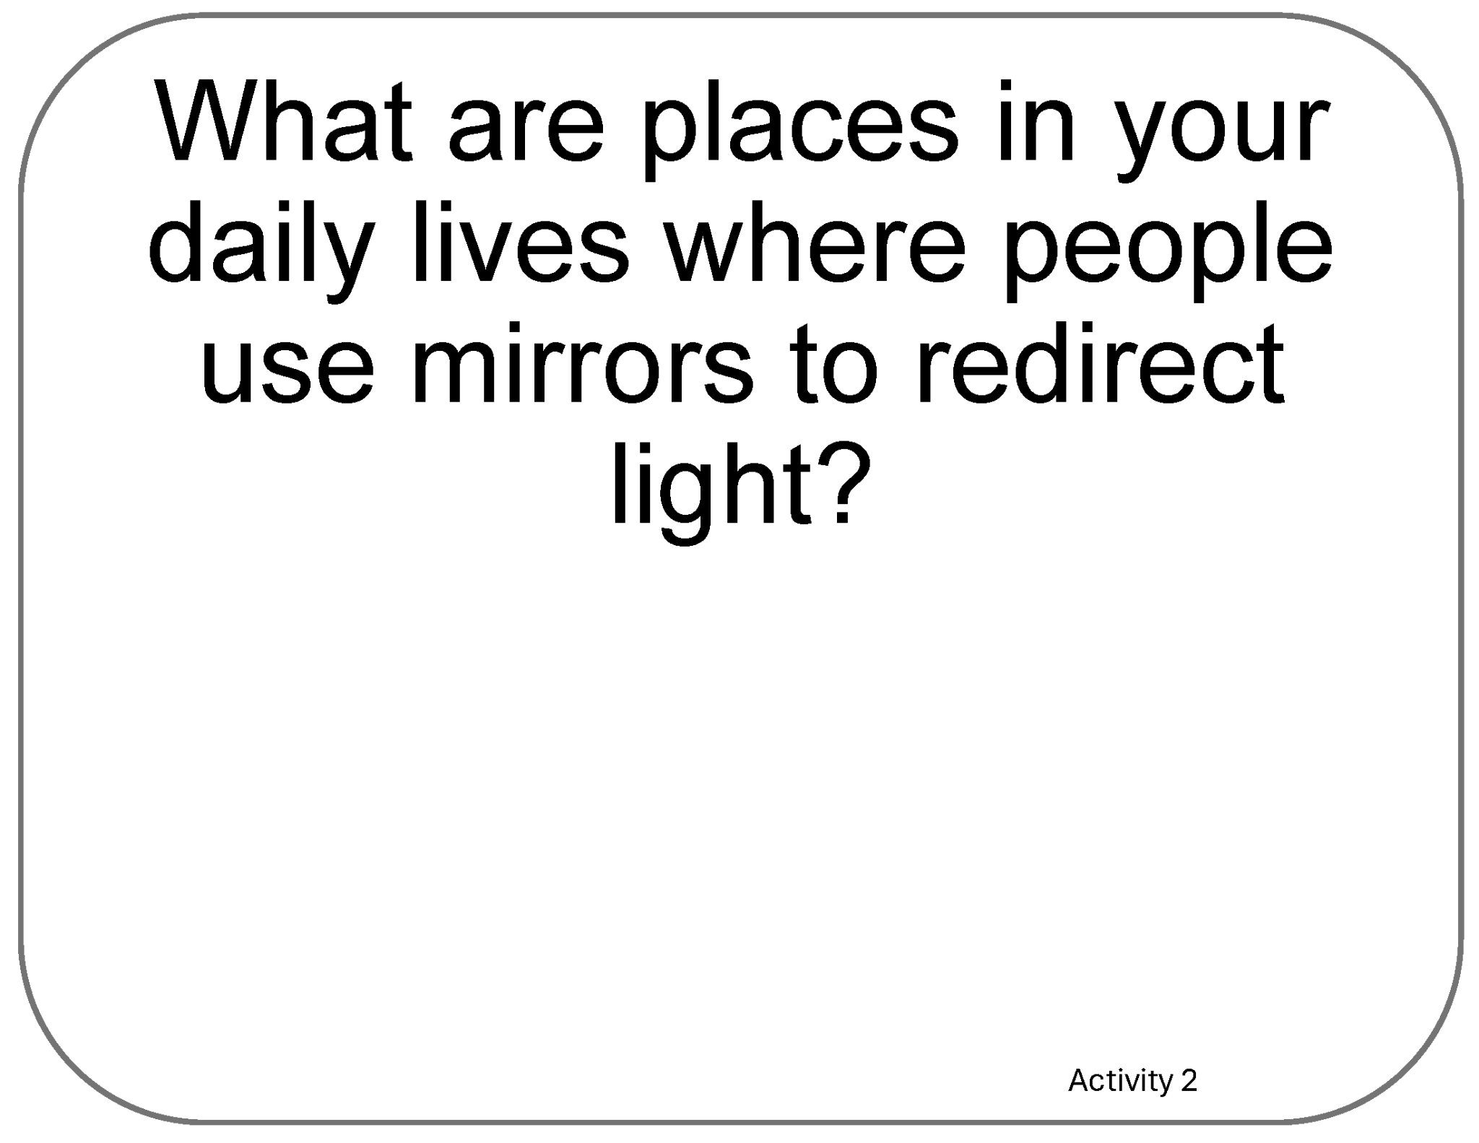
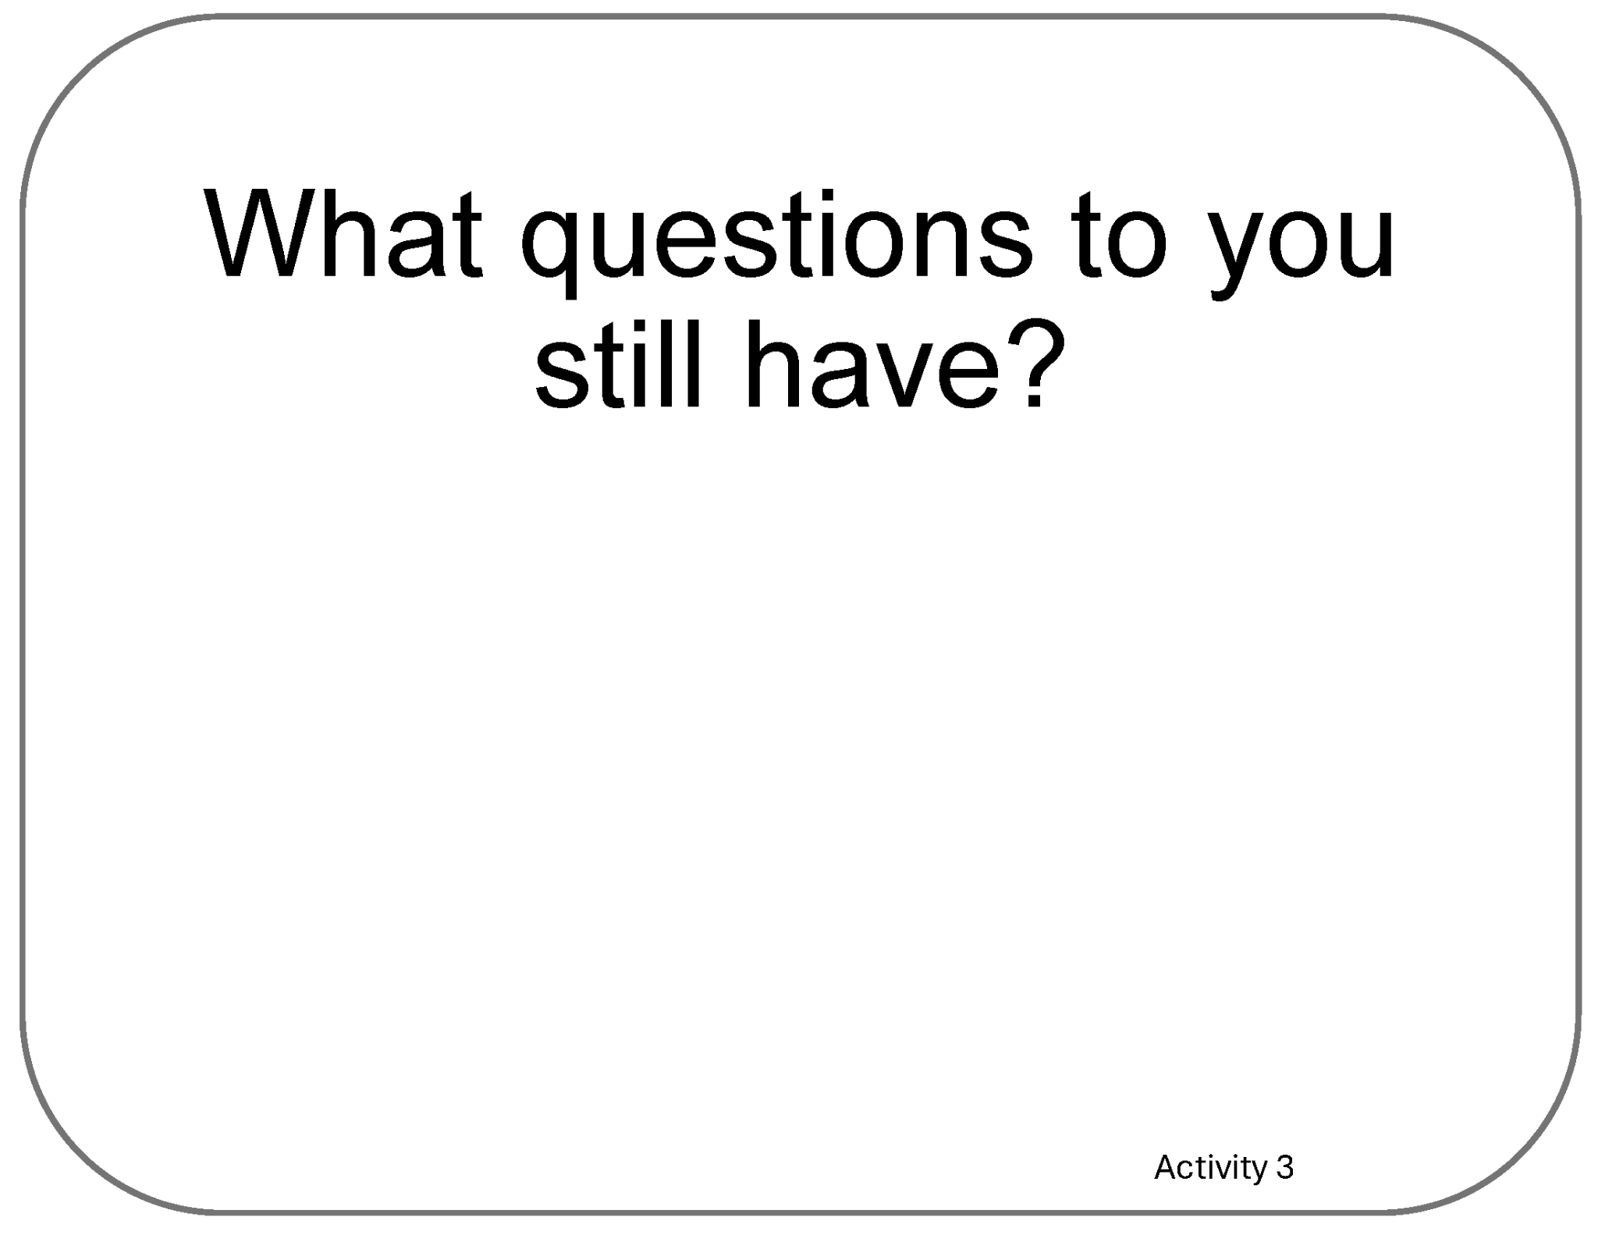
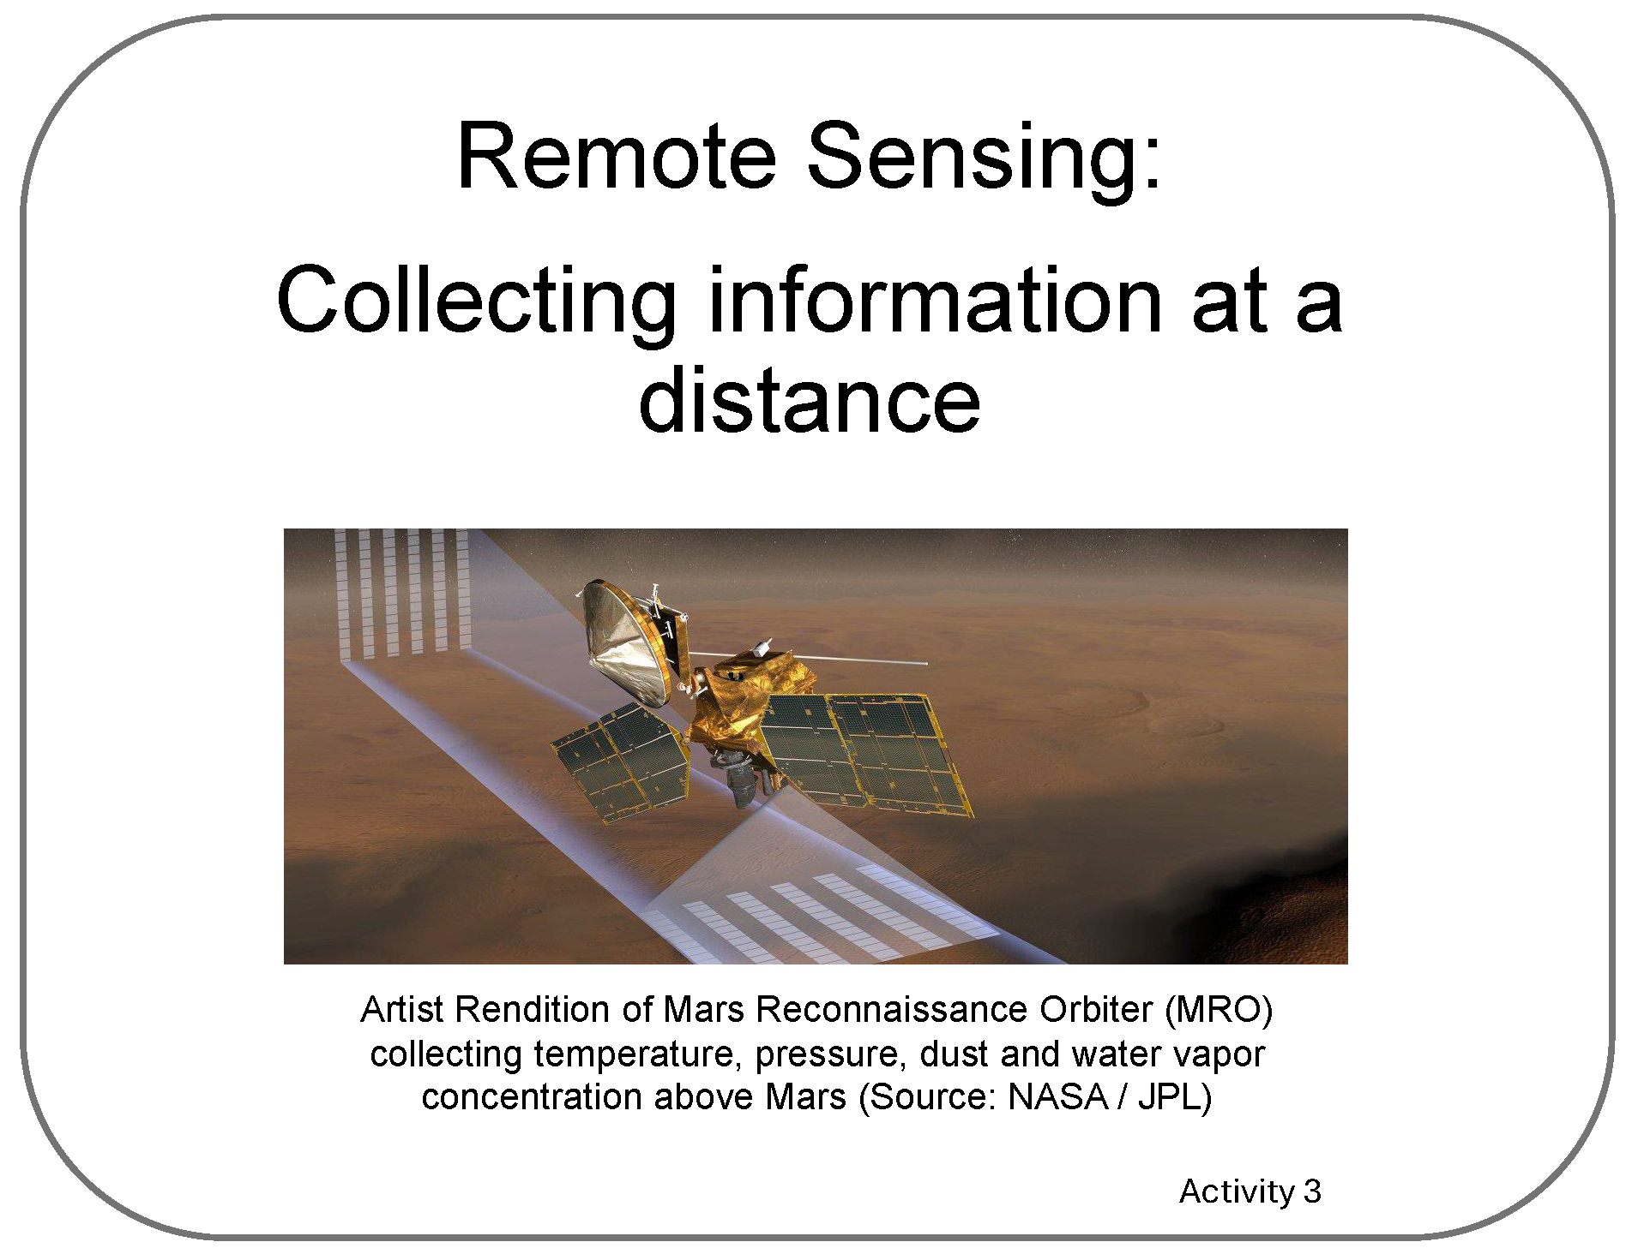


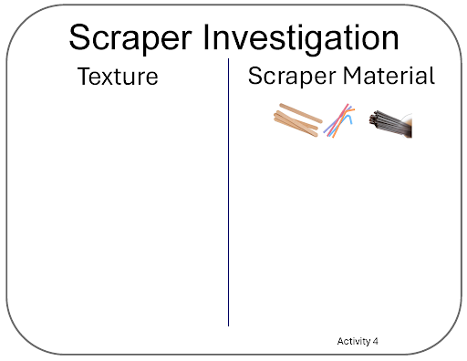
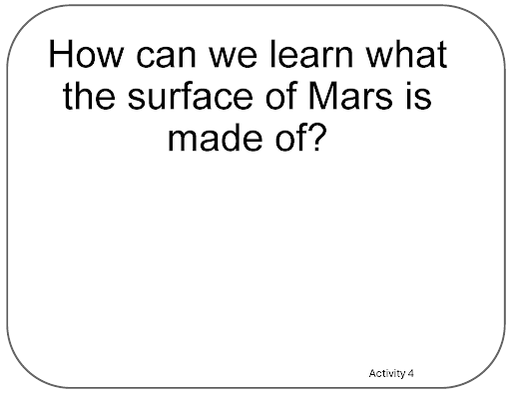
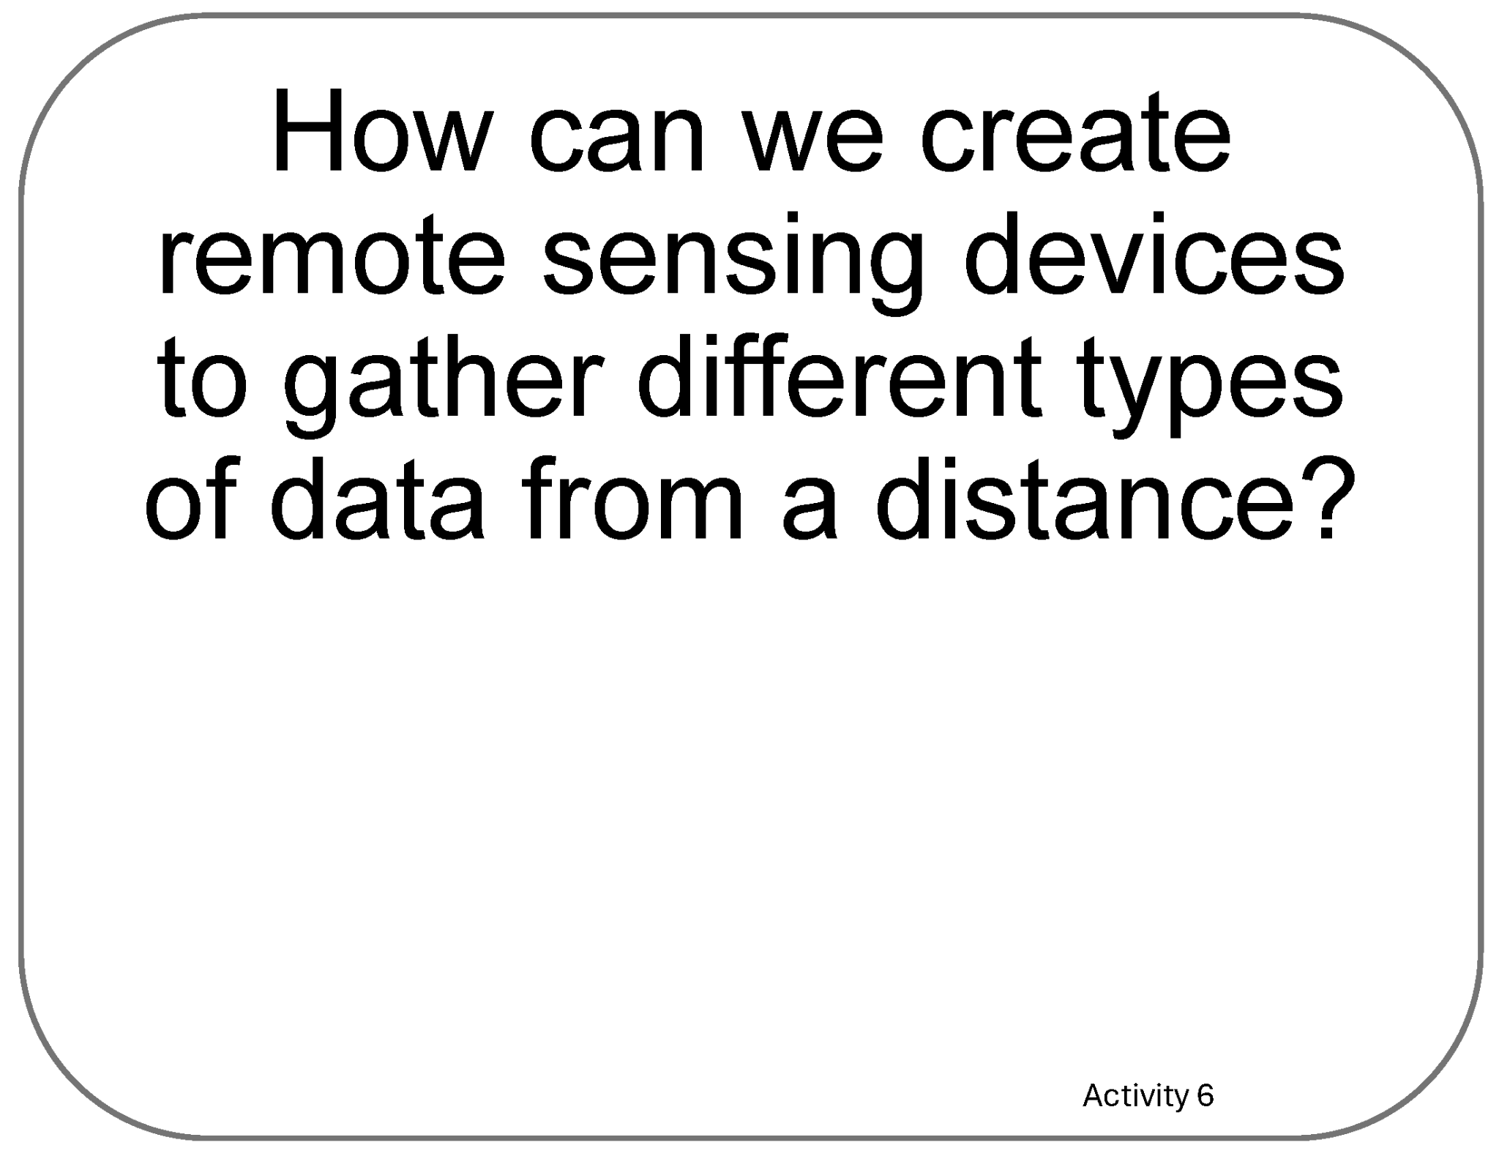
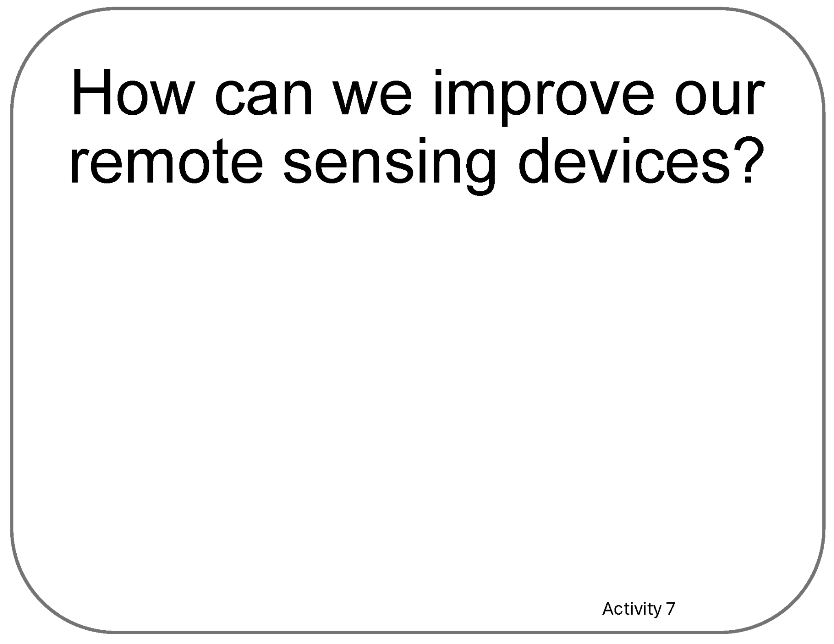
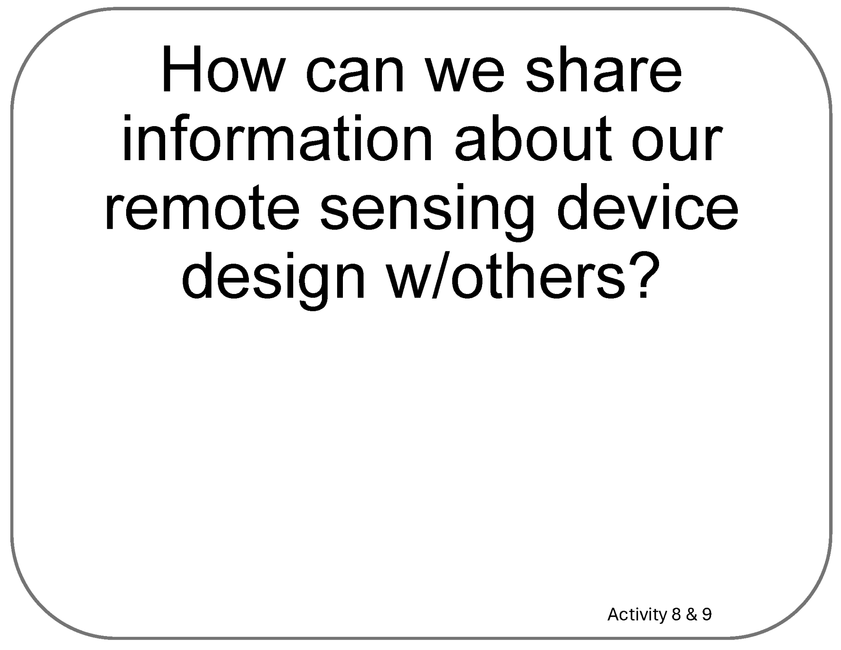
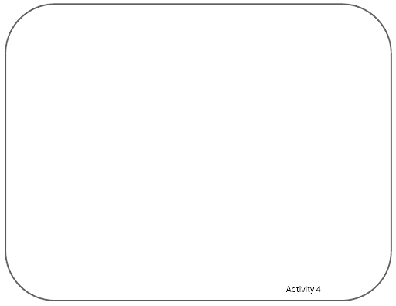
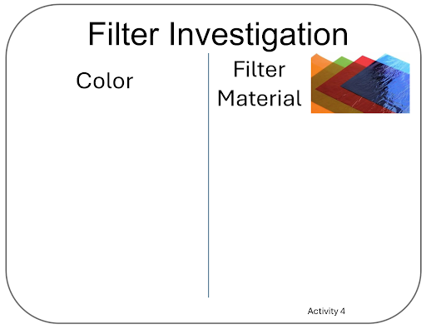

Poster Se tup (Empty Example)
Our Ideas about Remote Sensing
Engineering

Slide 14
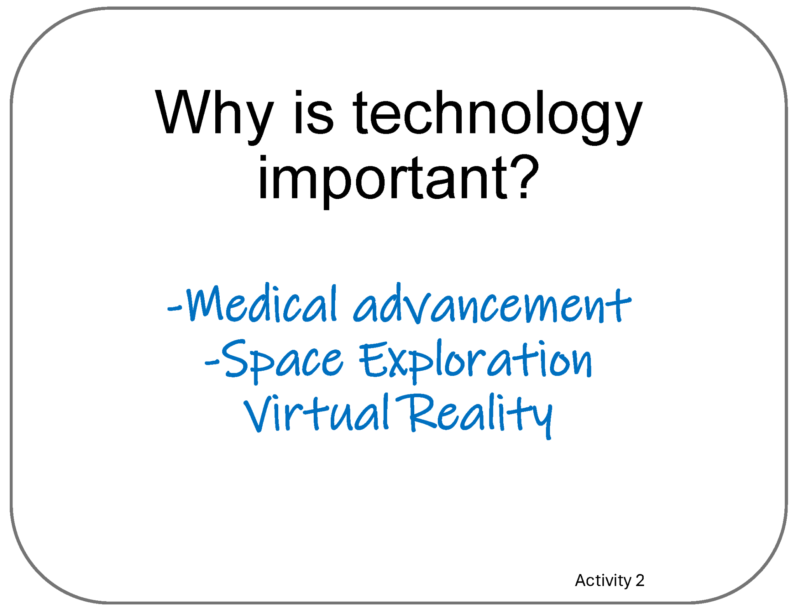
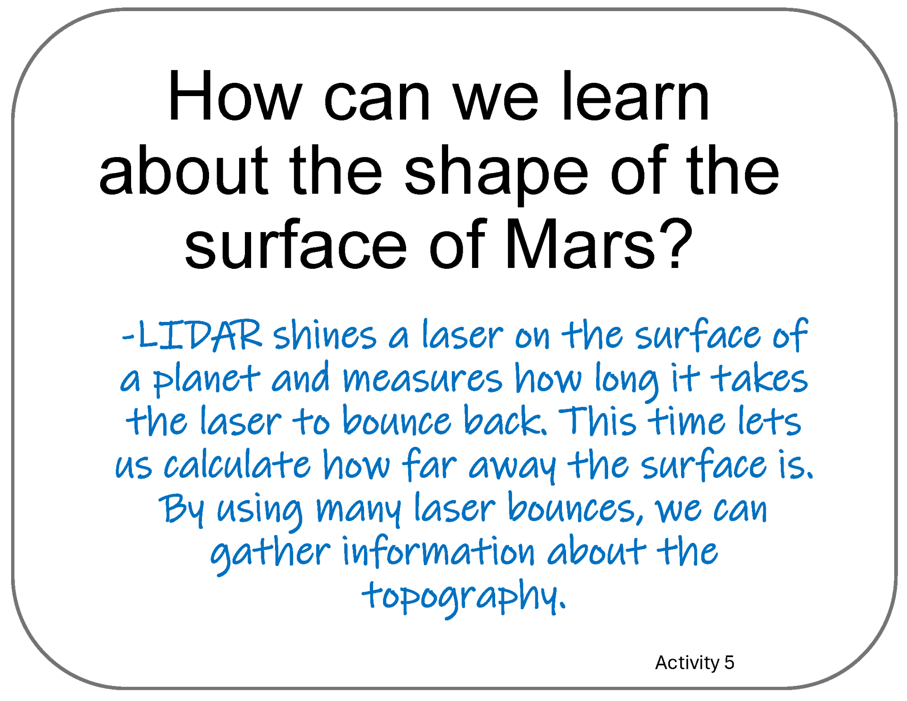
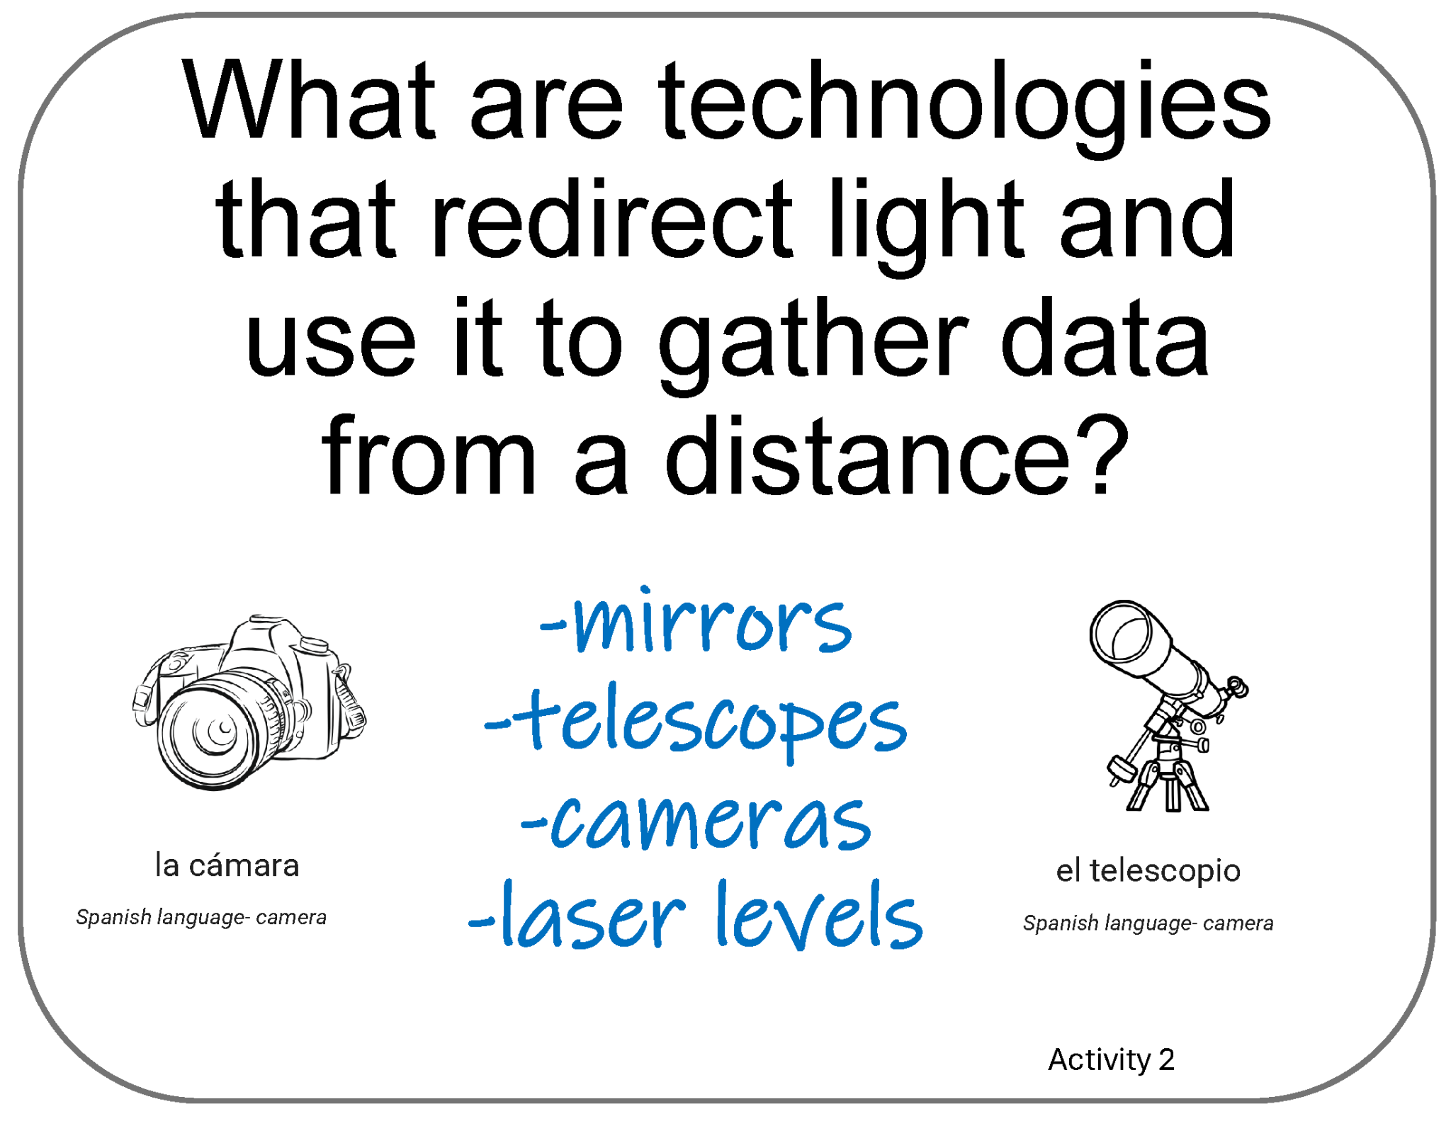
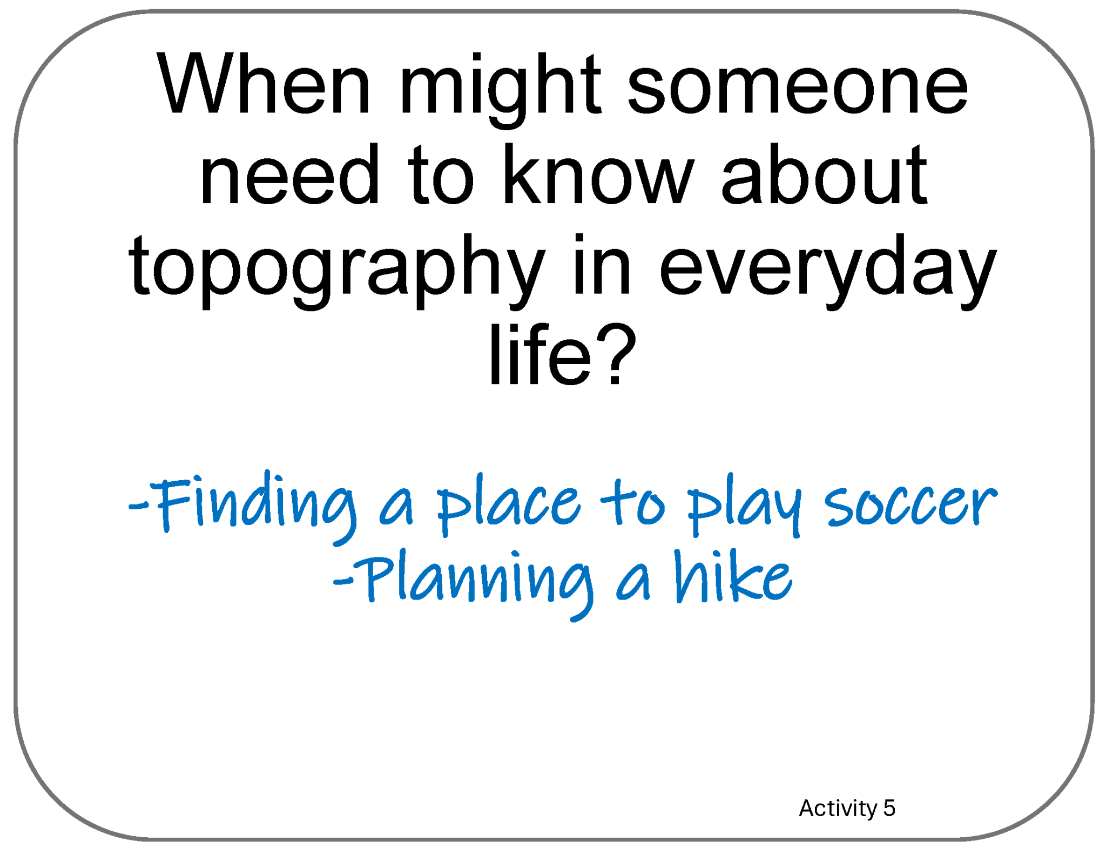
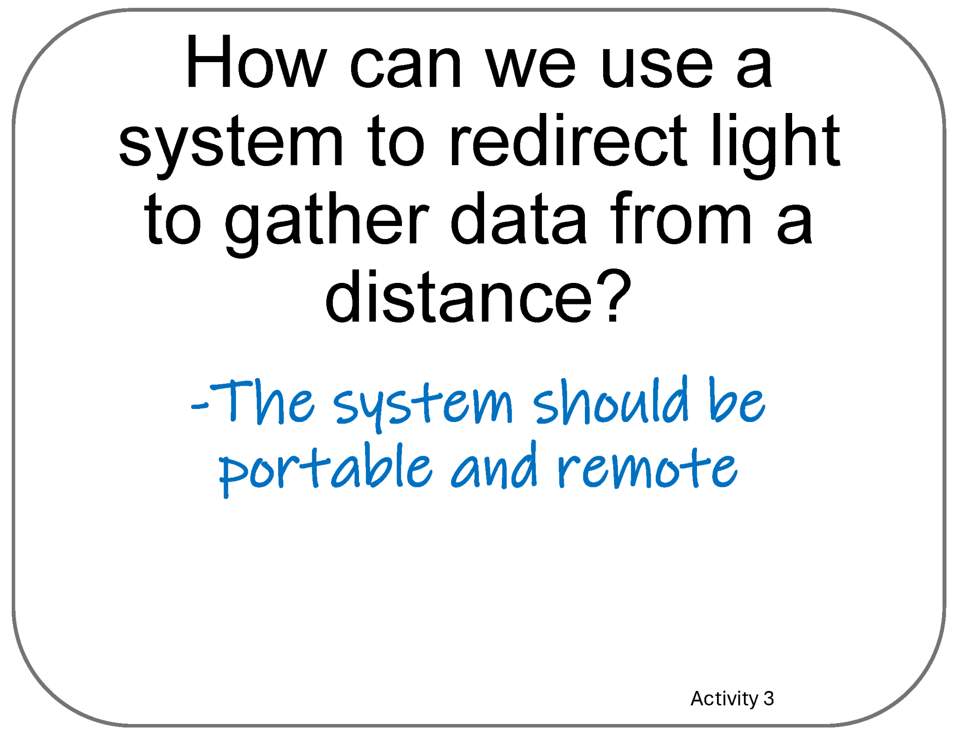
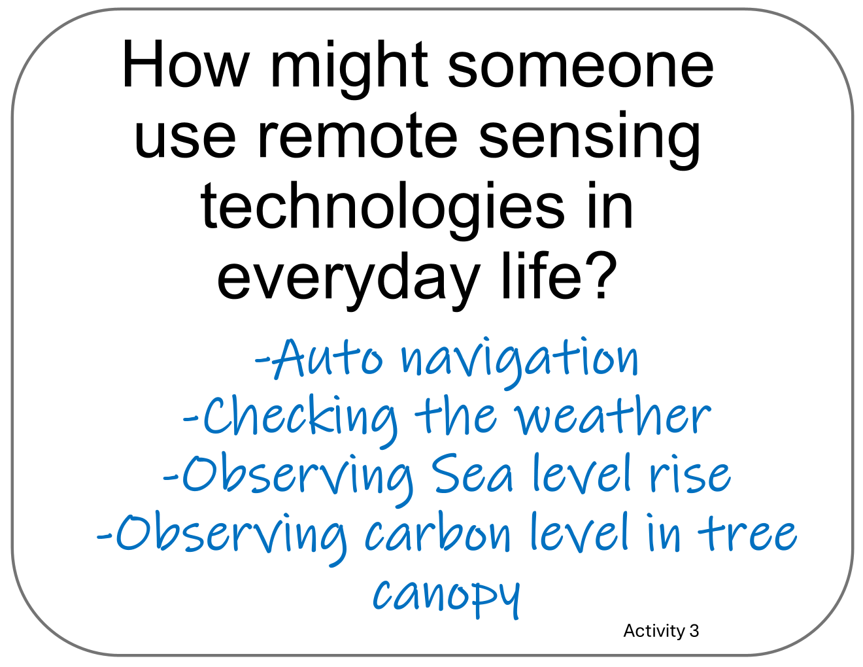
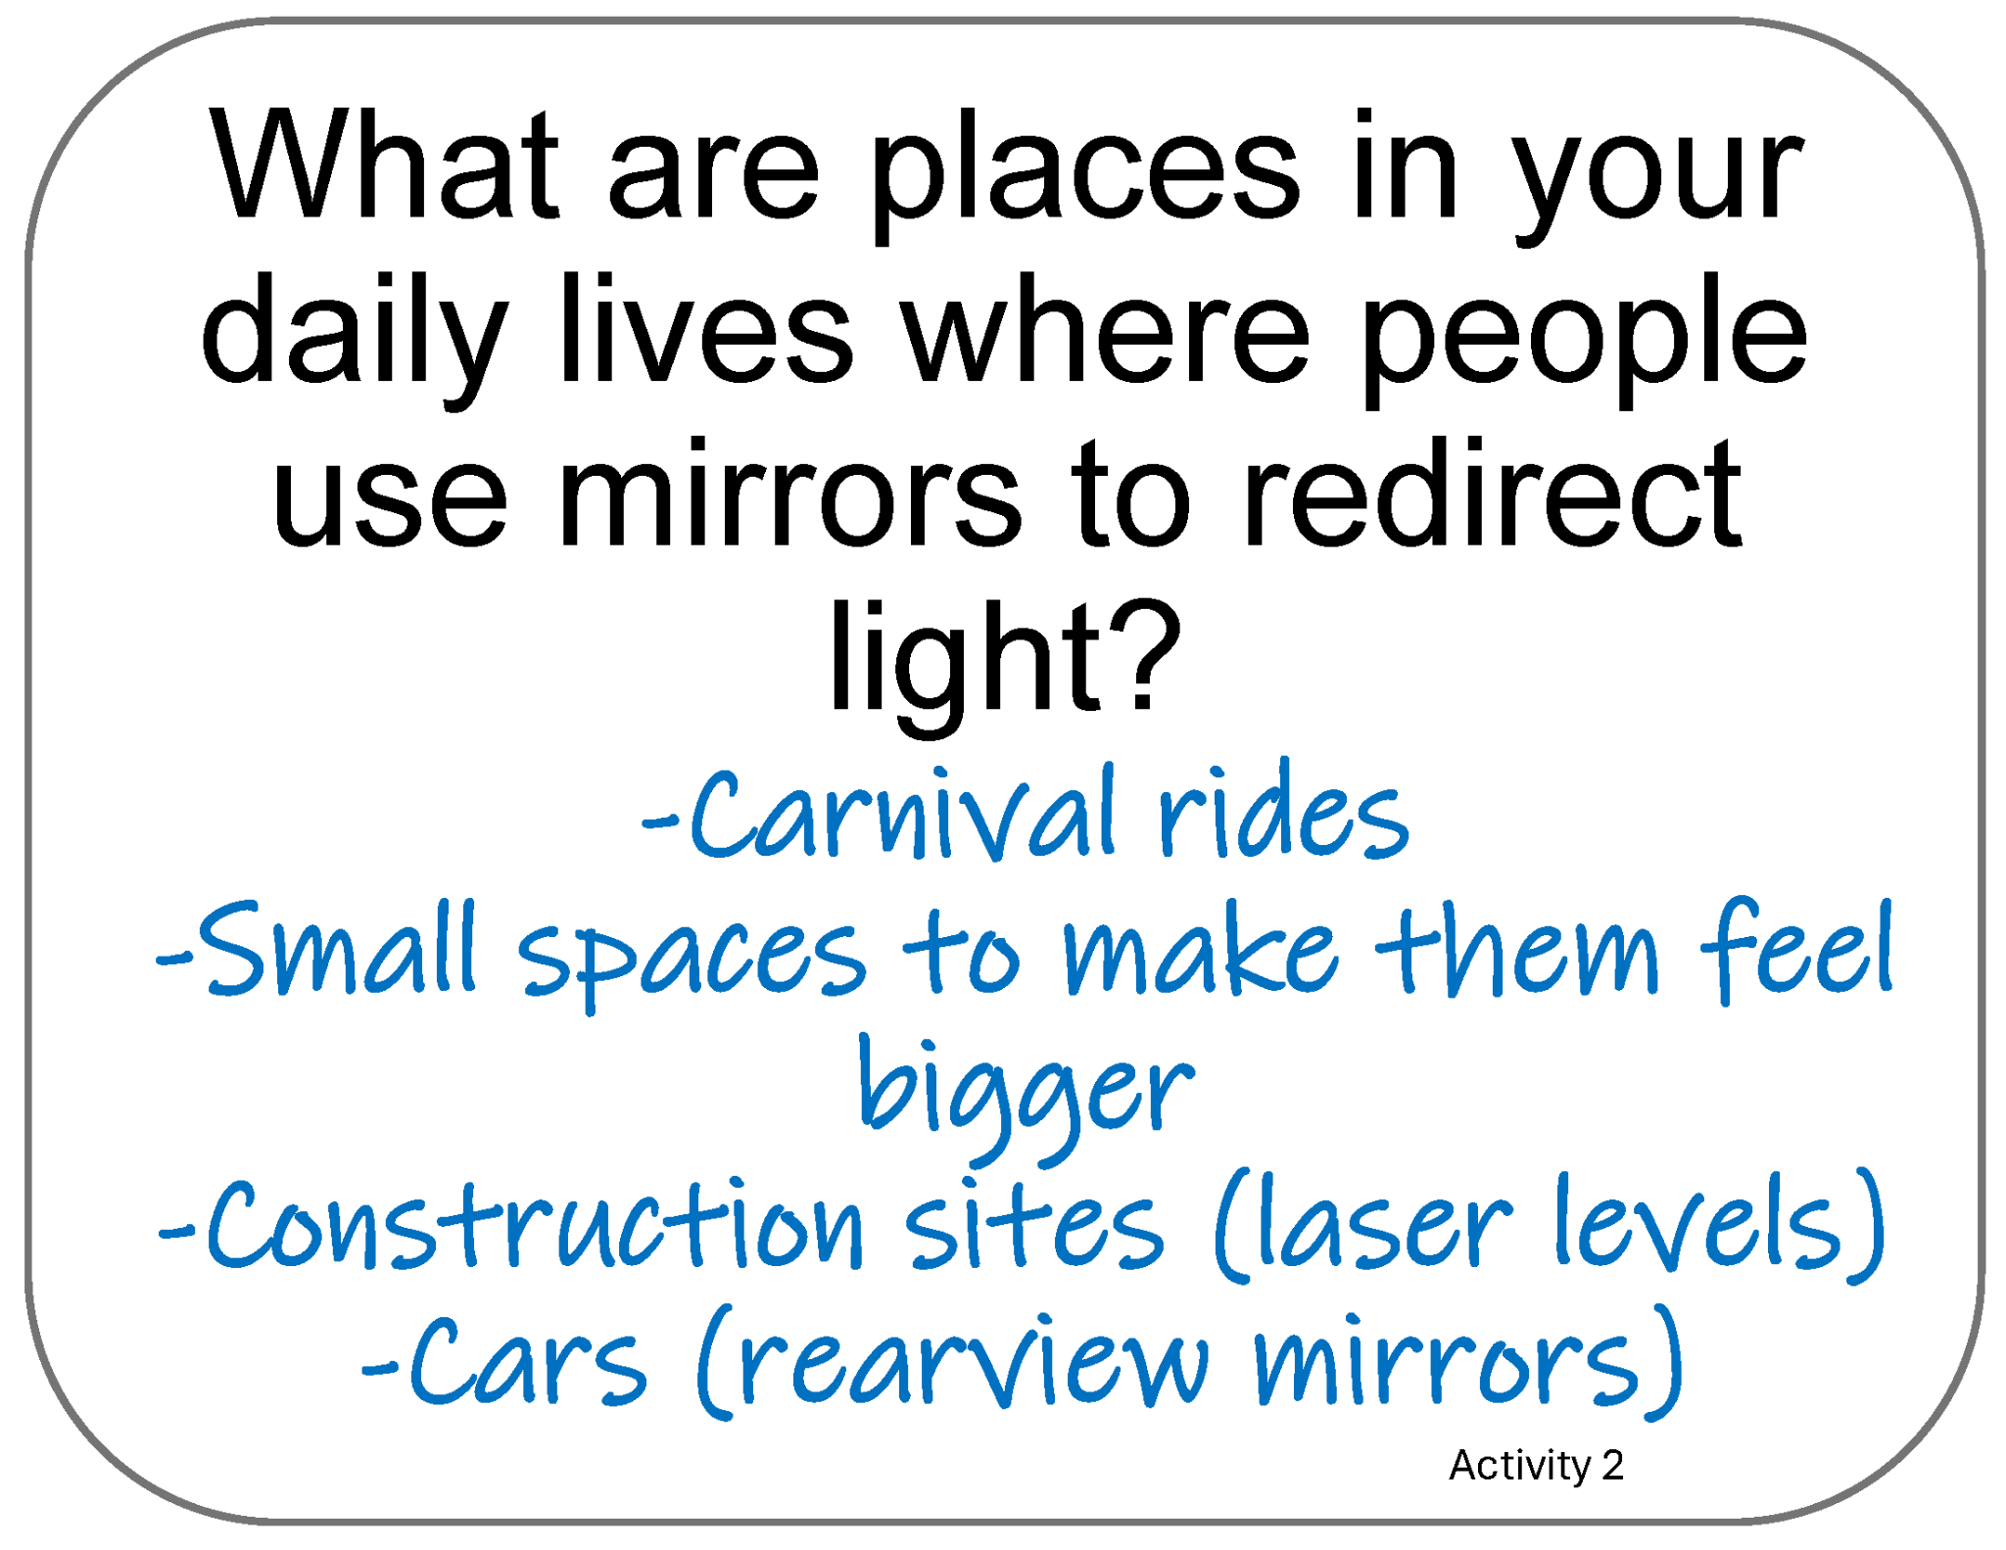
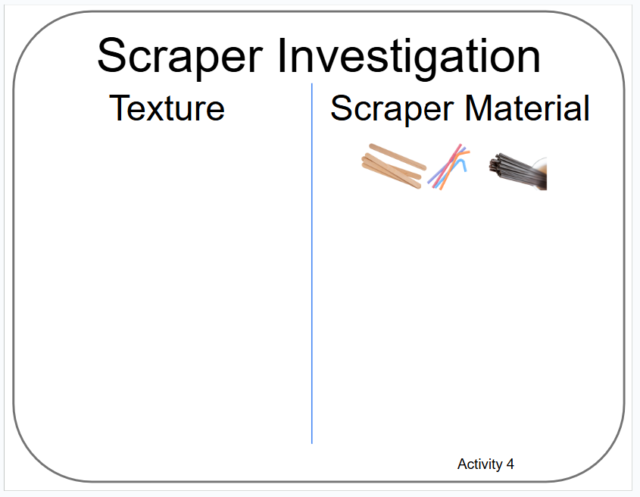
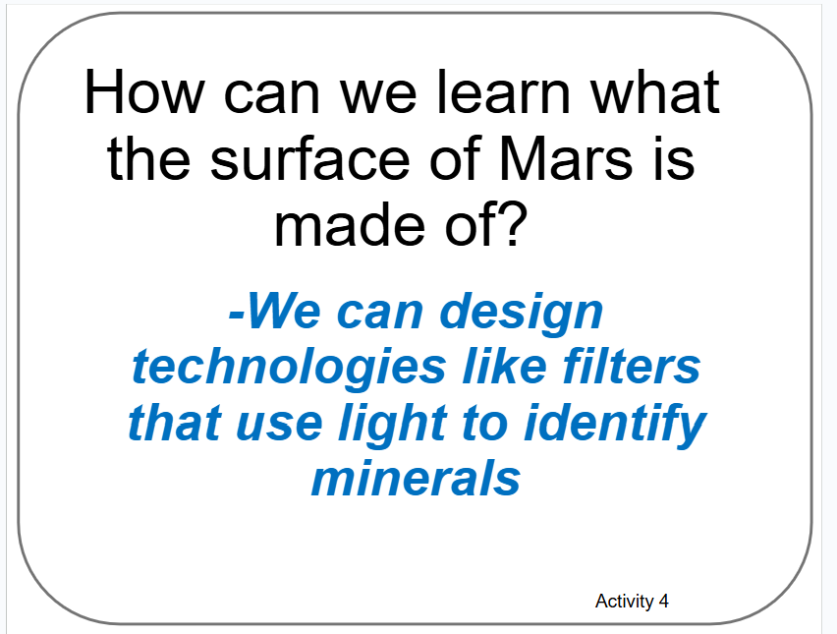
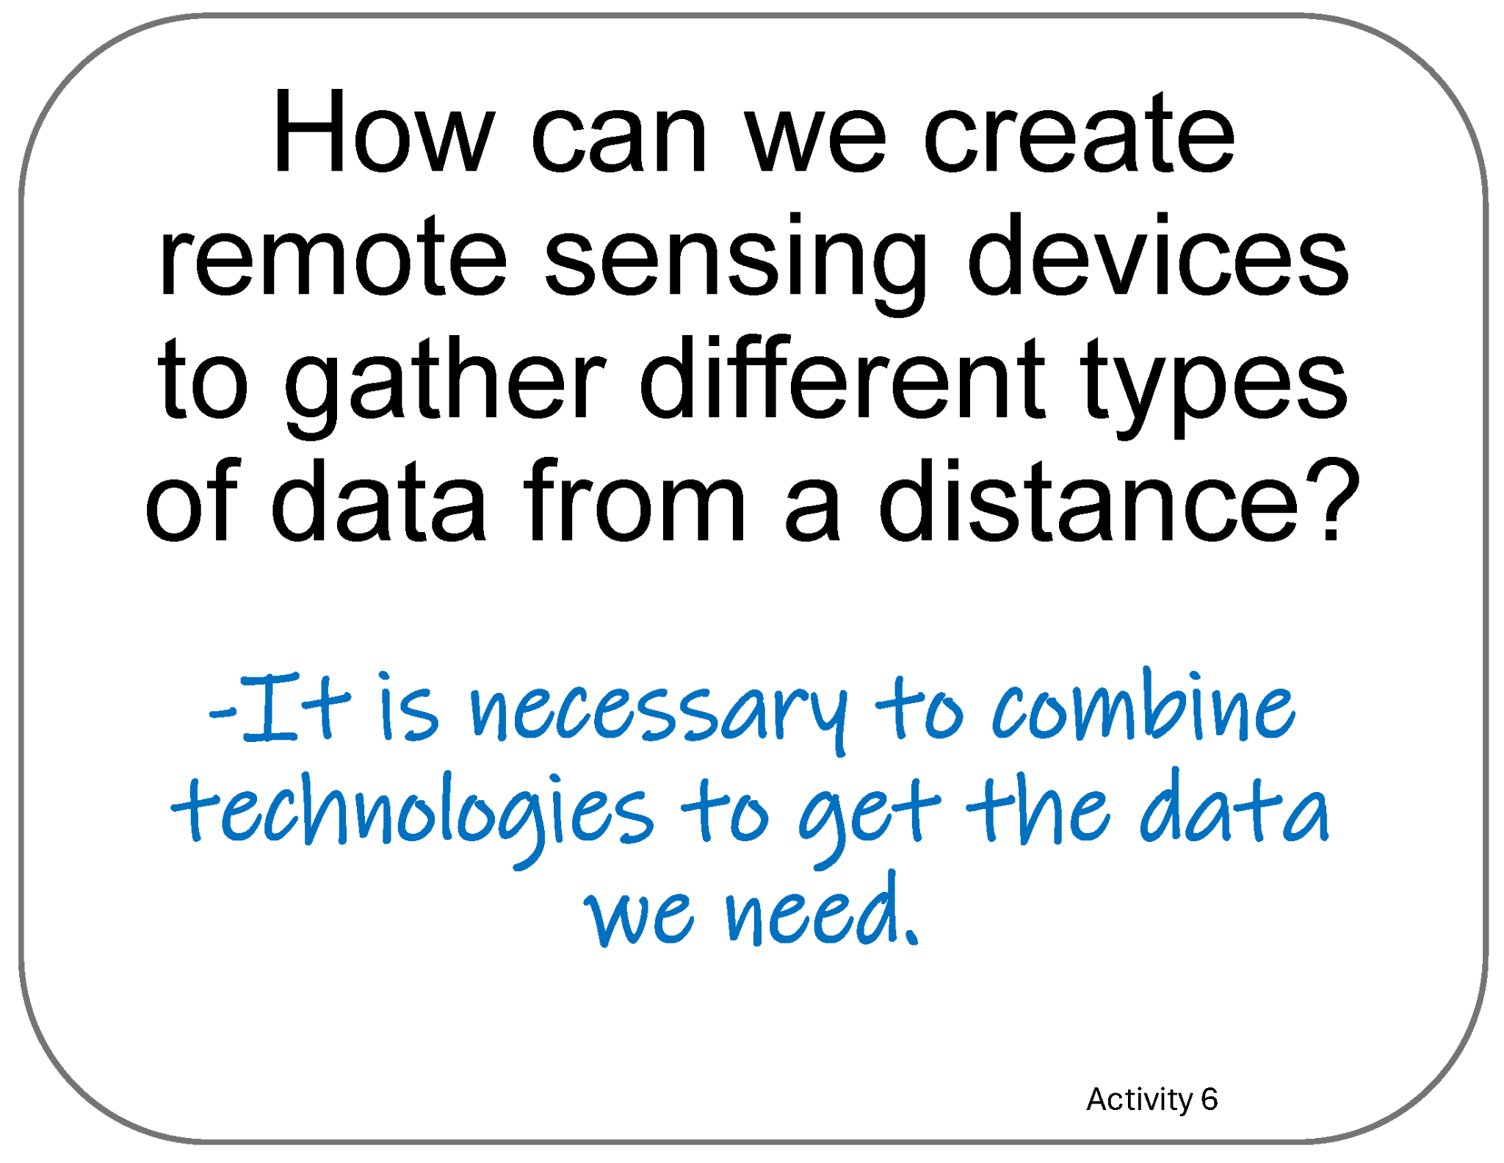
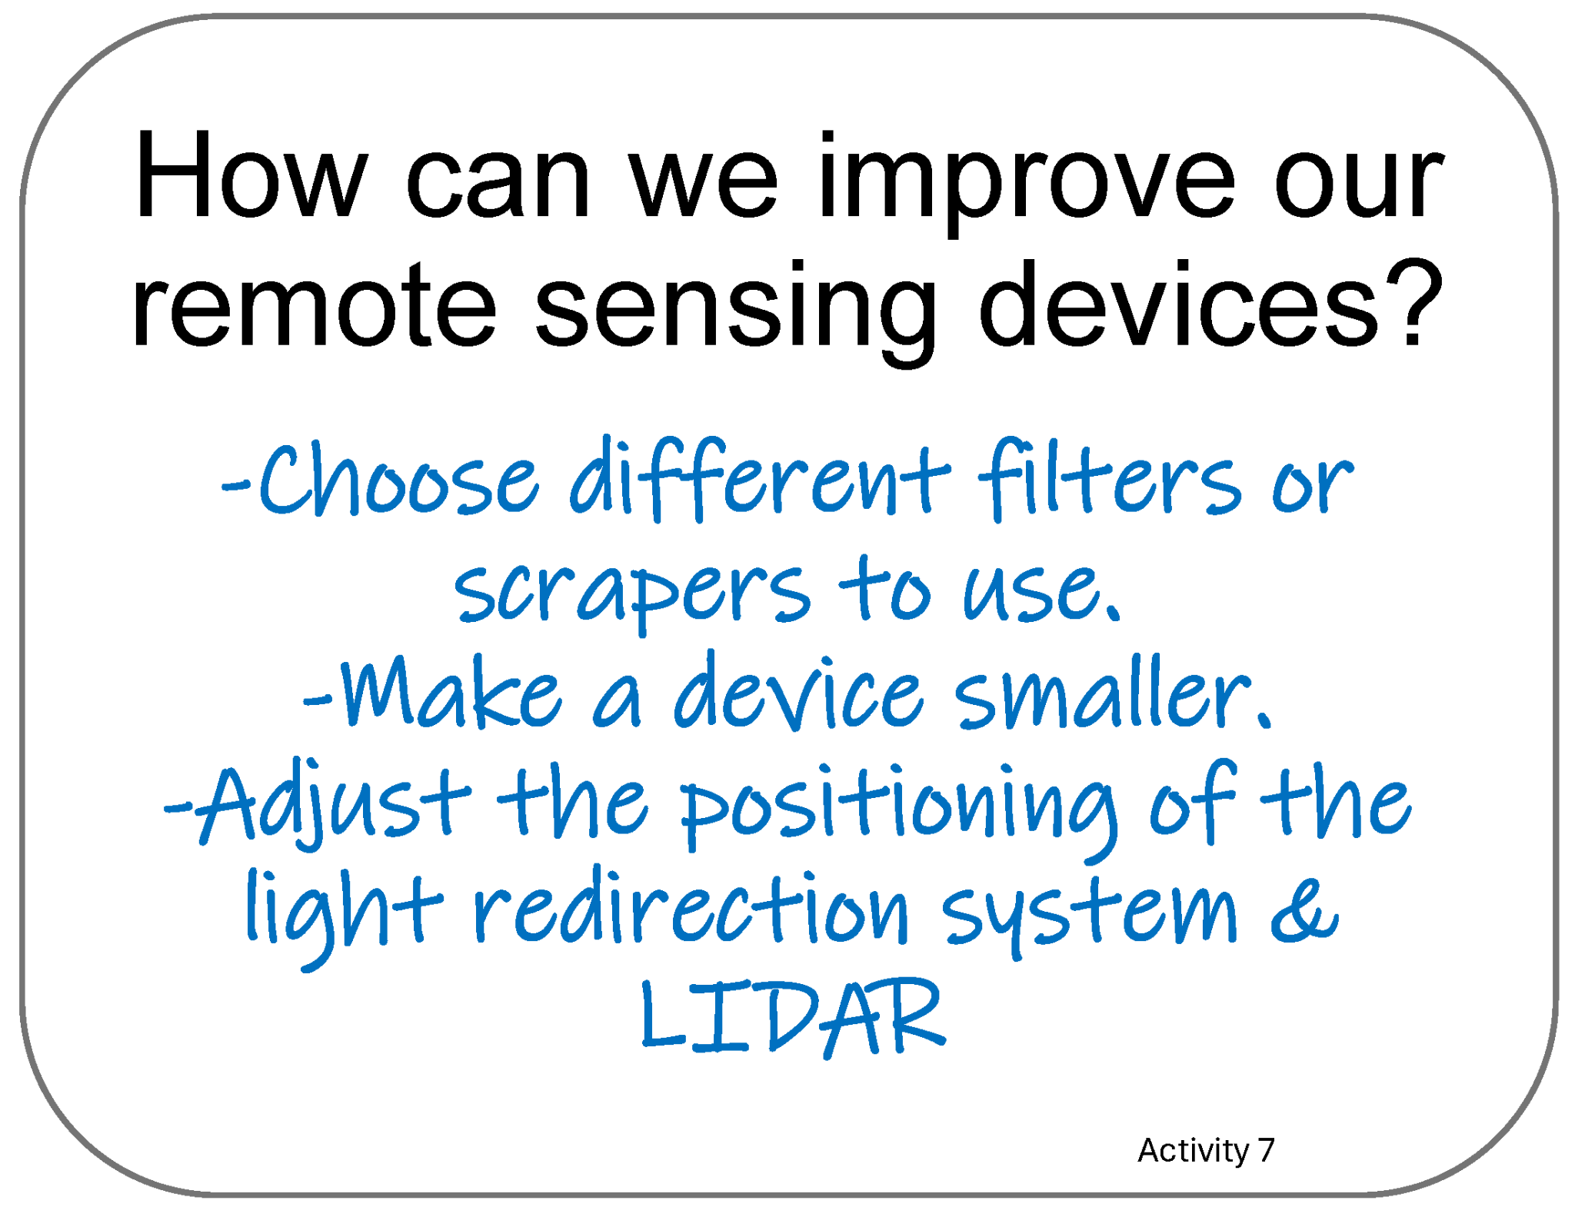
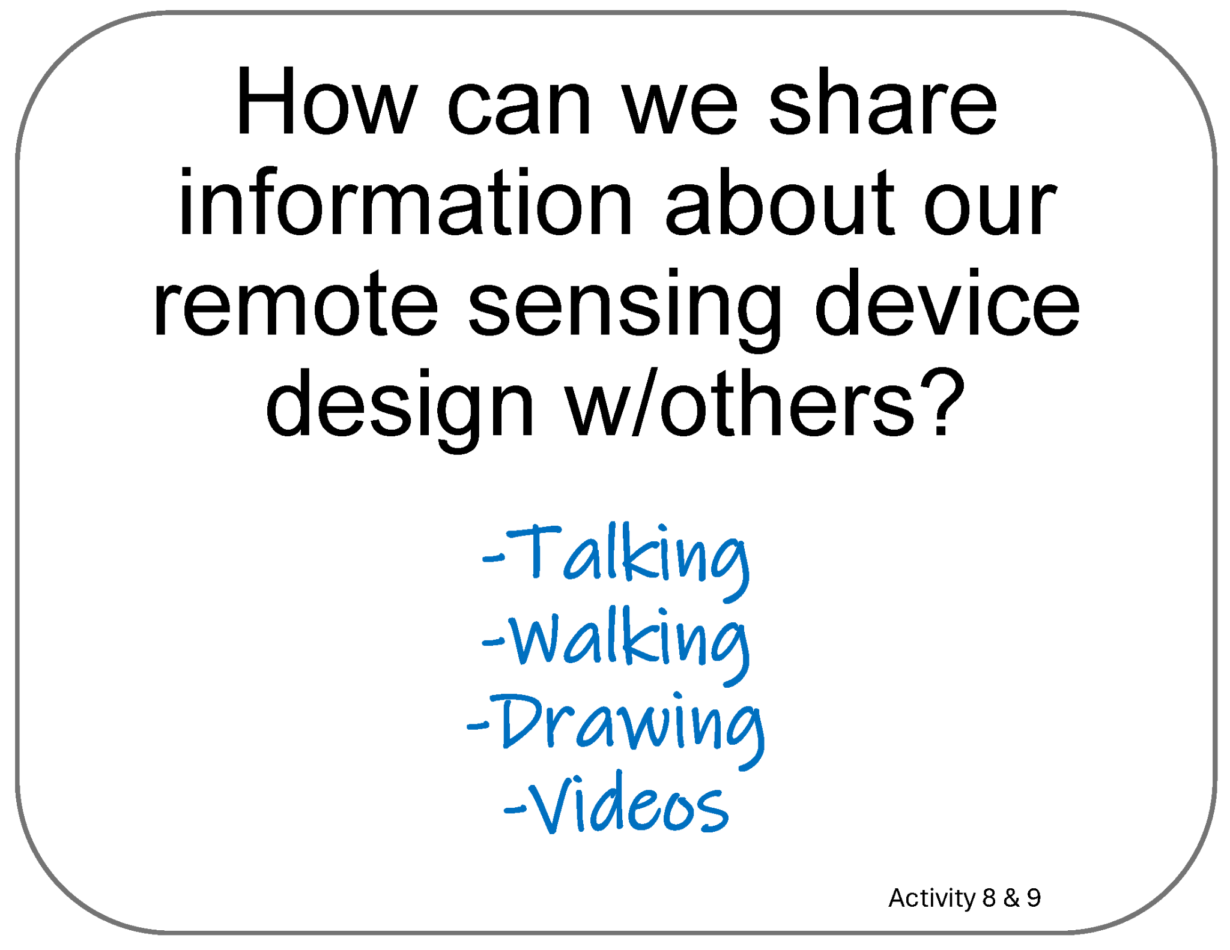
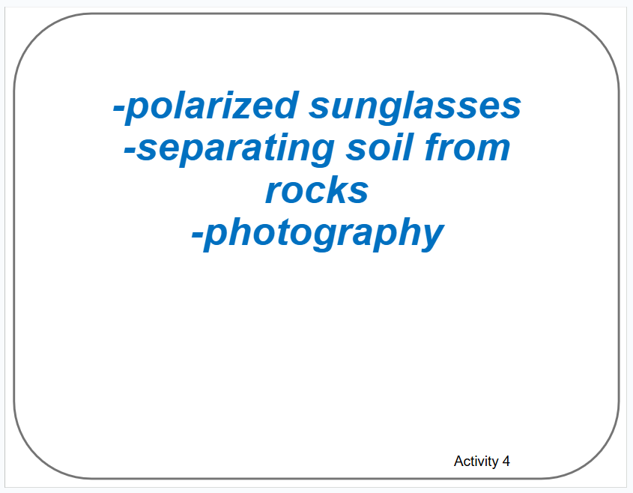

Poster Setup (Empty Example)
Our Ideas about Remote Sensing
Engineering

Slide 15
Examples of Cards for Poster
The following slides are based on the printable PDF version of the blank cards you can use to set up your “Our Ideas Posters”
They have been altered to be more accessible to screen readers.

Slide 16
Card: Why is technology important?

Slide 17
Card: How can we redirect light…?

Slide 18
Card: What are technologies that redirect…?

Slide 19
Card: System

Slide 20
Card: What are places in your daily lives…?

Slide 21
Card: How can we gather information about…?

Slide 22
Card: How can we use a system to redirect…?

Slide 23
Card: Portable

Slide 24
Card: How might someone use…?

Slide 25
Card: What questions do you have…Activity 3?

Slide 26
Card: Remote Sensing

Slide 27
Card: NASA is interested…

Slide 28
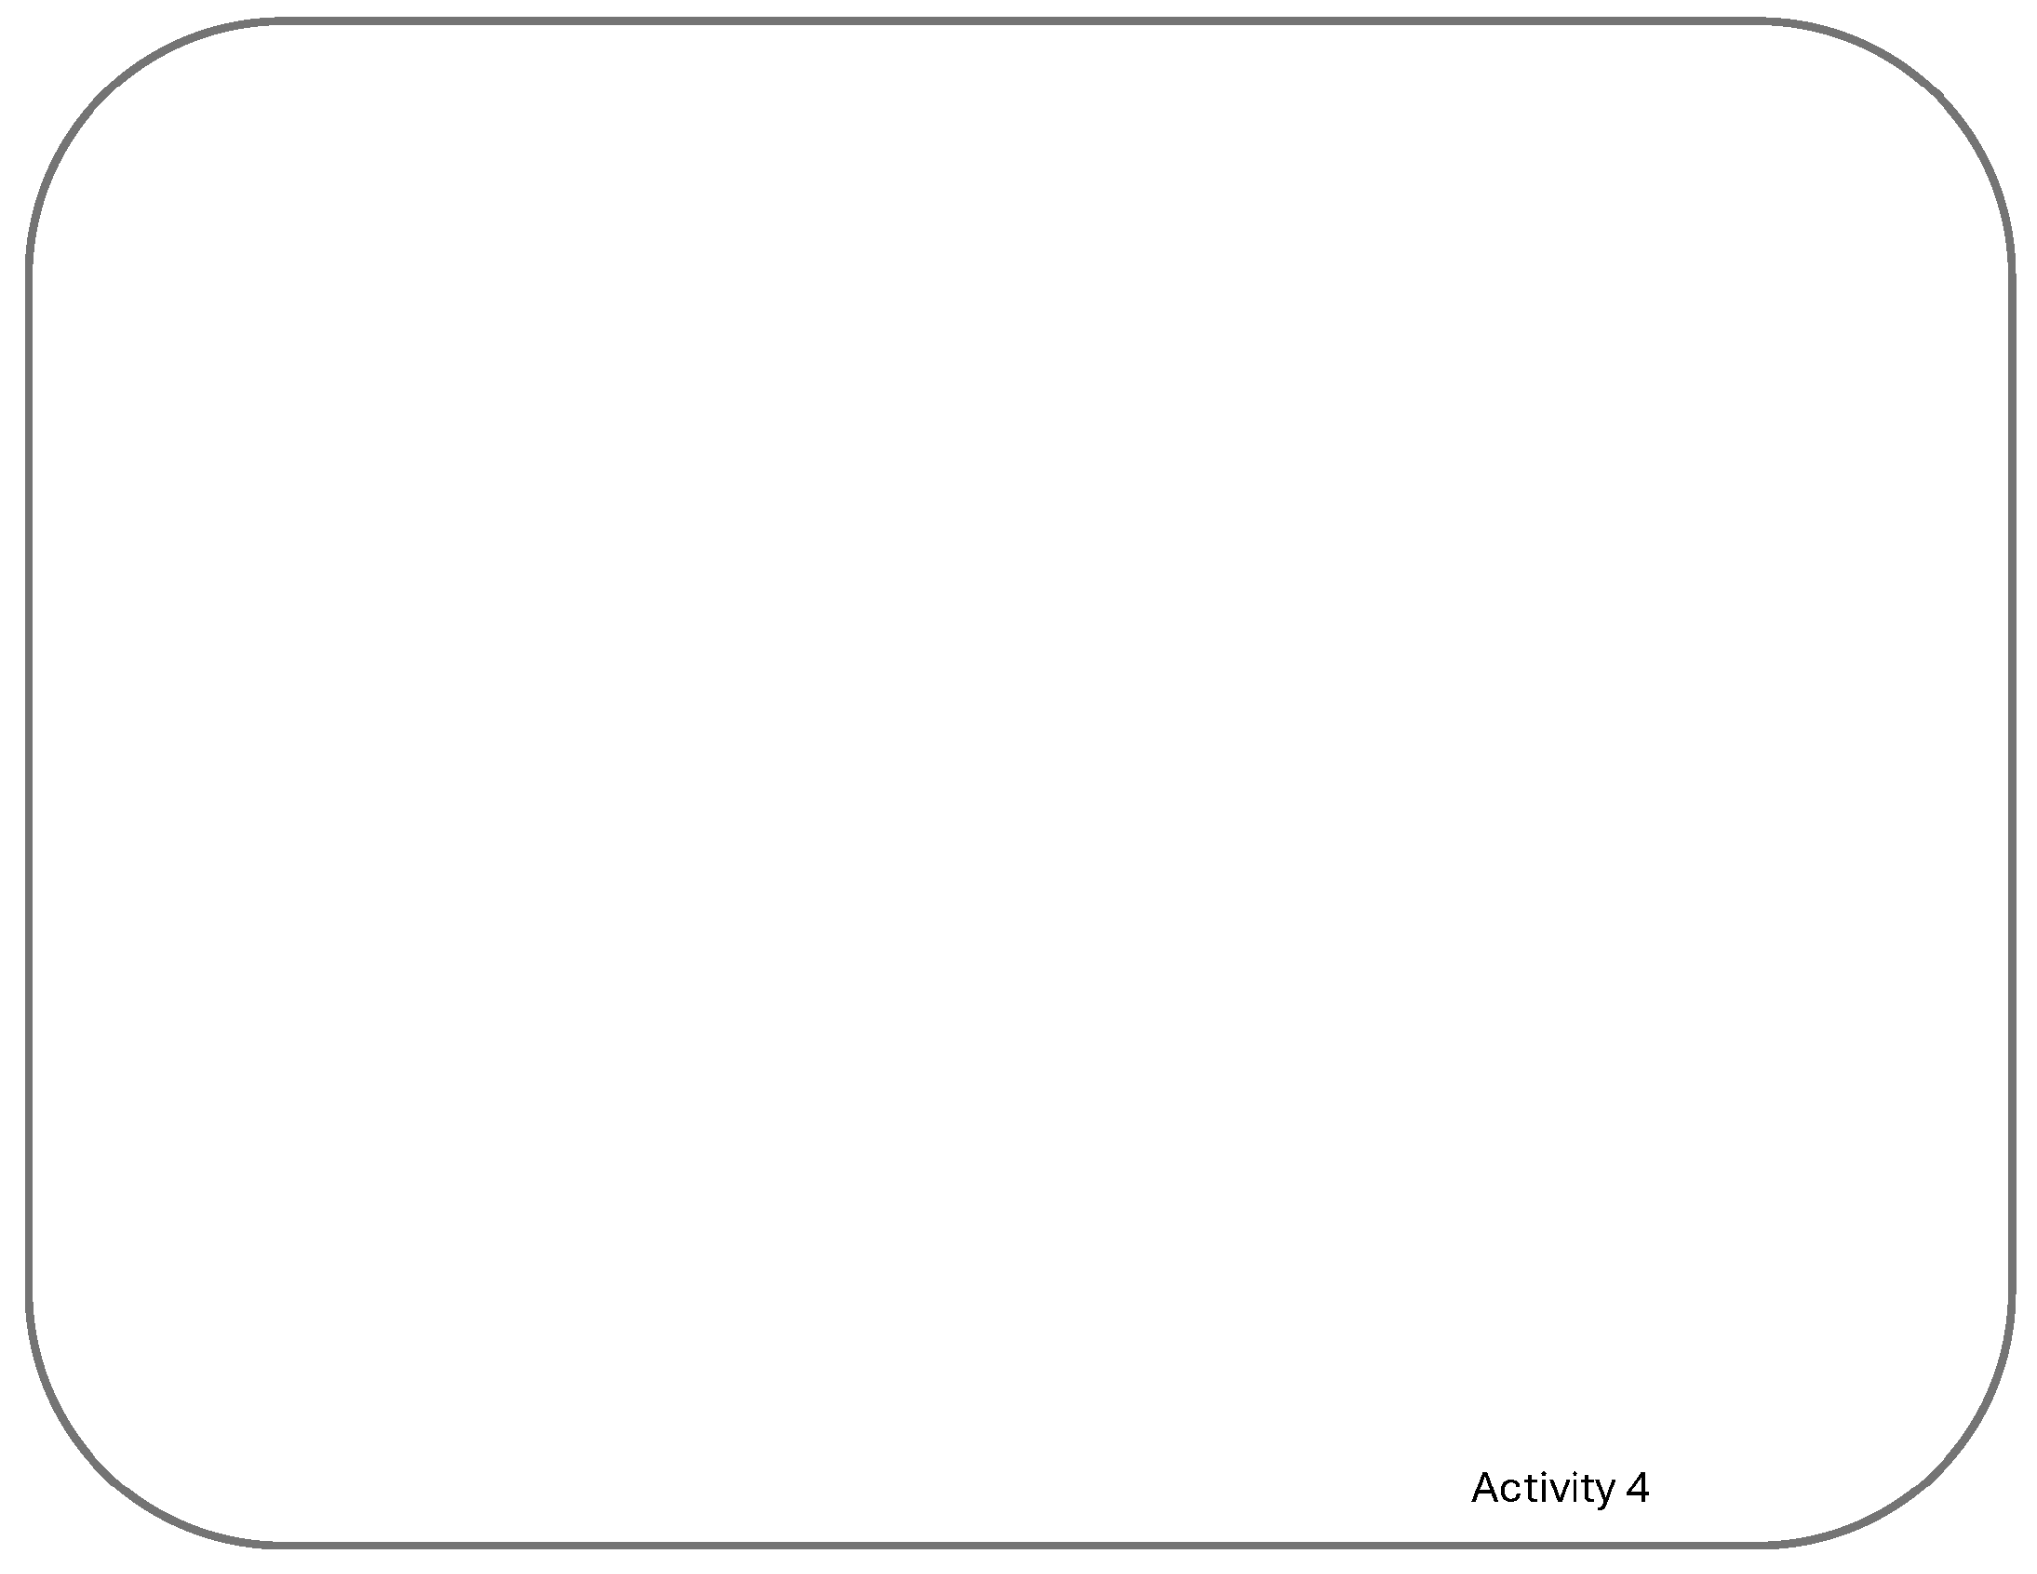
Card: Blank Activity 4 card

Slide 29
Card: Filter Investigation

Slide 30
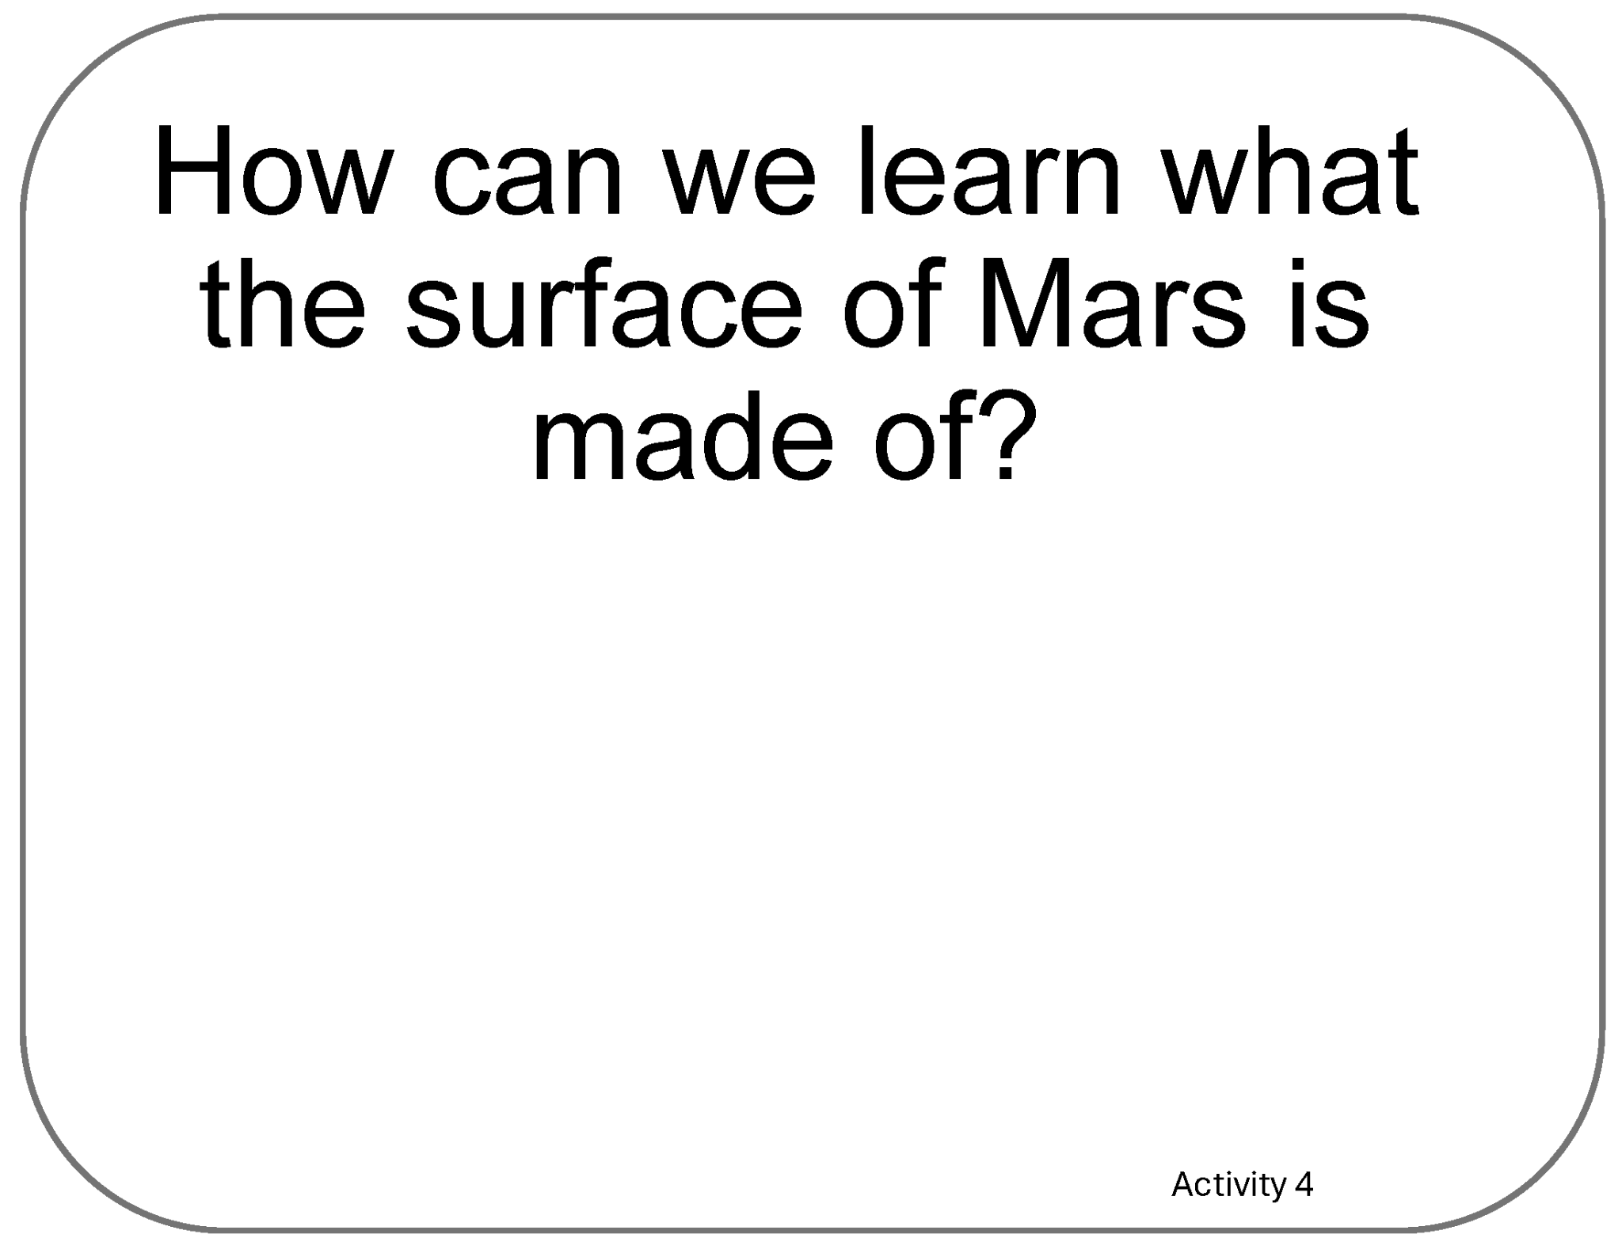
Card: How can we learn what the surface…?

Slide 31
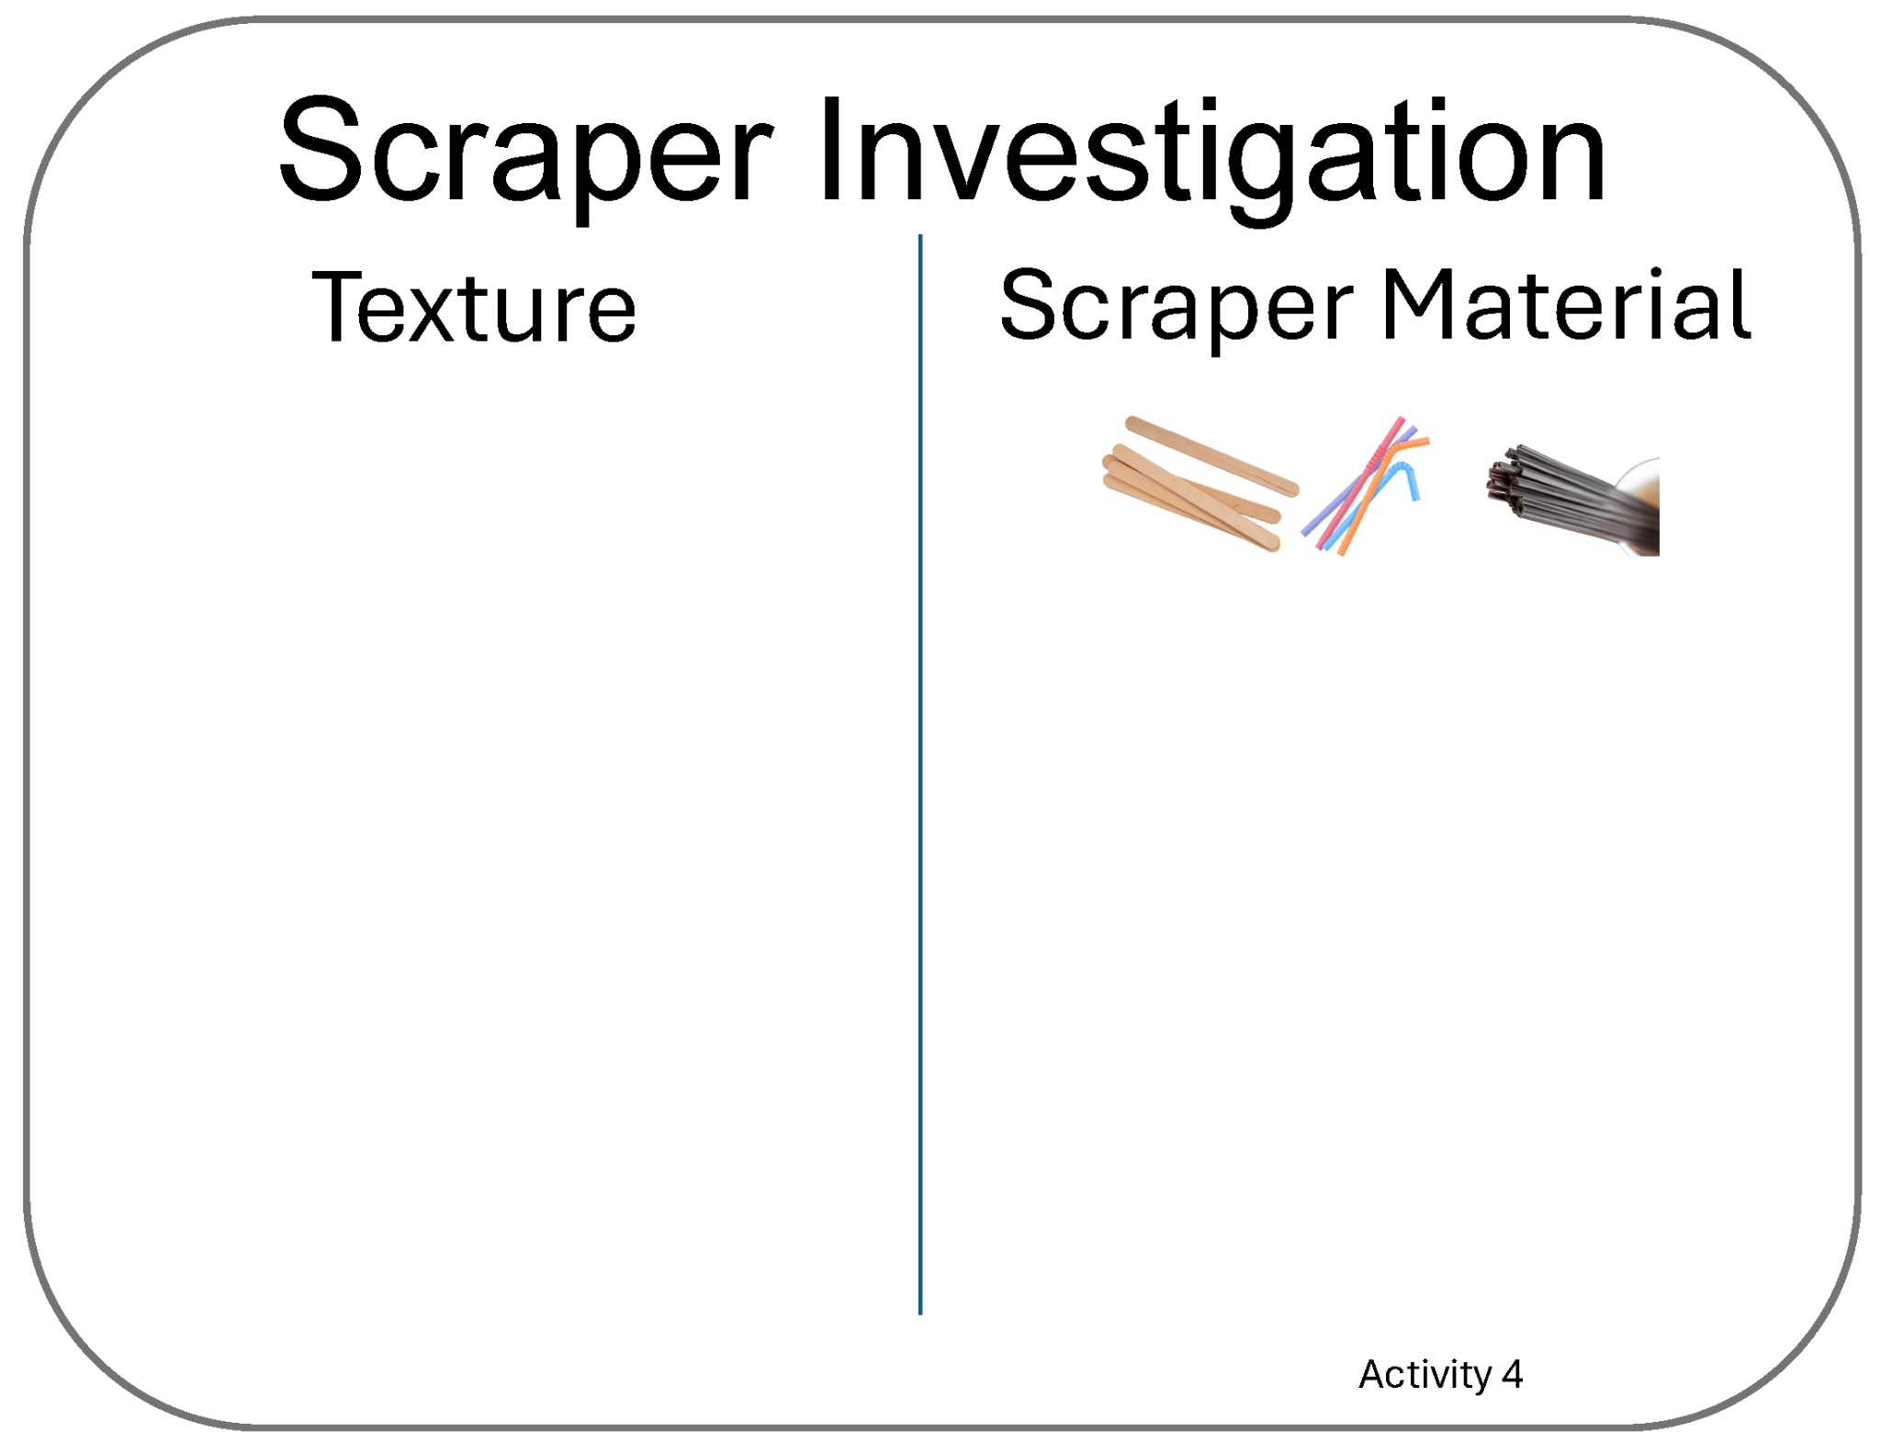
Card: Scraper Investigation…

Slide 32
Card: What questions do you have…Activity 4

Slide 33
Card: How can we learn about the shape…?

Slide 34
Card: LiDAR

Slide 35
Card: Birds-eye view

Slide 36
Card: Topography

Slide 37
Card: Physical Properties

Slide 38
Card: When might someone need to know…?

Slide 39
Card: What questions do you have? Activity 5

Slide 40
Card: How can we create remote sensing…?

Slide 41
Card: How can we improve our…devices?

