Slide 1
Science
Remote Sensing
Activities 1-9
Our Ideas Poster
Prep & Setup Guide with Examples
Screen Reader Version - NOT for Print

Slide 2
Poster Components
The following slides are based on the printable PDF version of the blank slides/cards with examples that you can use to set up your “Our Ideas Posters” and are not intended to be printed.
These slides are formatted to be more accessible to screen readers.
We recommend using these slides as a guide for blind and low vision educators and printing out the PDFs for sighted learners.

Slide 3
Corresponding PDFs include
Poster Pages to build the poster
  (pages numbered in lower right corner with corresponding adventure(s))
Poster Pages with examples are for educator reference only and not intended to print.
Blank Pages for more space or to build your own poster
Blank ¼ page cards for learners to add additional terms, drawings, ideas
Term cards:
Icon-only
Term + icon

Slide 4
Set Up
You need a wall or whiteboard area of about 80” Length x 60” Height.
Please see the following pages for setup examples.
You may choose alternative layouts or formats to fit your learning environment.

Slide 5
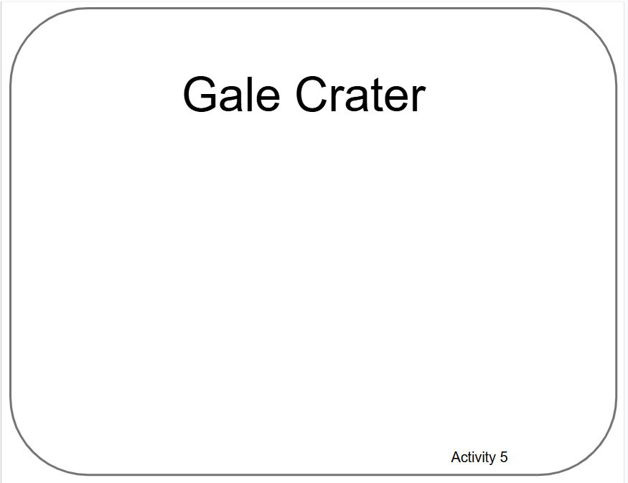
Poster Pages Examples
(Reference - do not print)

Slide 6
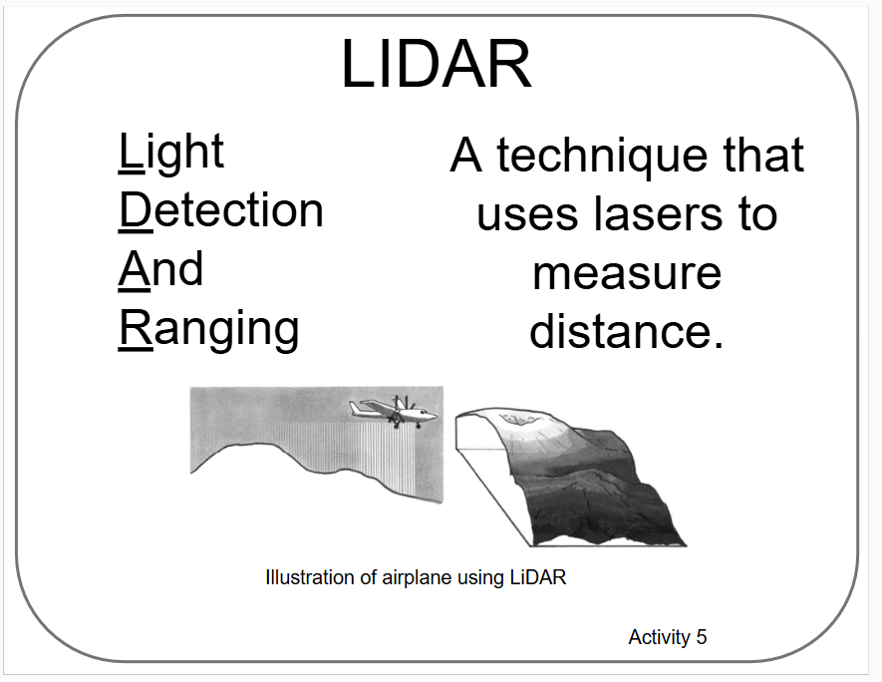
Term Card Example
(Reference - do not print)

Slide 7
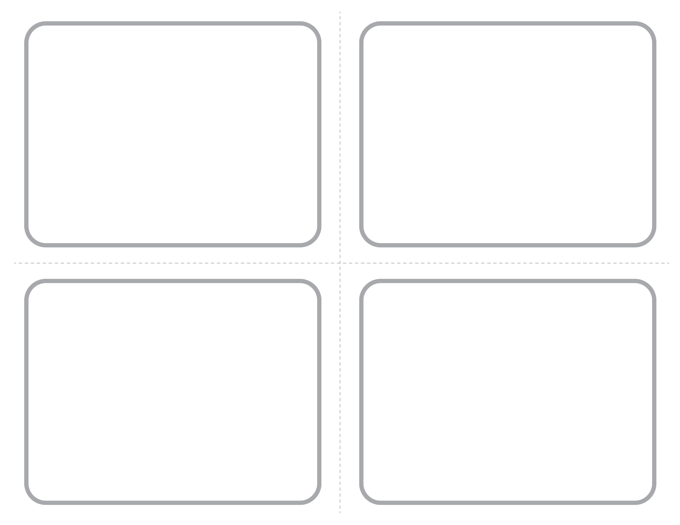
Blank ¼ Page Card Screenshot
Intended for learner responses

Slide 8
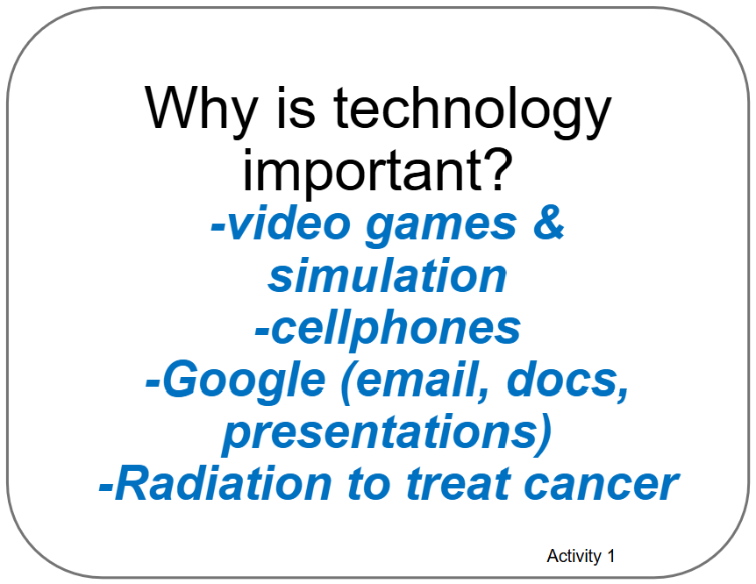
Poster Pages with Examples from Learners

Slide 9
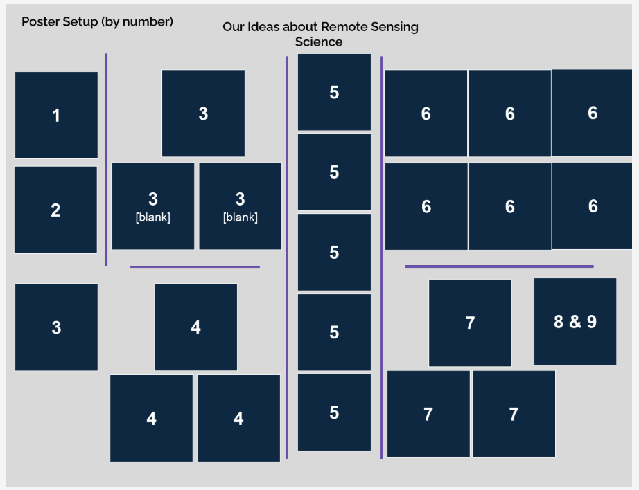
Poster Setup Layout

Slide 10
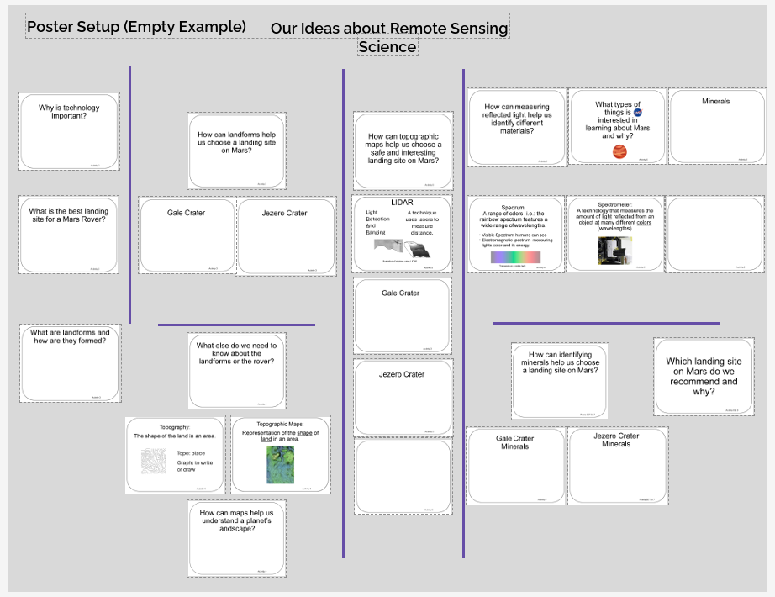
Poster Setup with Unfilled Examples

Slide 11
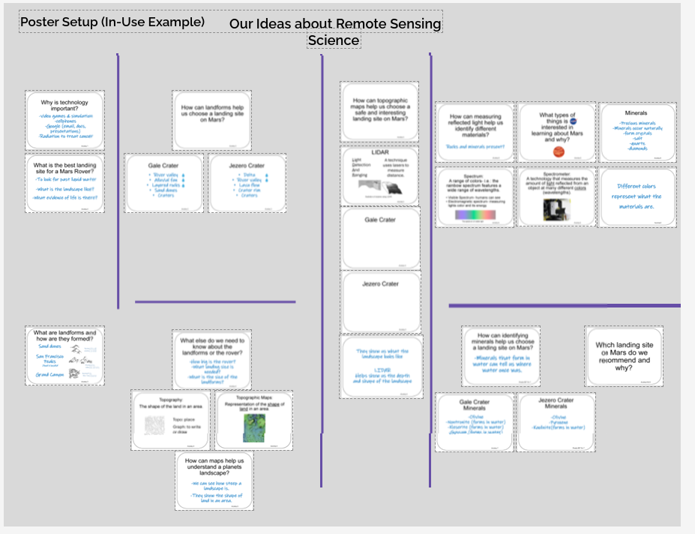
Poster Setup Layout with Learner Examples

Slide 12
Details about Learner Examples
The following two slides are a compromise to allow for alt text readability.
They are formatted for visual access, and not necessarily in a way that is best for screen readers, but do allow for alt text for each of the example cards.
They are optional, and can be skipped if they are not helpful to you.

Slide 13
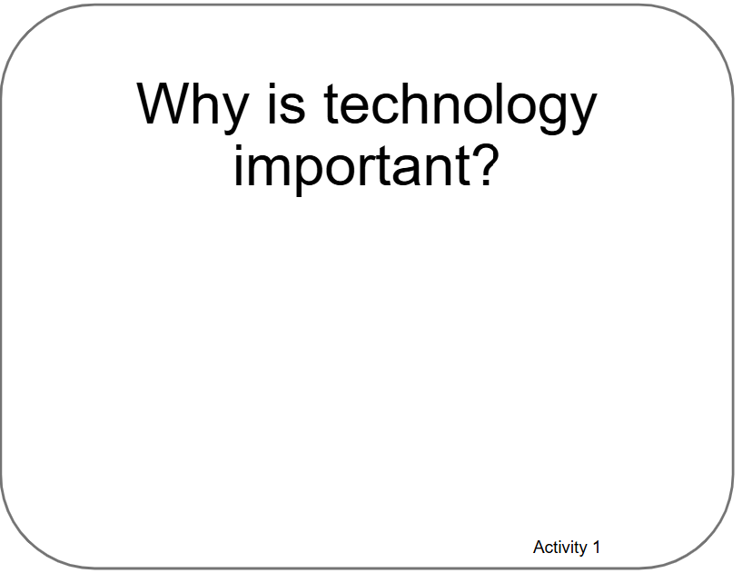
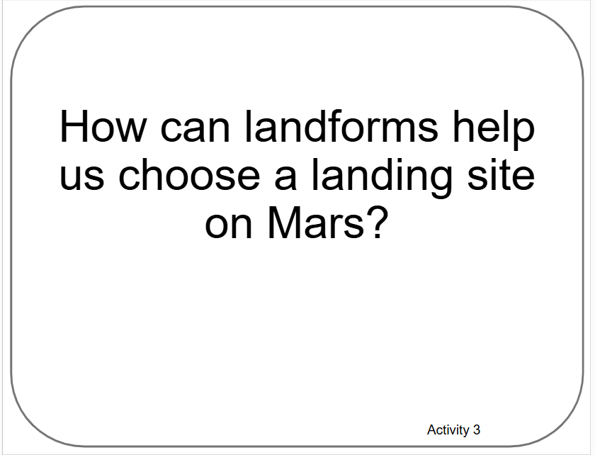
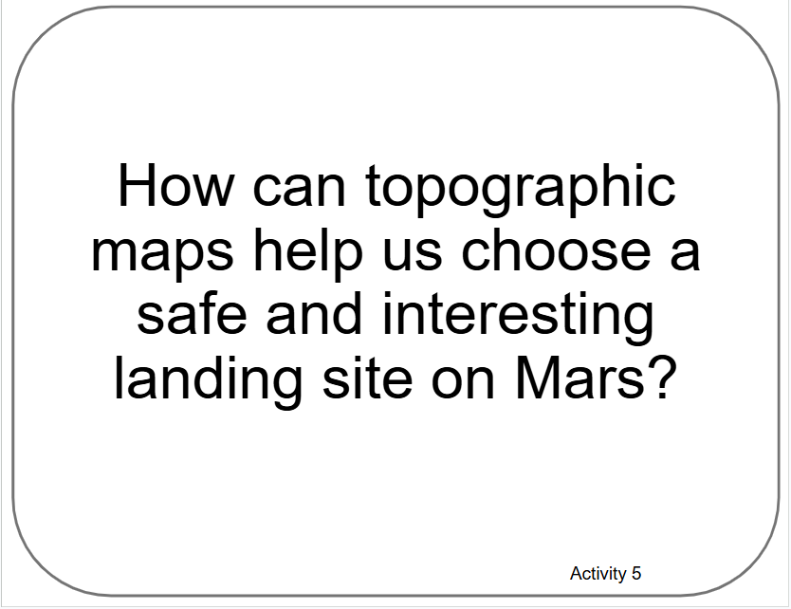
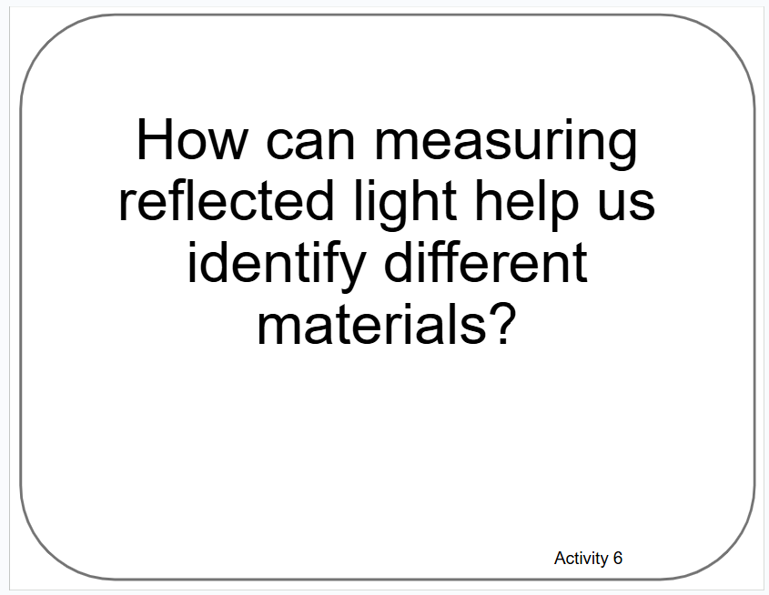
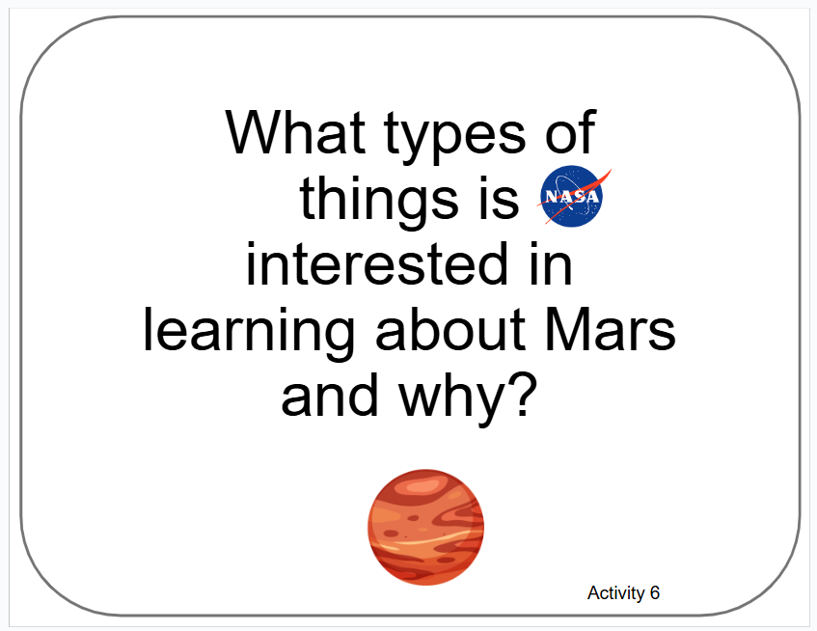
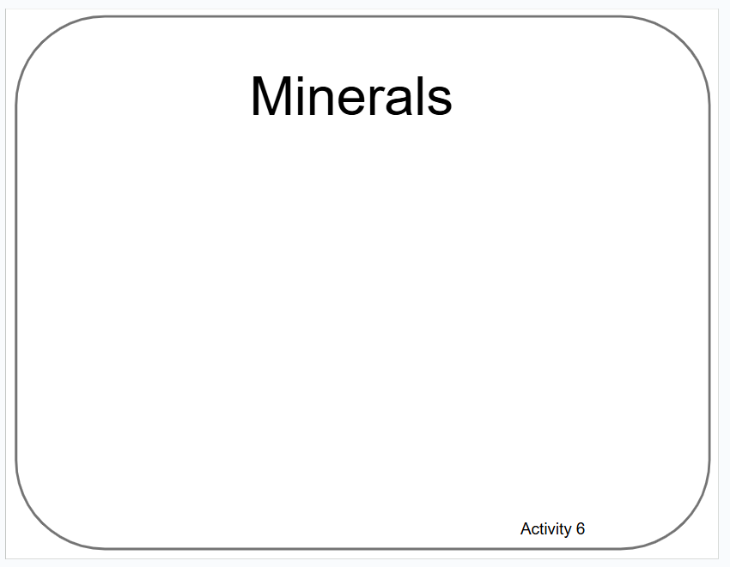
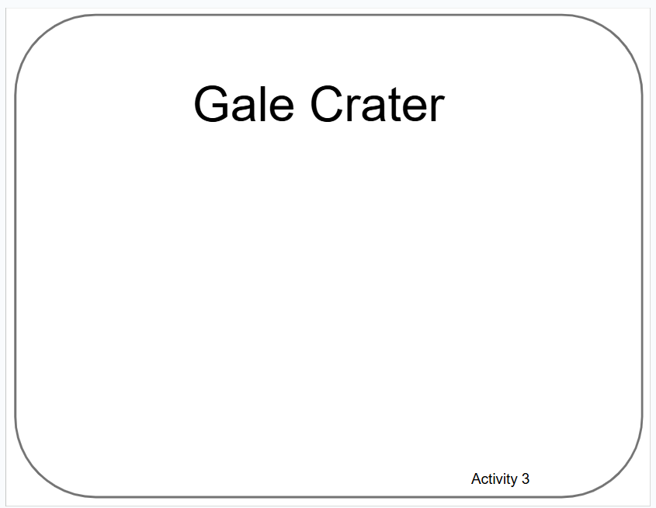
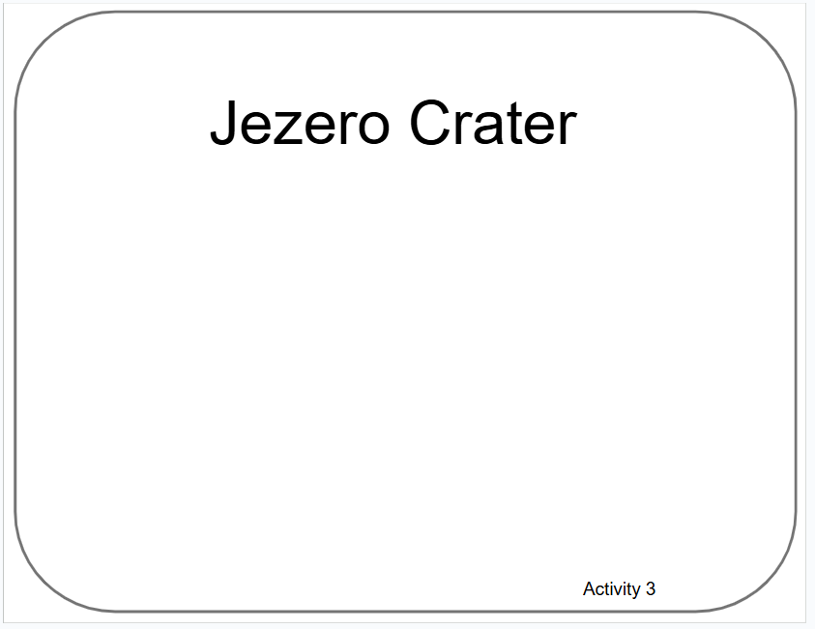
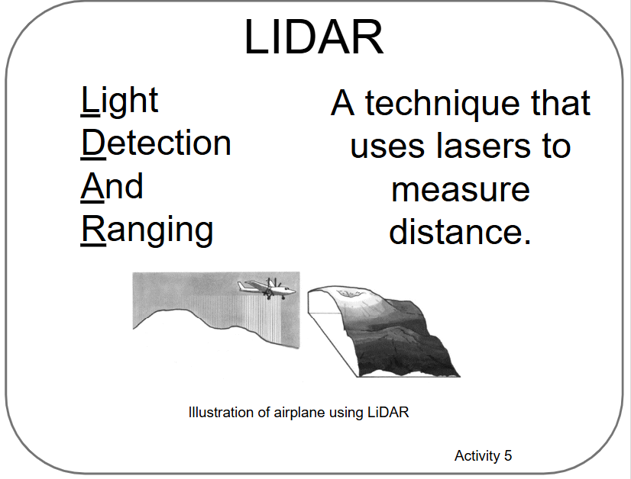
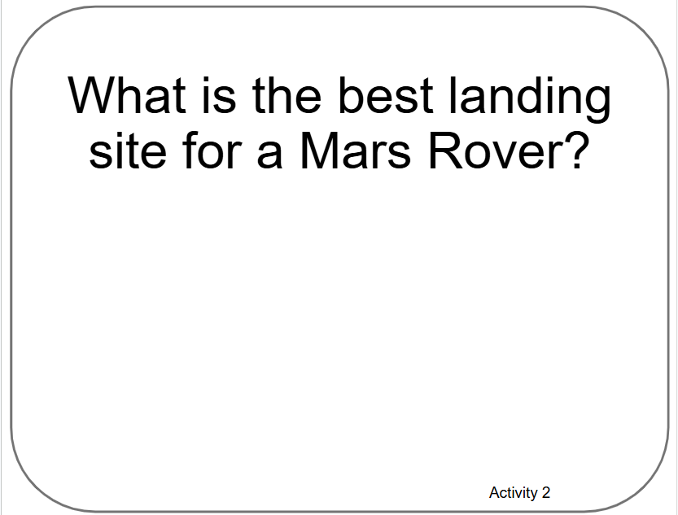
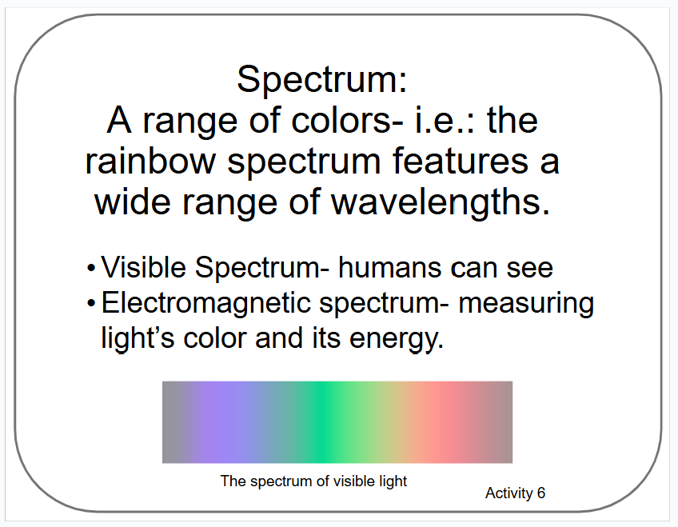
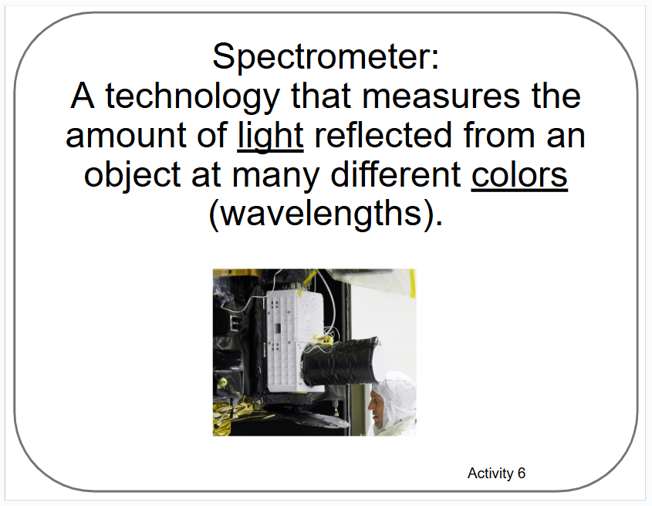
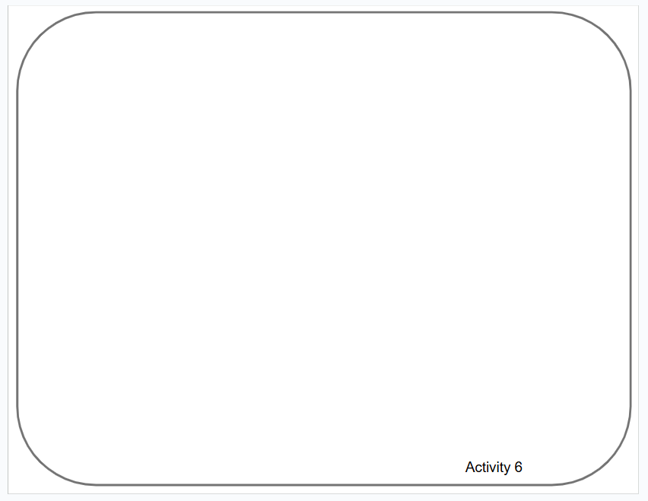
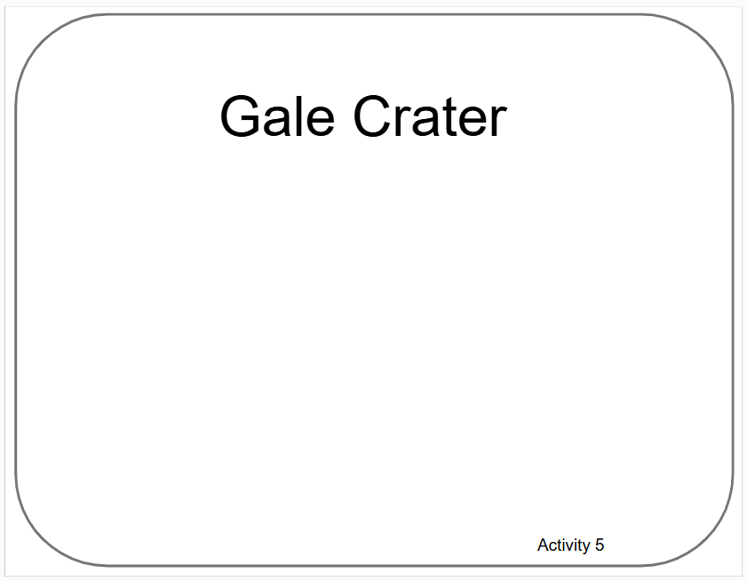
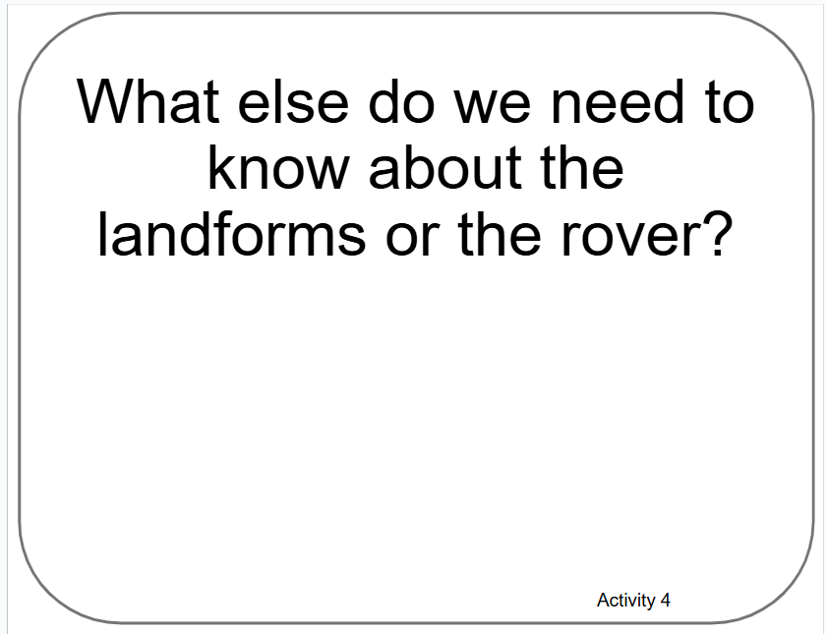
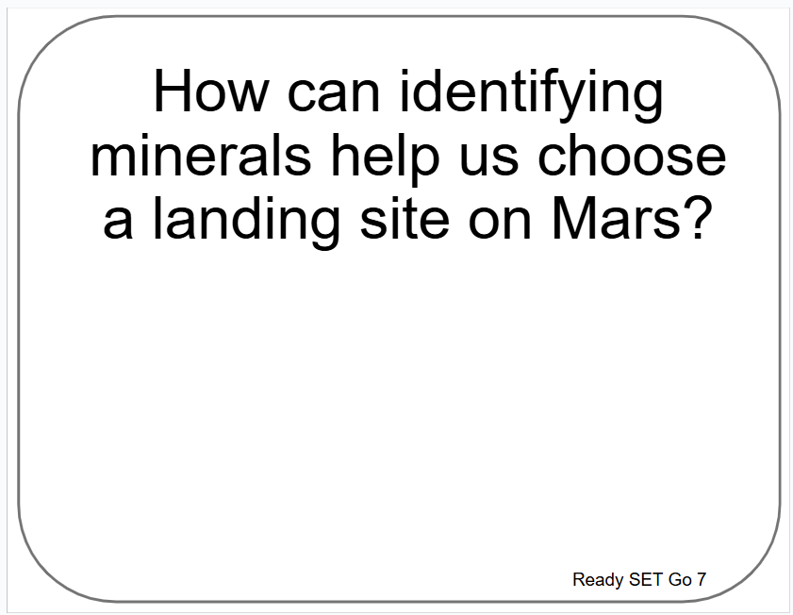
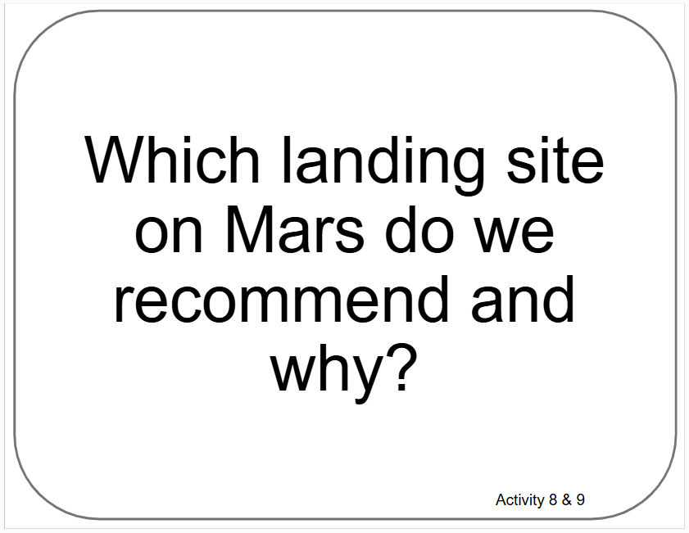
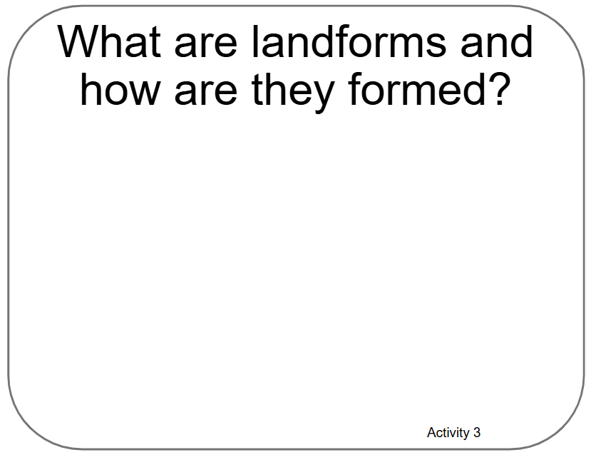
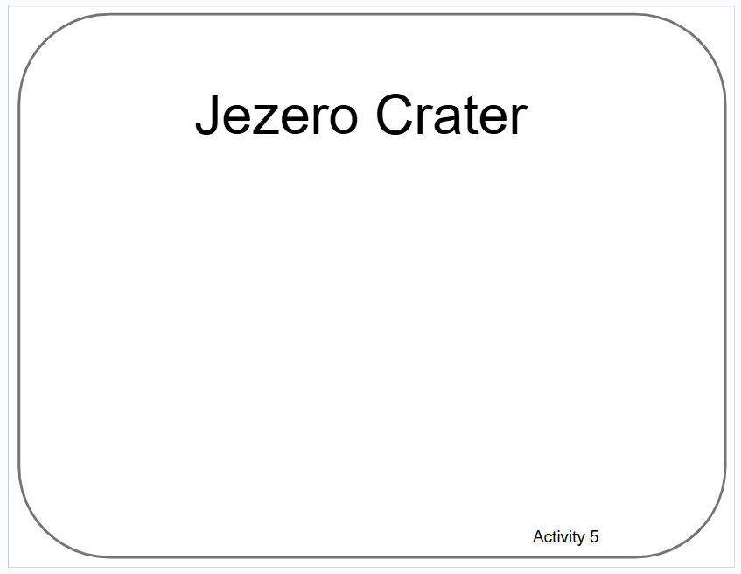
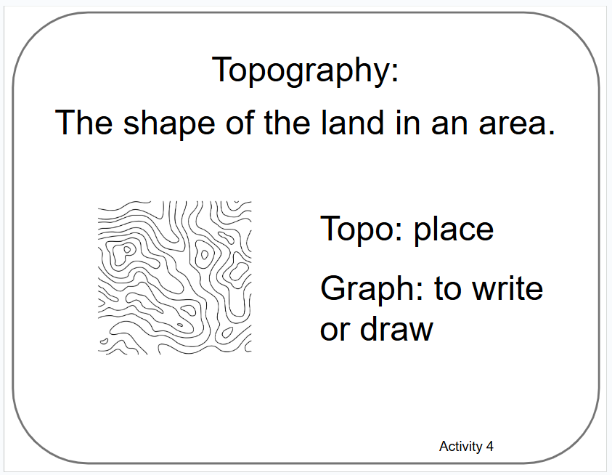
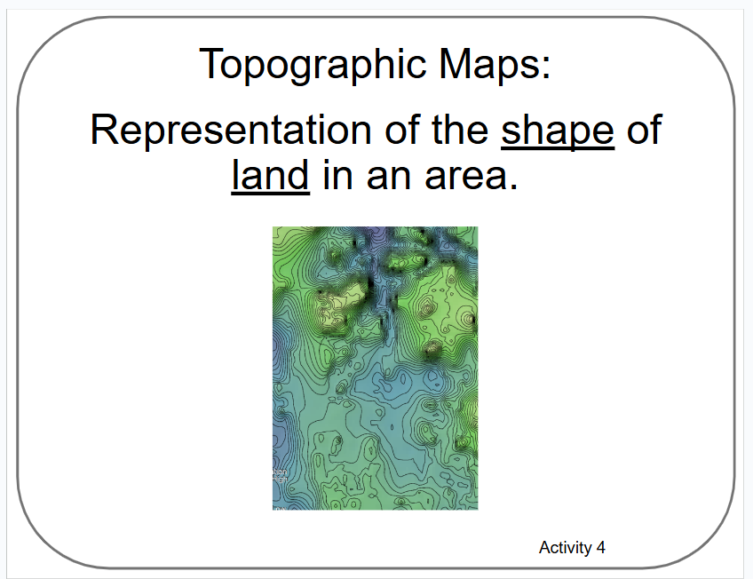
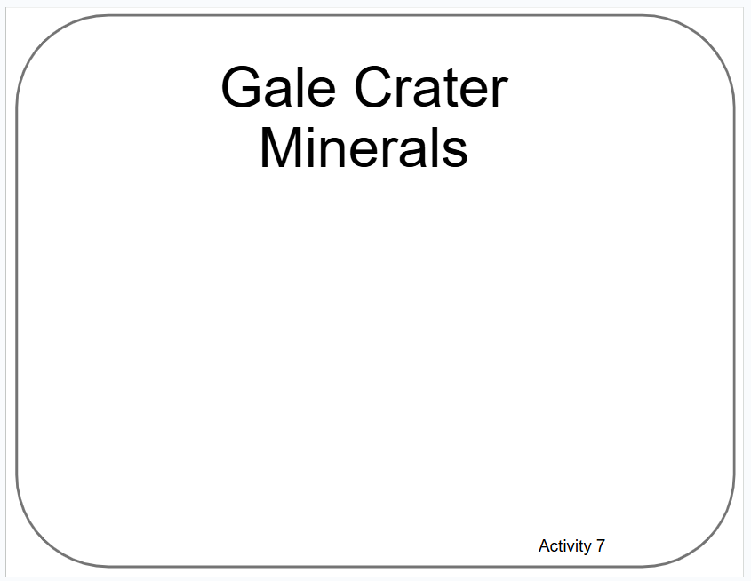
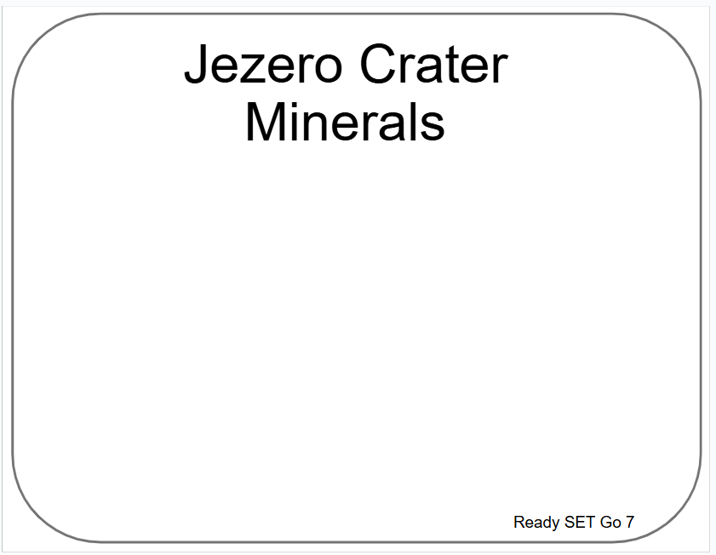
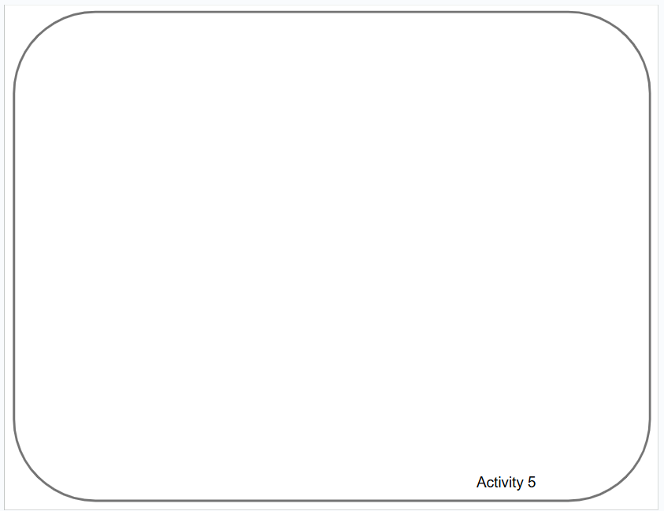
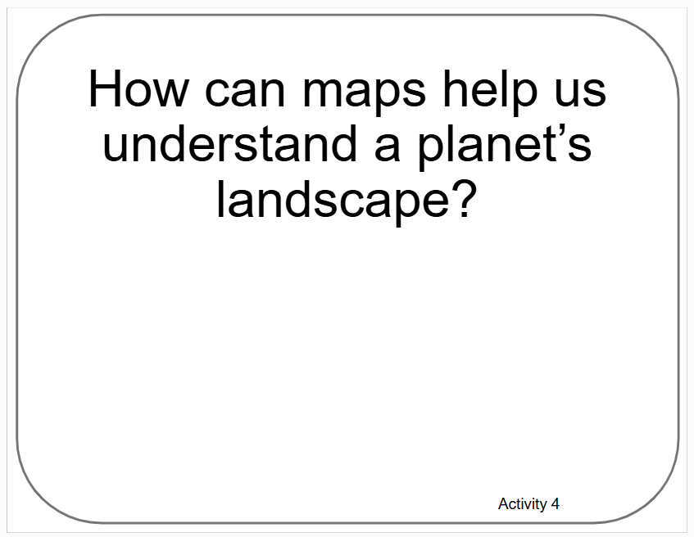
Poster Setup (Empty Example)
Our Ideas about
Remote Sensing
Science

Slide 14
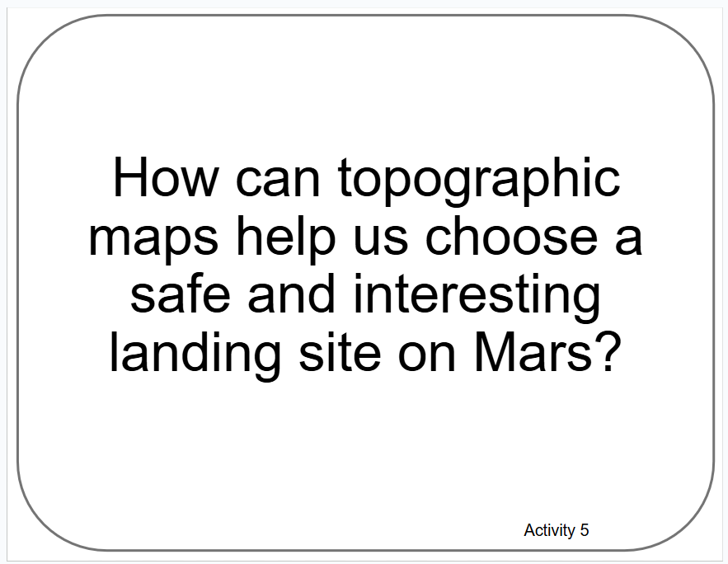
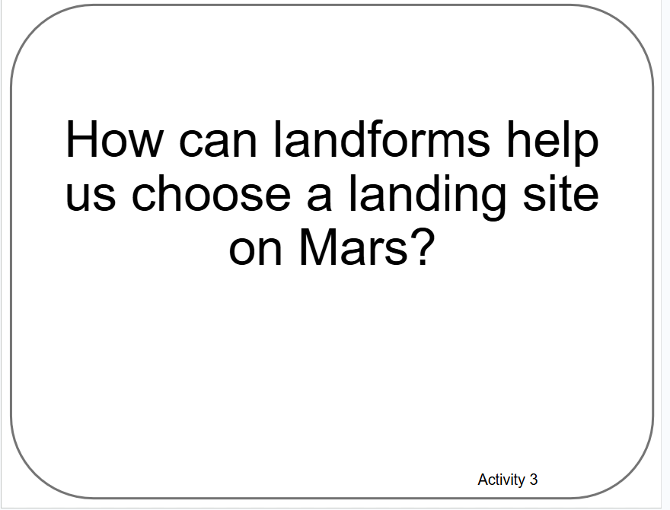
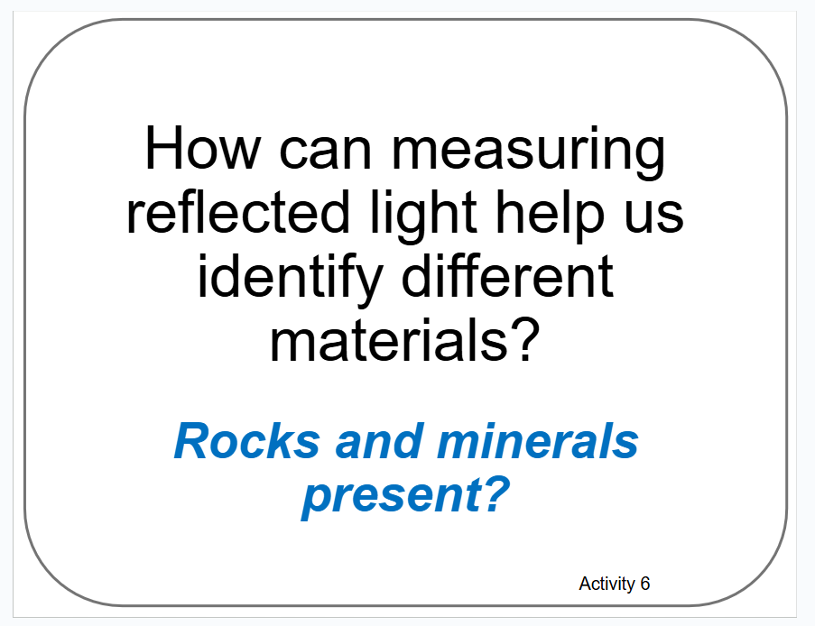
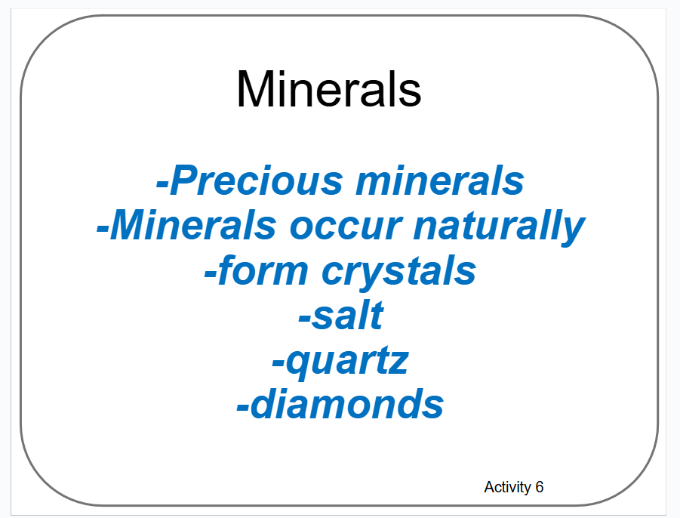
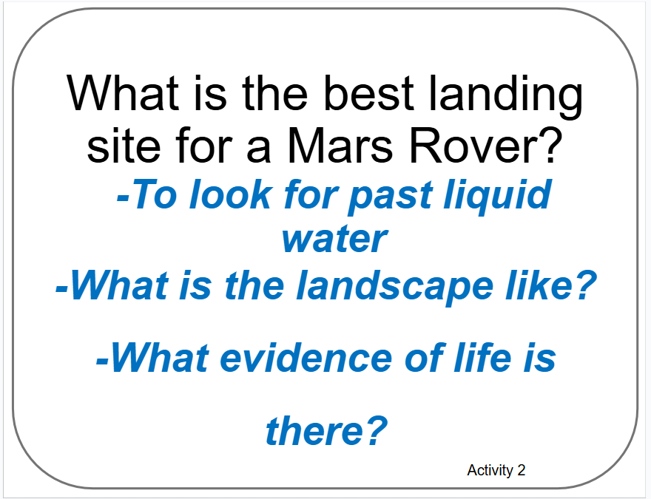
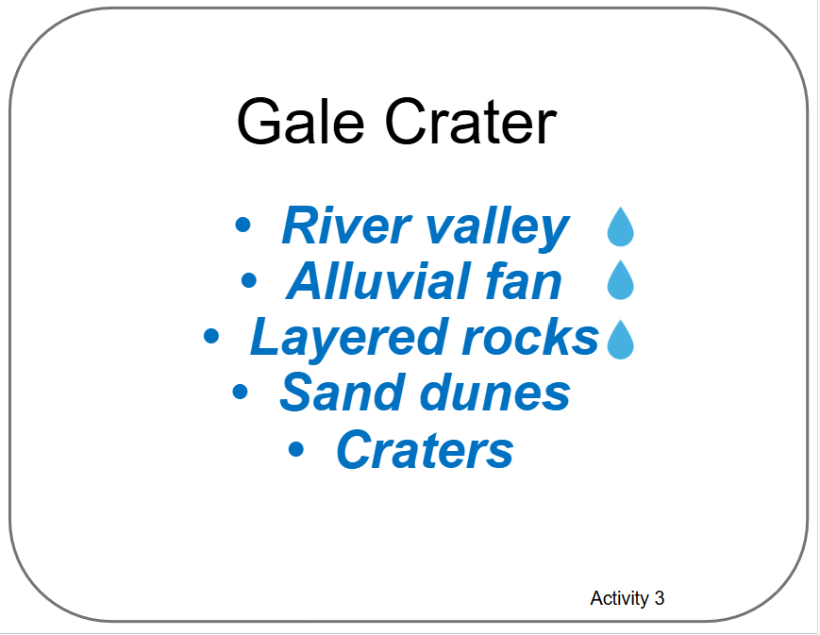
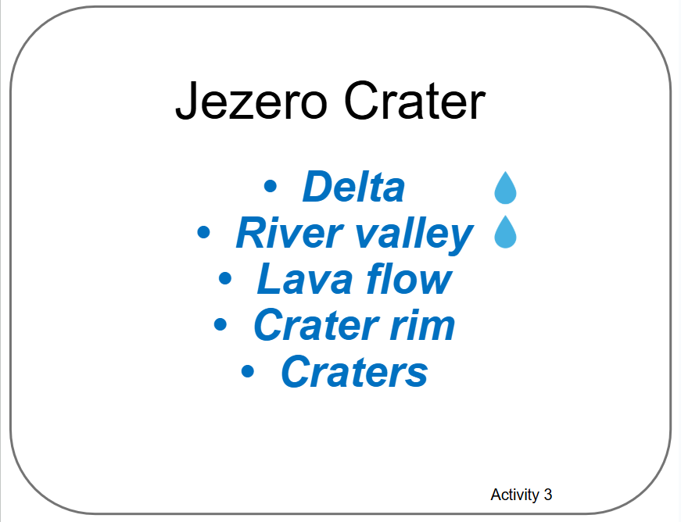

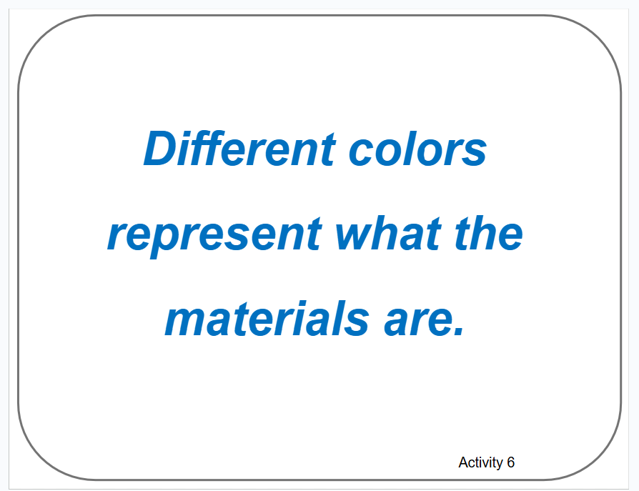
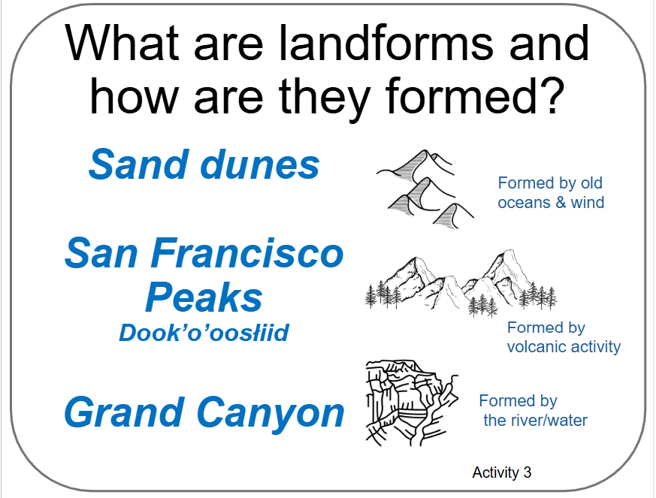
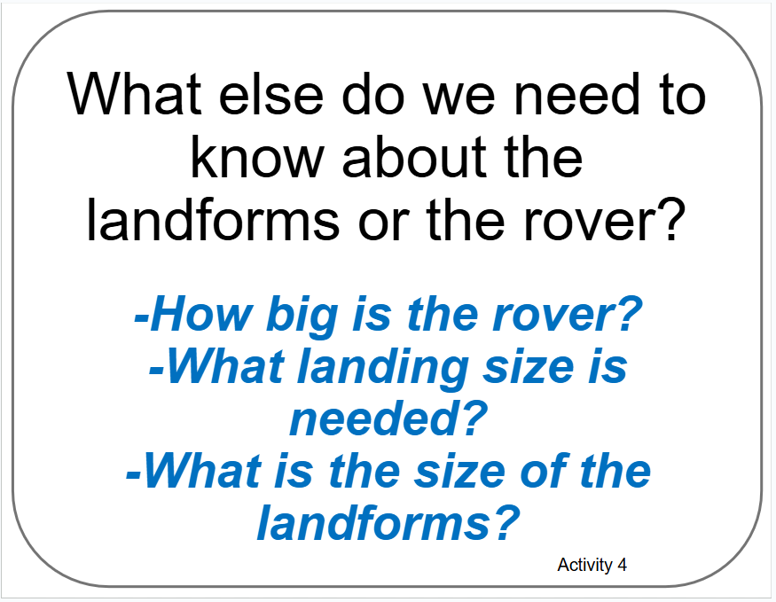
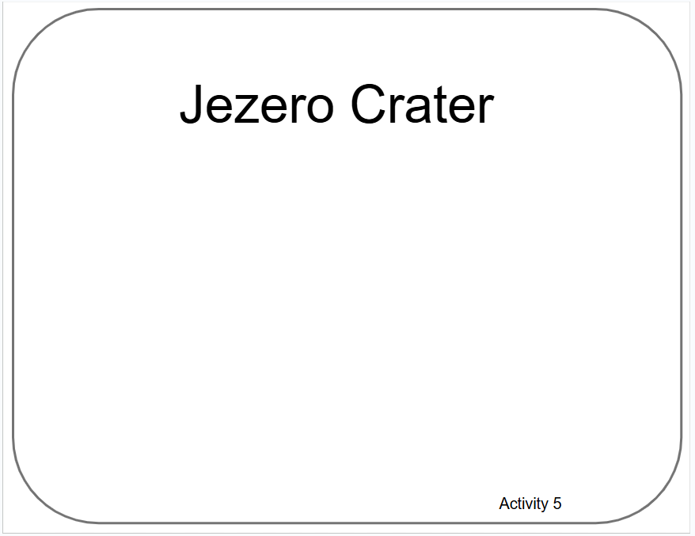
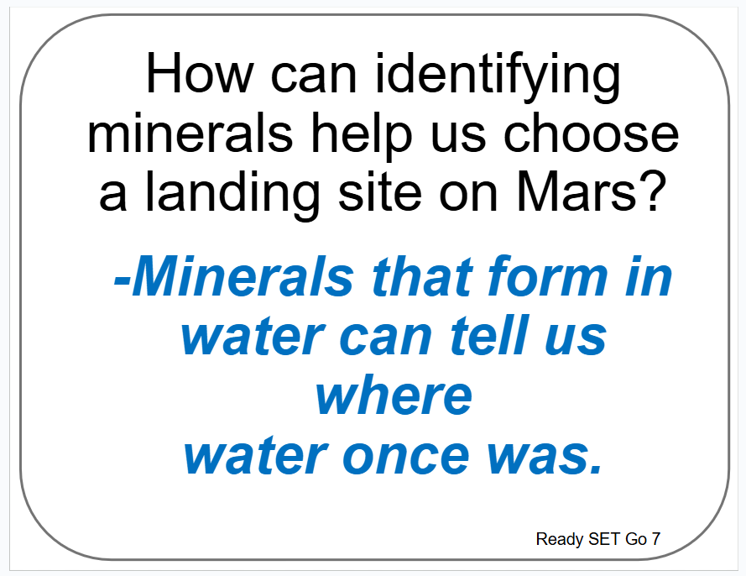

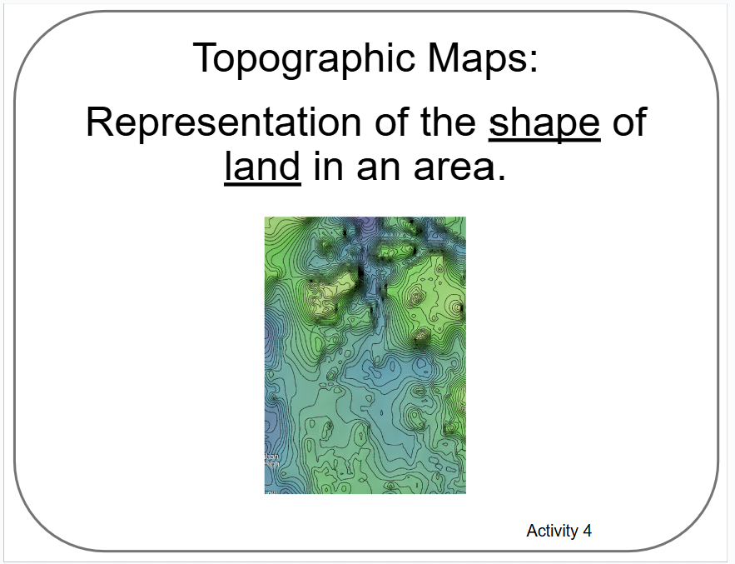
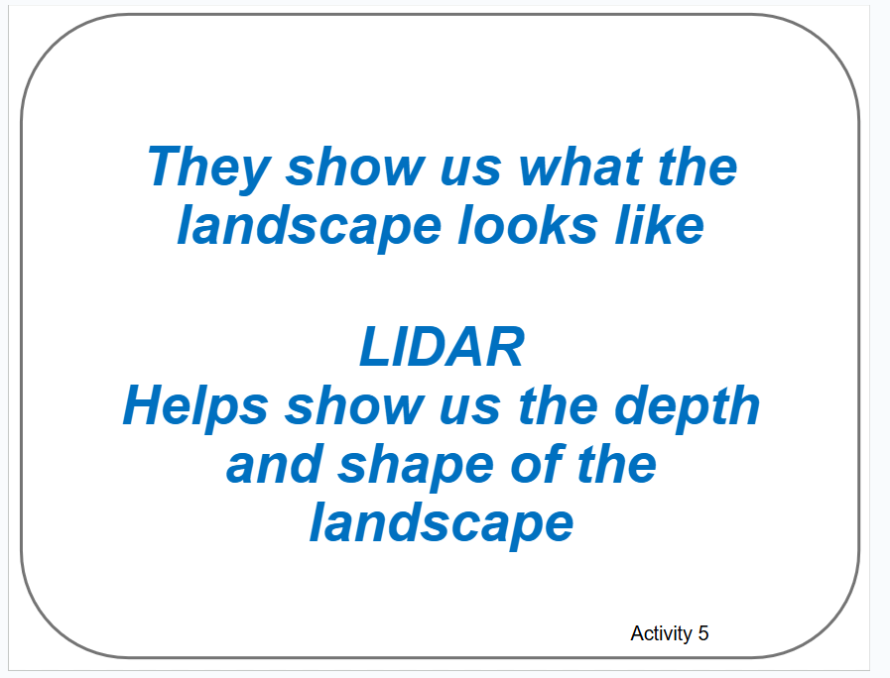
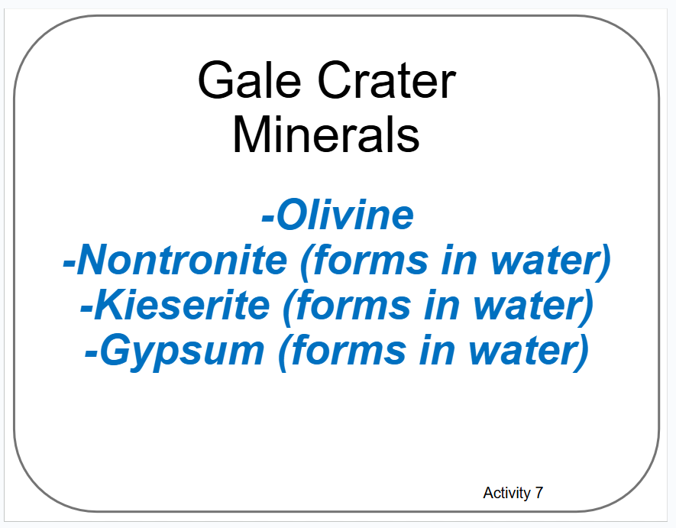
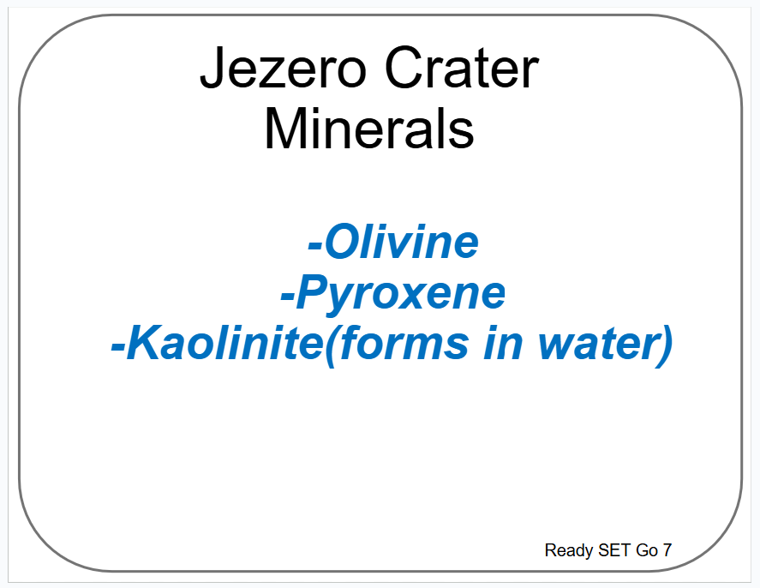
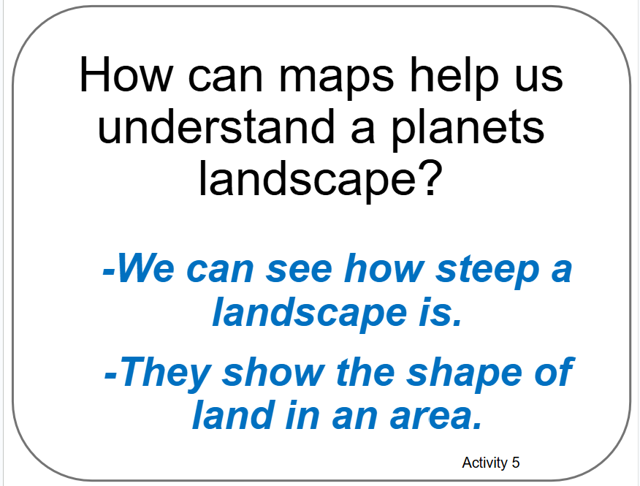
Poster Setup (In-Use Example)
Our Ideas about
Remote Sensing
Science

Slide 15
Examples of Cards for Poster
The following slides are based on the printable PDF version of the blank cards you can use to set up your “Our Ideas Posters”
They have been altered to be more accessible to screen readers.

Slide 16
Card: Why is technology important?

Slide 17
Card: Best landing site for Mars Rover

Slide 18
Card: What are landforms?

Slide 19
Card: How landforms help choose landing site

Slide 20
Card: Gale Crater

Slide 21
Card: Jezero Crater

Slide 22
Card: What else do we need to know?

Slide 23
Card: Topography

Slide 24
Card: Topographic Map

Slide 25
Card: How maps help us understand landscape

Slide 26
Card: How topographic maps help choose site

Slide 27
Card: LiDAR

Slide 28
Card: Gale Crater

Slide 29
Card: Jezero Crater

Slide 30
Card: Blank card filled in Activity 5

Slide 31
Card: How measuring light helps ID materials

Slide 32
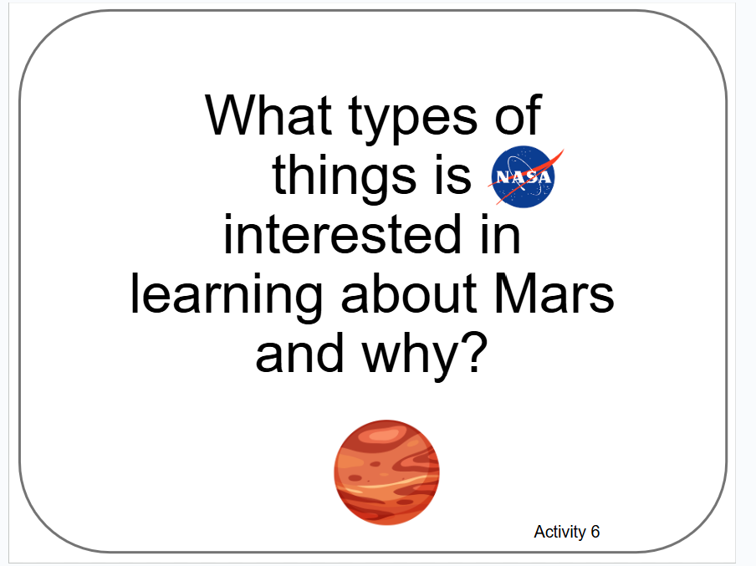
Card: What is NASA interested in?

Slide 33
Card: Minerals

Slide 34
Card: Spectrum

Slide 35

Card: Spectrometer

Slide 36
Card: Blank card filled in from Activity 6

Slide 37
Card: How IDing minerals help choose site

Slide 38
Card: Gale Crater Minerals

Slide 39
Card: Jezero Crater Minerals

Slide 40

Card: Which site do we recommend?

