Slide 1
Science & Engineering
Remote Sensing
Ready Set Go
Our Ideas Poster
Prep & Setup Guide with Examples
Screen Reader Version - NOT for Print

Slide 2
Poster Components
The following slides are based on the printable PDF version of the blank slides/cards with examples that you can use to set up your “Our Ideas Posters” and are not intended to be printed.
These slides are formatted to be more accessible to screen readers.
We recommend using these slides as a guide for blind and low vision educators and printing out the PDFs for sighted learners.

Slide 3
Corresponding PDFs include
Poster Pages to build the poster
  (pages numbered in lower right corner with corresponding adventure(s))
Poster Pages with examples are for educator reference only and not intended to print.
Blank Pages for more space or to build your own poster
Blank ¼ page cards for learners to add additional terms, drawings, ideas
Term cards:
Icon-only
Term + icon

Slide 4
Set Up
You need a wall or whiteboard area of about 80” Length x 60” Height.
Please see the following pages for setup examples.
You may choose alternative layouts or formats to fit your learning environment.

Slide 5
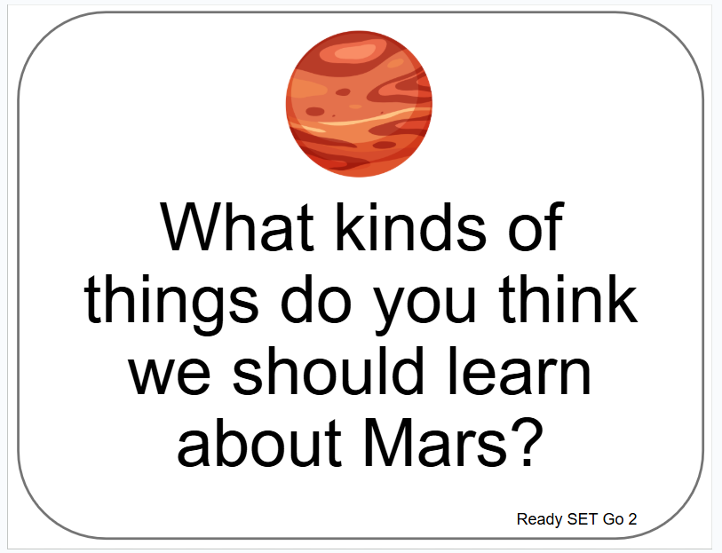
Poster Pages Examples
(Reference - do not print)

Slide 6
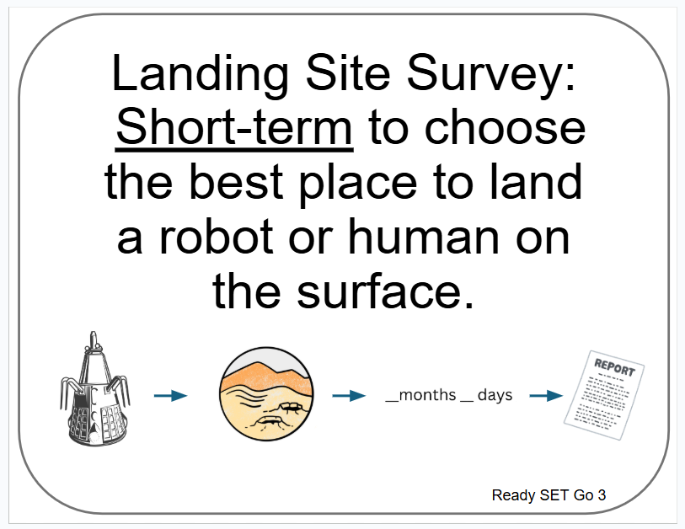
Term Card Example
(Reference - do not print)

Slide 7
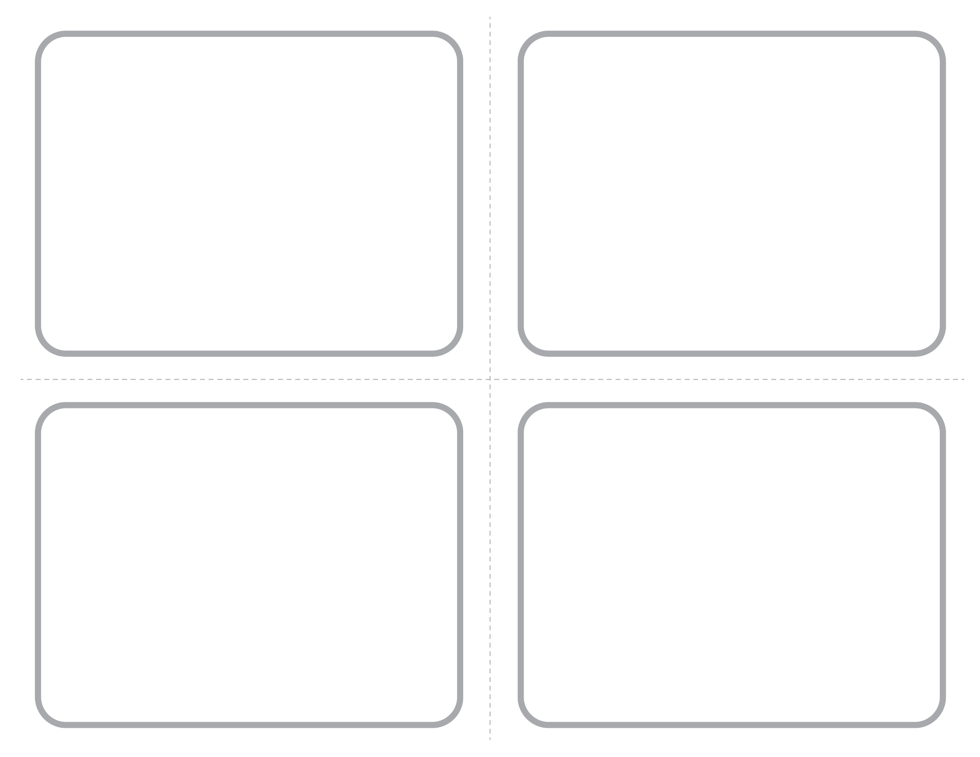
Blank ¼ Page Card Screenshot
Intended for learner responses

Slide 8
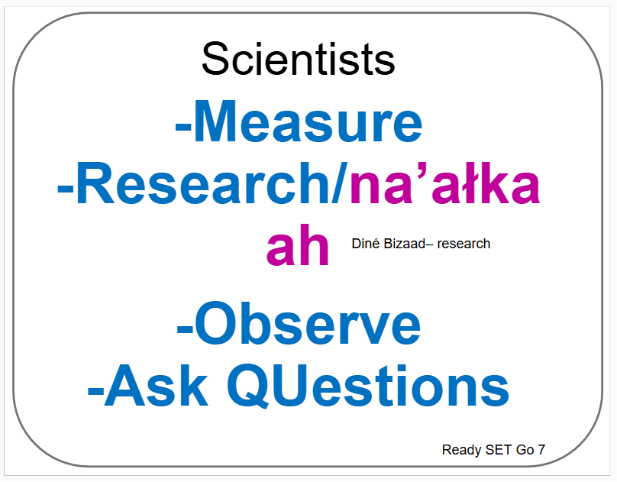
Poster Pages with Examples from Learners

Slide 9
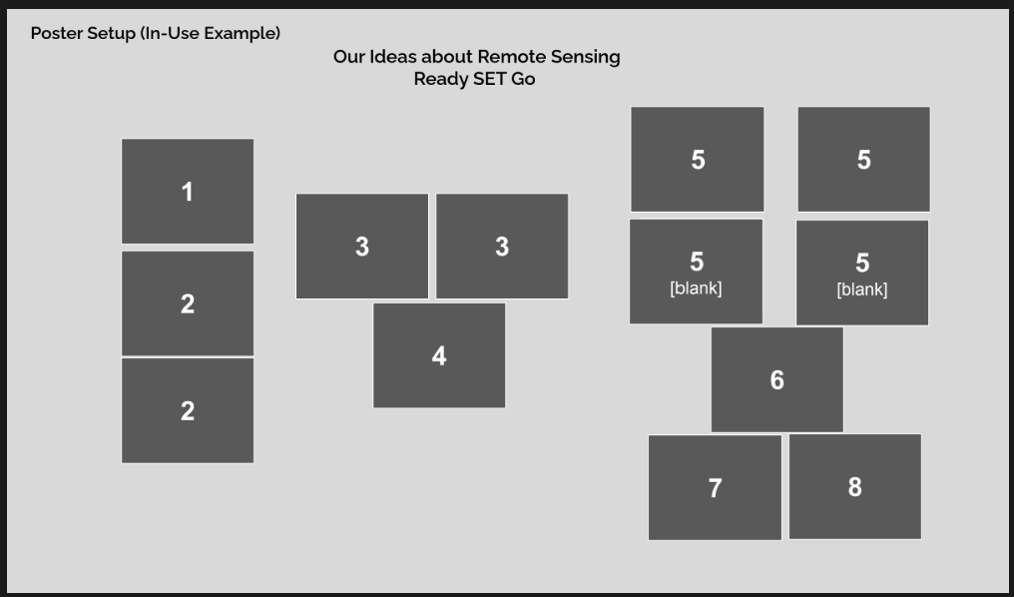
How to Set Up Poster by Activity Numbers

Slide 10
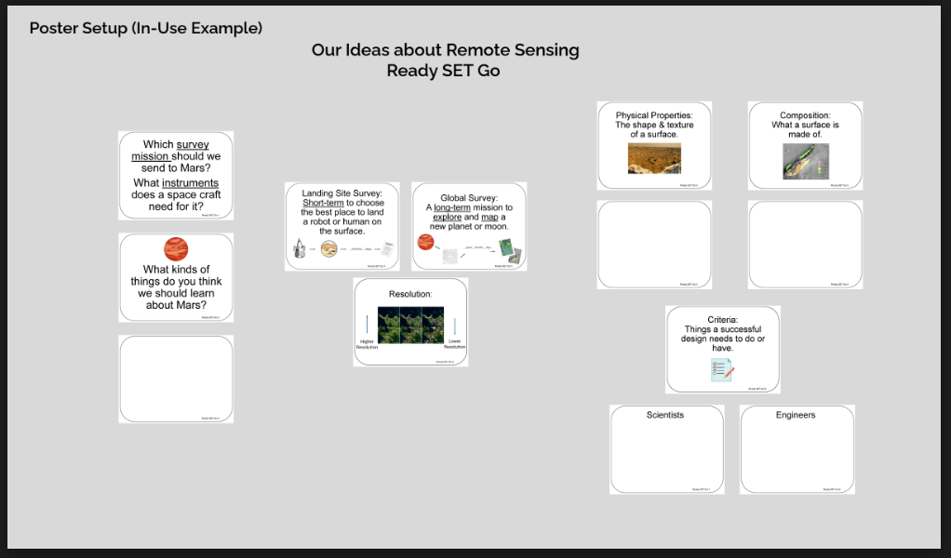
Poster Setup with Unfilled Examples

Slide 11
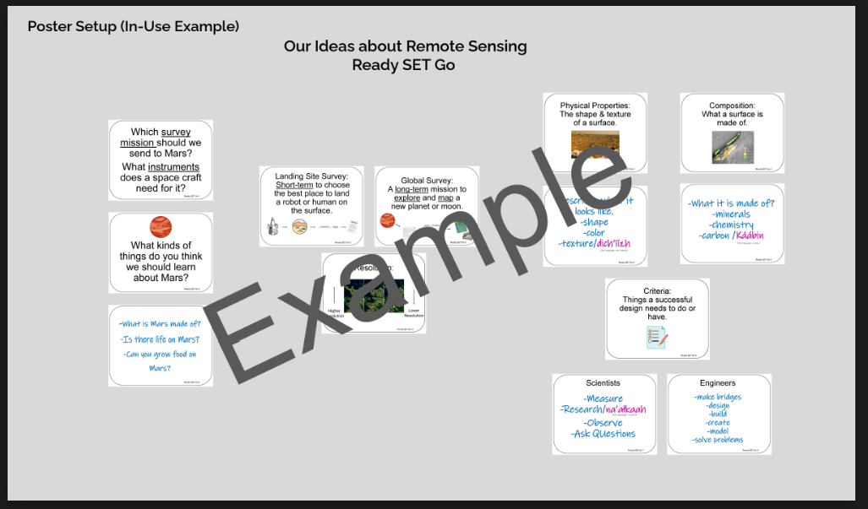
Poster Setup Layout with Learner Examples

Slide 12
Details about Learner Examples
The following two slides are a compromise to allow for alt text readability.
They are formatted for visual access, and not necessarily in a way that is best for screen readers, but do allow for alt text for each of the example cards.
They are optional, and can be skipped if they are not helpful to you.

Slide 13
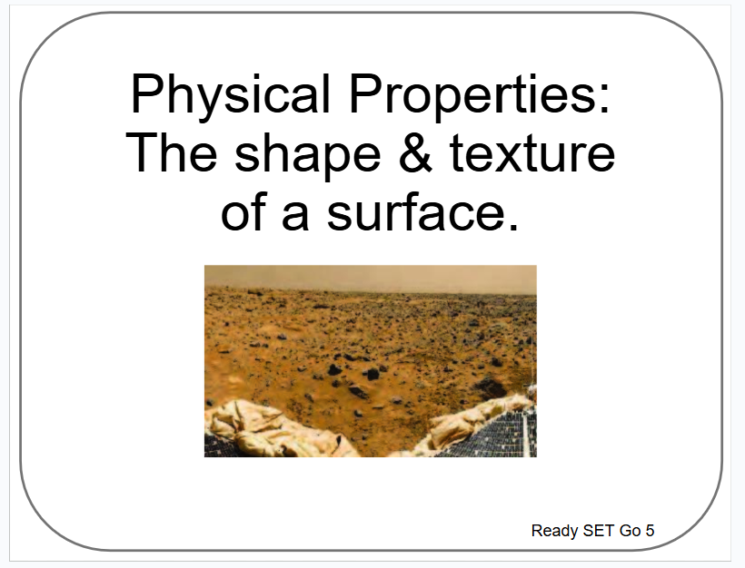
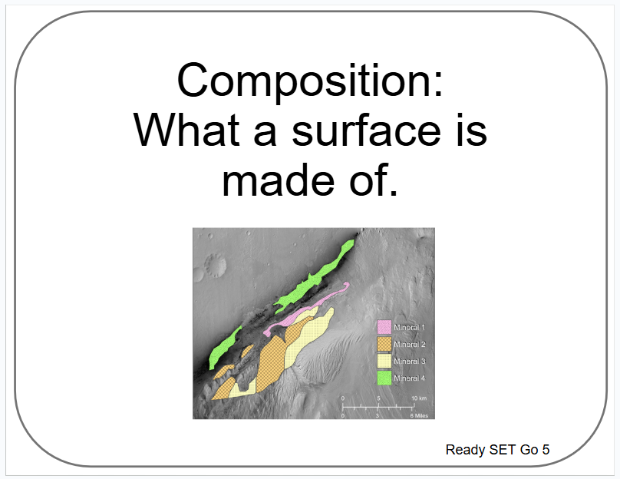
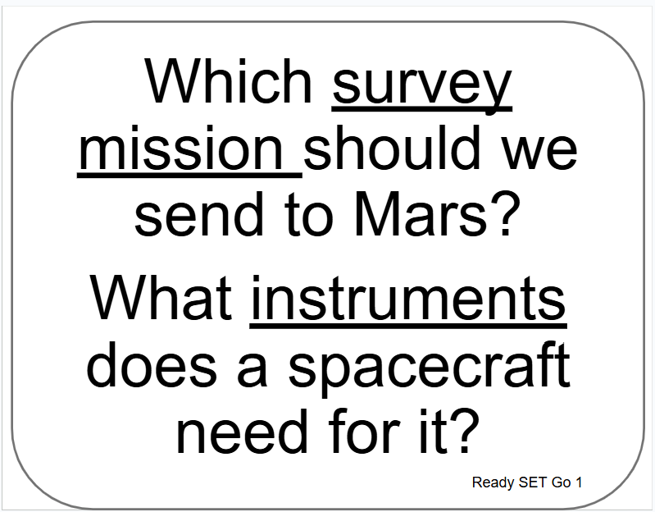
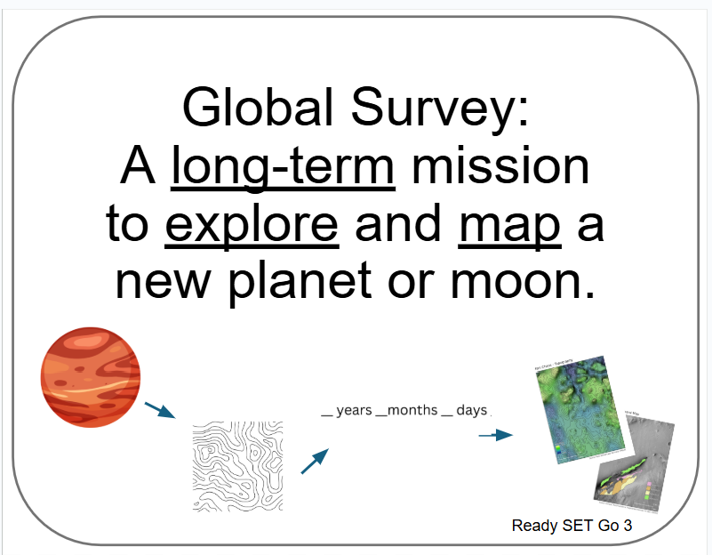
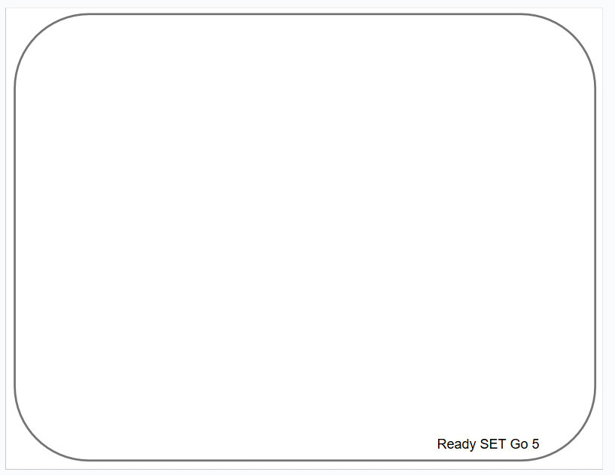
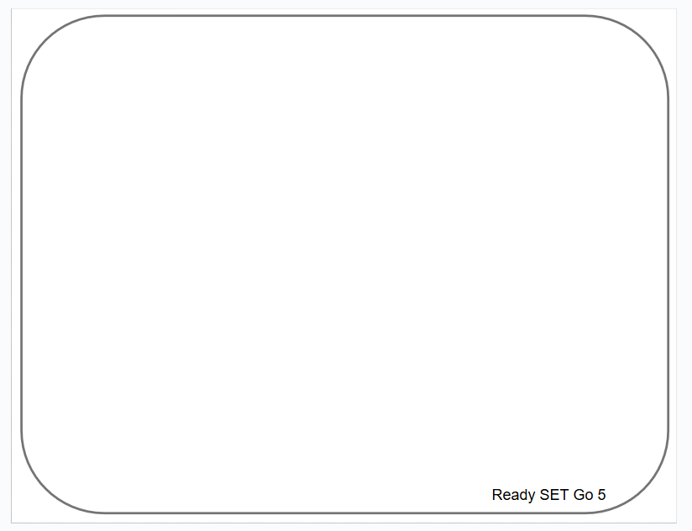
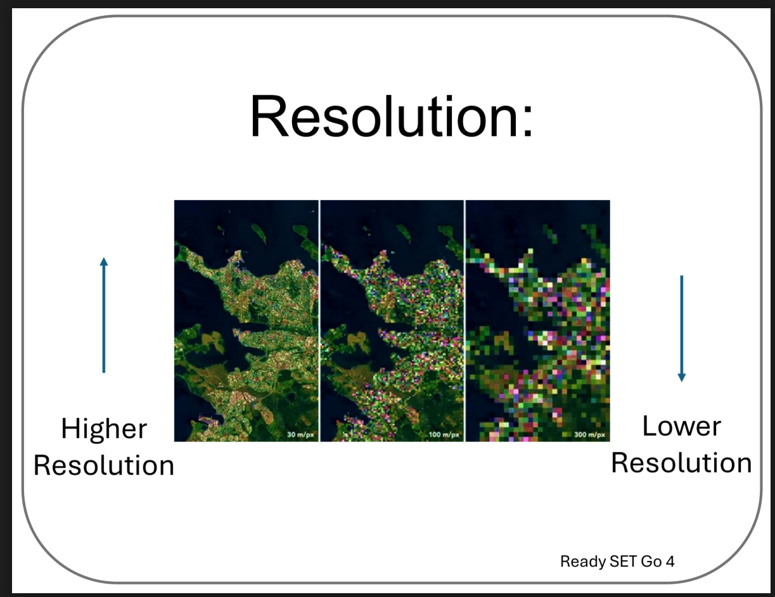
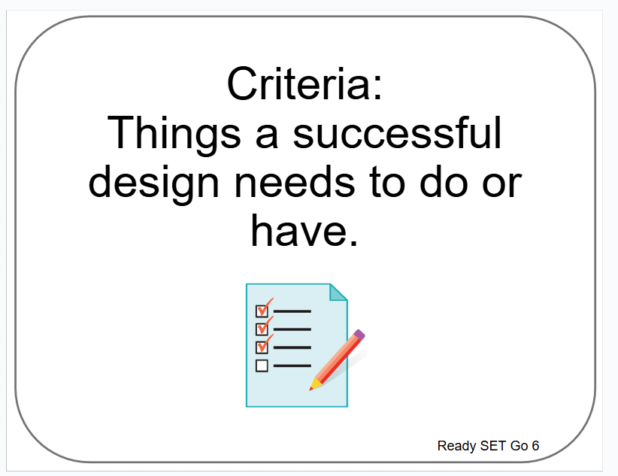
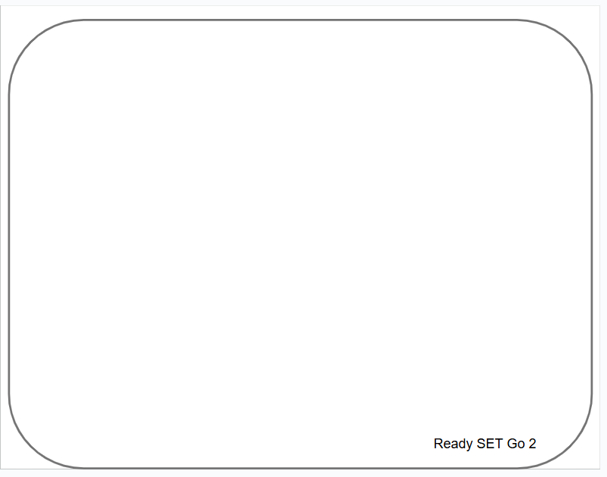
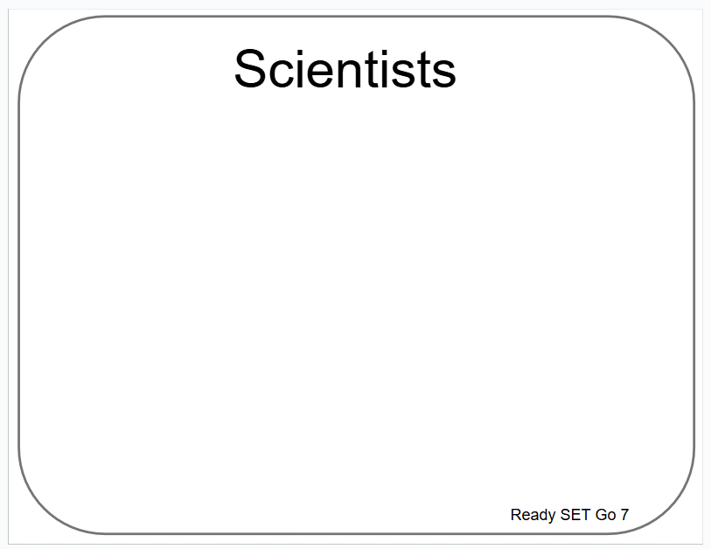
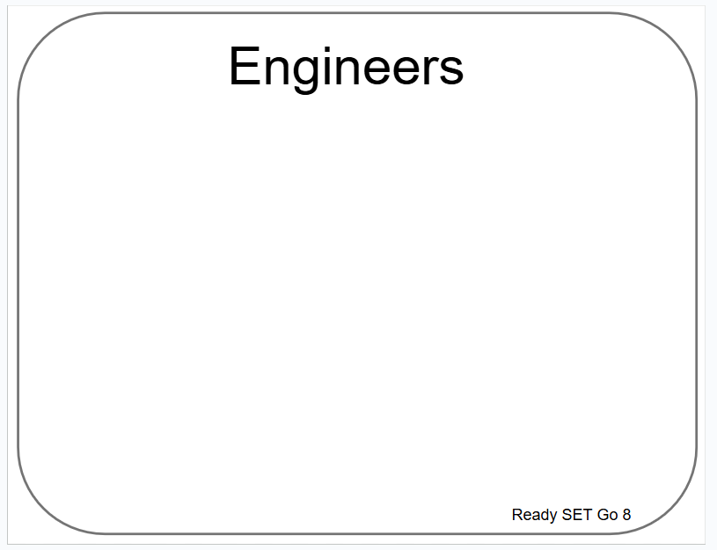
Poster Se tup (Empty Example)
Our Ideas about Remote Sensing
Ready SET Go

Slide 14

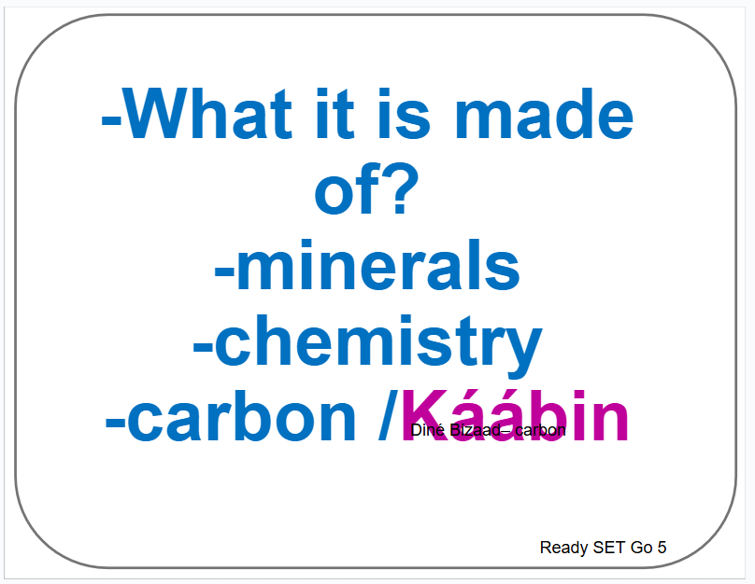
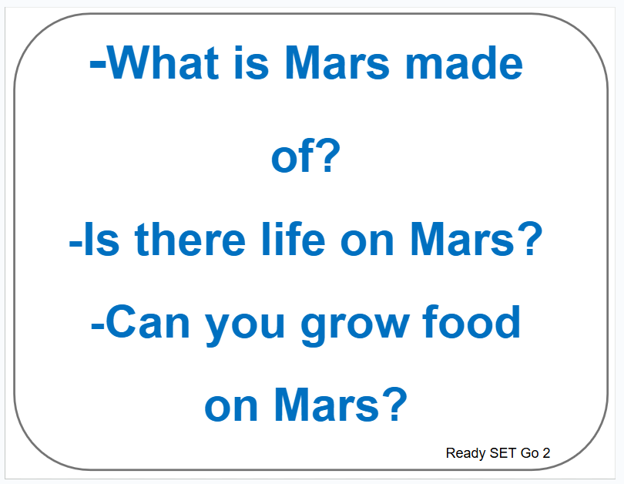
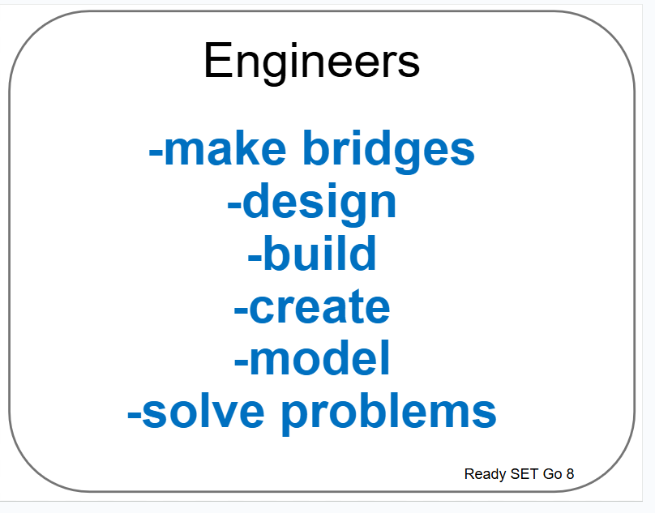
Poster Se tup (Empty Example)
Our Ideas about Remote Sensing
Ready SET Go

Slide 15
Examples of Cards for Poster
The following slides are based on the printable PDF version of the blank cards you can use to set up your “Our Ideas Posters”
They have been altered to be more accessible to screen readers.

Slide 16
Card: Which survey mission should we send?

Slide 17
Card: What kinds of things should we learn?

Slide 18
Card: Examples RSG 2

Slide 19
Card: Landing Site Survey

Slide 20
Card: Global Survey

Slide 21
Card: Resolution

Slide 22
Card: Physical Properties

Slide 23
Card: Composition

Slide 24
Card: RSG 5 examples

Slide 25
Card: More RSG 5 examples

Slide 26
Card: Criteria

Slide 27
Card: Scientists

Slide 28
Card: Engineers

