Slide 1
Engineering
Water in Extreme Environments
RSG & Adventures 1-9
Our Ideas Poster
Prep & Setup Guide with Blanks
Screen Reader Version - NOT for Print

Slide 2
Poster Components
The following slides are based on the printable PDF version of the blank slides/cards you can use to set up your “Our Ideas Posters” and are not intended to be printed.
These slides are formatted to be more accessible to screen readers.
We recommend using these slides as a guide for blind and low vision educators and printing out the PDFs for sighted learners.

Slide 3
Corresponding PDFs include
Poster Pages to build the poster
  (pages numbered in lower right corner with corresponding adventure(s))
Poster Pages with examples are for educator reference only and not intended to print.
Blank Pages for more space or to build your own poster
Blank ¼ page cards for learners to add additional terms, drawings, ideas
Term cards:
Icon-only
Term + icon

Slide 4
Set Up
You need a wall or whiteboard area of about 80” Length x 60” Height.
Please see the following pages for setup examples.
You may choose alternative layouts or formats to fit your learning environment.

Slide 5
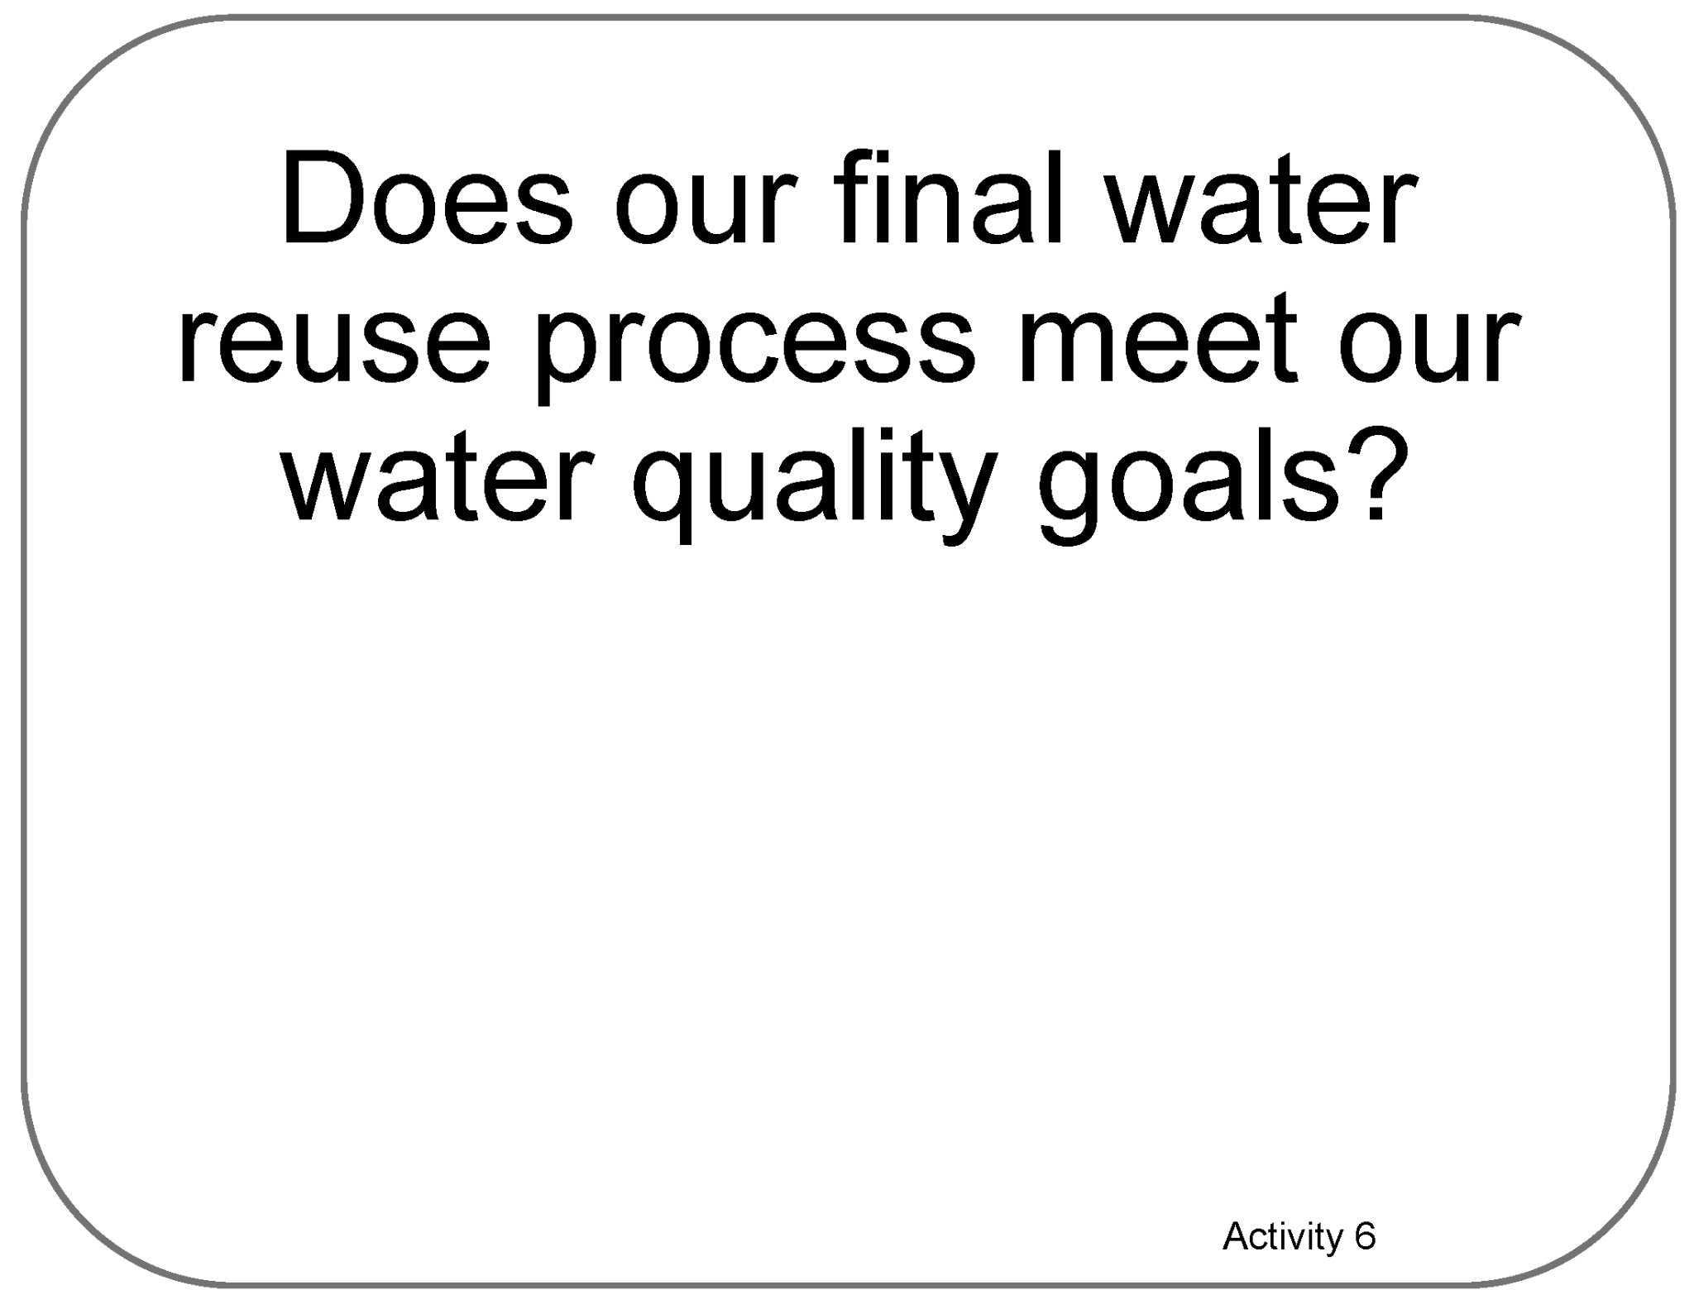
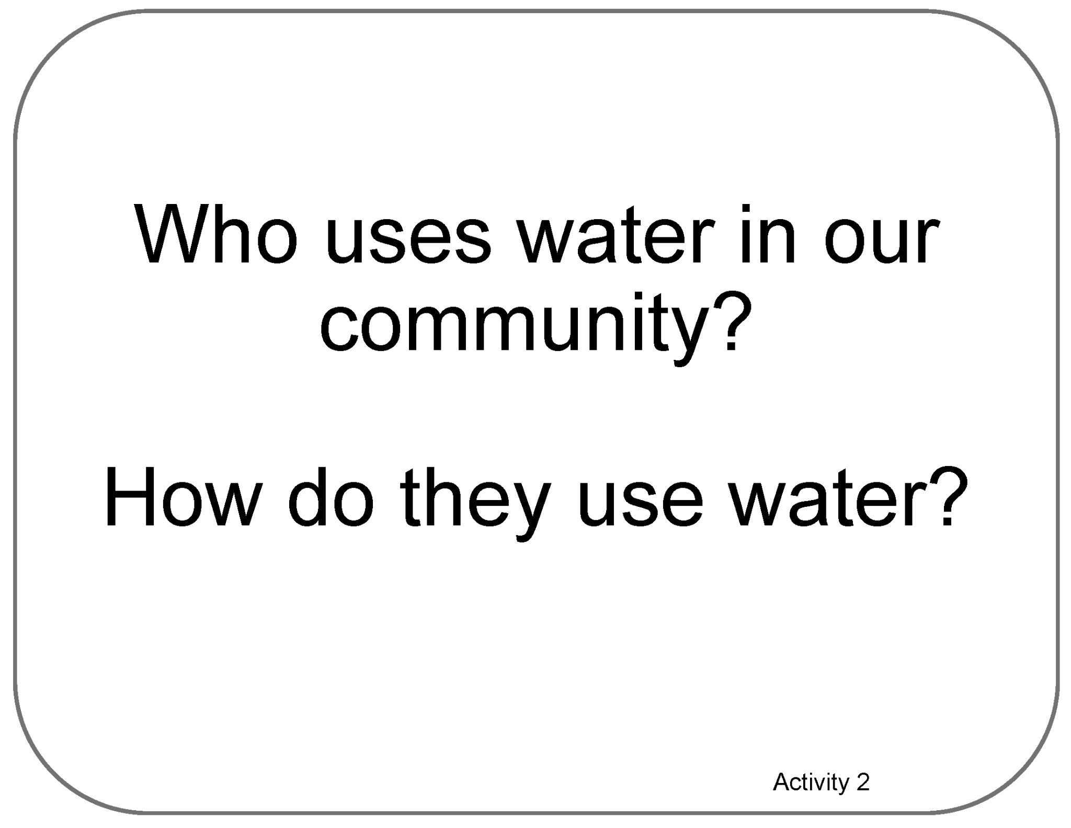
Poster Pages Examples
(Reference - do not print)

Slide 6
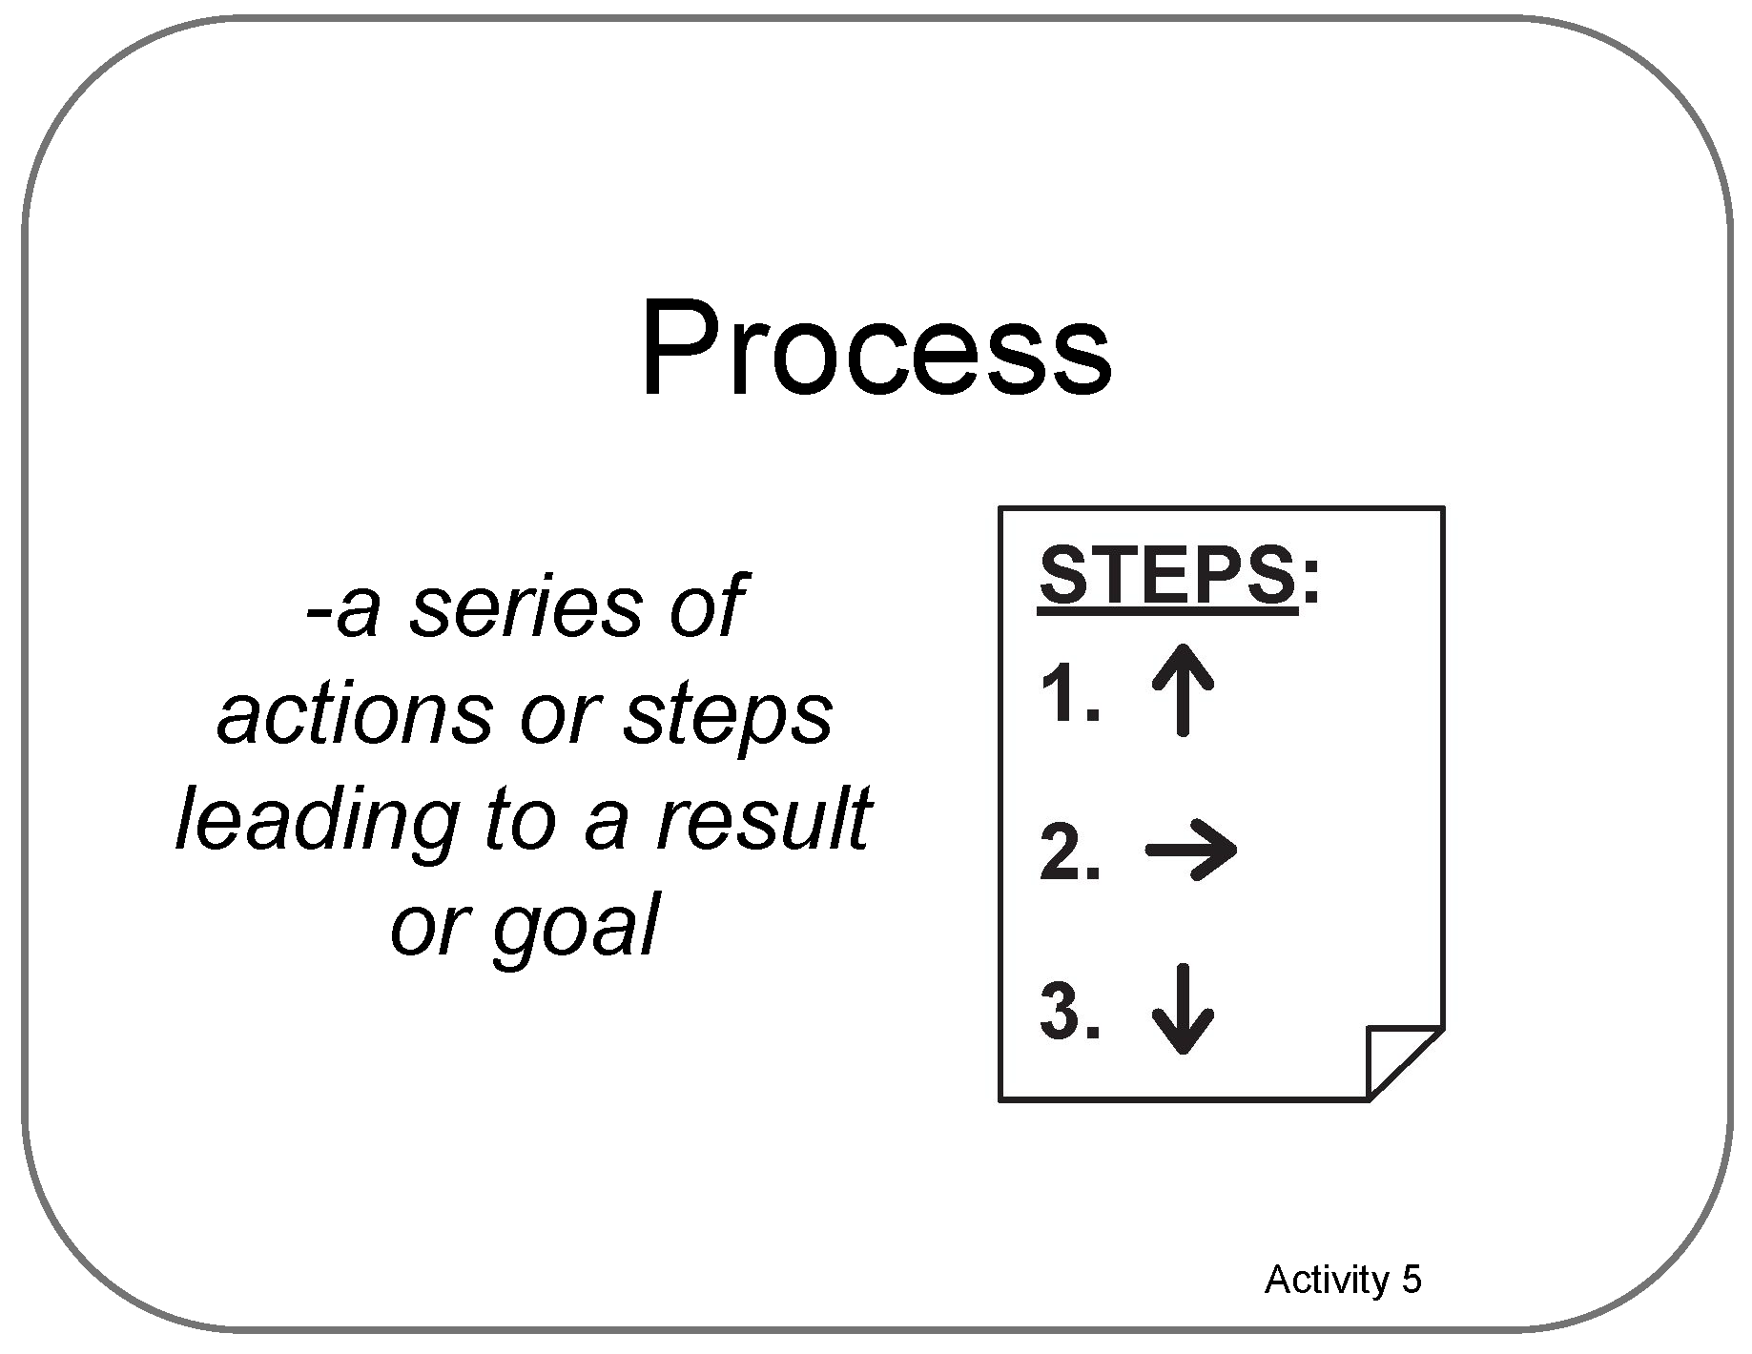
Term Card Example
(Reference - do not print)

Slide 7

Blank ¼ Page Card Screenshot
Intended for learner responses

Slide 8
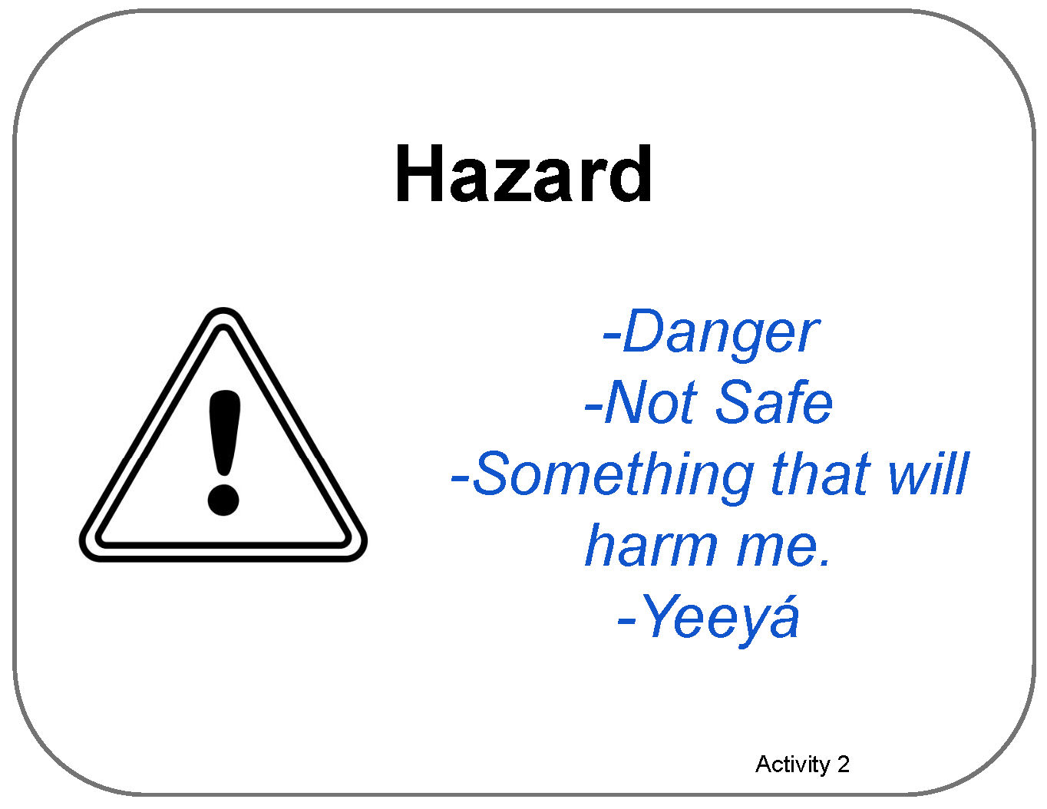
Poster Pages with Examples from Learners
(Reference - do not print)

Slide 9
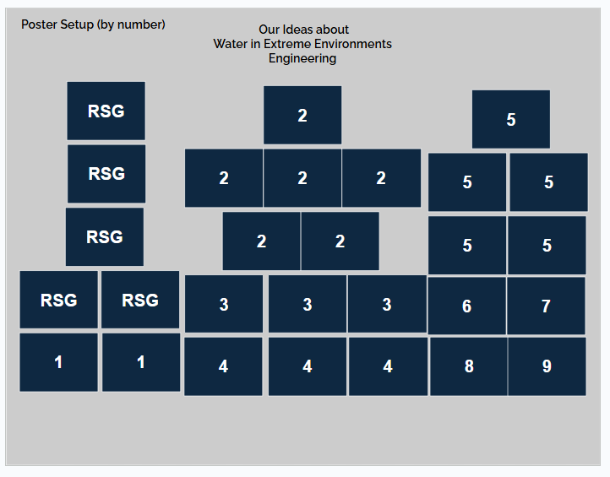
Poster Setup Layout

Slide 10
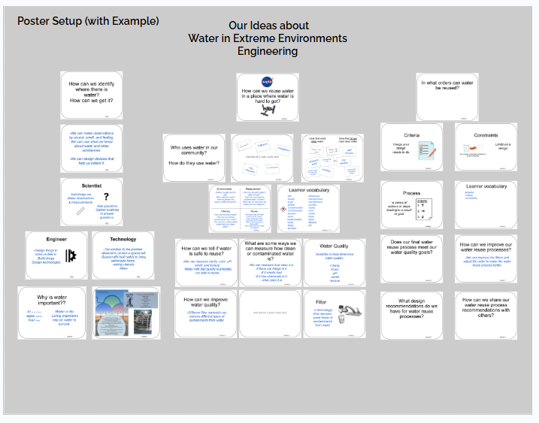
Poster Setup Layout with Learner Examples

Slide 11
Details about Learner Examples
The following two slides are a compromise to allow for alt text readability.
They are formatted for visual access, and not necessarily in a way that is best for screen readers, but do allow for alt text for each of the example cards.
They are optional, and can be skipped if they are not helpful to you.

Slide 12
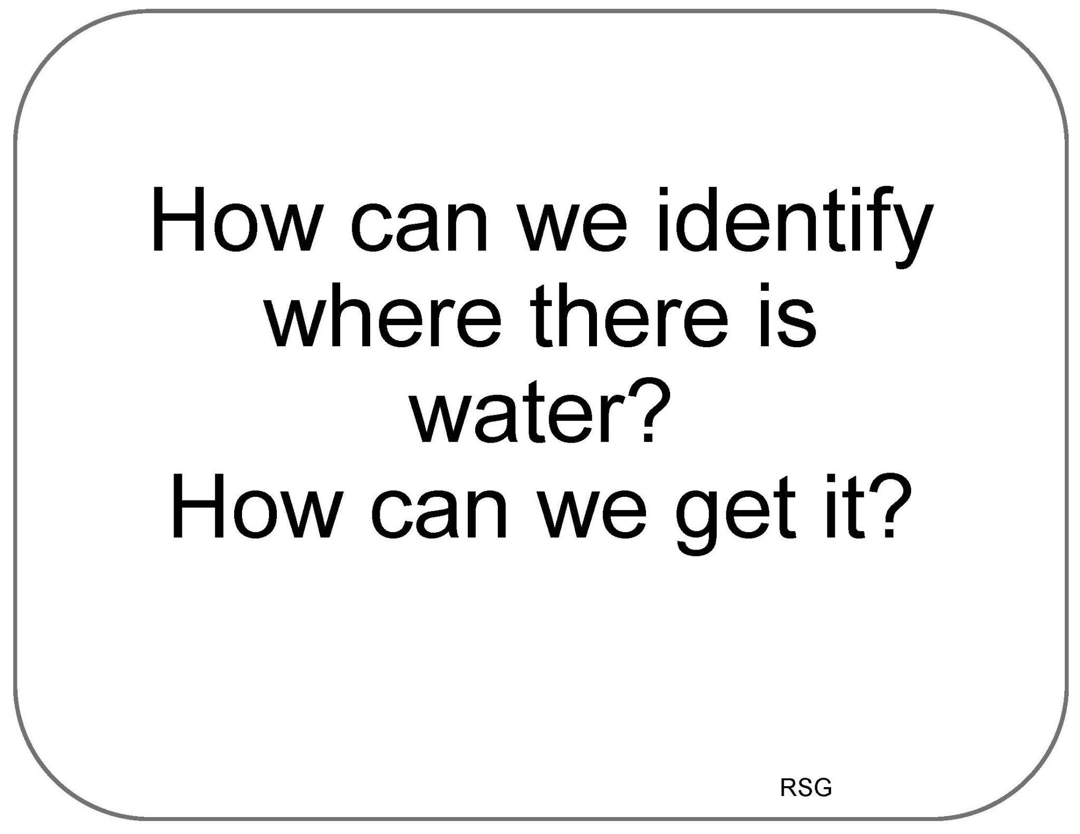
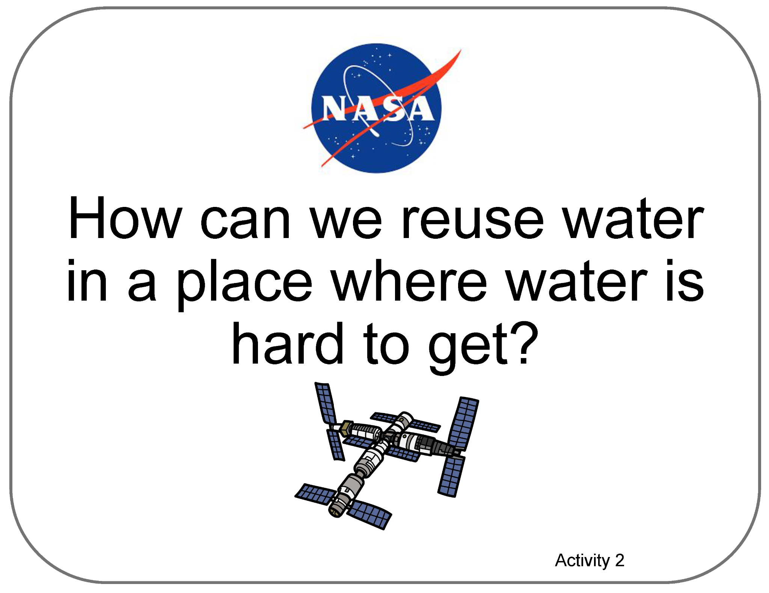
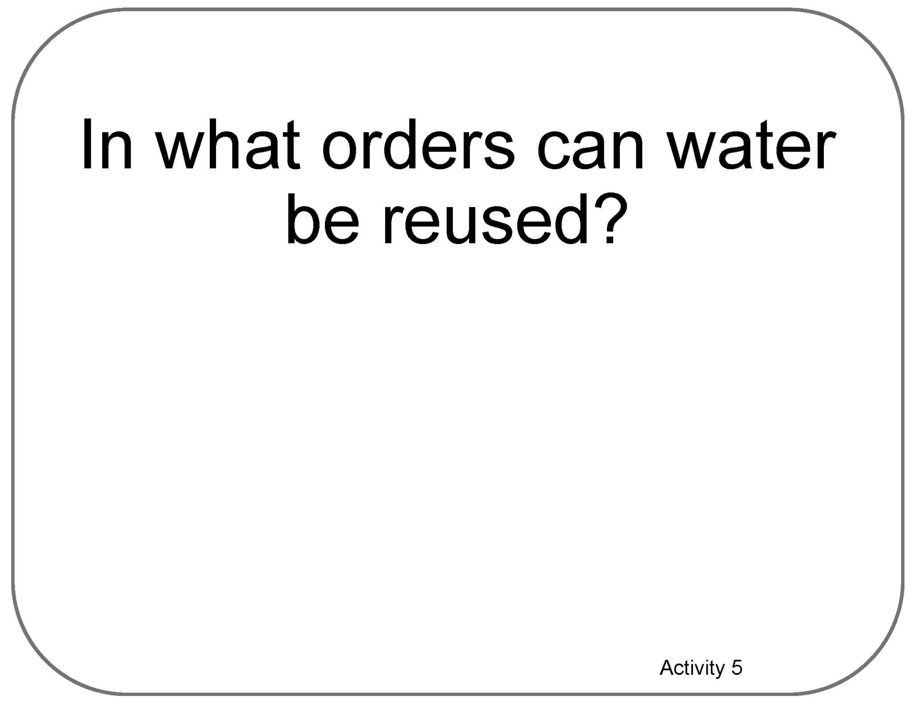
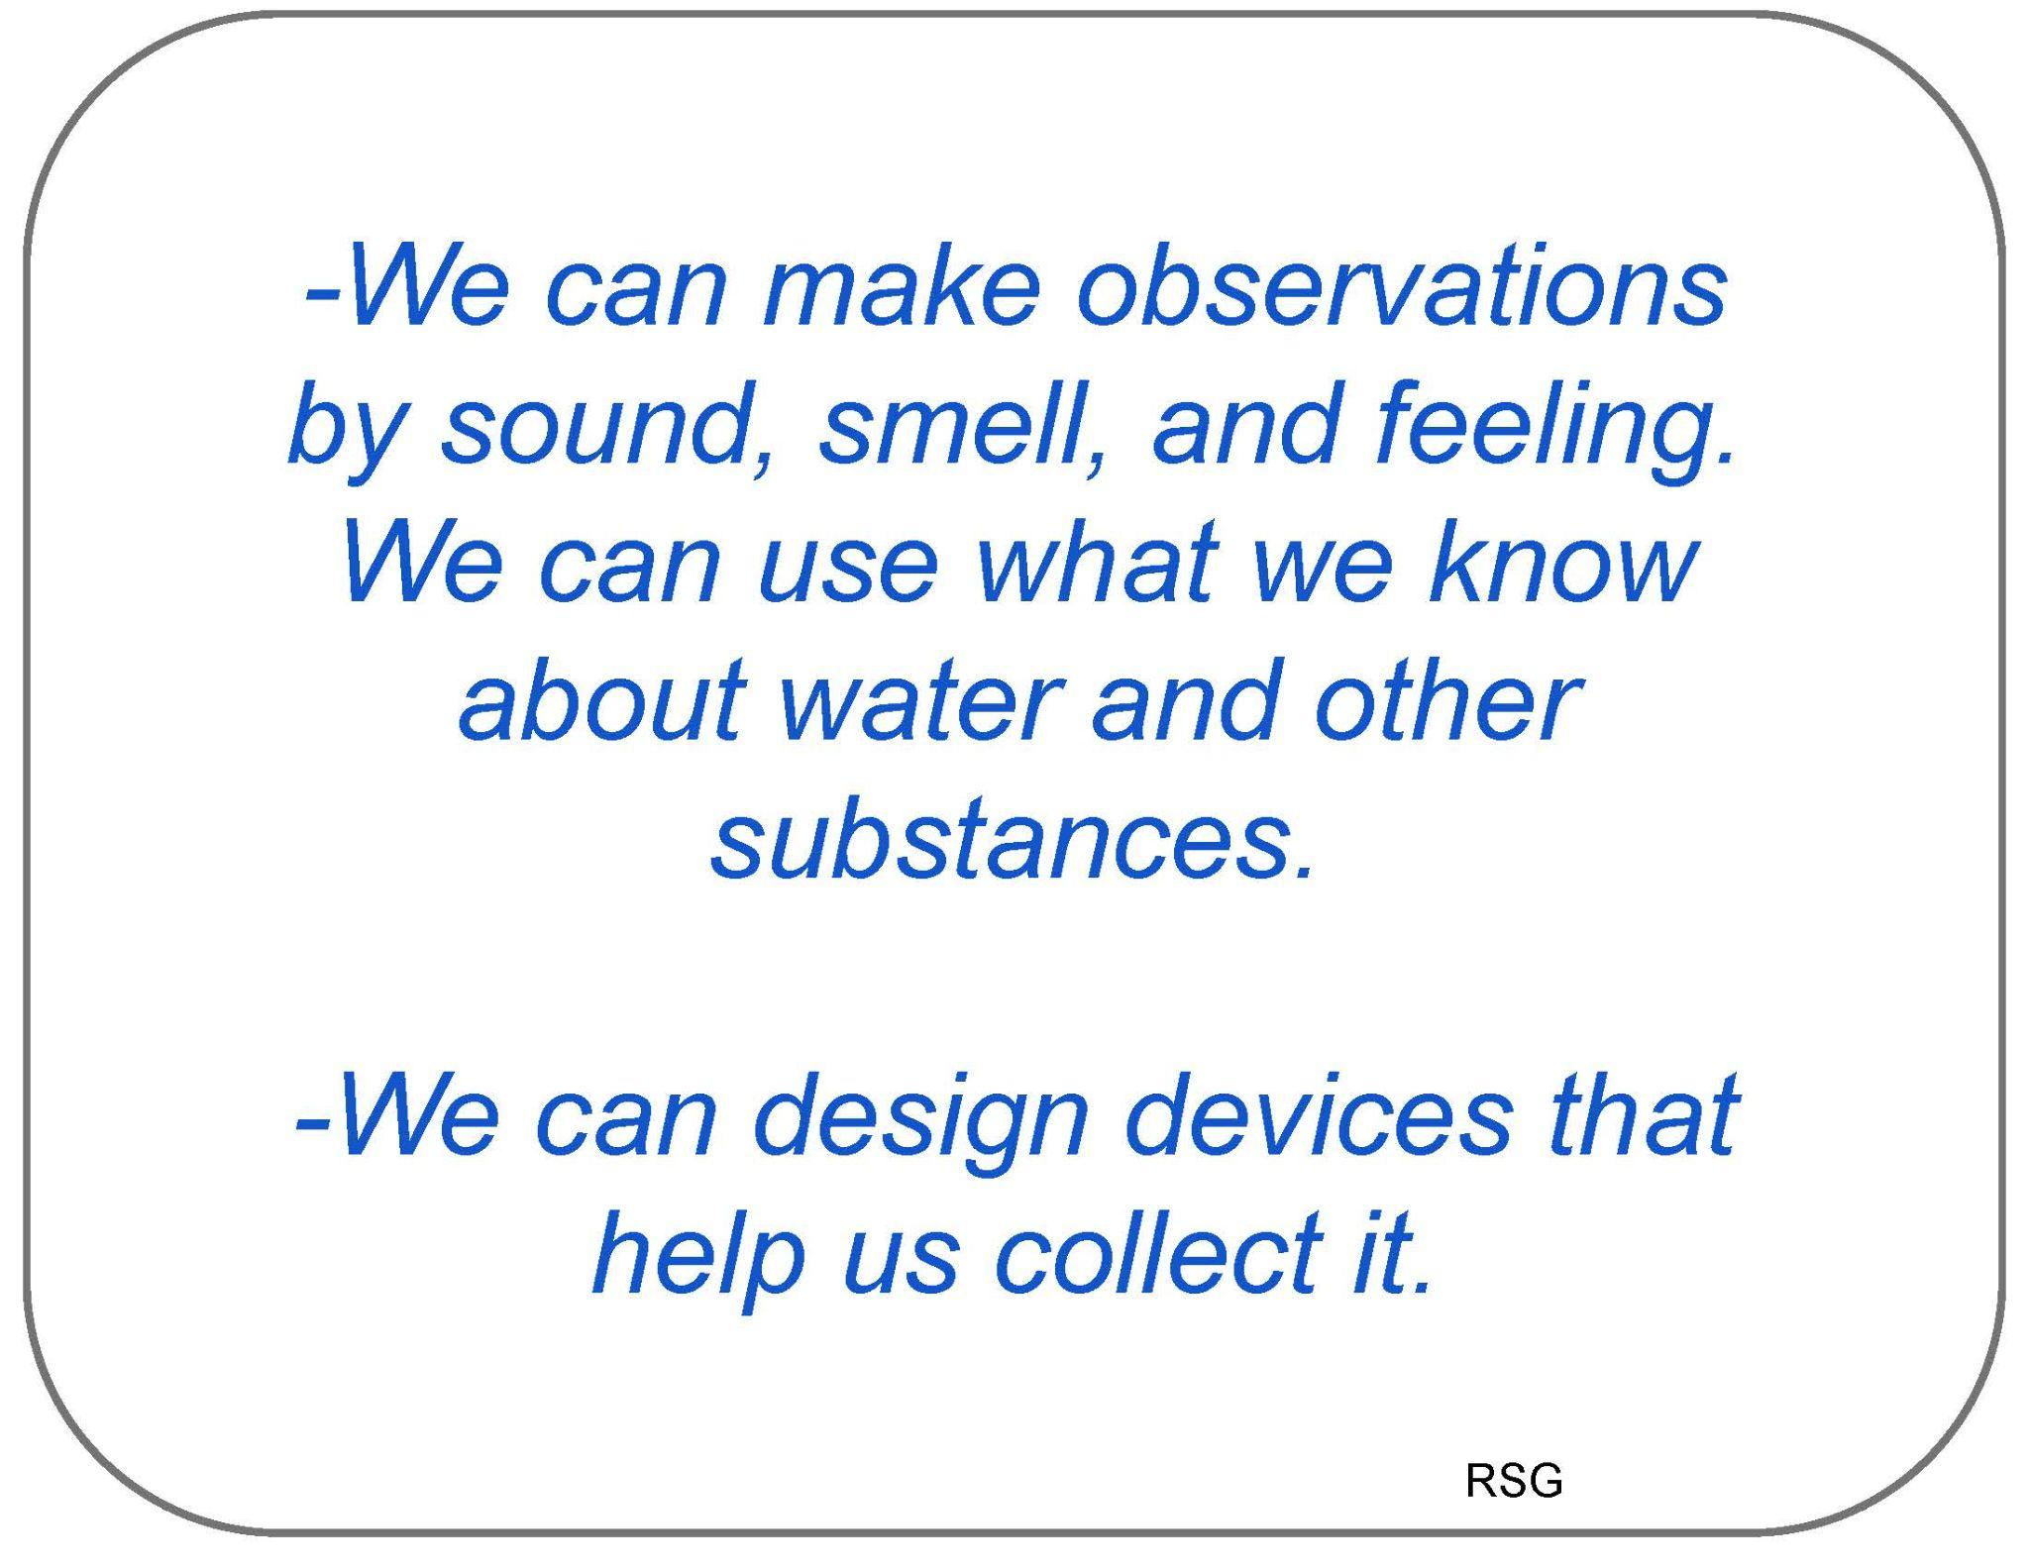
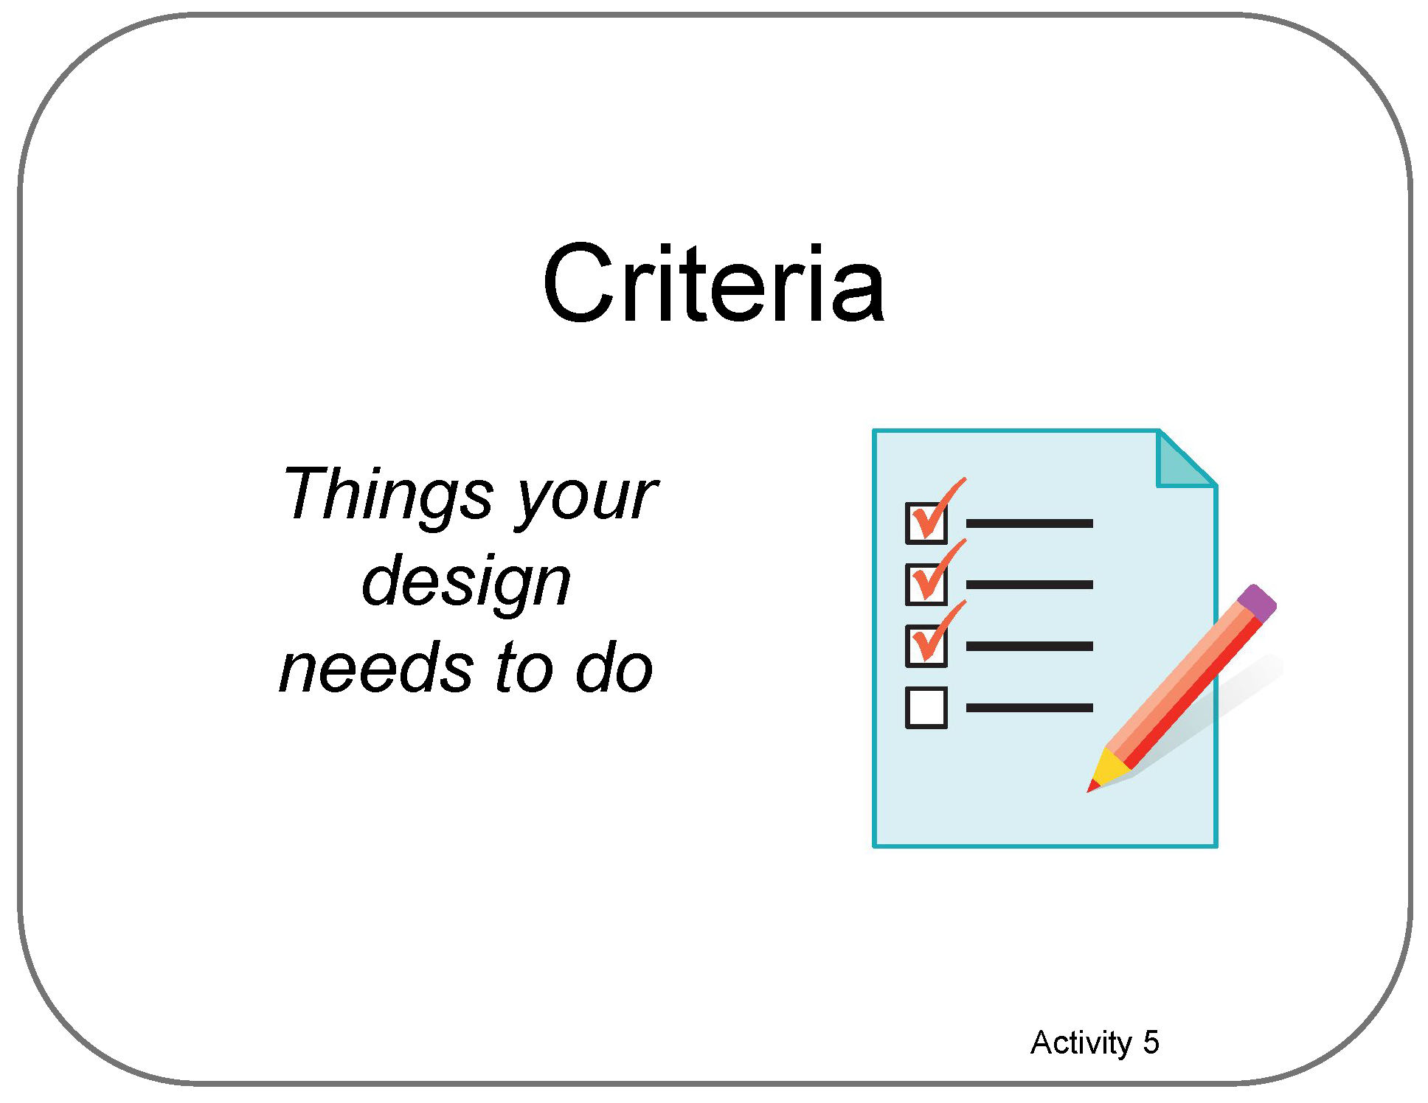
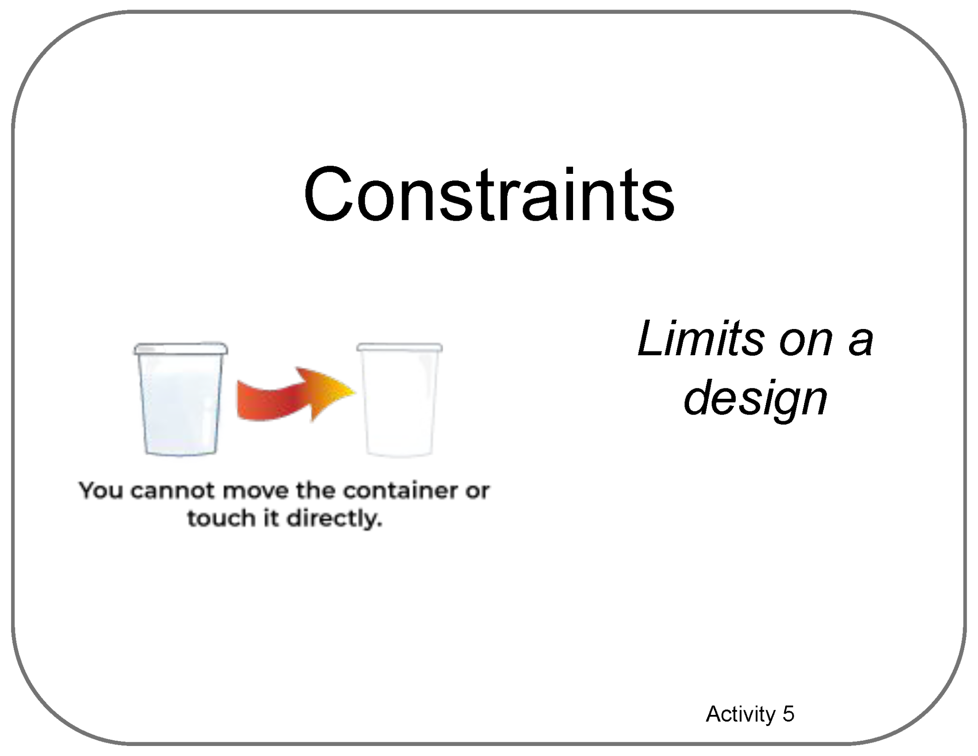

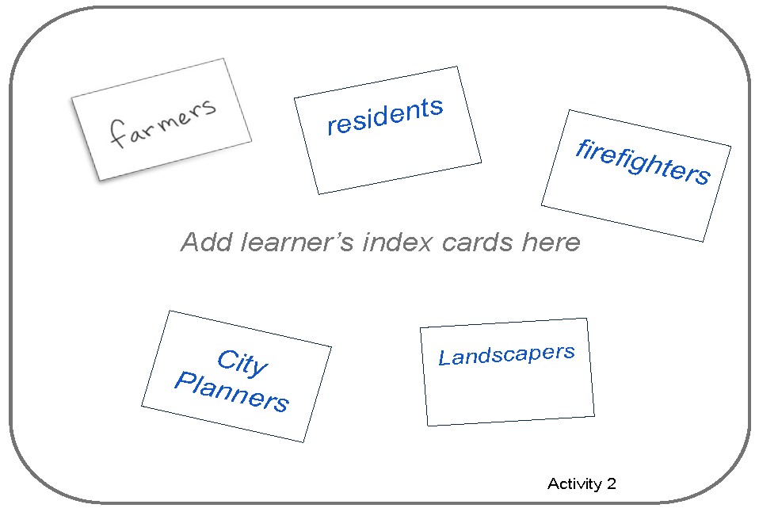
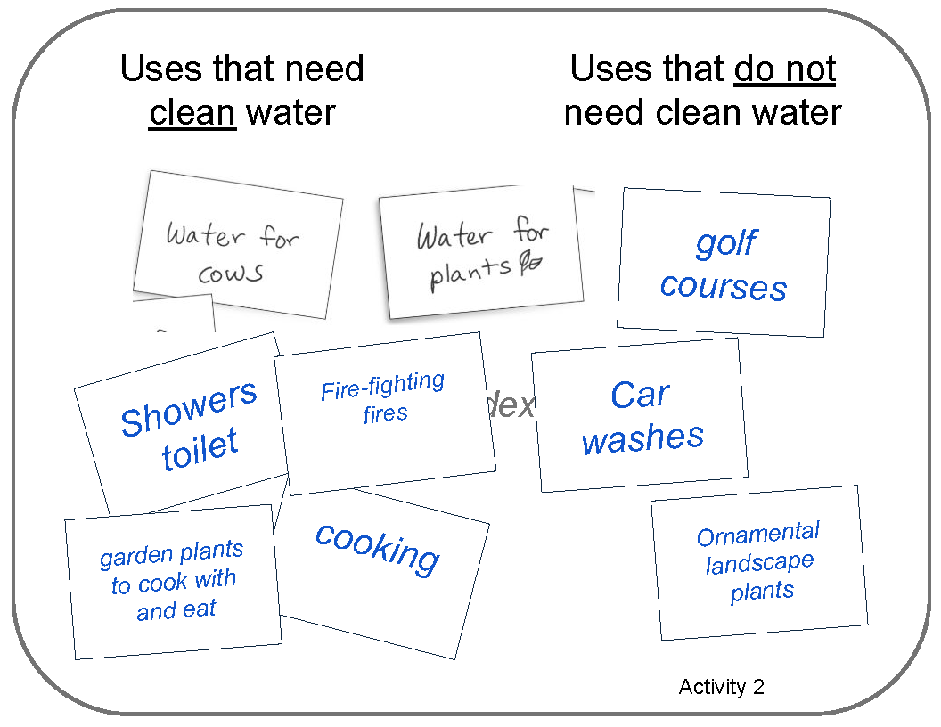
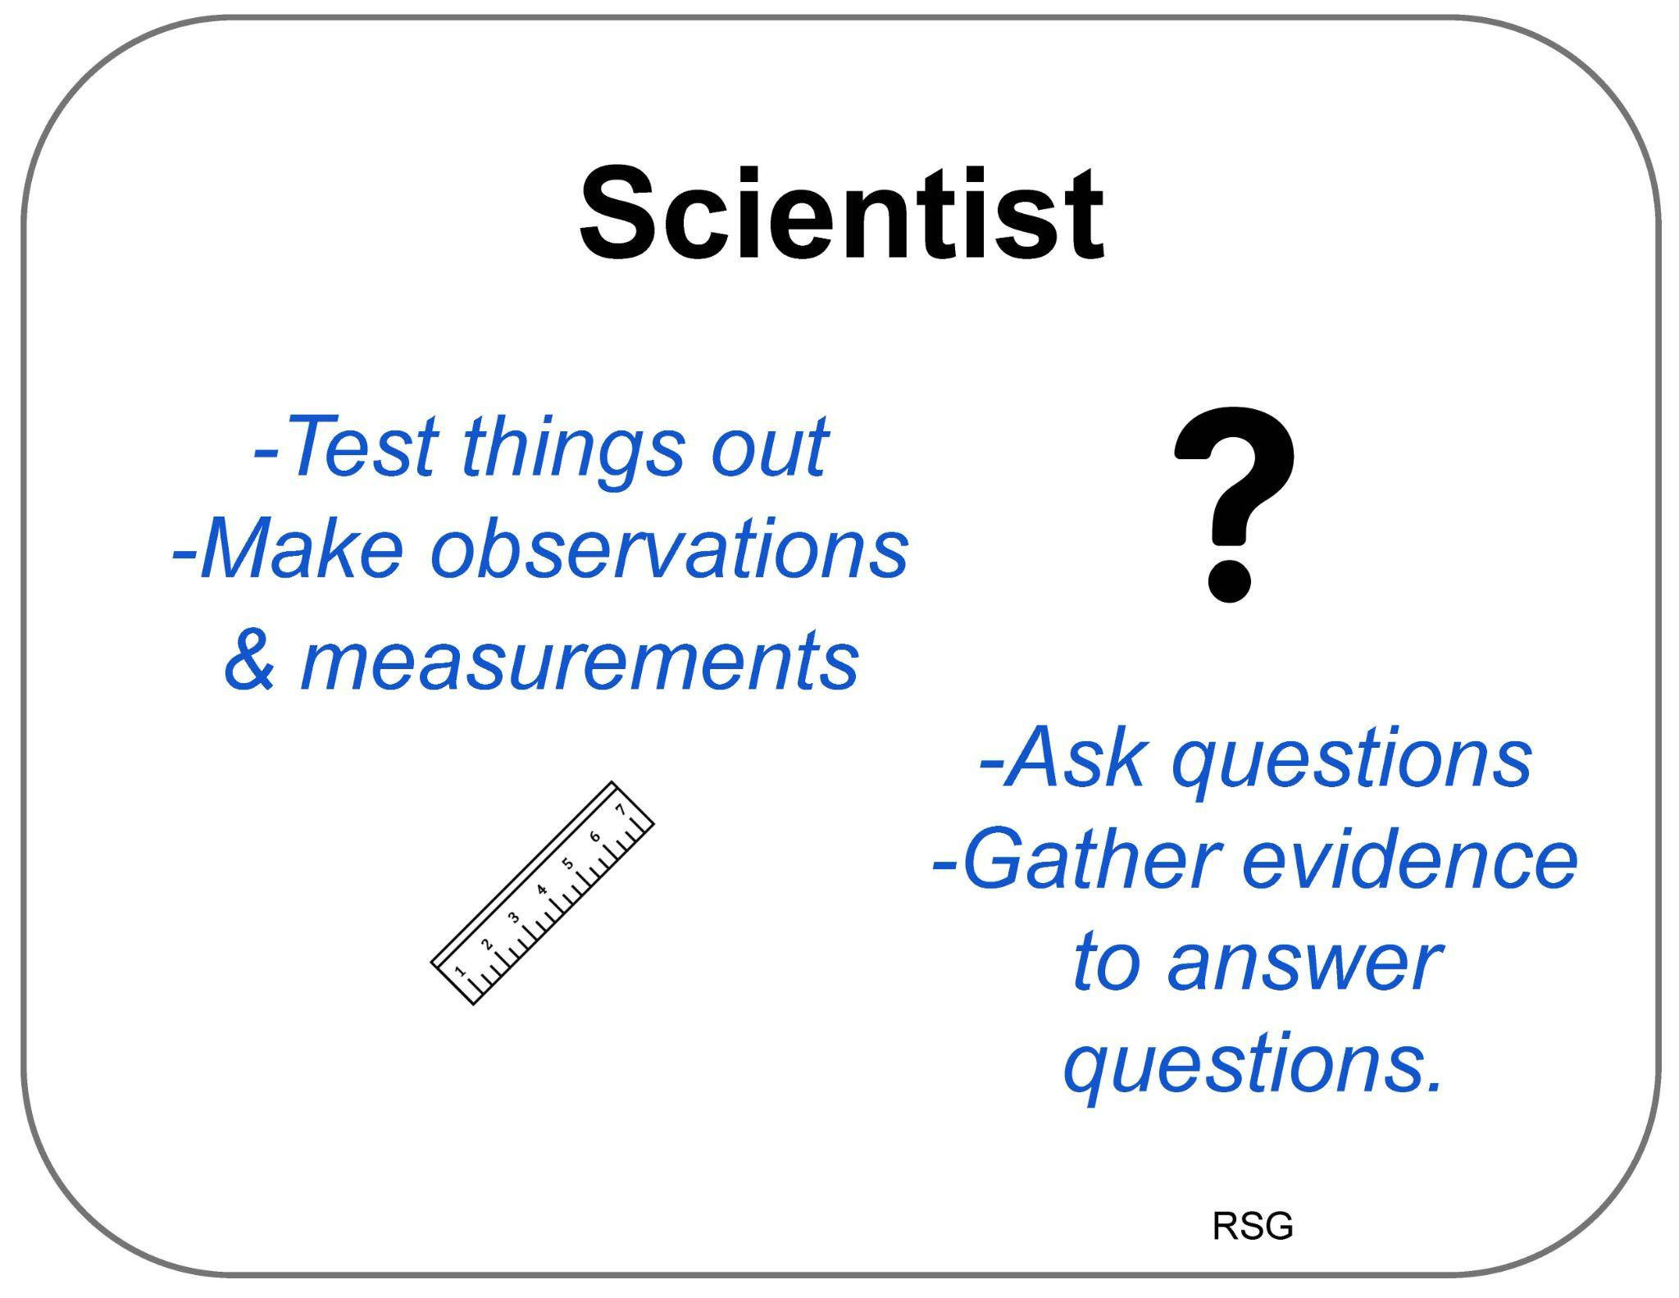
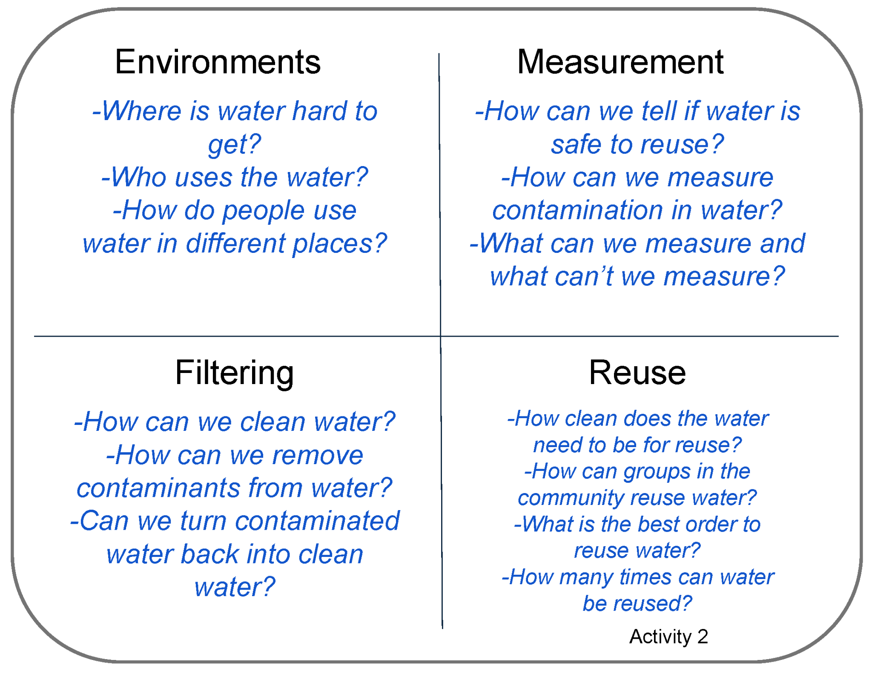
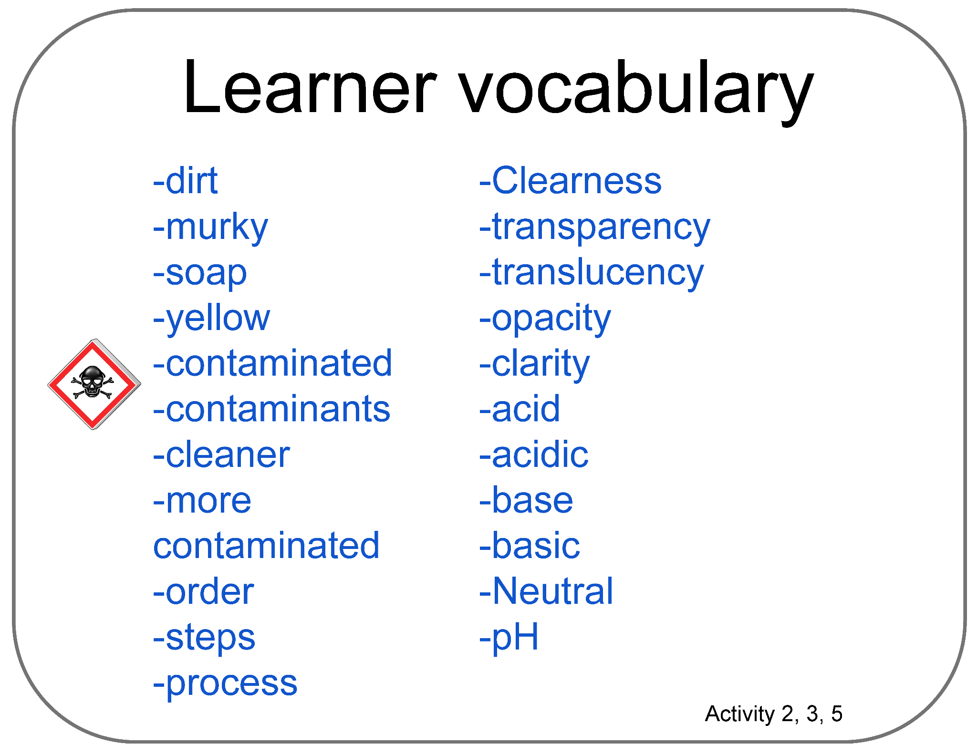
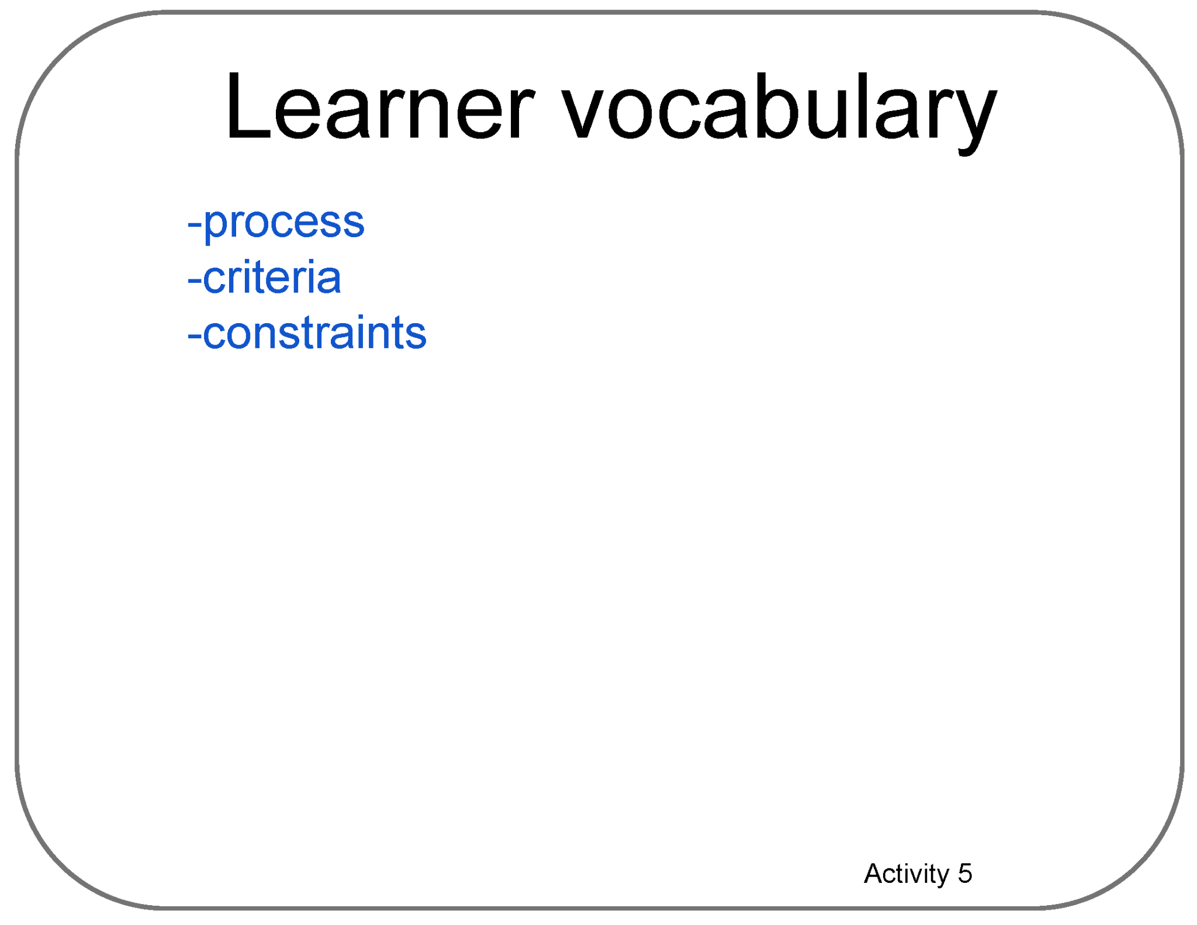

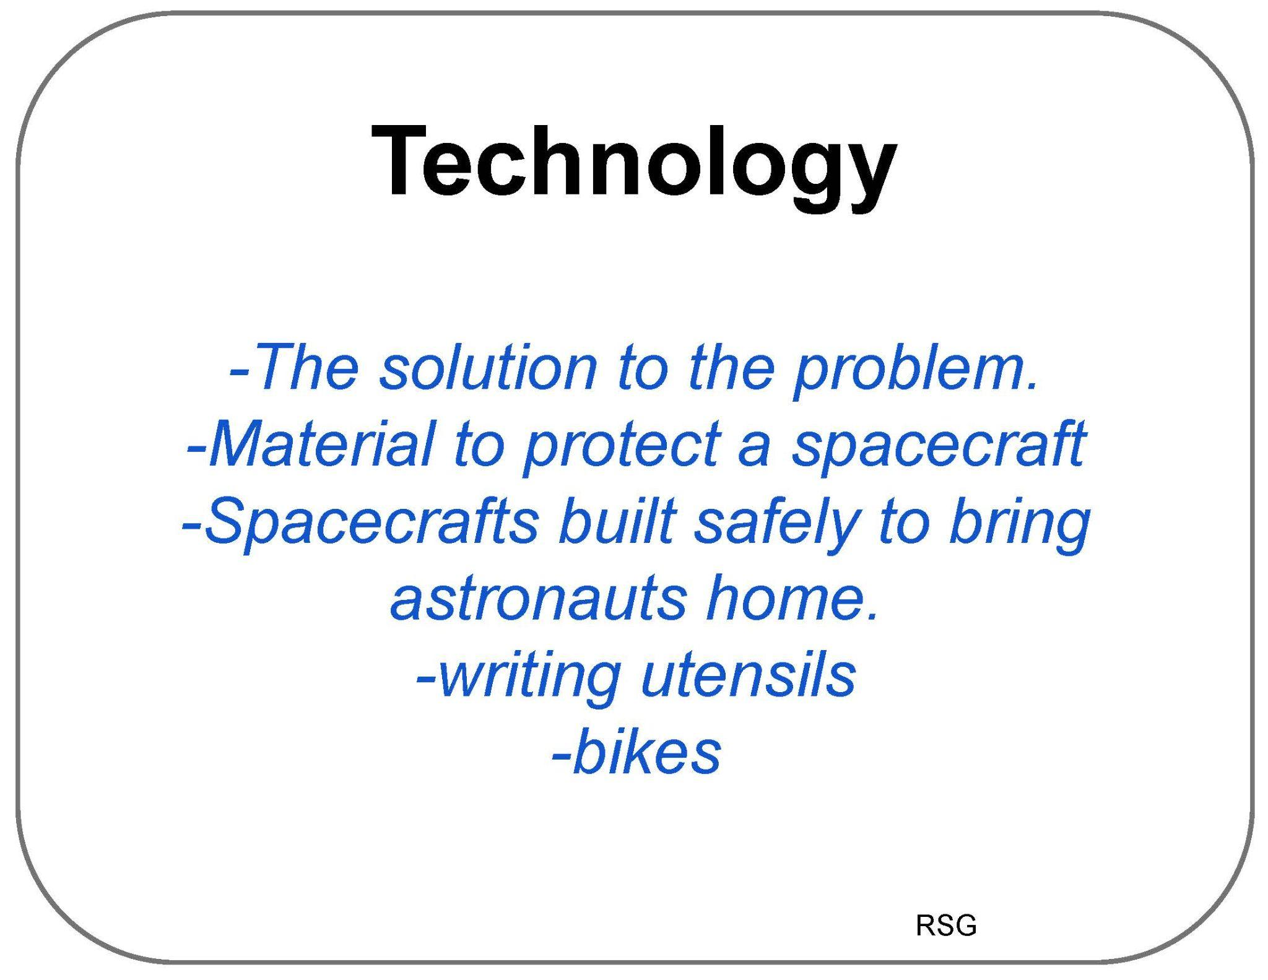
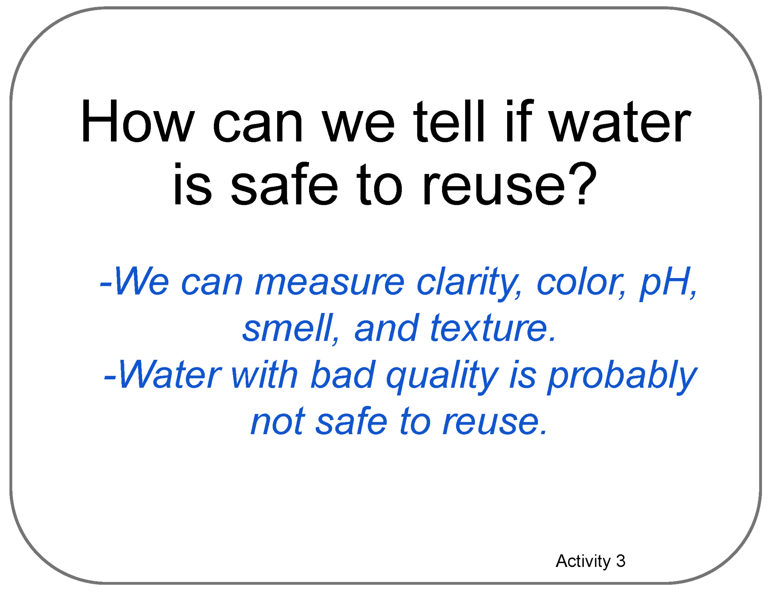
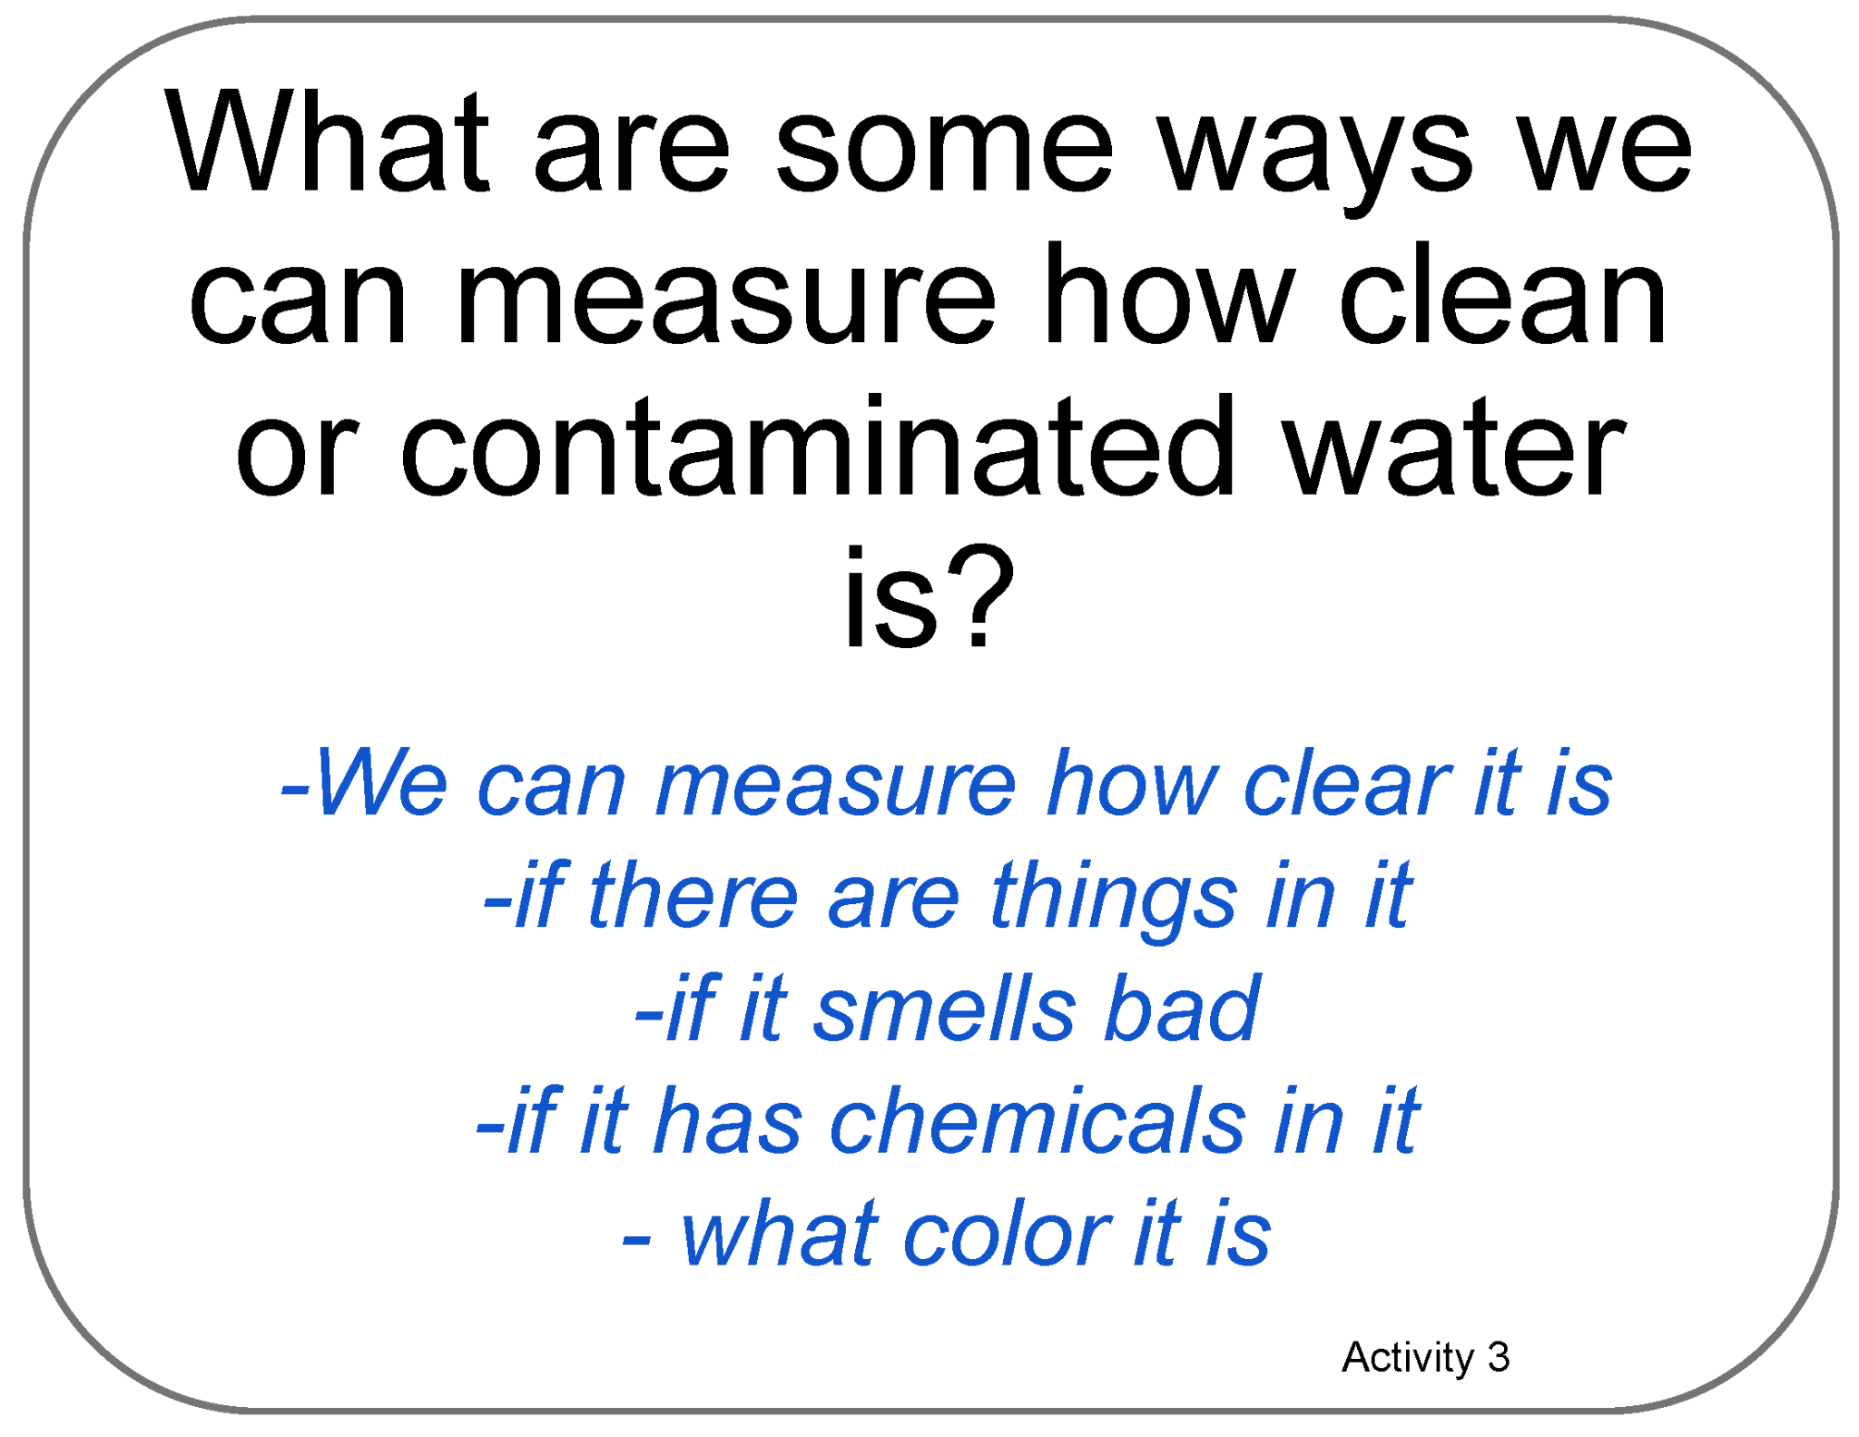
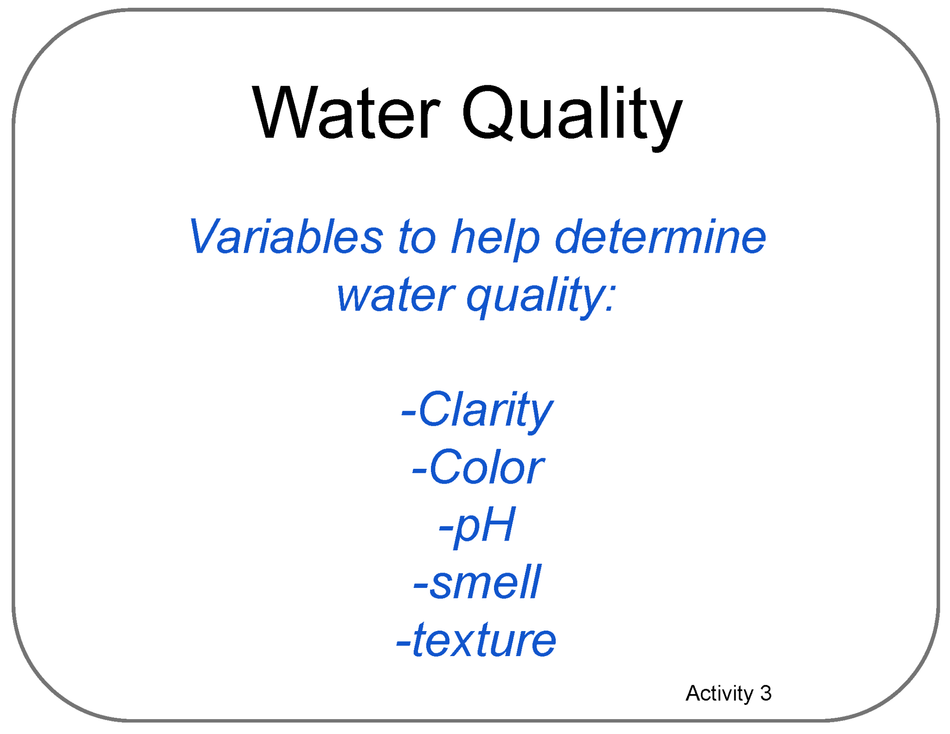

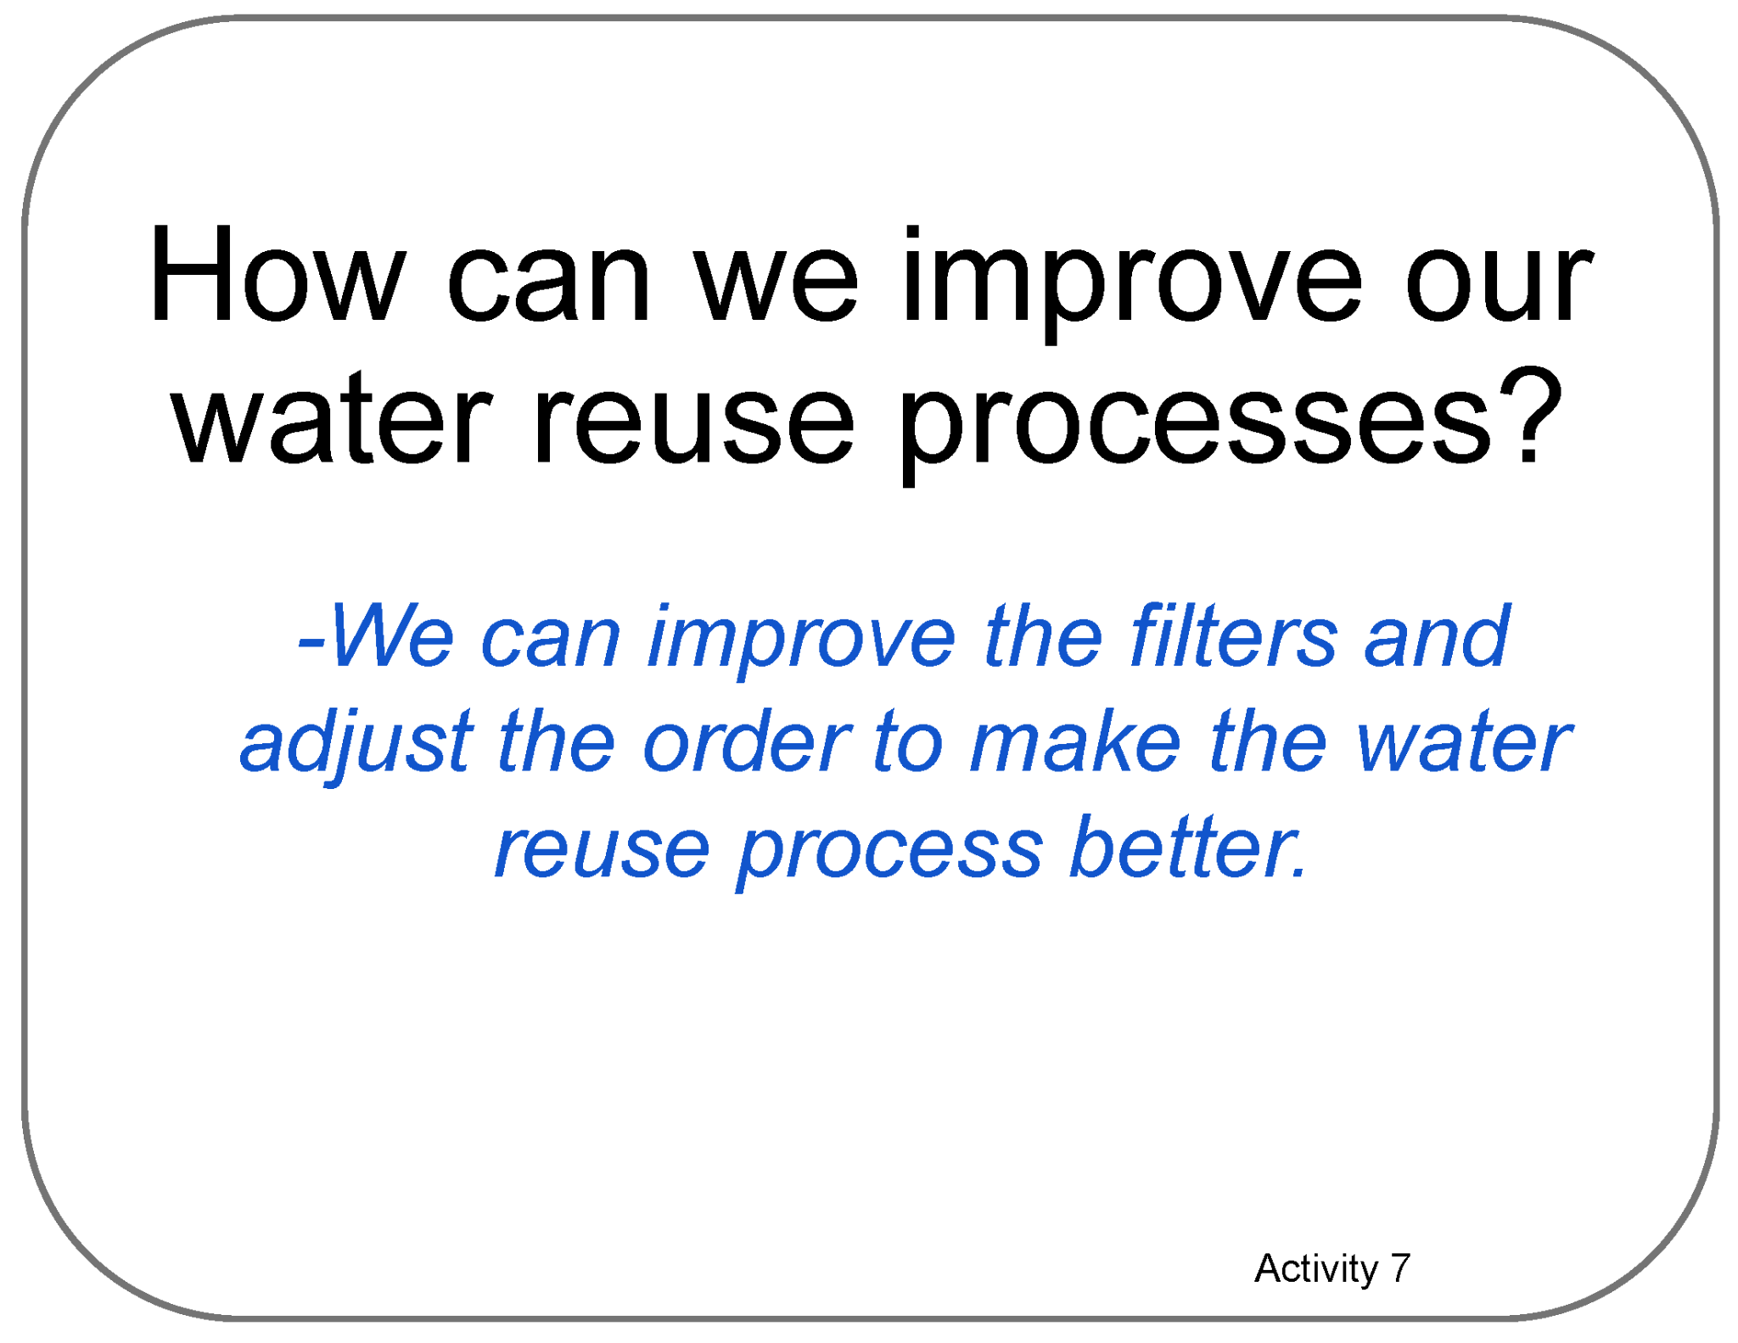
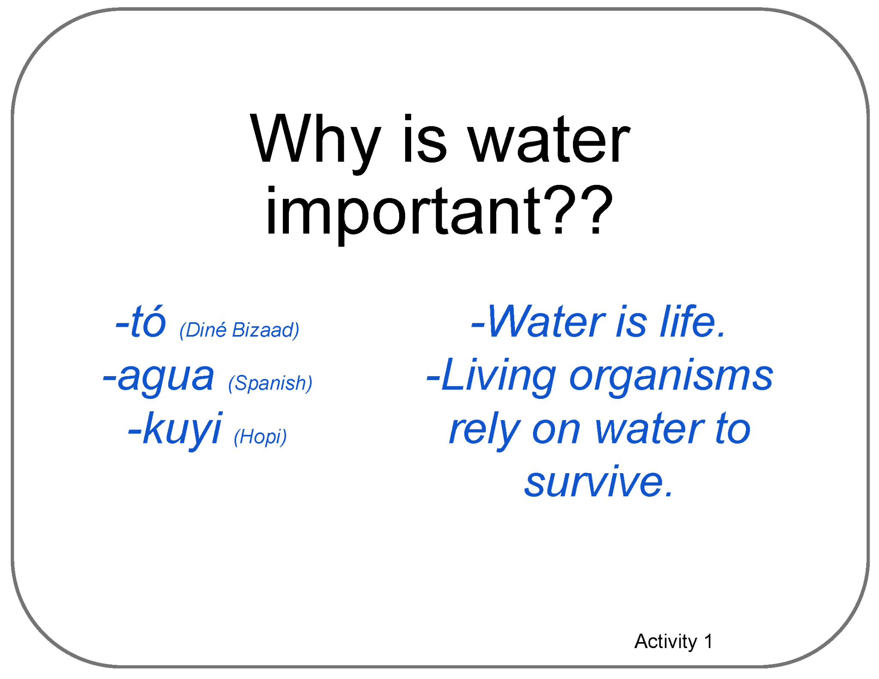

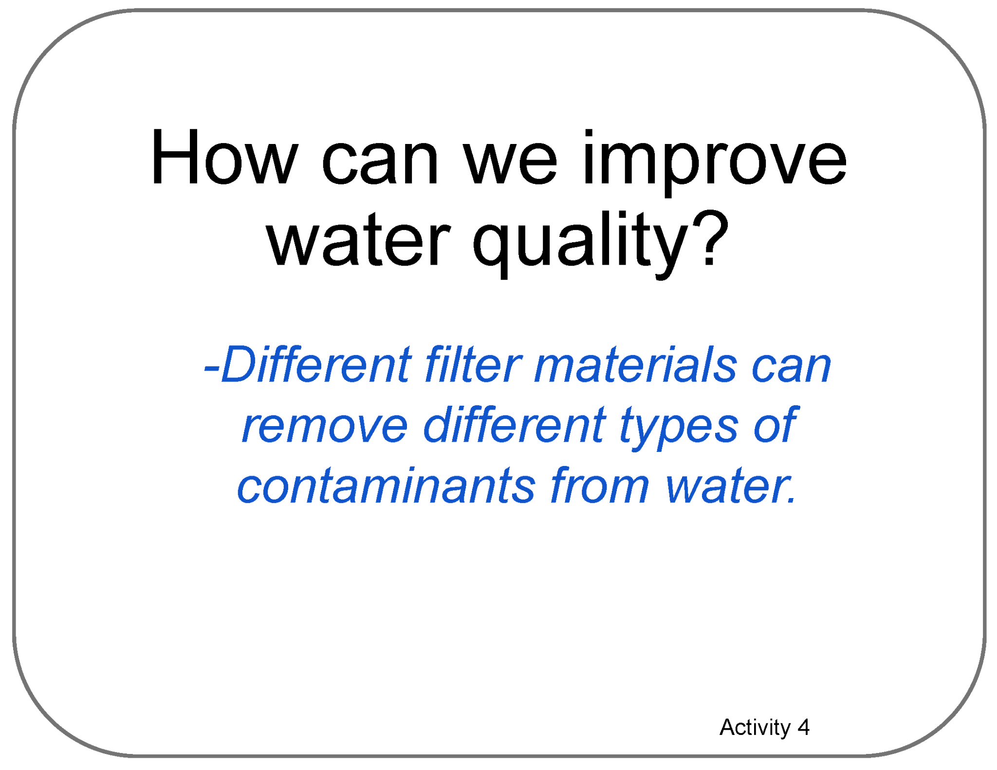
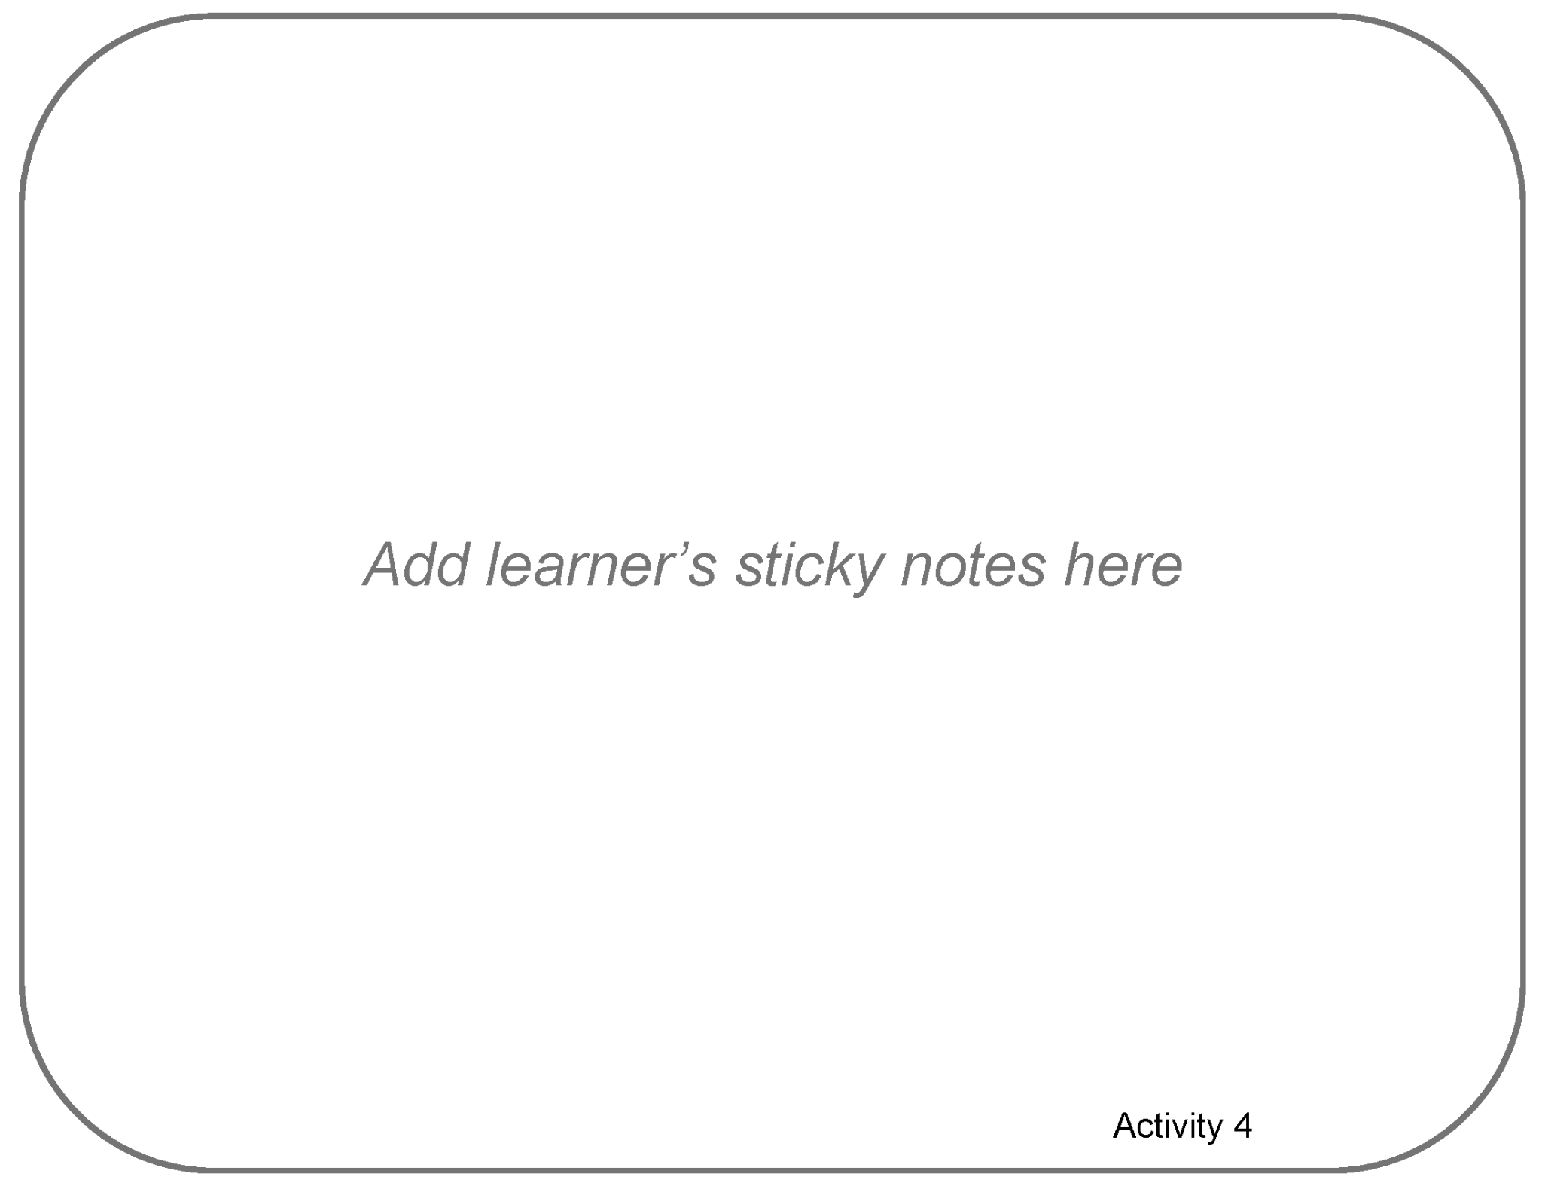
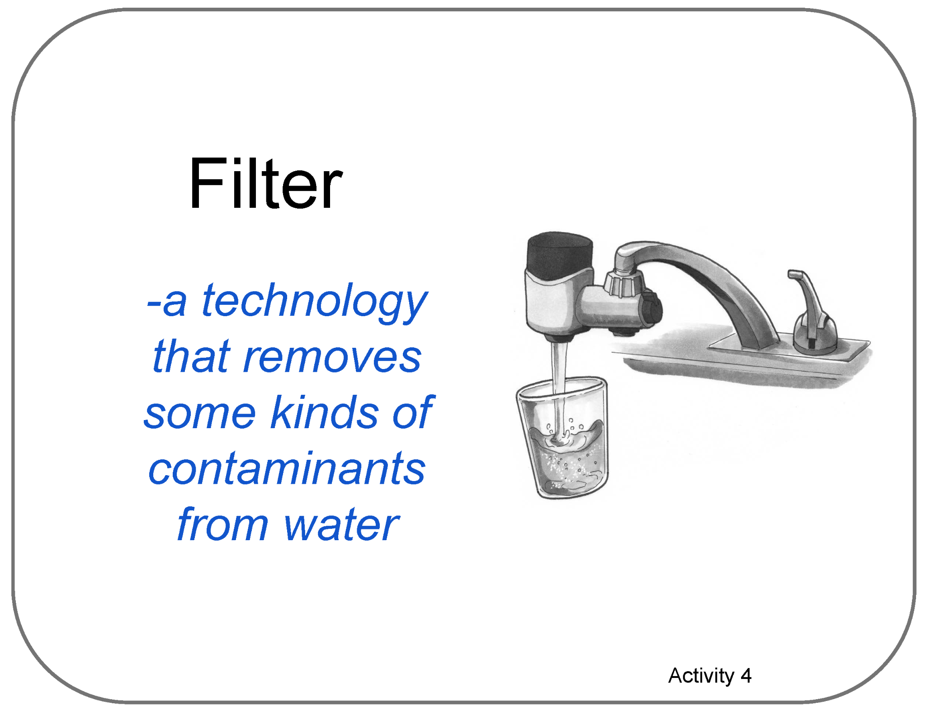
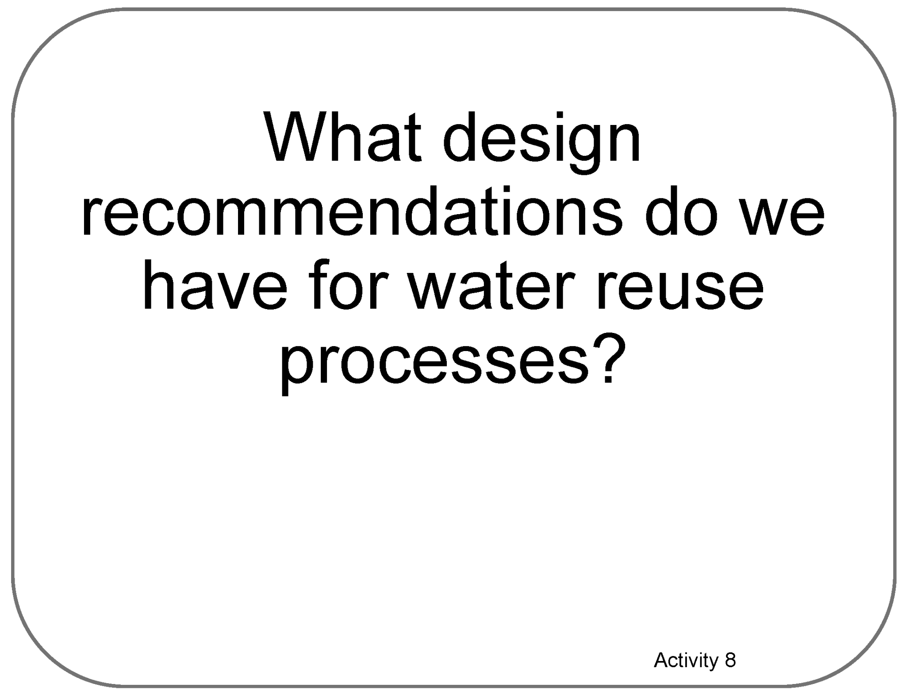
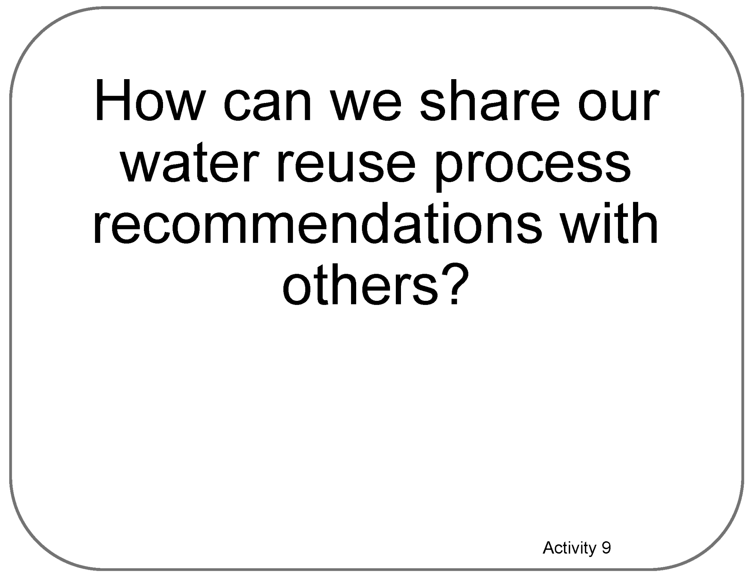
Poster Setup (with Example)
Our Ideas about
Water in Extreme Environments
Engineering

Slide 13


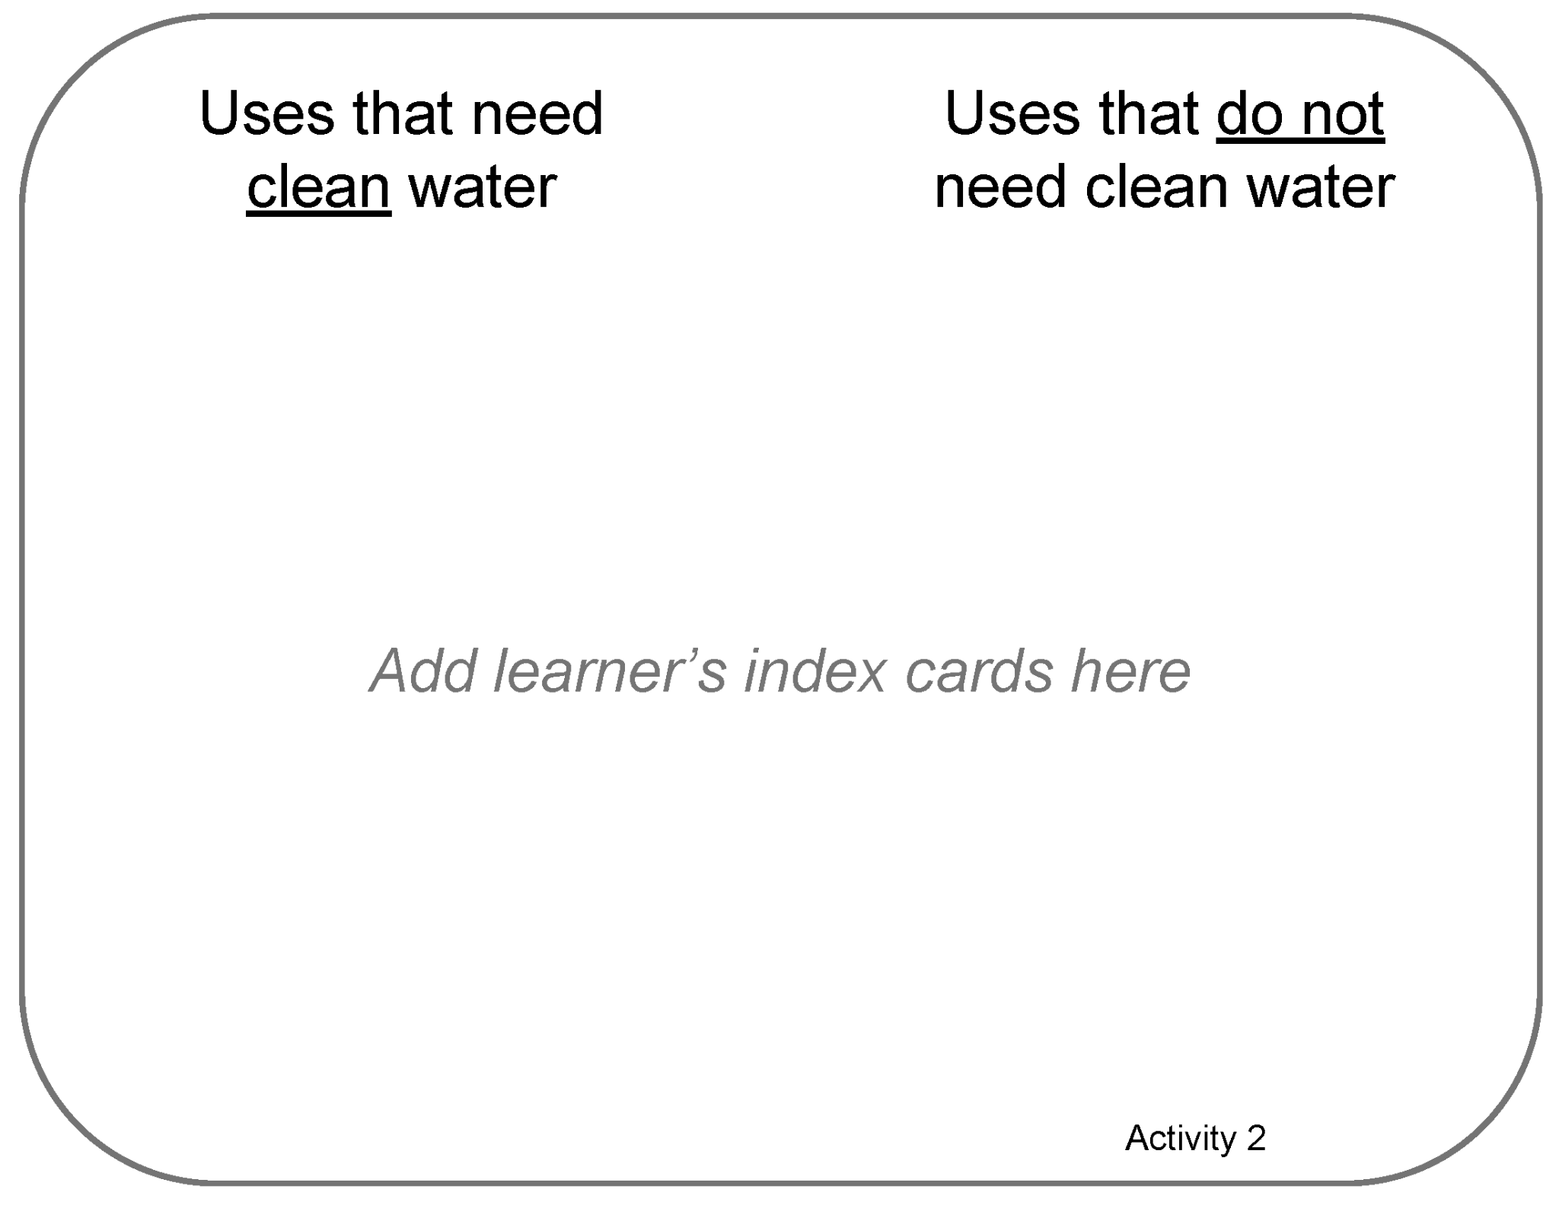

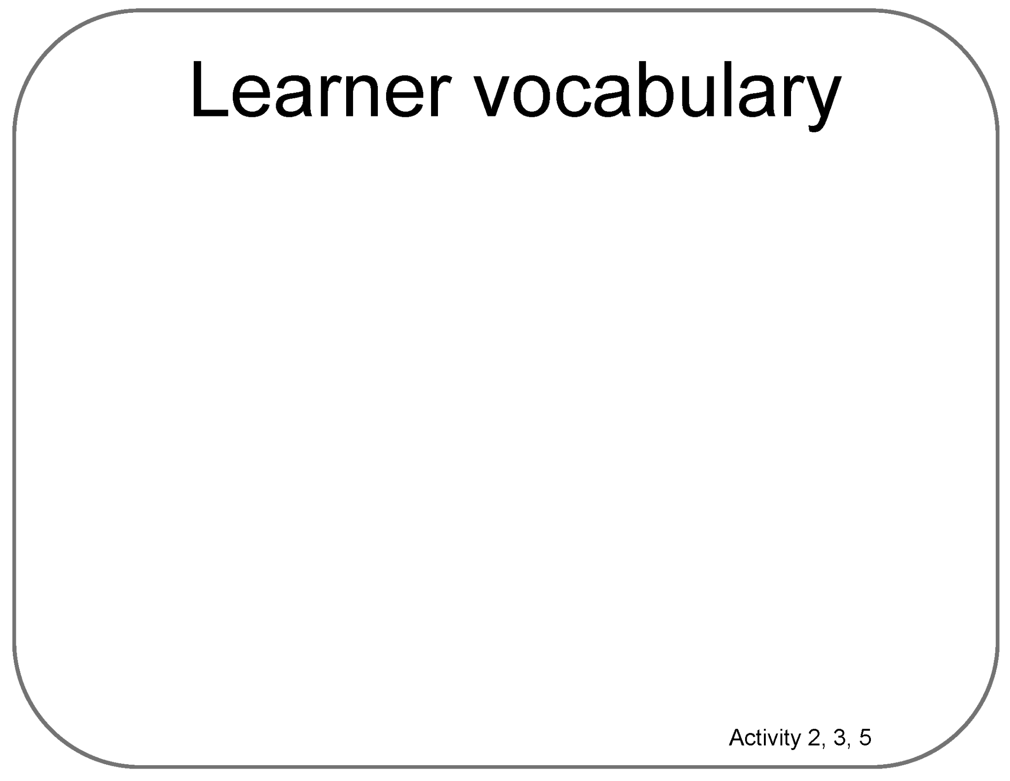
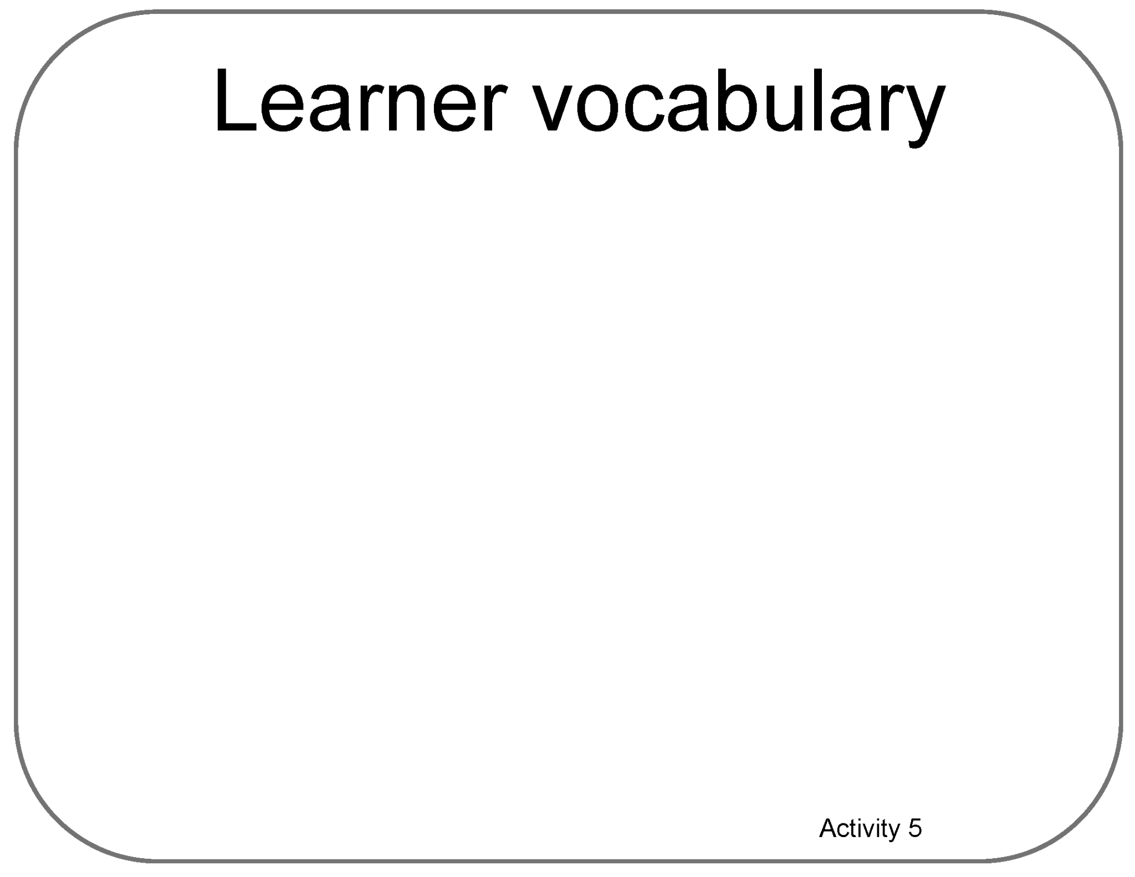
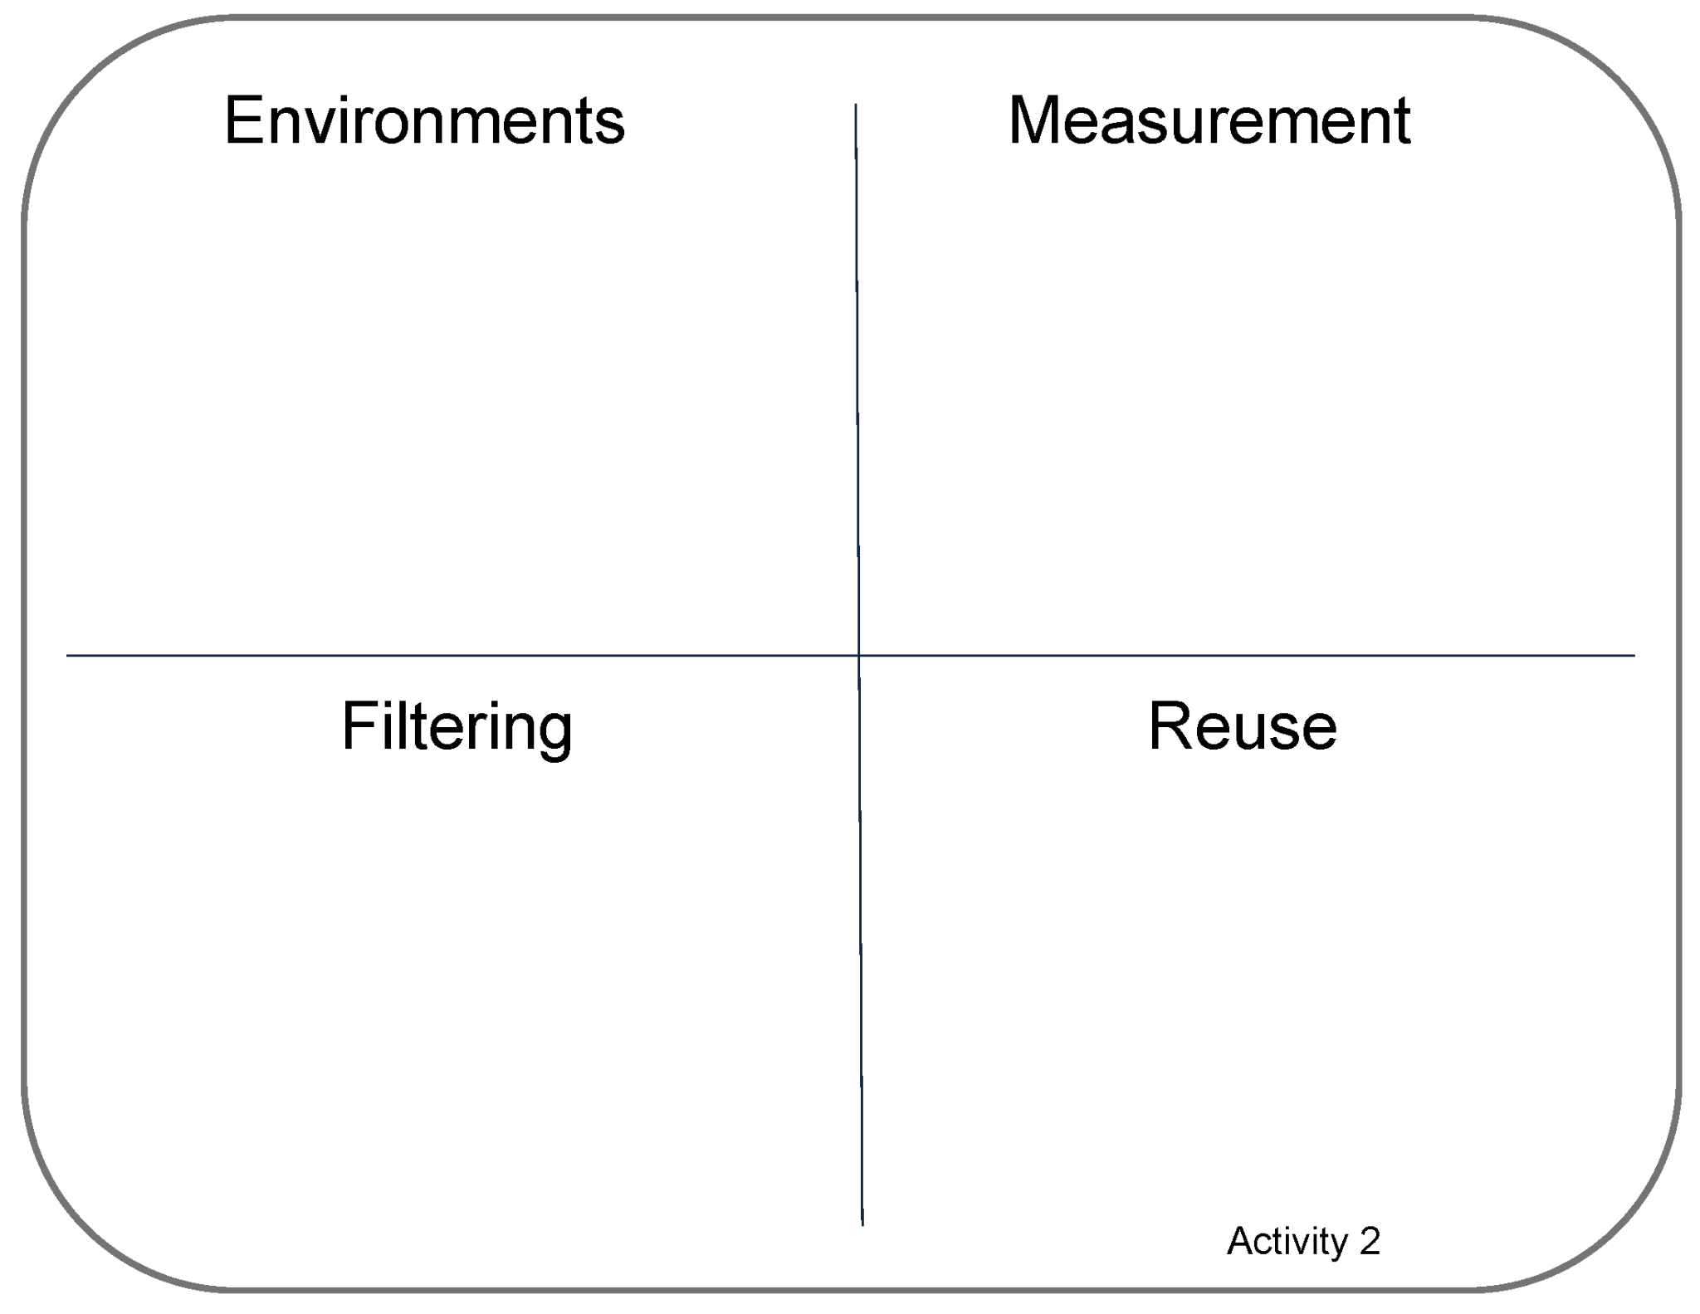
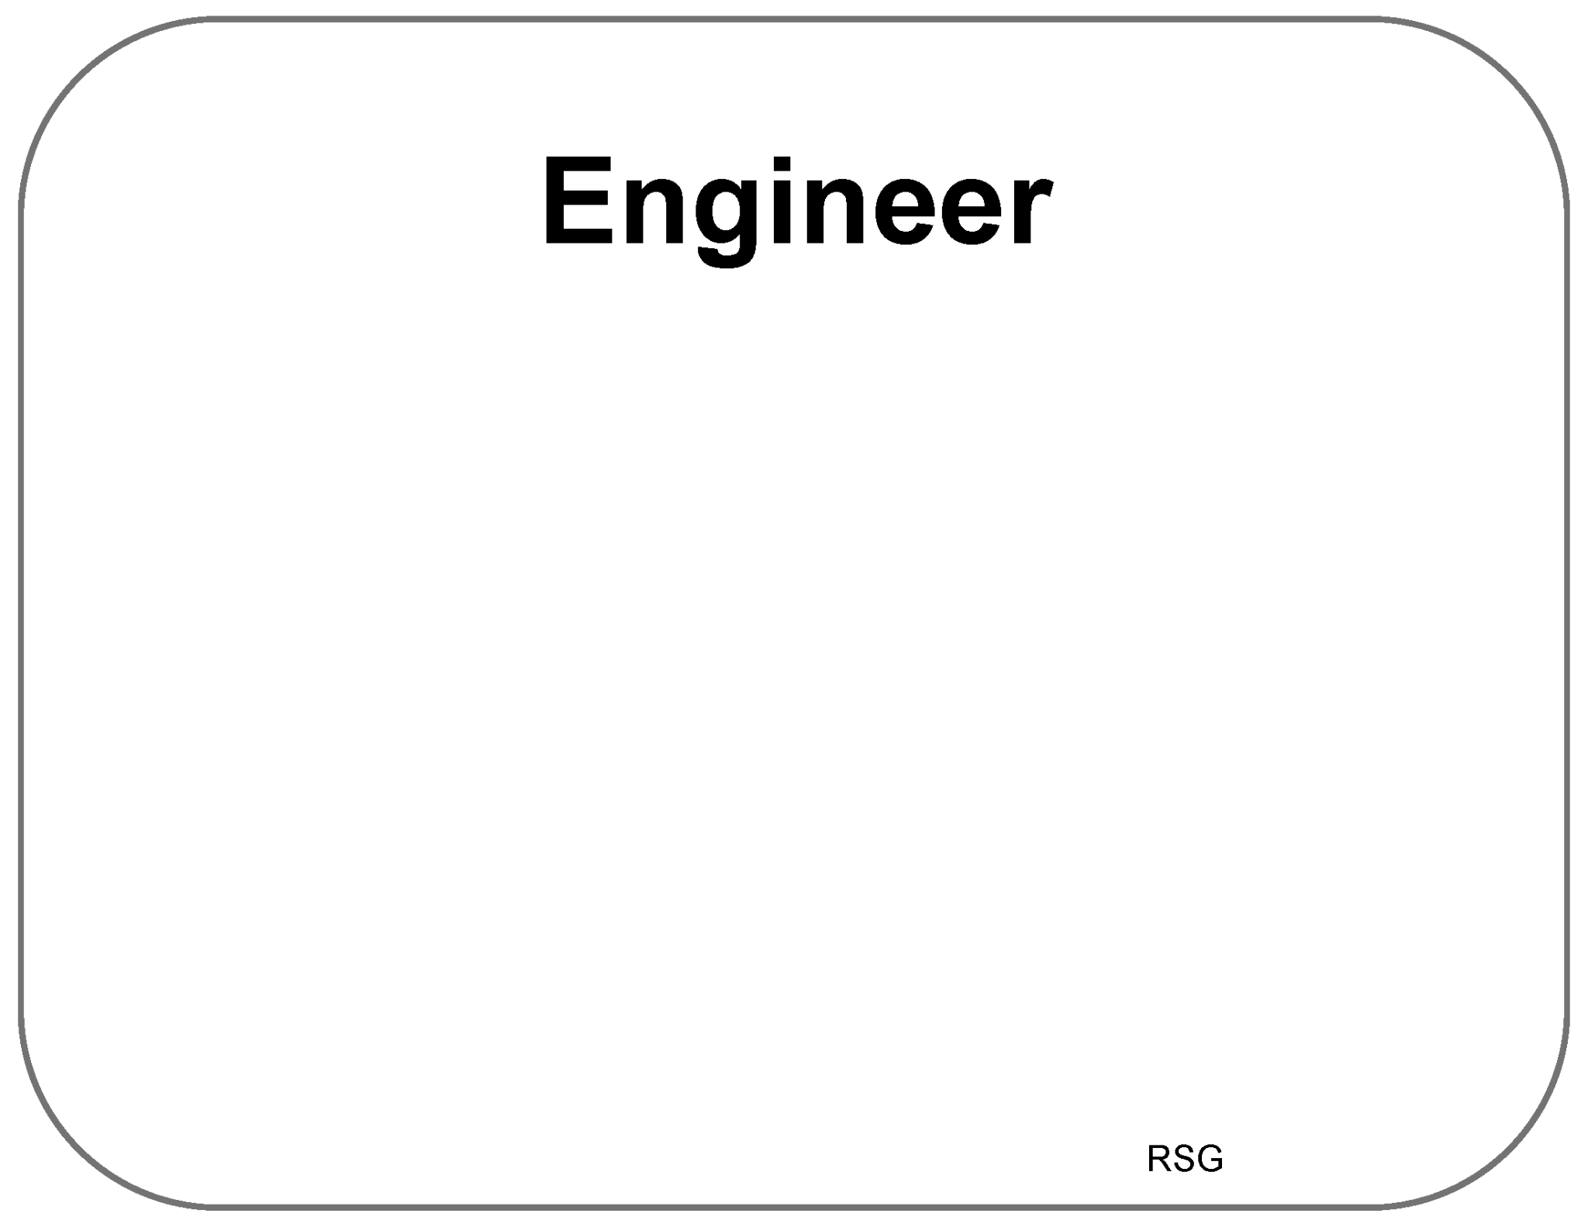

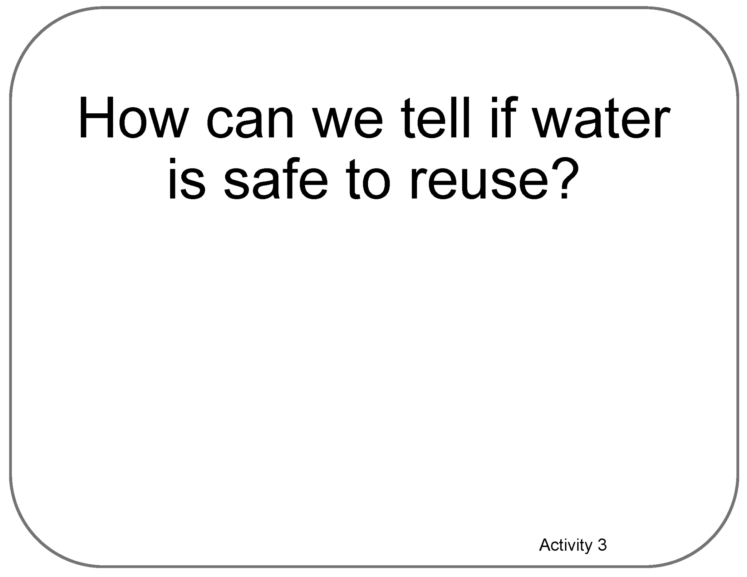
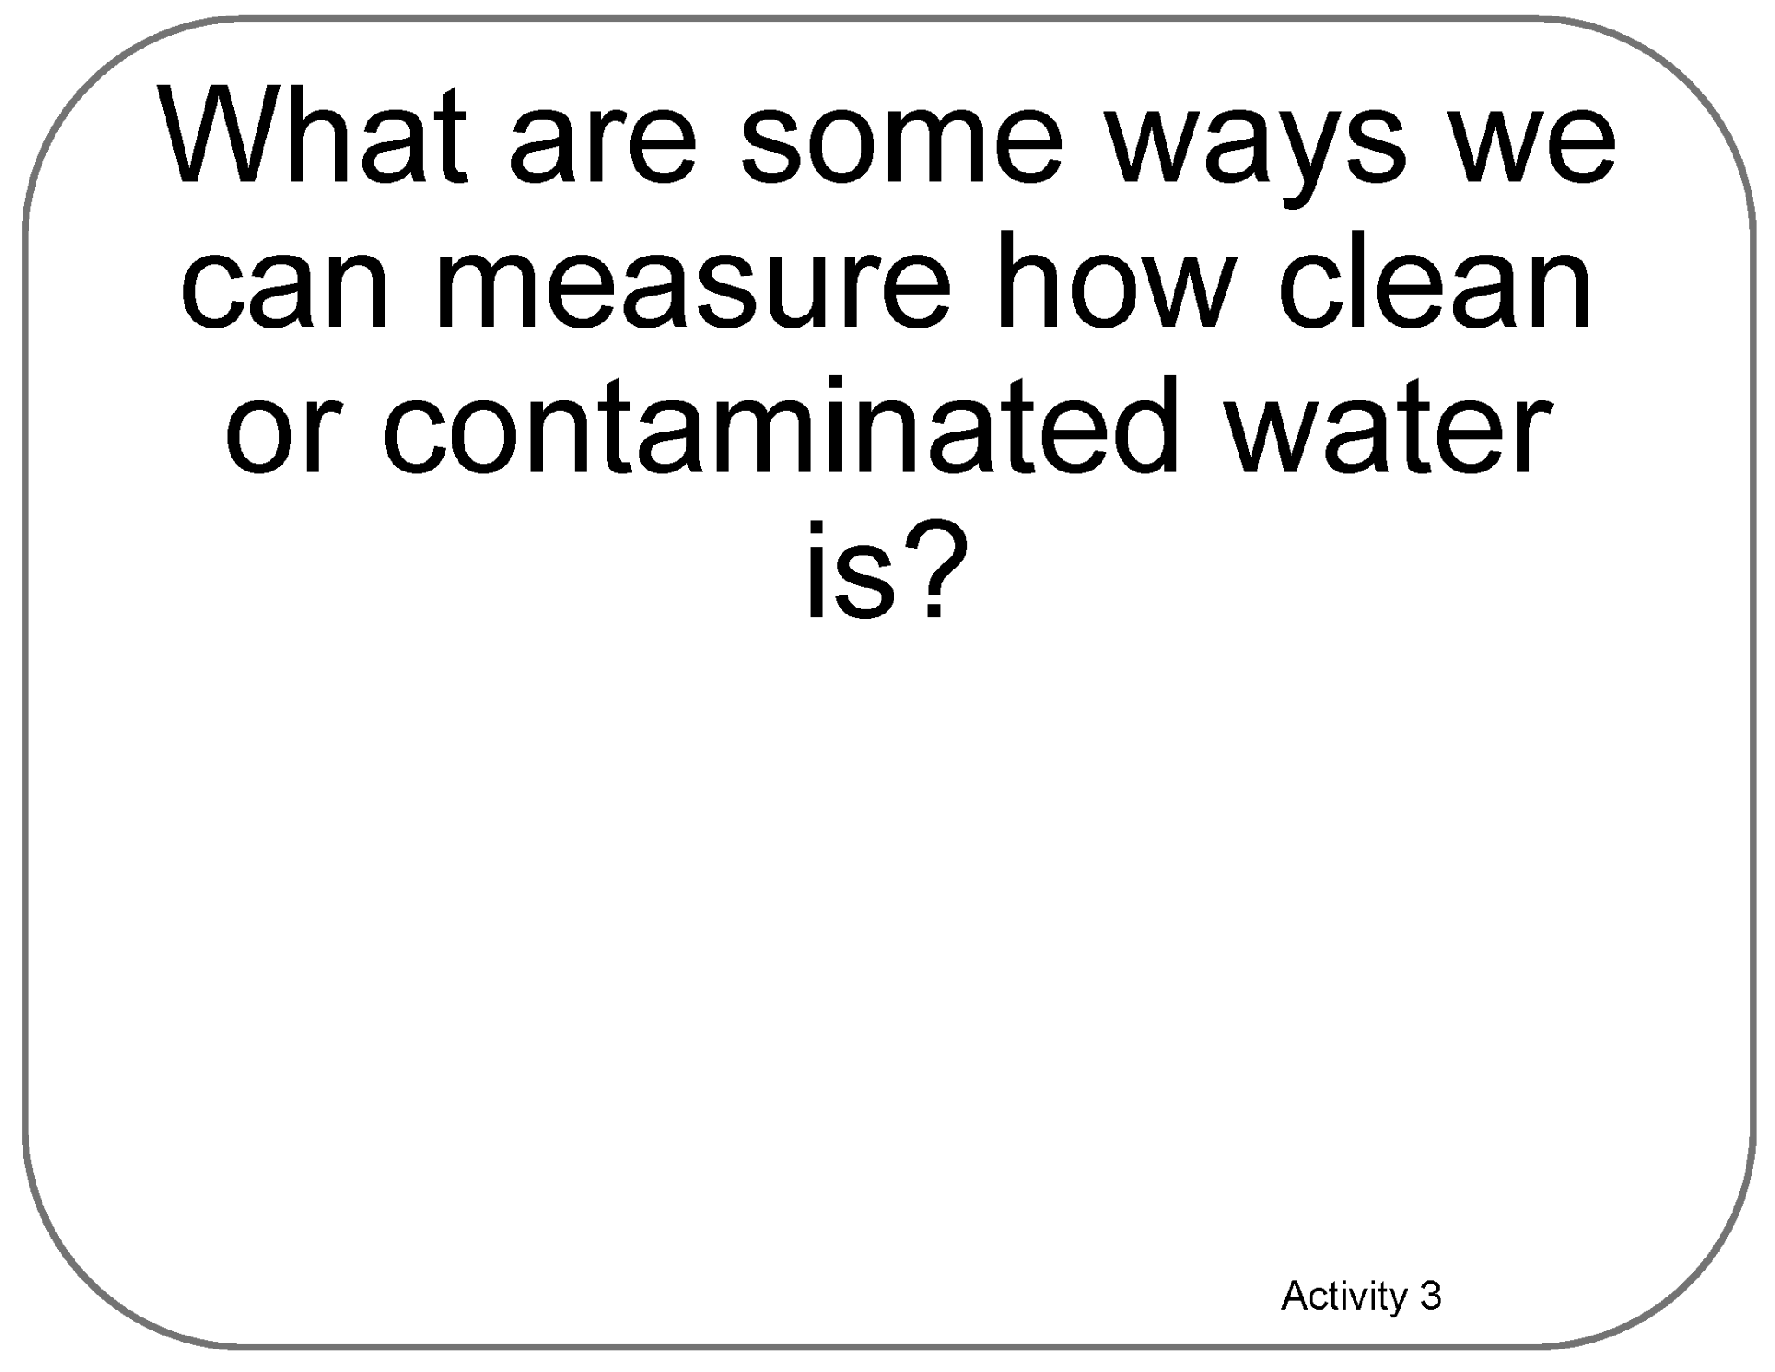
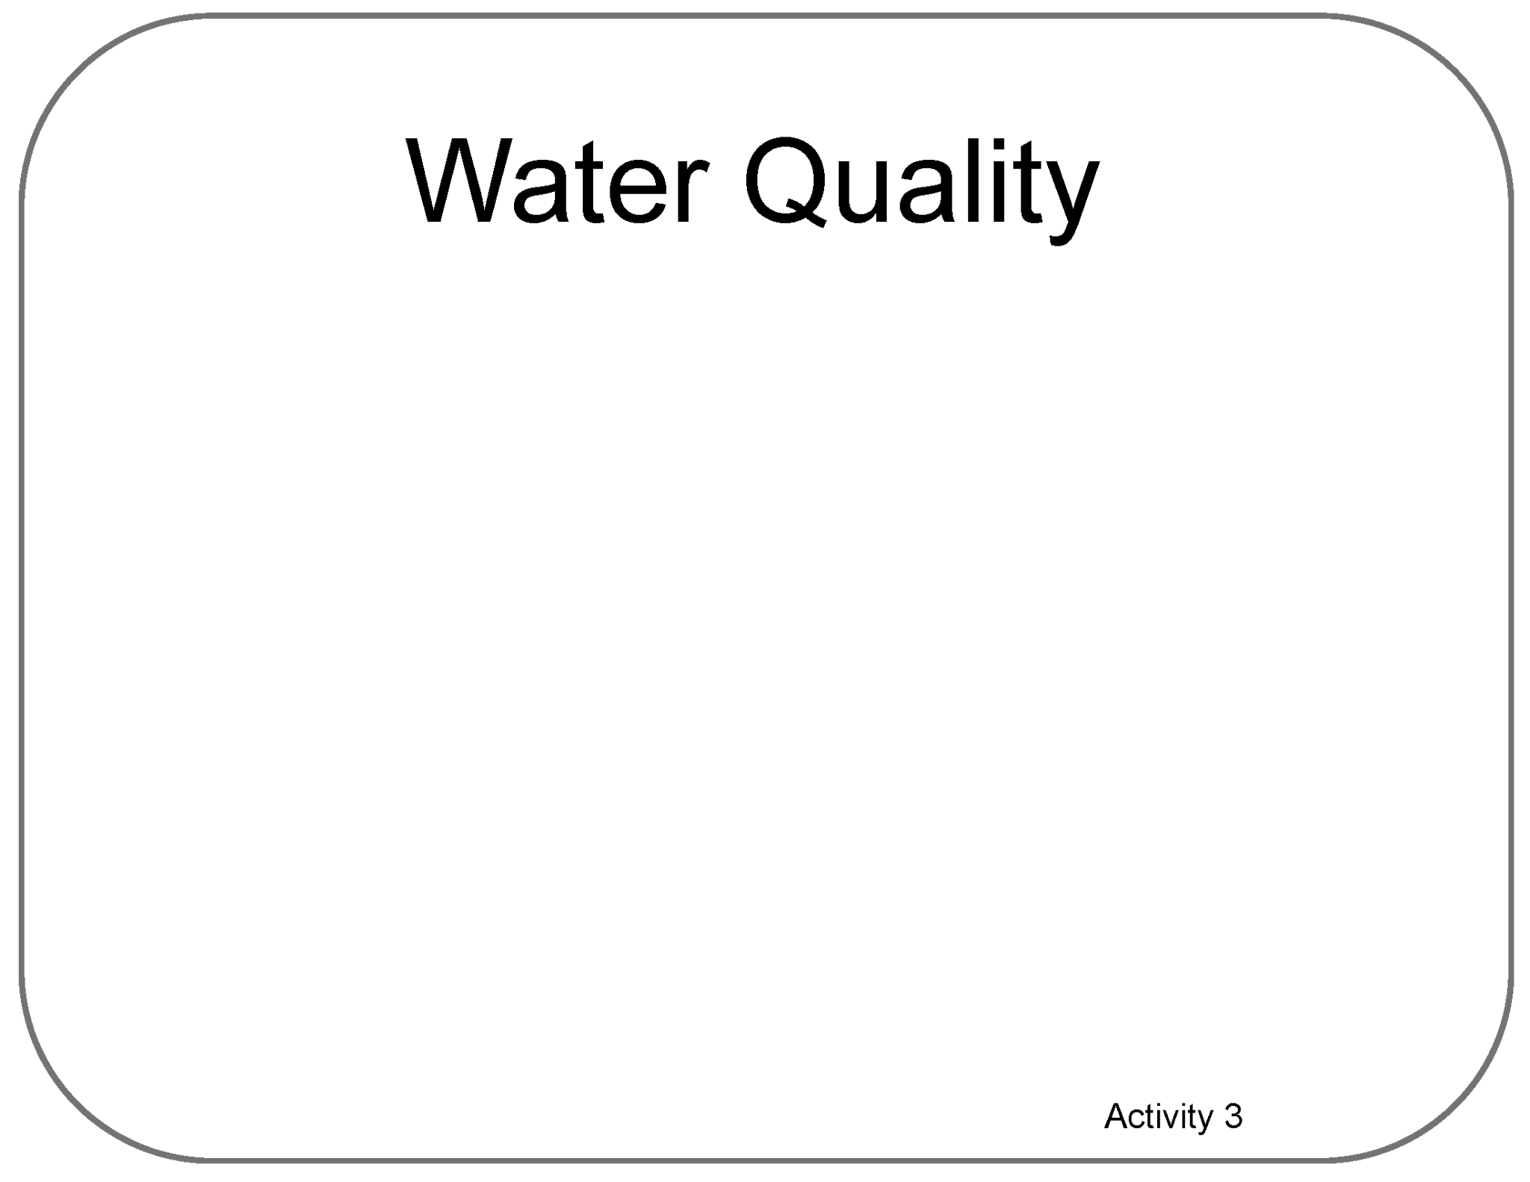
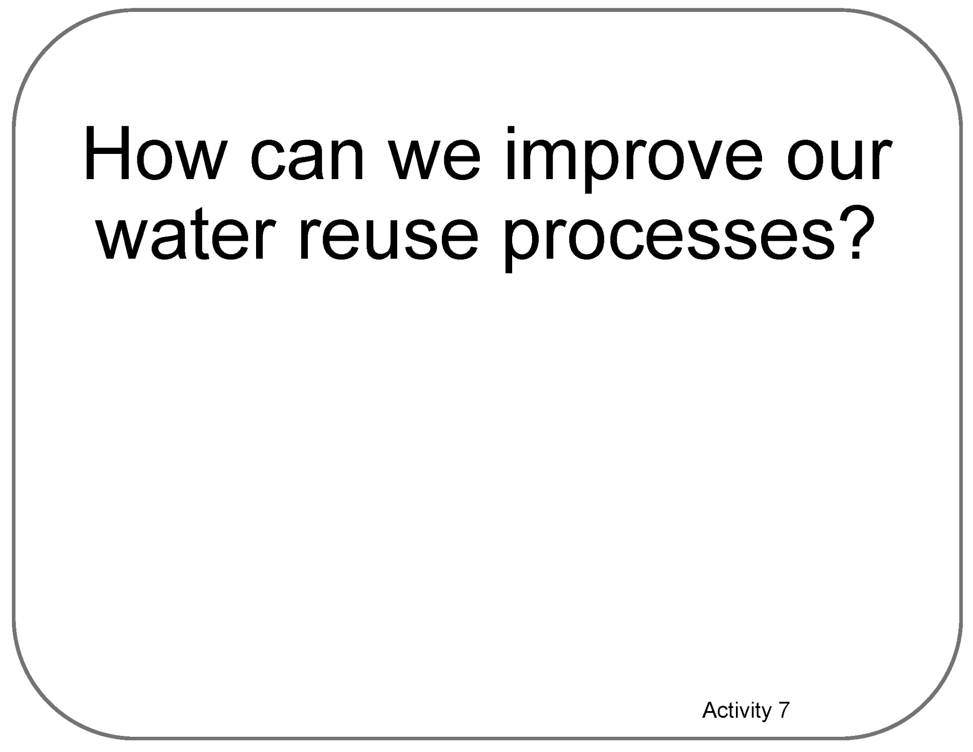
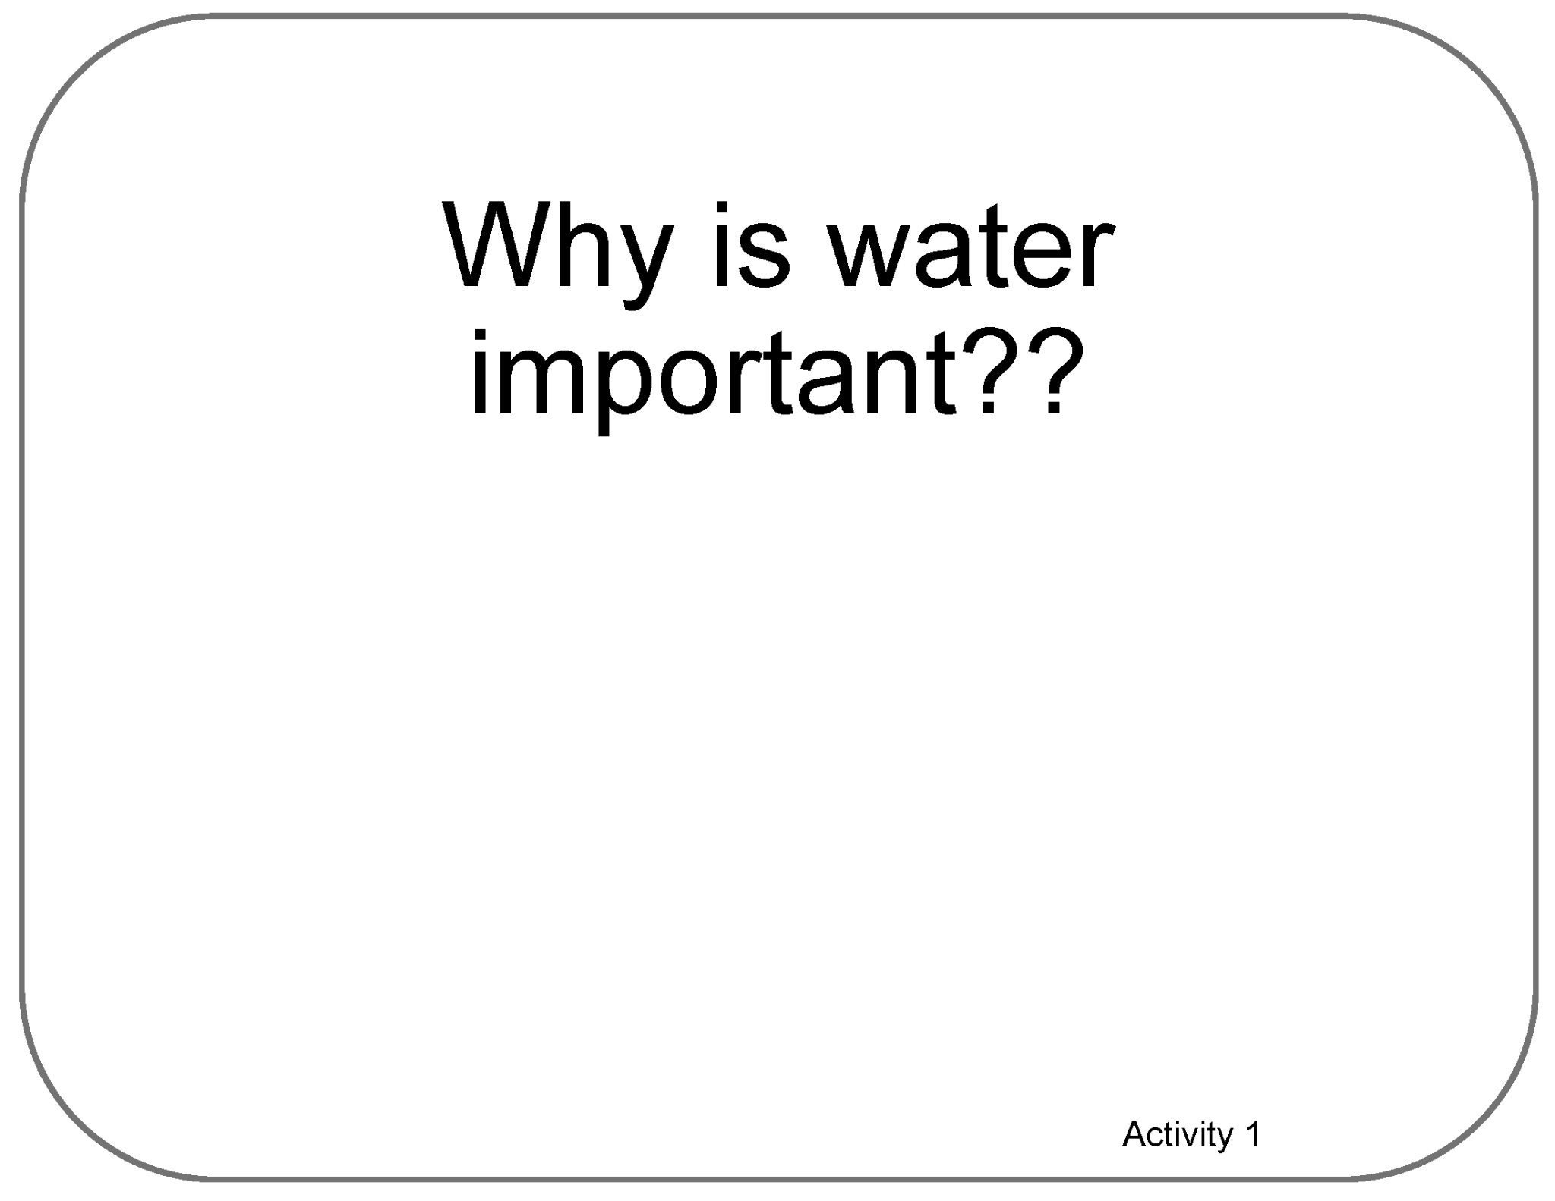

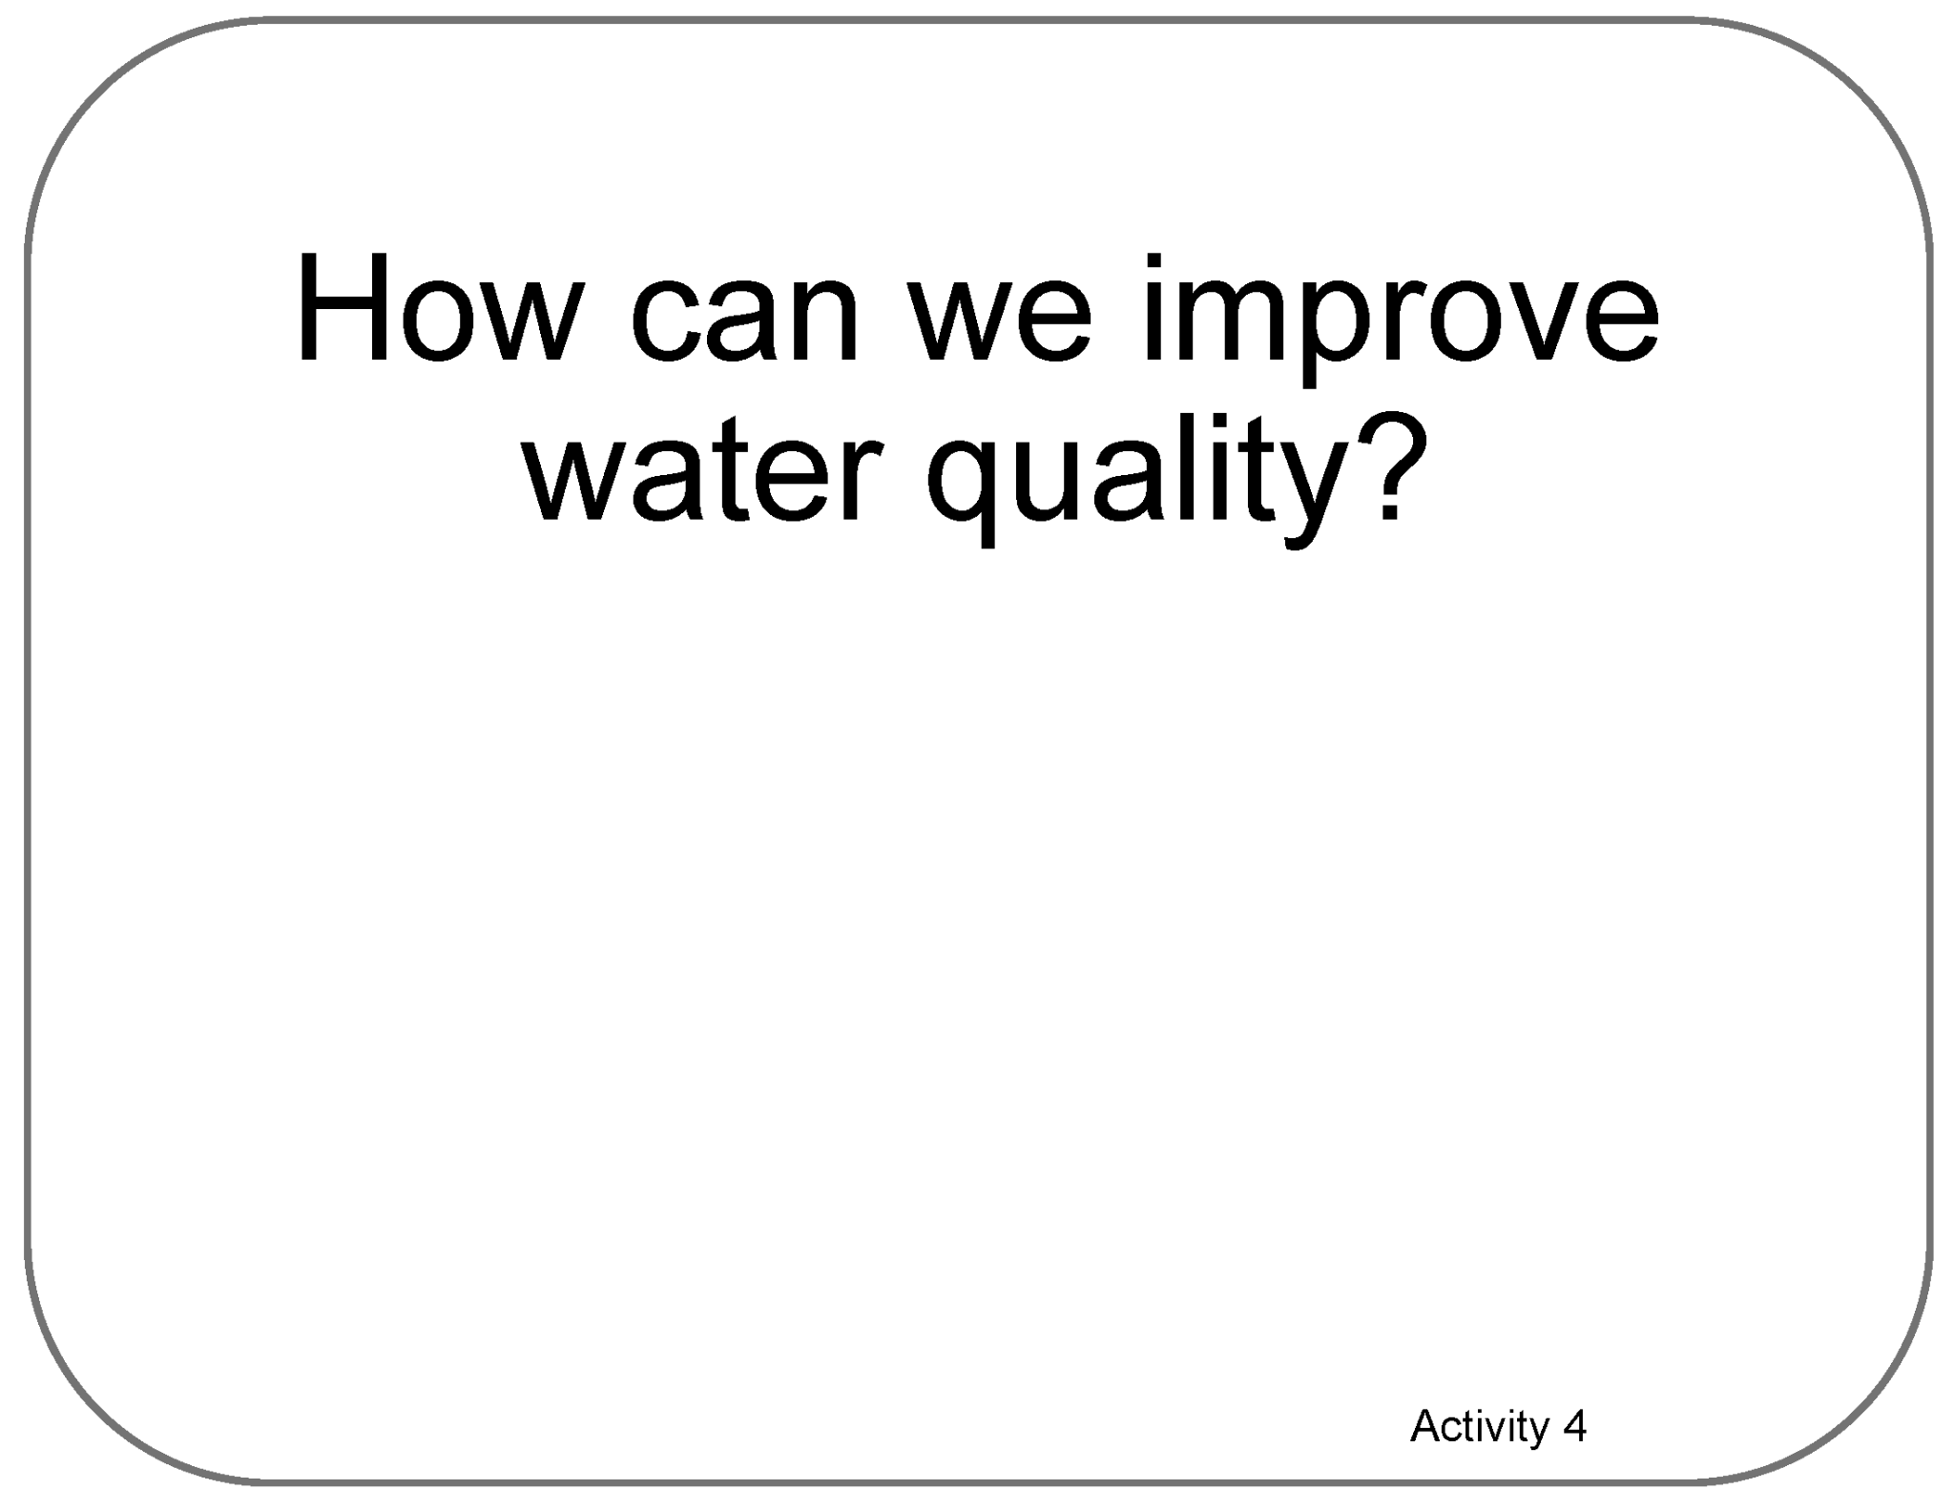
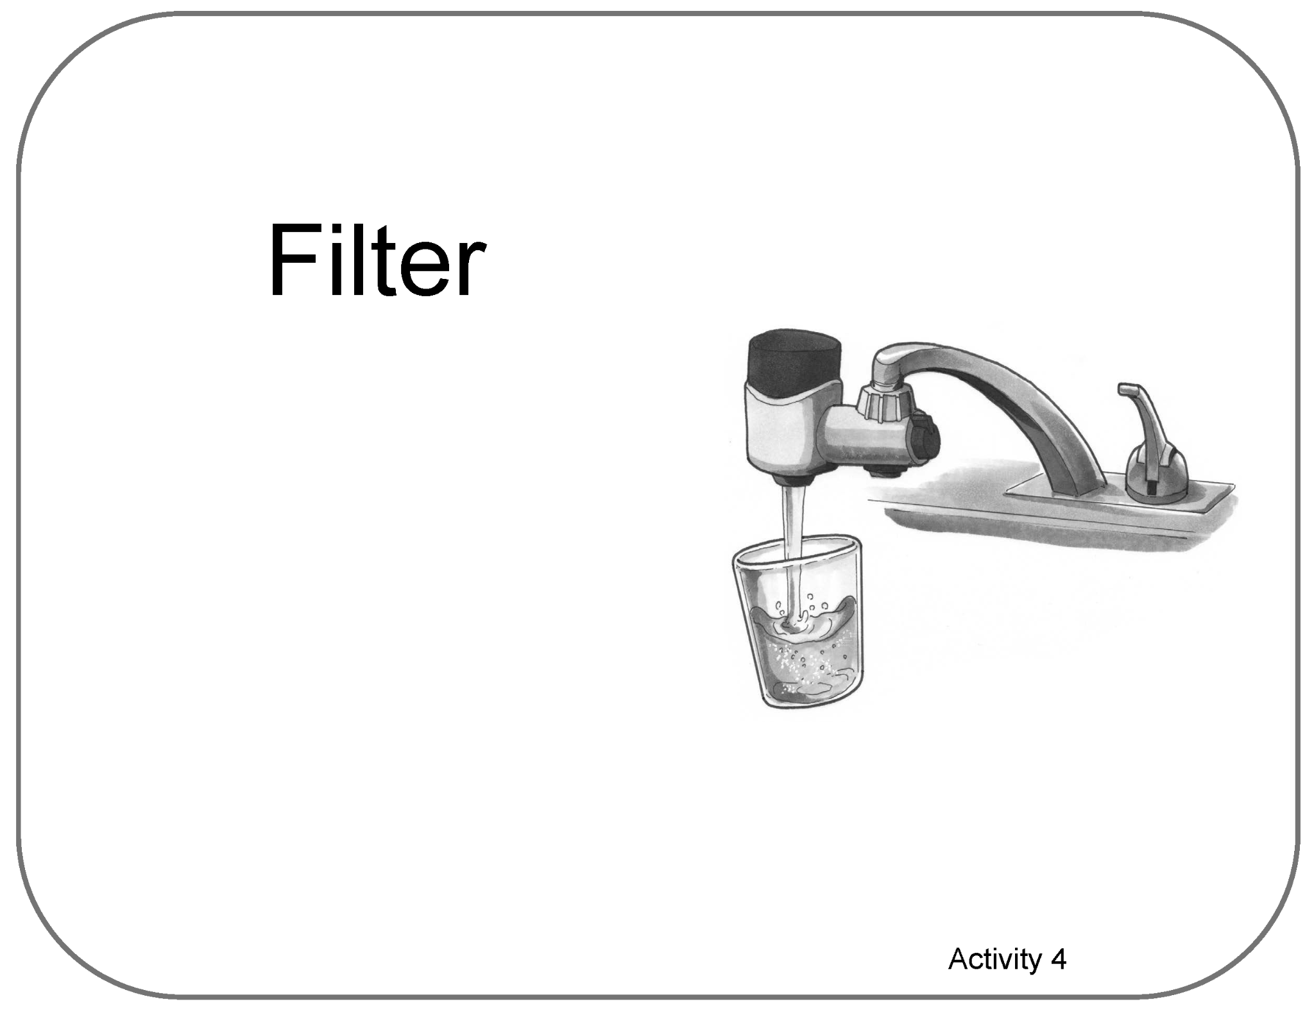
Poster Setup (with Example)
Our Ideas about
Water in Extreme Environments
Engineering

Slide 14
Water in Extreme Environments
Engineering RSG &
Adventures 1-9
Our Ideas Poster

Slide 15
Examples of Cards for Poster
The following slides are based on the printable PDF version of the blank cards you can use to set up your “Our Ideas Posters”
They have been altered to be more accessible to screen readers.

Slide 16
Ready S.E.T. Go! (RSG) - Activity 1

Slide 17
Card: How can we identify…?

Slide 18
RSG Activity Learner Answers

Slide 19
Card: Scientist

Slide 20
Card: Engineer

Slide 21
Card: Technology

Slide 22
Card: Why is water important??

Slide 23
Card: Activity 1 Learner Pictorial Answers

Slide 24
Activities 2-4

Slide 25
Card: How can we reuse water…?

Slide 26
Card: Who uses water in our community?

Slide 27
Activity 2 Learner Answers Card

Slide 28
Card: Uses that need clean or not…

Slide 29
Card: 4 square chart

Slide 30
Card: Learner Vocabulary Activity 2, 3, 5

Slide 31
Card: How can we tell if water is safe…?

Slide 32
Card: What are some ways we can…?

Slide 33
Card: Water Quality

Slide 34
Card: How can we improve water quality?

Slide 35
Blank Activity 4 Card

Slide 36
Card: Filter

Slide 37
Activities 5-9

Slide 38
Card: In what orders can water be reused?

Slide 39
Card: Criteria

Slide 40
Card: Constraints

Slide 41
Card: Process

Slide 42
Card: Learner Vocabulary Activity 5

Slide 43
Card: Does our final water reuse process…?

Slide 44
Card: How can we improve our water…?

Slide 45
Card: What design recommendations…?

Slide 46
Card: How can we share our water reuse…?

