Slide 1
Science
Water in Extreme Environments
RSG & Adventures 1-7
Our Ideas Poster
Prep & Setup Guide with Blanks
Screen Reader Version - NOT for Print

Slide 2
Poster Components
The following slides are based on the printable PDF version of the blank slides/cards you can use to set up your “Our Ideas Posters” and are not intended to be printed.
These slides are formatted to be more accessible to screen readers.
We recommend using these slides as a guide for blind and low vision educators and printing out the PDFs for sighted learners.

Slide 3
Corresponding PDFs include
Poster Pages to build the poster
  (pages numbered in lower right corner with corresponding adventure(s))
Poster Pages with examples are for educator reference only and not intended to print.
Blank Pages for more space or to build your own poster
Blank ¼ page cards for learners to add additional terms, drawings, ideas
Term cards:
Icon-only
Term + icon

Slide 4
Set Up
You need a wall or whiteboard area of about 80” Length x 60” Height.
Please see the following pages for setup examples.
You may choose alternative layouts or formats to fit your learning environment.

Slide 5
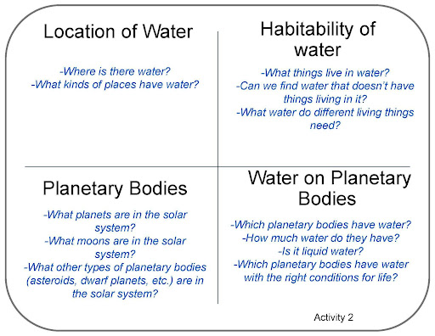
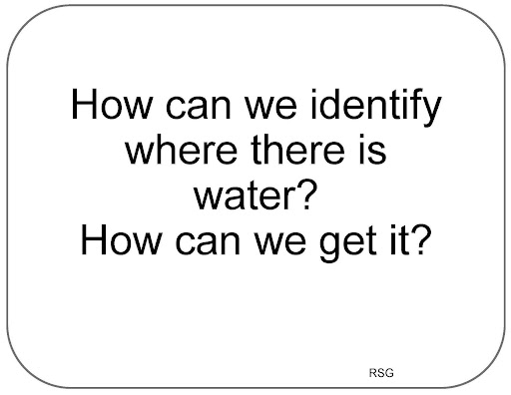
Poster Pages Examples
(Reference - do not print)

Slide 6
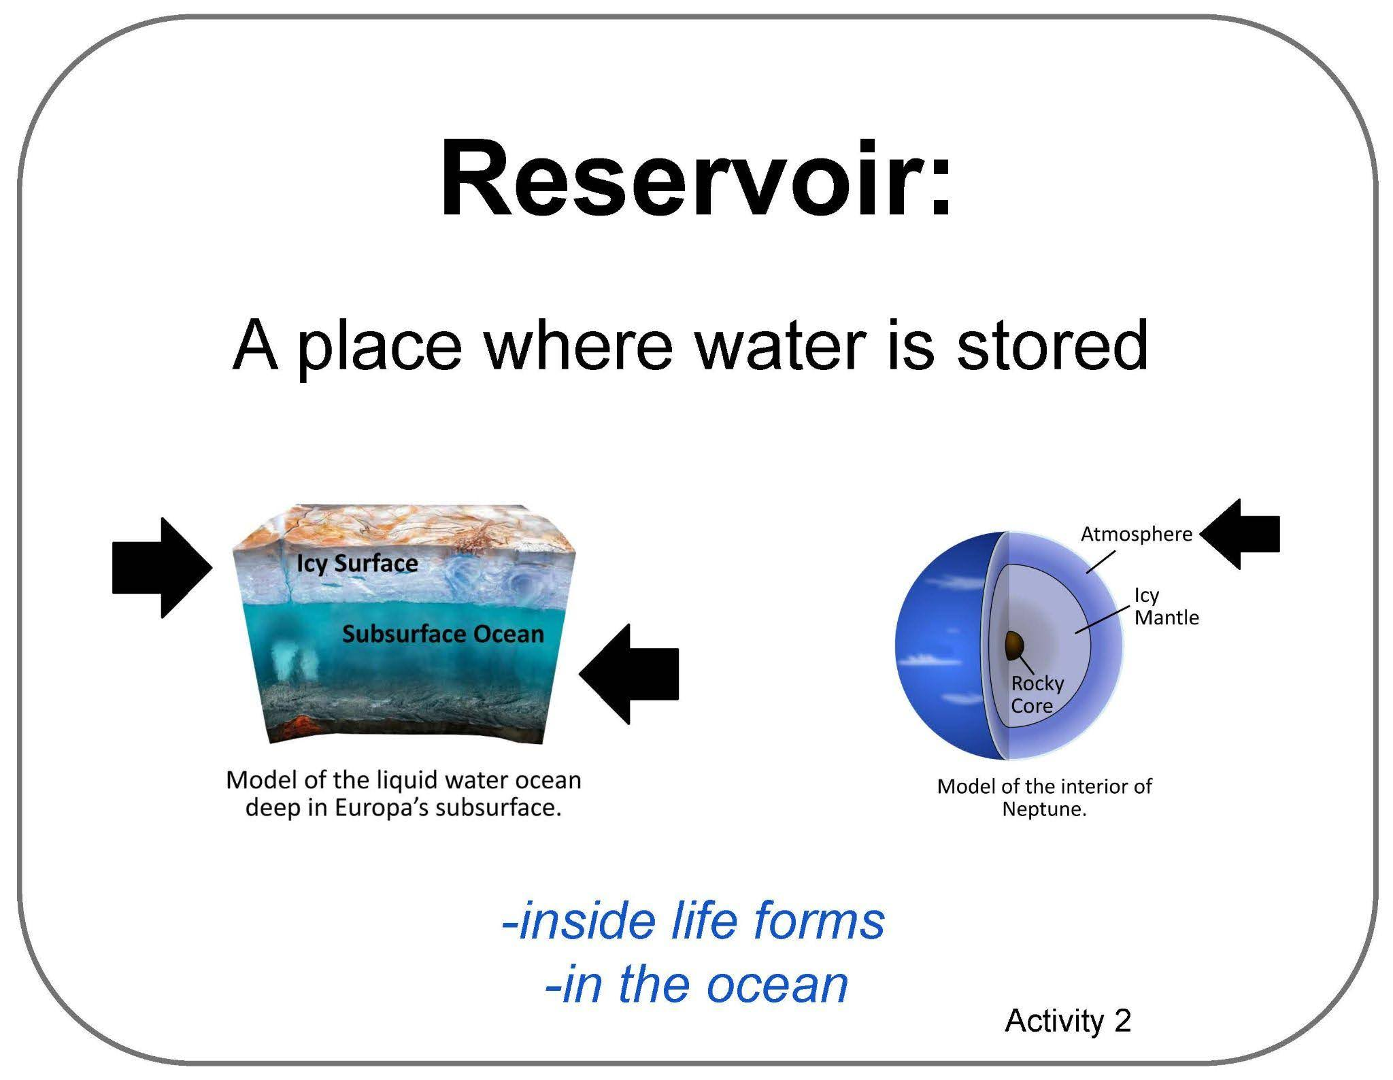
Term Card Example
(Reference - do not print)

Slide 7

Blank ¼ Page Card Screenshot
Intended for learner responses

Slide 8
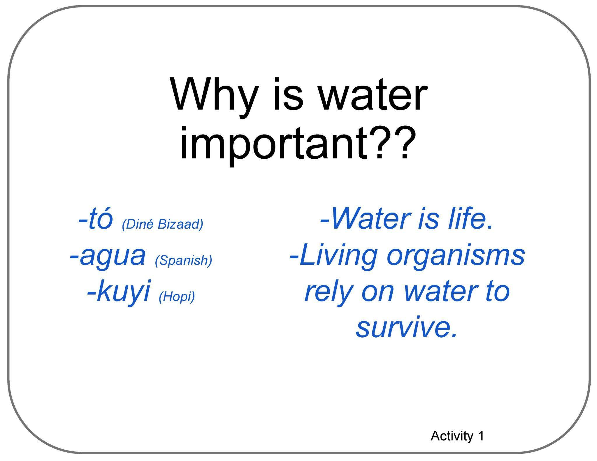
Poster Pages with Examples from Learners
(Reference - do not print)

Slide 9
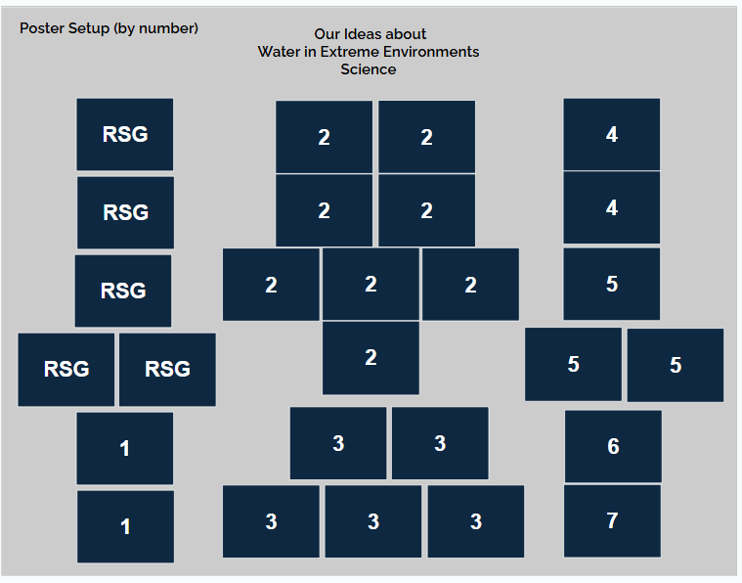
Poster Setup Layout

Slide 10
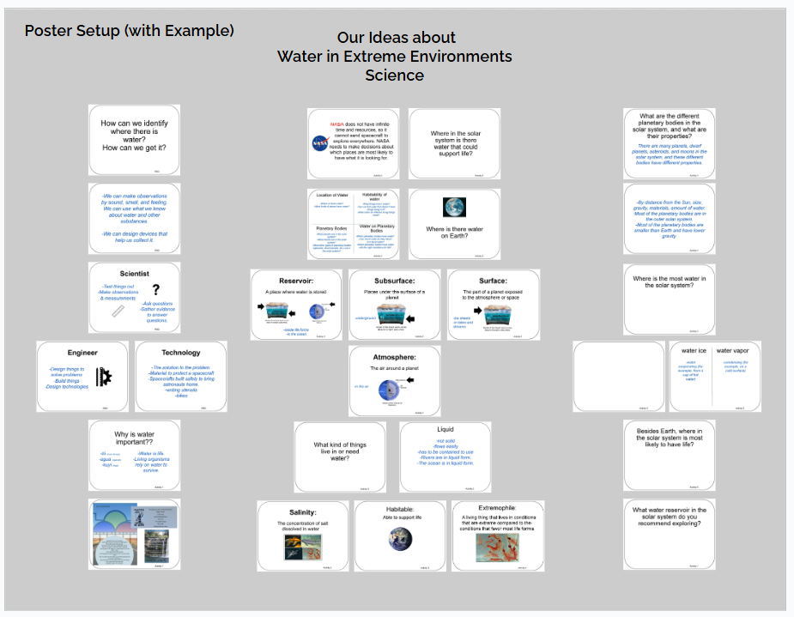
Poster Setup Layout with Learner Examples

Slide 11
Details about Learner Examples
The following two slides are a compromise to allow for alt text readability.
They are formatted for visual access, and not necessarily in a way that is best for screen readers, but do allow for alt text for each of the example cards.
They are optional, and can be skipped if they are not helpful to you.

Slide 12

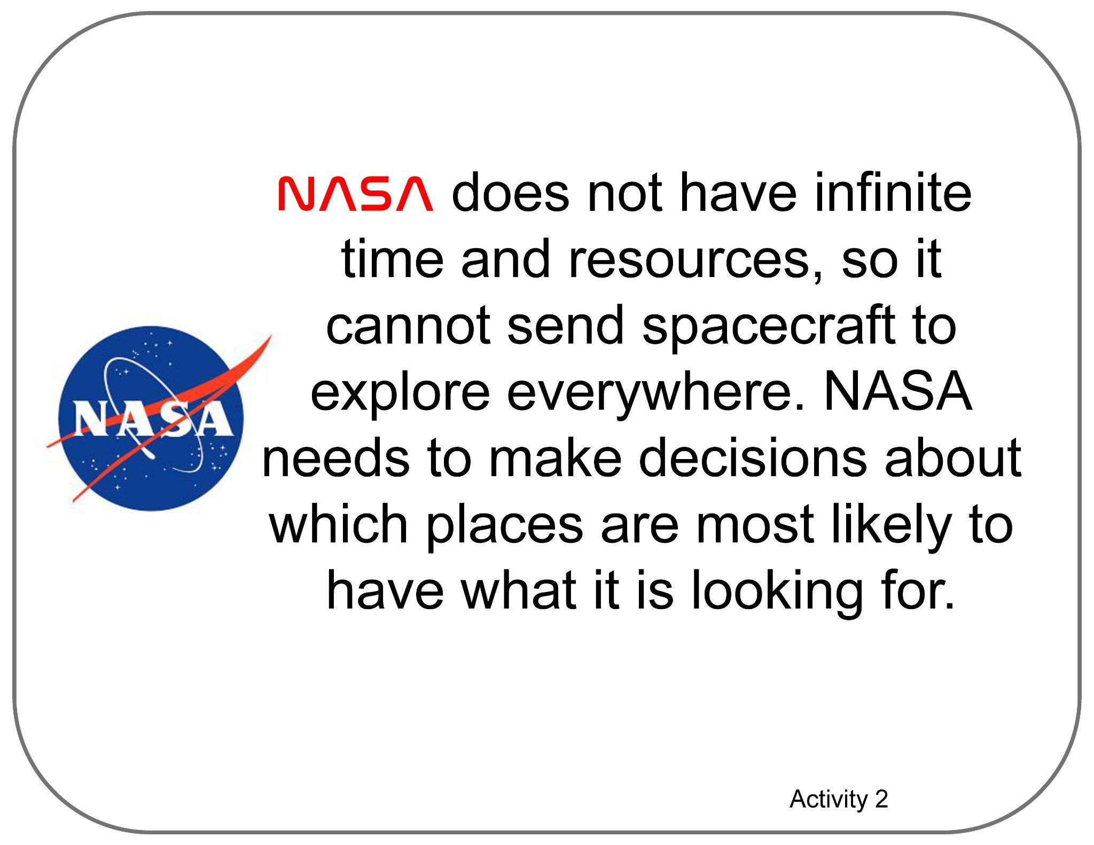
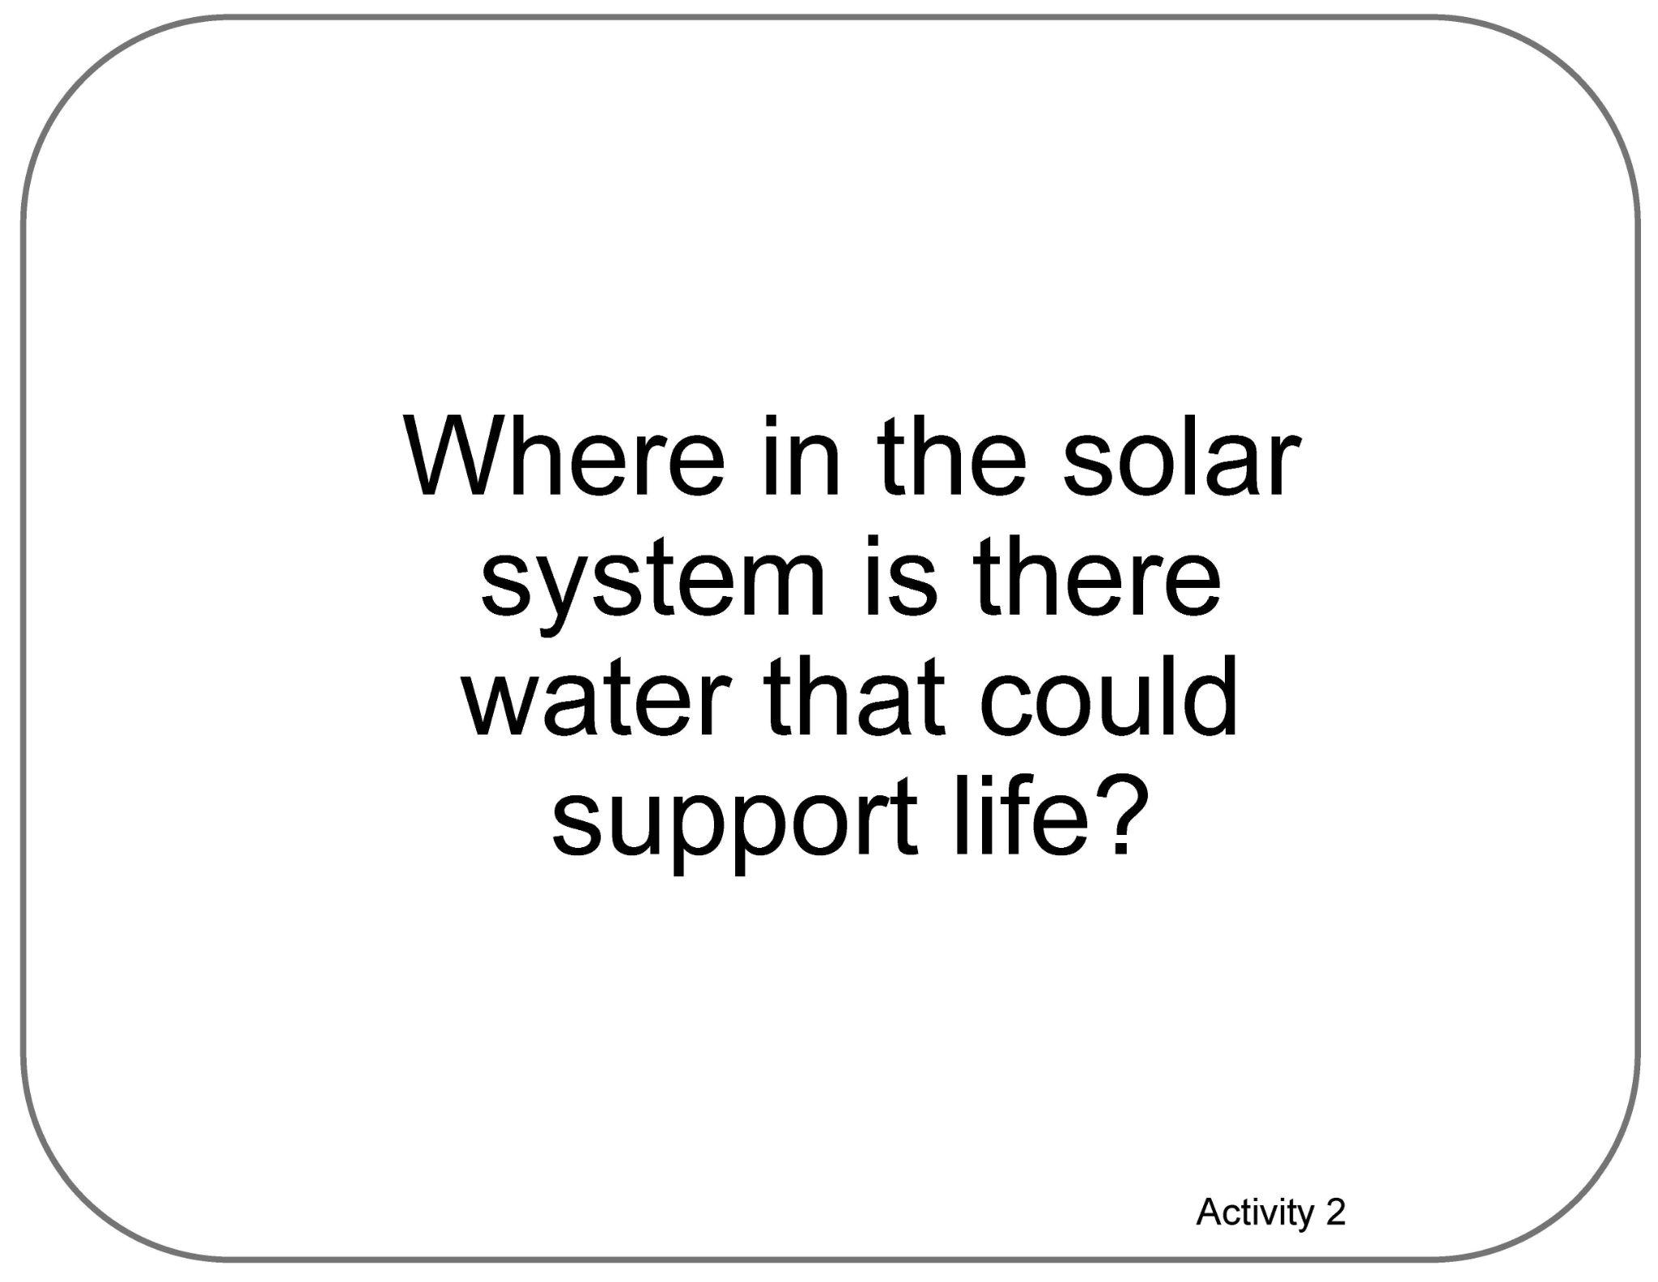
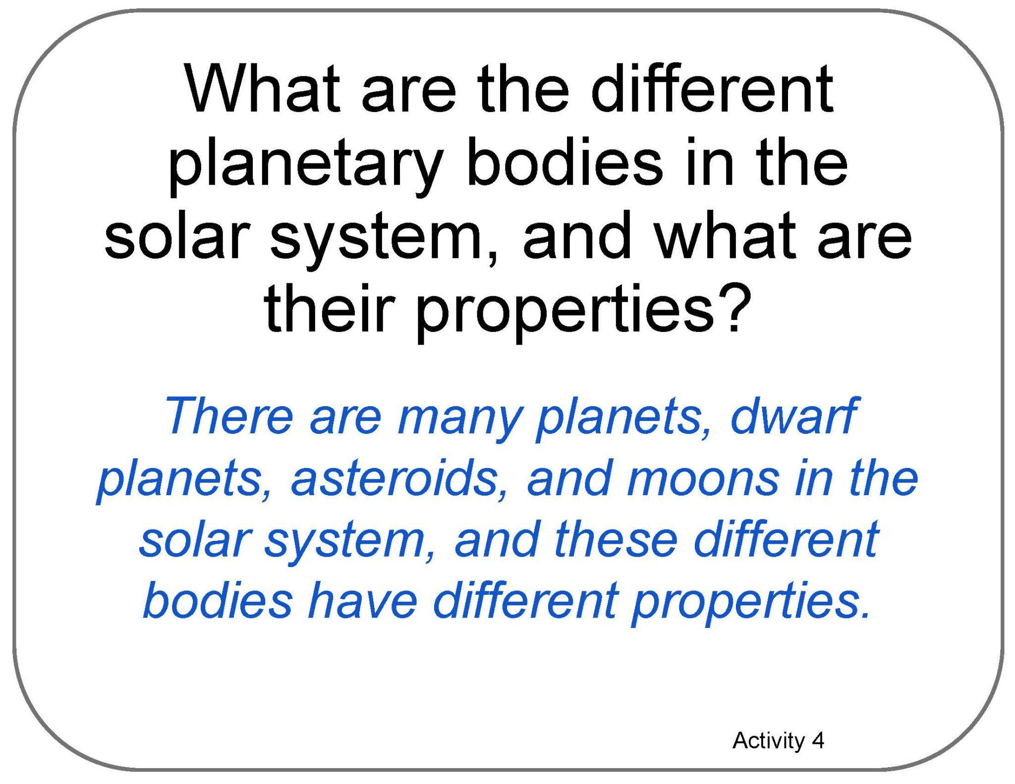
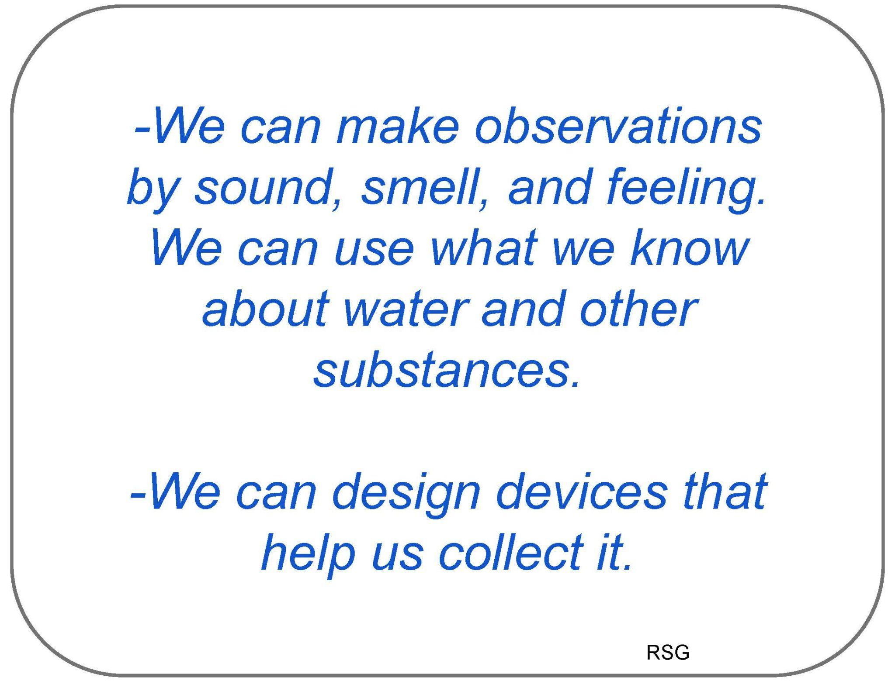
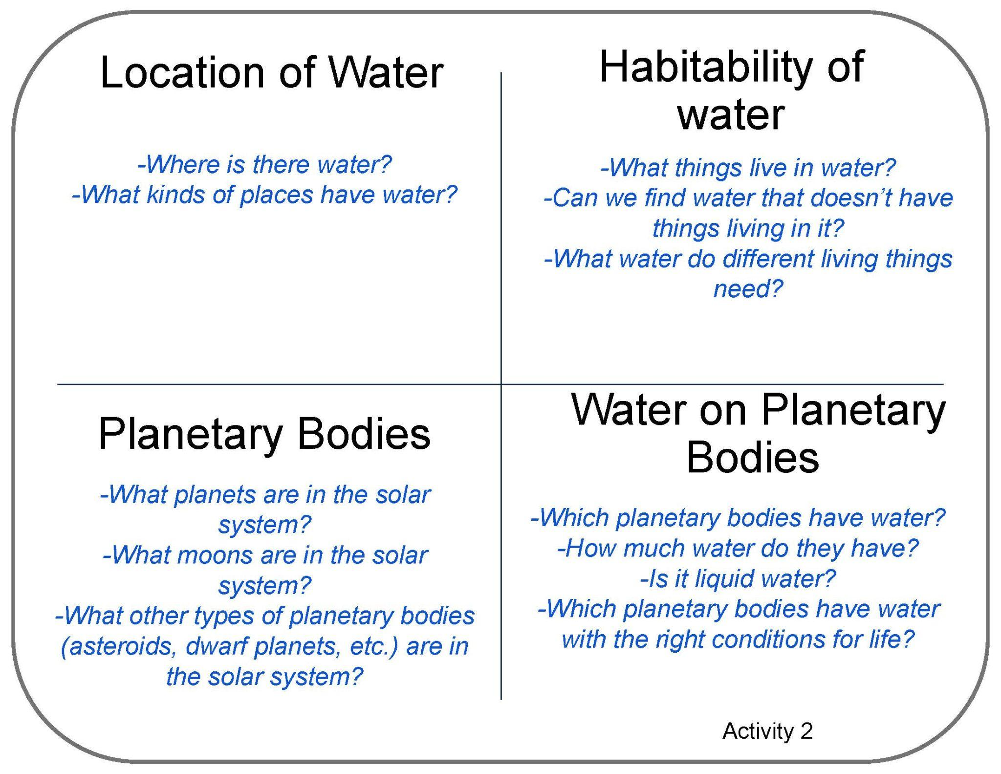
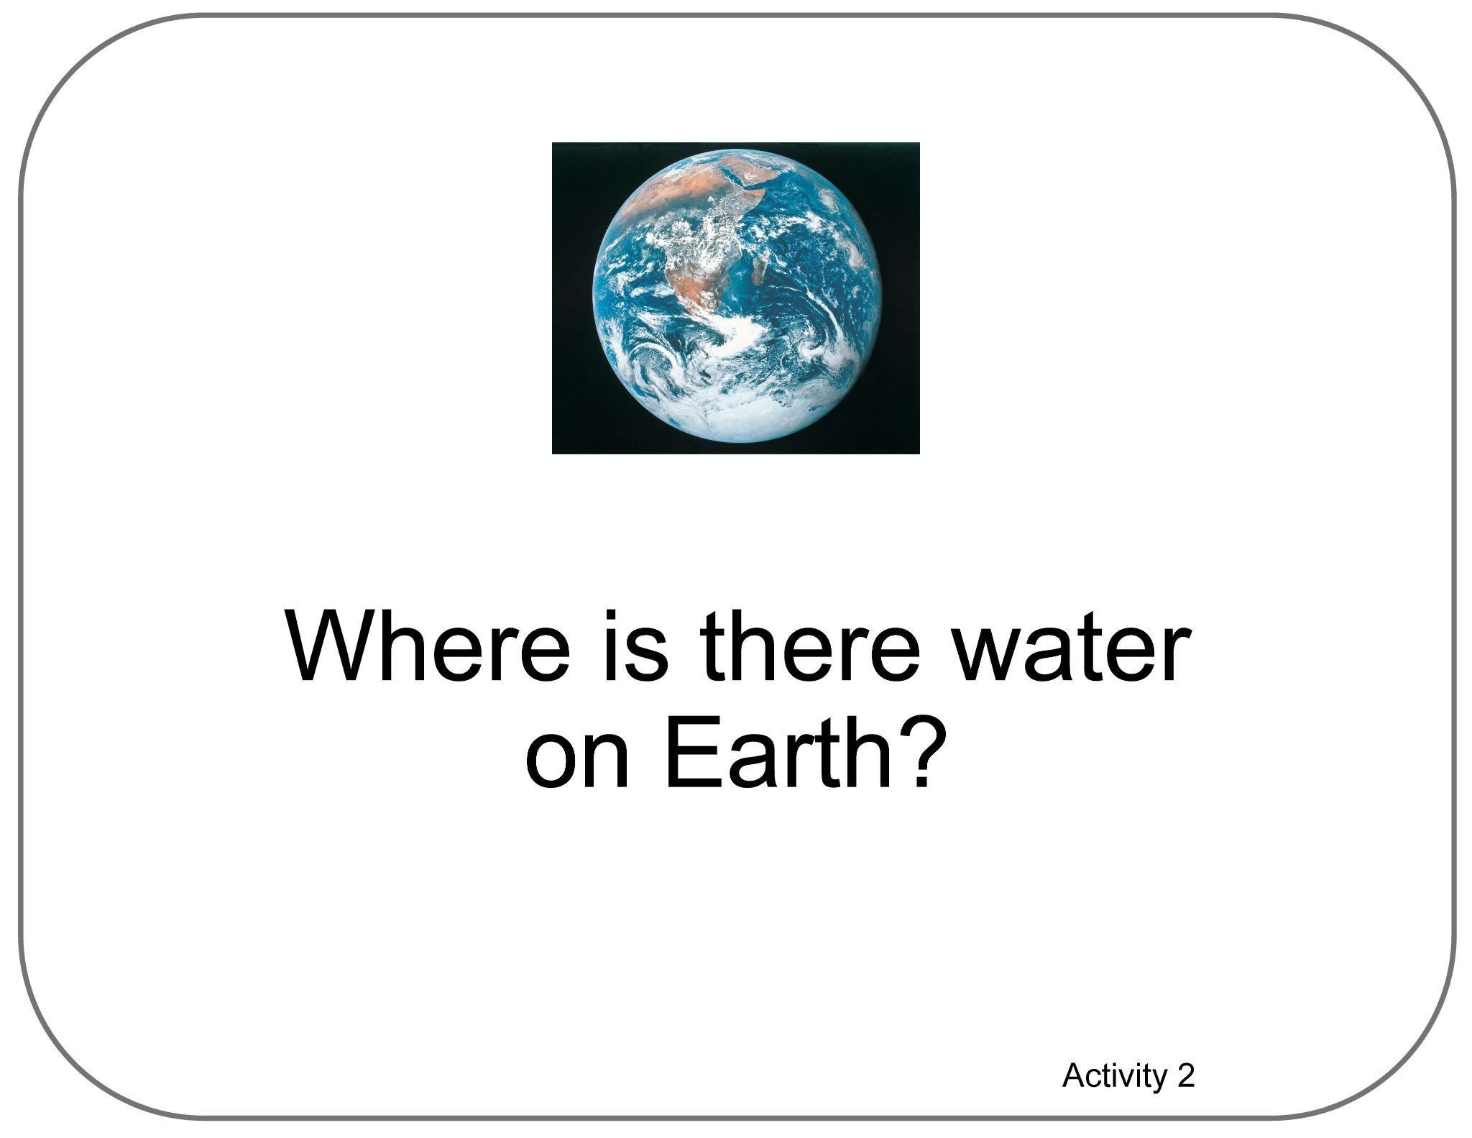
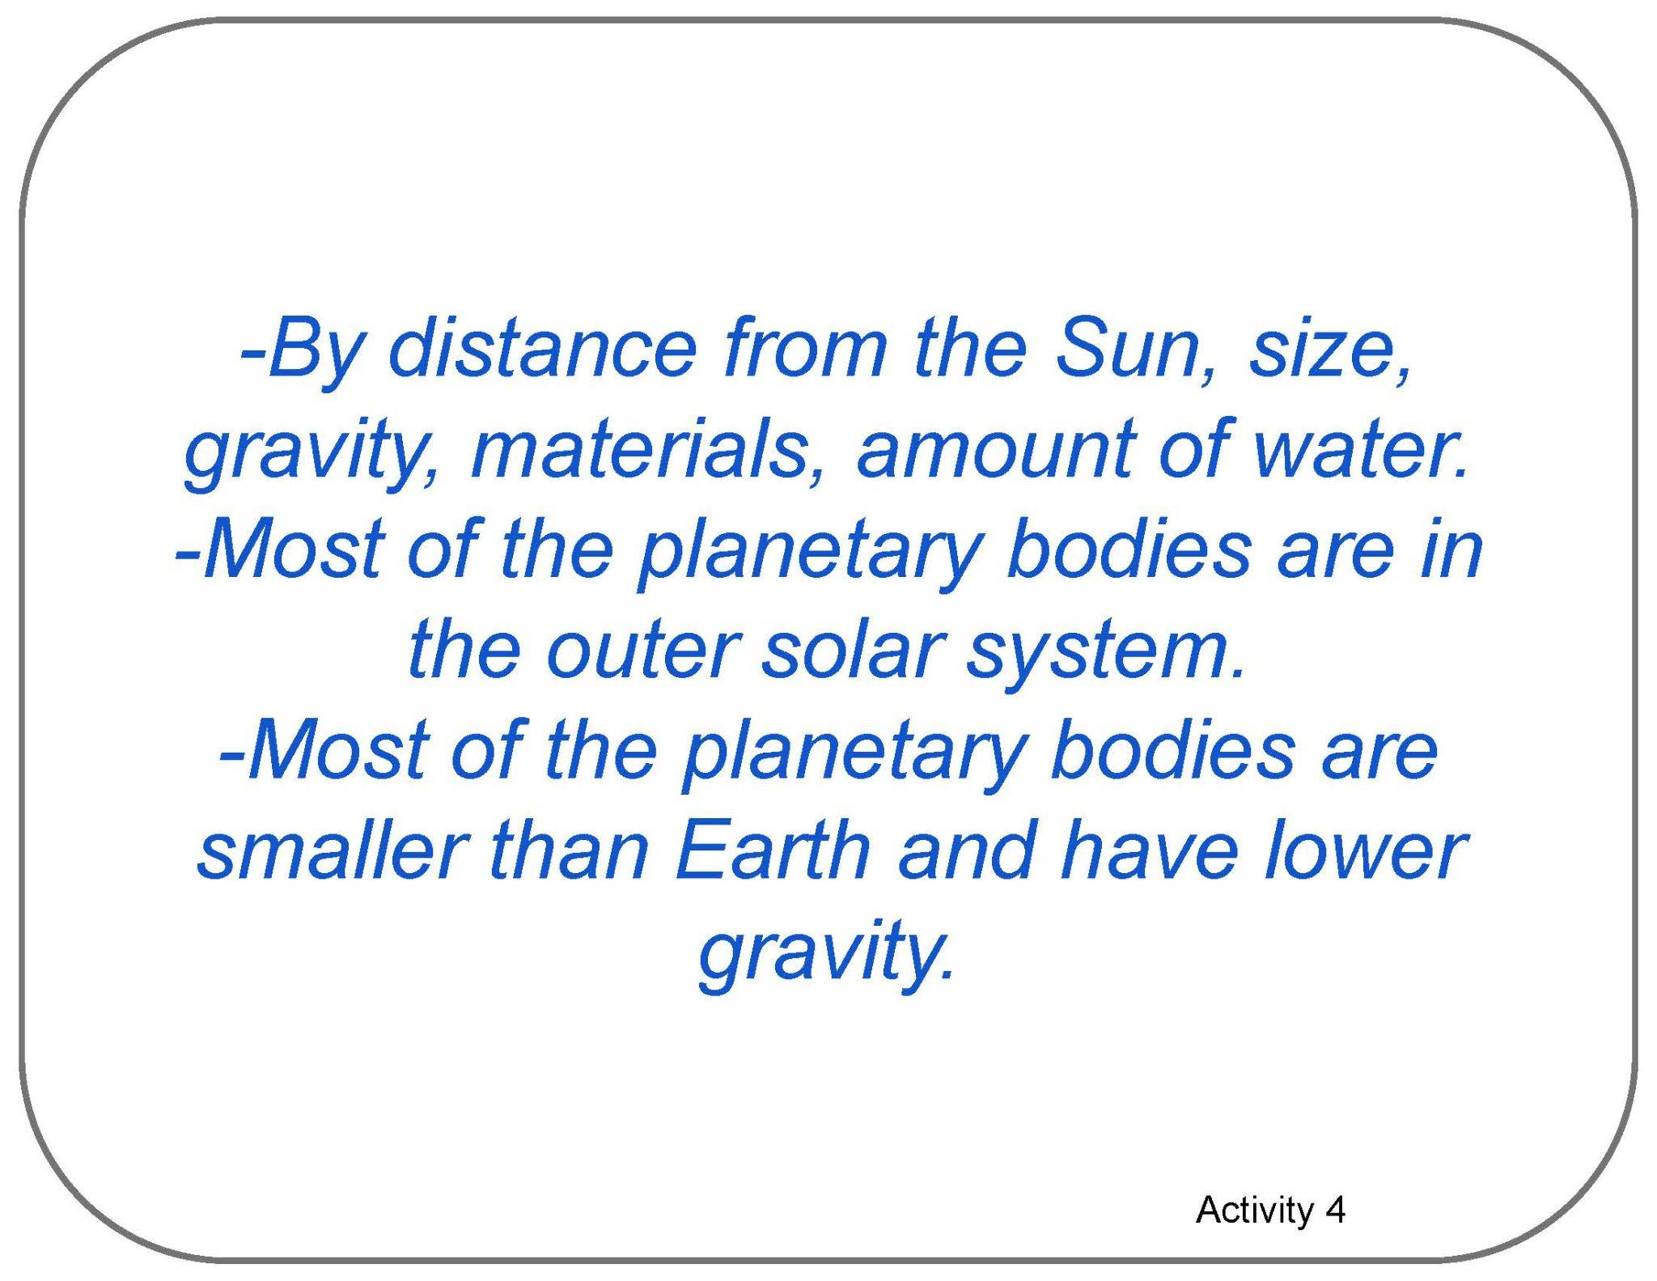
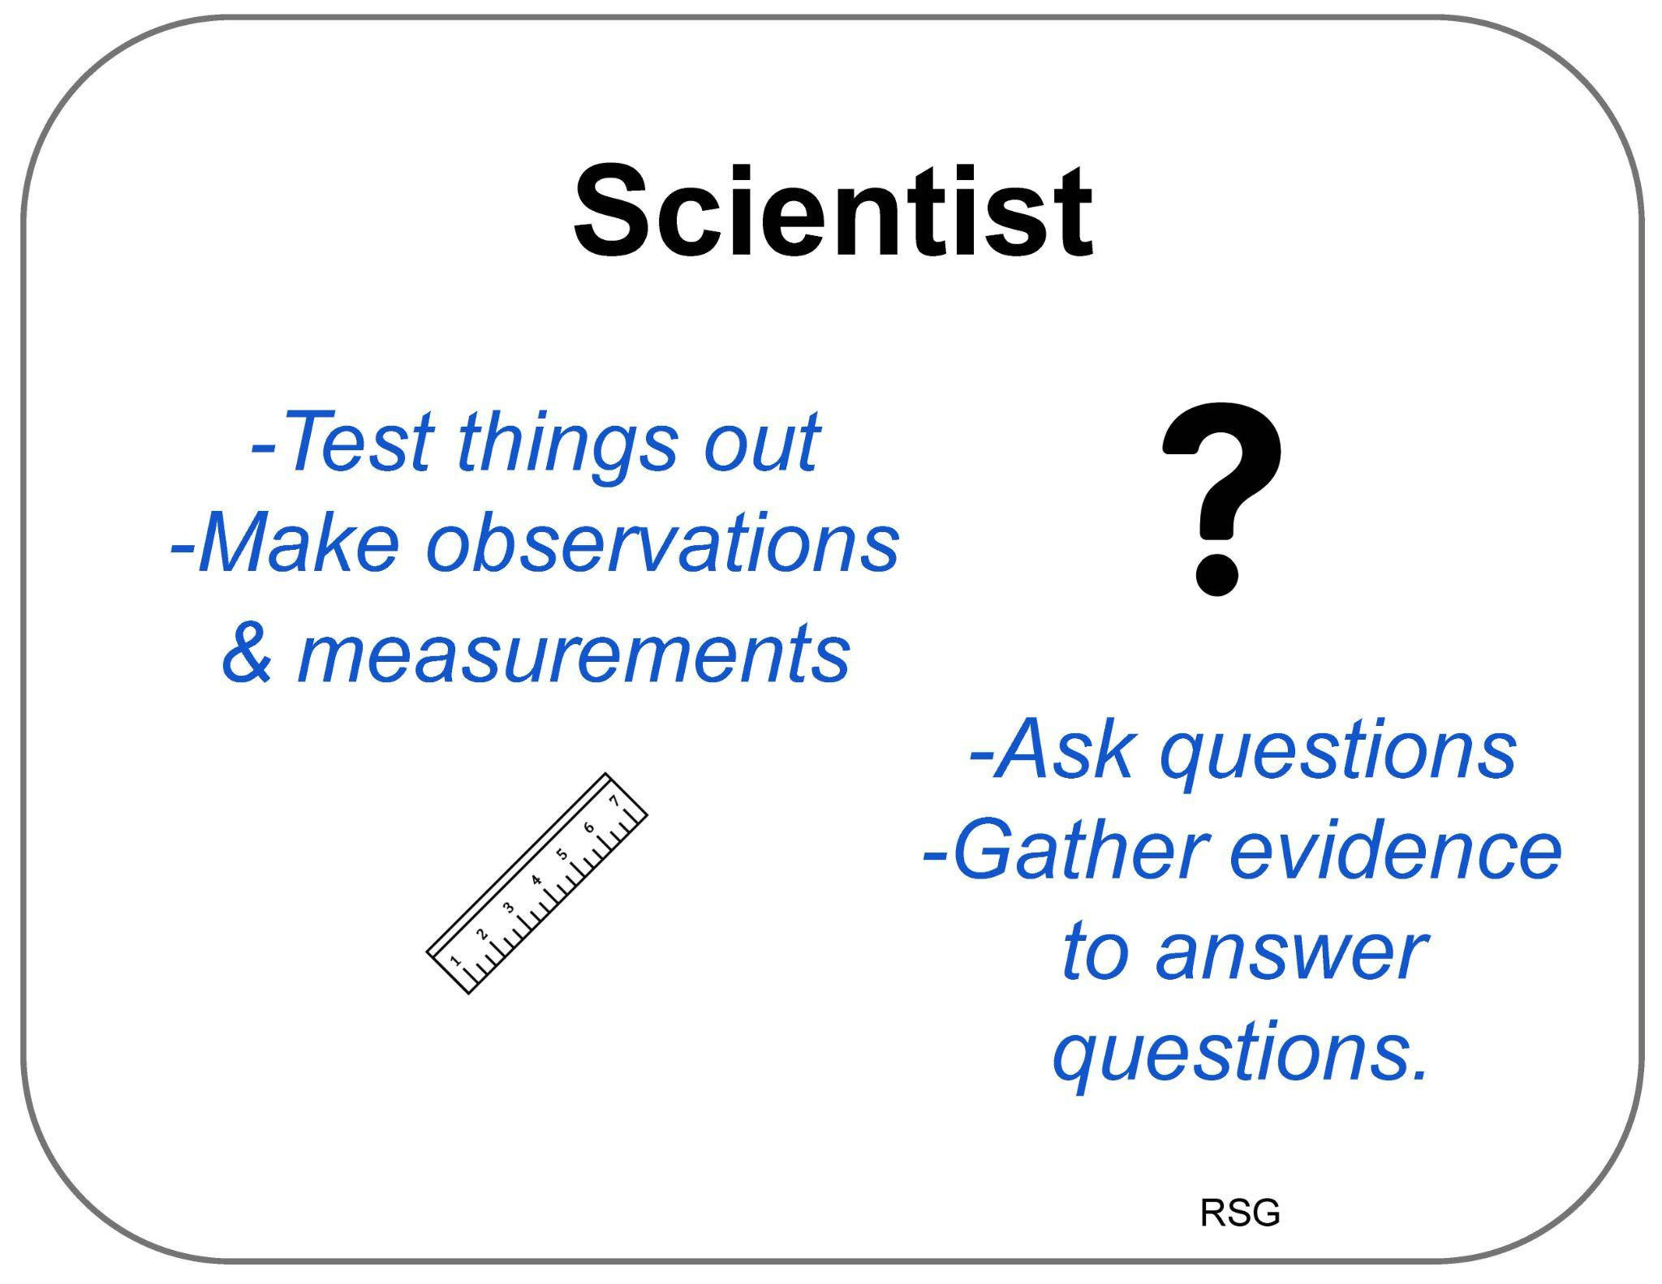

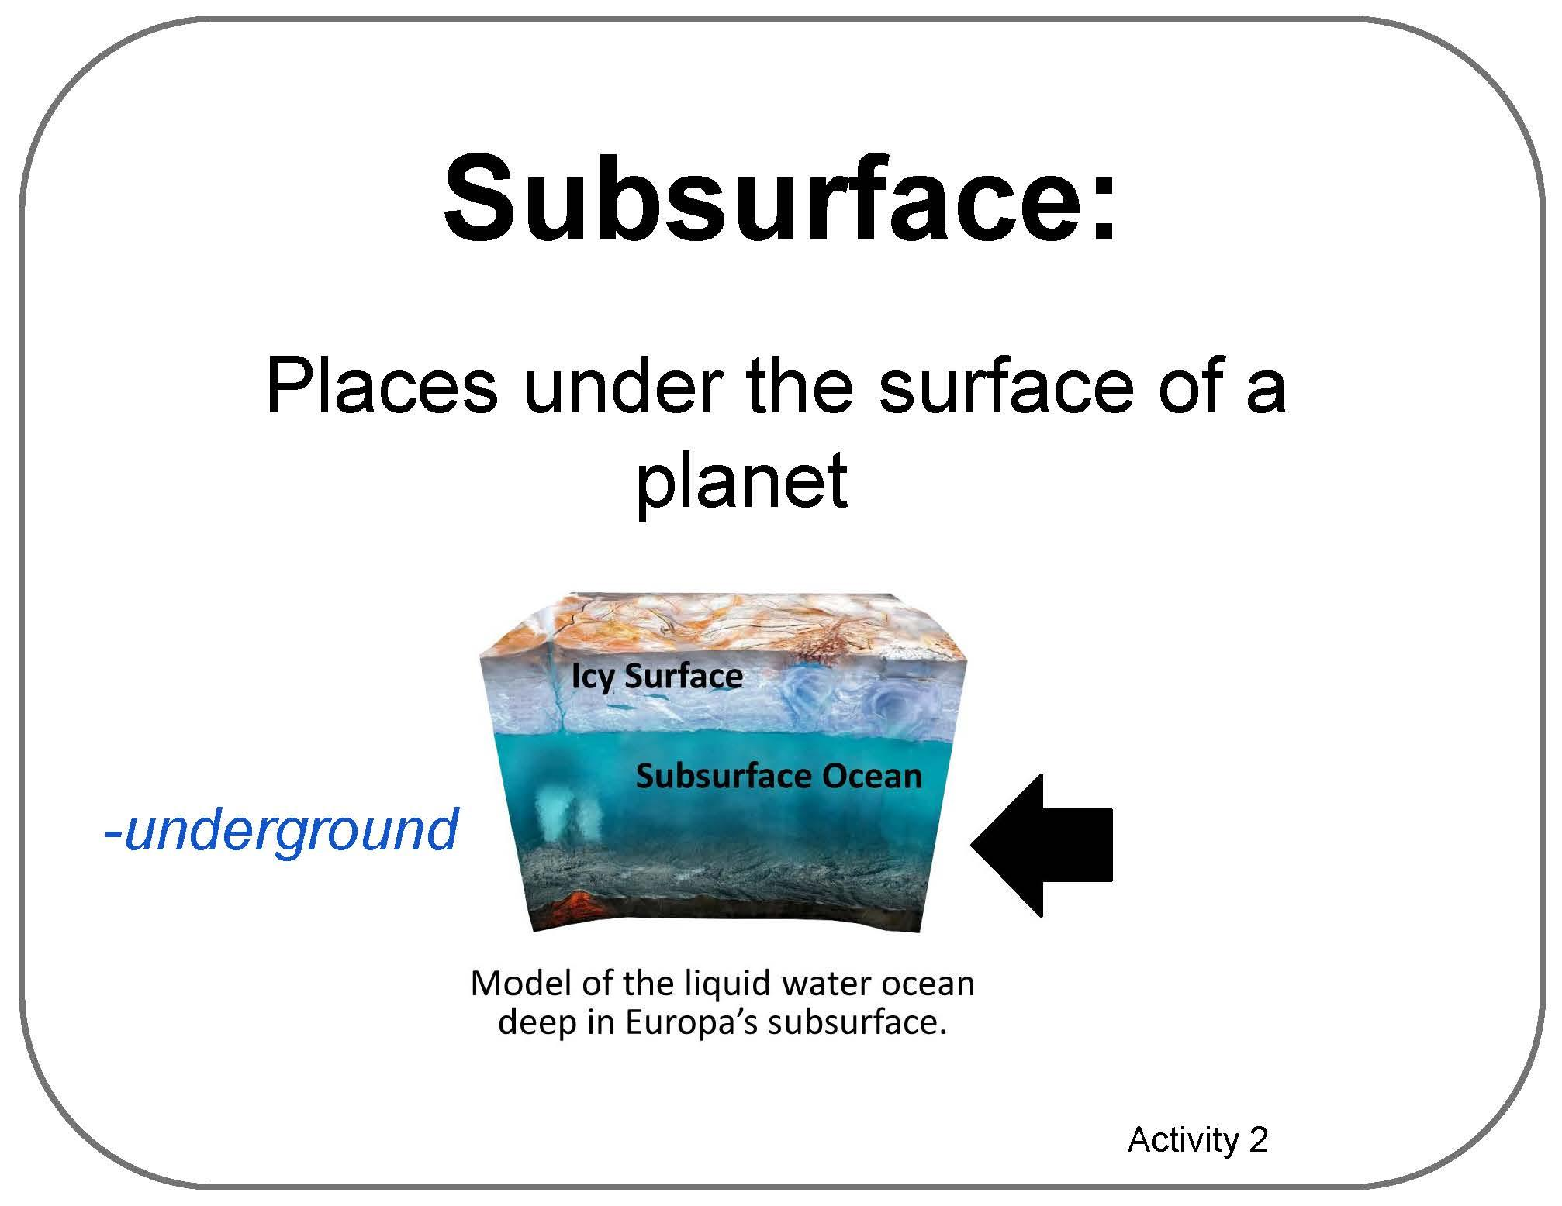
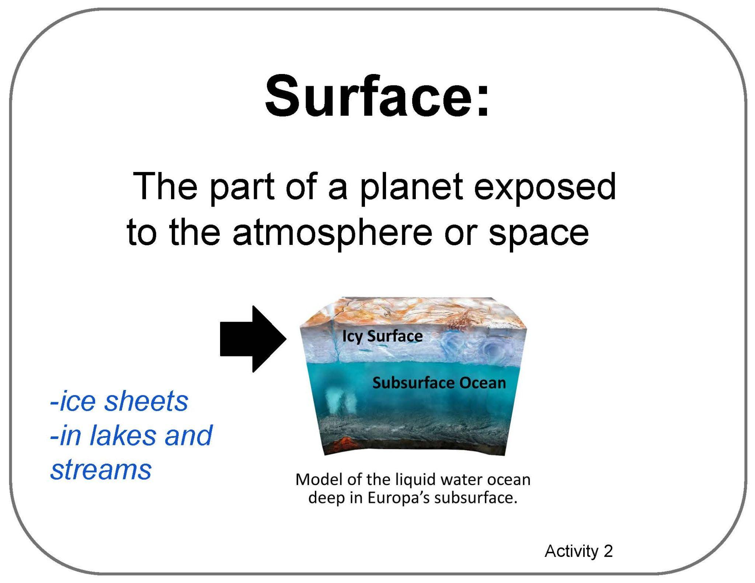
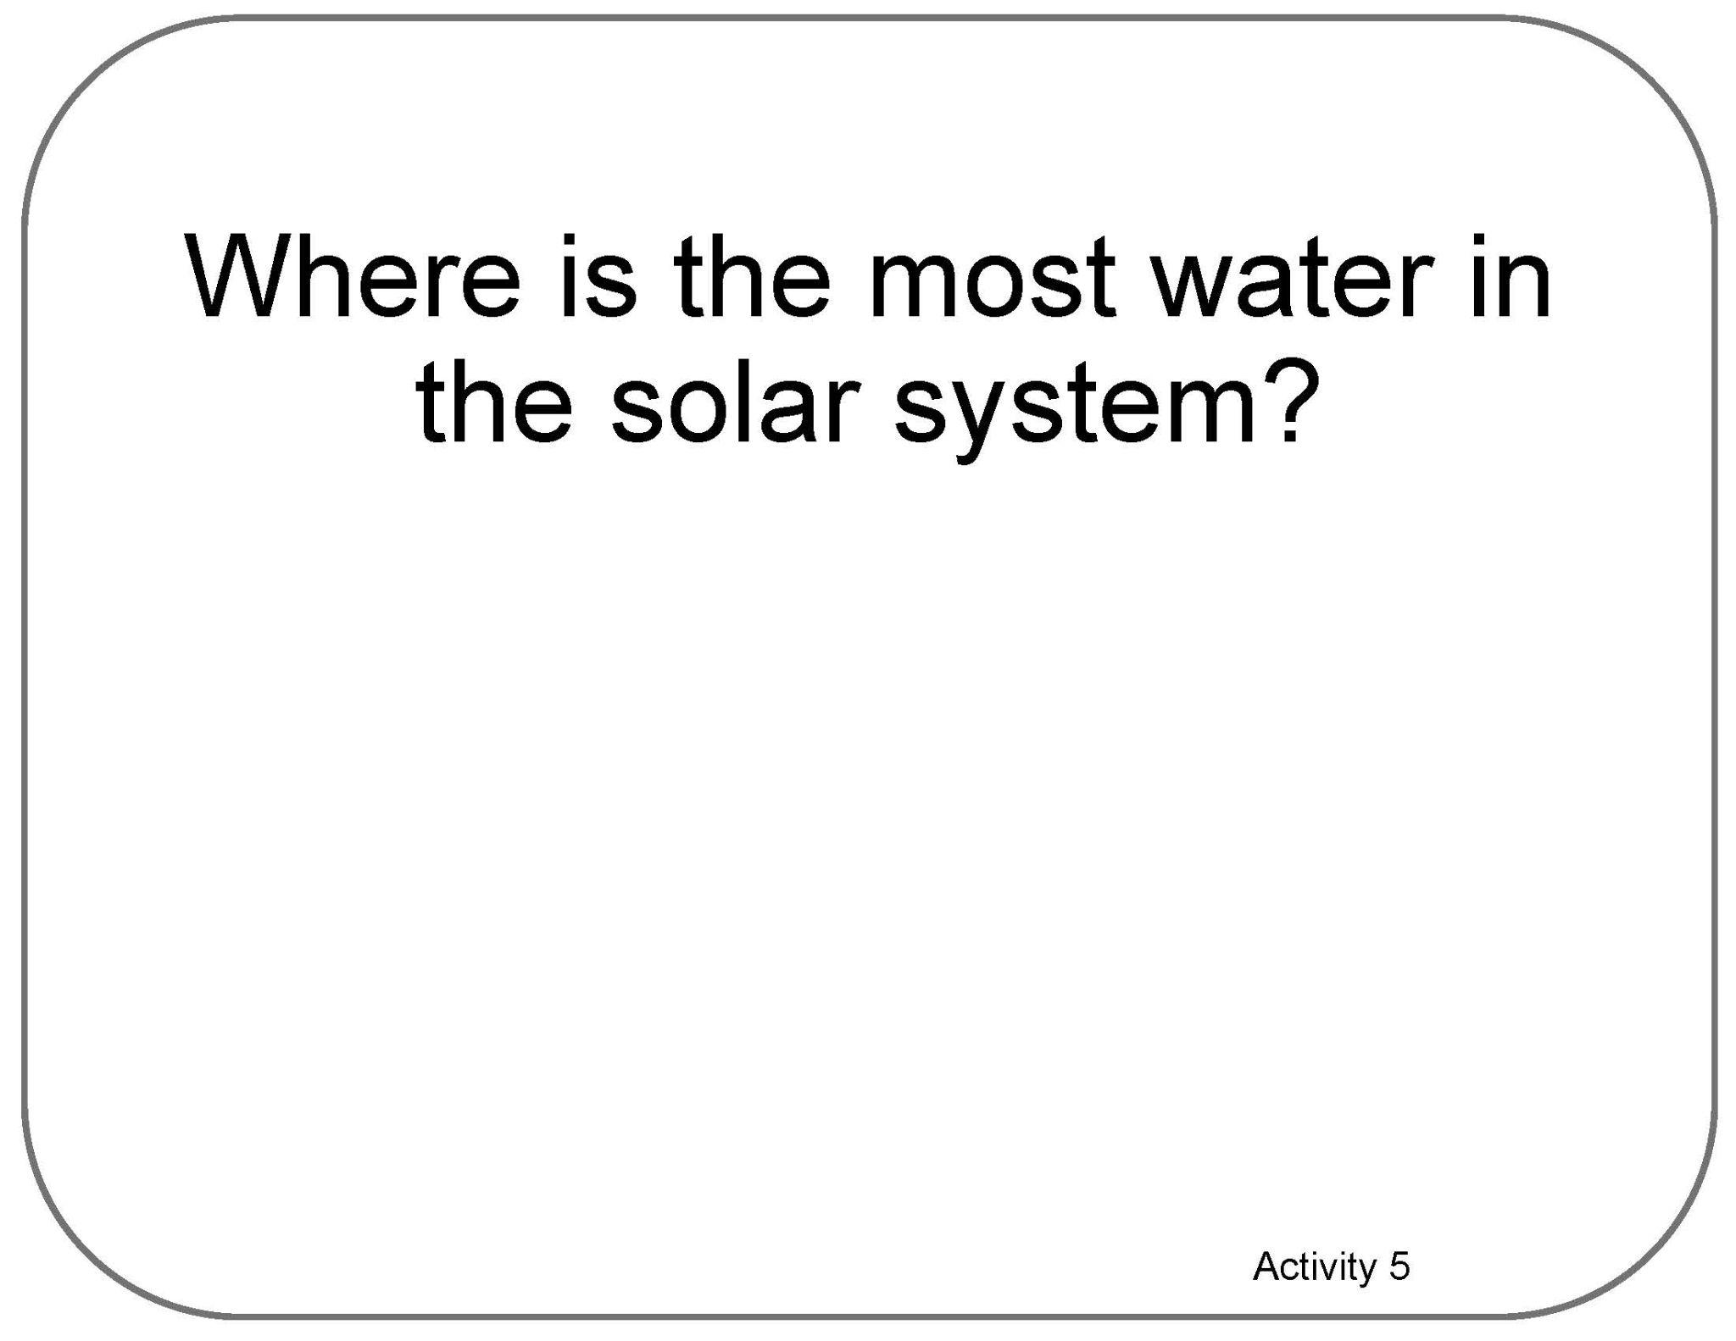

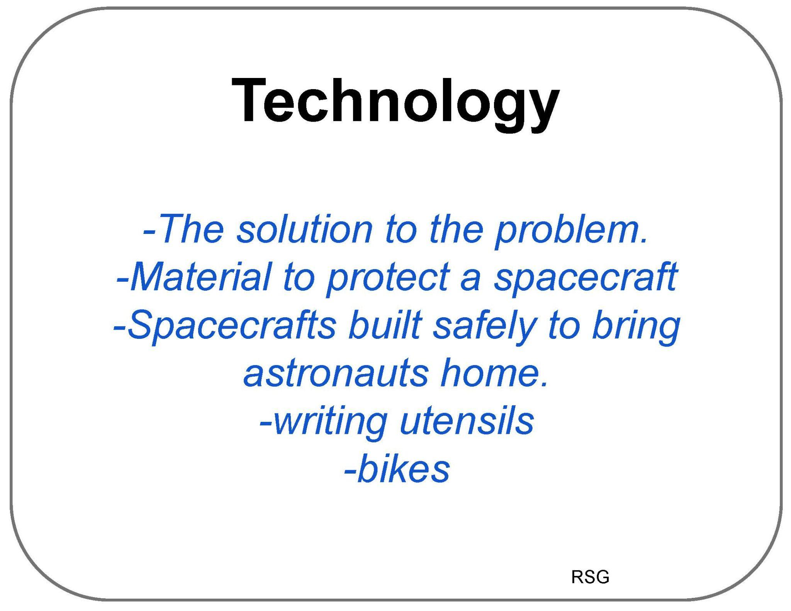
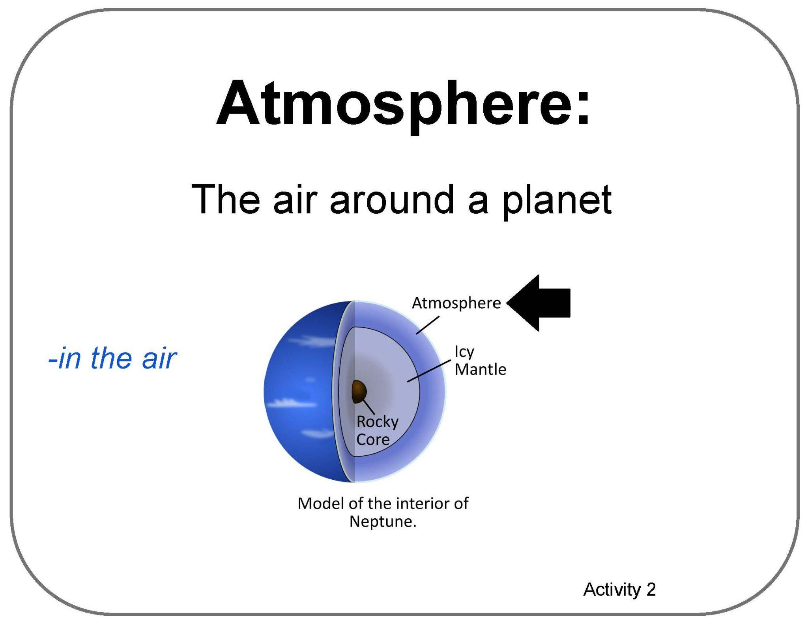

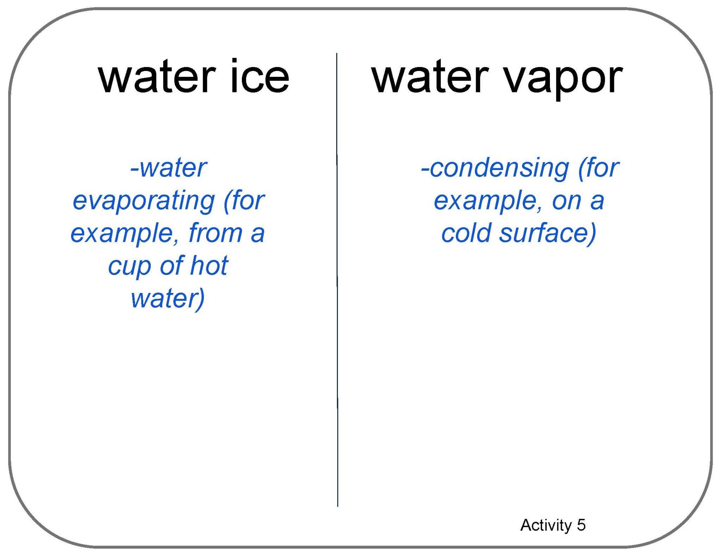

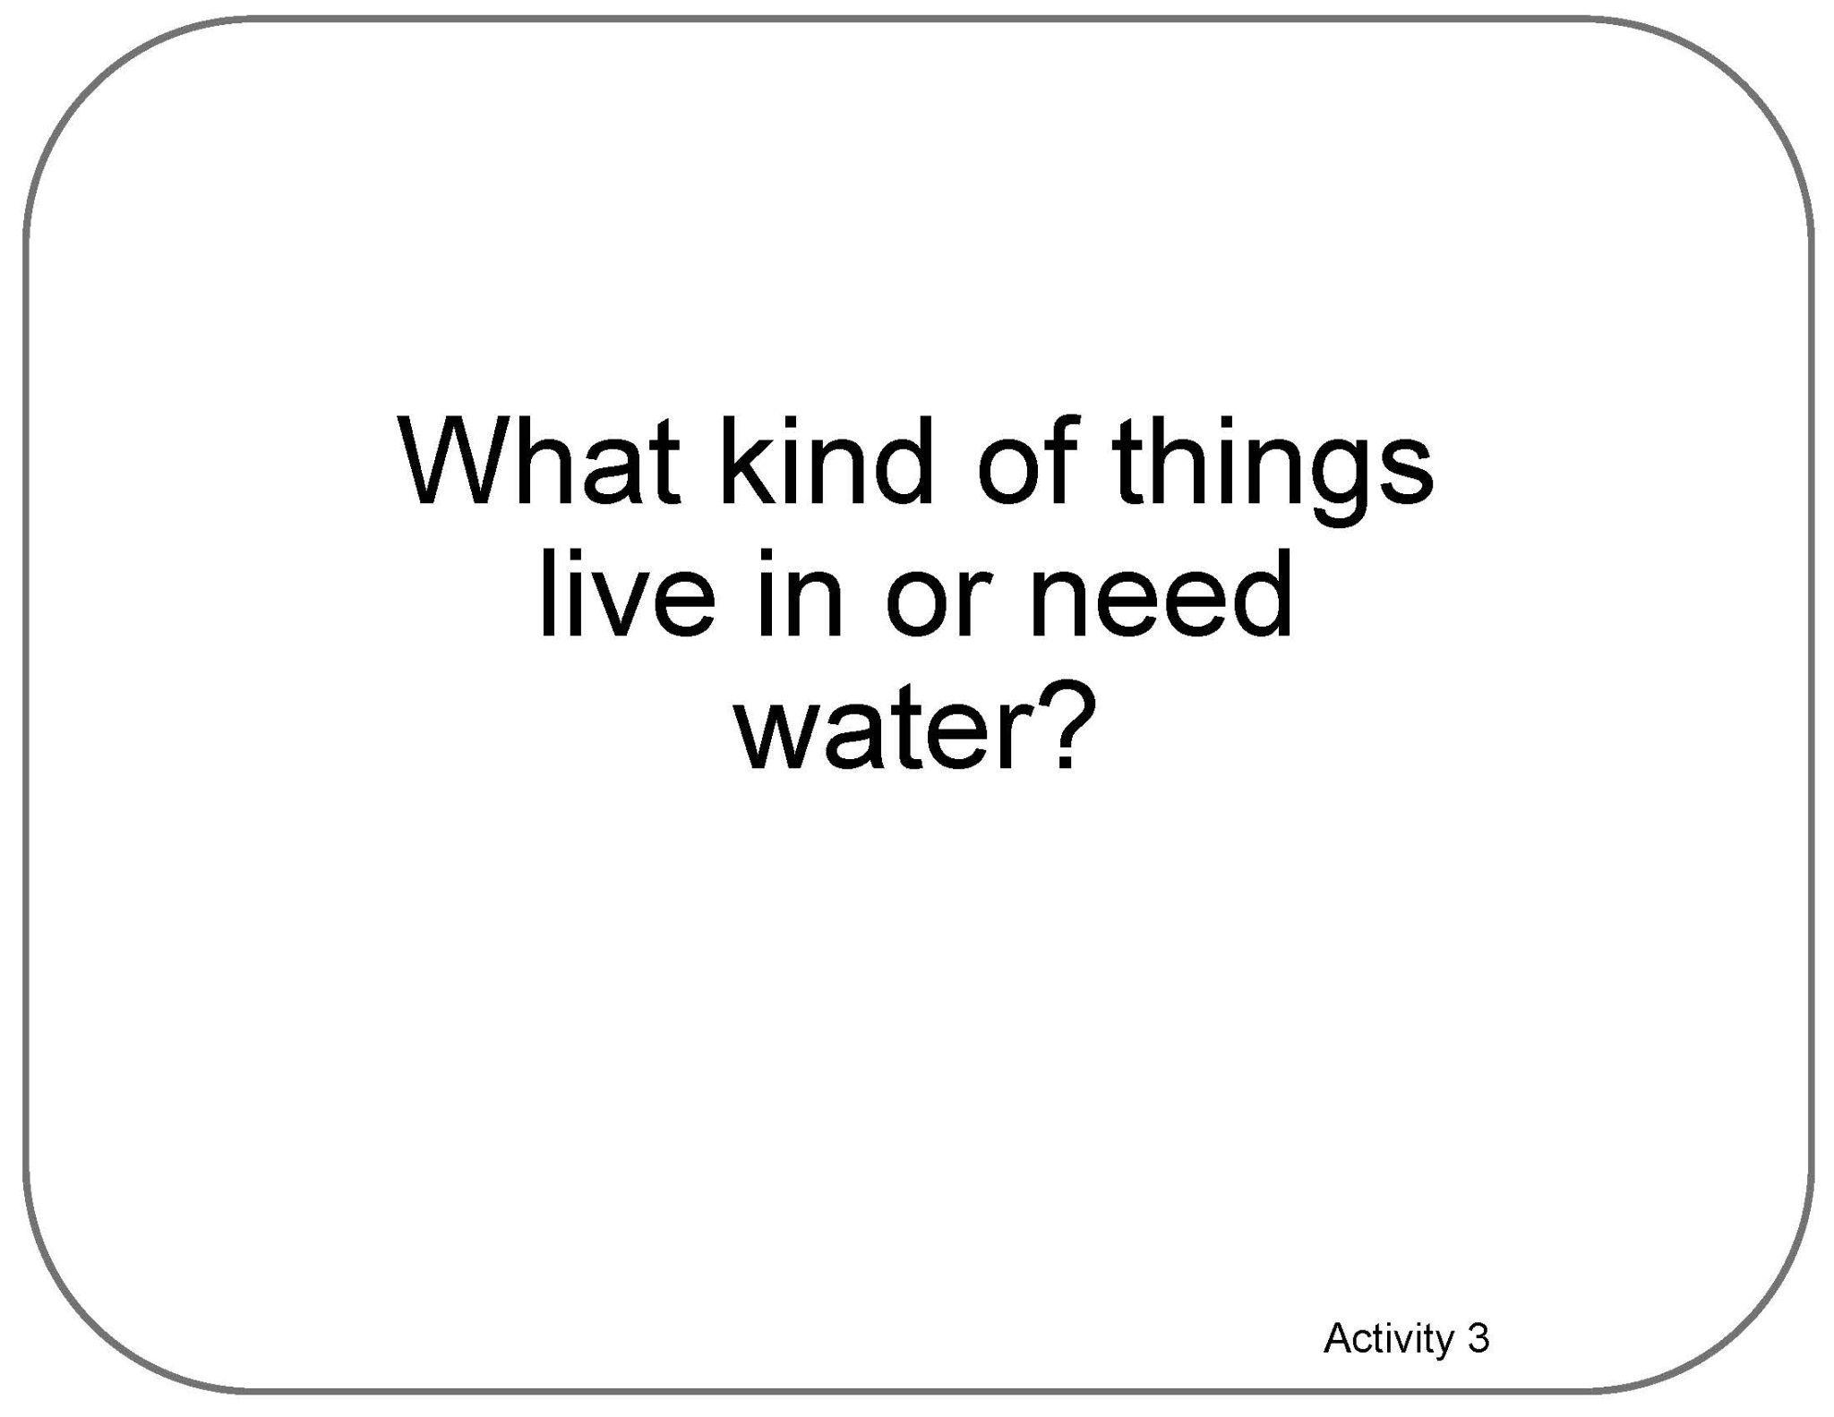
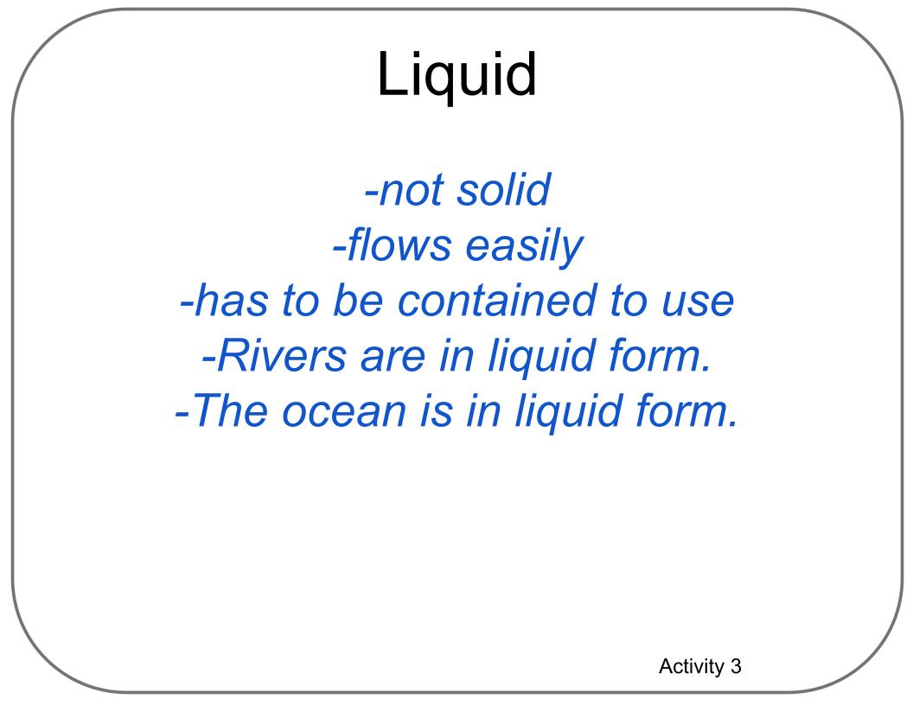
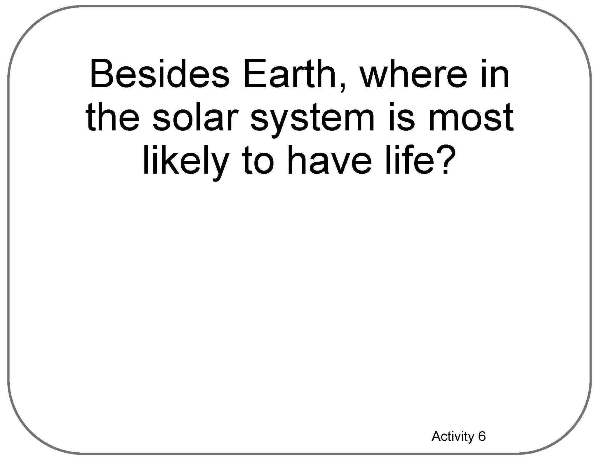

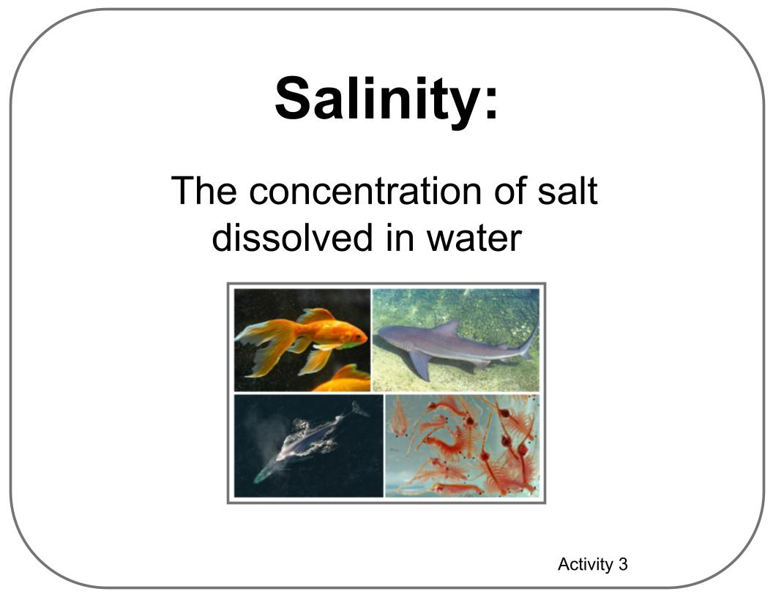
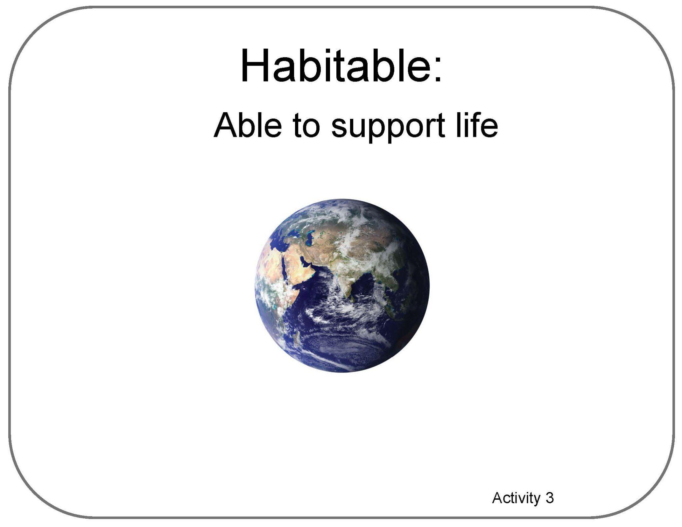
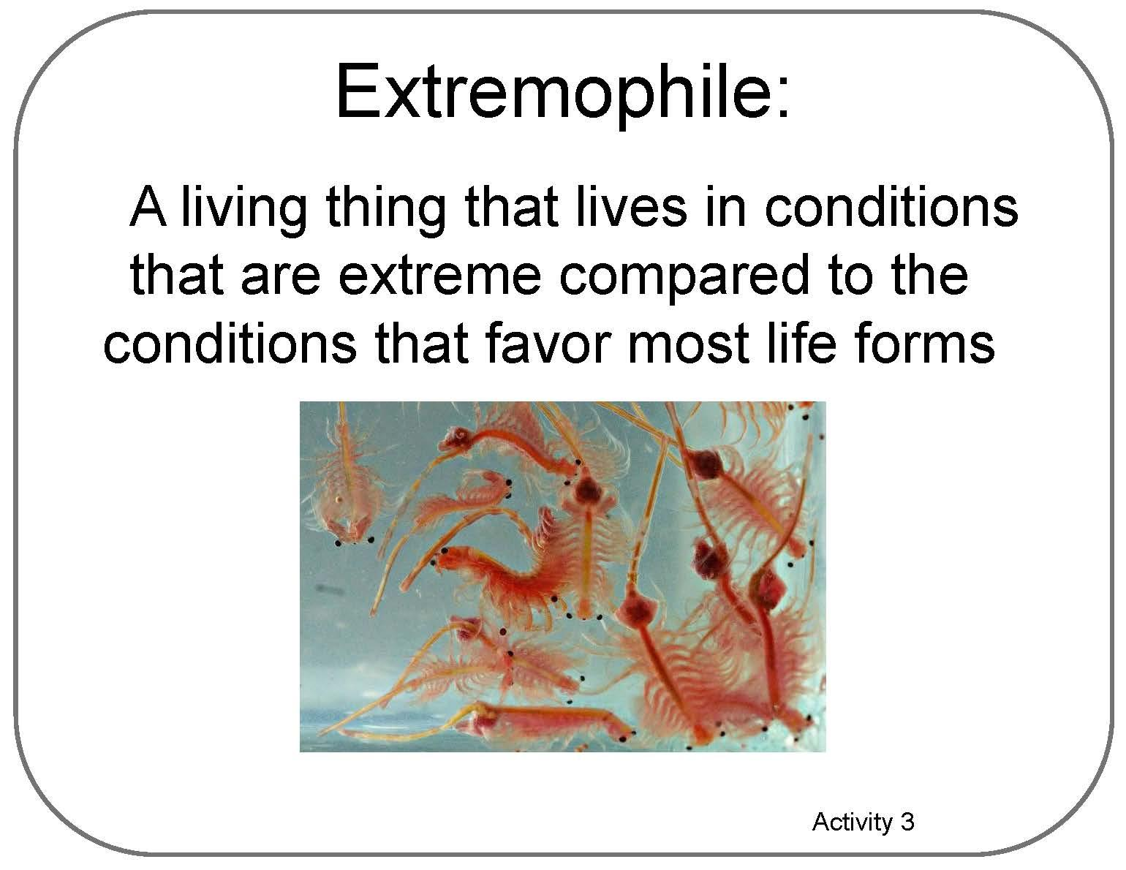
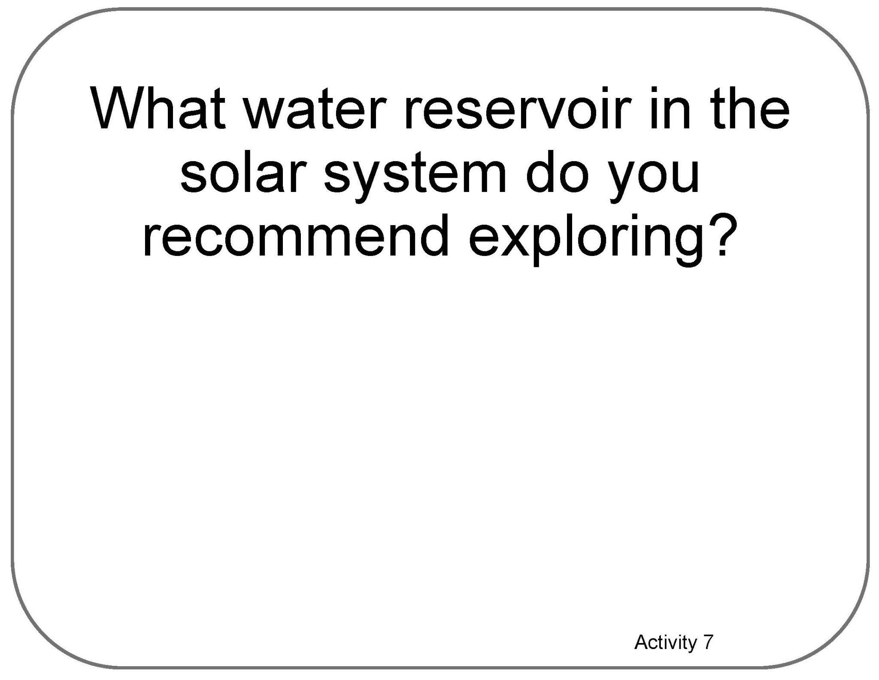
Poster Setup (with Example)
Our Ideas about
Water in Extreme Environments
Science

Slide 13
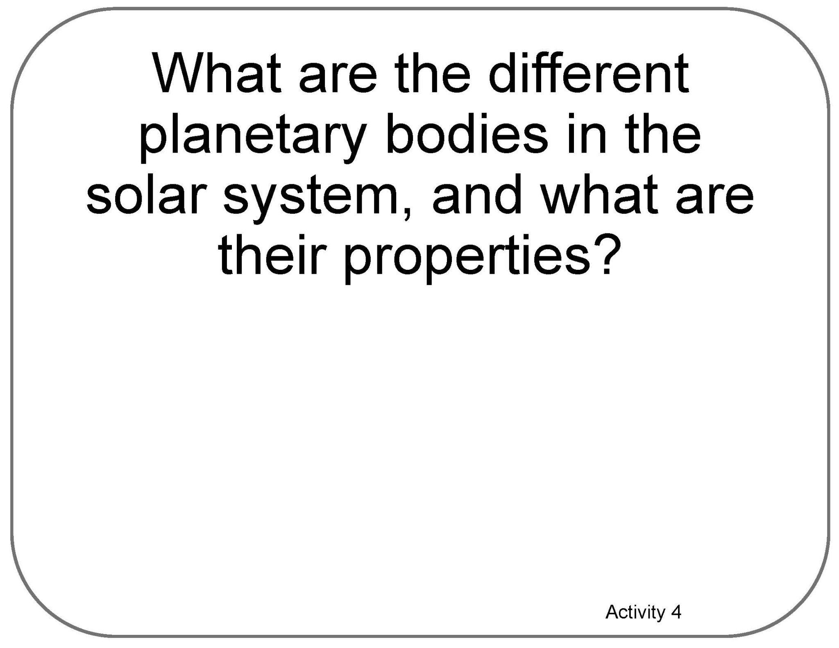

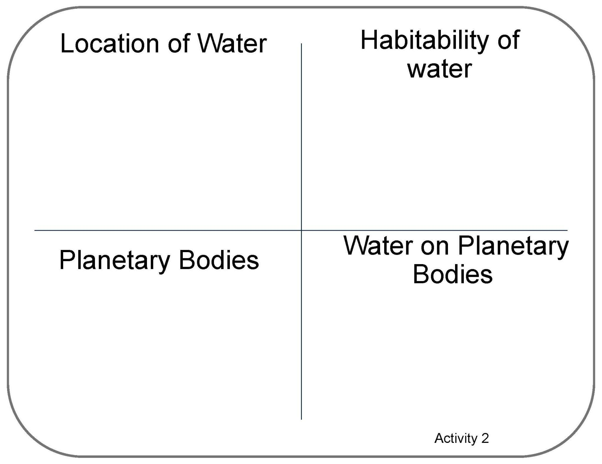


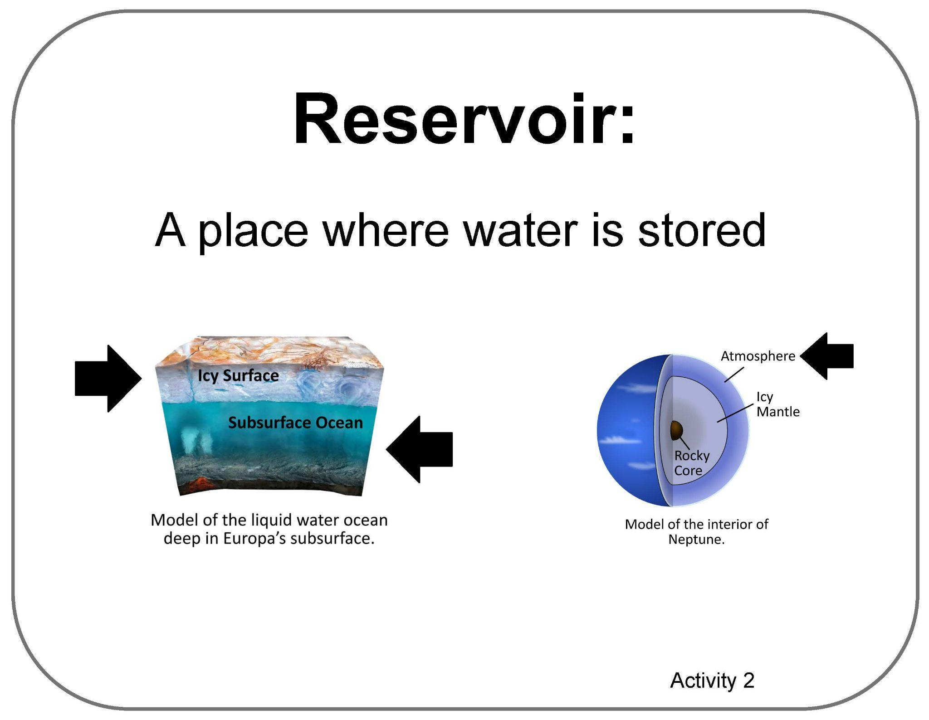
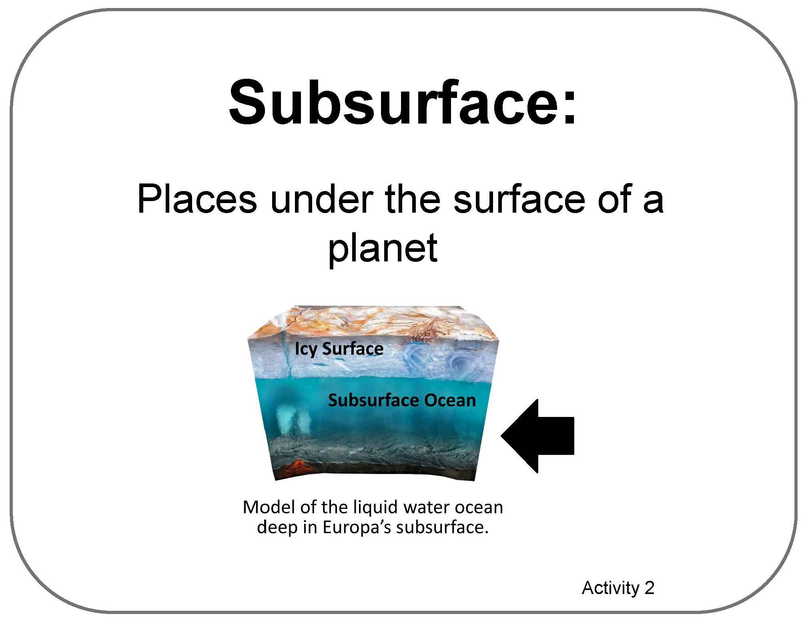
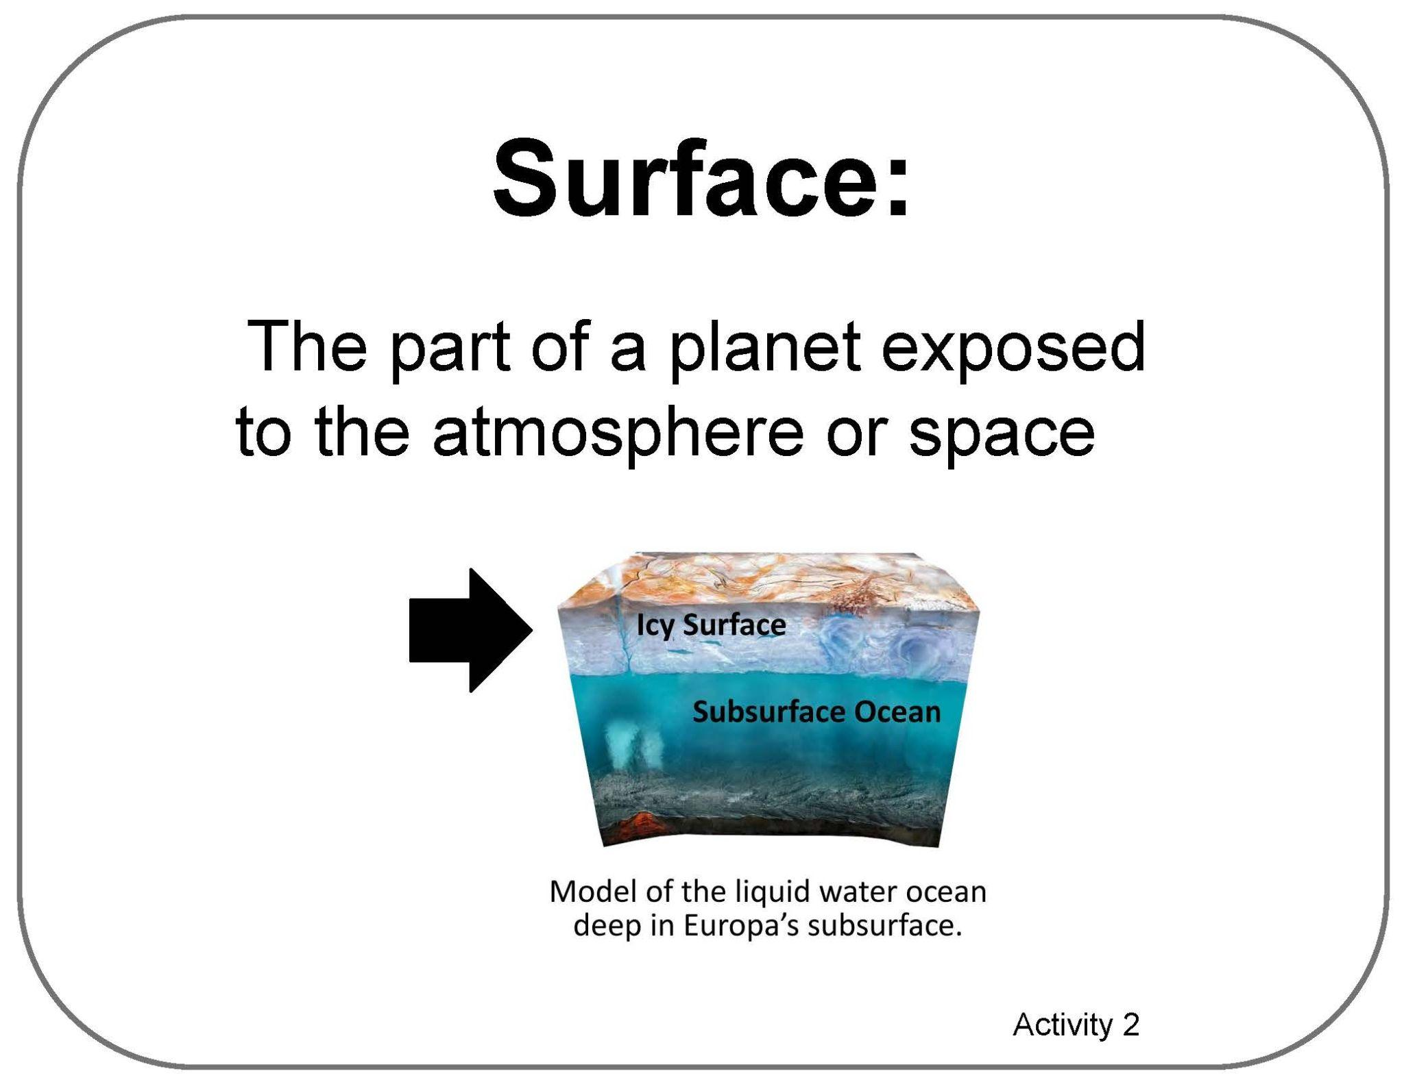


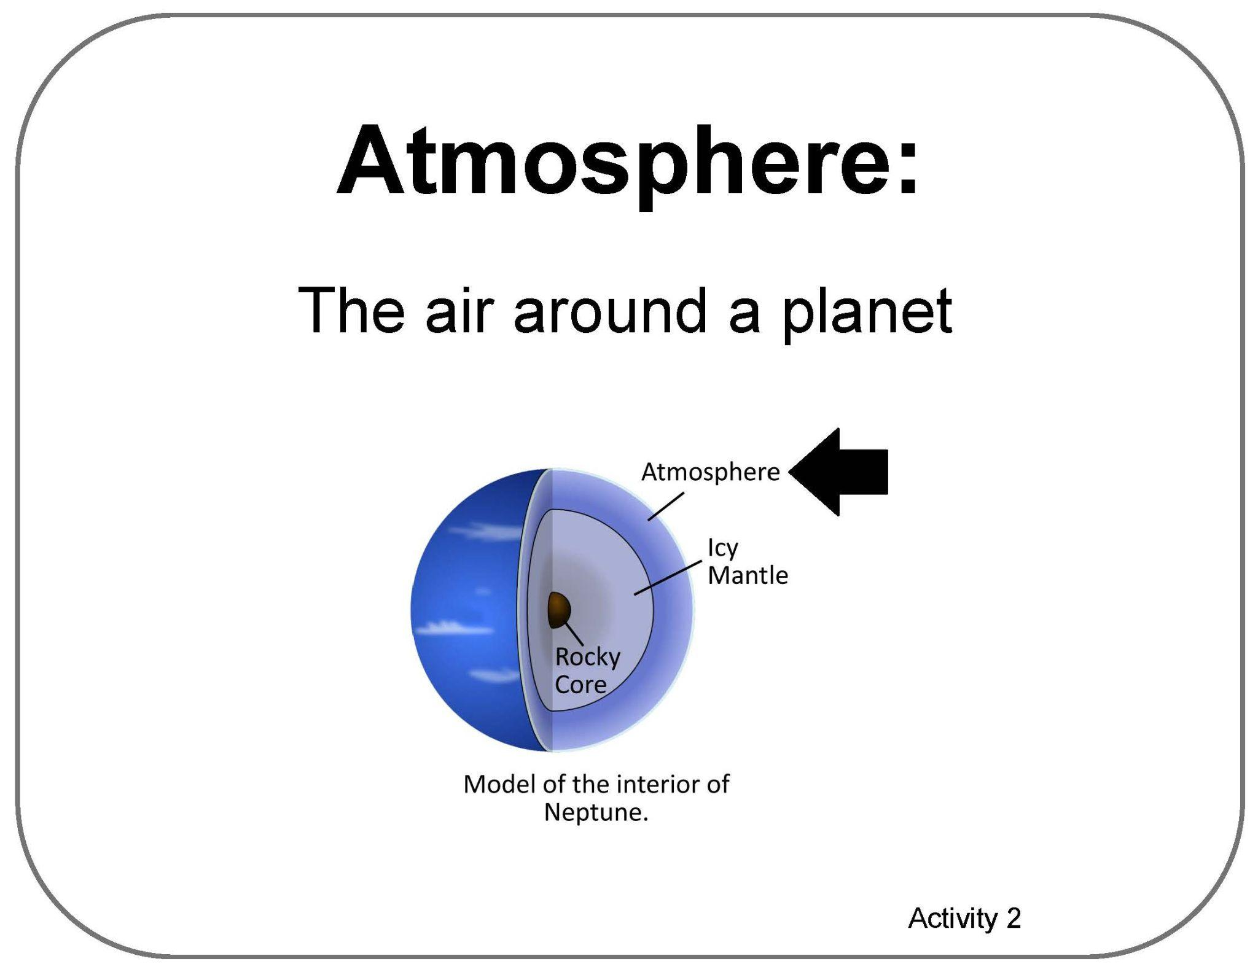
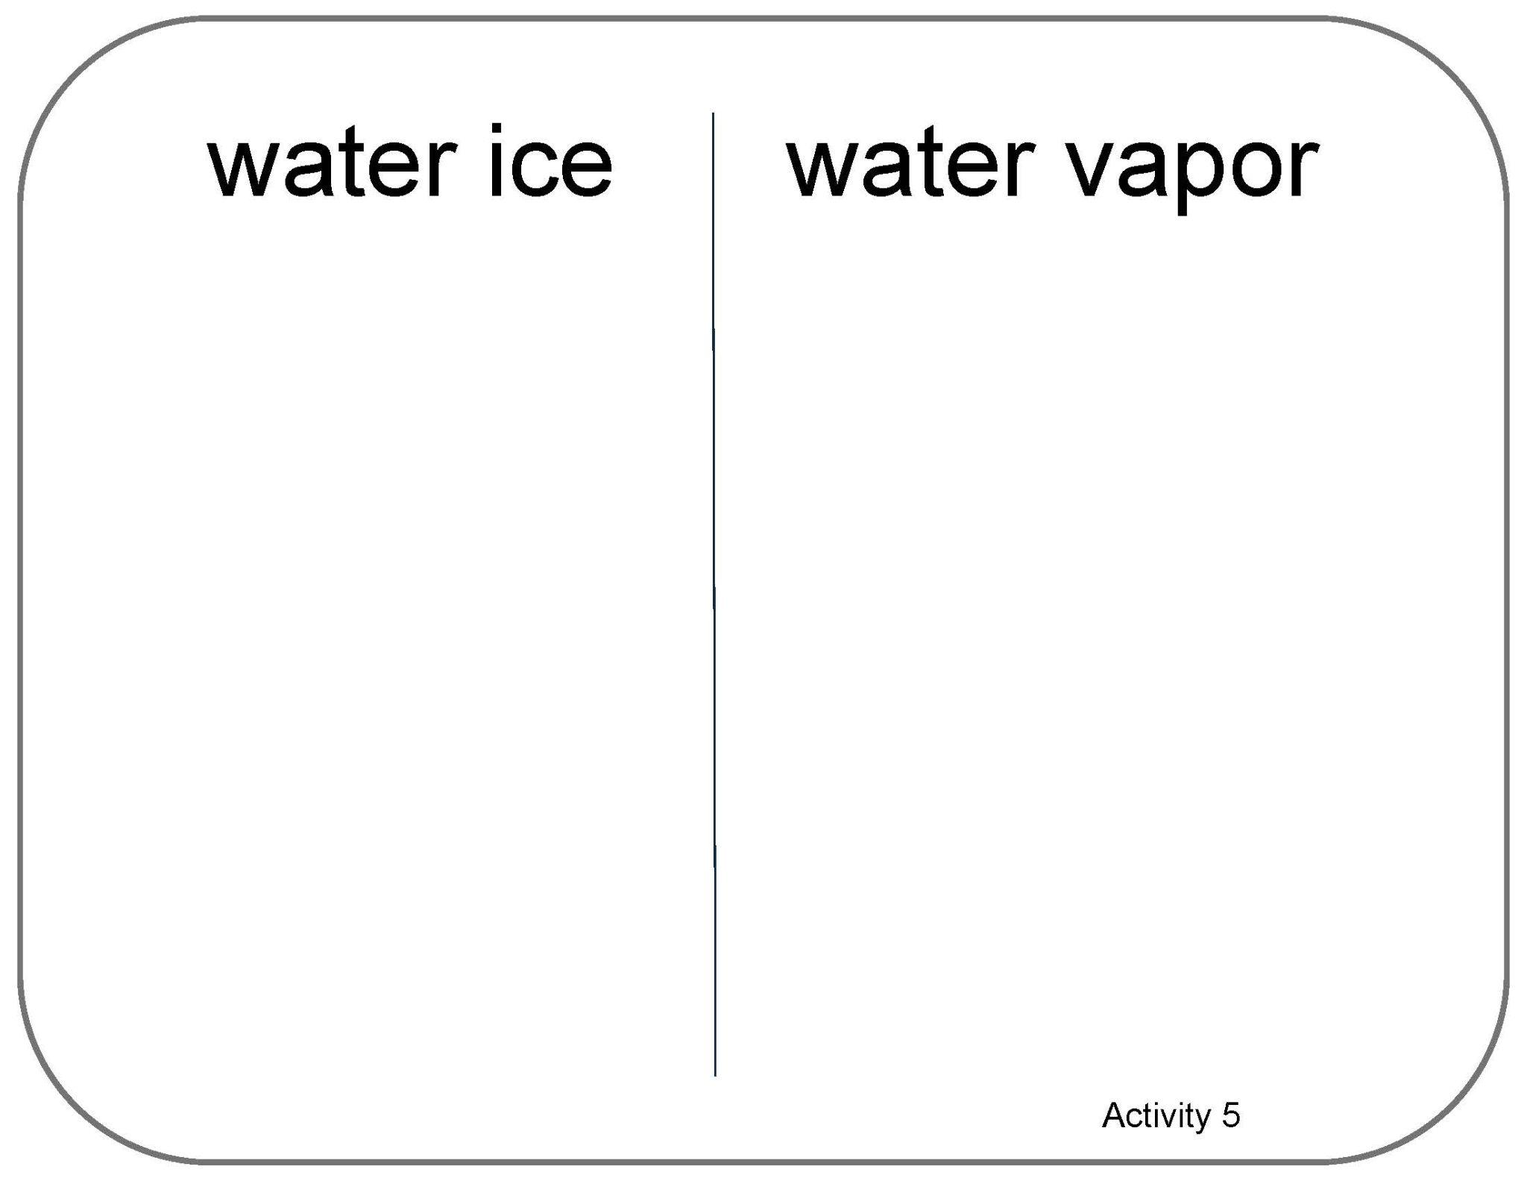
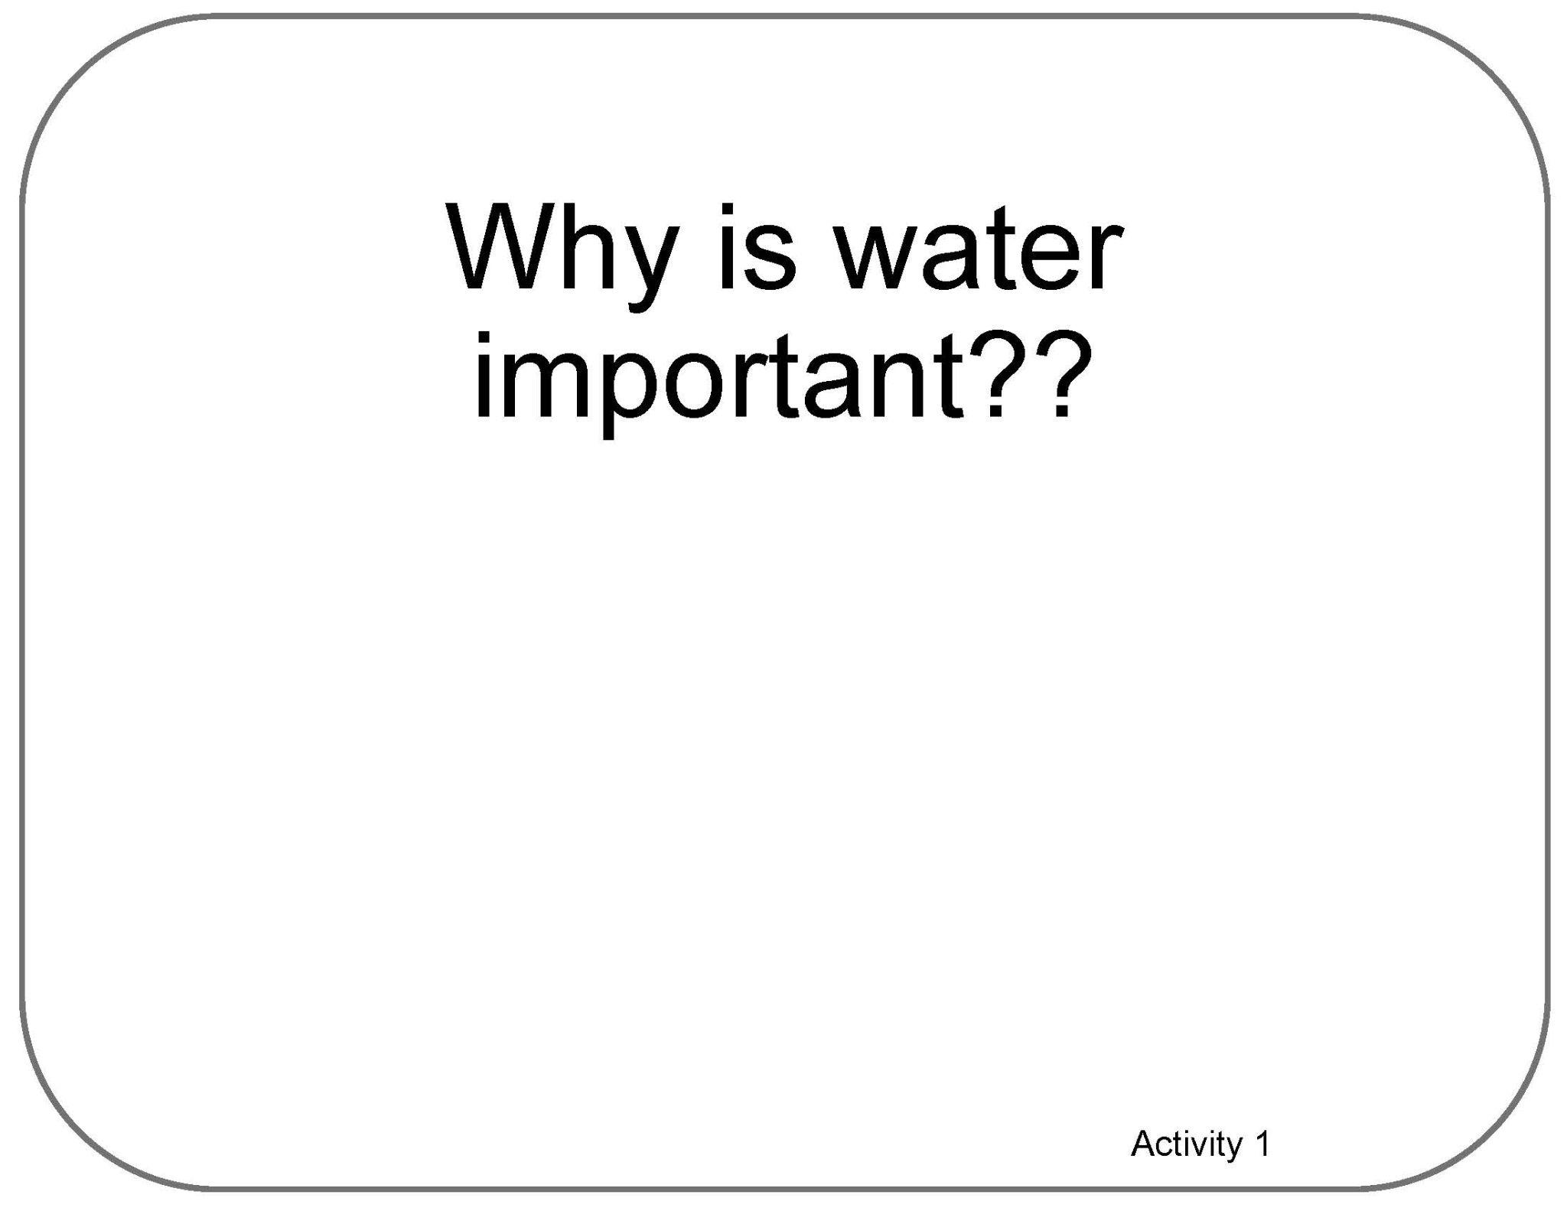
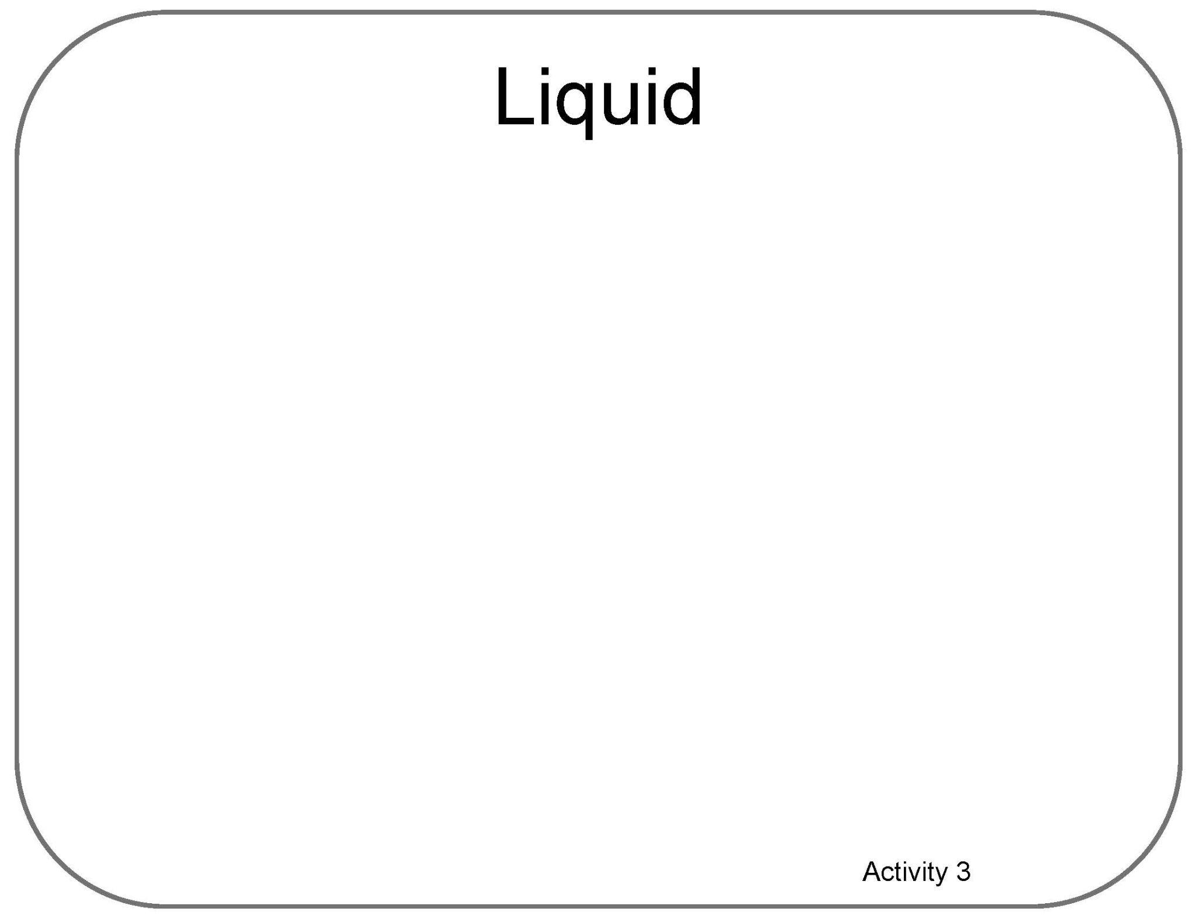

Poster Setup (Empty Example)
Our Ideas about
Water in Extreme Environments
Science

Slide 14
Water in Extreme Environments
Science RSG &
Adventures 1-7
Our Ideas Poster

Slide 15
Examples of Cards for Poster
The following slides are based on the printable PDF version of the blank cards you can use to set up your “Our Ideas Posters”
They have been altered to be more accessible to screen readers.

Slide 16
Ready S.E.T. Go! (RSG)

Slide 17
Card: How does space trash…

Slide 18
Blank RSG Card

Slide 19
Card: Scientist

Slide 20
Card: Engineer

Slide 21
Card: Technology

Slide 22
Card: Why is water important??

Slide 23
Blank Activity 1 Card

Slide 24
Activities 2-3

Slide 25
Card: NASA has limited time and resources

Slide 26
Card: Where in the solar system is water…

Slide 27
Card: Charting water location

Slide 28
Card: Where is there water on Earth?

Slide 29
Card: Reservoir

Slide 30
Card: Subsurface

Slide 31
Card: Surface

Slide 32
Card: Atmosphere

Slide 33
Card: What kind of things…

Slide 34
Card: Liquid

Slide 35
Card: Salinity

Slide 36
Card: Habitable

Slide 37
Card: Extremophile

Slide 38
Activities 4-7

Slide 39
Card: What are the different planetary…

Slide 40
Blank Activity 4 Card

Slide 41
Card: Where is the most water…

Slide 42
Blank Activity 5 Card

Slide 43
Card: water ice vs. water vapor

Slide 44
Card: Besides Earth…

Slide 45
Card: What water reservoir…

