Slide 1
Engineering
Space Hazard
RSG & Adventures 1-9
Our Ideas Poster
Prep & Setup Guide with Examples
Screen Reader Version - NOT for Print

Slide 2
Poster Components
The following slides are based on the printable PDF version of the blank slides/cards you can use to set up your “Our Ideas Posters” and are not intended to be printed.
These slides are formatted to be more accessible to screen readers.
We recommend using these slides as a guide for blind and low vision educators and printing out the PDFs for sighted learners.

Slide 3
Corresponding PDFs include
Poster Pages to build the poster
  (pages numbered in lower right corner with corresponding adventure(s))
Poster Pages with examples are for educator reference only and not intended to print.
Blank Pages for more space or to build your own poster
Blank ¼ page cards for learners to add additional terms, drawings, ideas
Term cards:
Icon-only
Term + icon

Slide 4
Set Up
You need a wall or whiteboard area of about 80” Length x 60” Height.
Please see the following pages for setup examples.
You may choose alternative layouts or formats to fit your learning environment.

Slide 5
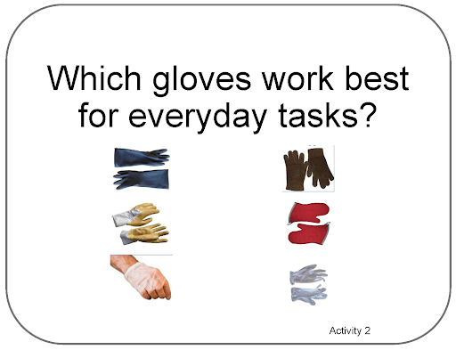
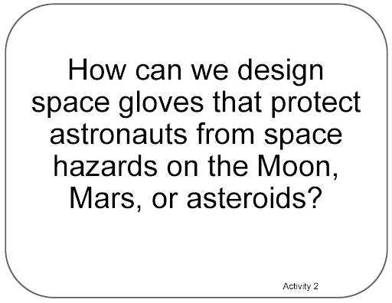
Poster Pages Examples
(Reference - do not print)

Slide 6

Term Card Example
(Reference - do not print)

Slide 7
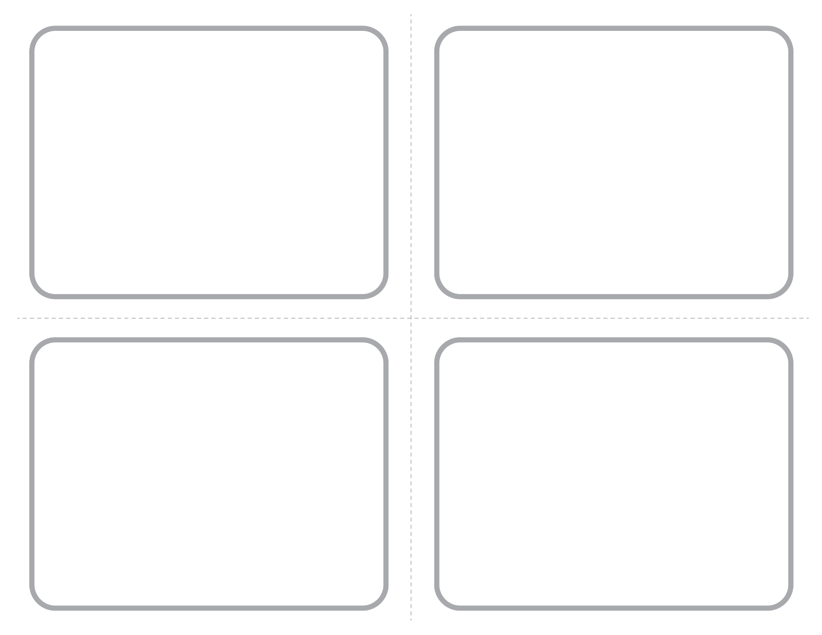
Blank ¼ Page Card Screenshot
Intended for learner responses

Slide 8
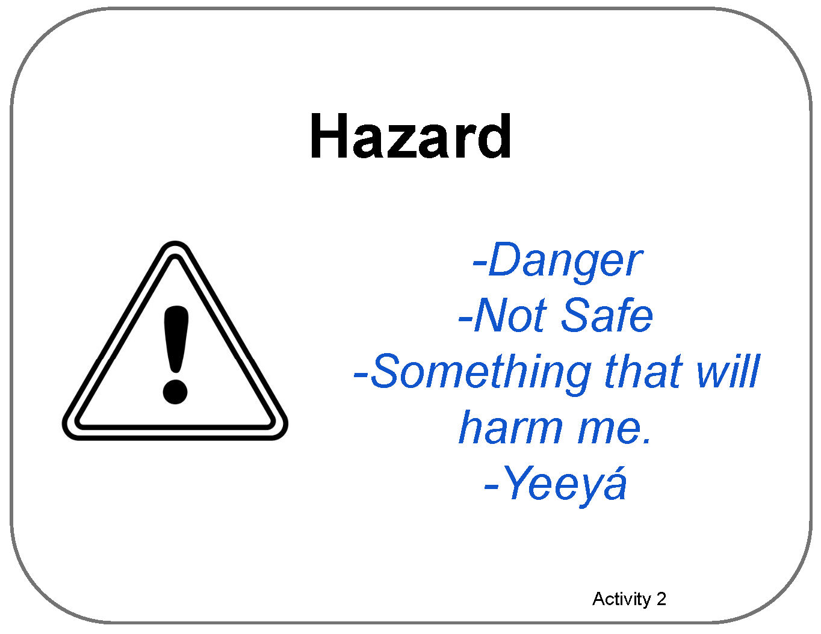
Poster Pages with Examples

Slide 9
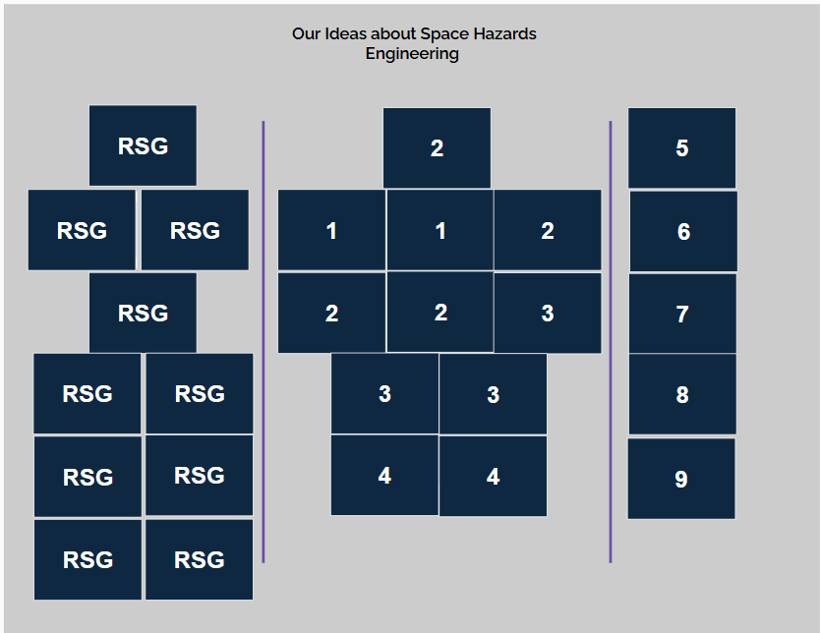
Poster Setup Layout

Slide 10
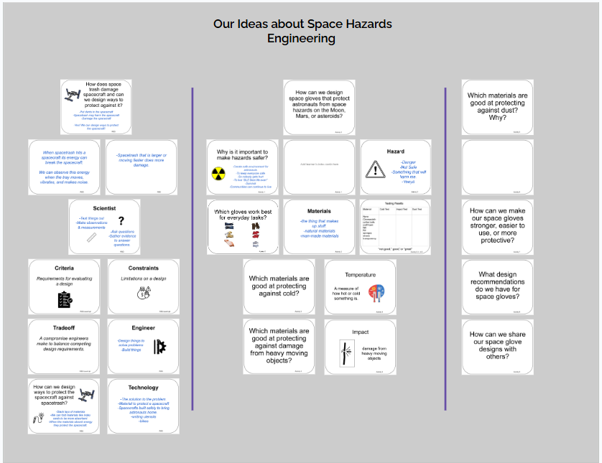
Poster Setup Layout with Learner Examples

Slide 11
Details about Learner Examples
The following two slides are a compromise to allow for alt text readability.
They are formatted for visual access, and not necessarily in a way that is best for screen readers, but do allow for alt text for each of the example cards.
They are optional, and can be skipped if they are not helpful to you.

Slide 12
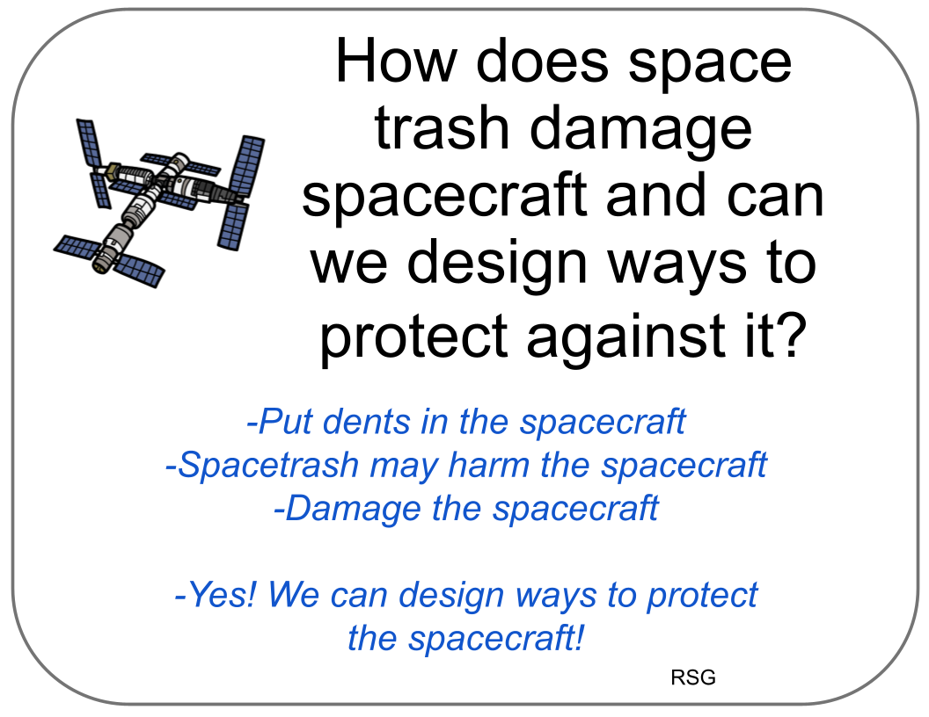


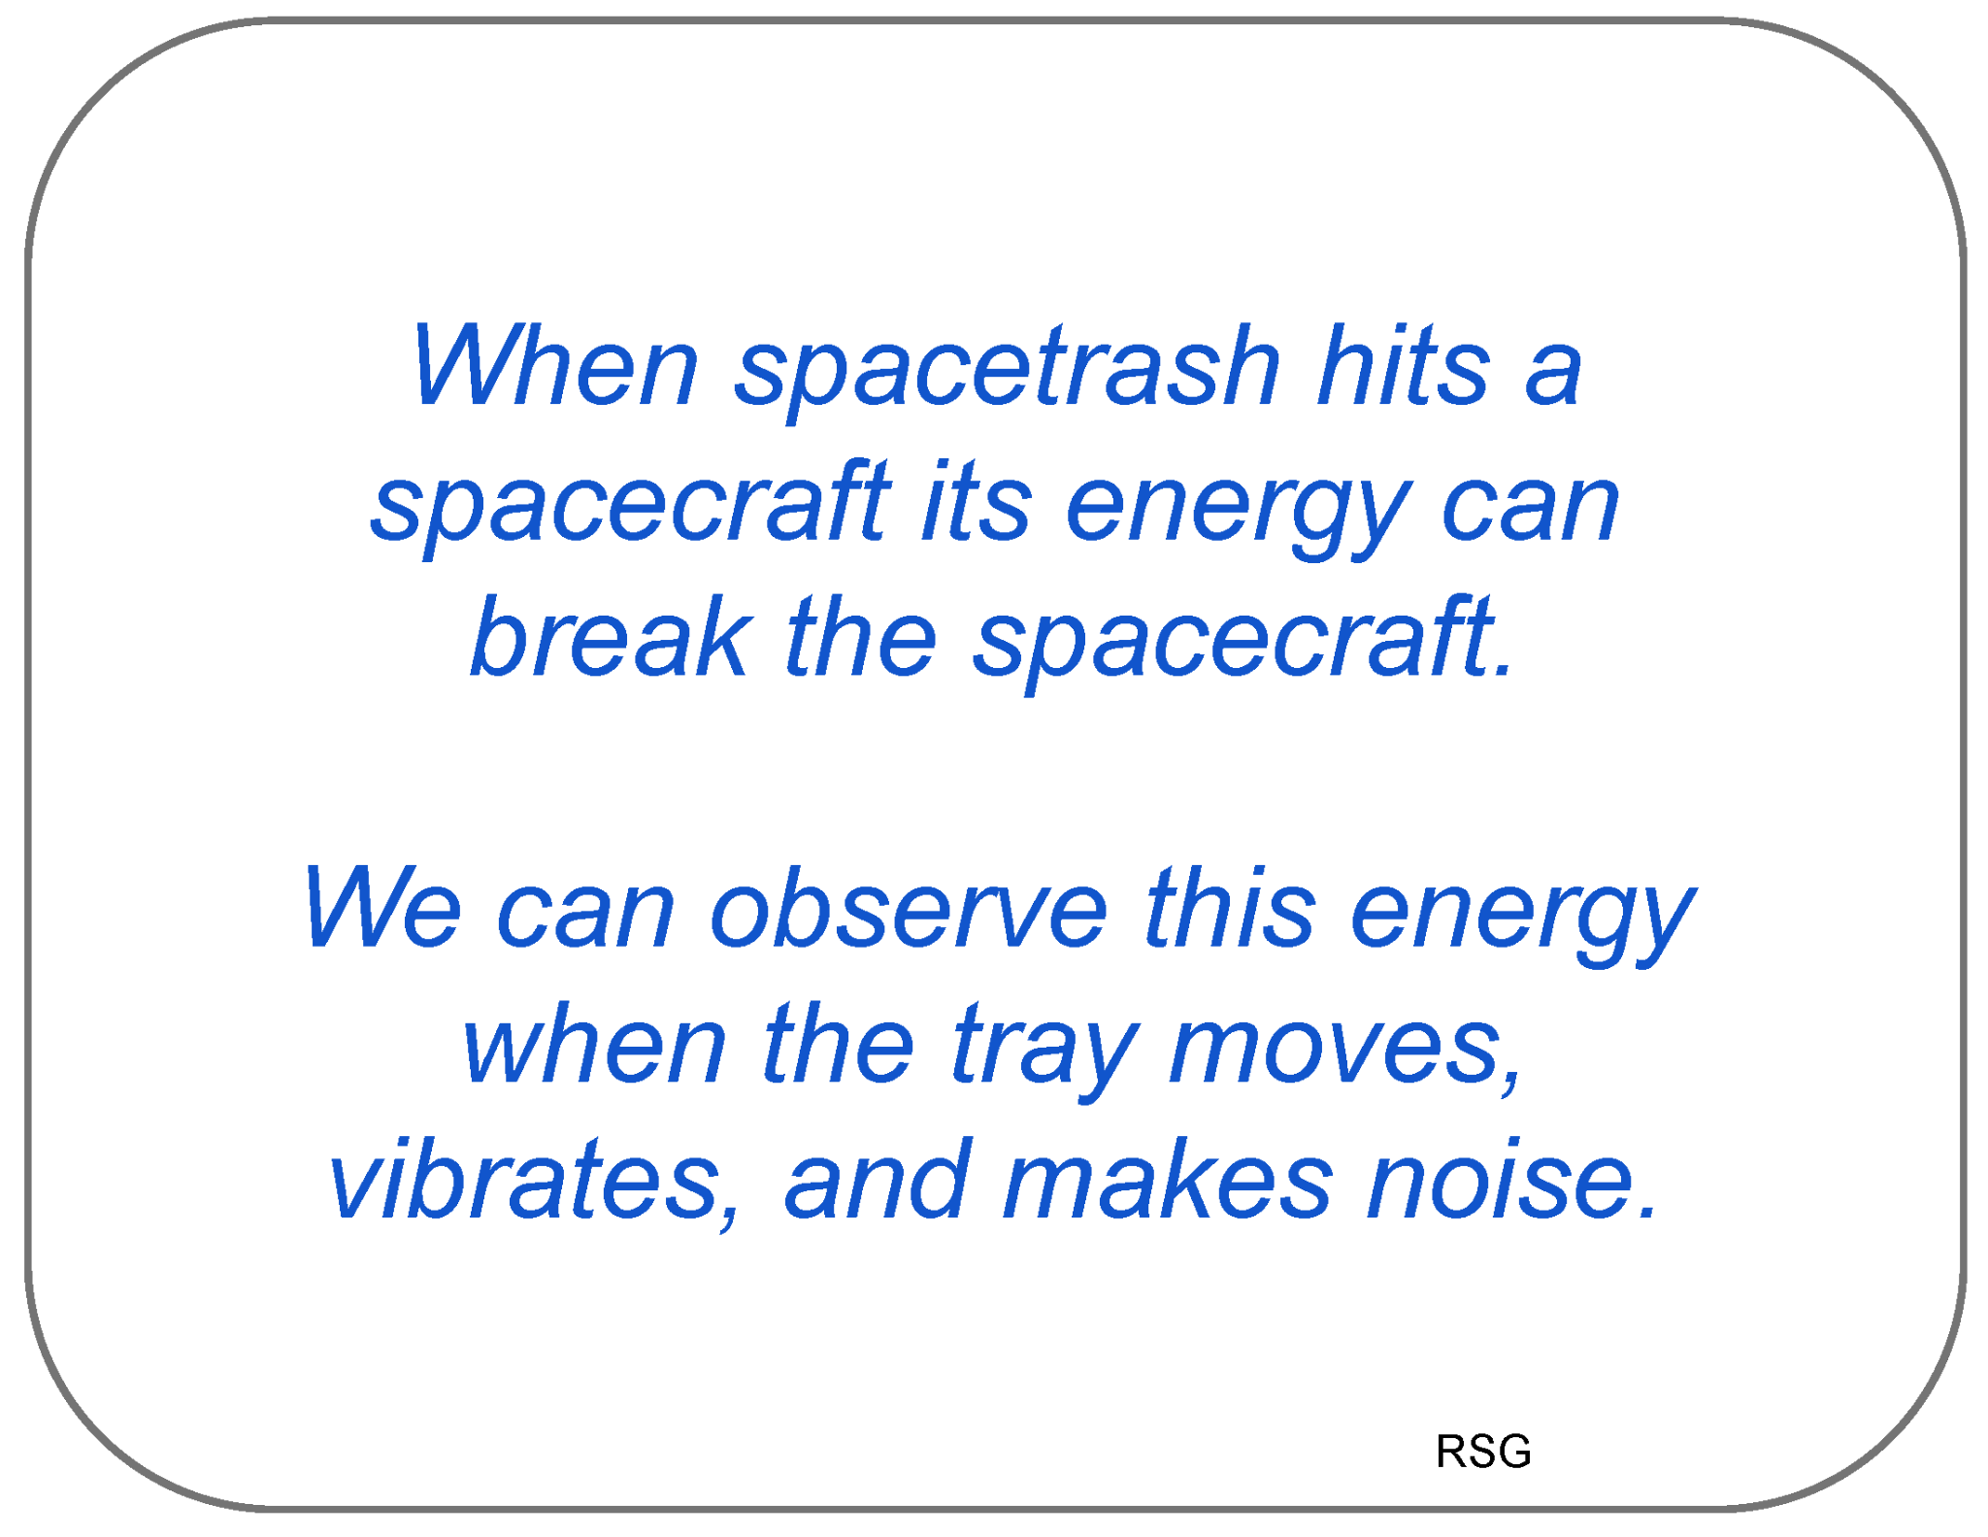
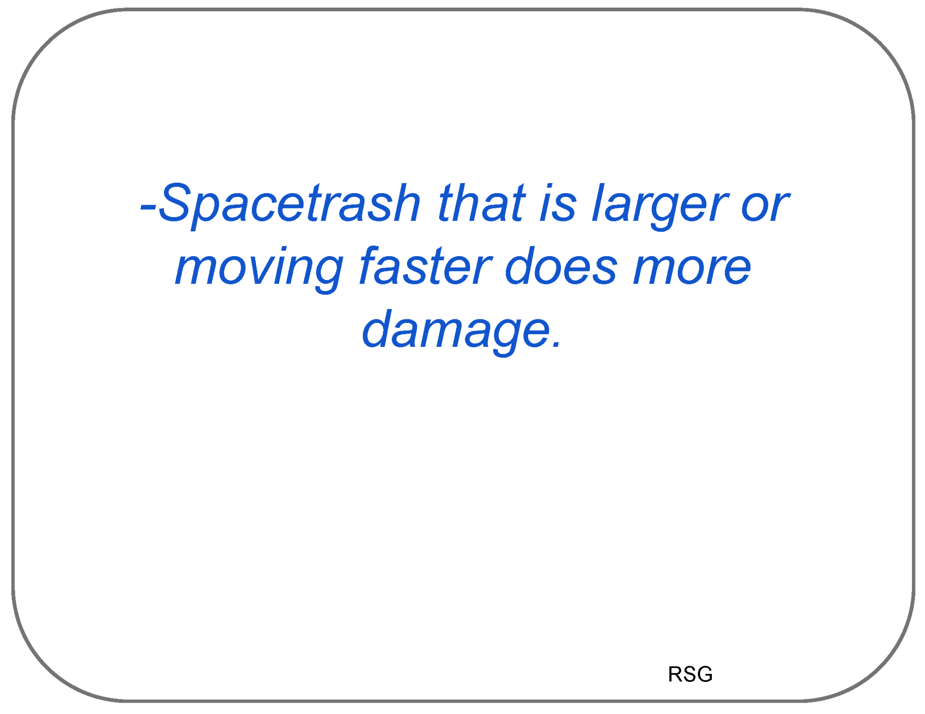
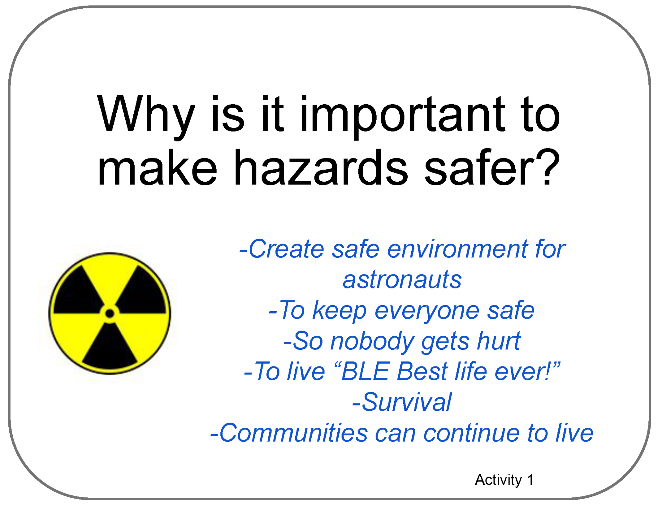
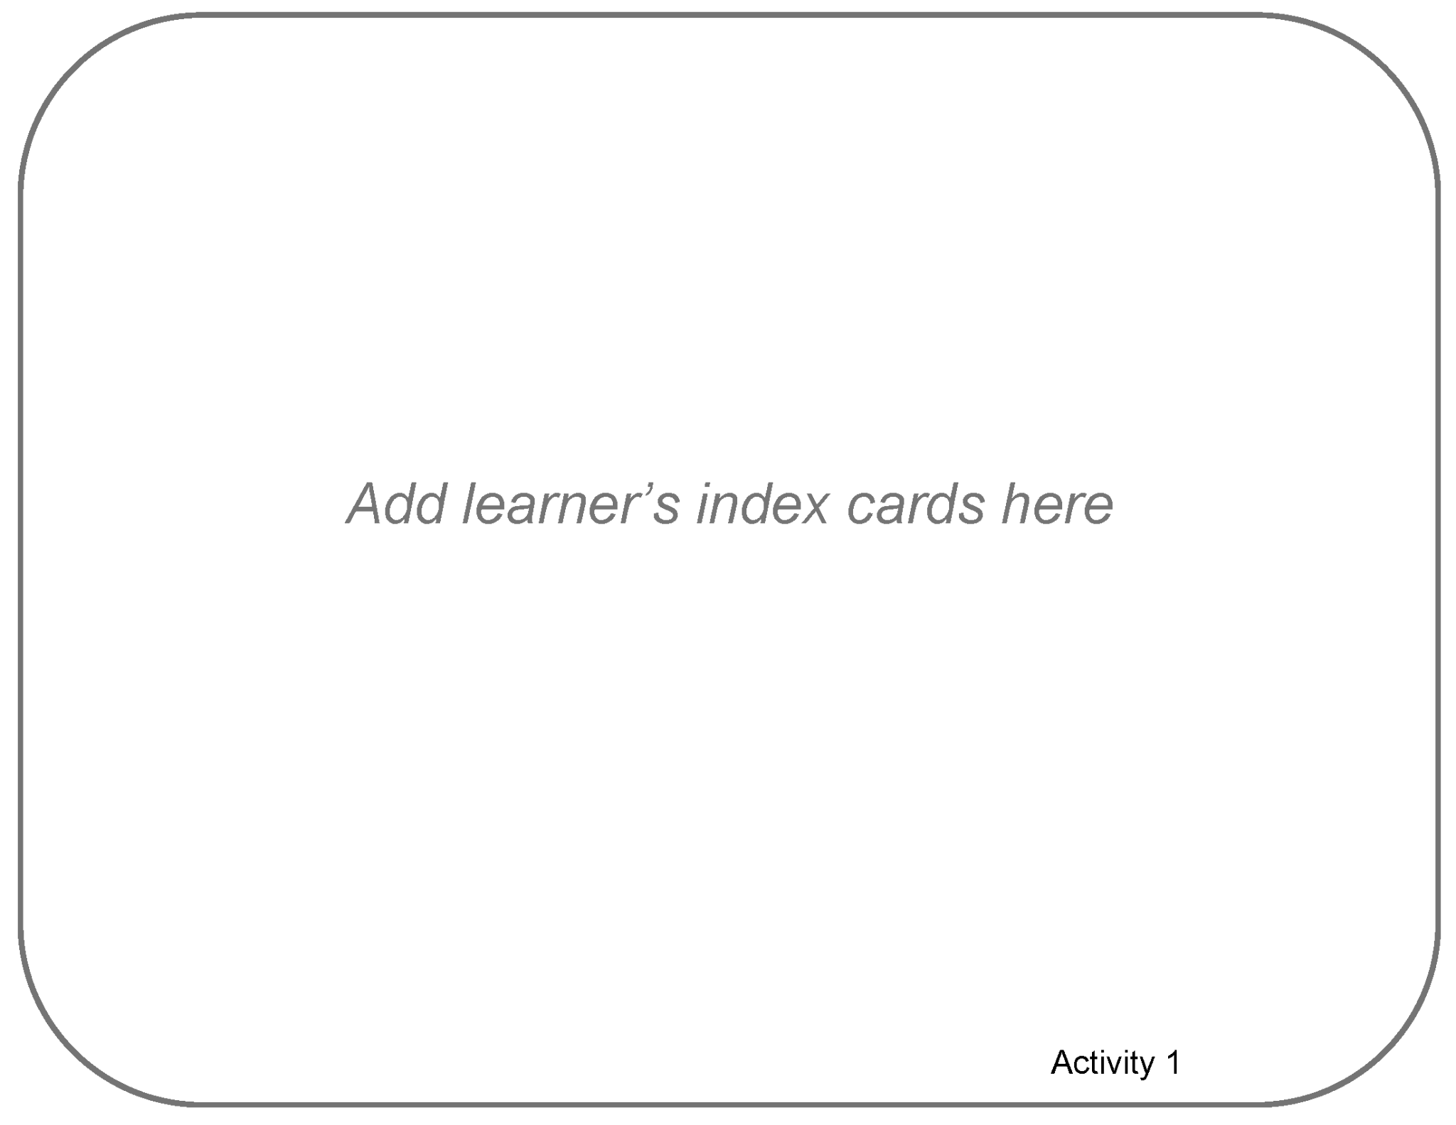
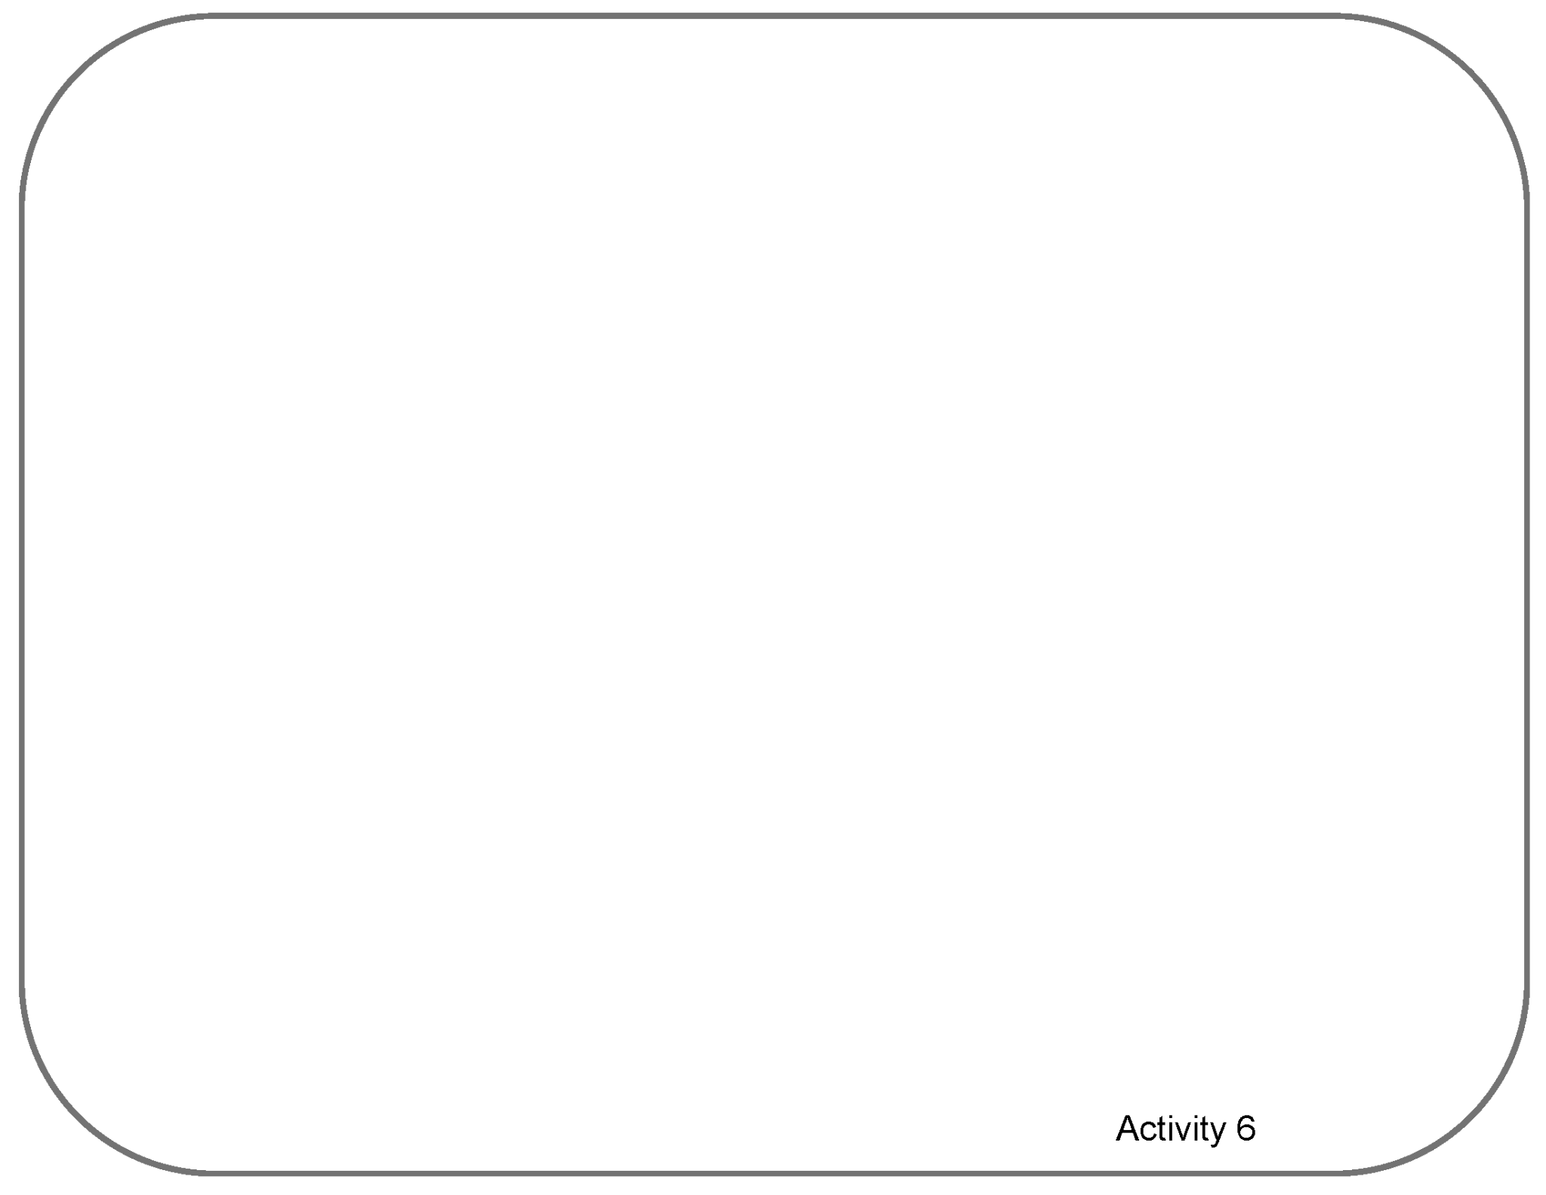
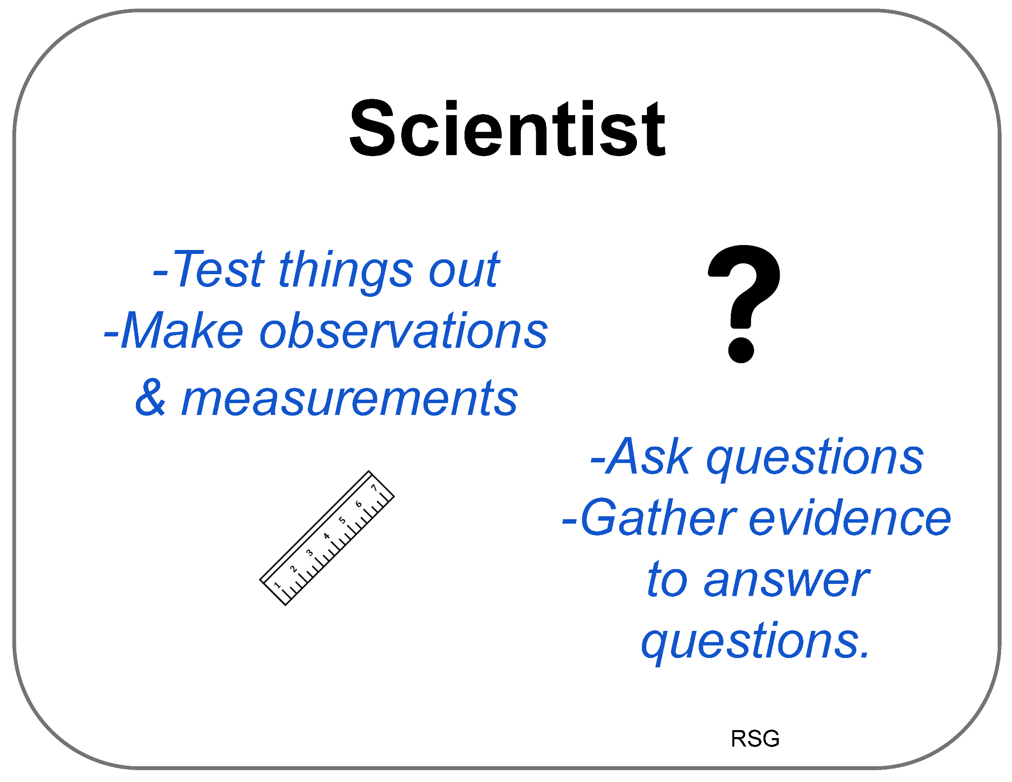
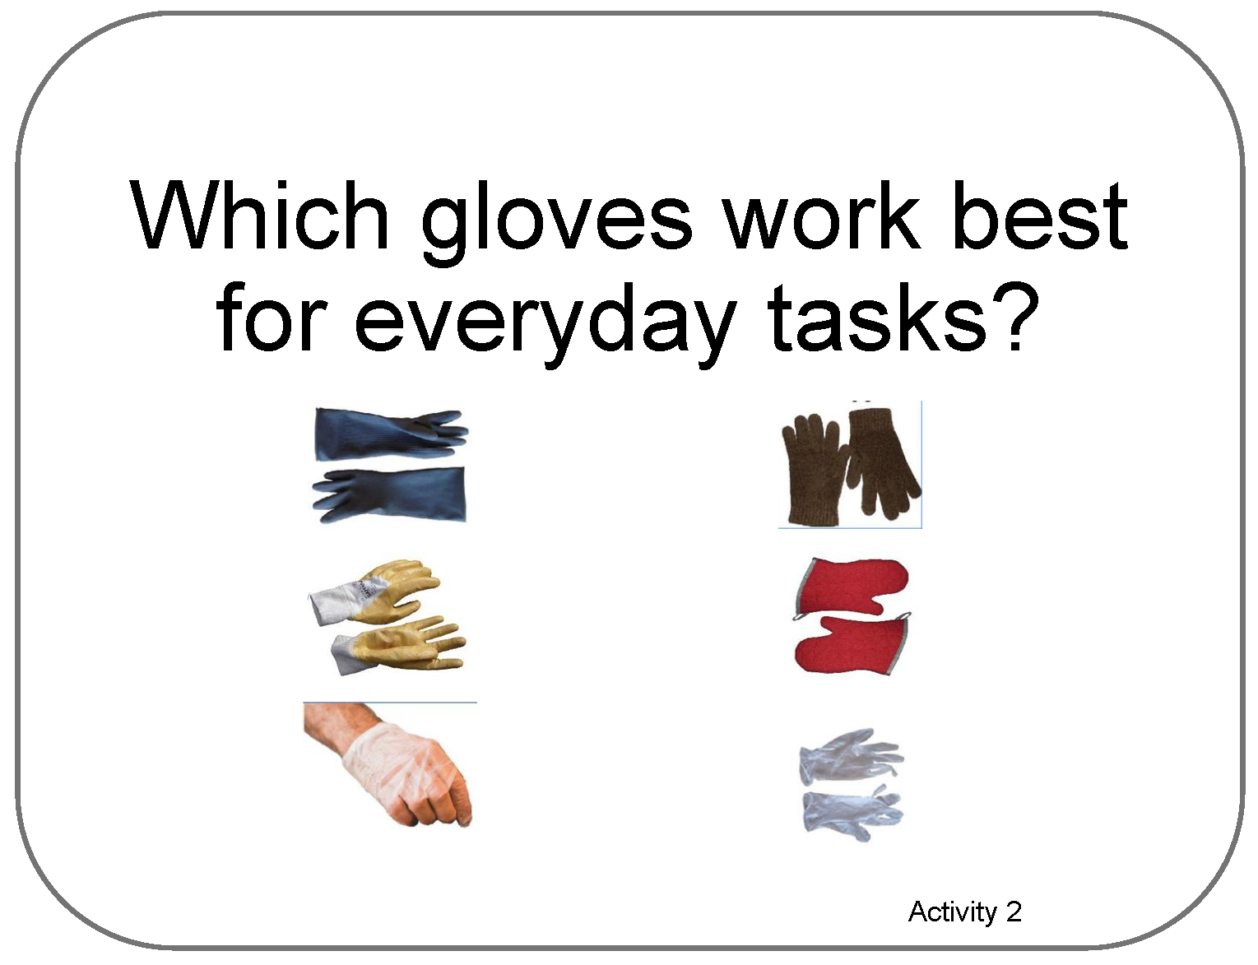
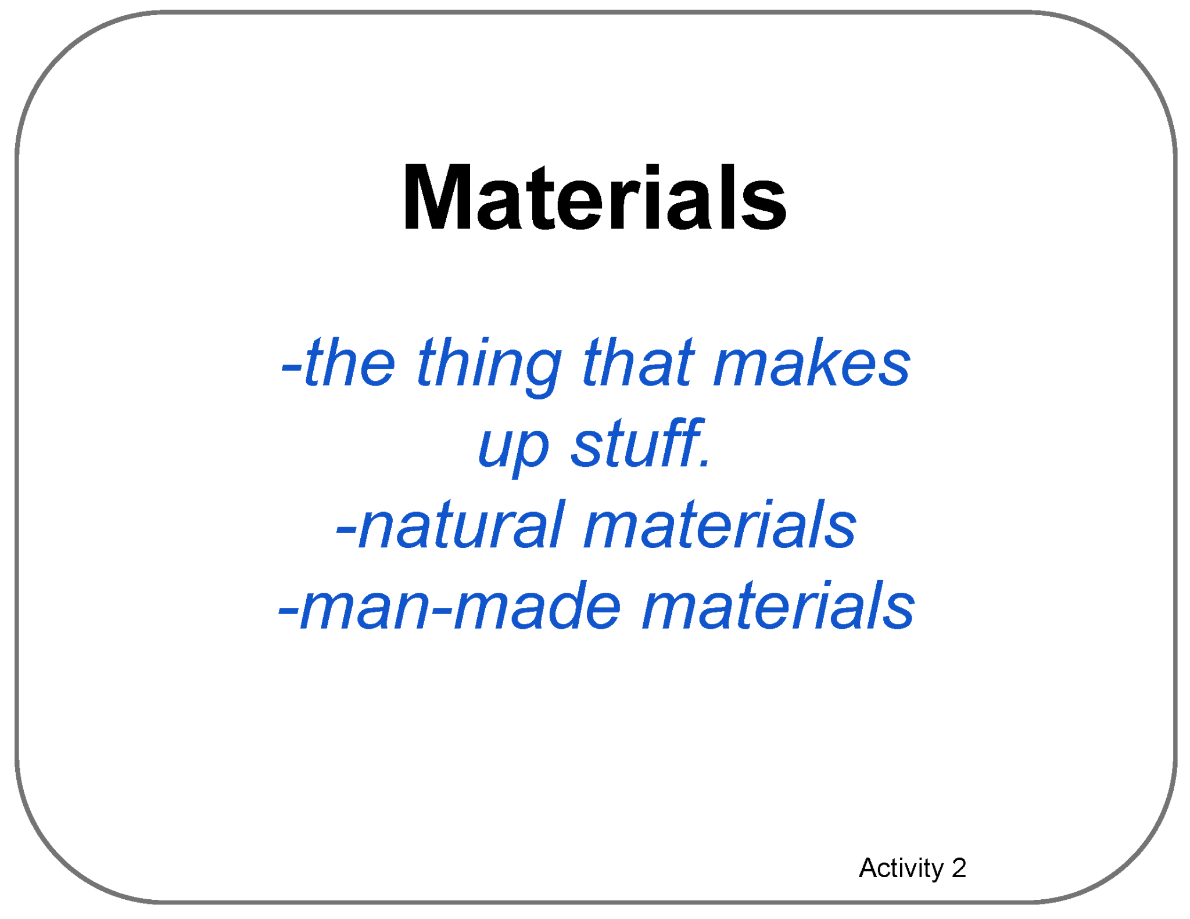
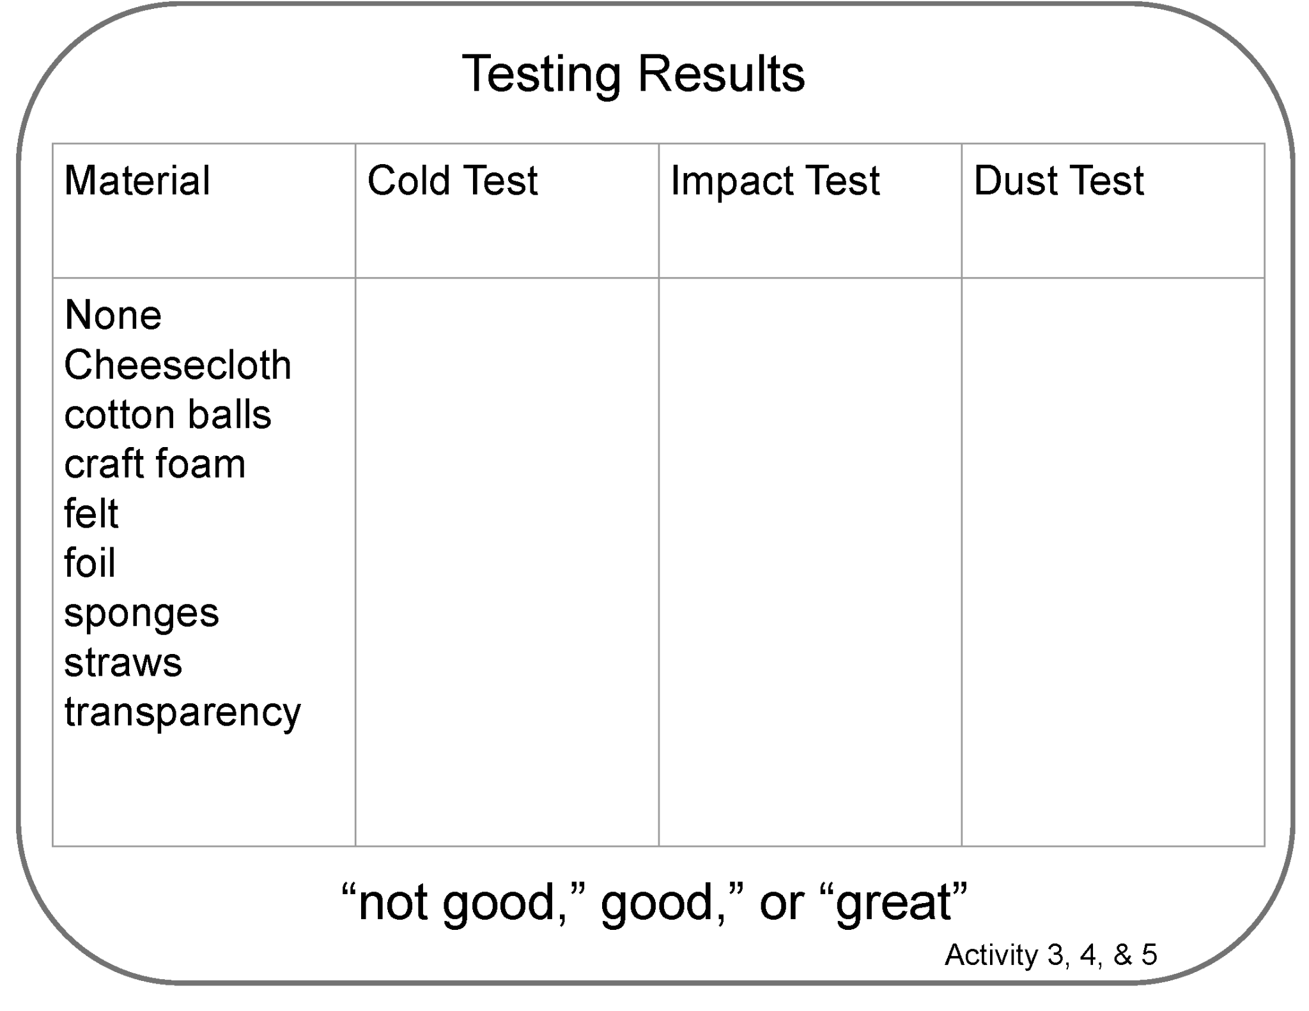
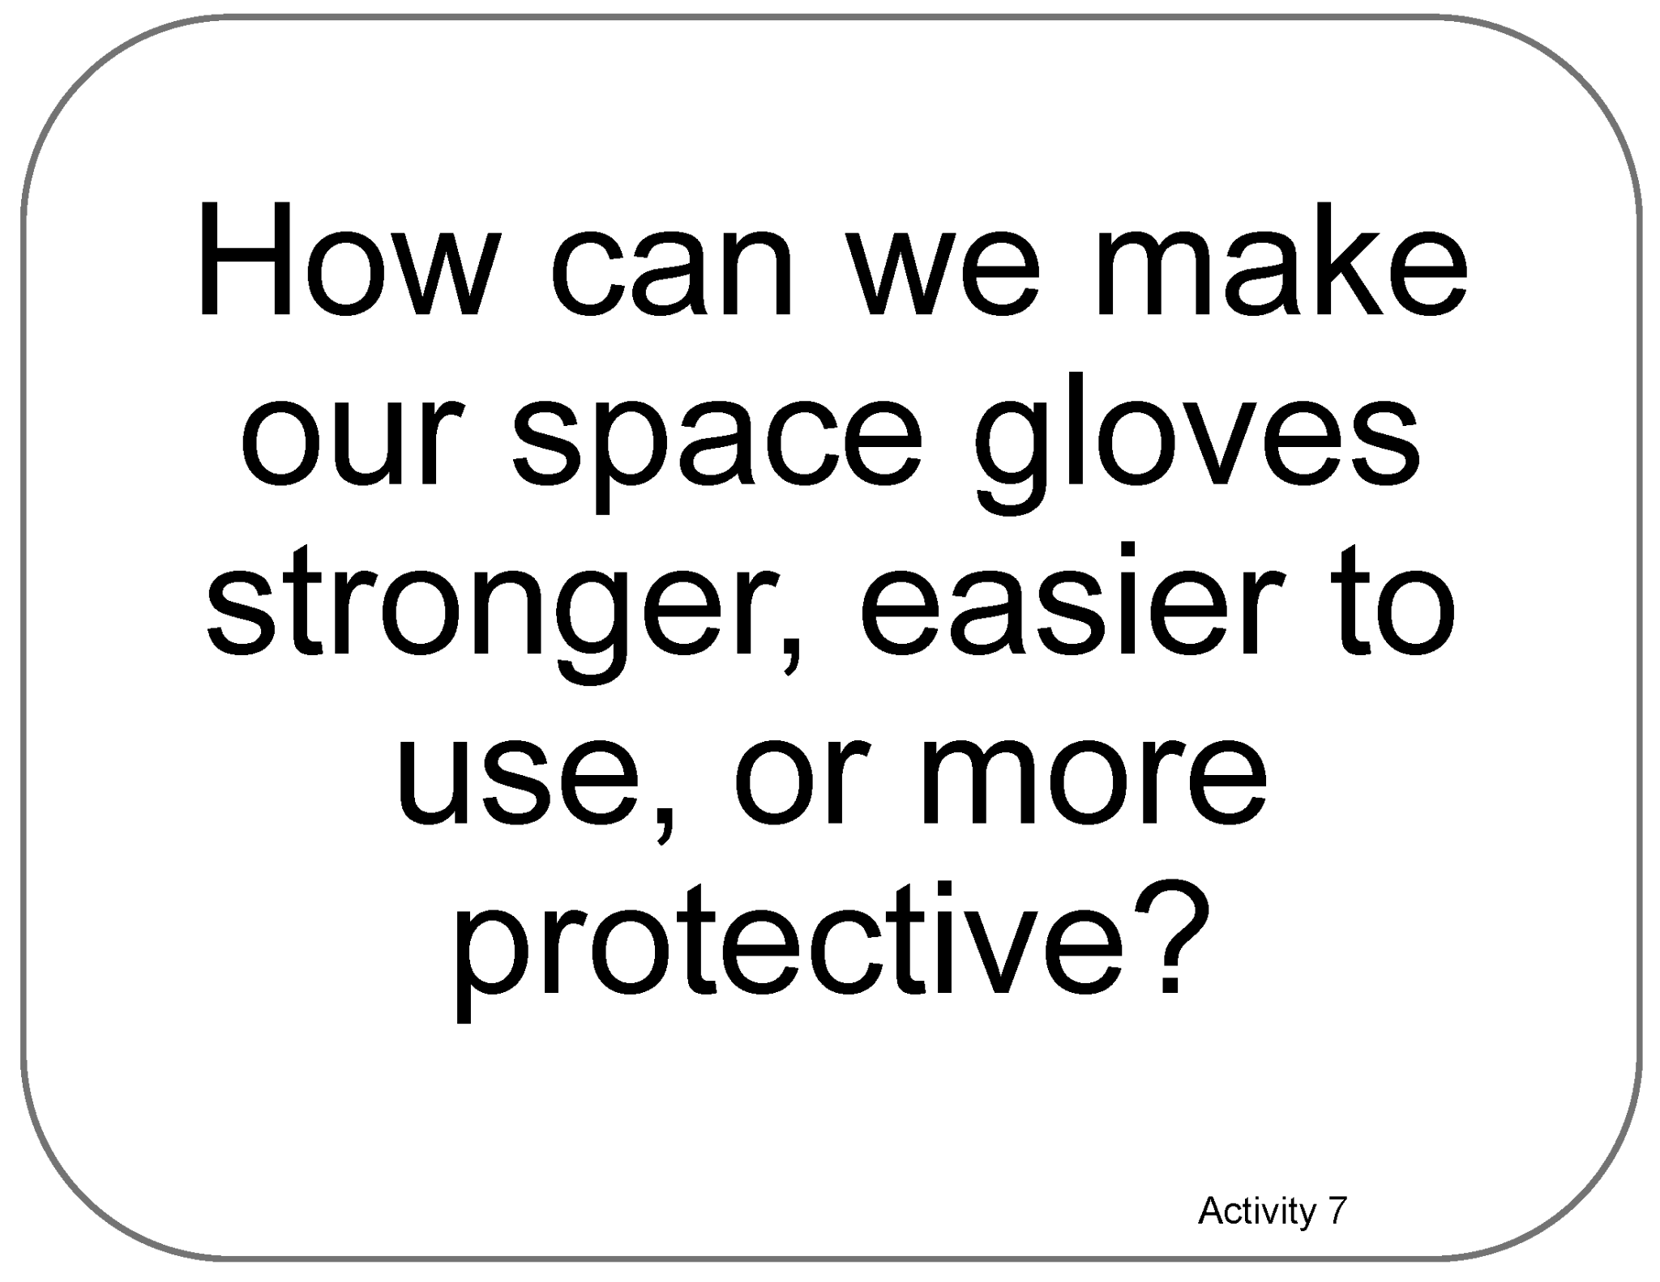
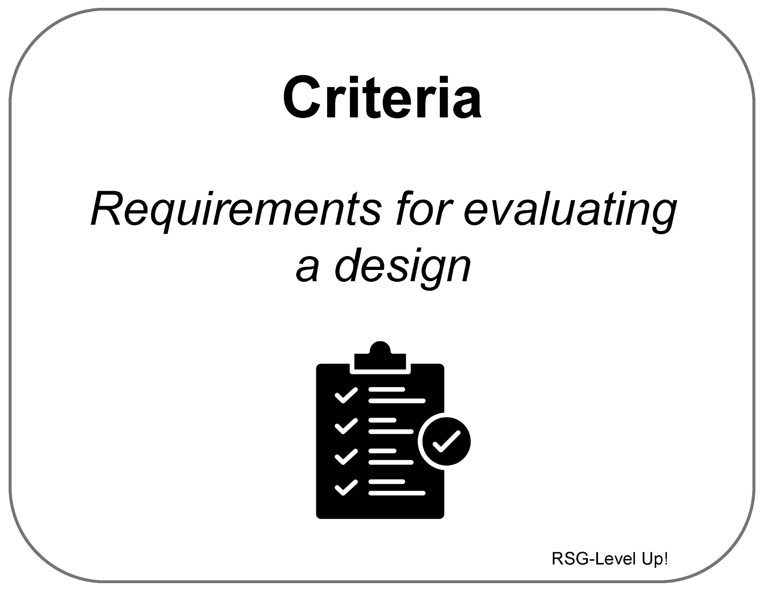
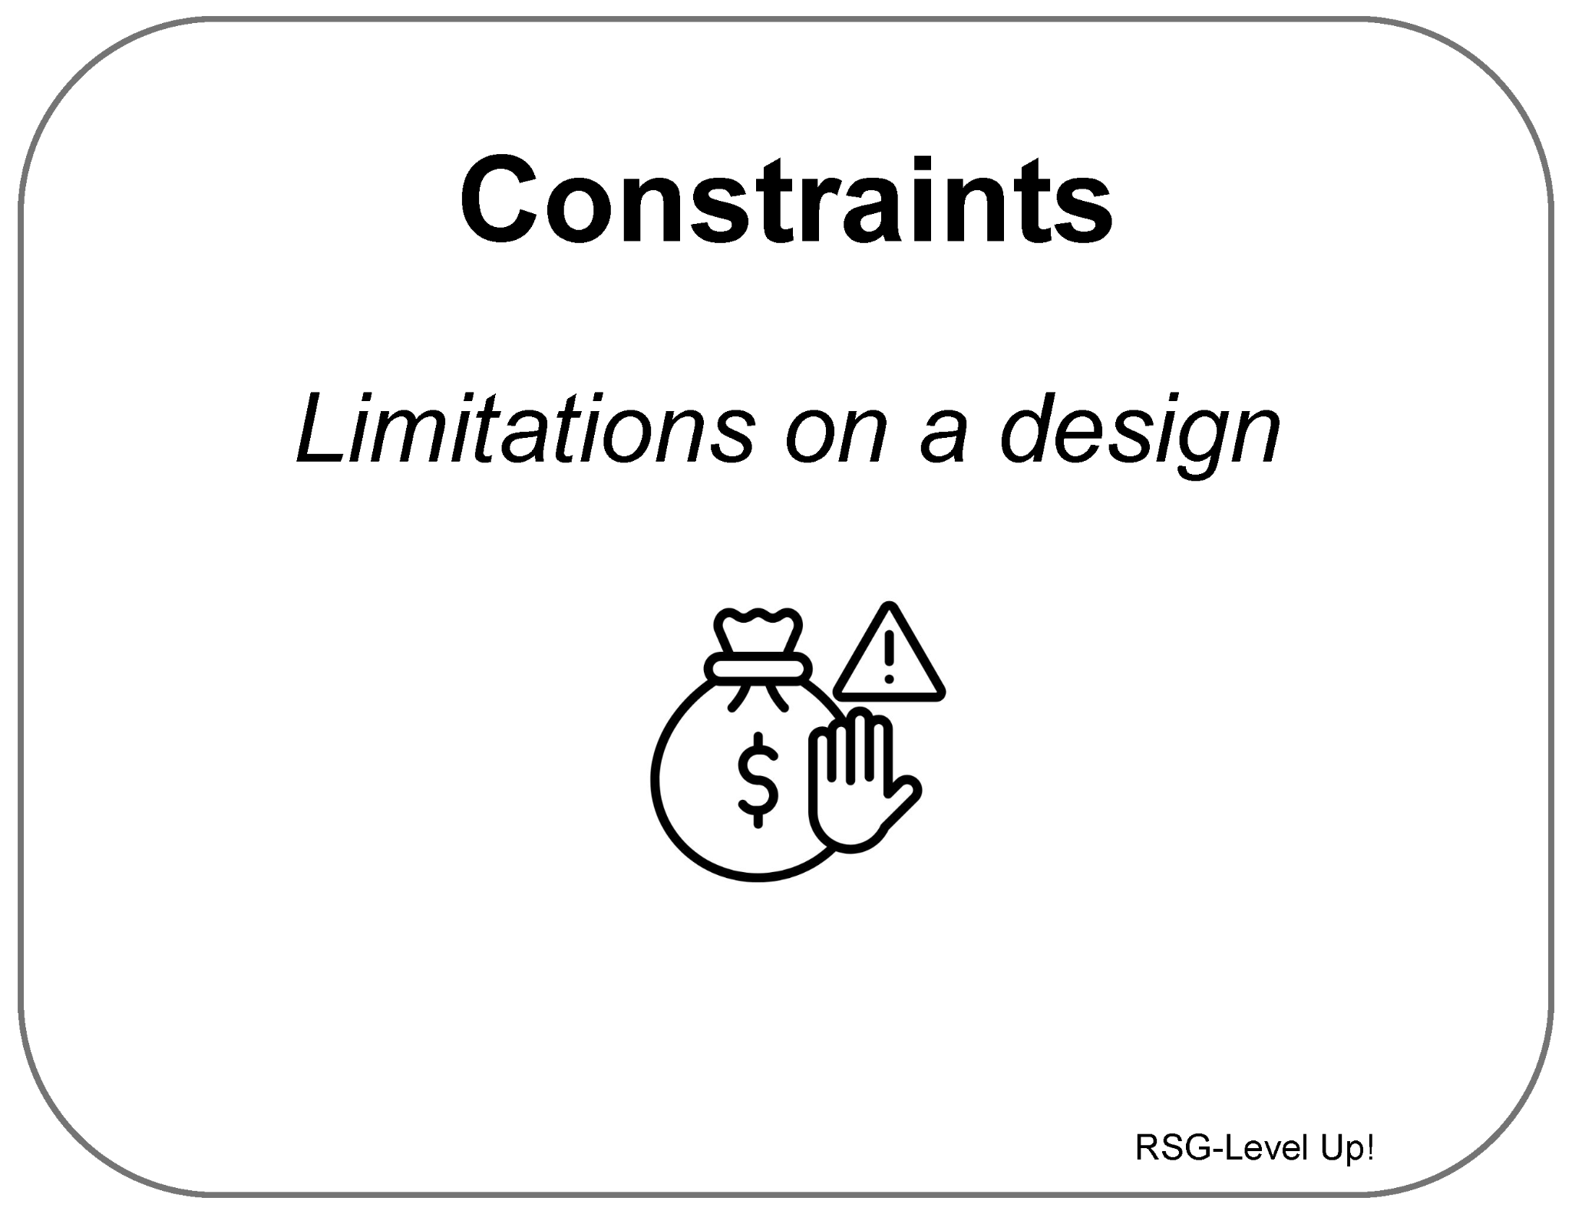
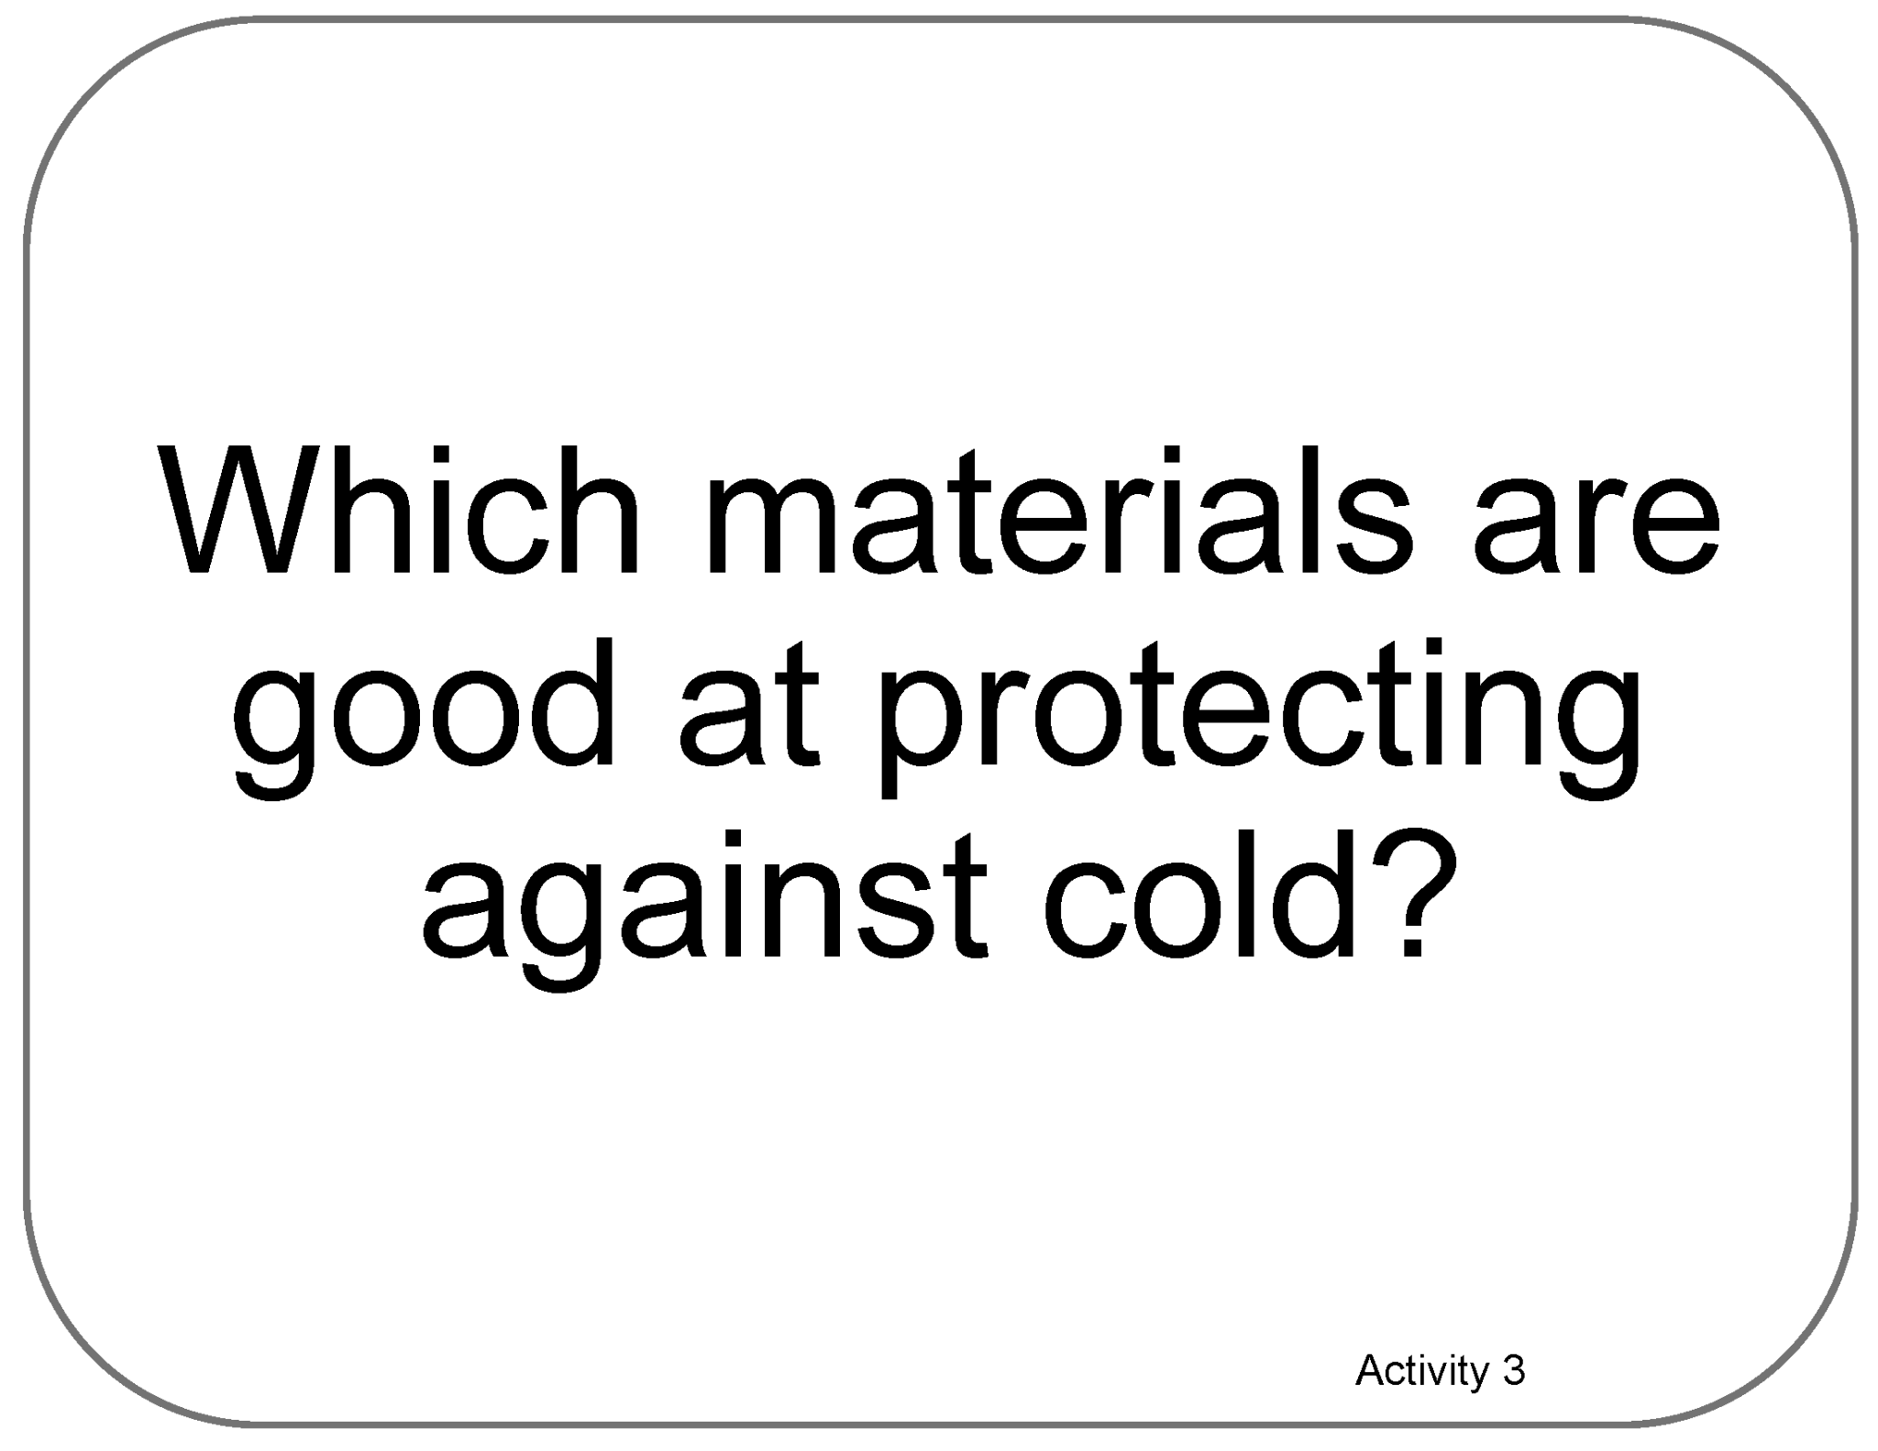
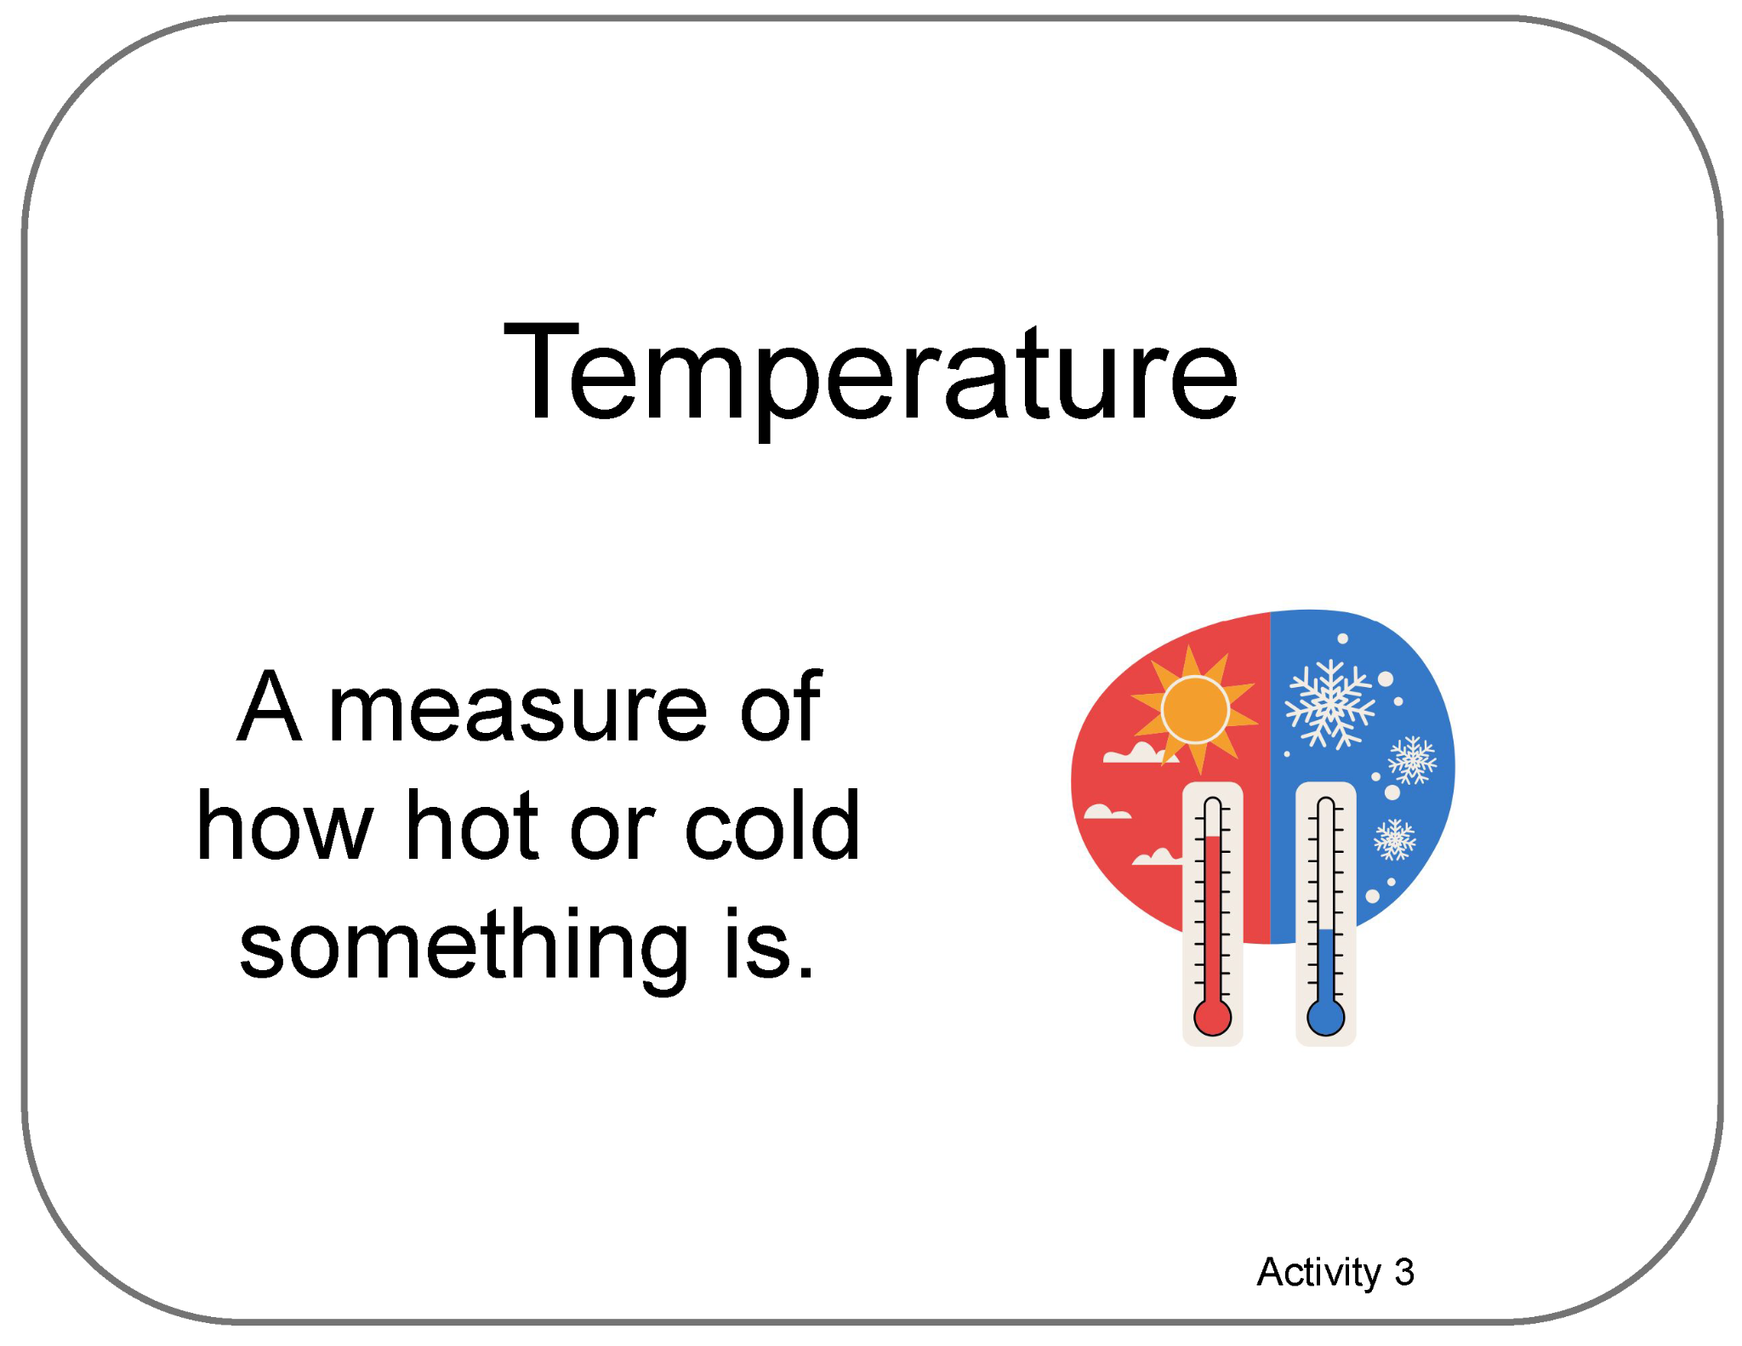


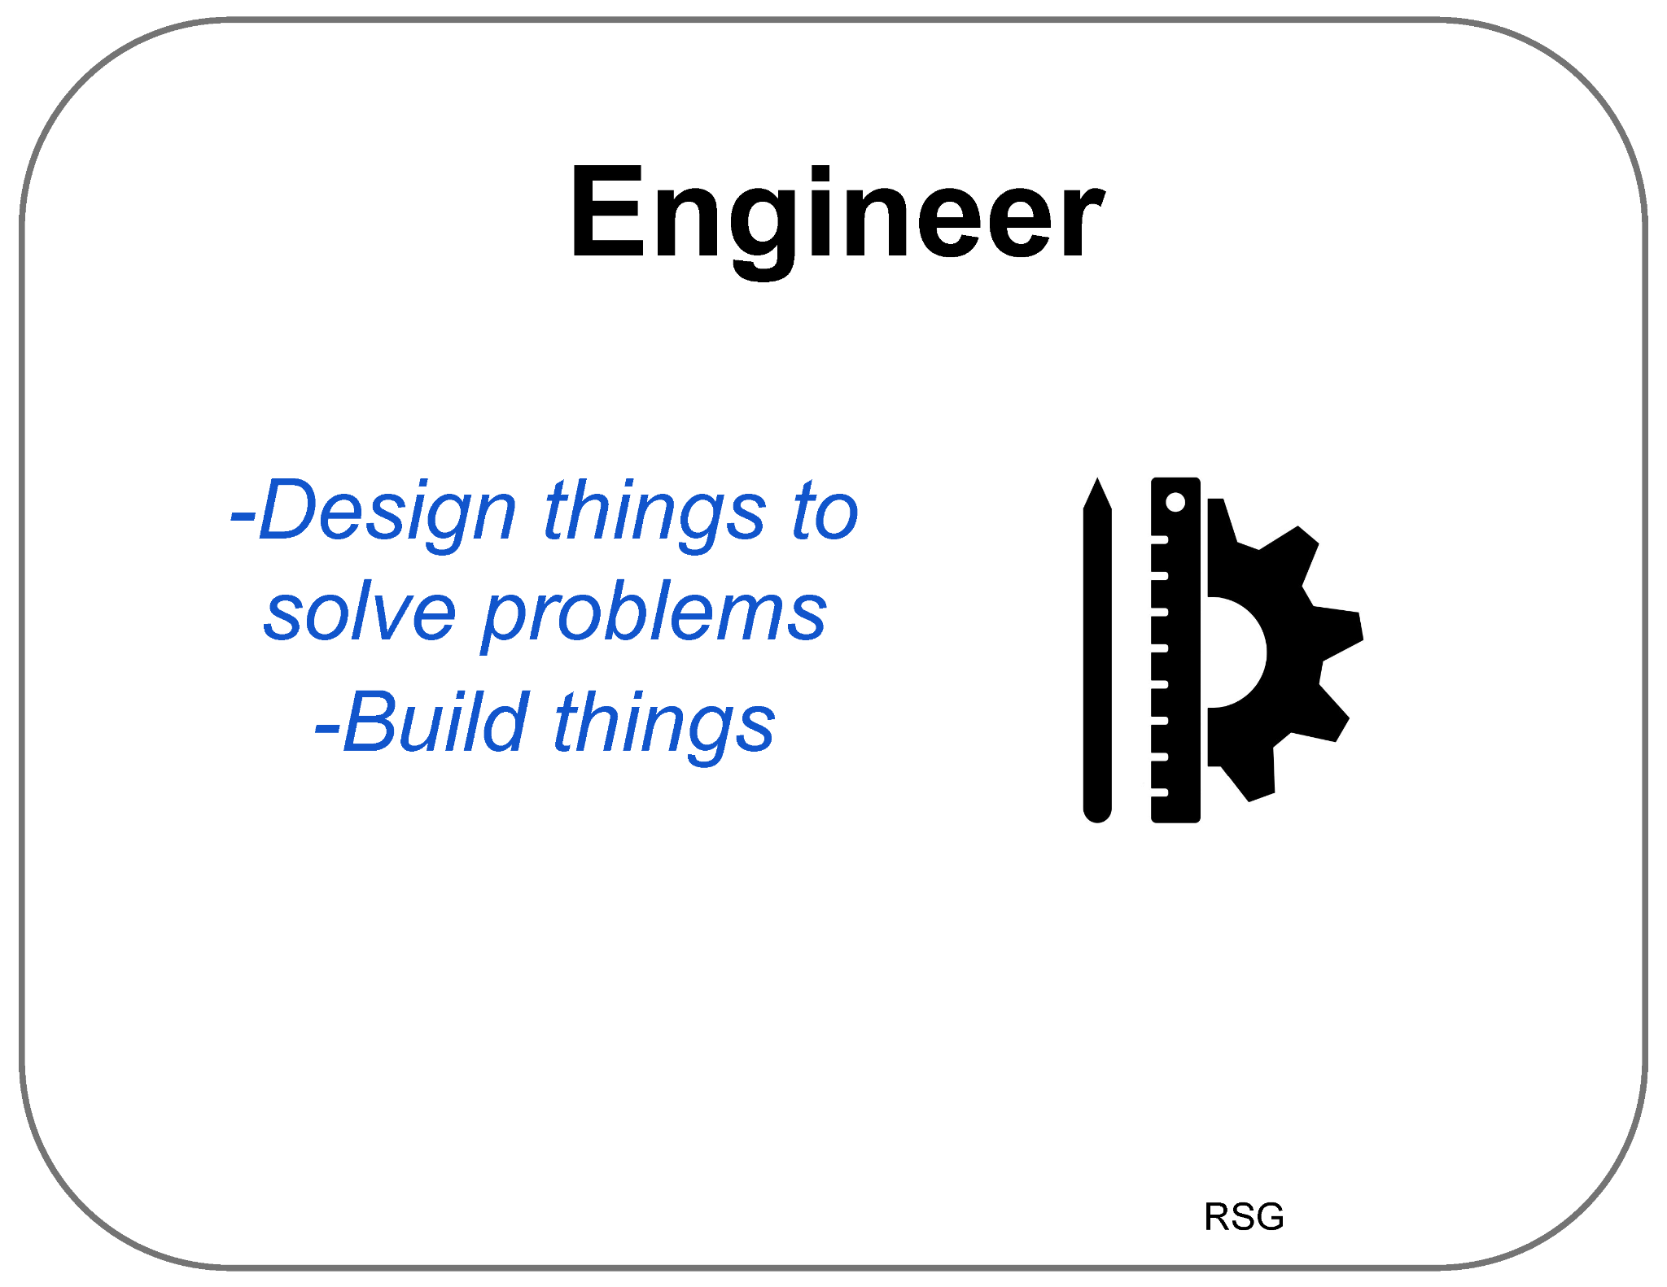
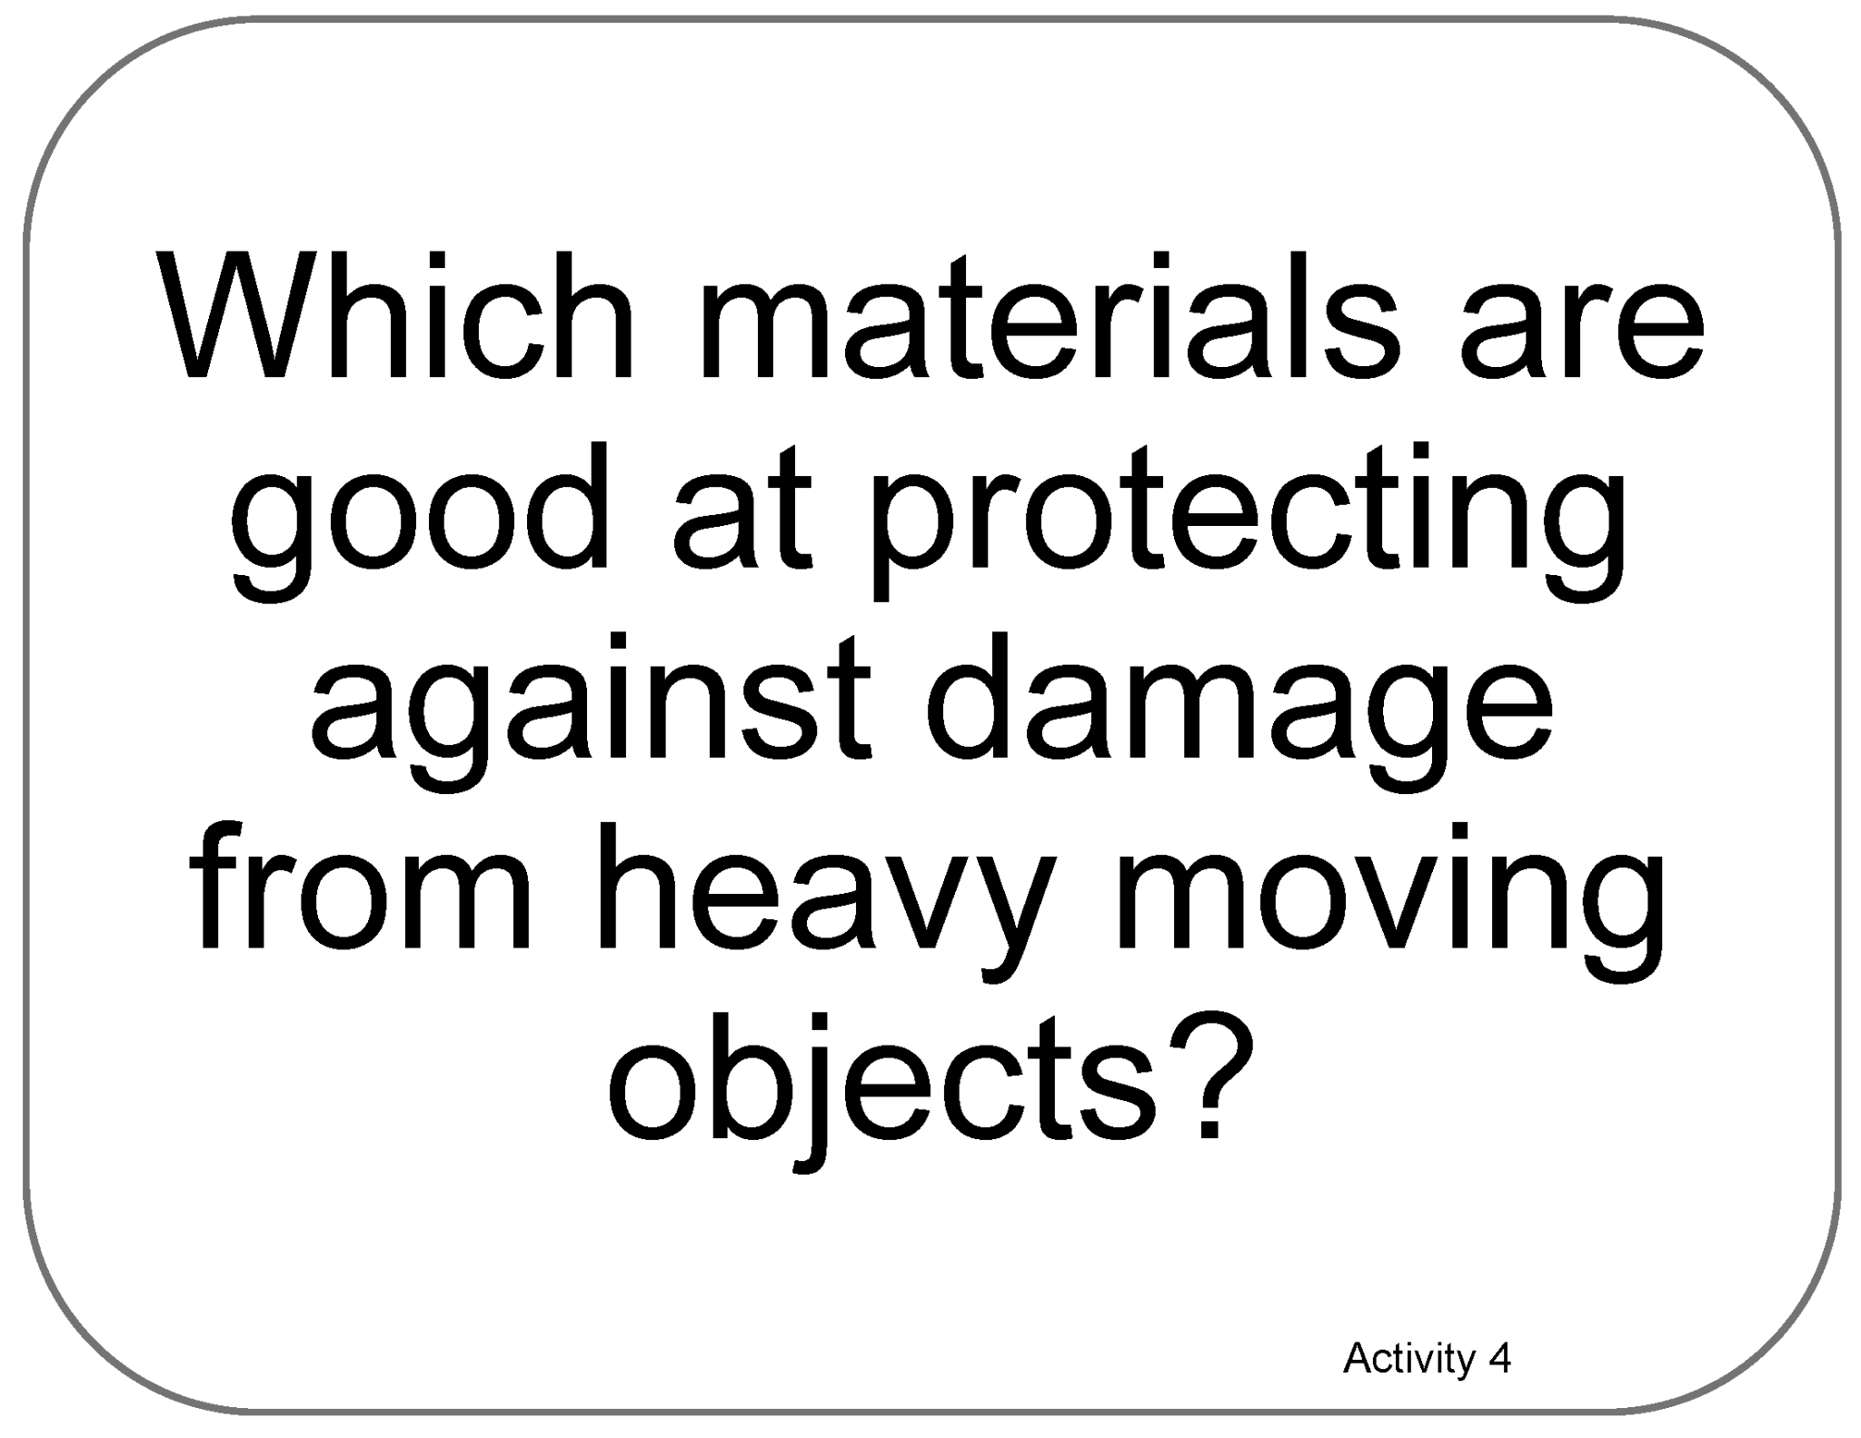

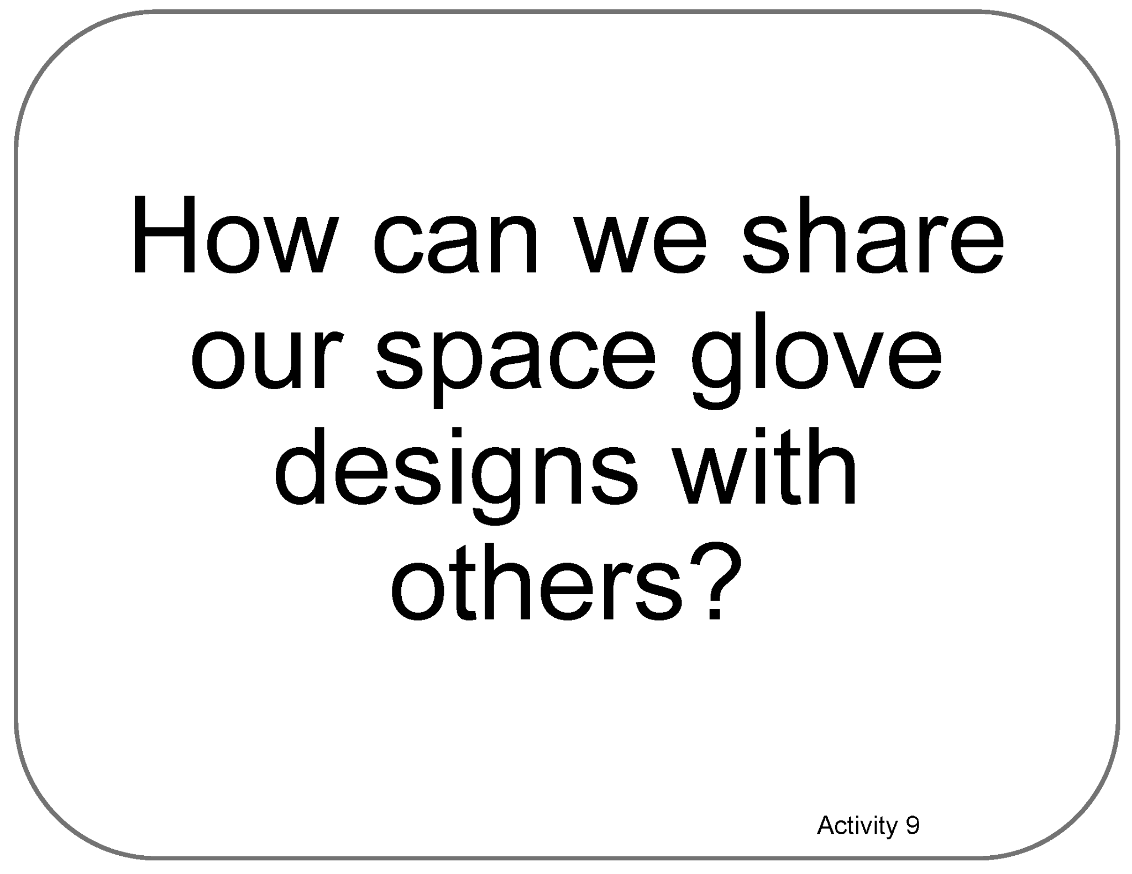
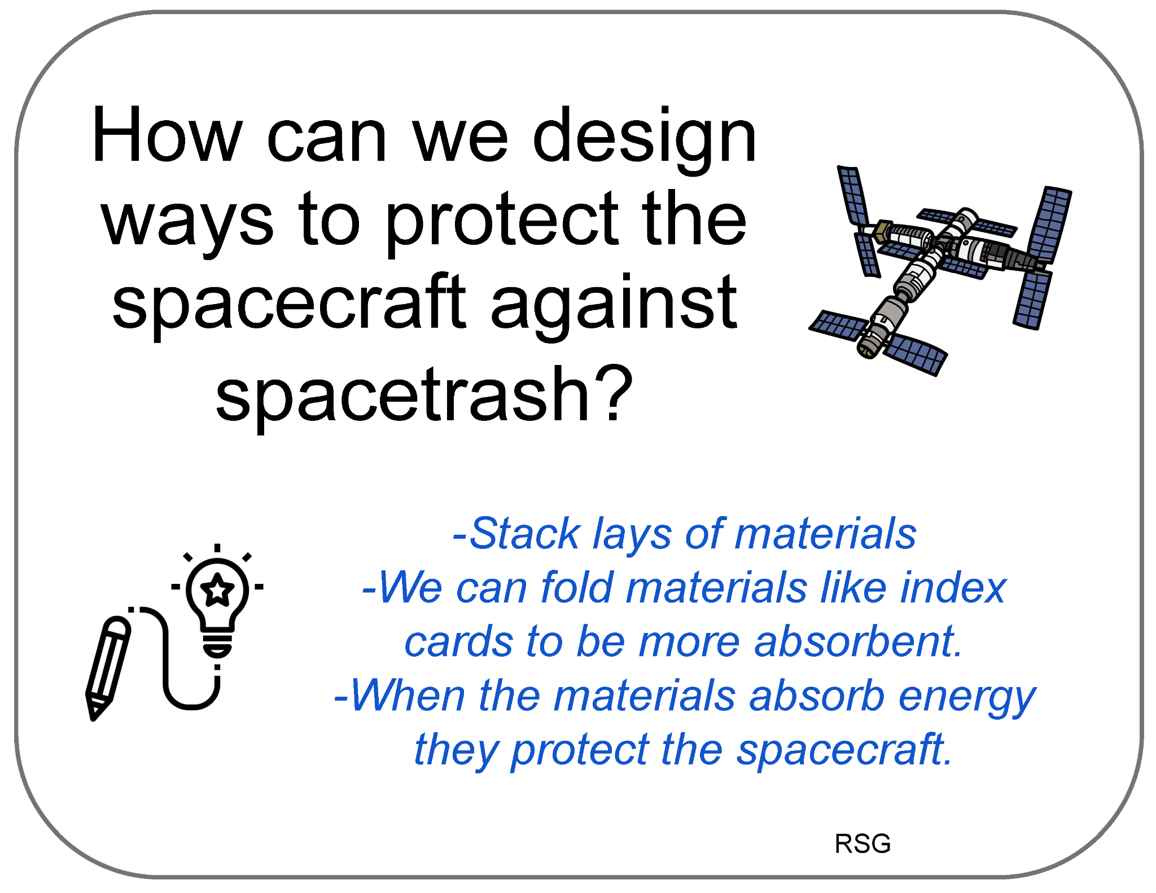
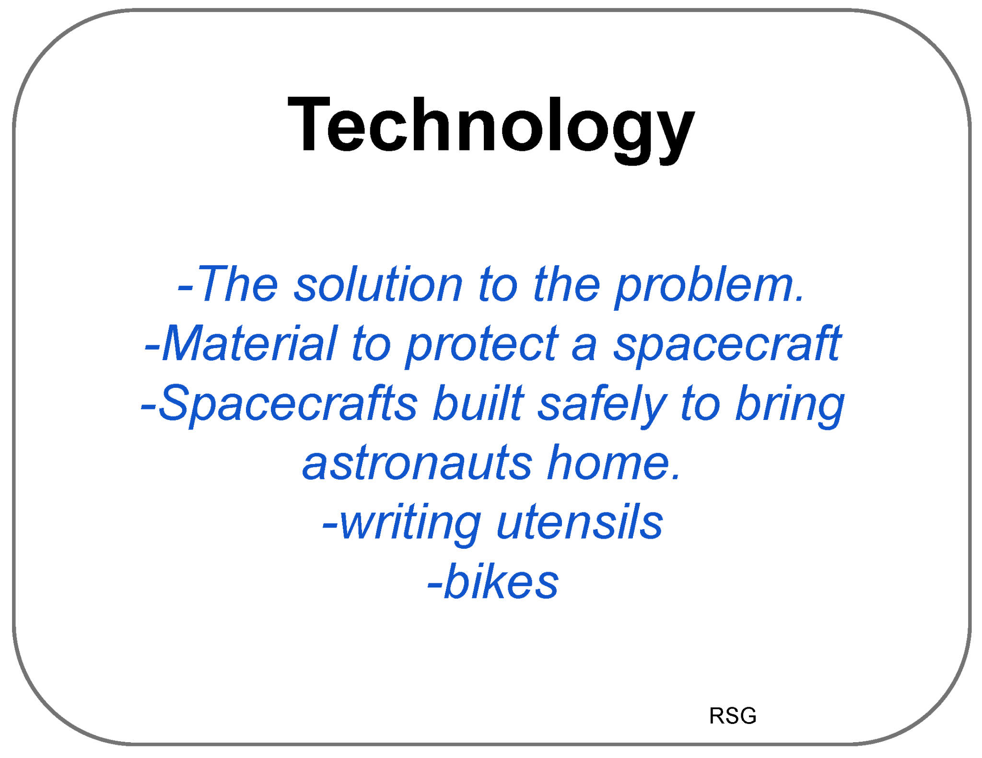
Poster Setup (with Example)
Our Ideas about Space Hazards
Engineering

Slide 13
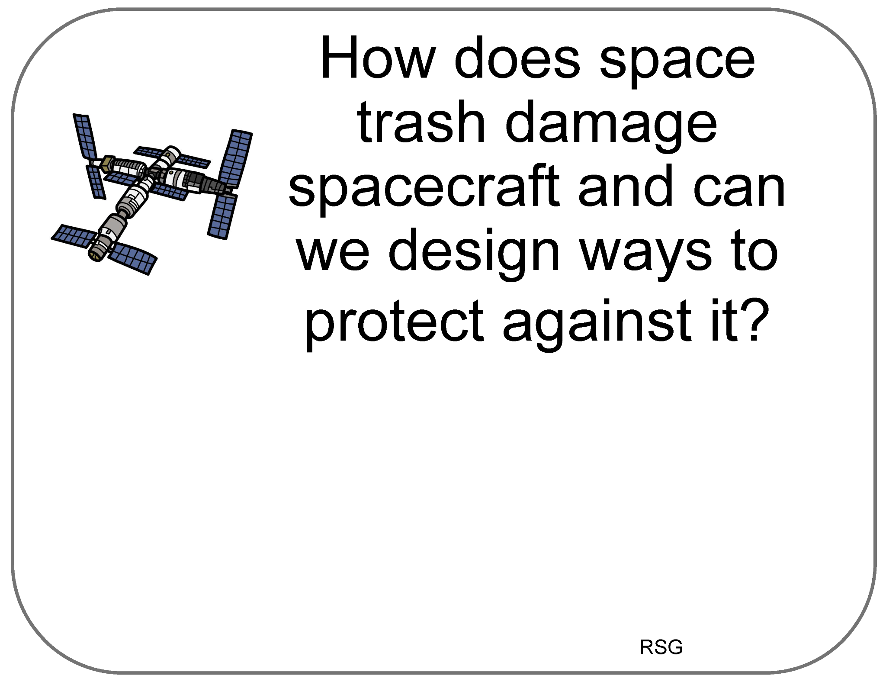

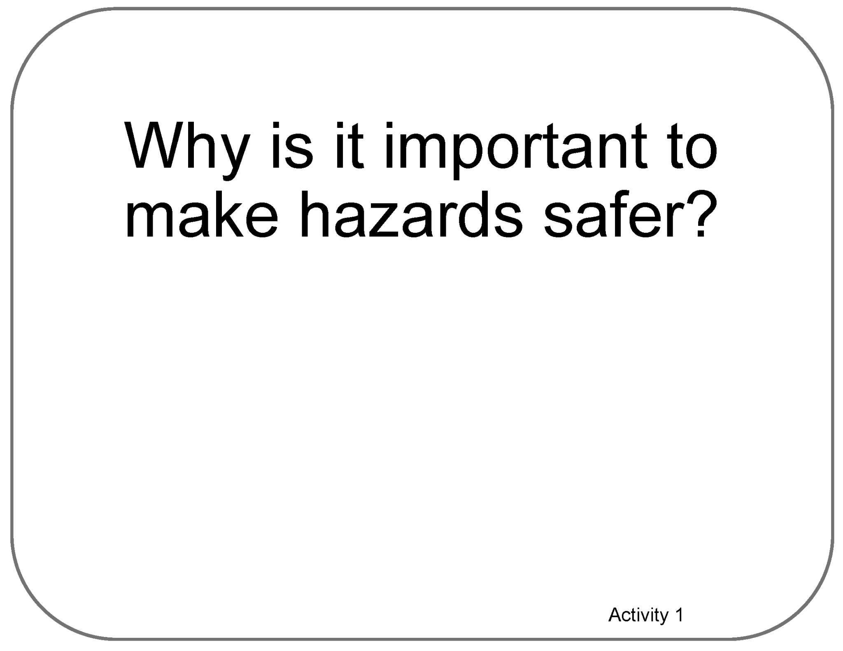
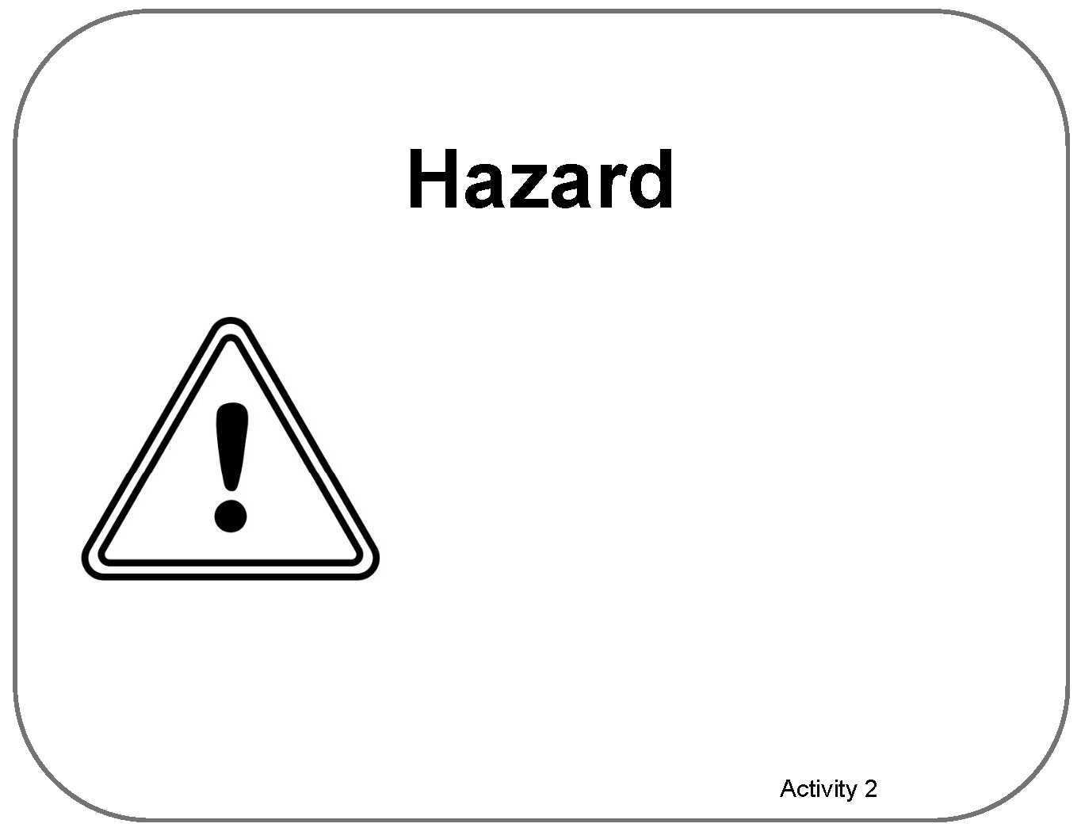


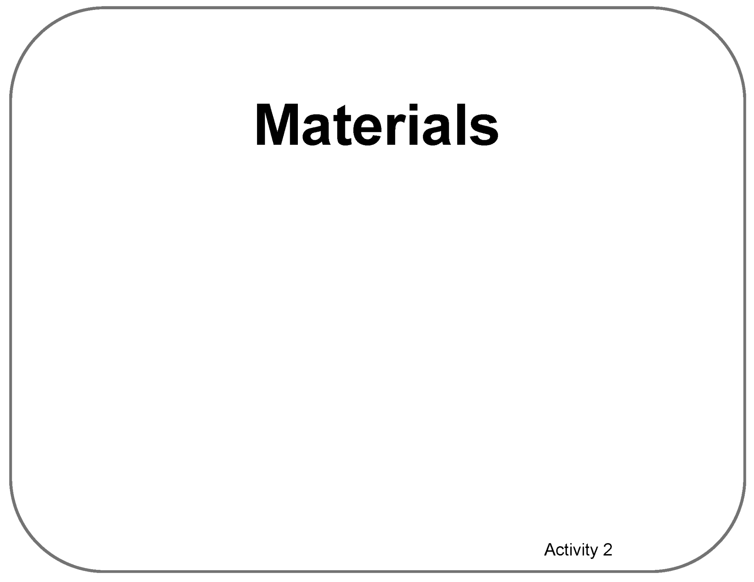

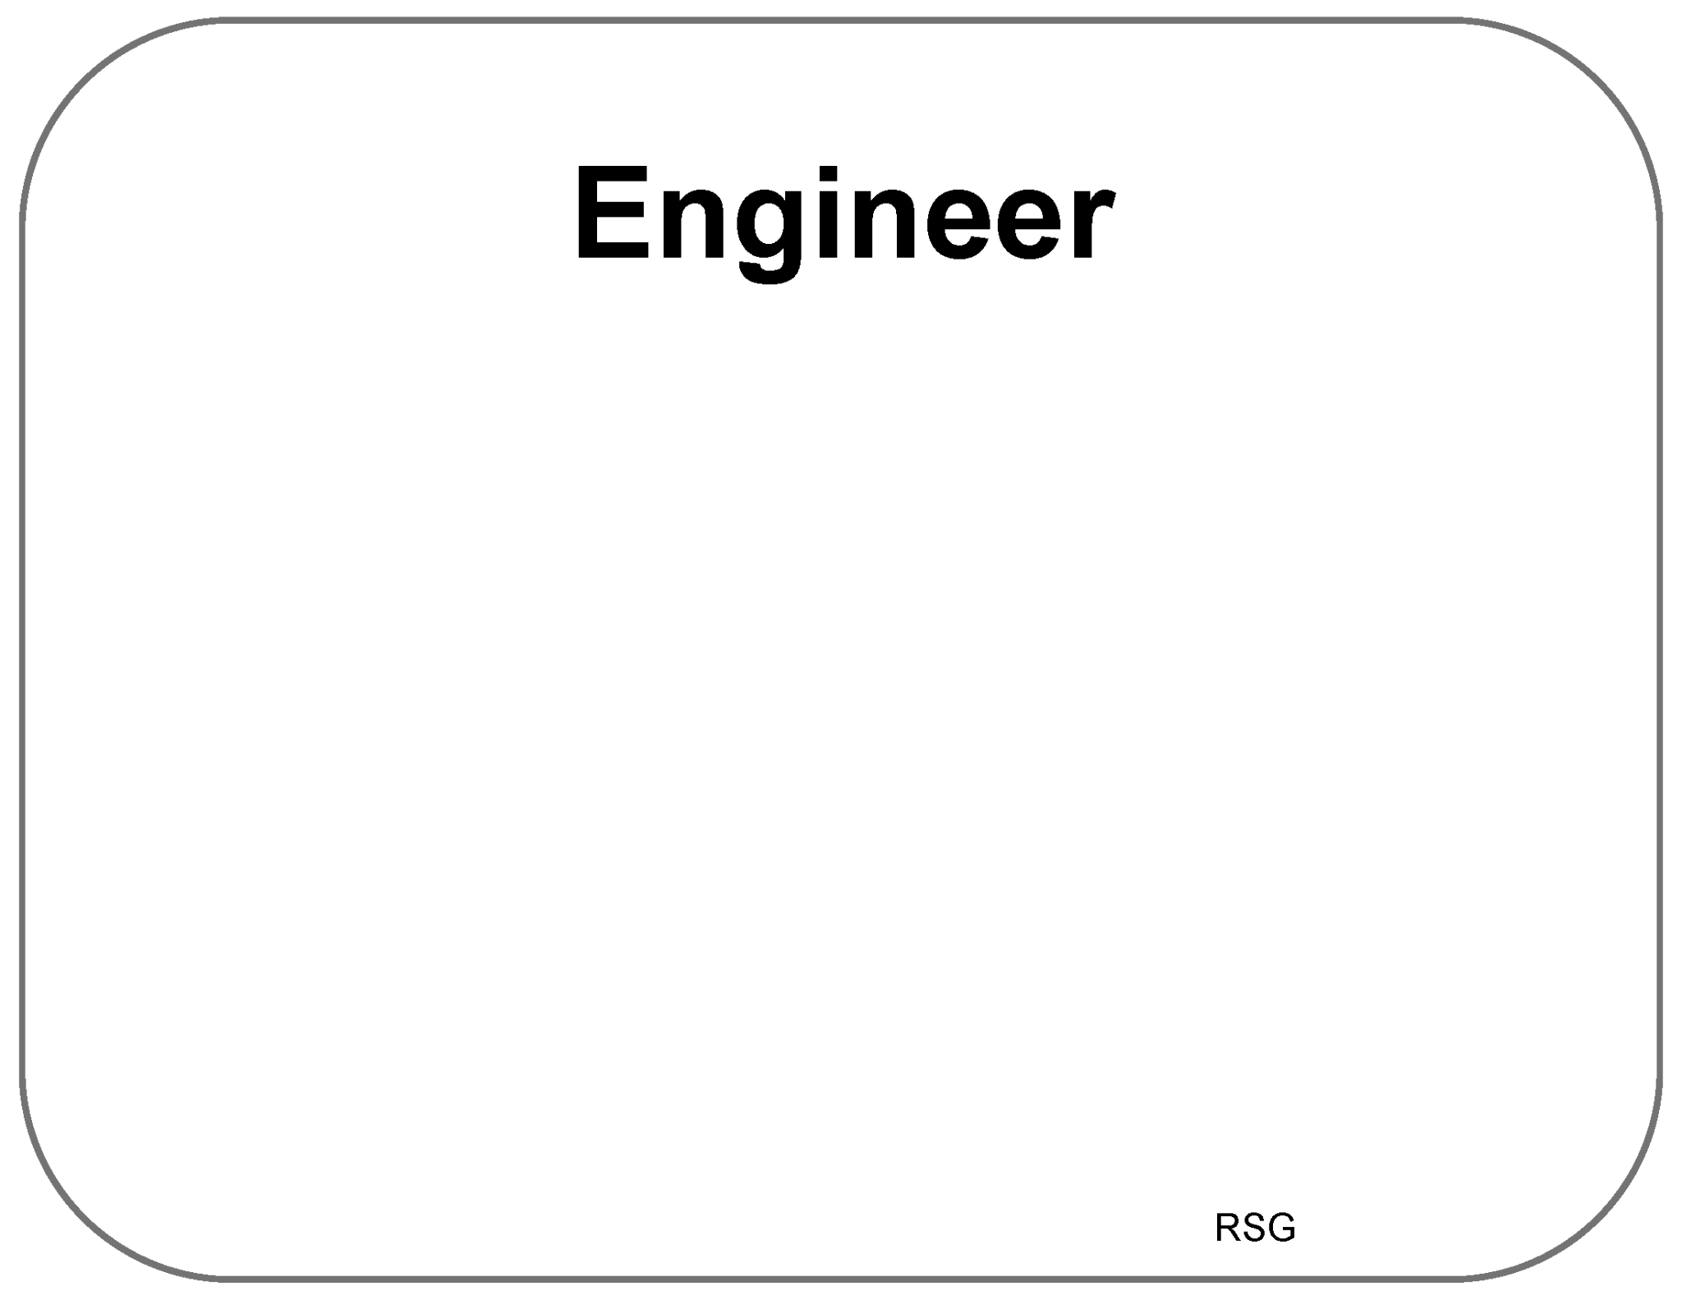

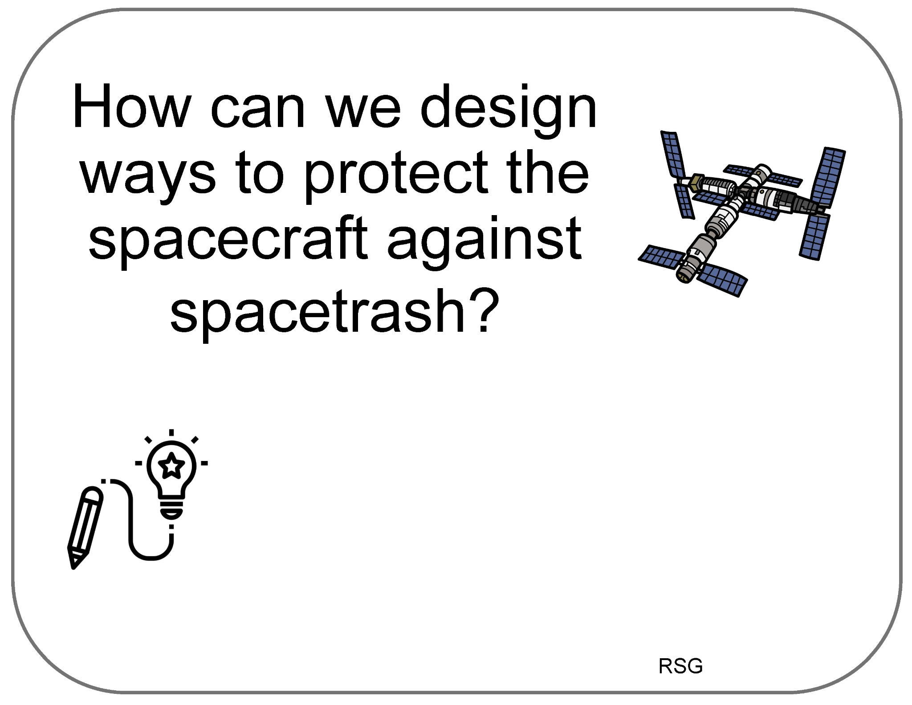

Poster Setup (Empty Example)
Our Ideas about Space Hazards
Engineering

Slide 14
Space Hazards
Engineering
RSG &
Adventures 1-9
Our Ideas Poster

Slide 15
Examples of Cards for Poster
The following slides are based on the printable PDF version of the blank cards you can use to set up your “Our Ideas Posters”
They have been altered to be more accessible to screen readers.

Slide 16
Ready S.E.T. Go! (RSG)

Slide 17
Card: How does space trash…

Slide 18
RSG Activity Card 1 with Learner Examples

Slide 19
RSG Activity Card 2 with Learner Examples

Slide 20
Card: Scientist

Slide 21
Card: Criteria

Slide 22
Card: Constraints

Slide 23
Card: Tradeoff

Slide 24
Card: Engineer

Slide 25
Card: How can we design ways to protect…

Slide 26
Card: Technology

Slide 27
Adventures 1-4

Slide 28
Card: How can we design space gloves…

Slide 29
Card: Why is it important to make…

Slide 30
Instructions for learners’ cards

Slide 31
Card: Hazard

Slide 32
Card: Which gloves work best…

Slide 33
Card: Materials

Slide 34
Card: Testing Results Table

Slide 35
Card: Which materials…cold?

Slide 36
Card: Temperature

Slide 37
Card: Which materials…moving objects?

Slide 38
Adventures 5-9

Slide 39
Card: Which materials..dust?

Slide 40
Blank Activity 6 Card

Slide 41
Card: How can we make gloves stronger…

Slide 42
Card: What design recommendations…

Slide 43
Card: How can we share our space glove…

