Slide 1
Science
Space Hazard
RSG & Adventures 1-9
Our Ideas Poster
Prep & Setup Guide with Blanks
Screen Reader Version - NOT for Print

Slide 2
Poster Components
The following slides are based on the printable PDF version of the blank slides/cards you can use to set up your “Our Ideas Posters” and are not intended to be printed.
These slides are formatted to be more accessible to screen readers.
We recommend using these slides as a guide for blind and low vision educators and printing out the PDFs for sighted learners.

Slide 3
Corresponding PDFs include
Poster Pages to build the poster
  (pages numbered in lower right corner with corresponding adventure(s))
Poster Pages with examples are for educator reference only and not intended to print.
Blank Pages for more space or to build your own poster
Blank ¼ page cards for learners to add additional terms, drawings, ideas
Term cards:
Icon-only
Term + icon

Slide 4
Set Up
You need a wall or whiteboard area of about 80” Length x 60” Height.
Please see the following pages for setup examples.
You may choose alternative layouts or formats to fit your learning environment.

Slide 5
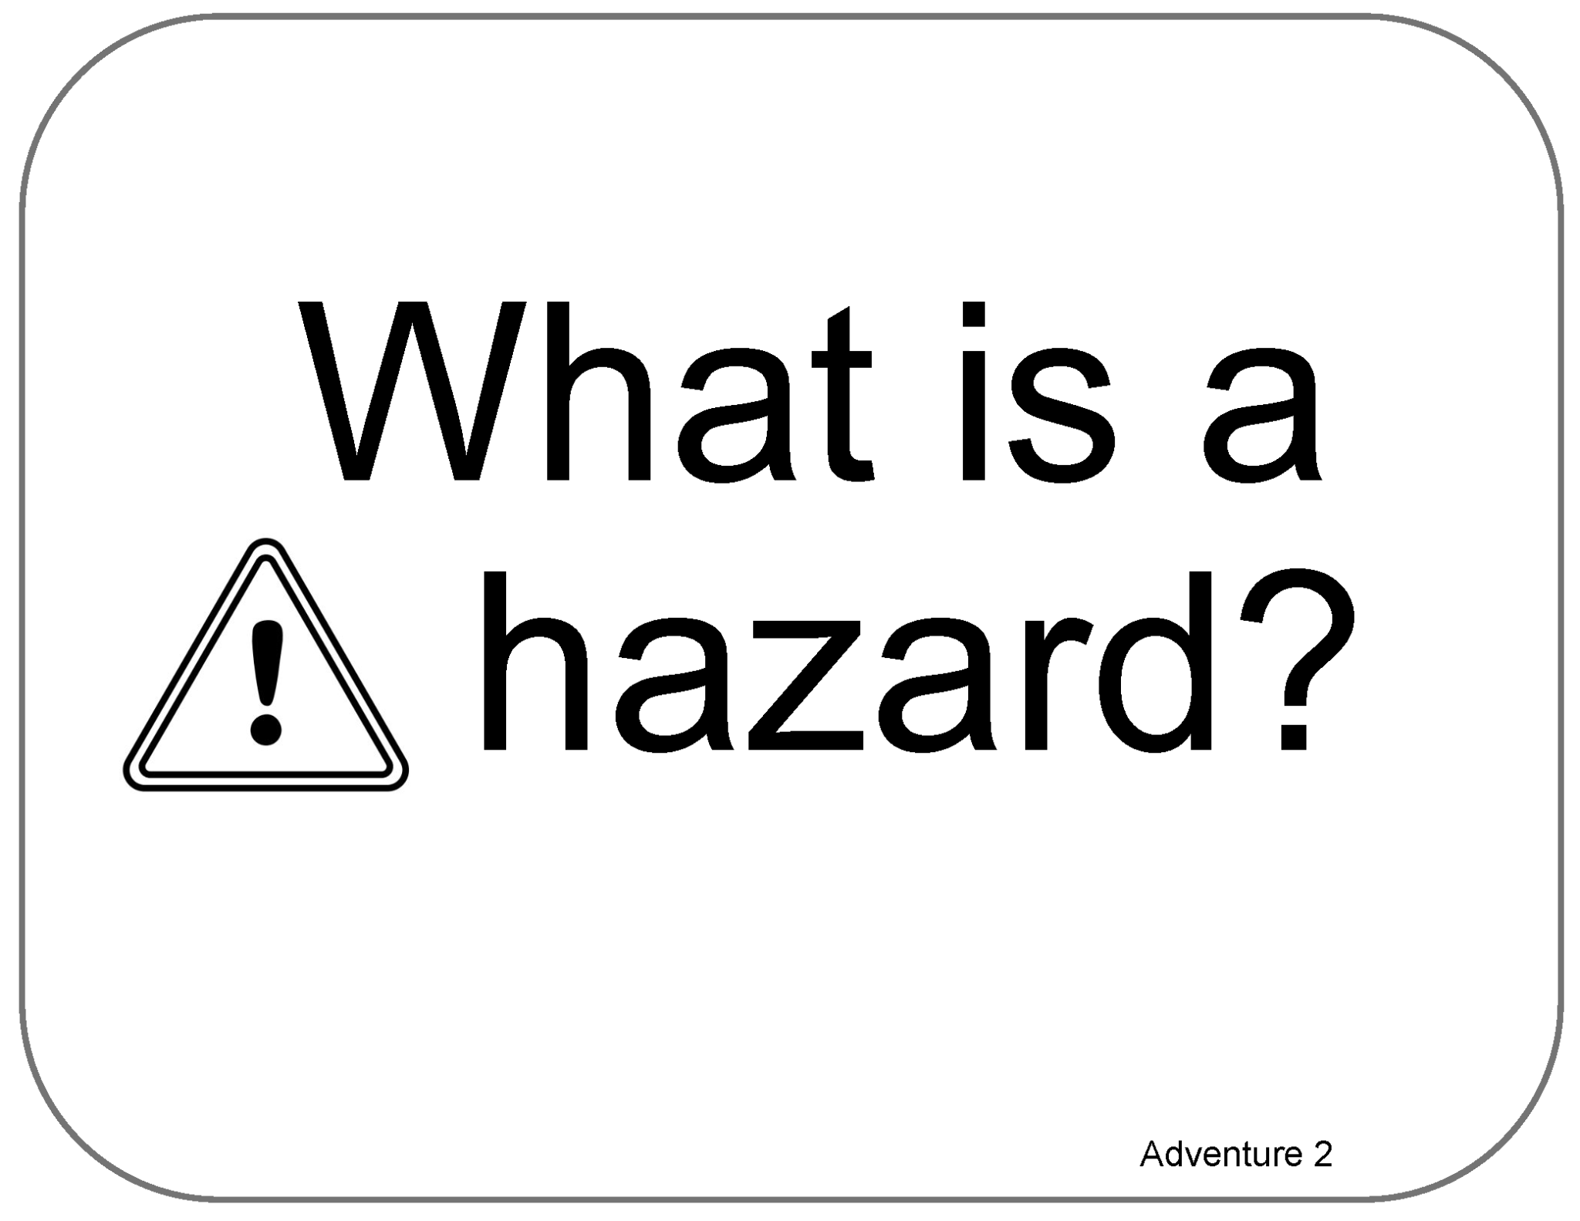
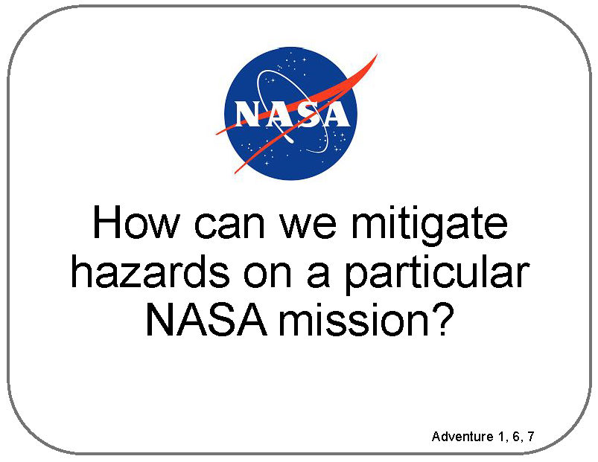
Poster Pages Examples
(Reference - do not print)

Slide 6
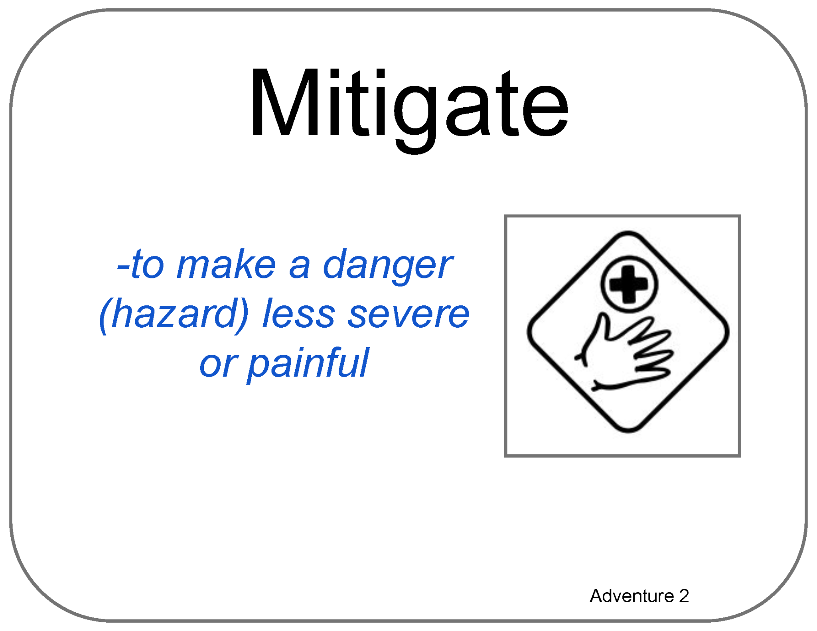
Term Card Example
(Reference - do not print)

Slide 7
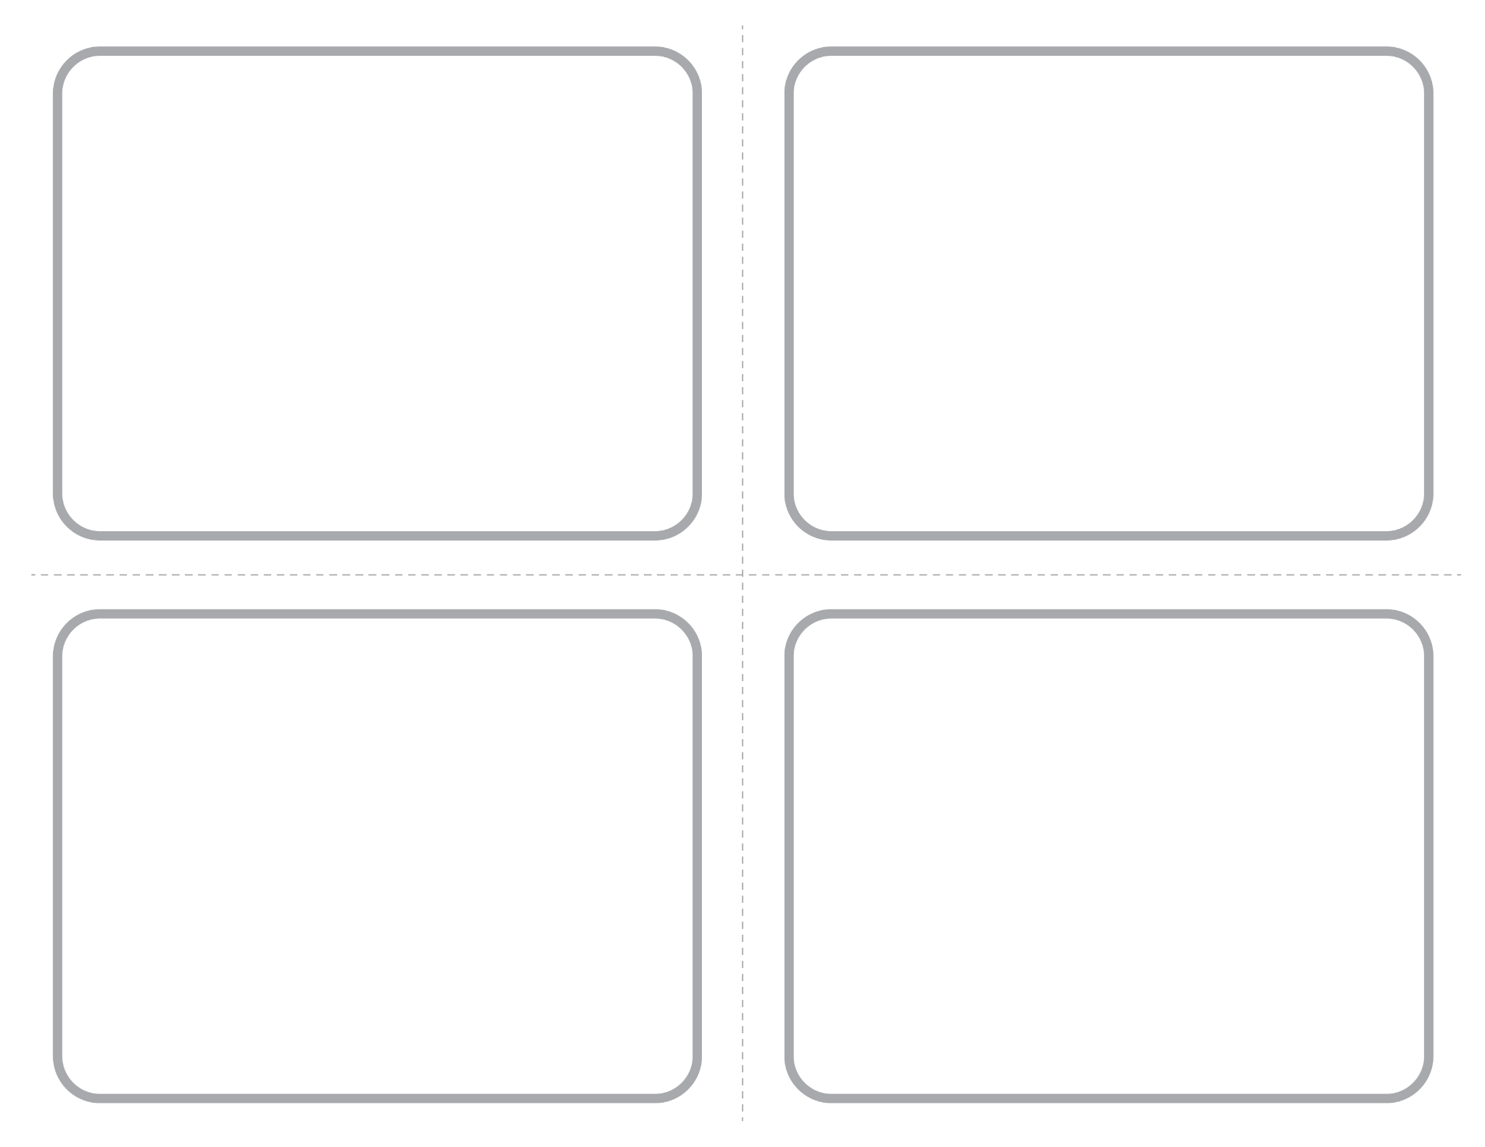
Blank ¼ Page Card Screenshot
Intended for learner responses

Slide 8
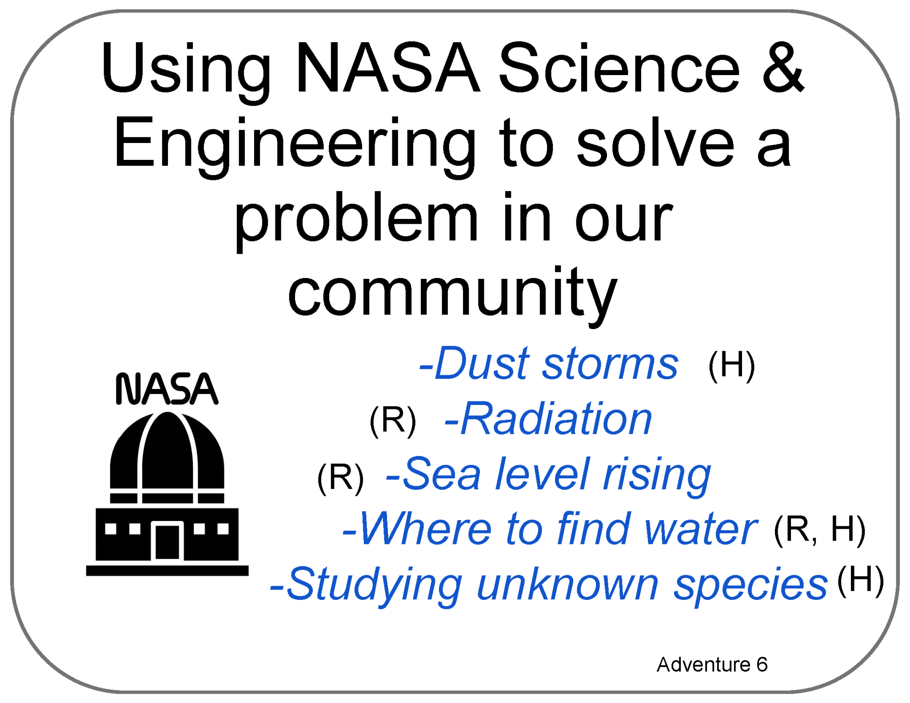
Poster Pages with Examples from Learners
(Reference - do not print)

Slide 9
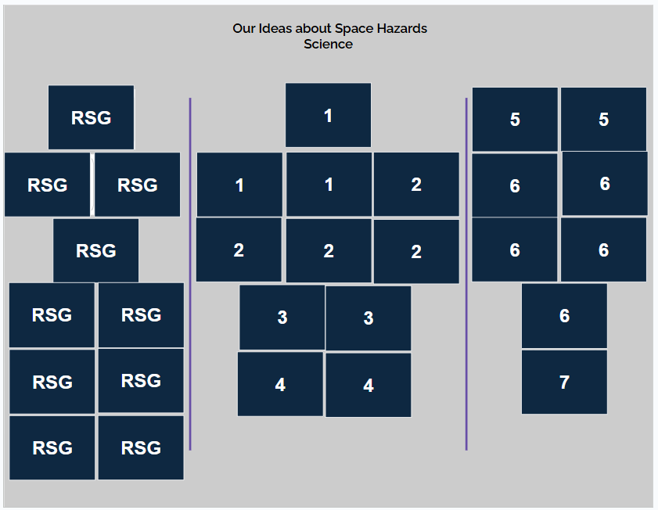
Poster Setup Layout

Slide 10
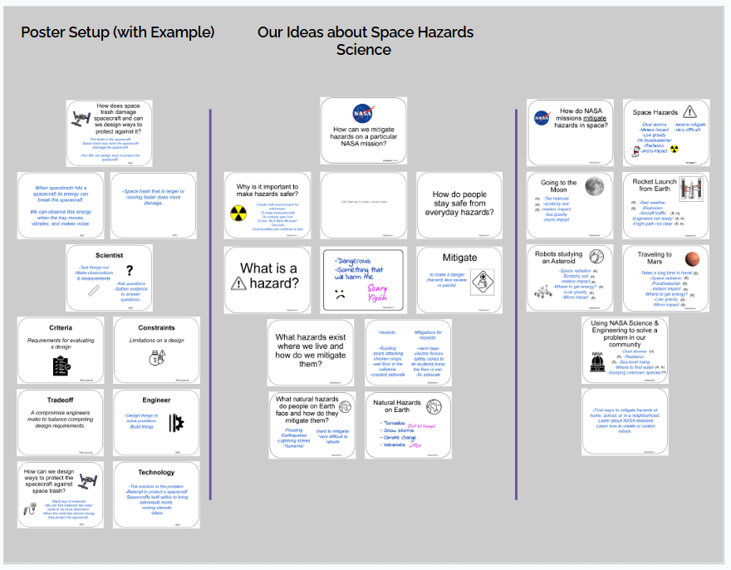
Poster Setup Layout with Learner Examples

Slide 11
Details about Learner Examples
The following two slides are a compromise to allow for alt text readability.
They are formatted for visual access, and not necessarily in a way that is best for screen readers, but do allow for alt text for each of the example cards.
They are optional, and can be skipped if they are not helpful to you.

Slide 12
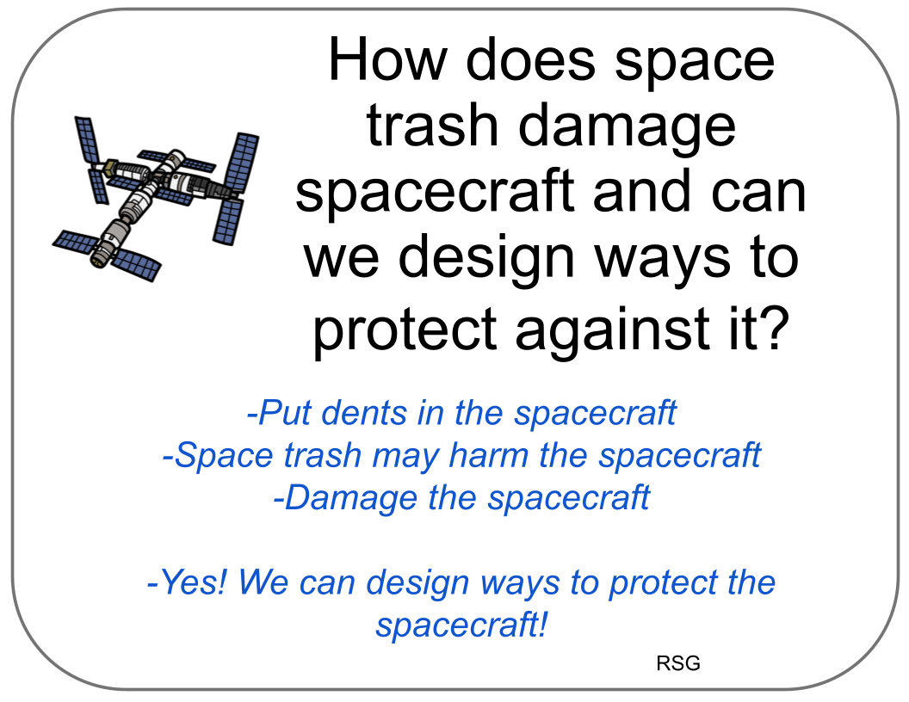
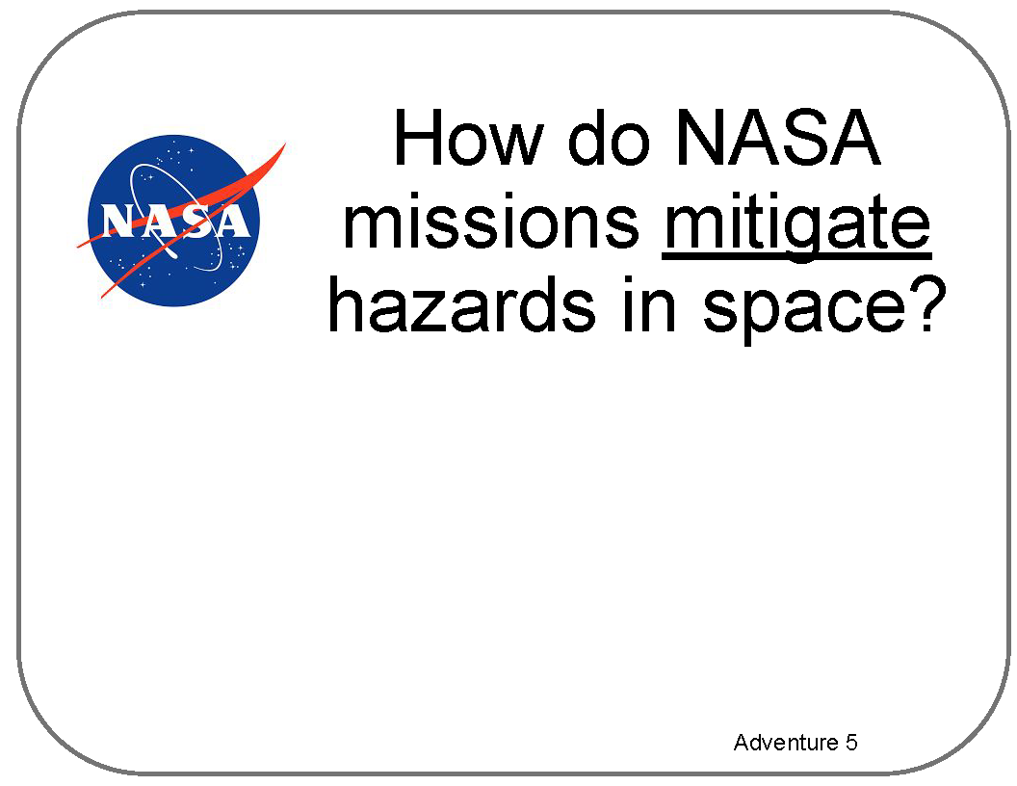
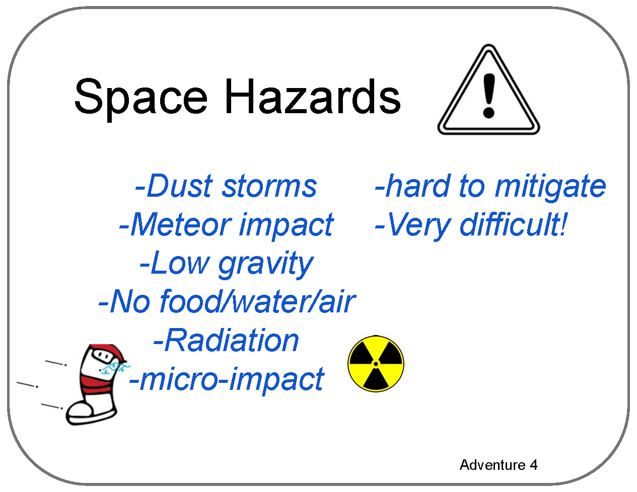
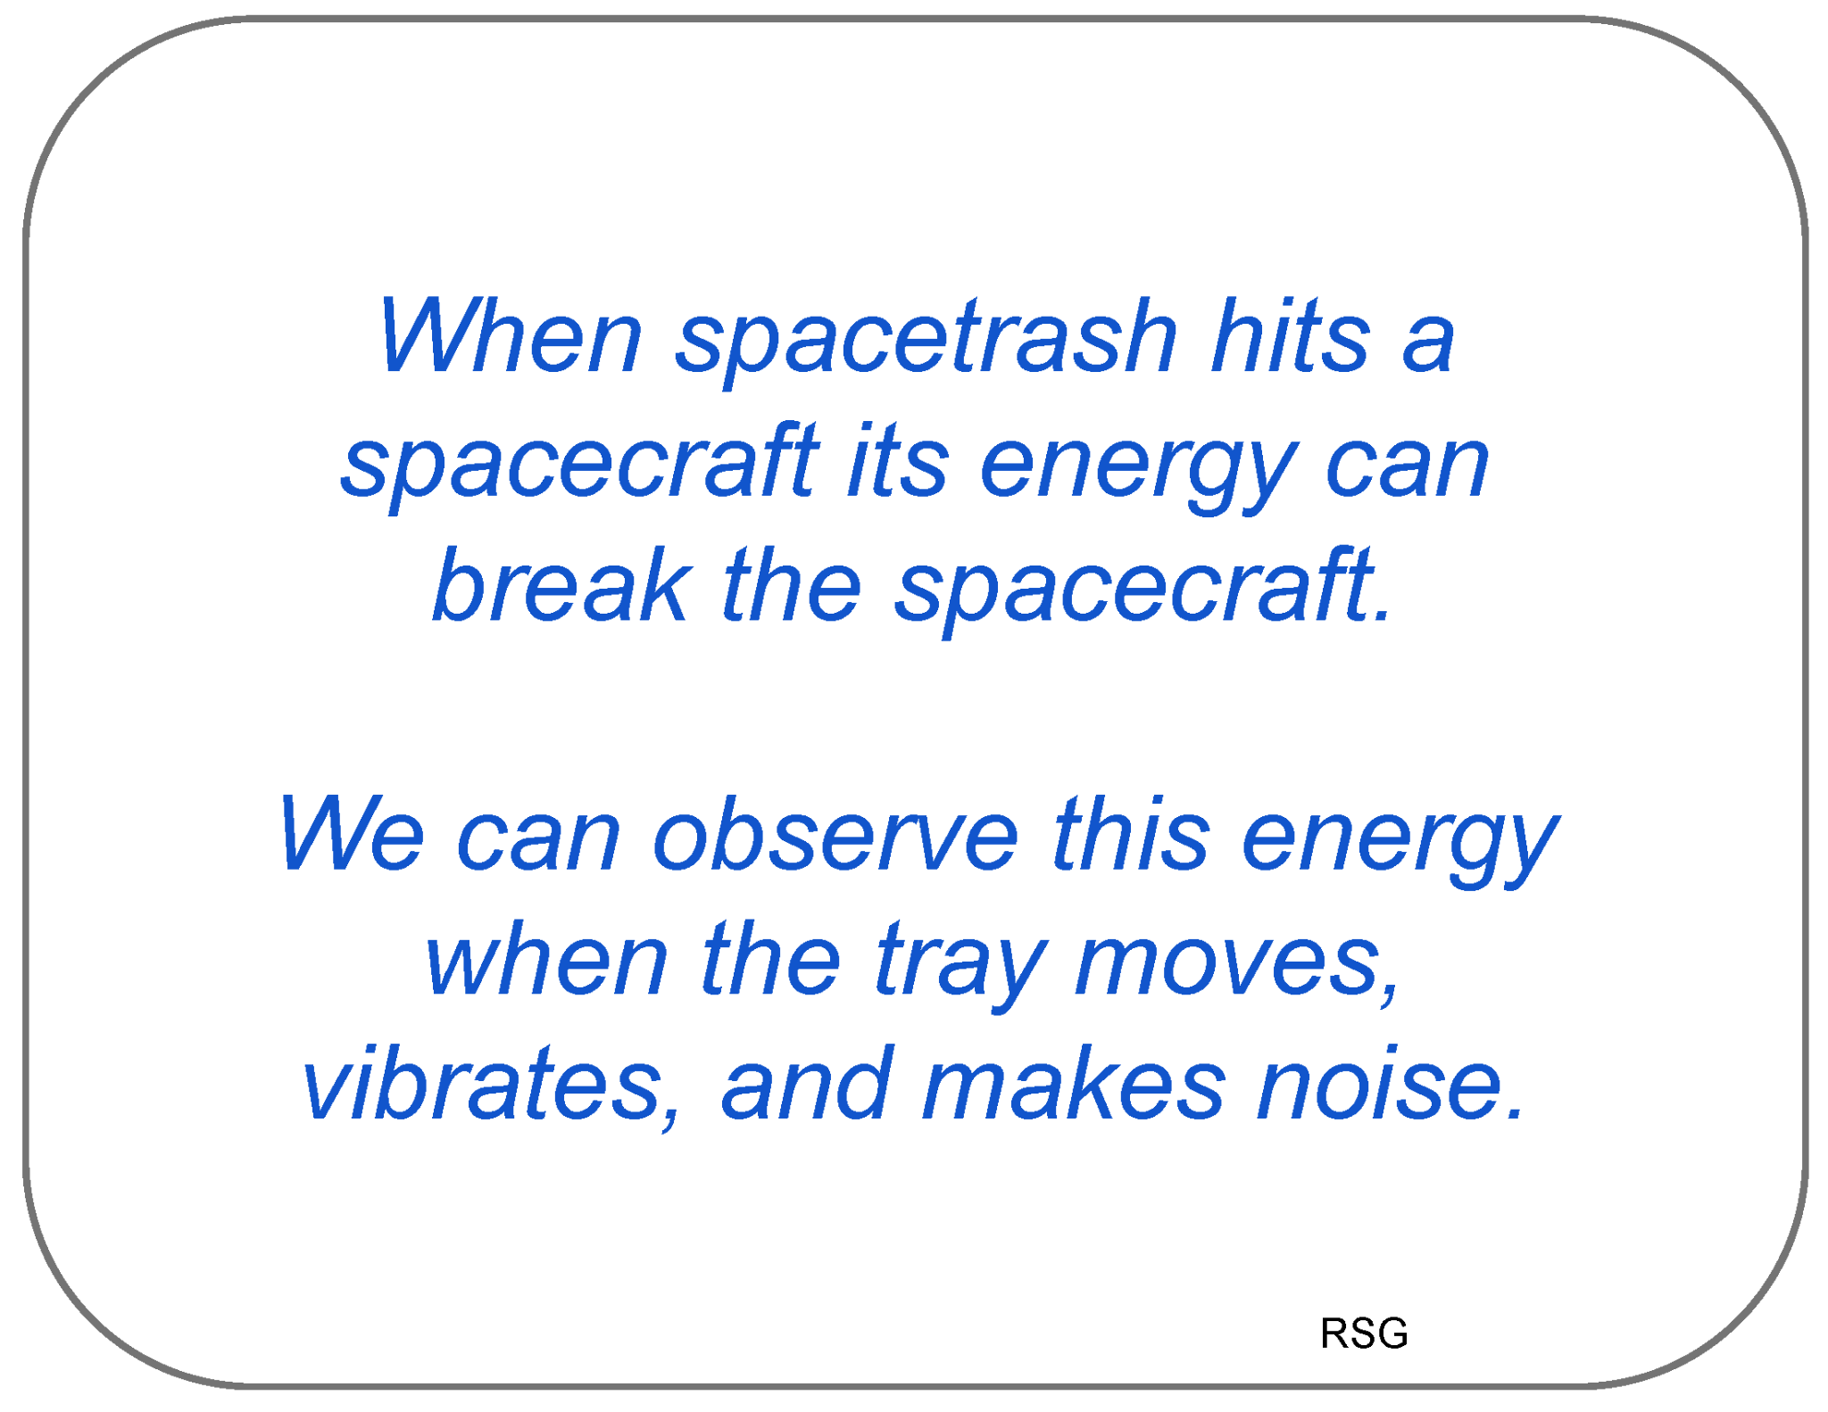
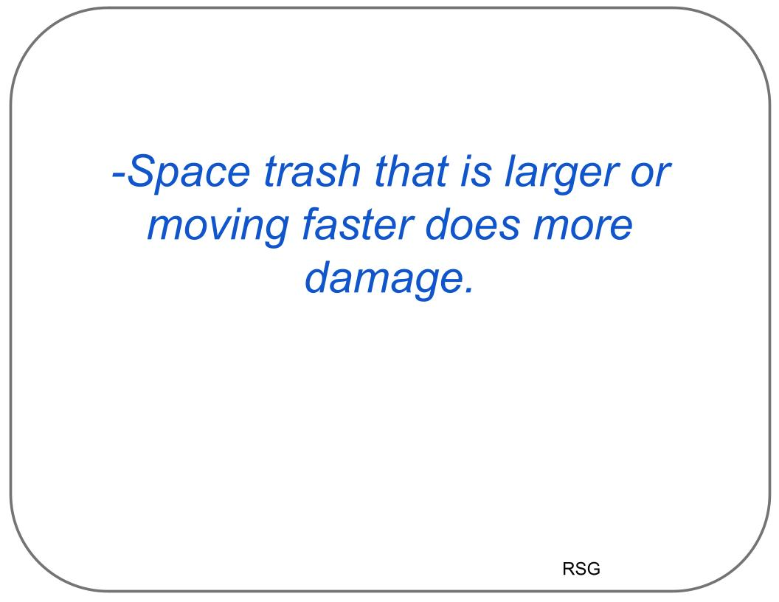
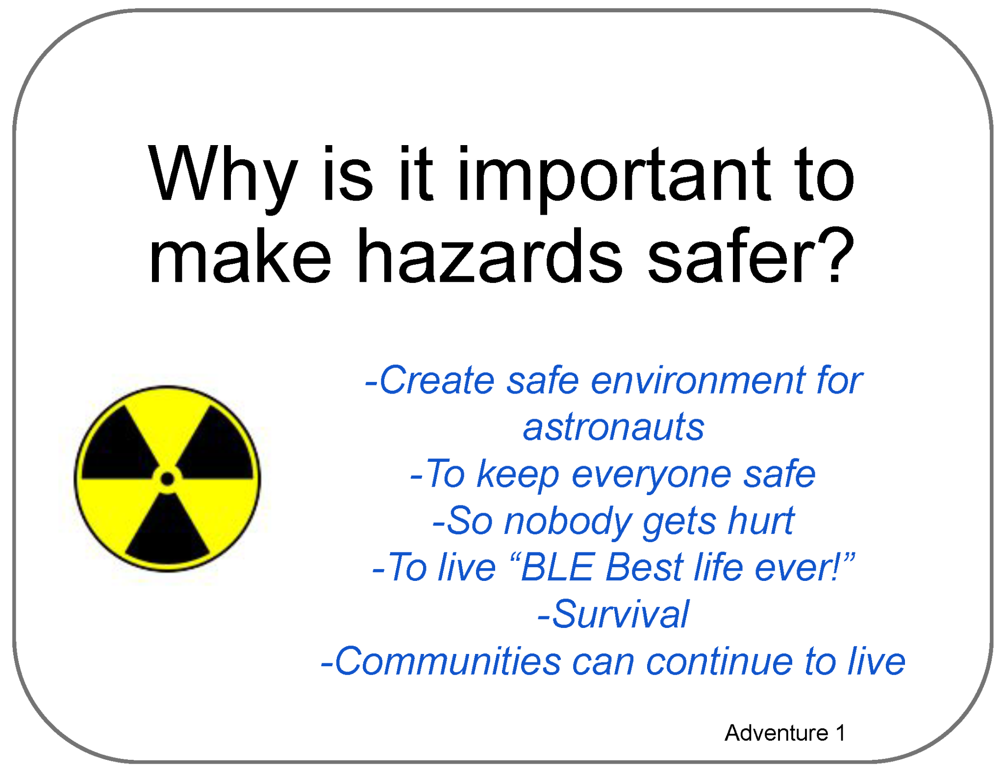
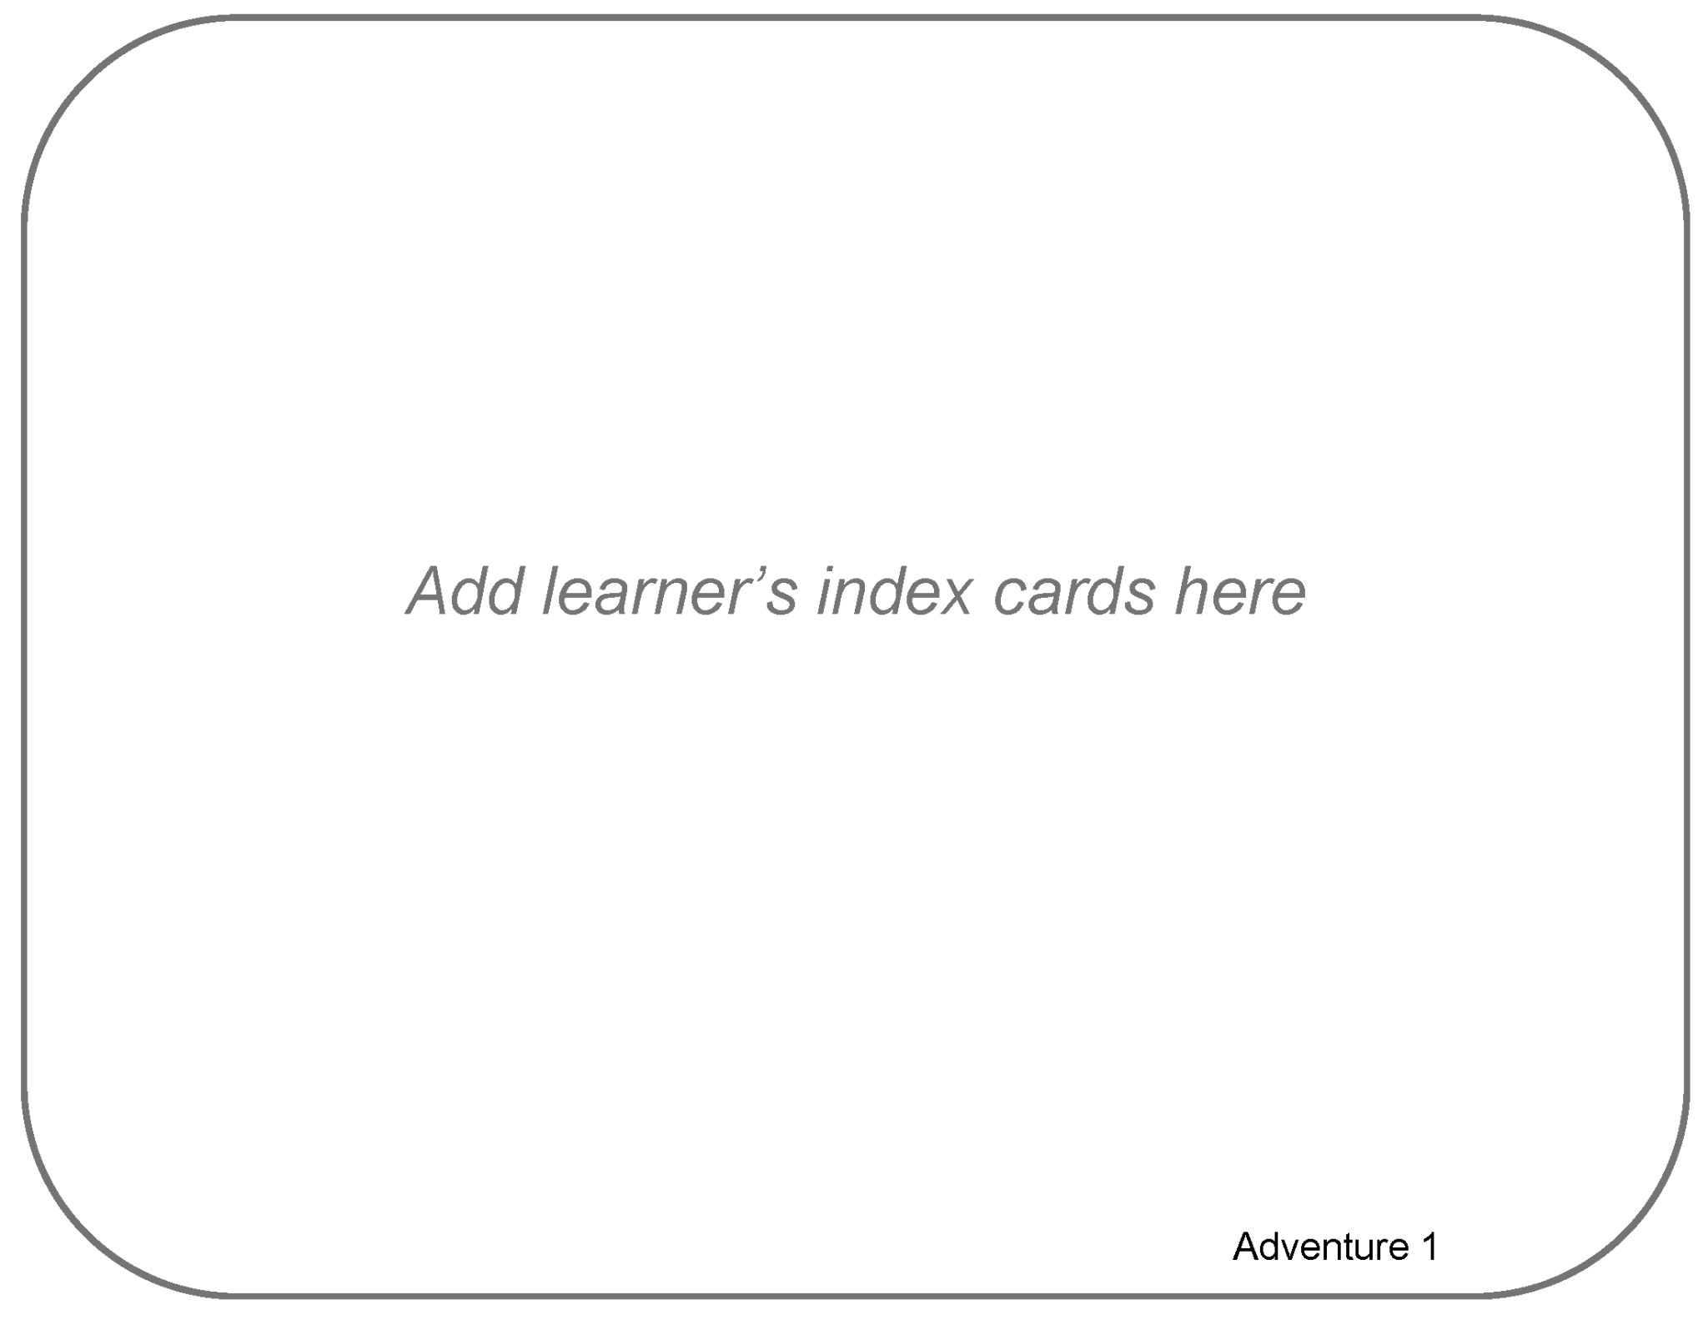
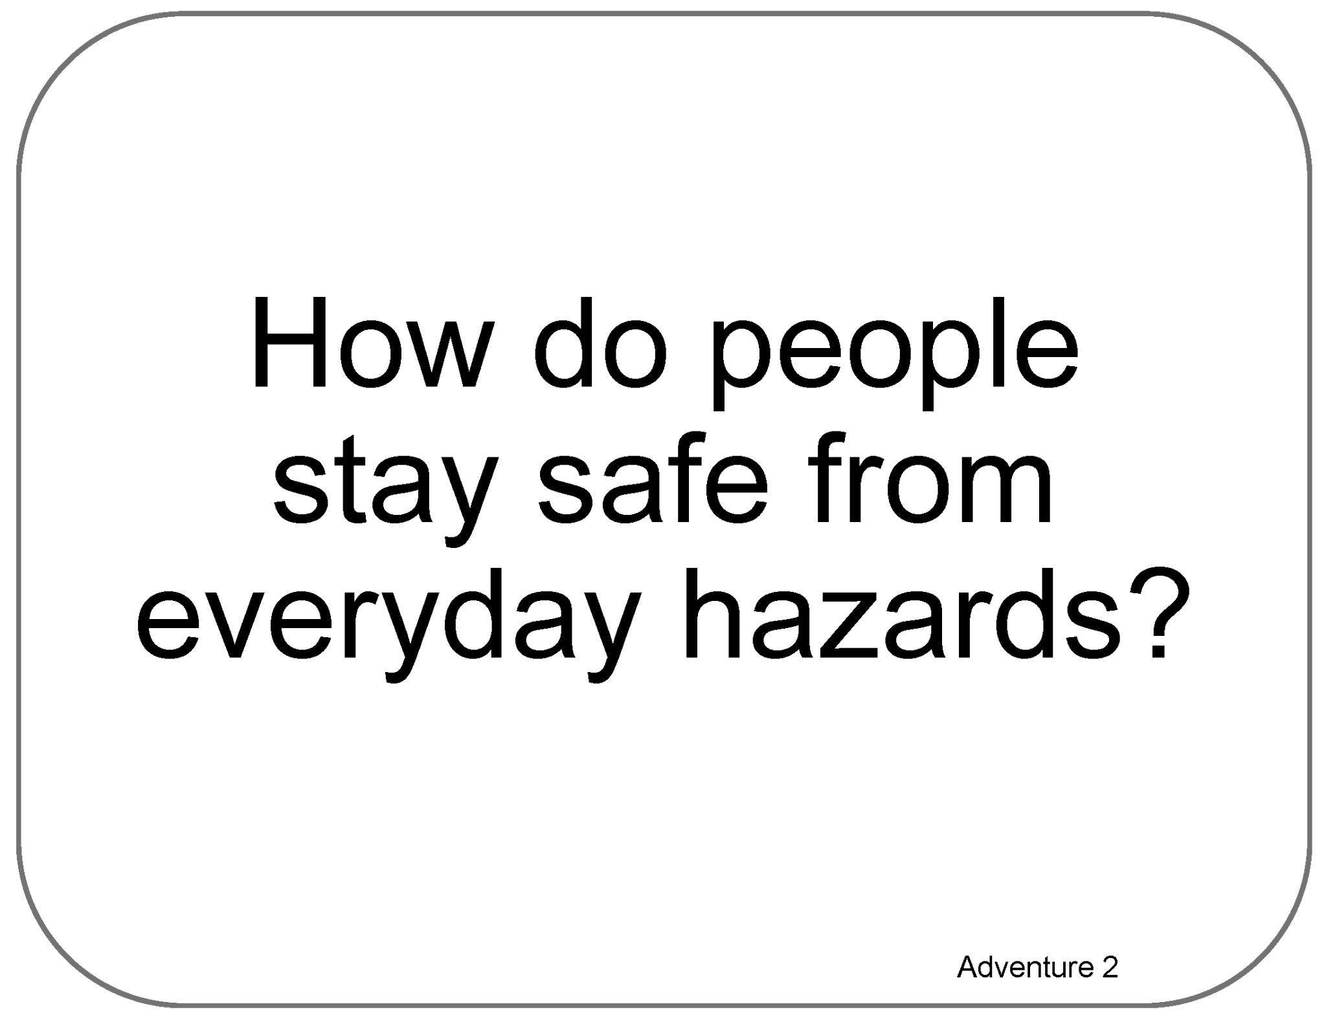
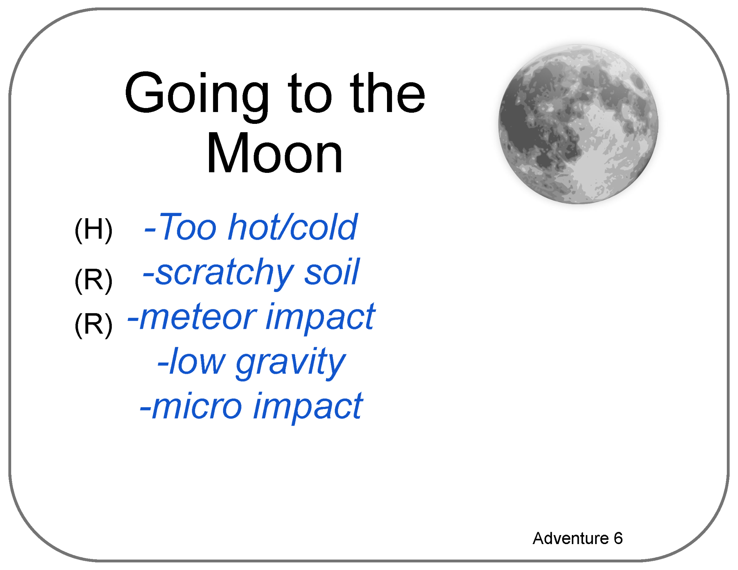
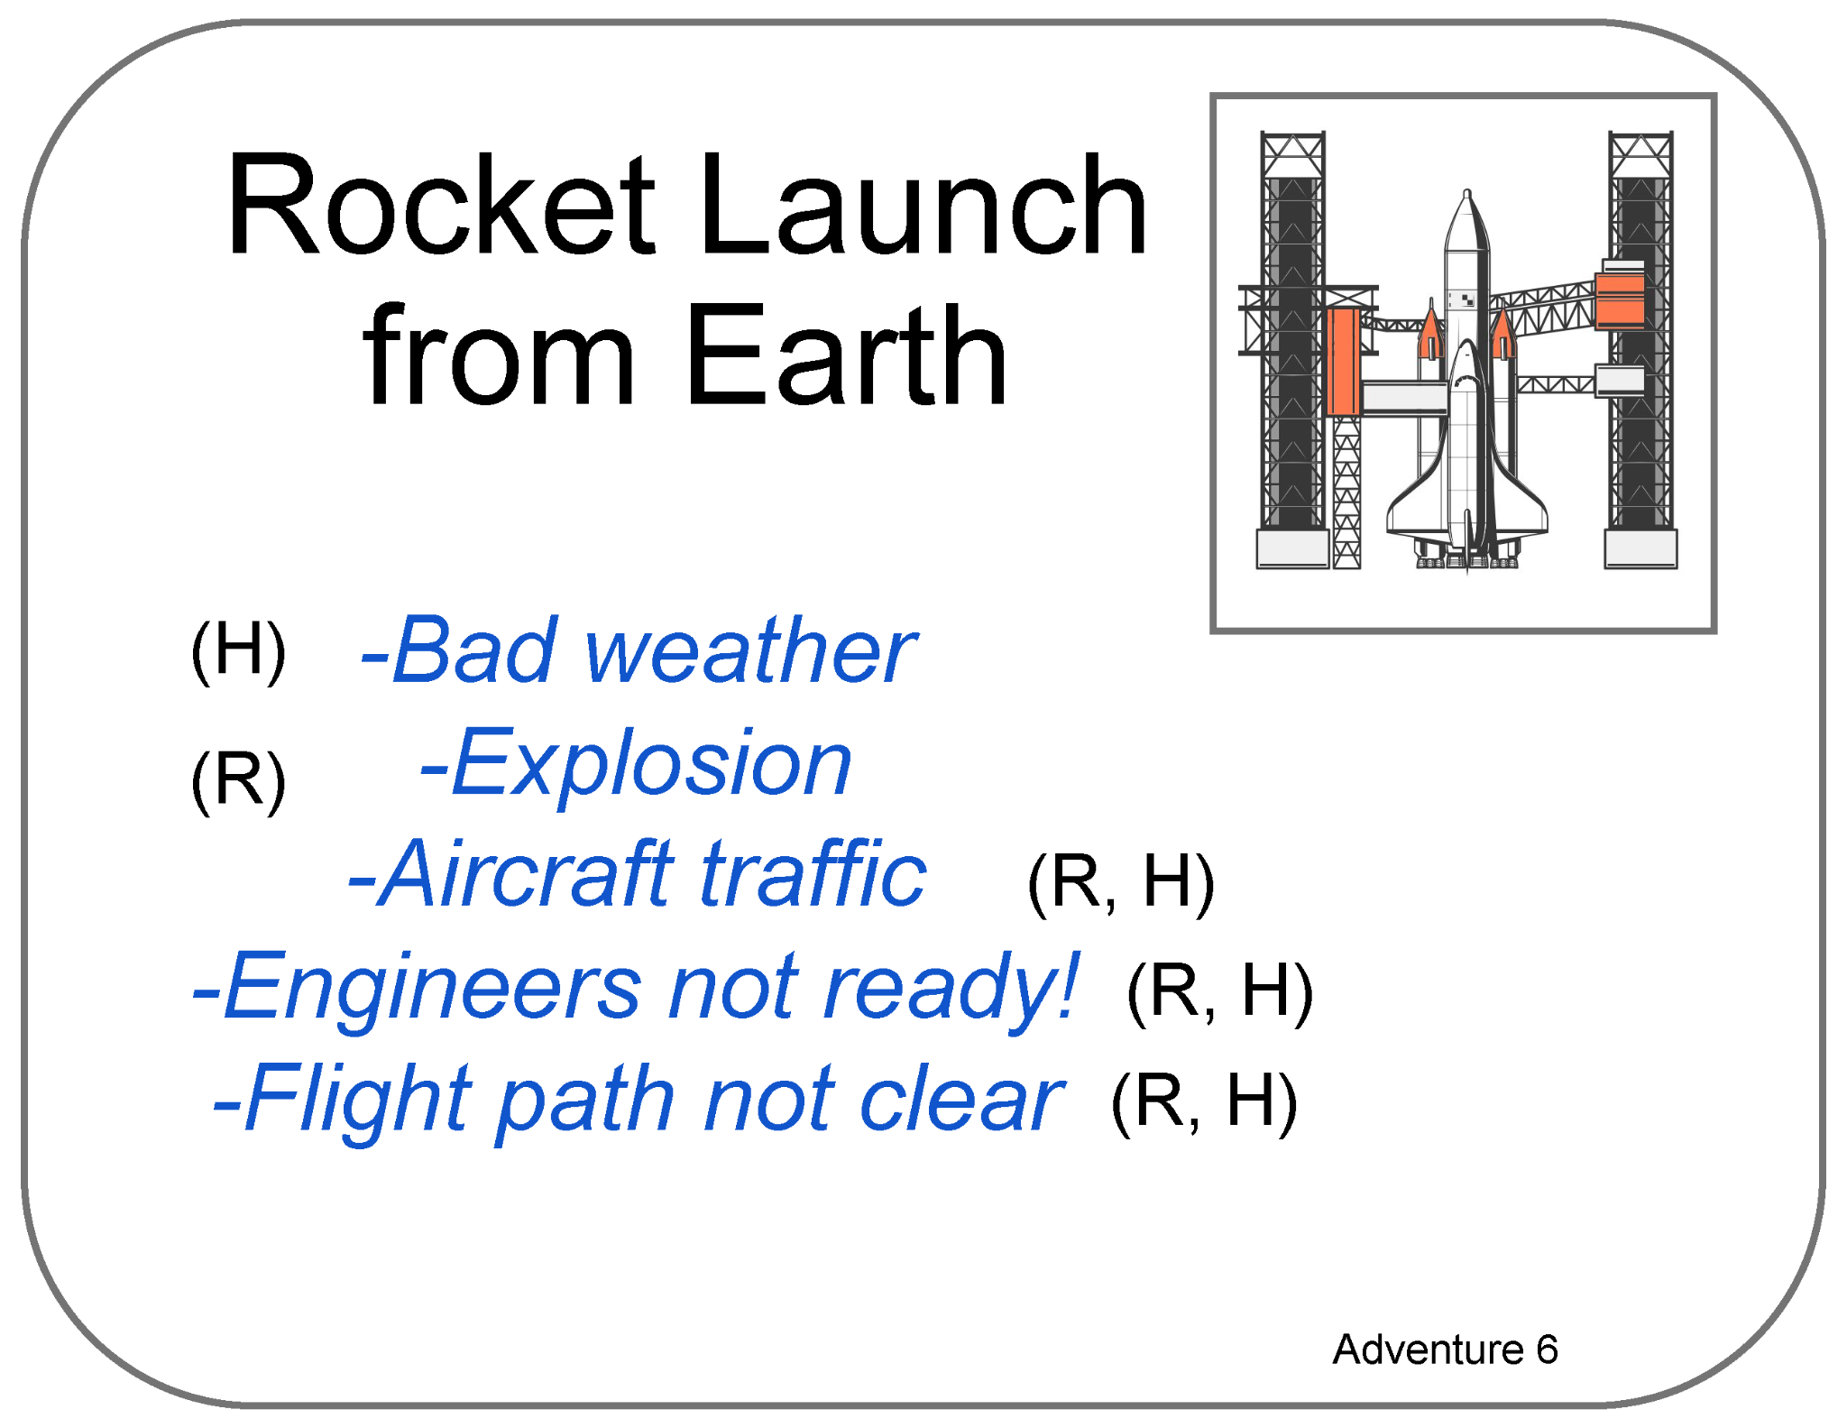
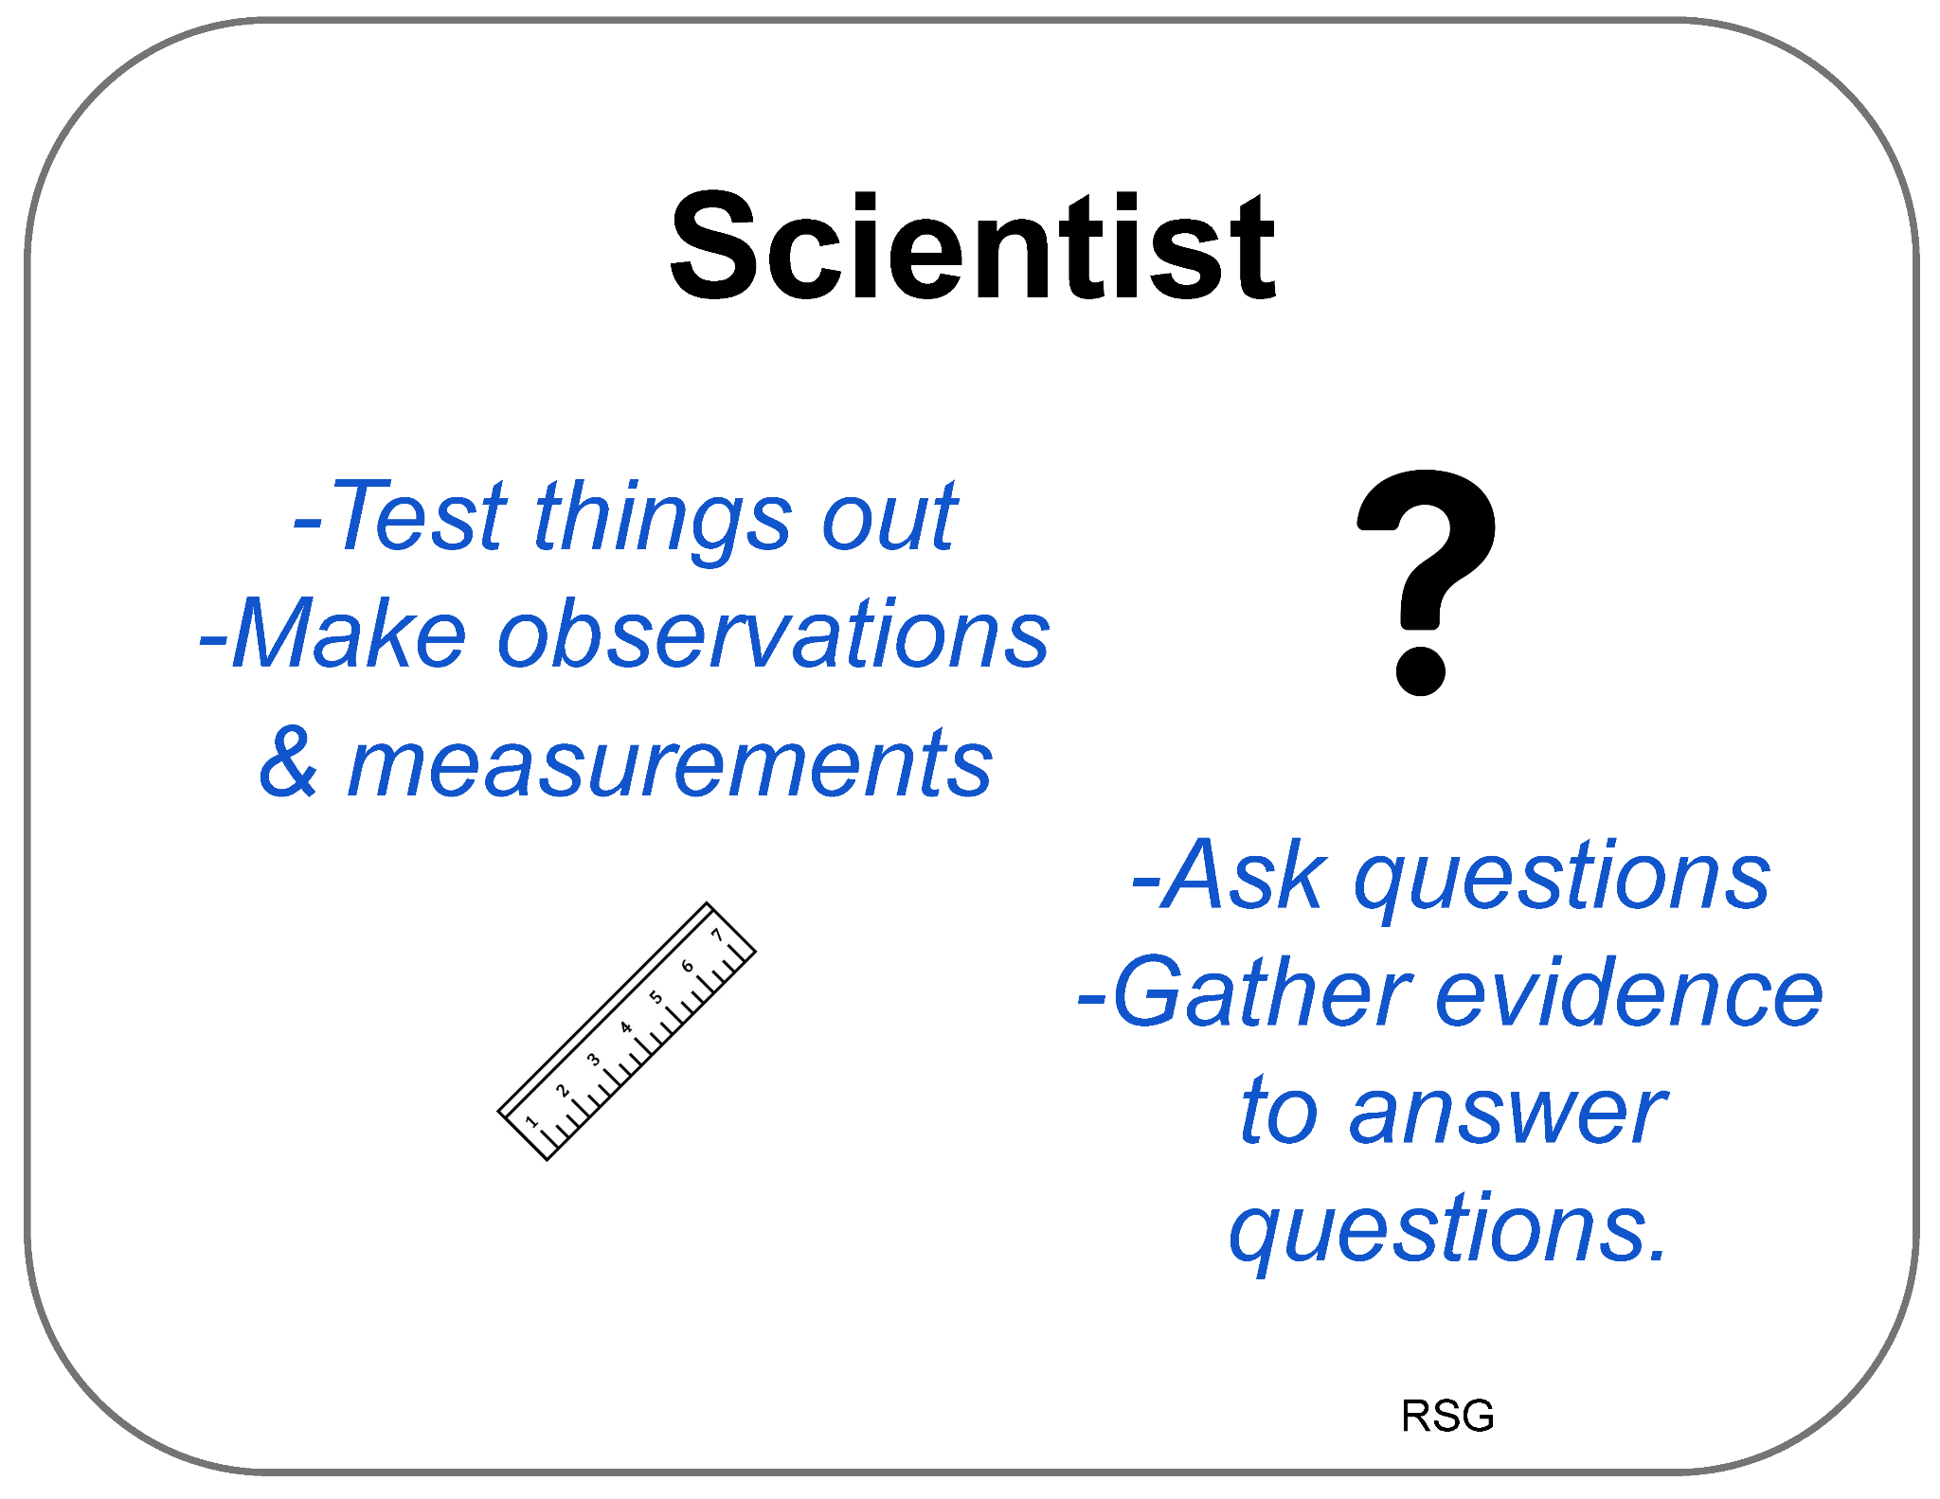
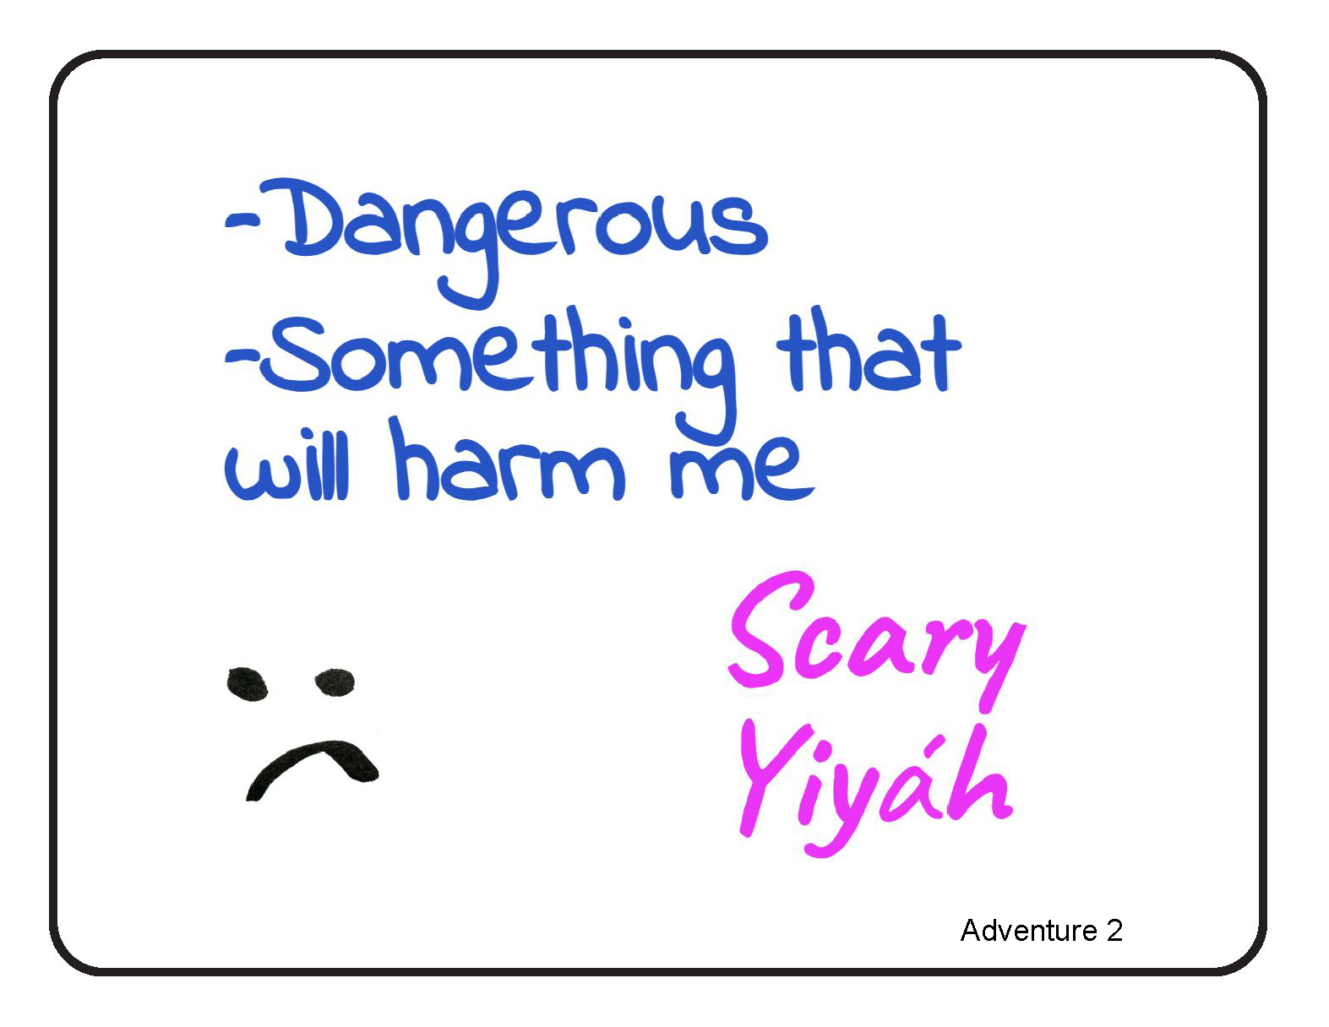
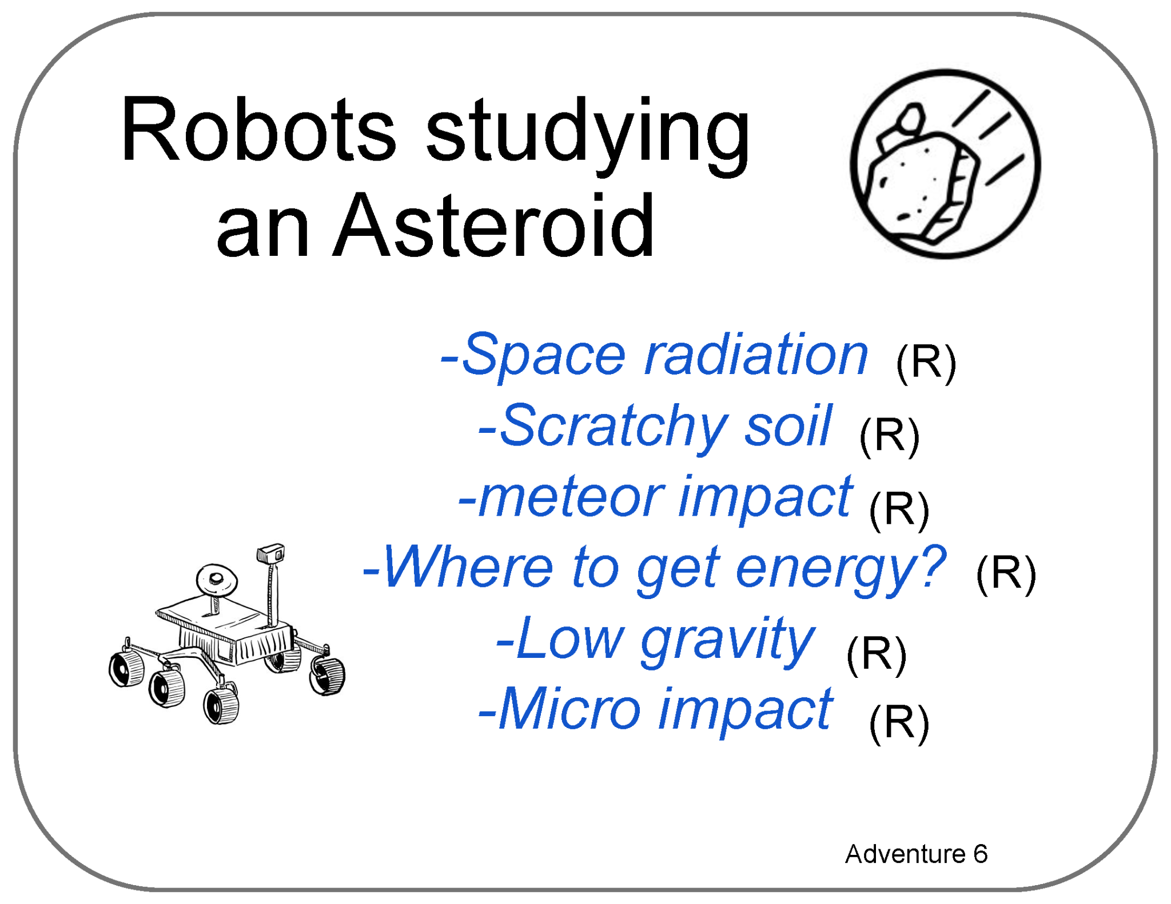
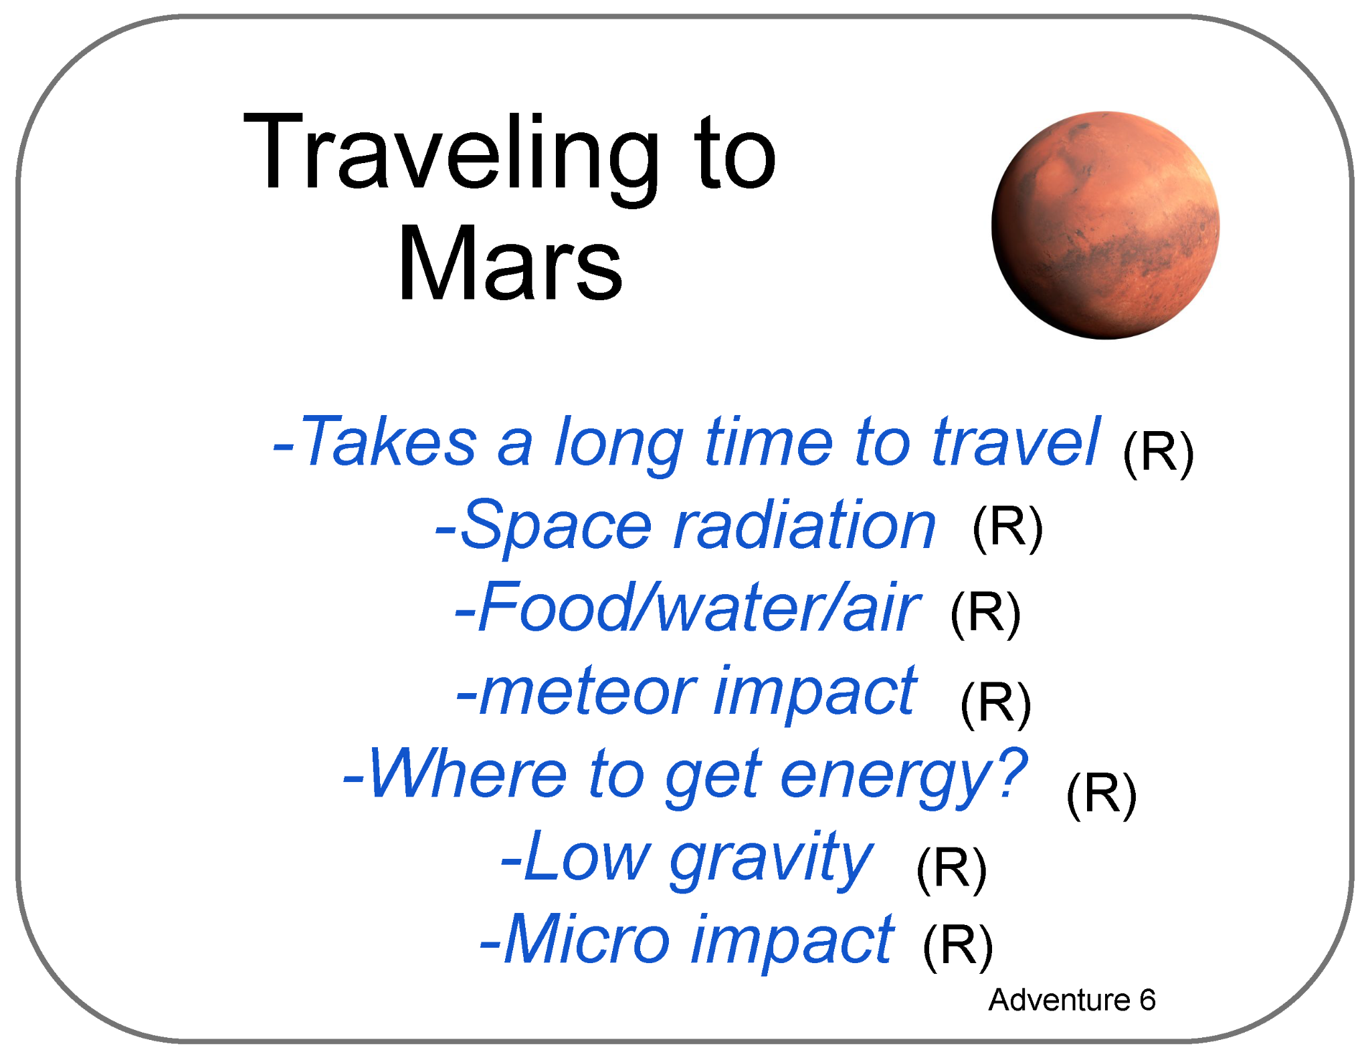
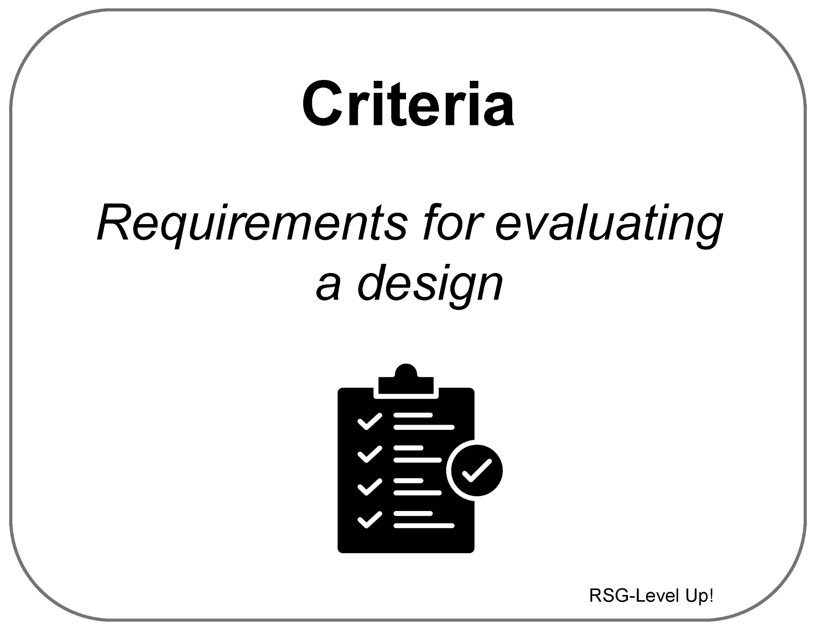
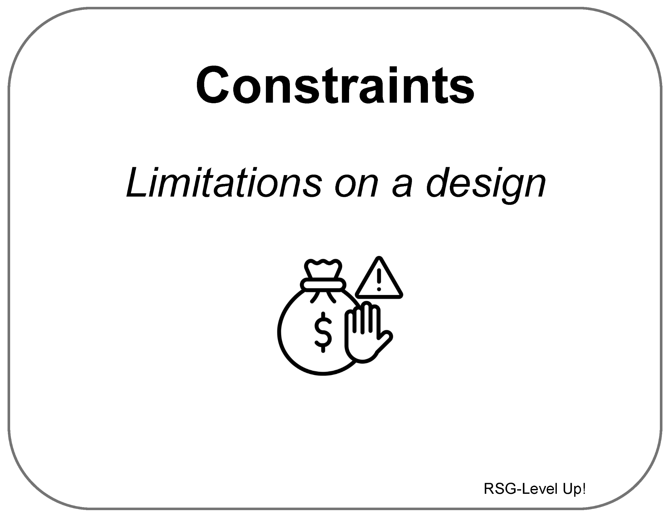
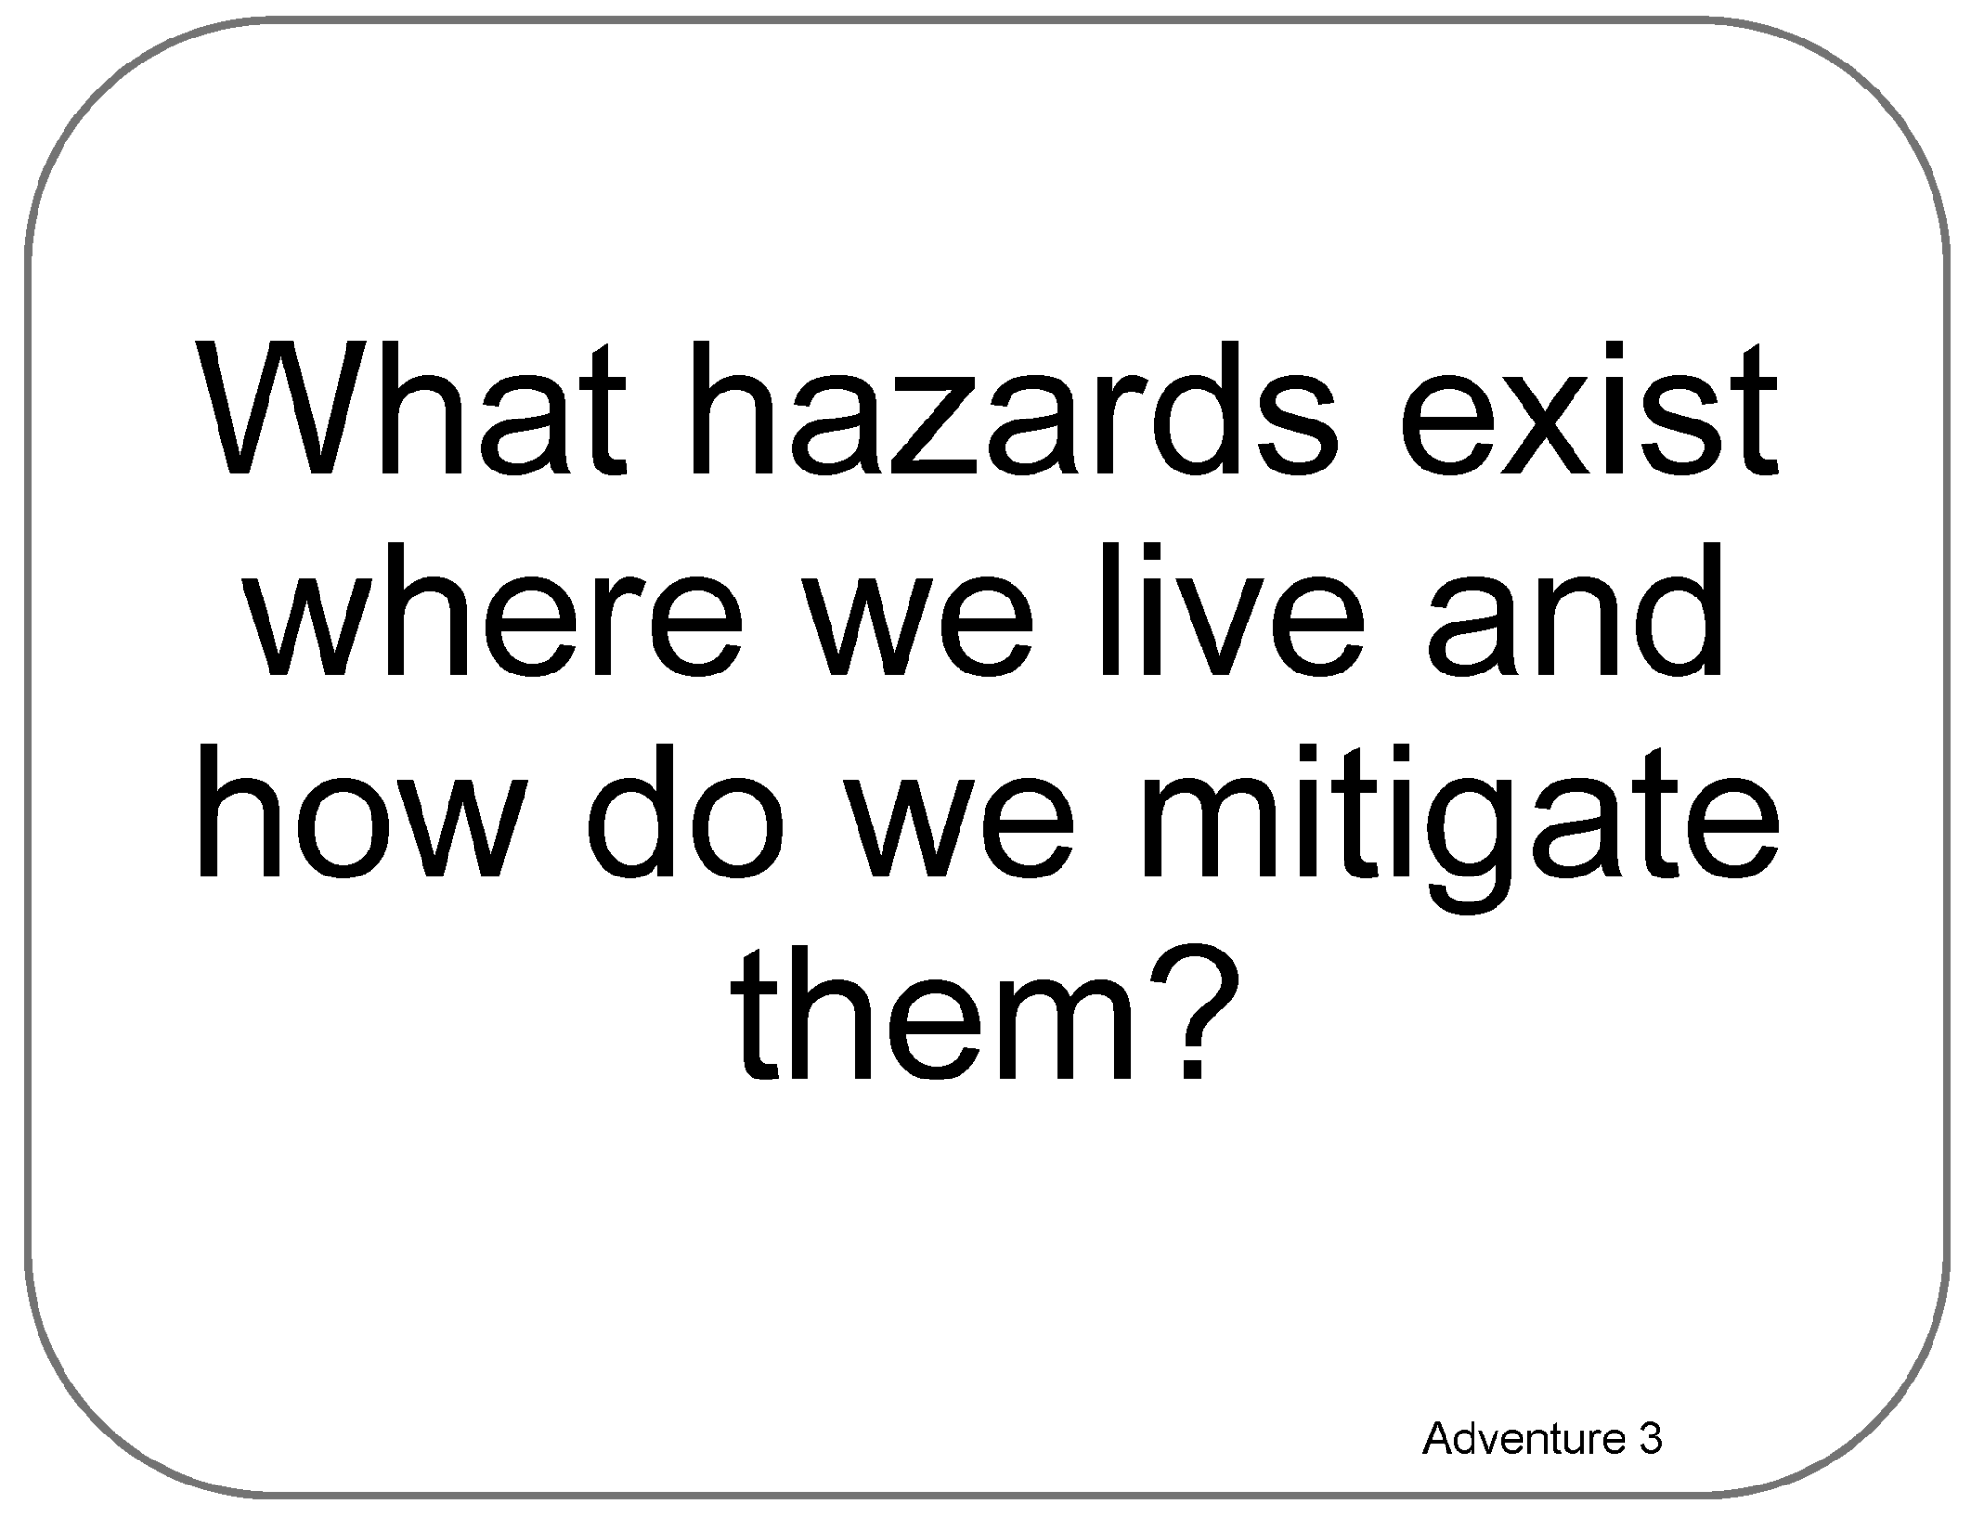
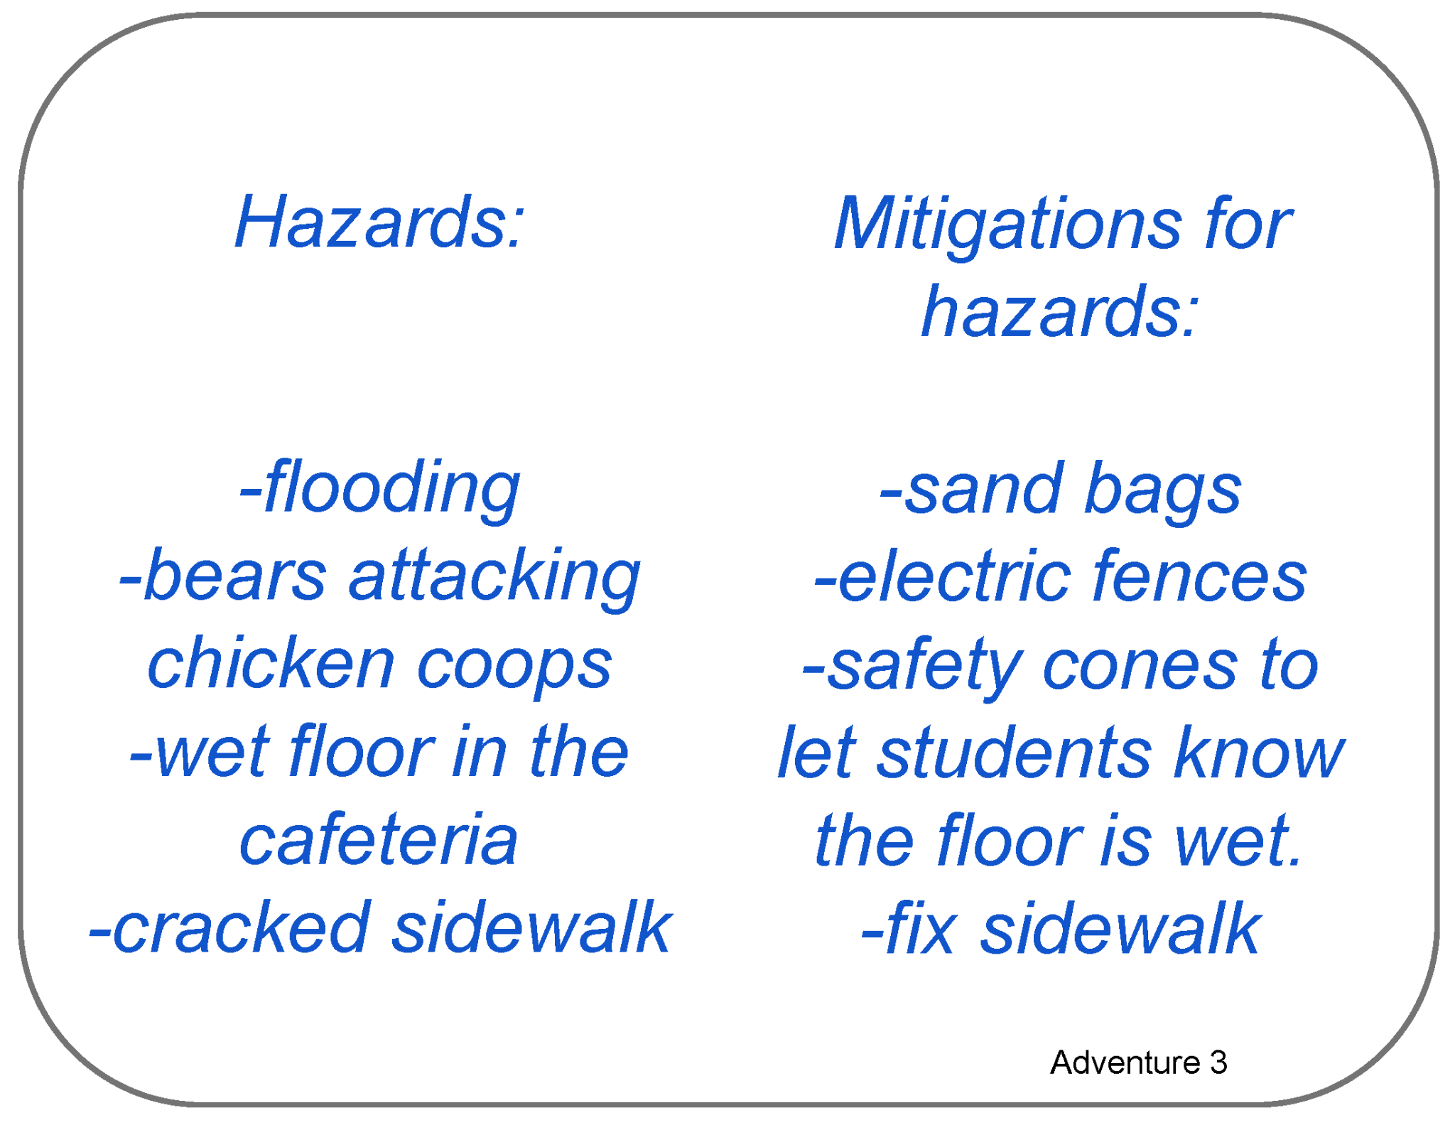

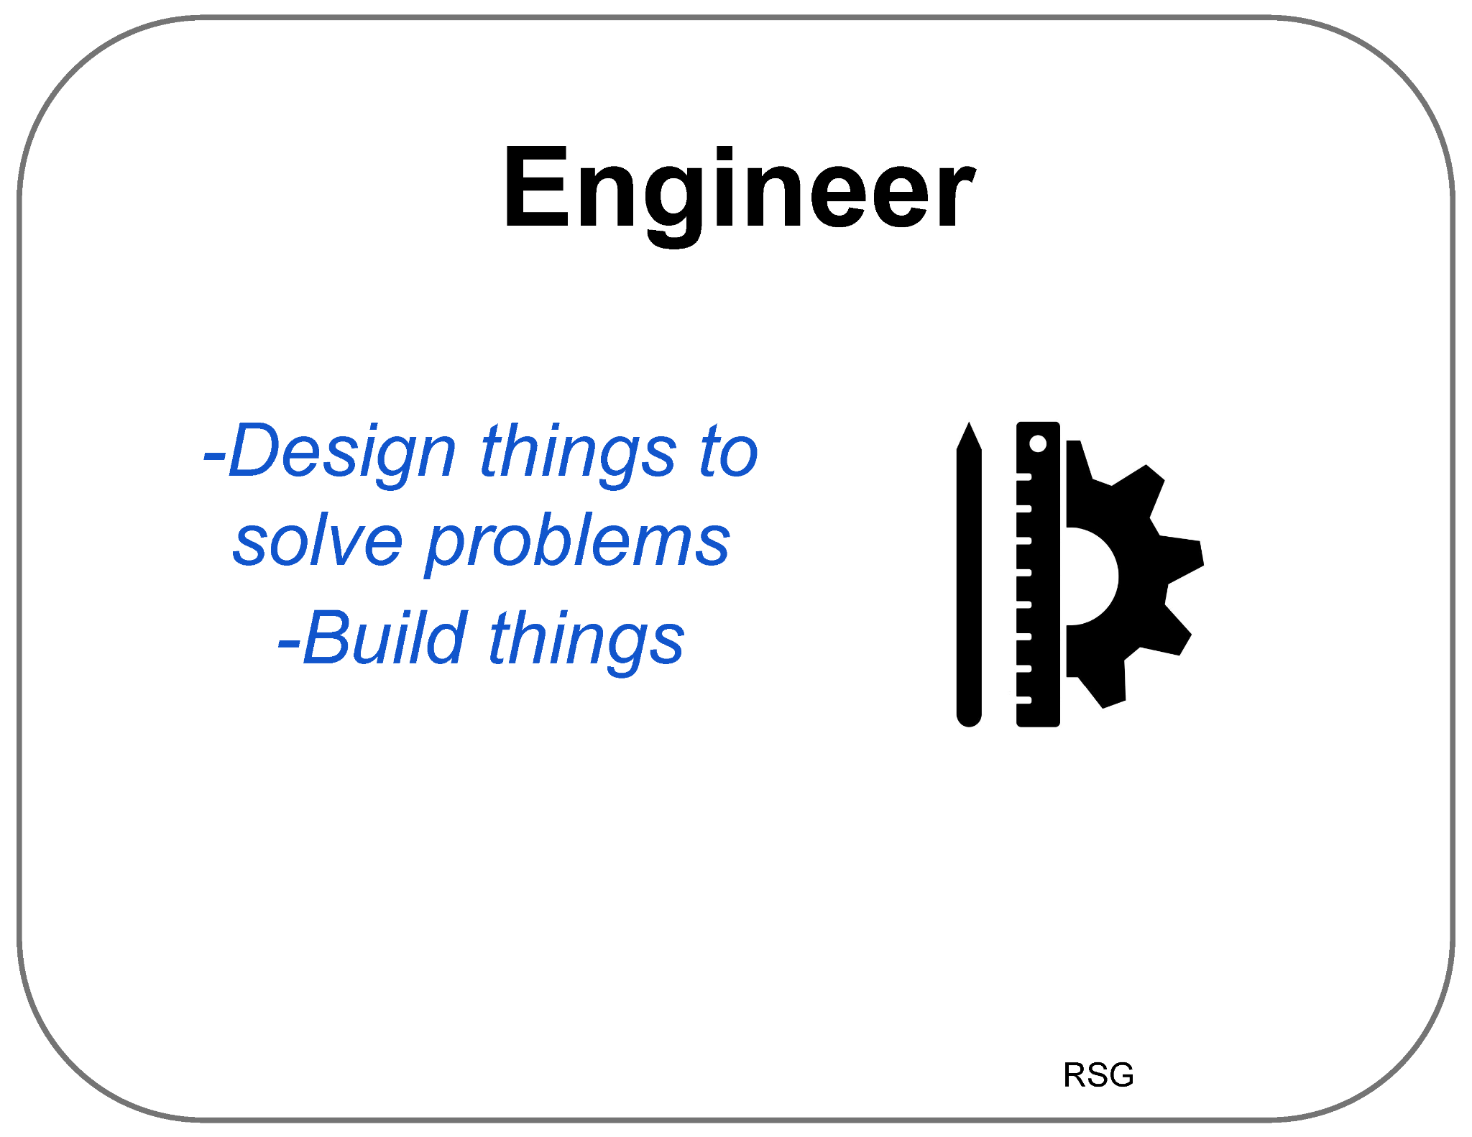
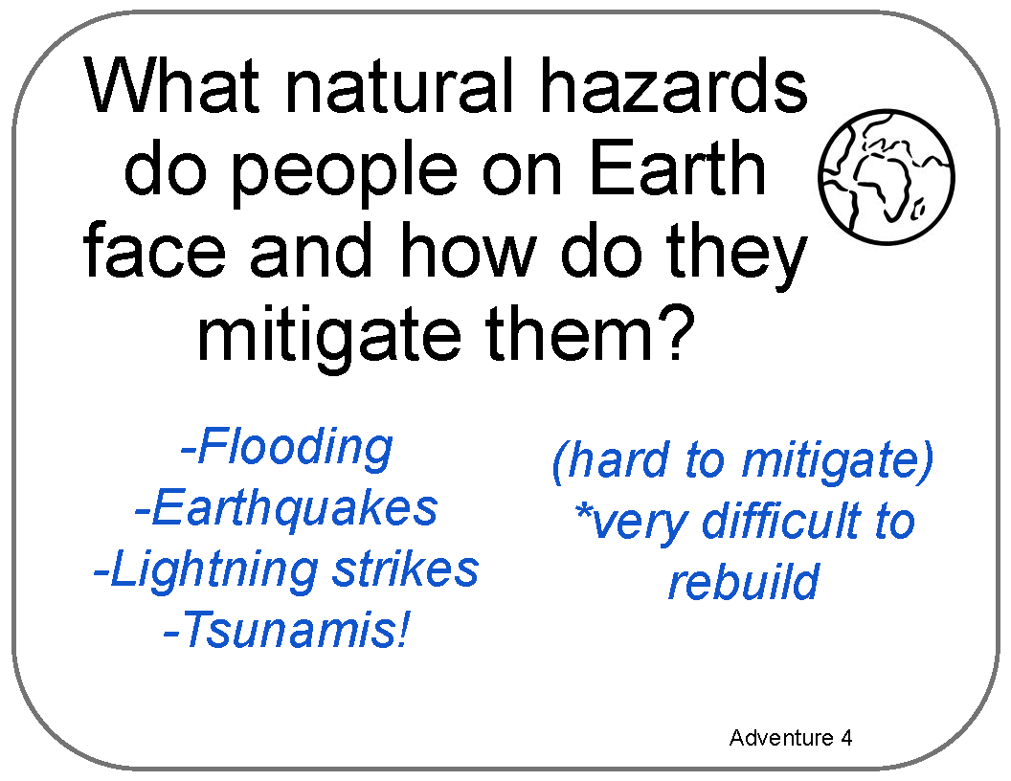
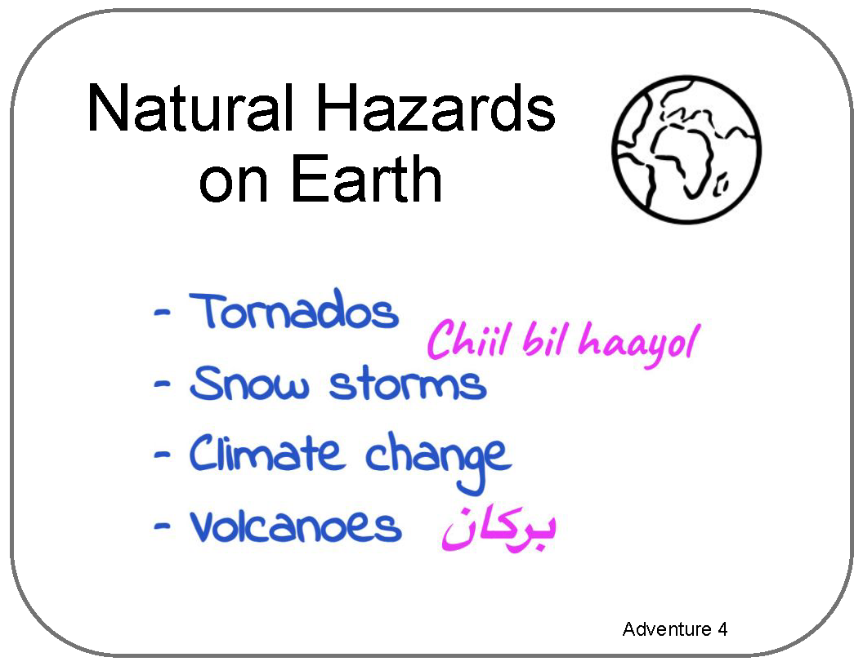
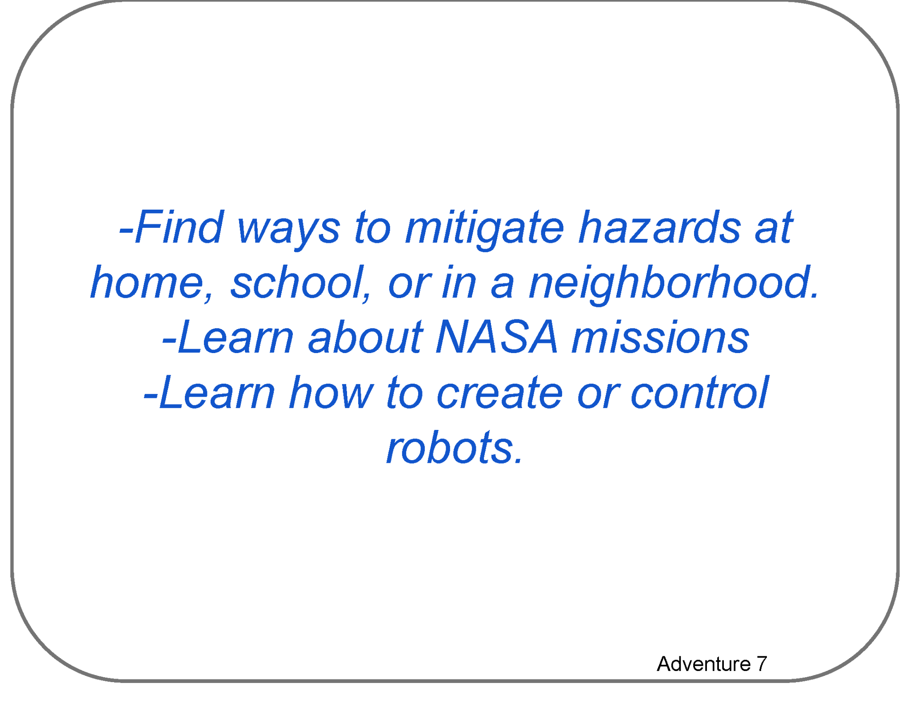
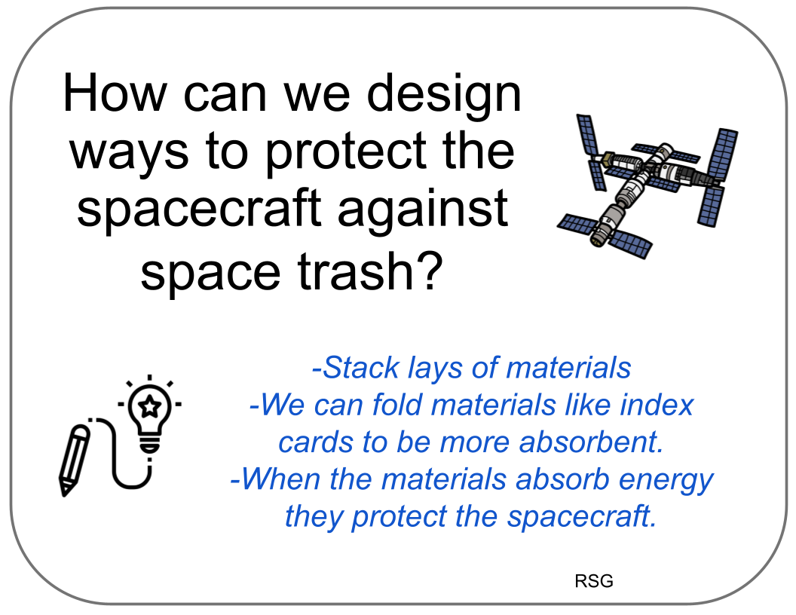
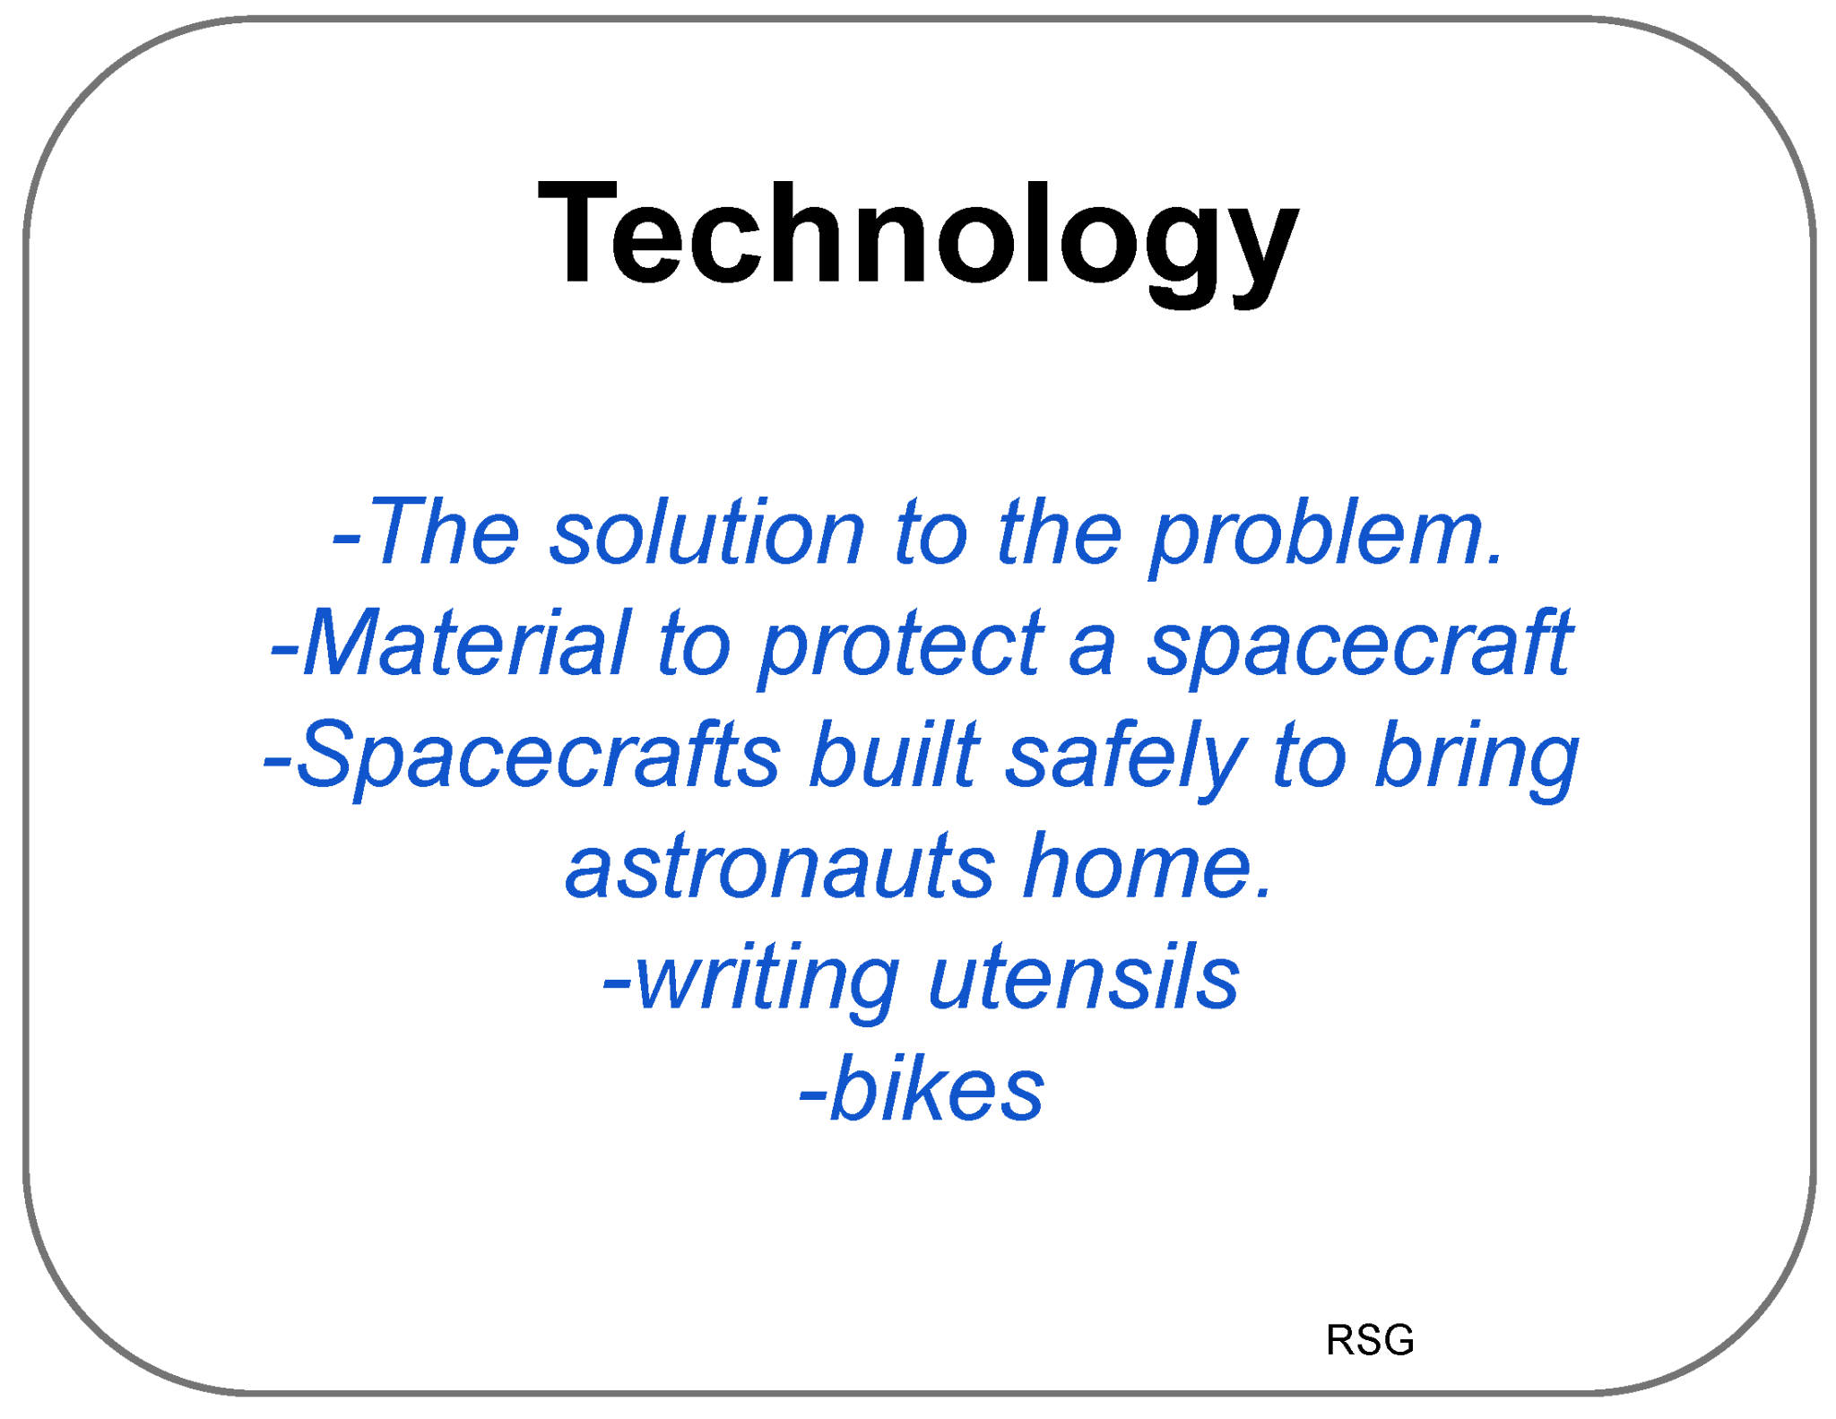
Poster Setup (with Example)
Our Ideas about Space Hazards
Science

Slide 13
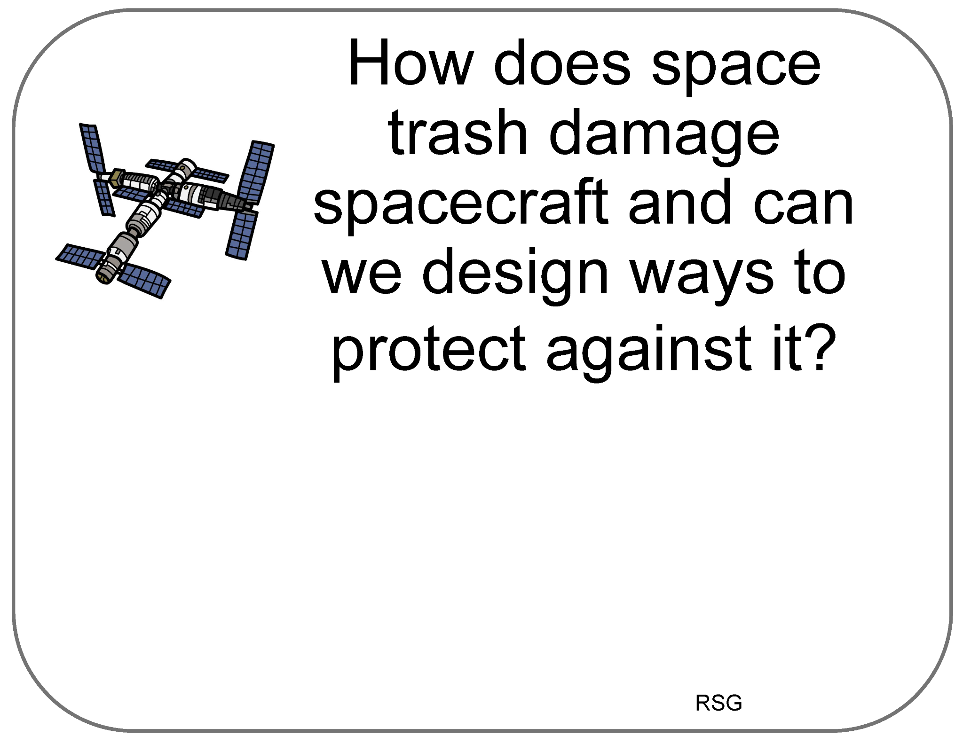
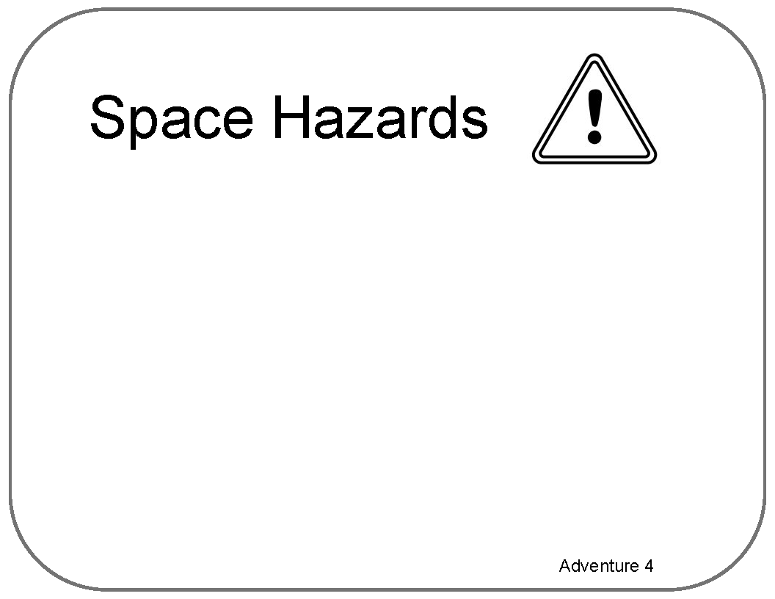
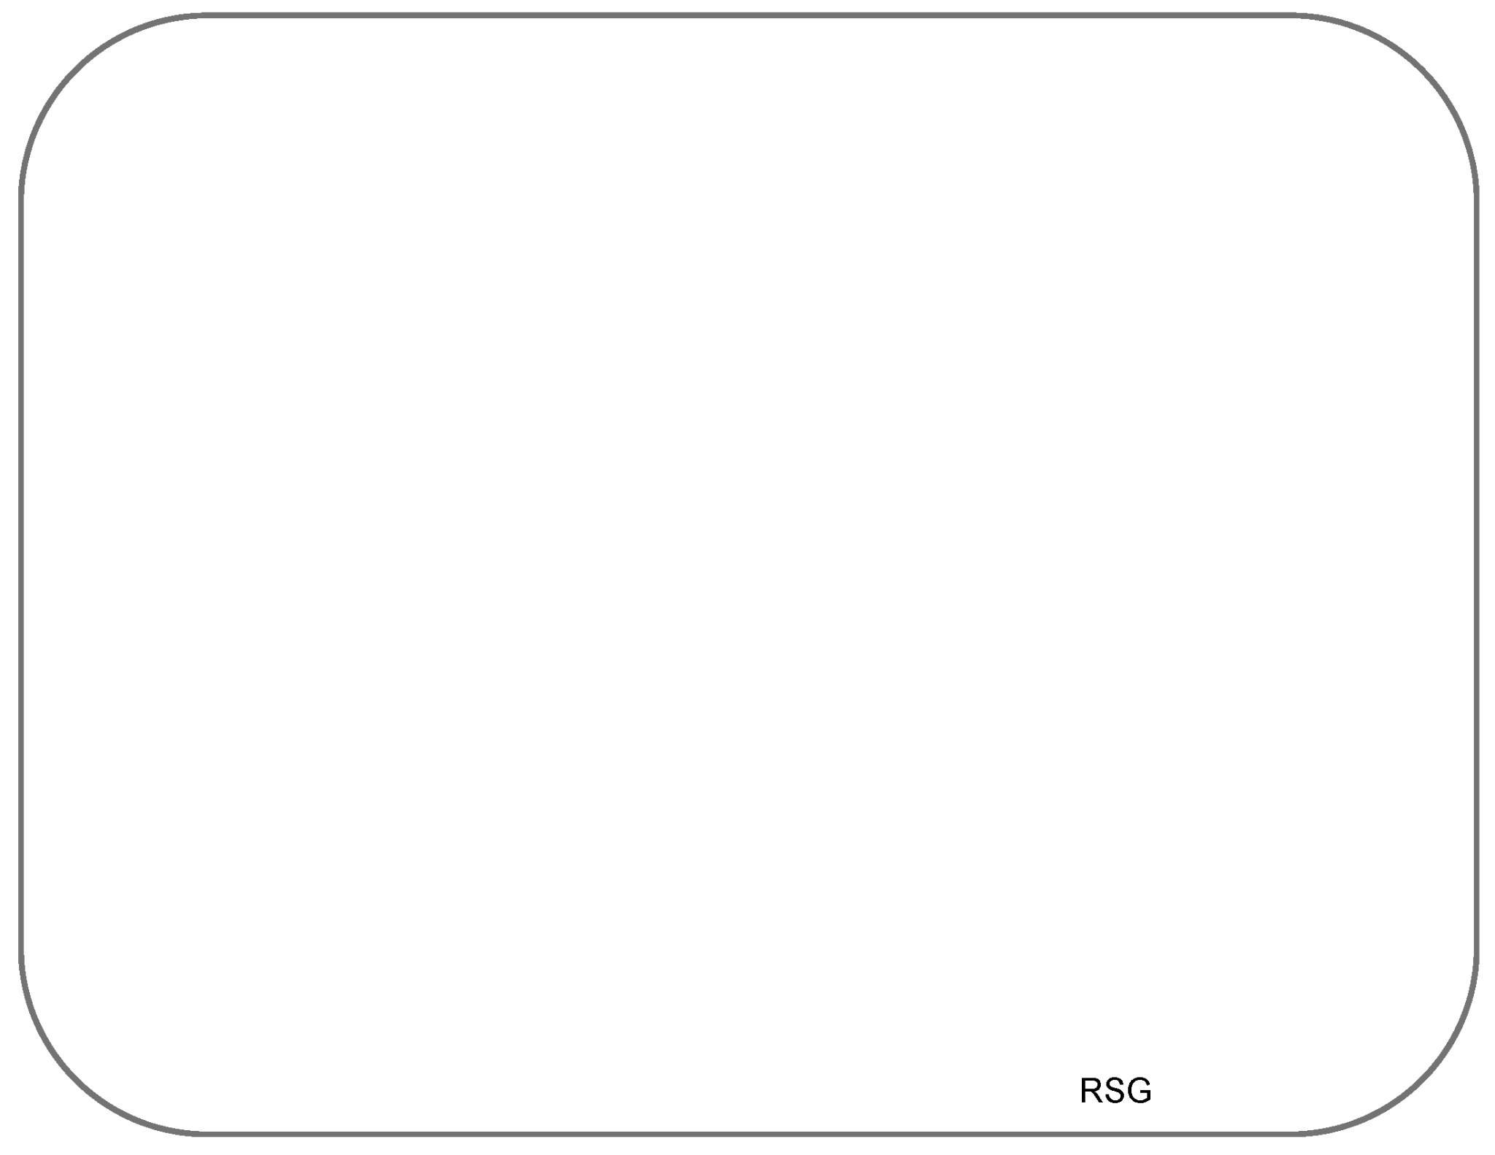
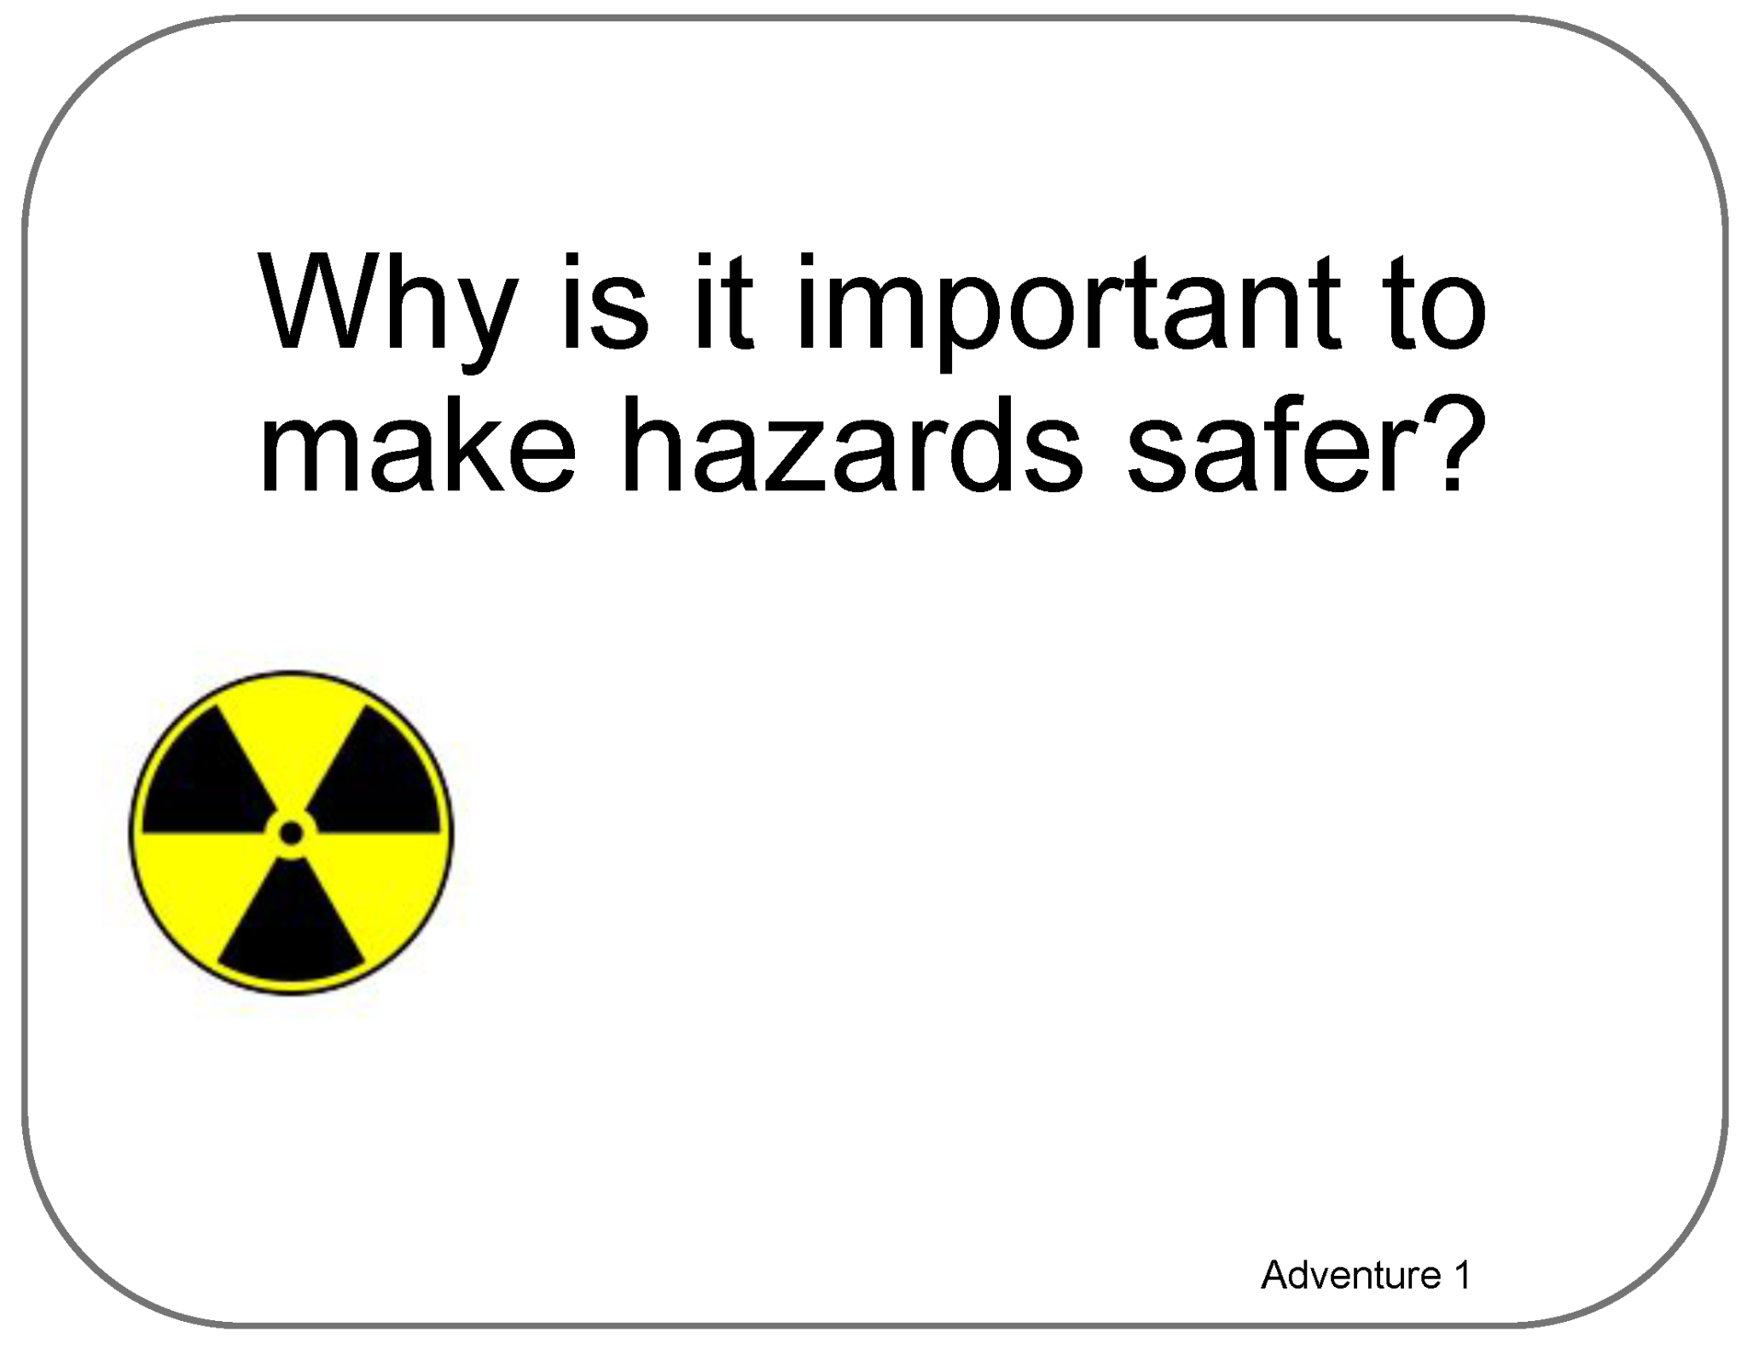
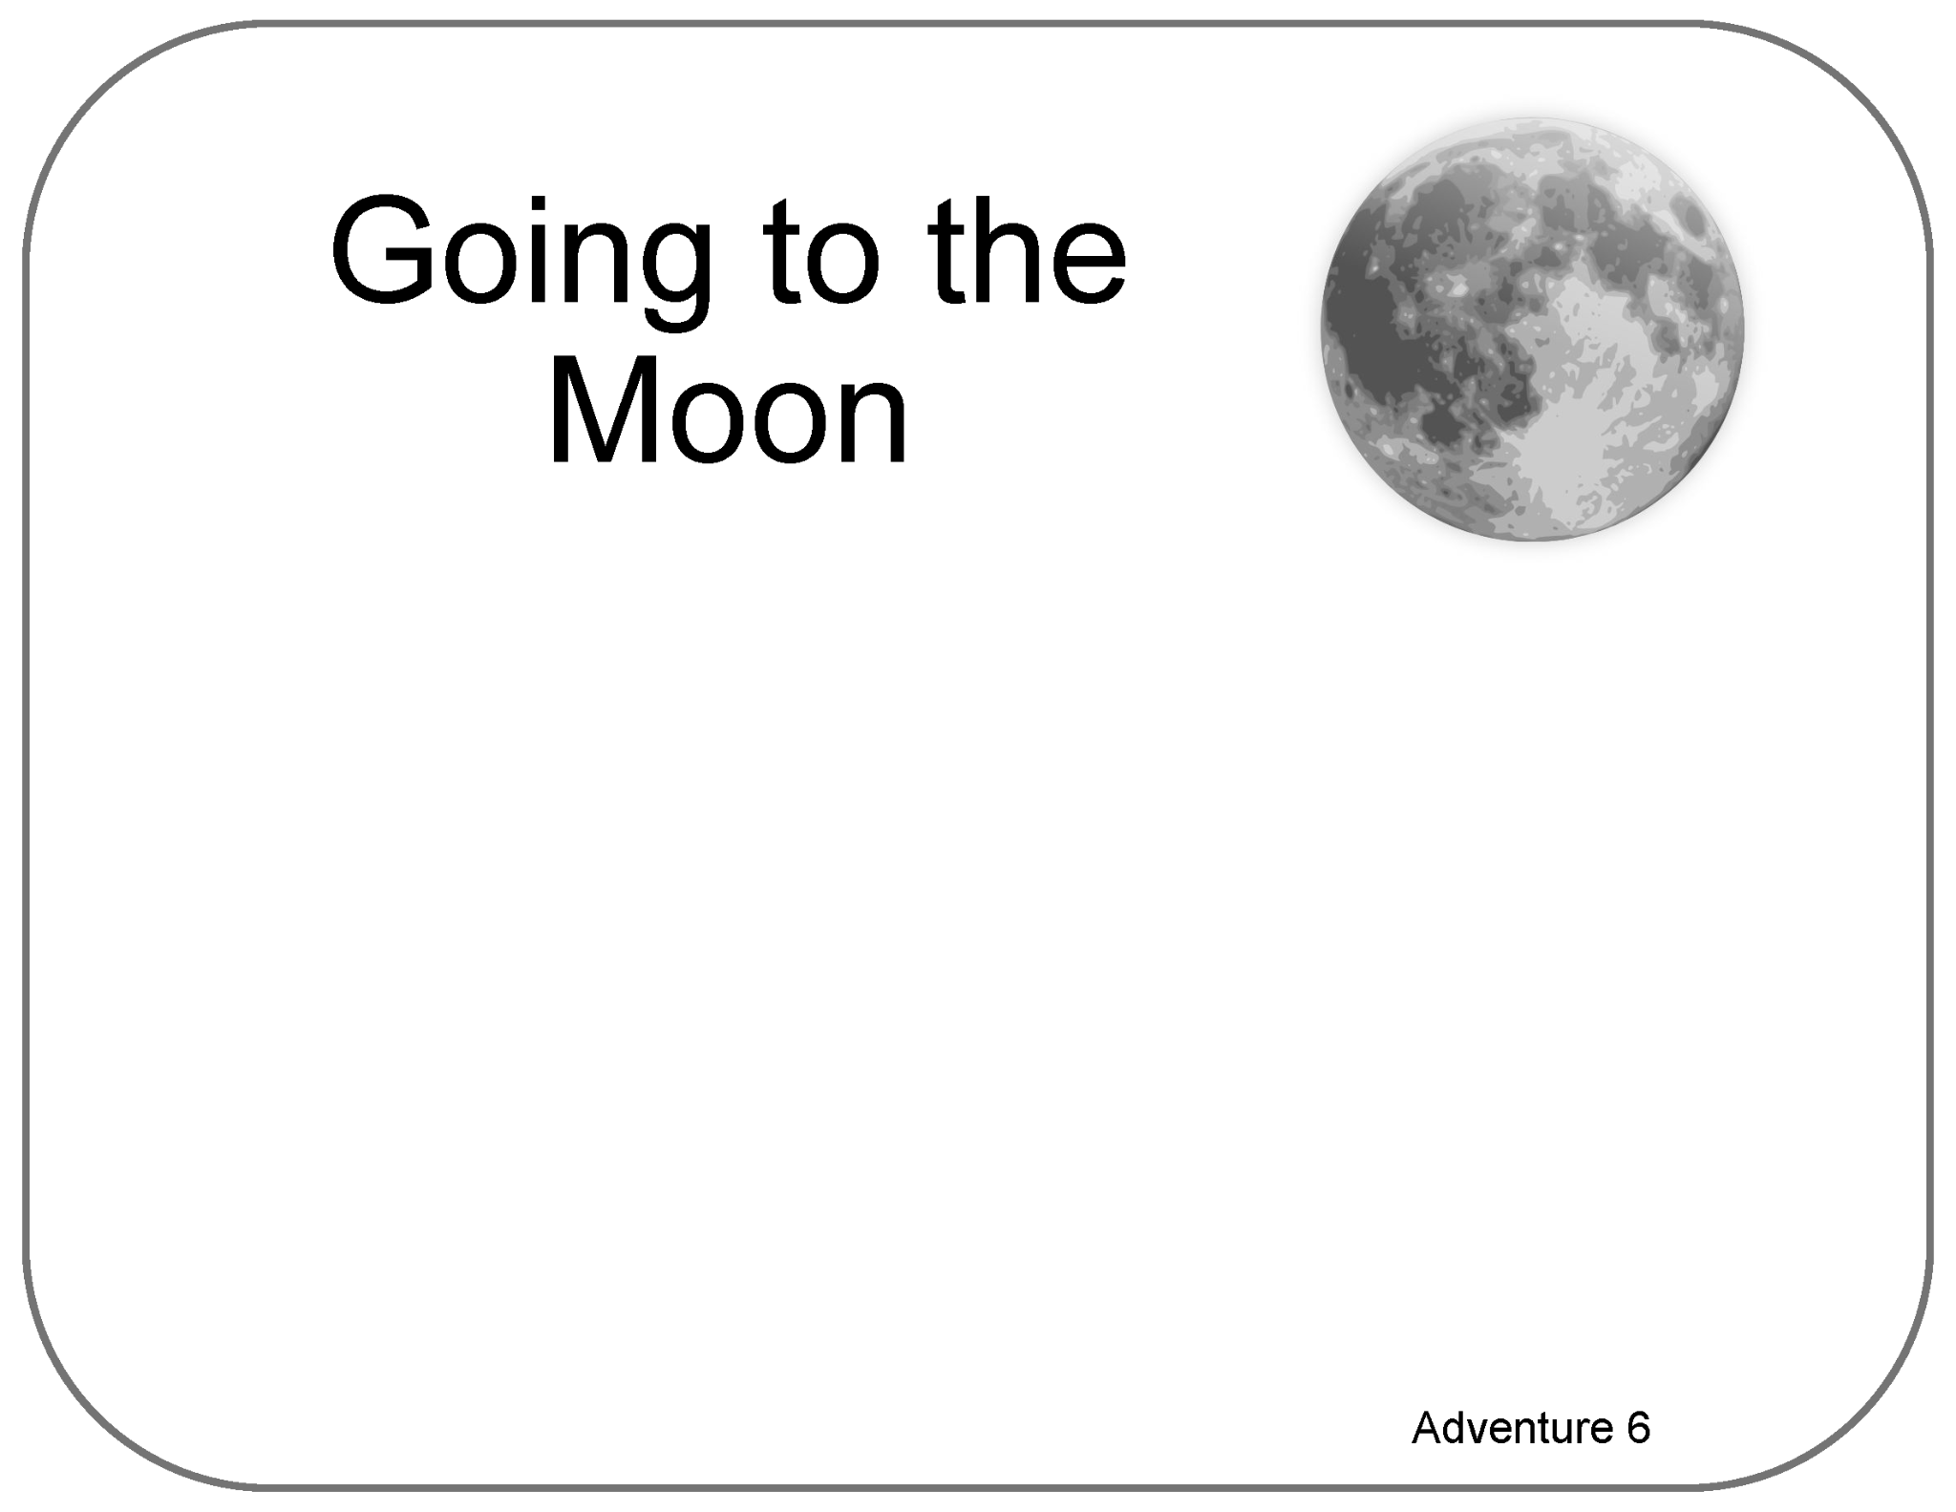
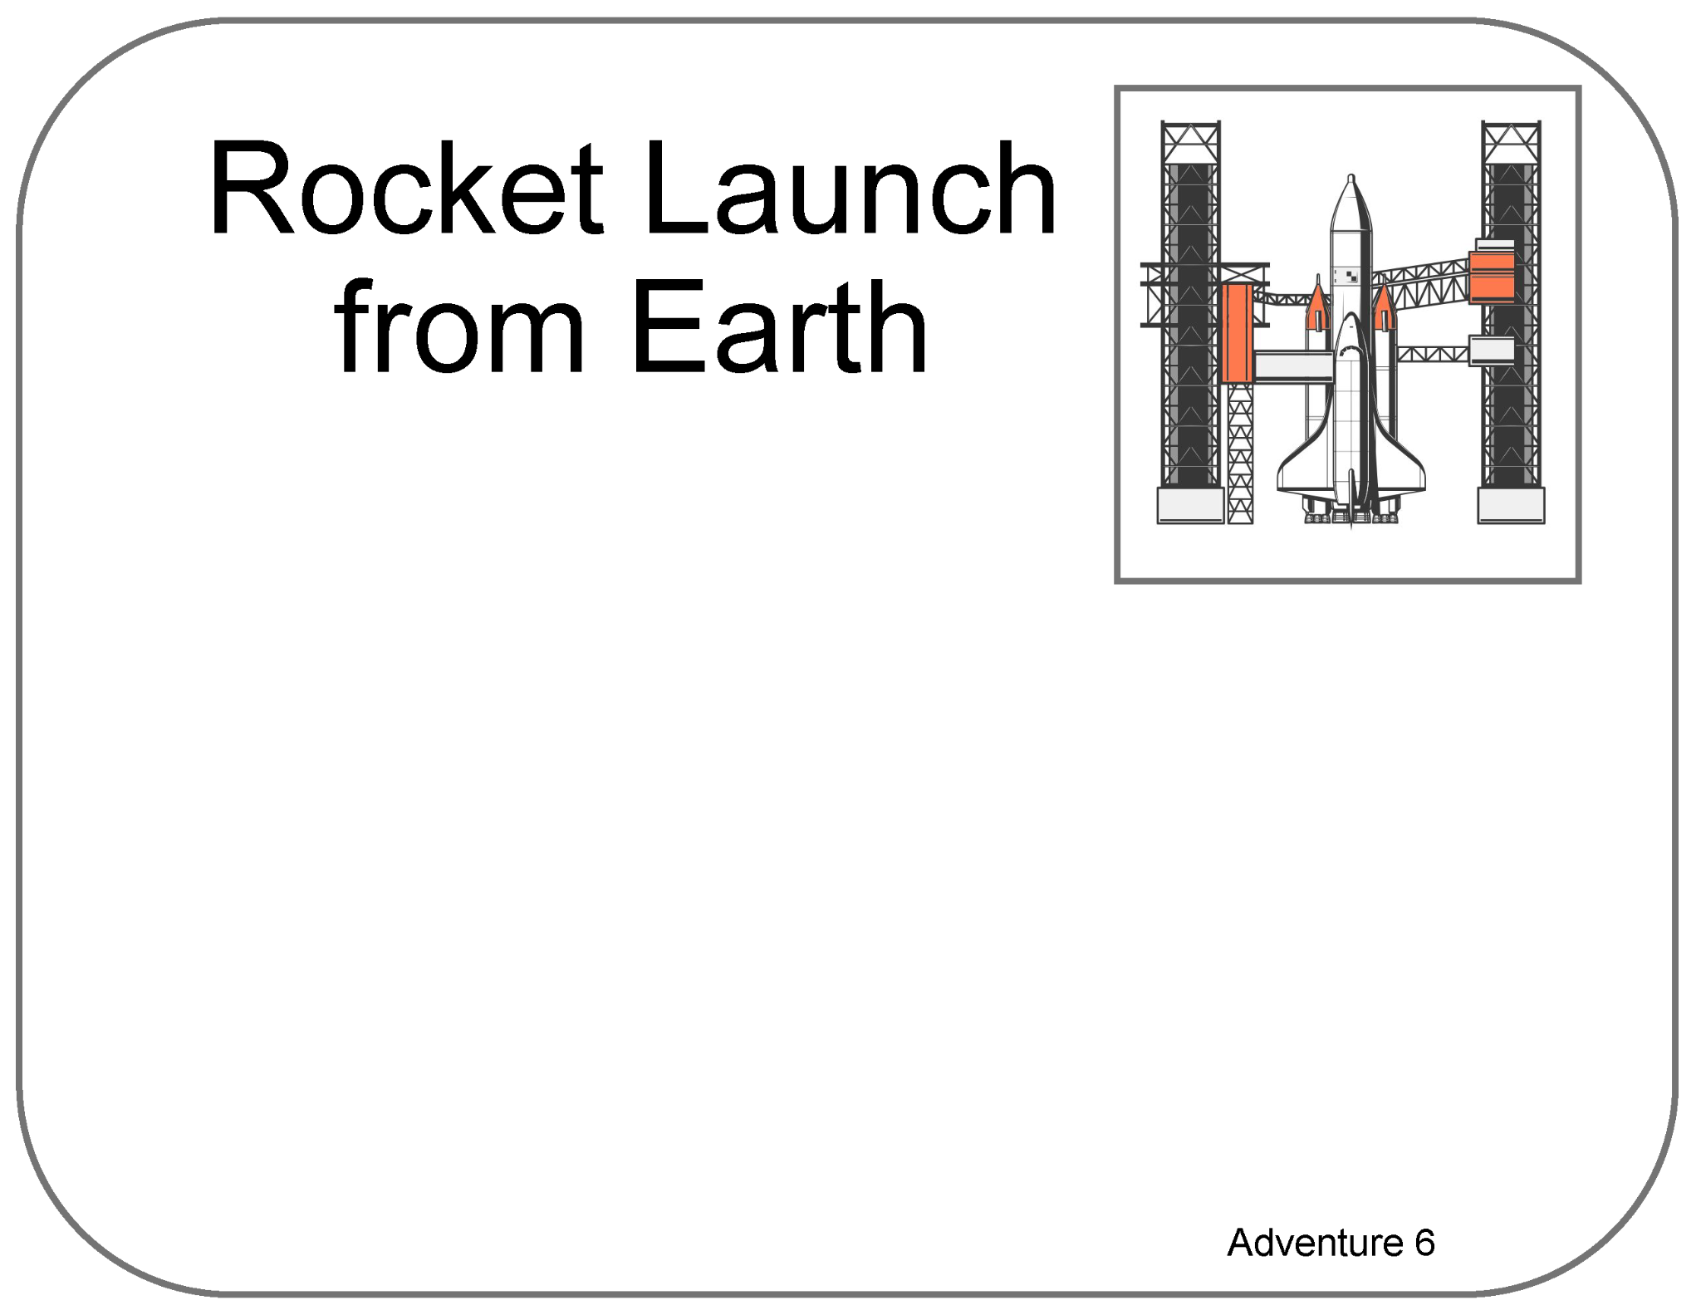
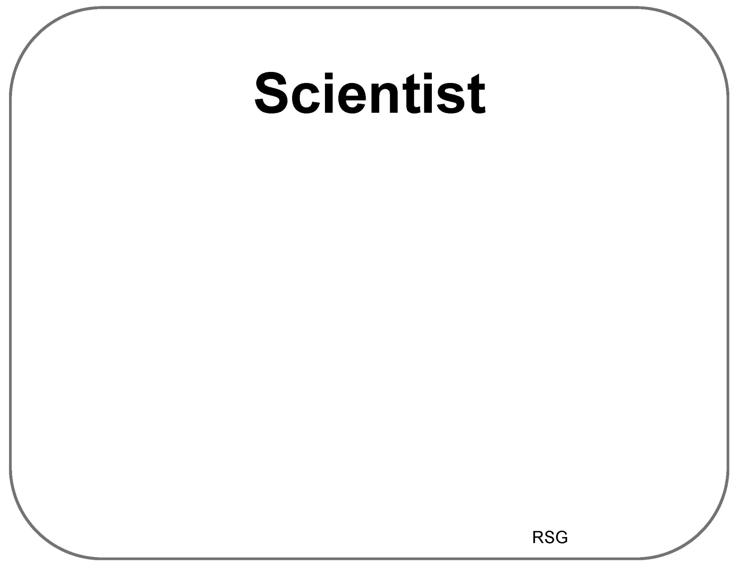
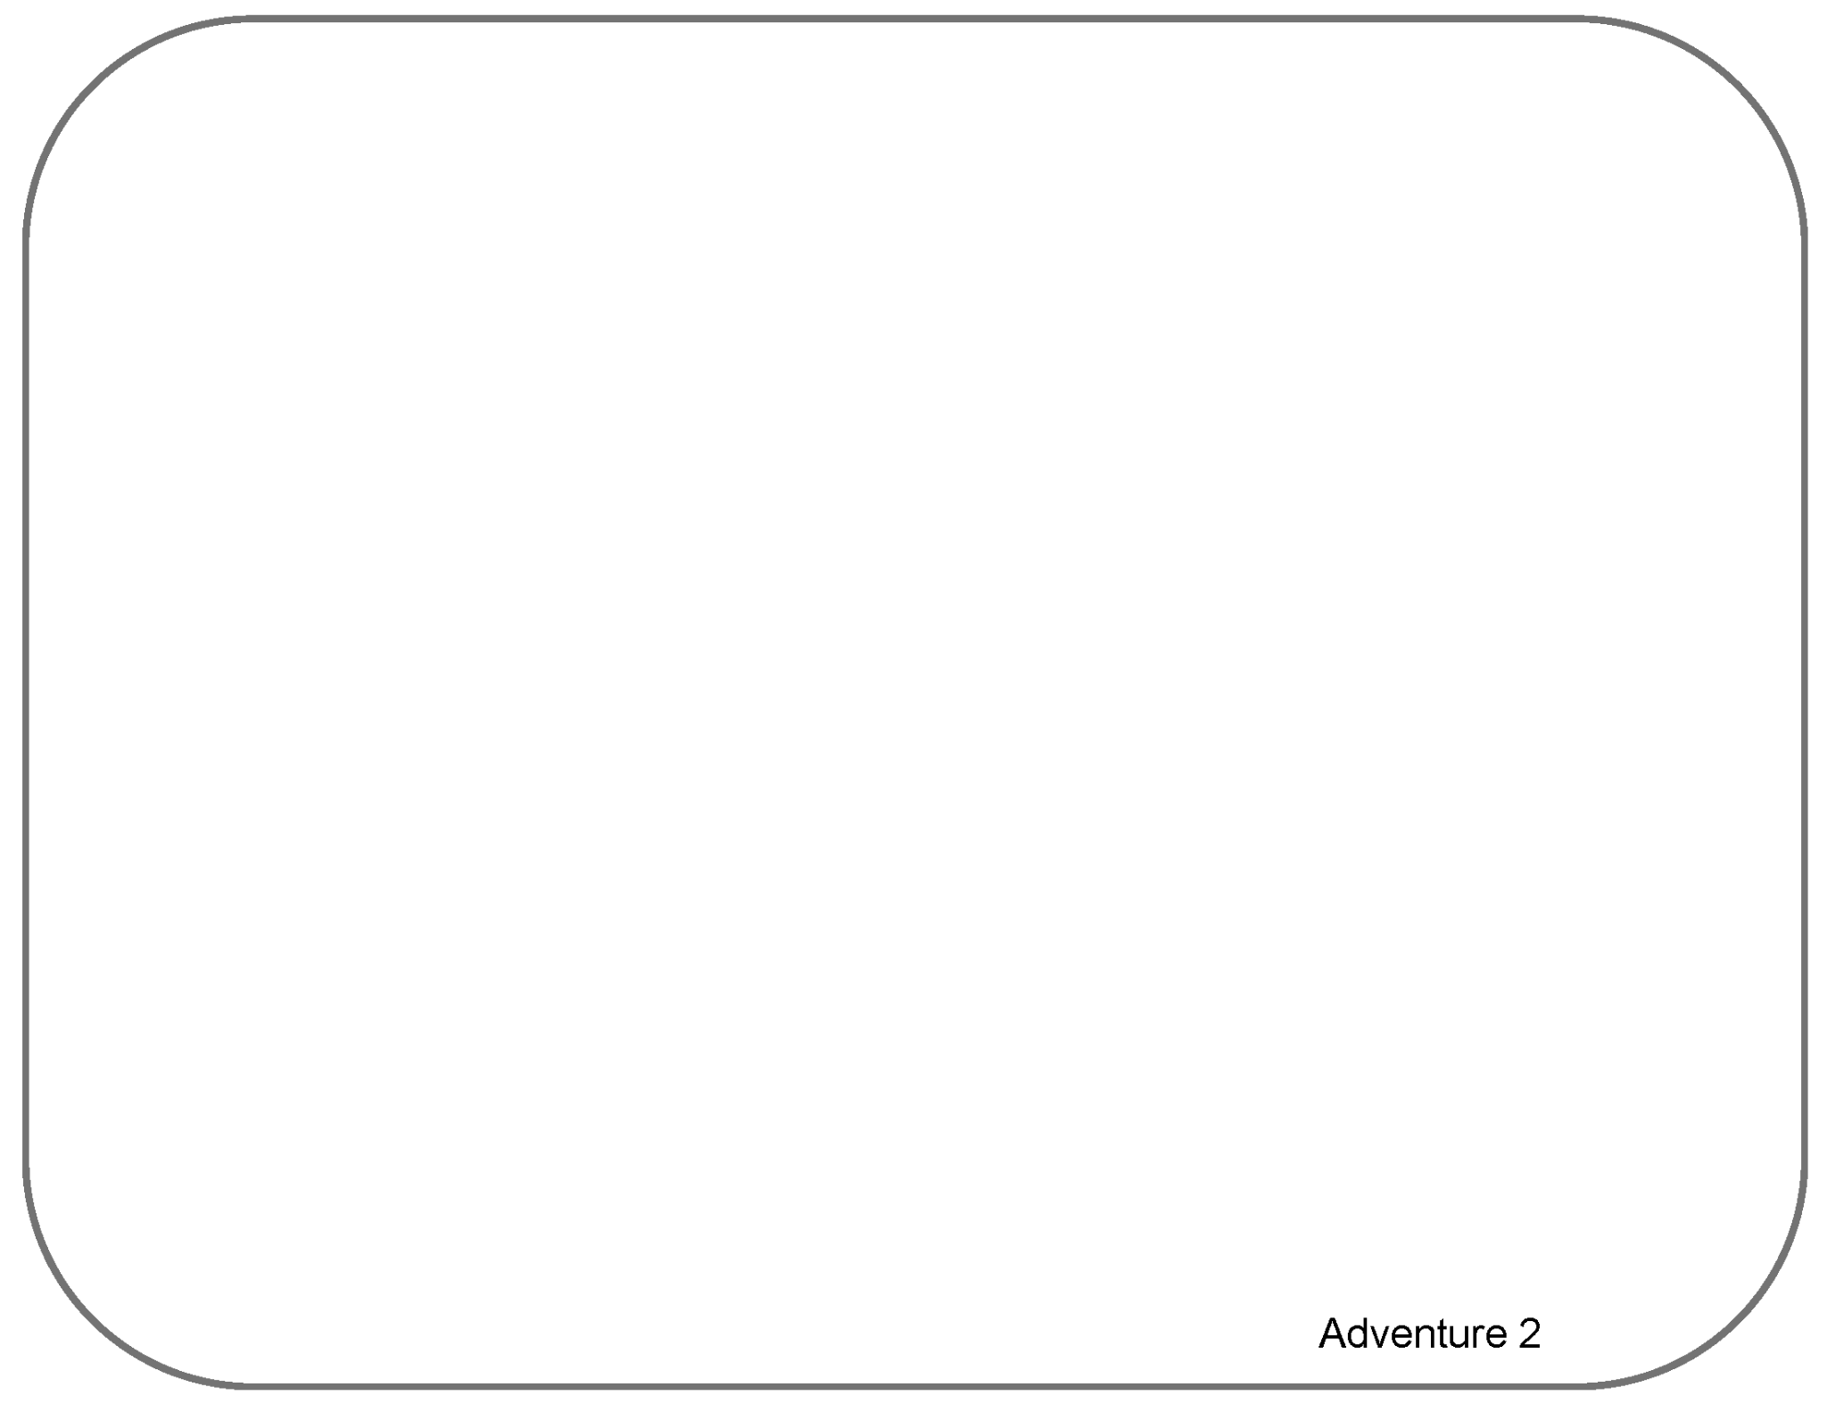
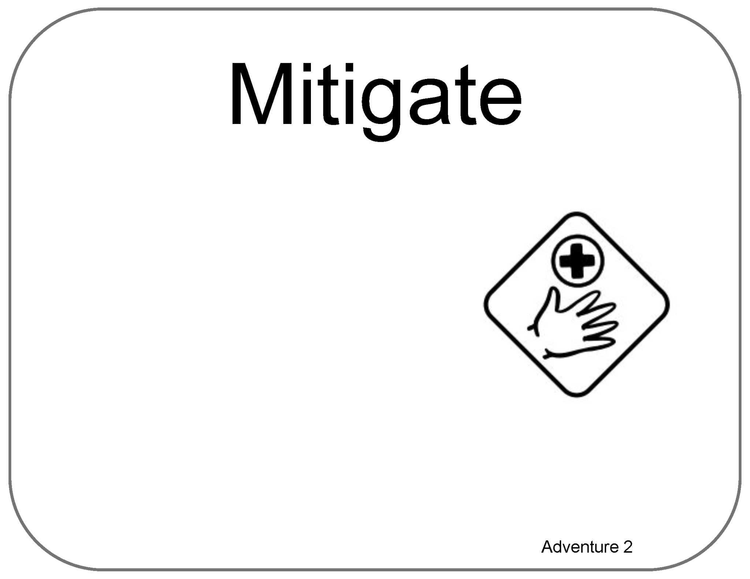
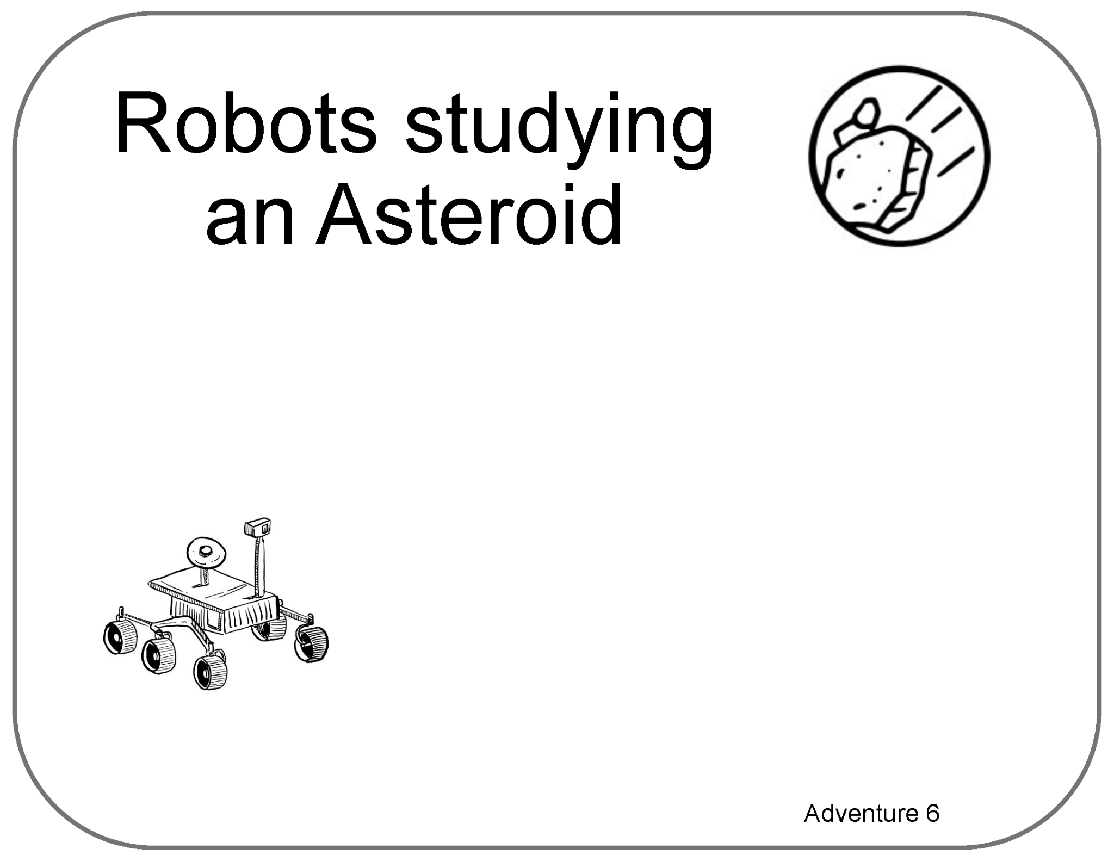
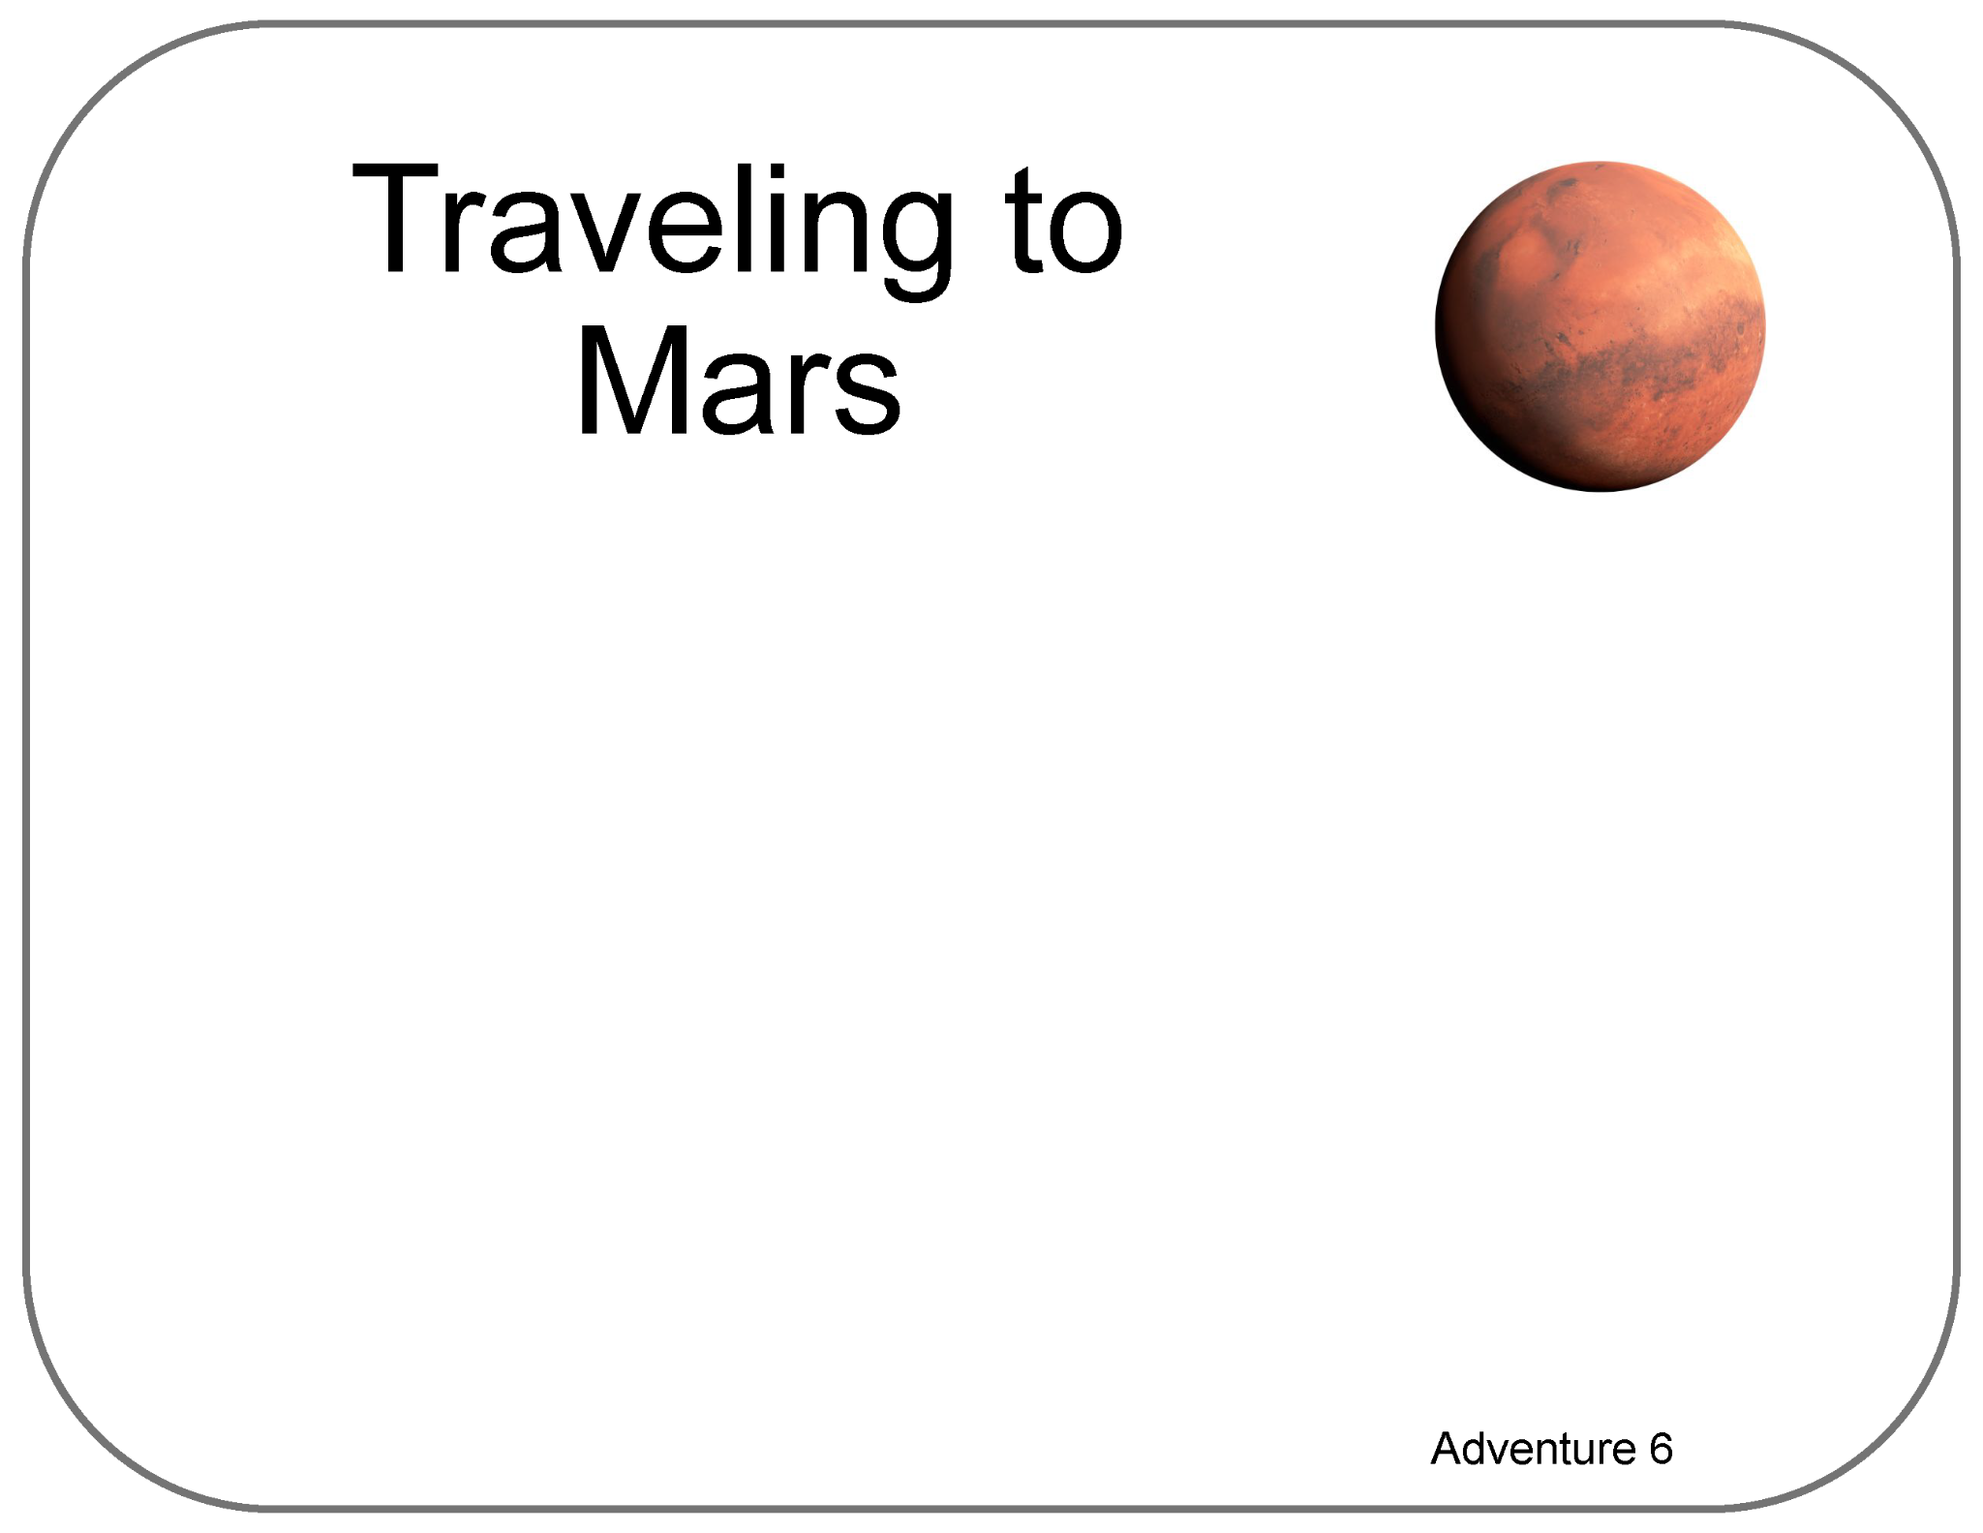

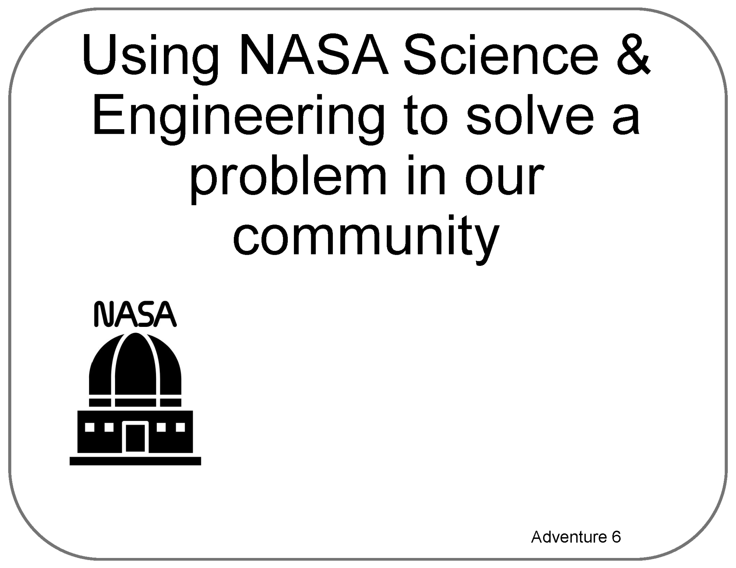
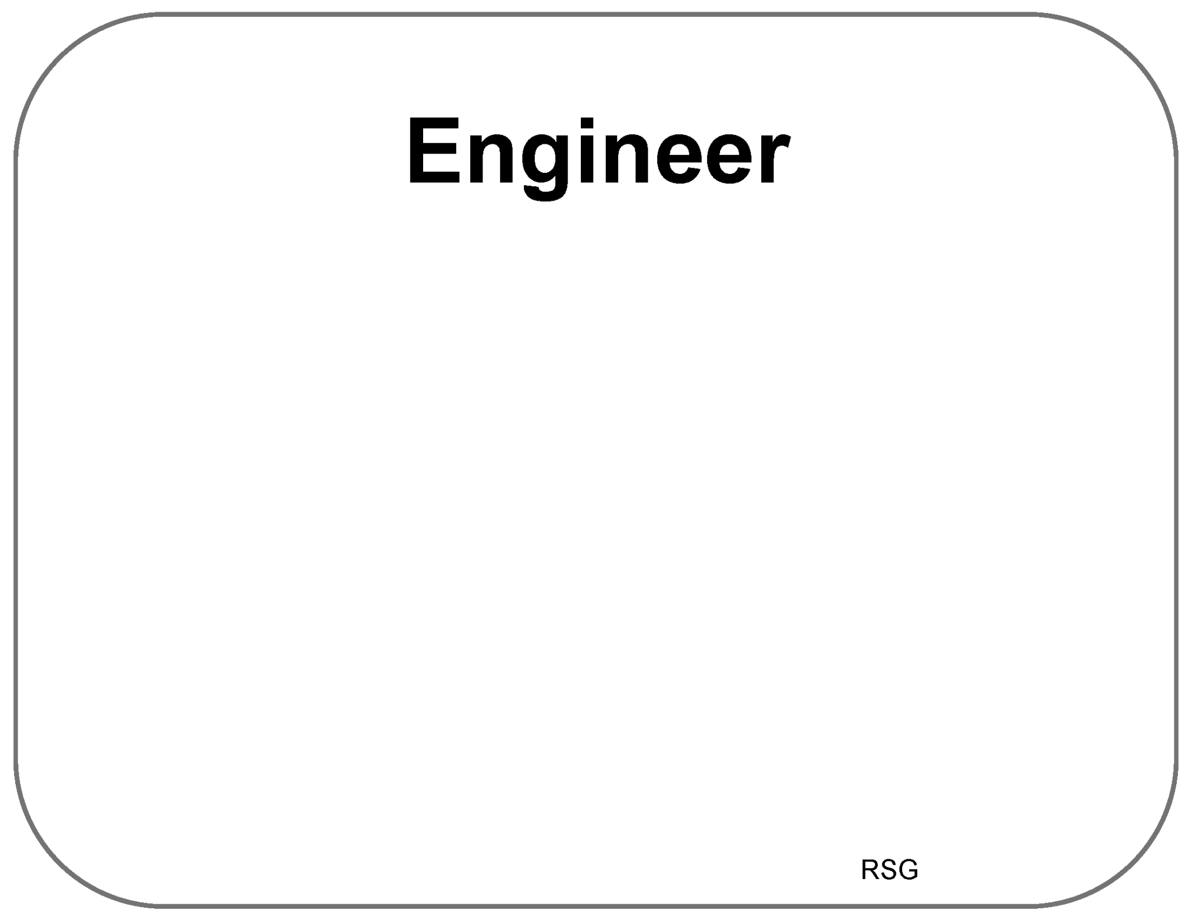
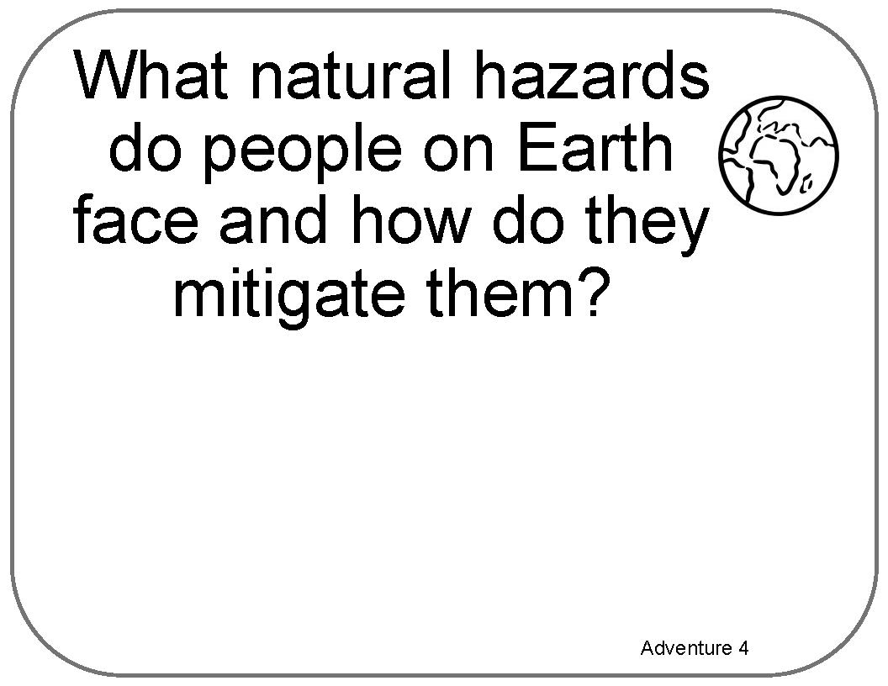


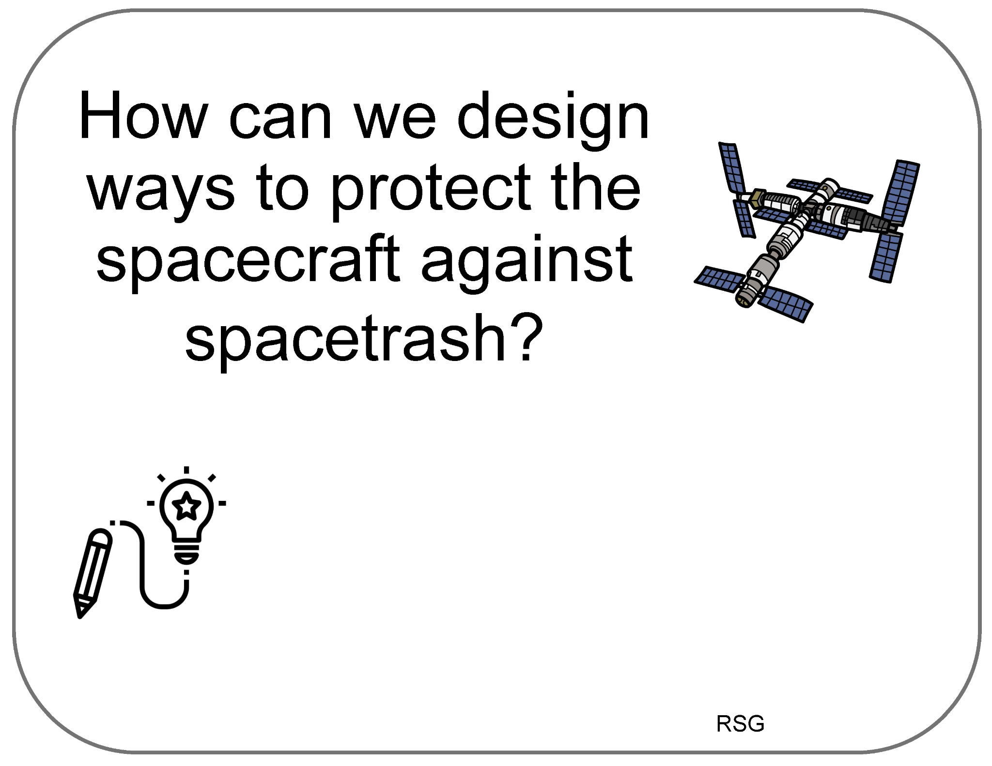
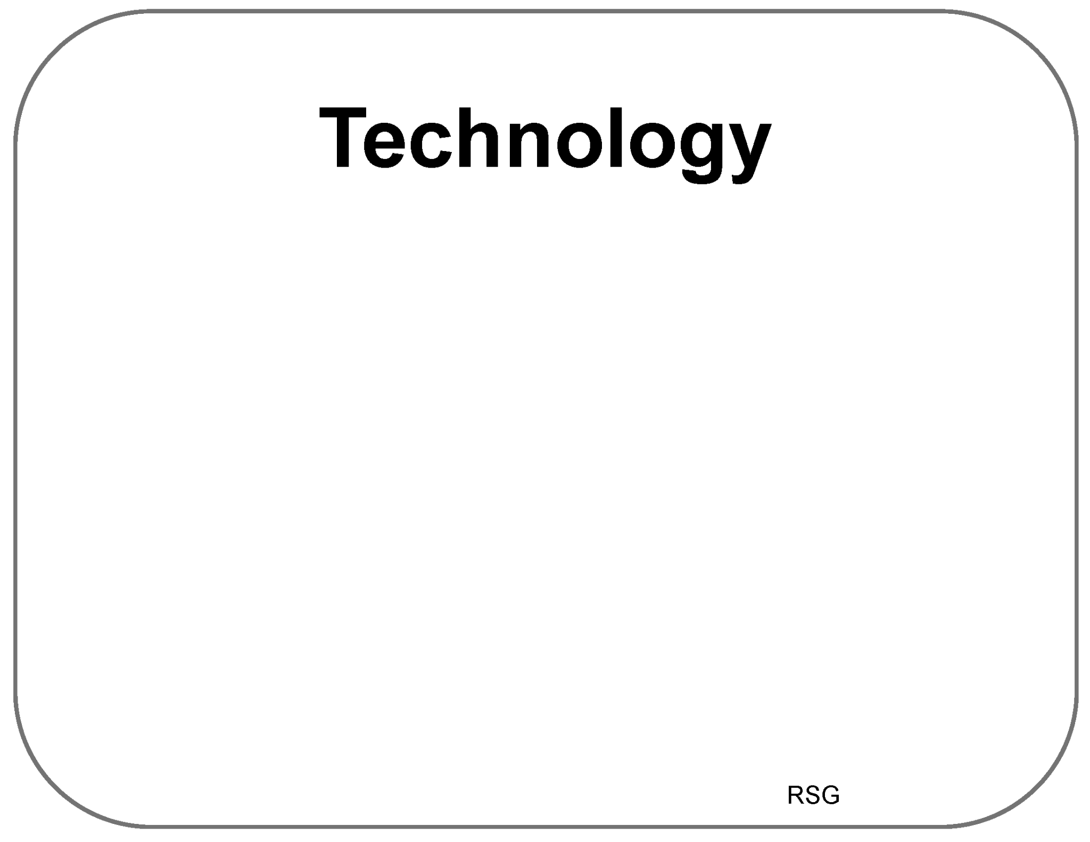
Poster Setup (Empty Example)
Our Ideas about Space Hazards
Science

Slide 14
Space Hazards
Science
RSG &
Adventures 1-9
Our Ideas Poster

Slide 15
Examples of Cards for Poster
The following slides are based on the printable PDF version of the blank cards you can use to set up your “Our Ideas Posters”
They have been altered to be more accessible to screen readers.

Slide 16
Ready S.E.T. Go! (RSG)

Slide 17
Card: How does space trash…

Slide 18
Blank RSG Card (1 of 2)

Slide 19
Blank RSG Card (2 of 2)

Slide 20
Card: Scientist

Slide 21
Card: Criteria

Slide 22
Card: Constraints

Slide 23
Card: Tradeoff

Slide 24
Card: Engineer

Slide 25
Card: How can we design…

Slide 26
Card: Technology

Slide 27
Card: How can we mitigate hazards…

Slide 28
Adventures 1-4

Slide 29
Card: Why is it important to make hazards safer?

Slide 30
Card: Instructions for learner’s cards

Slide 31
Card: How do people stay safe…

Slide 32
Card: What is a hazard?

Slide 33
Blank Adventure 2 Card

Slide 34
Card: Mitigate

Slide 35
Card: What hazards exist where we live…

Slide 36
Blank Adventure 3 Card

Slide 37
Card: What natural hazards do people on Earth…

Slide 38
Card: Natural Hazards on Earth

Slide 39
Adventures 5-7

Slide 40
Card: How do NASA missions mitigate…

Slide 41
Card: Space Hazards

Slide 42
Card: Going to the Moon

Slide 43
Card: Rocket Launch from Earth

Slide 44
Card: Robots studying an asteroid

Slide 45
Card: Traveling to Mars

Slide 46
Card: Using NASA Science & Engineering…

Slide 47
Blank Adventure 7 Card

