Slide 1
Screen Reader Version of Example Our Ideas Poster
The following slides are formatted to be more accessible for screen readers, but still convey the layout of the poster to the best of our ability.

Slide 2
How to set up the “Our Ideas Poster”
Set up your poster in columns so that learners can add their ideas underneath as you introduce new topics.
These can be tactile, Braille, written, drawings, digital, or any format that works best for your learners and your learning environment.

Slide 3
Screenshots from PDF with alt text added

Slide 4
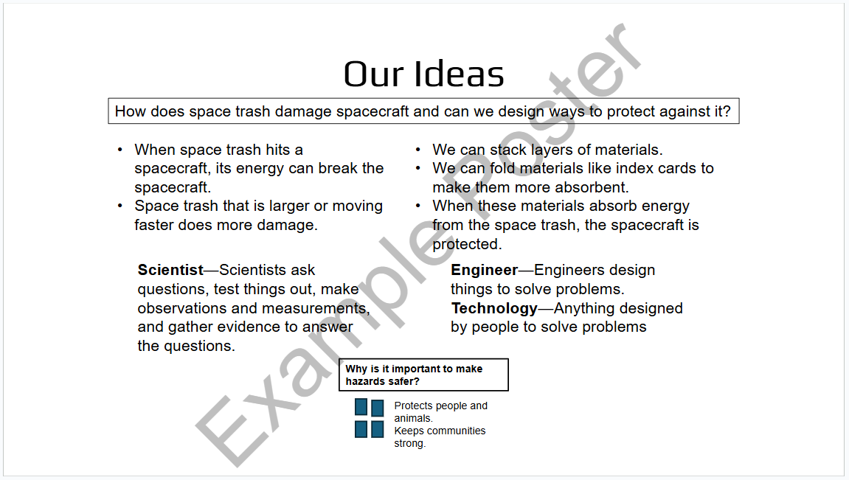
Our Ideas Overview Example Screenshot

Slide 5
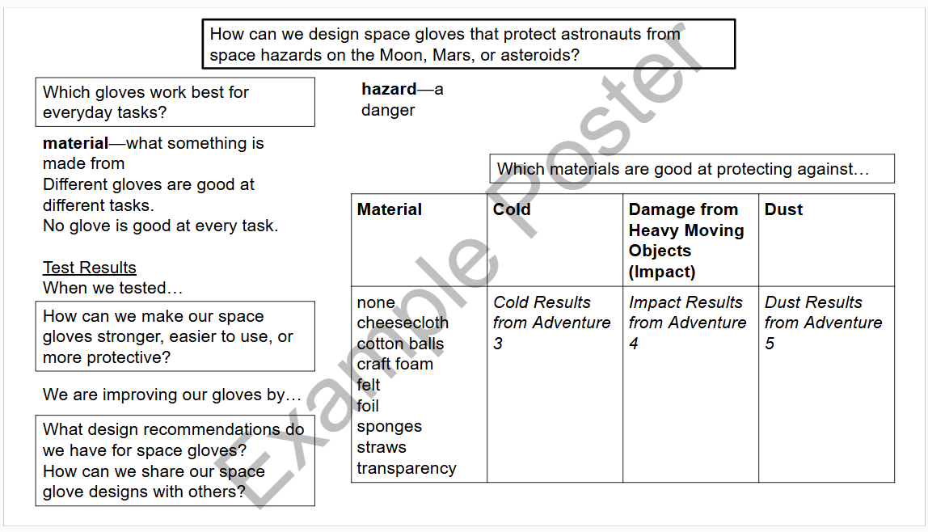
“How can we design space gloves…” poster example

Slide 6
Original Unformatted Slides

Slide 7
Our Ideas
How does space trash damage spacecraft and can we design ways to protect against it?
When space trash hits a spacecraft, its energy can break the spacecraft.
Space trash that is larger or moving faster does more damage.
We can stack layers of materials.
We can fold materials like index cards to make them more absorbent.
When these materials absorb energy from the space trash, the spacecraft is protected.
Scientist—Scientists ask questions, test things out, make observations and measurements, and gather evidence to answer the questions.
Engineer—Engineers design things to solve problems.
Technology—Anything designed by people to solve problems
Why is it important to make hazards safer?
Protects people and animals.
Keeps communities strong.

Slide 8
How can we design space gloves that protect astronauts from space hazards on the Moon, Mars, or asteroids?
Which gloves work best for everyday tasks?
hazard—a danger
material—what something is made from
Different gloves are good at different tasks.
No glove is good at every task.
Test Results
When we tested…
Which materials are good at protecting against…
Material | Cold | Damage from Heavy Moving Objects (Impact) | Dust
none cheesecloth cotton balls craft foam felt foil sponges straws transparency | Cold Results from Adventure 3 | Impact Results from Adventure 4 | Dust Results from Adventure 5
How can we make our space gloves stronger, easier to use, or more protective?
We are improving our gloves by…
What design recommendations do we have for space gloves?
How can we share our space glove designs with others?

