Slide 1
Screen Reader Version of Example Our Ideas Poster
The following slides are formatted to be more accessible for screen readers, but still convey the layout of the poster to the best of our ability.

Slide 2
How to set up the “Our Ideas Poster”
Set up your poster in columns so that learners can add their ideas underneath as you introduce new topics.
These can be tactile, Braille, written, drawings, digital, or any format that works best for your learners and your learning environment.

Slide 3
Screenshots from PDF with alt text added

Slide 4
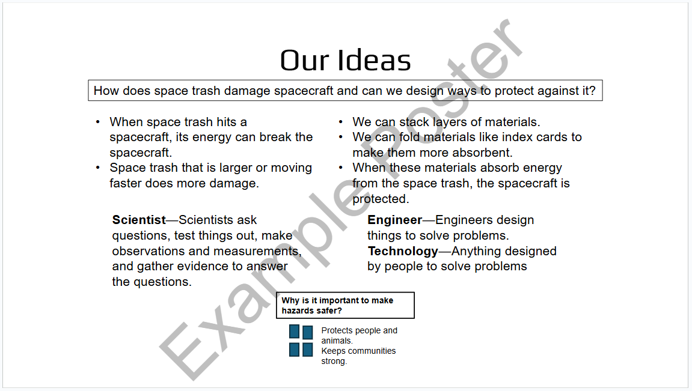
Our Ideas Overview Example Screenshot

Slide 5
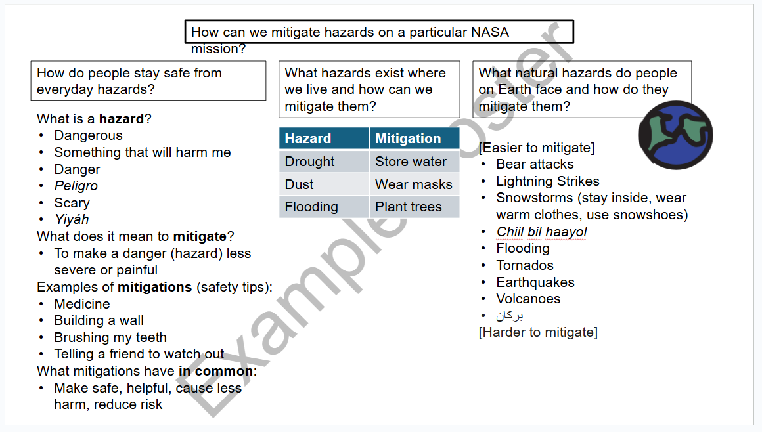
“How can we mitigate hazards on mission?” Poster example

Slide 6
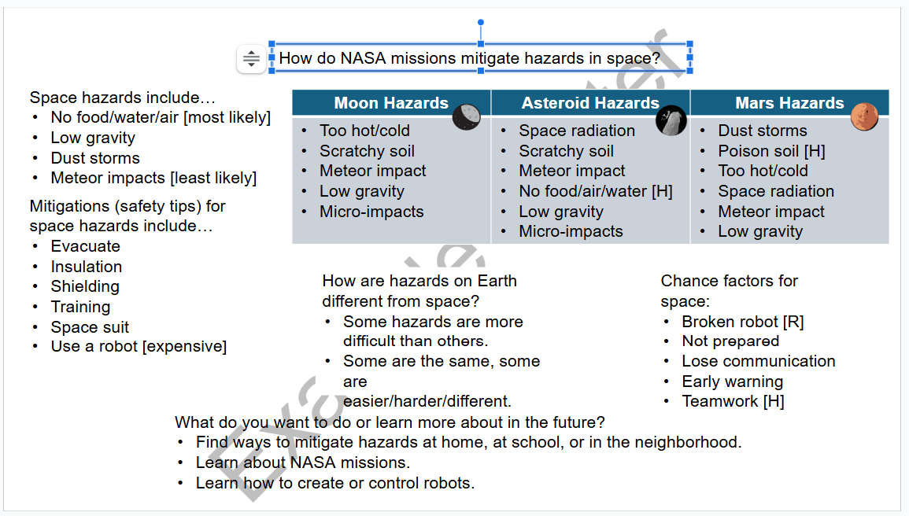
“How do NASA Missions…” Poster example

Slide 7
Original Unformatted Slides

Slide 8
Our Ideas
How does space trash damage spacecraft and can we design ways to protect against it?
When space trash hits a spacecraft, its energy can break the spacecraft.
Space trash that is larger or moving faster does more damage.
We can stack layers of materials.
We can fold materials like index cards to make them more absorbent.
When these materials absorb energy from the space trash, the spacecraft is protected.
Scientist—Scientists ask questions, test things out, make observations and measurements, and gather evidence to answer the questions.
Engineer—Engineers design things to solve problems.
Technology—Anything designed by people to solve problems
Why is it important to make hazards safer?
Protects people and animals.
Keeps communities strong.

Slide 9

How can we mitigate hazards on a particular NASA mission?
How do people stay safe from everyday hazards?
What hazards exist where we live and how can we mitigate them?
What natural hazards do people on Earth face and how do they mitigate them?
What is a hazard?
Dangerous
Something that will harm me
Danger
Peligro
Scary
Yiyáh
What does it mean to mitigate?
To make a danger (hazard) less severe or painful
Examples of mitigations (safety tips):
Medicine
Building a wall
Brushing my teeth
Telling a friend to watch out
What mitigations have in common:
Make safe, helpful, cause less harm, reduce risk
Hazard | Mitigation
Drought | Store water
Dust | Wear masks
Flooding | Plant trees
[Easier to mitigate]
Bear attacks
Lightning Strikes
Snowstorms (stay inside, wear warm clothes, use snowshoes)
Chiil bil haayol
Flooding
Tornados
Earthquakes
Volcanoes
بركان
[Harder to mitigate]

Slide 10

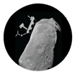

How do NASA missions mitigate hazards in space?
Space hazards include…
No food/water/air [most likely]
Low gravity
Dust storms
Meteor impacts [least likely]
Moon Hazards | Asteroid Hazards | Mars Hazards
Too hot/cold Scratchy soil Meteor impact Low gravity Micro-impacts | Space radiation Scratchy soil Meteor impact No food/air/water [H] Low gravity Micro-impacts | Dust storms Poison soil [H] Too hot/cold Space radiation Meteor impact Low gravity
Mitigations (safety tips) for space hazards include…
Evacuate
Insulation
Shielding
Training
Space suit
Use a robot [expensive]
How are hazards on Earth different from space?
Some hazards are more difficult than others.
Some are the same, some are easier/harder/different.
Chance factors for space:
Broken robot [R]
Not prepared
Lose communication
Early warning
Teamwork [H]
What do you want to do or learn more about in the future?
Find ways to mitigate hazards at home, at school, or in the neighborhood.
Learn about NASA missions.
Learn how to create or control robots.

