Slide 1

Living Things
American Sign Language

Slide 2
Nouns

Slide 3
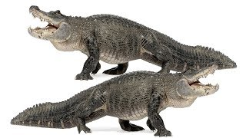
Alligator
Notes:
Hold hands palms together, parallel to the ground. Keep base of palms together while making chomping motion with fingers. Keep mouth in flat but open position.
(For blind learners: use the same hand motion, but gently “chomp” the blind learner’s flat, outstretched palm. Then sign “A” (see slide 23) into the learner’s palm.)

Slide 4
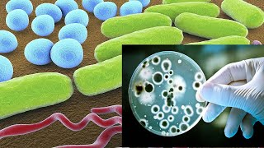
Bacterium
Notes:
Hold non-dominant arm horizontally in front of you. Circle dominate fingers on top of other hand, then run fingers up non-dominant arm.
(For blind learners, have learners hold arm horizontally in front of themself. Circle your fingers on top of their hand, then run fingers up their arm.)

Slide 5
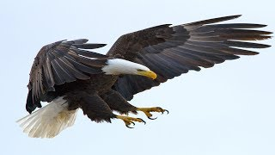
Bald Eagle
Notes:
Bring “X” finger (curved index finger) up to nose to show shape of curved beak.
(For blind learners, sign “E.A.G.L.E.” into palm of learner’s hand - see slide 23)

Slide 6
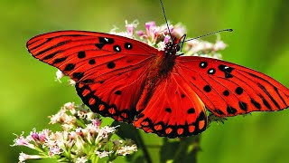
Butterfly
Notes:
Cross hands in front of each other and lock thumbs. Flutter fingers.
(For blind learners, cross hands in front of each other and lock thumbs. Place all in palm of learner’s hand and flutter fingers.)

Slide 7
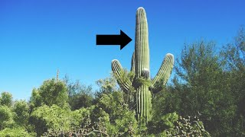
Cactus
Notes:
Use hands to form the shape of a cactus starting at the base. Go straight up, then indicate side branches. End with fingers simulating getting poked and mouth “ow!”
(For blind learners, gentle take hands, and form the shape of a cactus starting at the base. Go straight up, then indicate side branches. End with fingers simulating getting poked and say “ow!”)

Slide 8
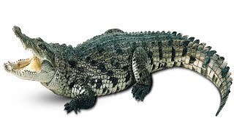
Crocodile
Notes:
Hold hands palms together, parallel to the ground. Keep base of palms together while making chomping motion with fingers. Purse lips and move mouth at the same time as hands.
(For blind learners: use the same hand motion, but gently “chomp” the blind learner’s flat, outstretched palm. Then sign “C” (see slide 23) into the learner’s palm.)

Slide 9
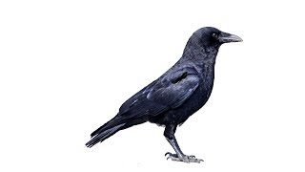
Crow
Notes:
Fingerspell C.R.O.W., (see last slide) then take thumb and index finger in front of nose and bring together to make a clicking beak.
(For blind learners, fingerspell C.R.O.W. into palm of learner’s hand - see slide 23)

Slide 10
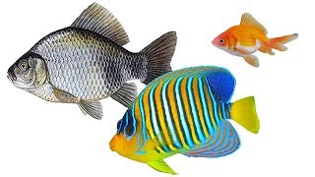
Goldfish
Notes:
Non-dominant hand held out like you are going to shake someone’s hand. Place dominant hand’s palm base on the non dominant hand’s finger tips and wiggle hand like a fish swimming.
(For blind learners, rotate their hand to be held out like they are going to shake someone’s hand. Place your palm base on their fingertips and wiggle hand like a fish swimming.)

Slide 11
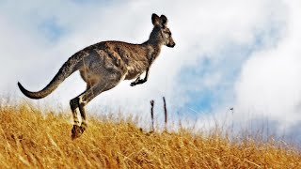
Kangaroo
Notes:
Hold hands in front of you with fingers pointing down. Bounce them up and down like a kangaroo hopping.
(For blind learners, take their hands, and hold hands in front of you with fingers pointing down. Bounce them up and down like a kangaroo hopping.)

Slide 12
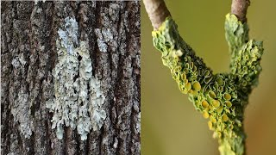
Lichen
Notes:
Start with the sign for “plant”: dominant hand “grows” straight up through the non-dominant hand held palm towards body.
Then twiddle fingers of dominant hand down the arm of the non-dominant hand.
Last: clap the dominant hand down on the top of the non-dominant hand once, then knock the top of that hand two times.

Slide 13








Mangrove
Notes:
Fingerspell M.A.N.G.R.O.V.E.

Slide 14
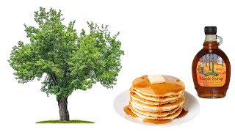
Maple
Notes:
Fingerspell M.A.P.L.E. (see last slide for images)

Slide 15
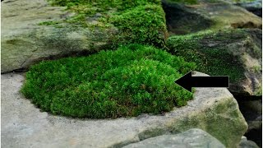
Moss
Notes:
Fingerspell M.O.S.S. (see last slide for images)

Slide 16
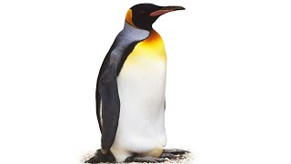
Penguin
Notes:
Place arms firmly on either side of body with hands pointing out. Keep palms touching body. Wiggle back and forth like a penguin waddling.

Slide 17
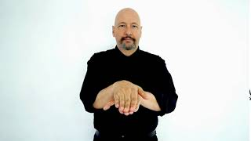
Sea Turtle
Notes:
Place one hand palm down on top of the other hand palm down. Keep fingers together, but extend thumbs, like turtle flapper/legs. Move thumbs in circles like the sea turtle is swimming.

Slide 18
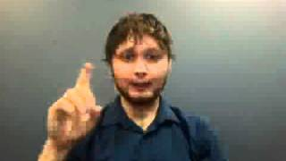
Seaweed
Notes:
Bring both hands together in a line with all fingers extended and pointing up. Gently wave fingers as if fronds being moved by the sea currents.

Slide 19
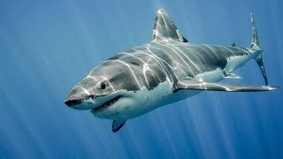
Shark
Notes:
Non-dominant hand straight up vertical forming the “fin”, split your dominant hand between your ring finger and tall finger around the “fin.” Move hands forward as well as side to side in a shark-like motion.
(For blind learners, split fingers of learners palm with vertical “fin” of your hand.)

Slide 20
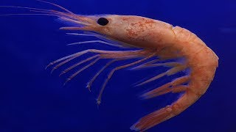
Shrimp
Notes:
Point inward with dominant hand while moving hand slowly across chest from non-dominant to dominant side.
(For blind learners, fingerspell S.H.R.I.M.P. into palm of learner’s hand. - see slide 23)

Slide 21
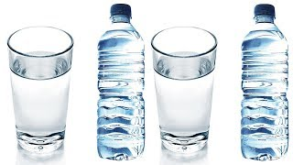
Water
Notes:
Tap the W shaped hand (see last slide for image) to your chin.
(For blind learners, tap W to the palm of their hand 3 times).

Slide 22
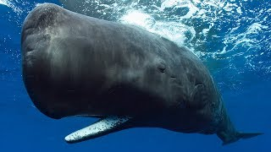
Whale
Notes:
Non-dominant arm is horizontal to show ocean, make fist with dominant hand while extending pinkie. Bring hand up and down in a wave motion along the line of your non-dominant arm starting from the elbow and moving inward.
(For blind learners, have learner hold arm horizontally to show ocean, make a fist with your dominant hand while extending your pinkie. Bring your hand up and down in a wave motion along the line of the blind learner’s arm starting from the elbow and moving inward.)

Slide 23
Adjectives

Slide 24
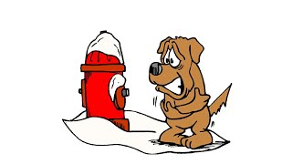
Cold
Notes:
Make fists by your shoulders and shake like you are cold.
(For blind learners, gently take both hands, raise to their shoulders and shake as if they were cold.)

Slide 25
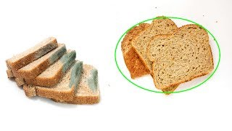
Fresh
Notes:
Hold non-dominant hand against body, palm up. Use dominant hand with palm facing up in a scooping motion, brushing the non-dominant hand as if you are scooping something off a plate.

Slide 26
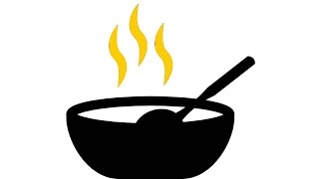
Hot
Notes:
Touch mouth with fingers of open hand, then “throw” them down as if something has burned you.
(For blind learner, guide their hand to either your mouth or their own, then “throw” hand down as if something has burned their fingers.)

Slide 27
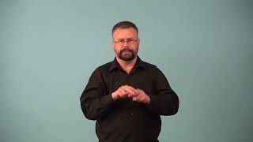
Salty/Saltier/Saltiest
Notes:
Salty - lightly tap “V” shaped fingers of one hand twice on “V” shaped fingers of other hand twice.
Saltier - firmly tap “V” shaped fingers of one hand twice on “V” shaped fingers of other hand twice.
Saltiest - shake fist in front of nose before very firmly tapping “V” shaped fingers of one hand twice on “V” shaped fingers of other hand twice.
(For blind learners, do these motions into the palm of the learner’s hand.)

Slide 28
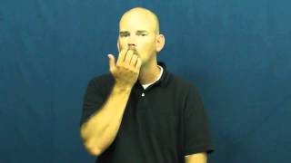
Warm
Notes:
Start with fingers of one hand curled to lips. Blow gently and open your fingers as you pull your hand away from your face as if you are releasing a breath of warm air.

Slide 29
Resources

Slide 30
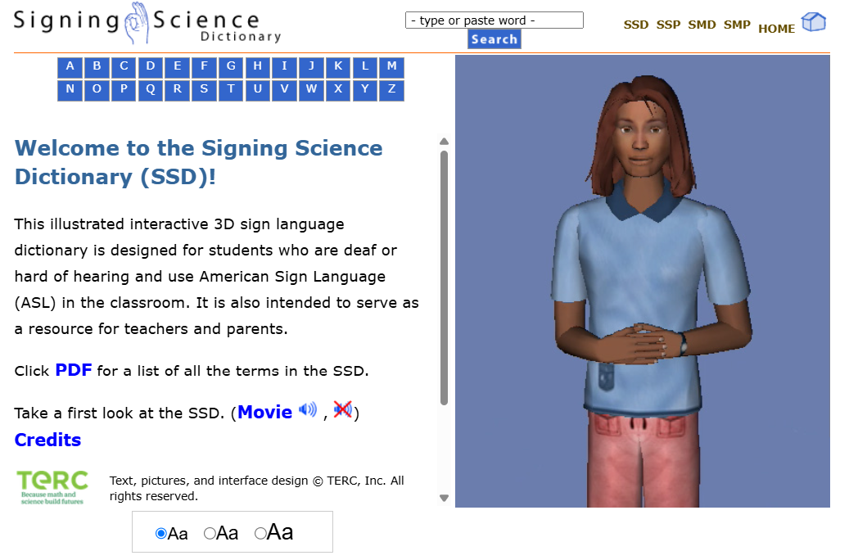
Signing Science (& Math) Dictionary
Watch the Signing Science Dictionary Demonstration Movie to learn more American Sign Language Science and Math terms.
Notes:
https://signsci.terc.edu/video/SSD.htm

Slide 31
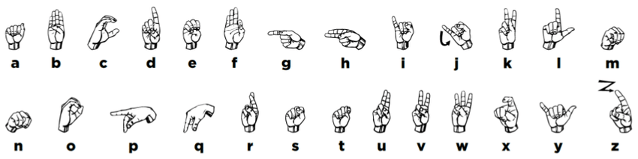
Fingerspelling Signs
Shi, Bowen & Rio, Aurora & Keane, Jonathan & Brentari, Diane & Shakhnarovich, Greg & Livescu, Karen. (2019). Fingerspelling recognition in the wild with iterative visual attention.

